Slide 1
Projection for Dilepton Measurement at 39 GeV
Stefan Bathe for PHENIX
RHIC Machine-Experiment Meeting
4/13/2010

Slide 2
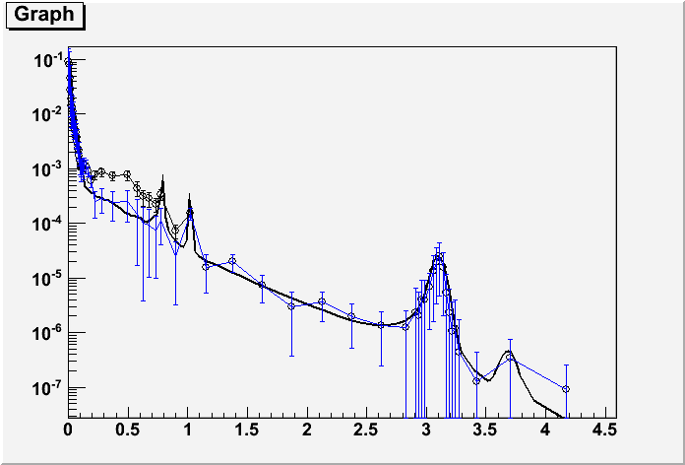
Dilepton Measurement at 39 GeV
Dilepton measurement with HBD at 39 GeV possible with 280 M min. bias events
Measurement of low-mass enhancement from SPS energy, via 39 and 62 GeV, to top RHIC energy

Slide 3
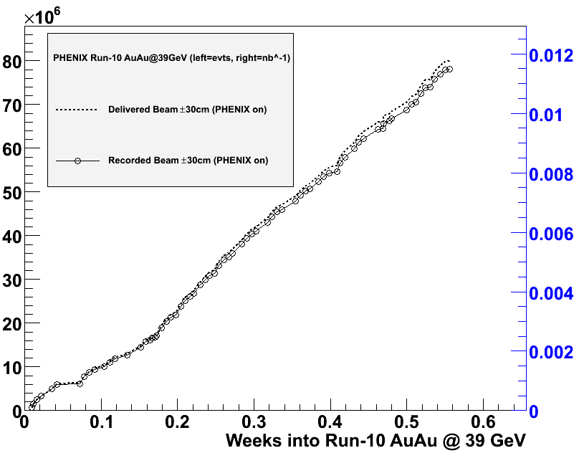
Projection
Physics since noon, Friday, April 9 (right after beam development finished)
Slope in past two days constant: 150 M events/week
Translates into 280 M events in 13 days
April-14 beam development adds one day
April-21 MD? would add 0.5 days
Goal will be reached on Friday, April 23, noon (midnight Sat with MD)
# of events
Integrated lumi. [nb⁻¹]
Slope
150 M evts./week
Proposal: switch on Monday, April 26, 8:00am (and delay MD until then)
or keep decision open until next Tuesday when we’ll have better projection

