Slide 1
PHENIX Event Rate and Checks
Stefan Bathe for PHENIX
RHIC Machine-Experiment Meeting
05/04/2010

Slide 2
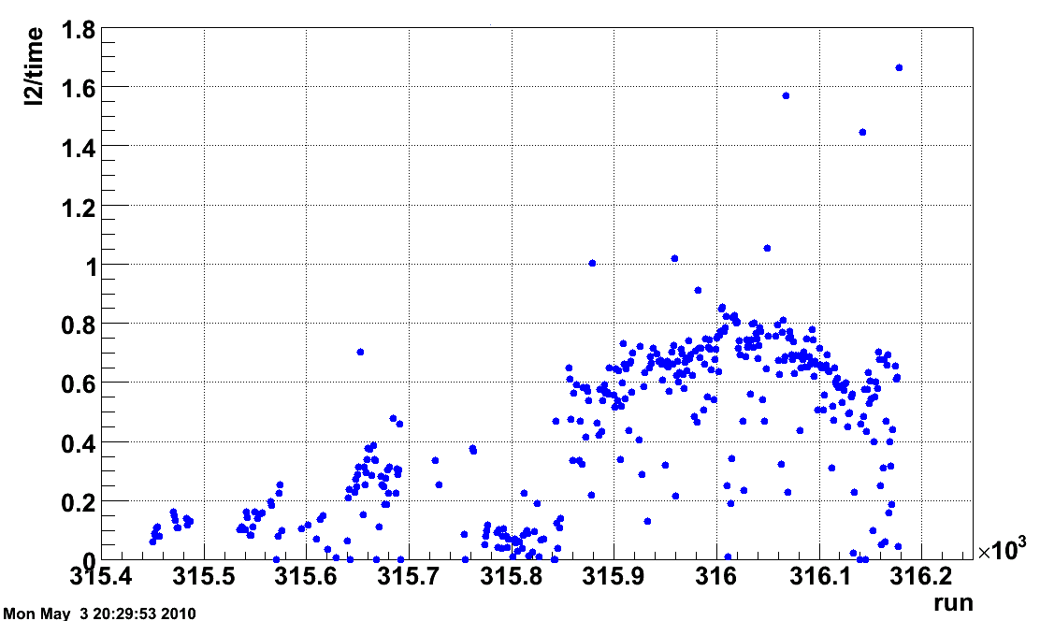
BBCLL1(>1 tubes) Rate (average for each run)
by Jamie Nagle
Over the last 4 days, the average physics trigger rate ~ 0.7 Hz taken over a given PHENIX run (which typically corresponds to one store).
We expect to “see” ~ 70% of the AuAu inelastic cross section within |z|< 30cm. Is there background in this trigger sample?

Slide 3
PHENIX-STAR Comparison
STAR has reported similar rate of good events from offline (vertex) validation
STAR’s vertex cut is +/- 75 cm (cf. +/- 30 cm in PHENIX); this should give factor 2.4 larger rate
How can this be reconciled?
Our part: check PHENIX rate

Slide 4
This set of runs includes 100,702 live BBCLL1(>0 tubes) recorded
and as a subset of that 87,611 live BBCLL1(>1 tubes) recorded.
by Jamie Nagle
Very stable except one “bad run” period (beam problems).
Fraction of BBCLL1(>1 tubes) passing offline |z|<30 cm
Fraction of BBCLL1(>0 tubes) passing offline |z|<30 cm
Run Number

Slide 5
Run-10 AuAu @ 7.7 GeV
72,078 events total up to Run Number 315,999 passing BBCLL1(>1 tubes)
and |z| < 30 cm.
by Jamie Nagle
Is there hidden background?
Very similar to what was seen at 9 GeV and
expected from URQMD + fragmentation model. Direct comparison to URQMD + fragmentation model through PISA will be very interesting (Jeff Mitchell is running more URQMD jobs for this comparison).
https://www.phenix.bnl.gov/phenix/WWW/p/info/an/843/AnalysisNote_LowEnergyRun8v2.pdf
AuAu 9 GeV

Slide 6
URQMD is normalized to match the real data integral for PC1 hits > 40.
URQMD is not matched to the z distribution in real data. However, note that there is no rescaling of the x-axis.
Then comparing the integrals implies (as a first look) that the BBCLL1(>0 tubes) fires on 77% of the cross section and the BBCLL1(> 1 tubes) fires on 70% of the cross section.
No indication of deviation at low PC1 hits from background (at least by this particular check).
URQMD AuAu @ 7.7 GeV through PHENIX full simulation
PHENIX AuAu @ 7.7 GeV Data
w/ BBCLL1(>0 tubes) |z| < 30 cm
PHENIX AuAu @ 7.7 GeV Data
w/ BBCLL1(>1 tubes) |z| < 30 cm
by Jamie Nagle

Slide 7
Just as a curiosity, compare this PC1 hits distribution for the “bad running” period 315600-315850.
The BBCLL1(>1 tubes) distribution looks very similar to the other running periods.
However, the BBCLL1(> 0 tubes) distribution has a large excess of events at low PC1 hits (indication of background). Compare magneta points to the black histogram.
URQMD AuAu @ 7.7 GeV through PHENIX full simulation
PHENIX AuAu @ 7.7 GeV Data
w/ BBCLL1(>0 tubes) |z| < 30 cm
PHENIX AuAu @ 7.7 GeV Data
w/ BBCLL1(>1 tubes) |z| < 30 cm
by Jamie Nagle

Slide 8
Random Coincidence Rate
BBC singles rate from Blue Logic: ~ 4 Hz
Blue Logic uses only 4 out of 64 tubes on each side
Scale up by factor 10 (16 max.): 40 Hz
Random coincidence rate from singles:
40 Hz/9.4 MHz * 40 Hz/9.4 MHz * 9.4 MHz = 1.7x10⁻⁴ Hz
Why is PHENIX BBC so clean compared to STAR VPD?
Closer to nominal interaction point: 150 cm
Shielded
20 ns timing window

Slide 9
Summary
If PHENIX rate were due to random coincidences, singles rate would have to be high → excluded!
If PHENIX rate were due to interactions of beam with non-beam (beam pipe, gas), expect events to pile up at low PC multiplicity →not observed
If S/B is decreased by large factor, small contamination is observed →confirms that that contimation of good event sample is very small (of order couple percent)

