Slide 1
Run 10 plan based on 25 Nov Revised Plan and √s=200 extended by 1 week
Dec. 1, Begin cool down to 4.5K
Dec. 4, Cooldown to 4.5K complete in both rings!
Dec. 5, beam setup in RHIC begins.
Dec 16, 20 hr unplanned Maintenance day
Dec 20 (AM)-21(PM), blizzard 09 shut us down
Dec. 27, RHIC Setup complete, begin Ramp Up for Physics (was 14 Dec, late)
Dec 31 (midnight-store 11340), Machine (and PHENIX?) Physics declared √s=200 GeV/n Au-Au
Jan 2 (midnight) STAR in Physics Mode
Jan 8 (0600) PHENIX in Physics Mode
Jan 12, Rebucketing not yet routine, stochastic cooling still to come.
Jan 22, changed beta* from 0.6 to 0.7 meters, rebucketing ~established, yellow transverse stochastic cooling on
Mar. 18, End 10 week √s = 200 GeV/n Run, begin √s = 62.4 GeV/n setup
Mar. 20, Begin 4 week √s = 62.4 GeV/n run
Apr 10-14, Satogata is away
Apr. 17, End 4 week √s = 62.4 GeV/n Run, begin √s = 39 GeV/n setup
Apr. 19, Begin 1.5 week √s = 39 GeV/n run
Apr 17-23, Satogata is away
Apr. 30, End 1.5 week √s = 39 GeV/n Run, begin ν= 0.67 studies before polarity switches begin (i.e. this is a placeholder)
May 1, complete ν= 0.67 studies for pp and √s = 7.7 GeV/n setup (12 hr pol. switches)
May. 3, Begin 4 week √s = 7.7 GeV/n run
May 23 – 28 IPAC (Kyoto)
May 22 Jun 3, Satogata is away
May 31, End 4 week √s = 7.7 GeV/n Run, begin √s = 11.5 GeV/n setup (4-6 hr polarity switch, if necessary)
Jun 2, begin √s = 11.5 GeV/n for STAR
Jun 16, end 2 week √s = 11.5 GeV/n run, begin √s = 5 GeV/n setup (4-6 hr polarity switch, if necessary)
Jun 18, begin √s = 5 GeV development
Jun 21, end 3 days at √s = 5 GeV/n
Jun 22 , Begin Cryo Warm-up
Jun 23, Warm-up complete, Run 10 ends – 29.2 CRYO WEEKS

Slide 3
PHENIX Goal*
STAR Goal
PHENIX Minimum Goal*
* With 20 cm sigma IR diamond

Slide 5
Max
Goal
Min

Slide 6
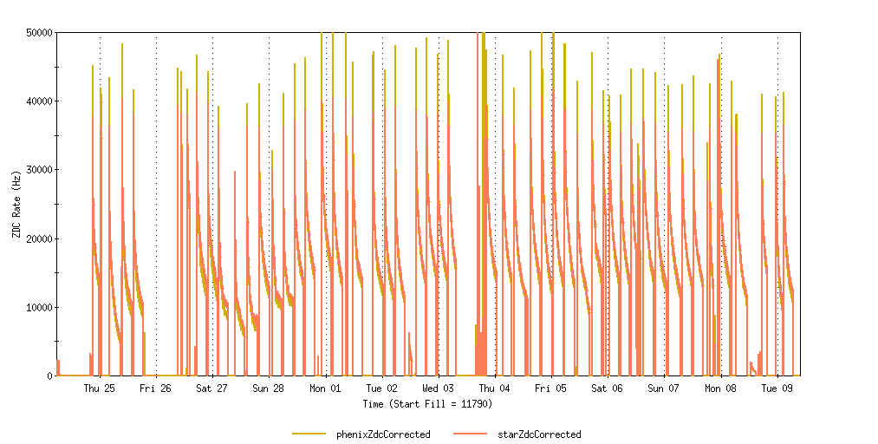
24 Feb – 9 Mar 10
Look at this one in detail (11824)
PHENIX ~ Saturated
Notes:
6

Slide 7
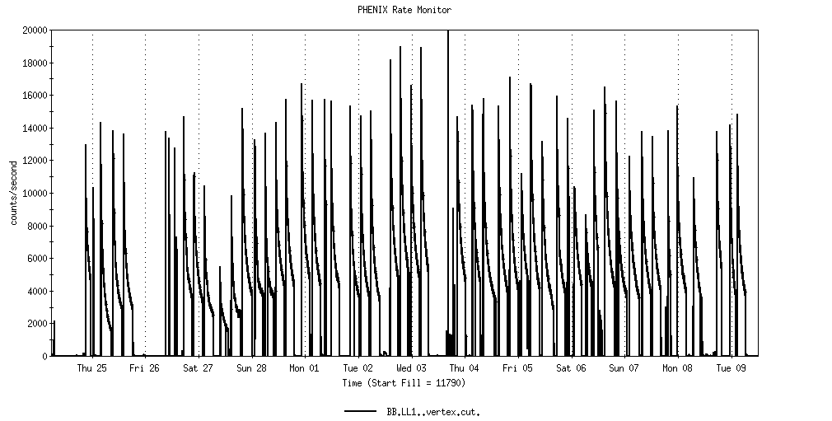
Store11824
PHENIX LL1 interaction rate
Notes:
7

Slide 8
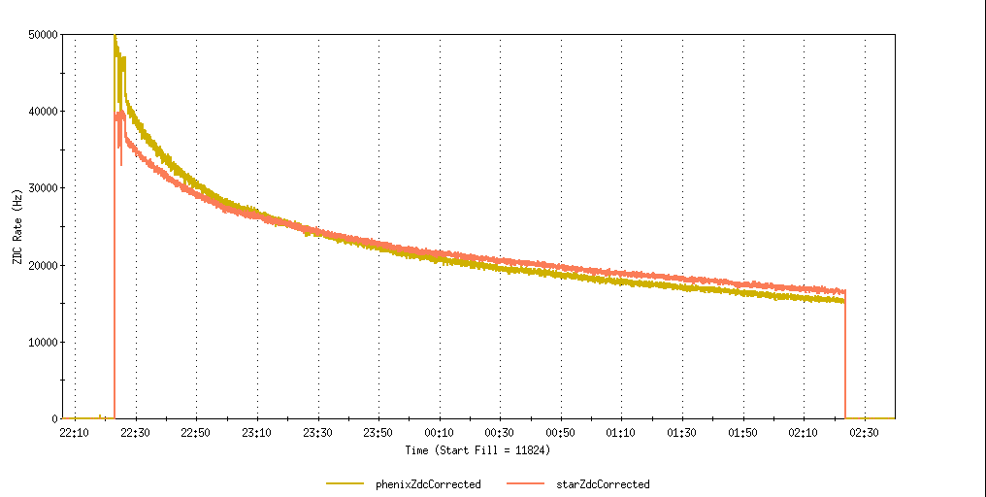
Fills 11824 28 Feb 10 -- still about the best store (with ~1.25 x 10⁹ ions/bunch)
0.7 m β* with some cooling and with rebucketing, STAR 32.7 μb-1, 3.9 hr store
L_{peak} from Table 2 (Maximum Luminosities)
L_{store average} from Table 2
PHENIX ~ Saturated

Slide 9
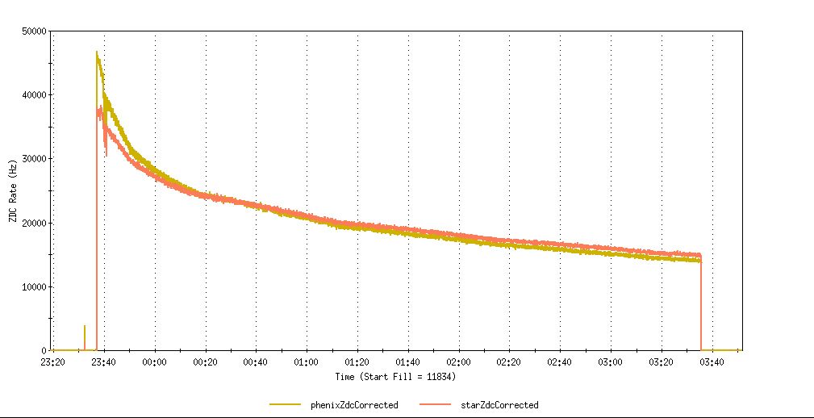
Fills 11824 2 Mar 10 (with ~1.36 x 10⁹ ions/bunch)
0.7 m β* with some cooling and with rebucketing,STAR 29.4 μb⁻¹,3.9 hr store)
PHENIX ~ Saturated

Slide 10
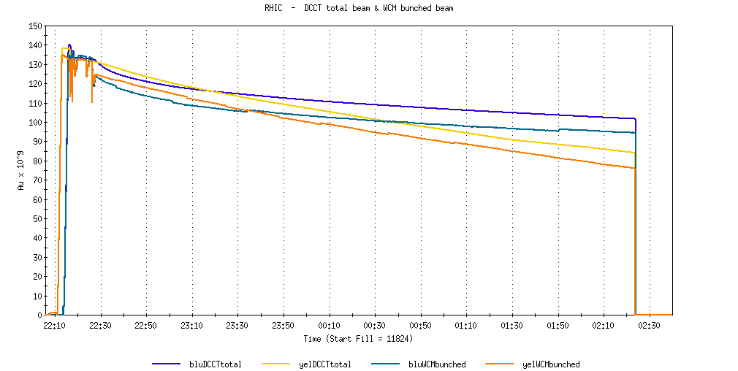
Fills 11824 28 Feb 10
Max ions/bunch goal from Table 2, 1.1 x 10⁹
Blue/Yellow Bunched
Ring | Bunches/Cycles | Avg Bunch in RHIC (10^6 ions) | Avg Efficiency XCBM to RHIC | XCBM to Uxf1 | Uxf1 to Wxf | Wxf to Arc | Arc to RHIC
Blue | 111/28 | 1262 | 0.917 | 0.975 | 0.961 | 1.001 | 0.977
Yellow | 111/28 | 1246 | 0.910 | 0.961 | 0.964 | 0.988 | 0.994

Slide 11
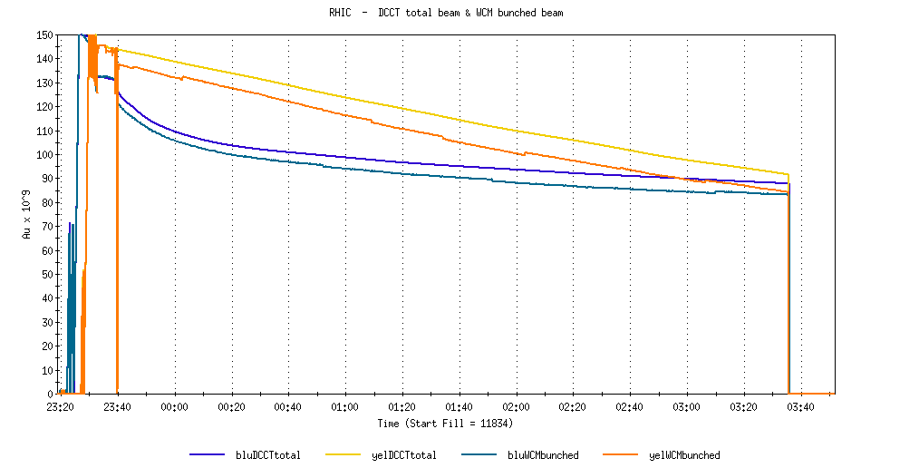
Fills 11824 2 Mar 10
Blue/Yellow Bunched
Ring | Bunches/Cycles | Avg Bunch in RHIC (10^6 ions) | Avg Efficiency XCBM to RHIC | XCBM to Uxf1 | Uxf1 to Wxf | Wxf to Arc | Arc to RHIC
Blue | 111/28 | 1354 | 0.927 | 0.990 | 0.965 | 1.003 | 0.968
Yellow | 111/28 | 1377 | 0.931 | 0.990 | 0.964 | 0.989 | 0.987

Slide 12
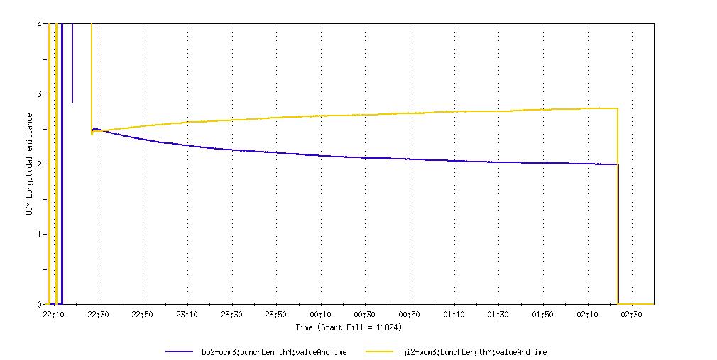
Fills 11824 28 Feb 10, Longitudal Stochastic Cooling (Blue only)

Slide 13
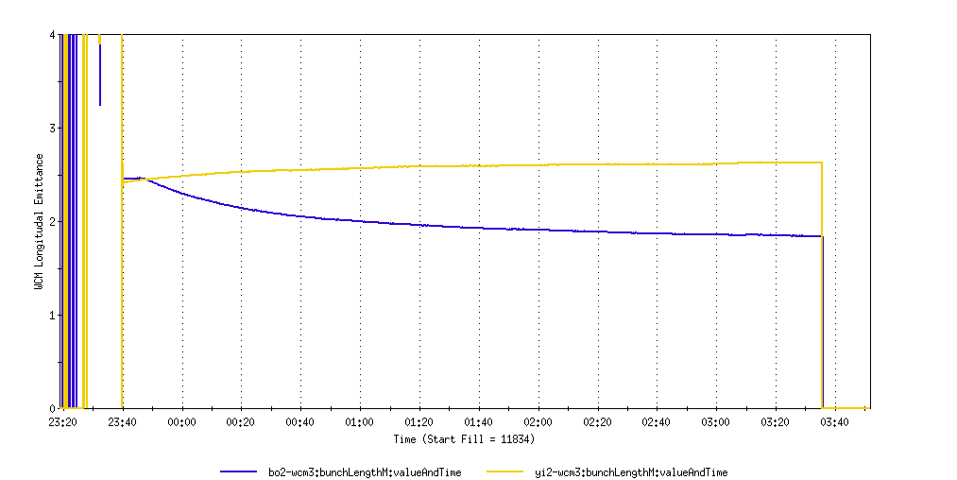
Fills 11824 2 Mar 10, Longitudal Stochastic Cooling, Blue only

Slide 14
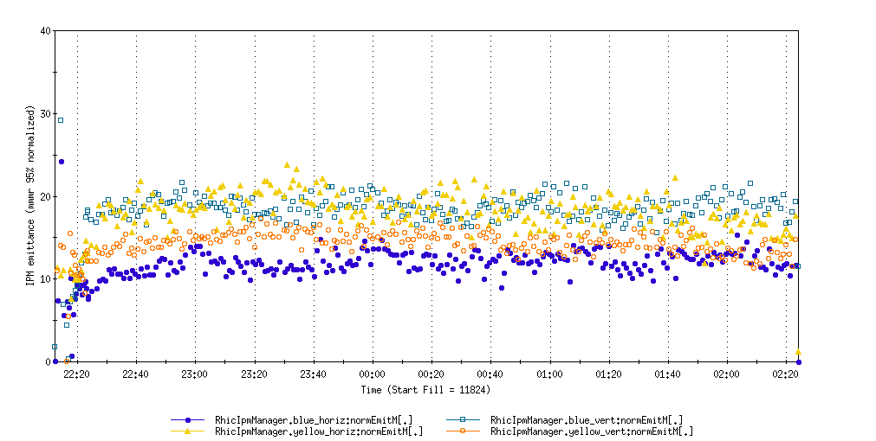
Fills 11824 28 Feb 10, Transverse Stochastic Cooling

Slide 15
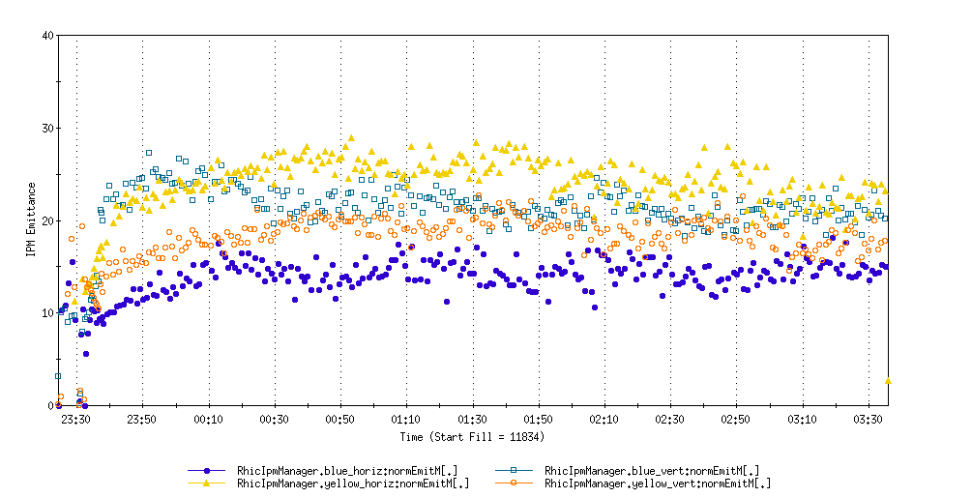
Fills 11824 2 Mar 10, Transverse Stochastic Cooling

Slide 16
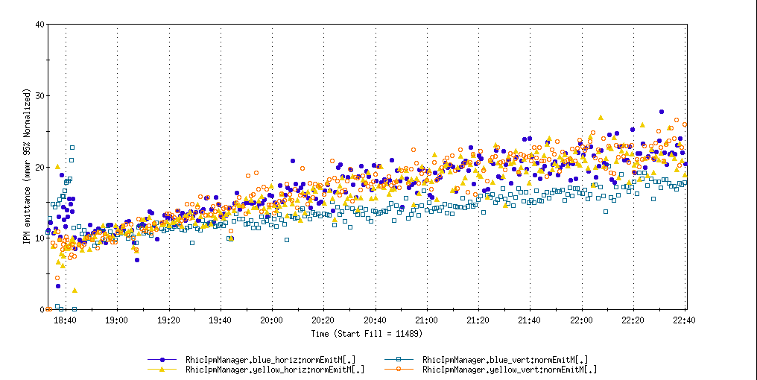
Fill 11489, no cooling, no rebucketing (0.6 m beta*)
Monday, 18 Jan.
Ring | Bunches/Cycles | Avg Bunch in RHIC (10^6 ions) | Avg Efficiency XCBM to RHIC | XCBM to Uxf1 | Uxf1 to Wxf | Wxf to Arc | Arc to RHIC
Blue | 111/28 | 1196 | 0.911 | 1.024 | 0.961 | 0.999 | 0.927
Yellow | 111/29 | 1168 | 0.879 | 1.023 | 0.961 | 0.989 | 0.905

Slide 17
31 Dec 1st Physics Store 11340, 0.6 m β* No cooling or rebucketing, STAR 3.2 μb⁻¹, 2.6 hr store
Ring | Bunches/Cycles | Avg Bunch in RHIC (10^6 ions) | Avg Efficiency XCBM to RHIC | XCBM to Uxf1 | Uxf1 to Wxf | Wxf to Arc | Arc to RHIC
Blue | 56/56 | 909 | 0.836 | 1.056 | 0.963 | 0.992 | 0.828
Yellow | 56/56 | 990 | 0.971 | 1.085 | 0.962 | 0.959 | 0.970
18 Jan Physics Store 11489, 0.6 m β* No cooling or rebucketing, STAR 22.6 μb⁻¹, 3.9 hr store
Ring
Bunches/Cycles
Avg Bunch in RHIC (10^6 ions)
Avg Efficiency XCBM to RHIC
XCBM to Uxf1
Uxf1 to Wxf
Wxf to Arc
Arc to RHIC
Blue
111/28
1196
0.911
1.024
0.961
0.999
0.927
Yellow
111/29
1168
0.879
1.023
0.961
0.989
0.905
28 Feb Physics Store 11824, 0.7 m β* with some cooling and with rebucketing, STAR 32.7 μb-1, 3.9 hr store
Ring | Bunches/Cycles | Avg Bunch in RHIC (10^6 ions) | Avg Efficiency XCBM to RHIC | XCBM to Uxf1 | Uxf1 to Wxf | Wxf to Arc | Arc to RHIC
Blue | 111/28 | 1262 | 0.917 | 0.975 | 0.961 | 1.001 | 0.977
Yellow | 111/28 | 1246 | 0.910 | 0.961 | 0.964 | 0.988 | 0.994
2 Mar Physics Store 11834, 0.7 m β* with some cooling and with rebucketing, STAR 29.4 μb⁻¹,3.9 hr store)
Ring | Bunches/Cycles | Avg Bunch in RHIC (10^6 ions) | Avg Efficiency XCBM to RHIC | XCBM to Uxf1 | Uxf1 to Wxf | Wxf to Arc | Arc to RHIC
Blue | 111/28 | 1354 | 0.927 | 0.990 | 0.965 | 1.003 | 0.968
Yellow | 111/28 | 1377 | 0.931 | 0.990 | 0.964 | 0.989 | 0.987

Slide 18
Through Jan 2010

Slide 19
Through 2/28/10

Slide 20
Future Topics
Toward Smaller beta* - new quad triplets – D. Trbojevic

Slide 21
Archive

Slide 22
Through 2/28/10

Slide 23
Through 2/28/10

Slide 24
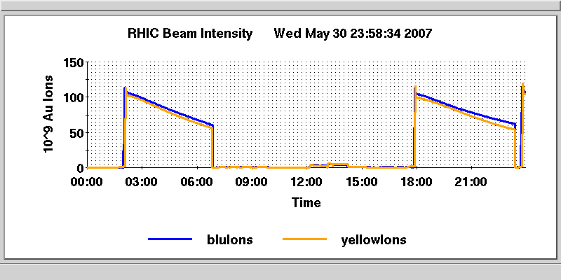
Run 7 Fill 8878 Injected Beam Statistics from ELOG
Blue = 103 bunches 1.04x10⁹/bunch
Yellow= 103 bunches 1.13x10⁹/bunch
(w/o stochactic cooling)
1.02 x 10⁹ /bunch
0.97 x 10⁹ /bunch

Slide 25
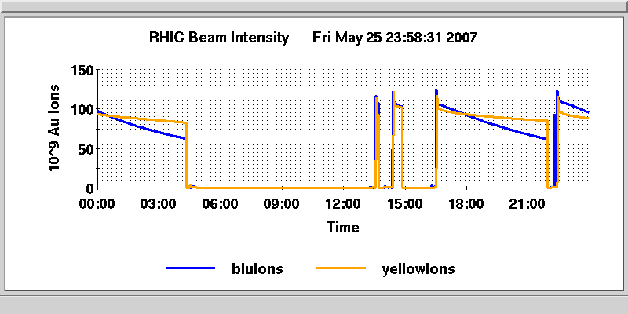
Run 7 Fill 8849 Injected Beam Statistics from ELOG
Blue = 103 bunches 1.23x10⁹/bunch
Yellow= 103 bunches 1.15x10⁹/bunch
Store 8849 (w/stochactic cooling)
1.02 x 10⁹ /bunch
0.97 x 10⁹ /bunch

Slide 26
Physics ON
Loss in 3 hrs
= 3.1
= 3.7

Slide 27
Revised Run 10 Plan, Nov 25, 2009
 | Physics production or beam studies weeks
√s_{NN} (GeV) | 25-cryoweek run | 27-cryoweek run
200 | 10 | 10
62.4 | 4 | 4
39 | 1.5 | 1.5
27 | 0 | 0
18 | 0 | 0
11.5 @ STAR | 0 | 2
7.7 | 4 | 4
Beam studies @ 5 GeV and @ ν≈ 0.67 | 0.5 | 0.5

Slide 28
Run 10 Au-Au Goals 11/19/09
STAR
√s = 200 GeV/n
Luminosity Sampled/Delivered = 2/4 nb⁻¹
250M Central Events
300M Min-bias events
PHENIX
√s = 200 GeV/n
Luminosity Recorded/Delivered = 1.4/>6 nb⁻¹
Minimum Goal:
Luminosity Recorded/Delivered = 1.1/3.9 nb⁻¹

Slide 30
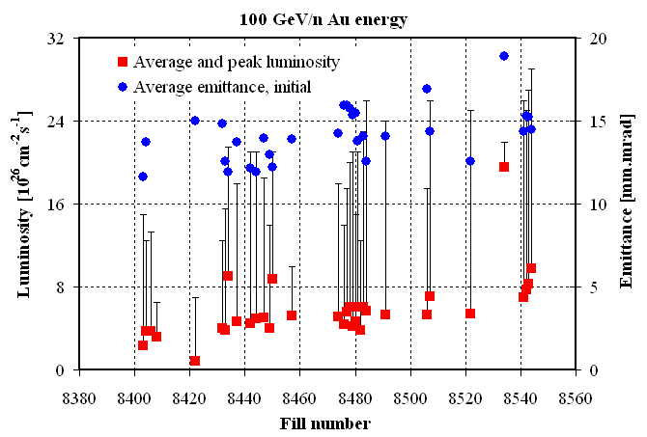
Run 7
Fill 8544

Slide 31
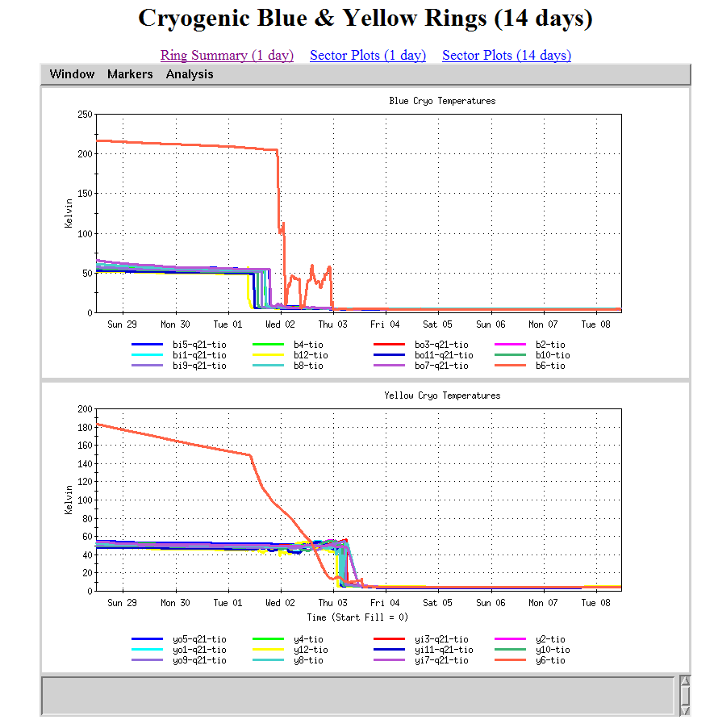
Wednesday midnight
Thursday midnight

