Slide 1
Run 10 plan based on 25 Nov Revised Plan and √s=200 extended by 1 week
Dec. 1, Begin cool down to 4.5K
Dec. 4, Cooldown to 4.5K complete in both rings!
Dec. 5, beam setup in RHIC begins.
Dec 16, 20 hr unplanned Maintenance day
Dec 20 (AM)-21(PM), blizzard 09 shut us down
Dec. 27, RHIC Setup complete, begin Ramp Up for Physics (was 14 Dec, late)
Dec 31 (midnight-store 11340), Machine, Physics declared (store 11340) √s=200 GeV/n Au-Au
Jan 2 (midnight) STAR in Physics Mode
Jan 8 (0600) PHENIX in Physics Mode
Jan 12, Rebucketing not yet routine, stochastic cooling still to come.
Jan 22, changed beta* from 0.6 to 0.7 meters, rebucketing ~established, yellow transverse stochastic cooling on
Mar. 18 (0556), End 10 week √s = 200 GeV/n Run, begin √s = 62.4 GeV/n setup
Mar. 20 19, Begin 4 week √s = 62.4 GeV/n run (gained a day of contingency)
Machine physics 19 March for stores ≥11954
PHENIX Physics 19 Mar for stores ≥11955
STAR Physics 21 March for stores ≥11971(?)
Apr. 1716, End 4 week √s = 62.4 GeV/n Run, begin √s = 39 GeV/n setup
Apr. 19, Begin 1.5 week √s = 39 GeV/n run
Apr. 30, End 1.5 week √s = 39 GeV/n Run, begin ν= 0.67 studies before polarity switches begin (i.e. this is a placeholder)
May 1, complete ν= 0.67 studies for pp and √s = 7.7 GeV/n setup (12 hr pol. switches)
May. 3, Begin 4 week √s = 7.7 GeV/n run
May 23 – 28 IPAC (Kyoto)
May 22 Jun 3, Satogata is away
May 31, End 4 week √s = 7.7 GeV/n Run, begin √s = 11.5 GeV/n setup (4-6 hr polarity switch, if necessary)
Jun 2, begin √s = 11.5 GeV/n for STAR
Jun 16, end 2 week √s = 11.5 GeV/n run, begin √s = 5 GeV/n setup (4-6 hr polarity switch, if necessary)
Jun 18, begin √s = 5 GeV development
Jun 21, end 3 days at √s = 5 GeV/n
Jun 22 , Begin Cryo Warm-up
Jun 23, Warm-up complete, Run 10 ends – 29.2 CRYO WEEKS

Slide 2
Run 10 Au-Au Goals 3/17/10
STAR
√s = 62 GeV/n
Luminosity Sampled/Delivered = ?/? μb⁻¹
100M Min-bias events
PHENIX
√s = 62 GeV/n
Luminosity Recorded/Delivered = 193/64 μb⁻¹
400M Min-bias events

Slide 3
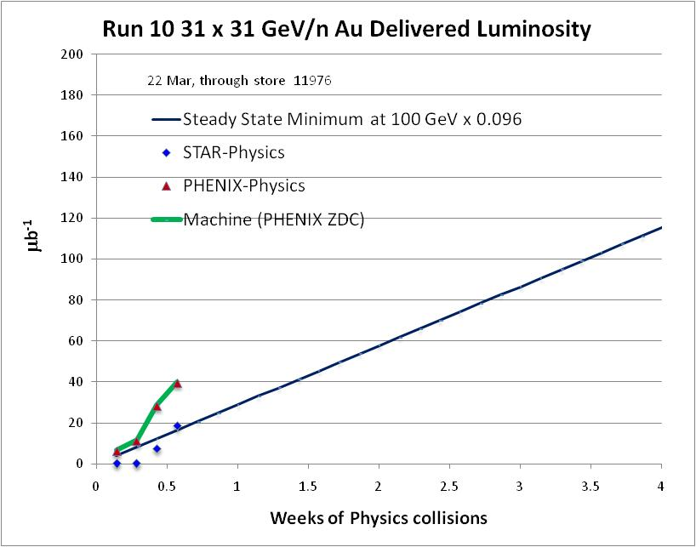
PHENIX Goal (400M min-bias events)

Slide 4
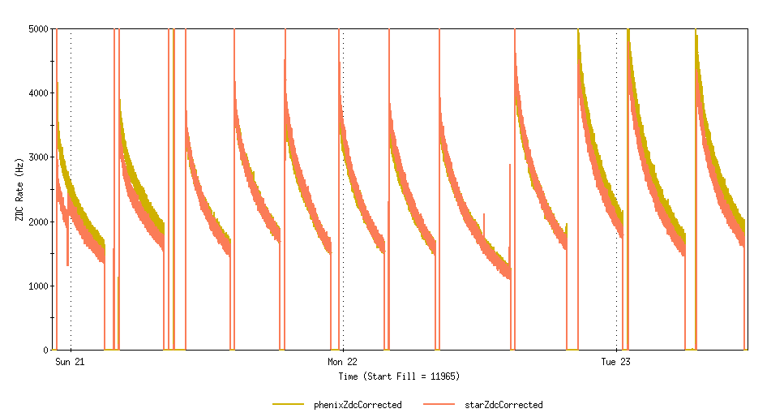
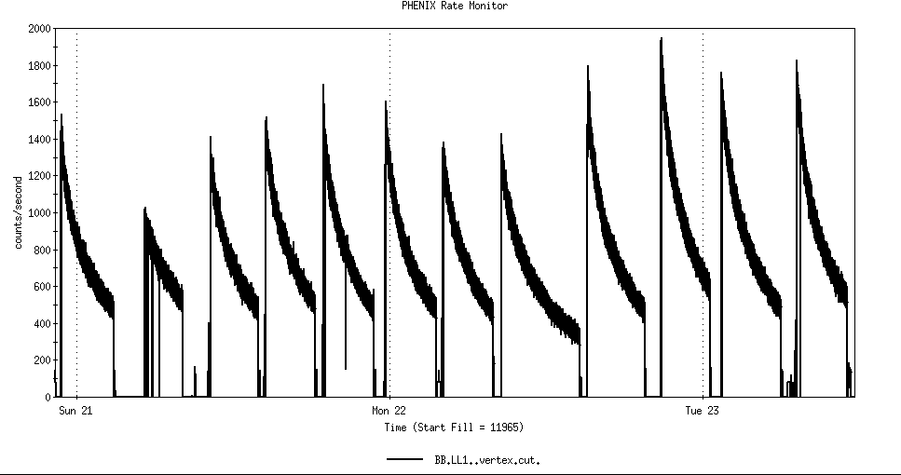
ZDC’s
31 x 31 GeV/n Au
PHENIX BBLL1(vertex cut)

Slide 5
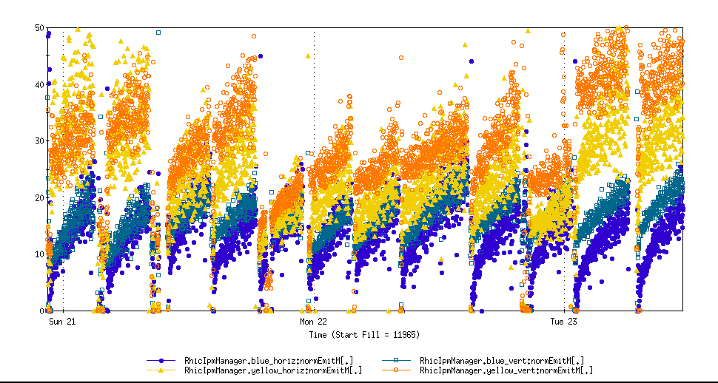
31 x 31 GeV/n Au horiz and vert emittances

Slide 6
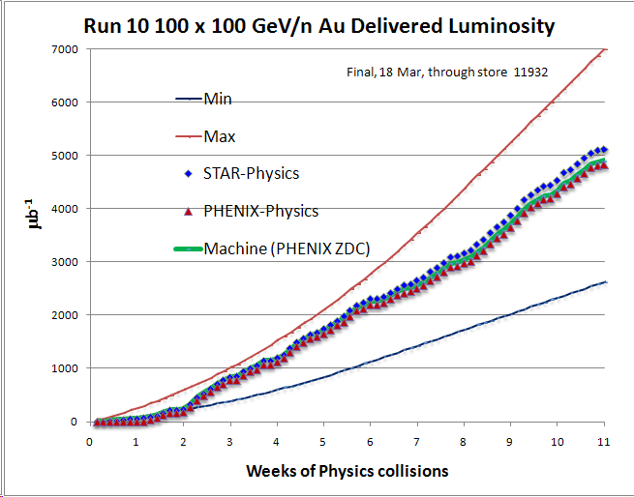
PHENIX Goal*
STAR Goal
PHENIX Minimum Goal*
* With 20 cm sigma IR diamond

Slide 7
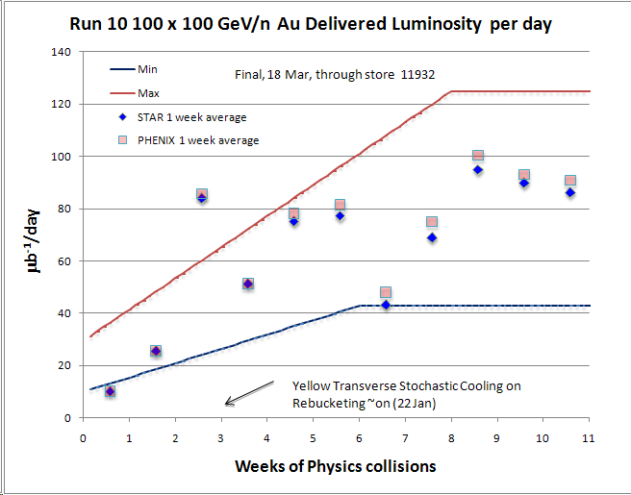

Slide 8
Average hours per week at store = 88.5

Slide 10
Future Topics
Toward Smaller beta* - new quad triplets – D. Trbojevic

Slide 11
Archive

Slide 12
Through Jan 2010

Slide 13
Through 2/28/10

Slide 14
31 Dec 1st Physics Store 11340, 0.6 m β* No cooling or rebucketing, STAR 3.2 μb⁻¹, 2.6 hr store
Ring | Bunches/Cycles | Avg Bunch in RHIC (10^6 ions) | Avg Efficiency XCBM to RHIC | XCBM to Uxf1 | Uxf1 to Wxf | Wxf to Arc | Arc to RHIC
Blue | 56/56 | 909 | 0.836 | 1.056 | 0.963 | 0.992 | 0.828
Yellow | 56/56 | 990 | 0.971 | 1.085 | 0.962 | 0.959 | 0.970
18 Jan Physics Store 11489, 0.6 m β* No cooling or rebucketing, STAR 22.6 μb⁻¹, 3.9 hr store
Ring
Bunches/Cycles
Avg Bunch in RHIC (10^6 ions)
Avg Efficiency XCBM to RHIC
XCBM to Uxf1
Uxf1 to Wxf
Wxf to Arc
Arc to RHIC
Blue
111/28
1196
0.911
1.024
0.961
0.999
0.927
Yellow
111/29
1168
0.879
1.023
0.961
0.989
0.905
28 Feb Physics Store 11824, 0.7 m β* with some cooling and with rebucketing, STAR 32.7 μb-1, 3.9 hr store
Ring | Bunches/Cycles | Avg Bunch in RHIC (10^6 ions) | Avg Efficiency XCBM to RHIC | XCBM to Uxf1 | Uxf1 to Wxf | Wxf to Arc | Arc to RHIC
Blue | 111/28 | 1262 | 0.917 | 0.975 | 0.961 | 1.001 | 0.977
Yellow | 111/28 | 1246 | 0.910 | 0.961 | 0.964 | 0.988 | 0.994
2 Mar Physics Store 11834, 0.7 m β* with some cooling and with rebucketing, STAR 29.4 μb⁻¹,3.9 hr store)
Ring | Bunches/Cycles | Avg Bunch in RHIC (10^6 ions) | Avg Efficiency XCBM to RHIC | XCBM to Uxf1 | Uxf1 to Wxf | Wxf to Arc | Arc to RHIC
Blue | 111/28 | 1354 | 0.927 | 0.990 | 0.965 | 1.003 | 0.968
Yellow | 111/28 | 1377 | 0.931 | 0.990 | 0.964 | 0.989 | 0.987

Slide 15
Through 2/28/10

Slide 16
Through 2/28/10

Slide 17
Revised Run 10 Plan, Nov 25, 2009
 | Physics production or beam studies weeks
√s_{NN} (GeV) | 25-cryoweek run | 27-cryoweek run
200 | 10 | 10
62.4 | 4 | 4
39 | 1.5 | 1.5
27 | 0 | 0
18 | 0 | 0
11.5 @ STAR | 0 | 2
7.7 | 4 | 4
Beam studies @ 5 GeV and @ ν≈ 0.67 | 0.5 | 0.5

Slide 18
Run 10 Au-Au Goals 11/19/09
STAR
√s = 200 GeV/n
Luminosity Sampled/Delivered = 2/4 nb⁻¹
250M Central Events
300M Min-bias events
PHENIX
√s = 200 GeV/n
Luminosity Recorded/Delivered = 1.4/>6 nb⁻¹
Minimum Goal:
Luminosity Recorded/Delivered = 1.1/3.9 nb⁻¹

