Slide 1
Run 10 plan based on 25 Nov Revised Plan and √s=200 extended by 1 week
Dec. 1, Begin cool down to 4.5K
Dec. 4, Cooldown to 4.5K complete in both rings!
Dec. 5, beam setup in RHIC begins.
Dec 16, 20 hr unplanned Maintenance day
Dec 20 (AM)-21(PM), blizzard 09 shut us down
Dec. 27, RHIC Setup complete, begin Ramp Up for Physics (was 14 Dec, late)
Dec 31 (midnight-store 11340), Machine, Physics declared (store 11340) √s=200 GeV/n Au-Au
Jan 2 (midnight) STAR in Physics Mode
Jan 8 (0600) PHENIX in Physics Mode
Jan 12, Rebucketing not yet routine, stochastic cooling still to come.
Jan 22, changed beta* from 0.6 to 0.7 meters, rebucketing ~established, yellow transverse stochastic cooling on
Mar. 18 (0556), End 10 week √s = 200 GeV/n Run, begin √s = 62.4 GeV/n setup
Mar. 20 19, Begin 4 week √s = 62.4 GeV/n run
  Machine physics 19 March for stores ≥11954
  PHENIX Physics 19 Mar for stores ≥11955
  STAR Physics 22 March for stores ≥11976
Apr. 8, End 2.9 week √s = 62.4 GeV/n Run, begin √s = 39 GeV/n setup
Apr. 9, Begin 1.5 week √s = 39 GeV/n run
  Machine physics 9 April for stores ≥12119
  PHENIX and STAR Physics 9 April for stores ≥12122
Apr. 14, 24 hours APEX for n= 0.67 studies
Apr. 22, End 1.9 week √s = 39 GeV/n Run
Apr 22, Begin √s = 7.7 GeV/n setup (12 hr pol. switches)
Apr 24 (fill 12238, 2300 hrs), Begin 4 week √s = 7.7 GeV/n run
May 22 End 4 week √s = 7.7 GeV/n Run, begin √s = 11.5 GeV/n setup (4-6 hr polarity switch, if necessary)
May 23 – 28 IPAC (Kyoto)
May 22 – Jun 3, Satogata is away
May 24, begin √s = 11.5 GeV/n for STAR
Jun 7, end 2 week √s = 11.5 GeV/n run, begin √s = 5 GeV/n setup (4-6 hr polarity switch, if necessary)
Jun 9, begin √s = 5 GeV development
Jun 12, end 3 days at √s = 5 GeV/n
Jun 13 , Begin Cryo Warm-up
Jun 14, Warm-up complete, Run 10 ends – 27.9 CRYO WEEKS
Last Week of June – Commission EBIS with He beam to NSRL

Slide 2
Run 10 plan based on 25 Nov Revised Plan and √s=200 extended by 1 week
Apr. 8, End 2.9 week √s = 62.4 GeV/n Run, begin √s = 39 GeV/n setup
Apr. 9, Begin 1.5 week √s = 39 GeV/n run
  Machine physics 9 April for stores ≥12119
  PHENIX and STAR Physics 9 April for stores ≥12122
Apr. 14, 24 hours APEX for n= 0.67 studies
Apr. 22, End 1.9 week √s = 39 GeV/n Run
Apr 22, Begin √s = 7.7 GeV/n setup (12 hr pol. switches)
Apr 24 (fill 12238, 2300 hrs), Begin 4 week √s = 7.7 GeV/n run
May 13 plus another day (or two?) √s = 5 GeV/n development, 8 hour blocks
May 22(Saturday) 24(Monday) End 4 week √s = 7.7 GeV/n Run, begin √s = 11.5 GeV/n setup (4-6 hr polarity switch)
May 22 – Jun 3, Satogata is away
May 23 – 28 IPAC (Kyoto)
May 24 26, begin √s = 11.5 GeV/n for STAR
Jun 7 9, end 2 week √s = 11.5 GeV/n run, begin √s = 5 GeV/n setup (4-6 hr polarity switch)
10-12 Jun – contingency
Jun 9, begin √s = 5 GeV development
Jun 12, end 3 days at √s = 5 GeV/n
Jun 13 , Begin Cryo Warm-up
Jun 14, Warm-up complete, Run 10 ends – 27.9 CRYO WEEKS
Last Week of June – Commission EBIS with He beam to NSRL

Slide 3
Run 10 Au-Au Goals
4/27/10
STAR
  √s = 7.7 GeV/n
    Luminosity Sampled/Delivered = ?/? μb⁻¹
    5M Min-bias events
PHENIX
  √s = 7.7 GeV/n
    Luminosity Recorded/Delivered = ?/? μb⁻¹
    0.5M Min-bias events

Slide 4
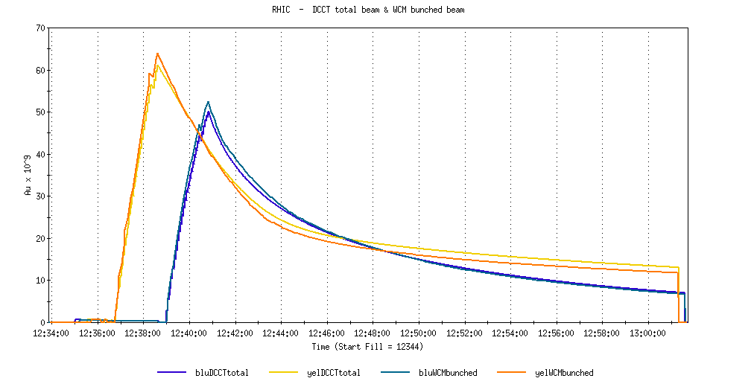
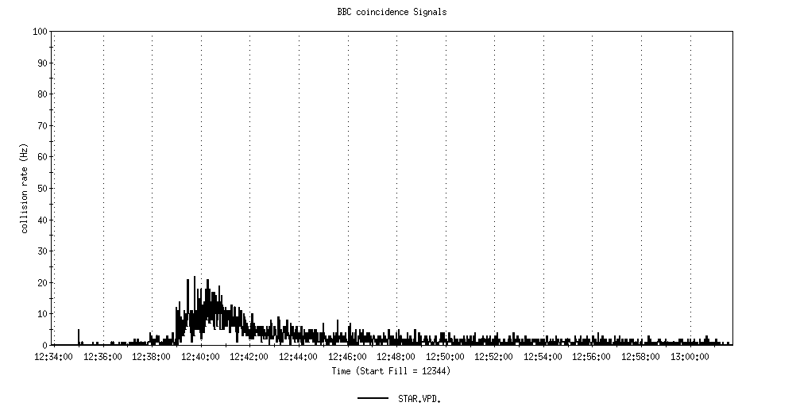
  √s = 7.7 GeV/n
  27 April
10 meter beta*
20 min stores
STAR

Slide 5
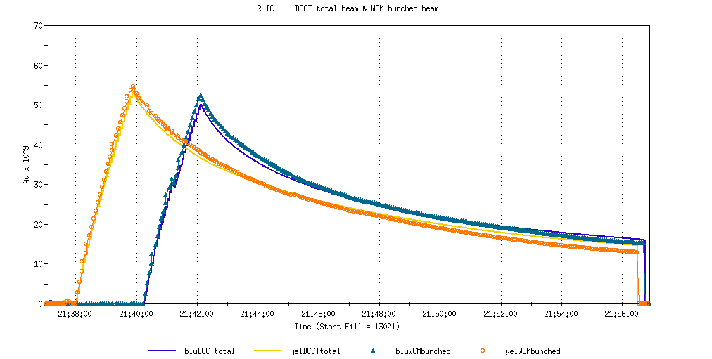
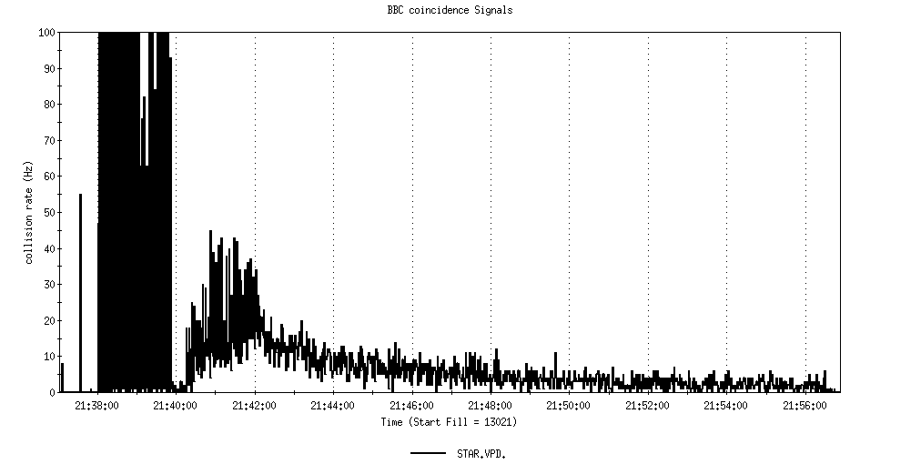
  √s = 7.7 GeV/n
  10 May
6 meter beta*
15 min stores
STAR

Slide 6
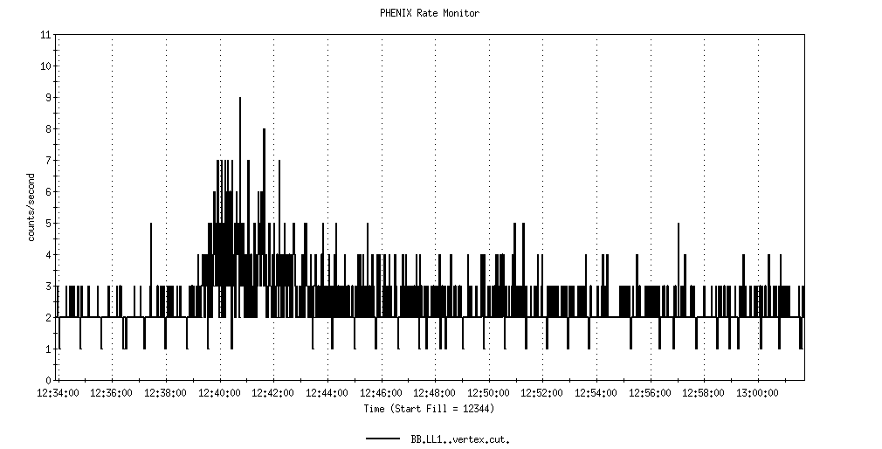
  √s = 7.7 GeV/n
  27 April
10 meter beta*
20 min stores
PHENIX

Slide 7
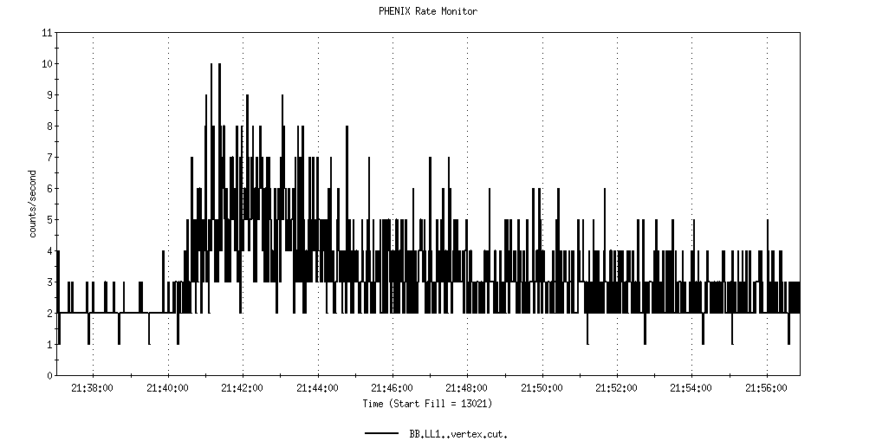
  √s = 7.7 GeV/n
  10 May
10 meter beta*
15 min stores
PHENIX

Slide 8
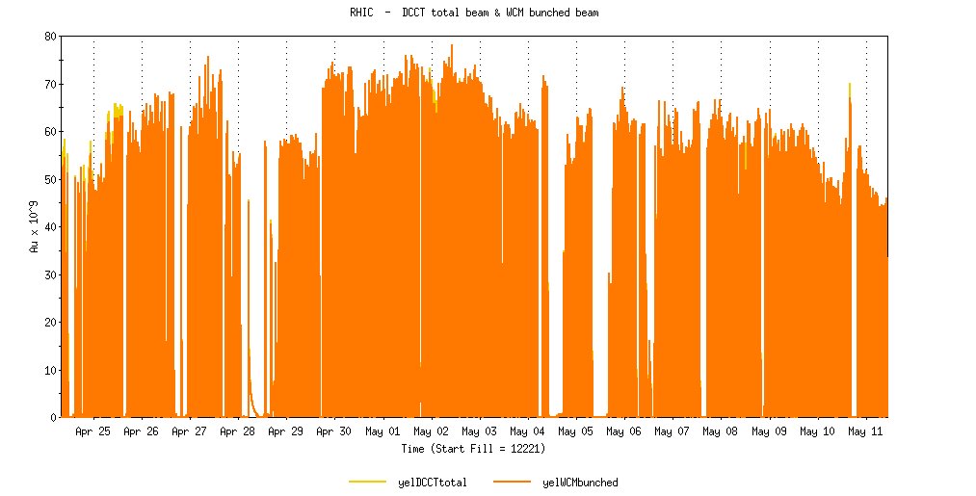
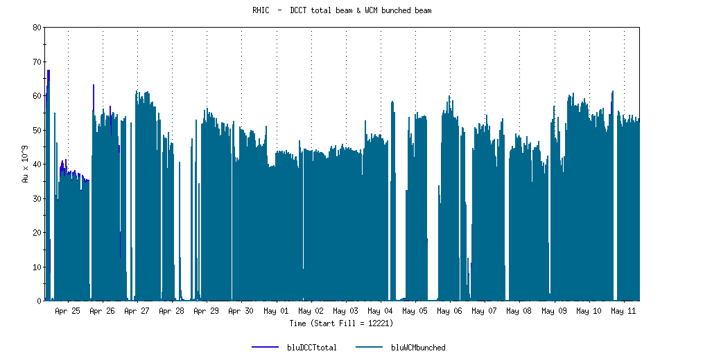
  √s = 7.7 GeV/n
  24 April-11 May
}
6 m β*
STAR/PHENIX 6/10 m β*

Slide 9
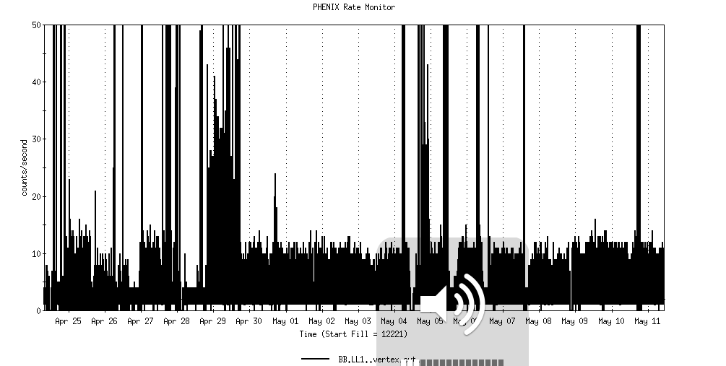
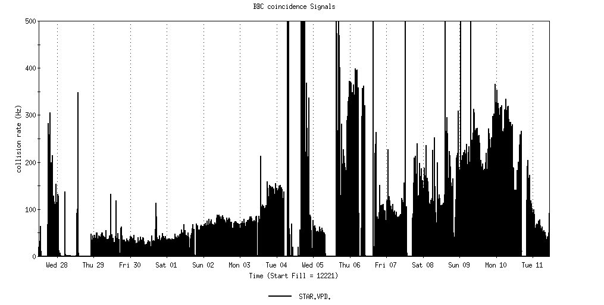
  √s = 7.7 GeV/n
  24 Apr - 10 May
PHENIX
}
STAR
6 m β*
STAR/PHENIX 6/10 m β*

Slide 11
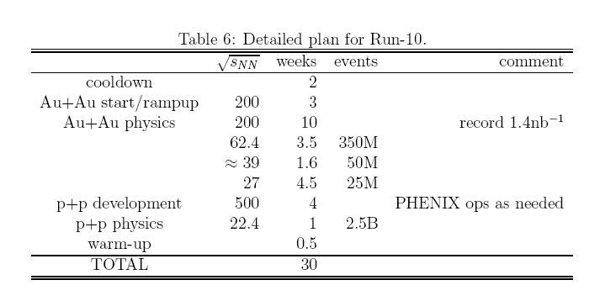
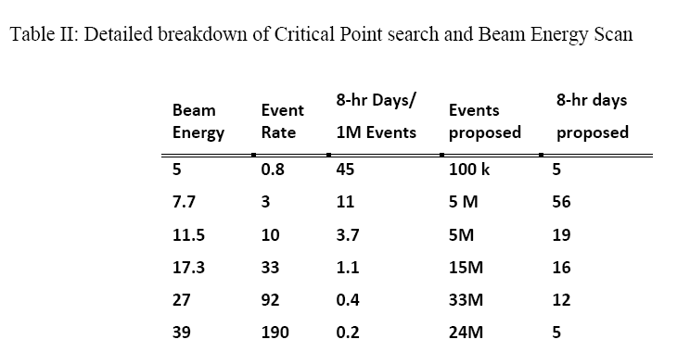
PHENIX BUR
(Actual 2.9 weeks, 660M)
(Actual 1.9 weeks, 250M)
STAR BUR
Actual Average ZDC Rate ~1200 Hz
(Actual 1.9 weeks, ~250M)

Slide 12
Archive

Slide 13
Future Topics
Toward Smaller beta* - new quad triplets – D. Trbojevic

Slide 14
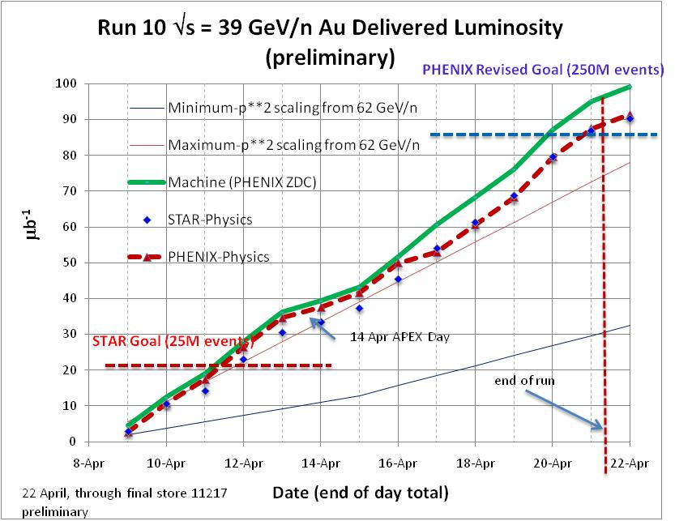

Slide 15
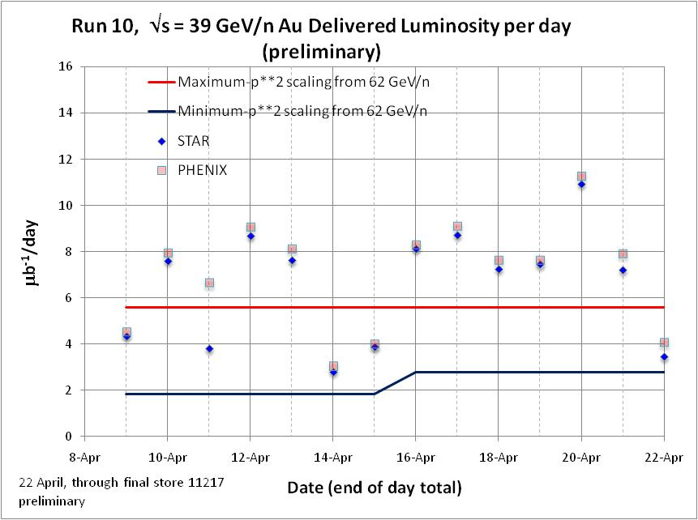

Slide 16
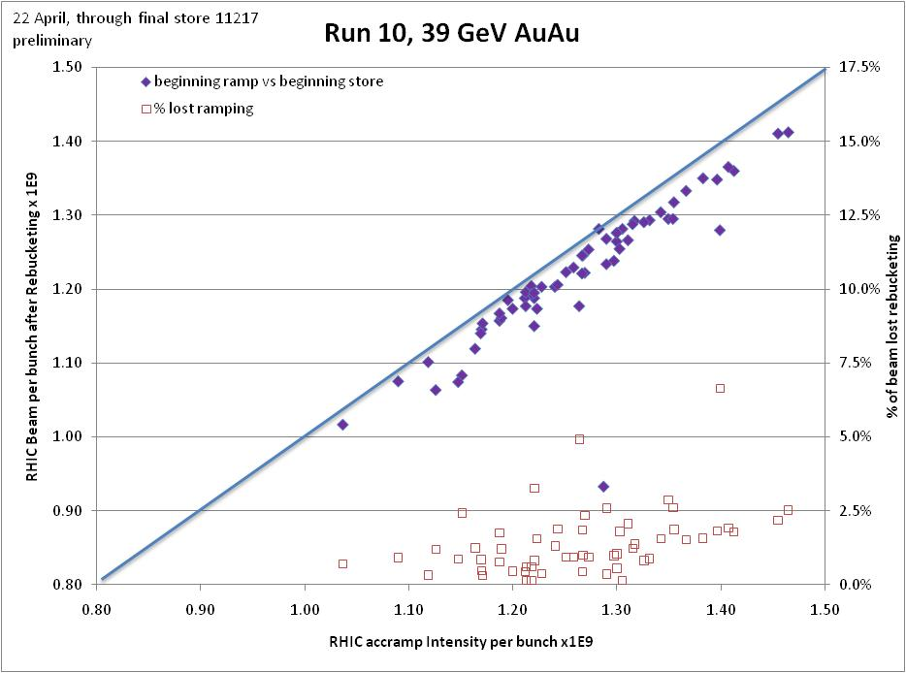

Slide 17
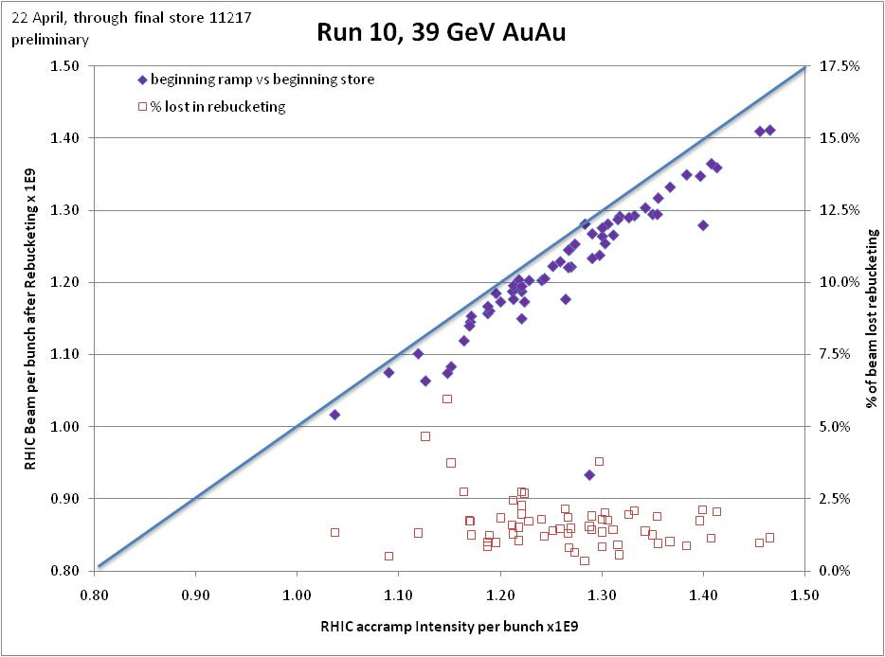

Slide 18
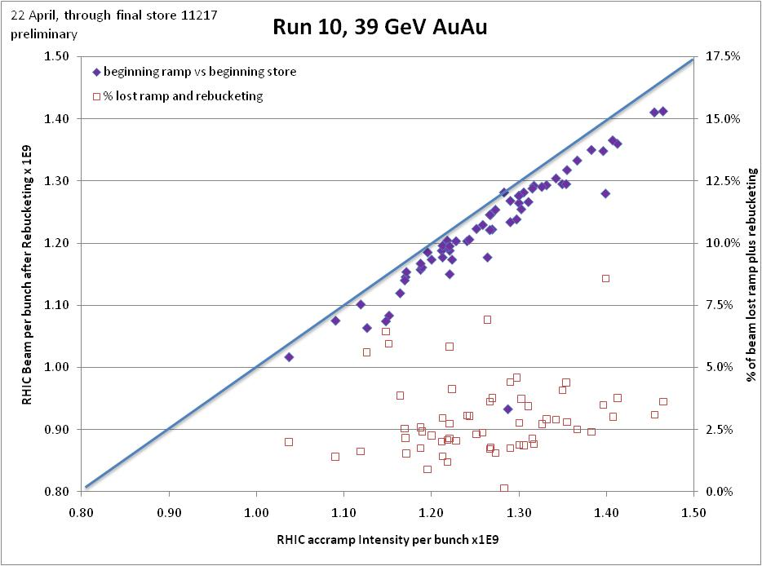

Slide 19
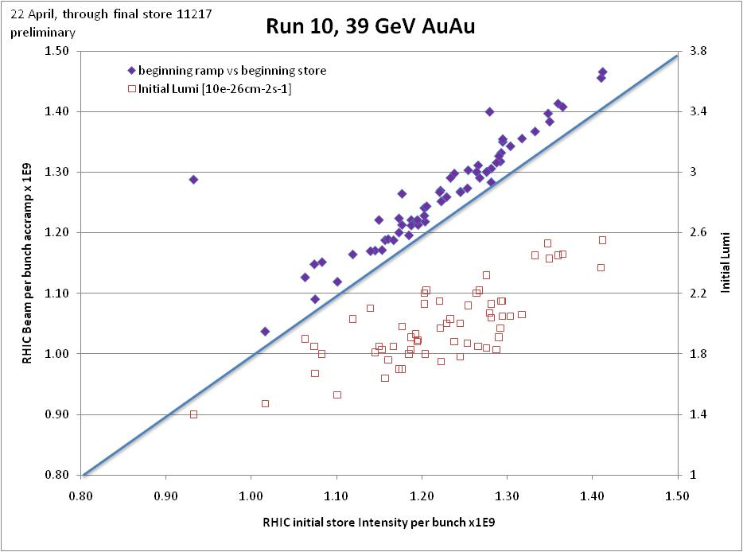

Slide 20
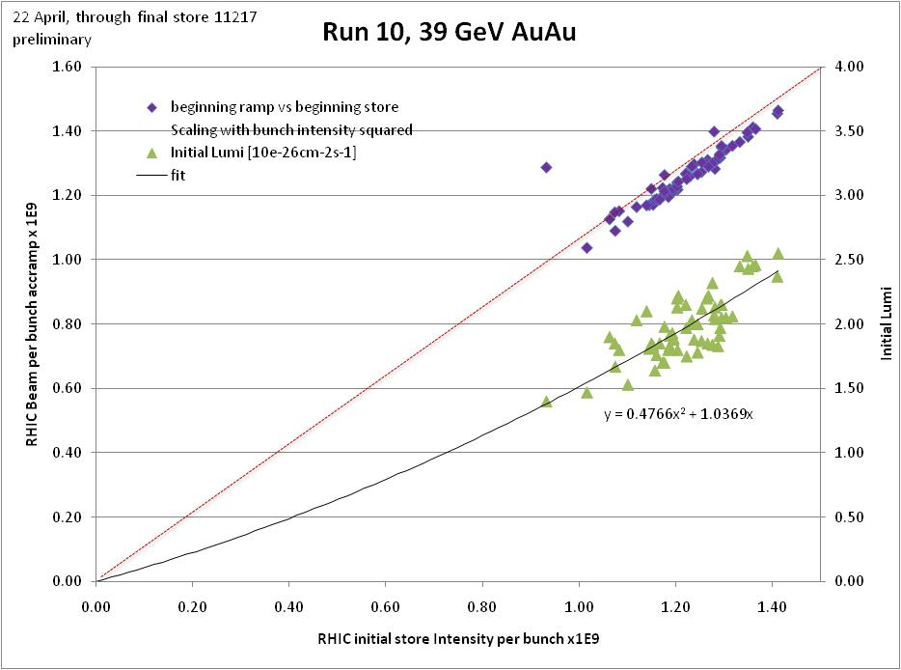

Slide 21
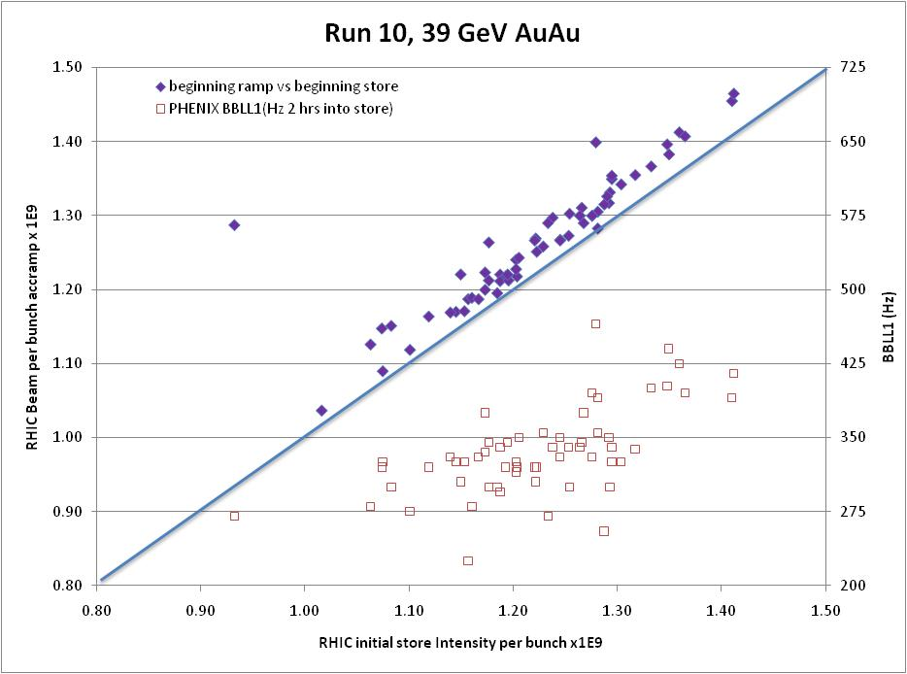

Slide 22
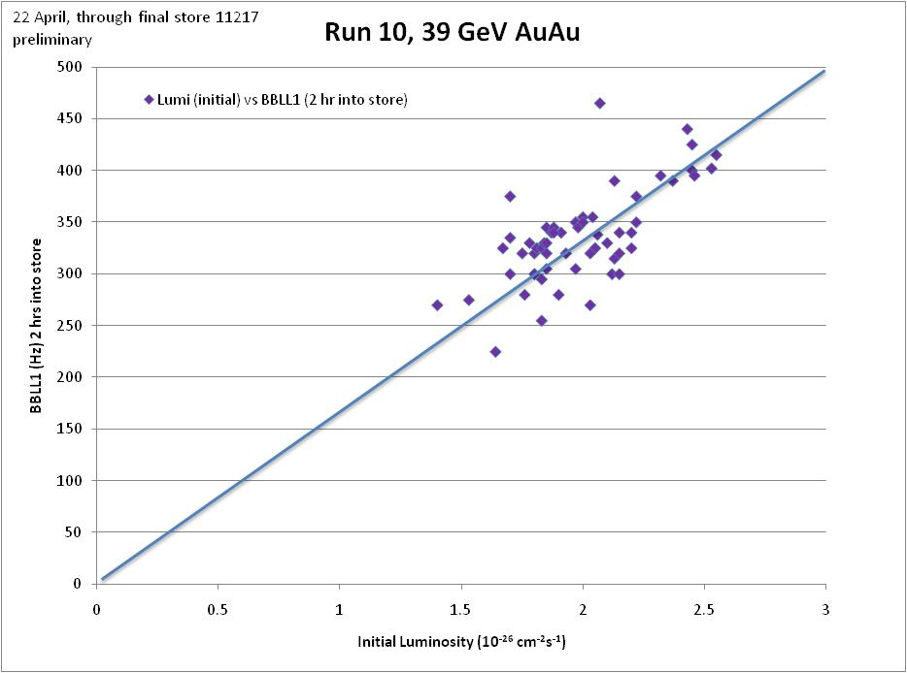

Slide 23
Run 10 Au-Au Goals, √s = 39 GeV/n
4/13/10
STAR
  √s = 39 GeV/n
    Luminosity Sampled/Delivered = ?/? μb⁻¹
    24M Min-bias events
PHENIX
  √s = 39 GeV/n
    Luminosity Recorded/Delivered = ?/? μb⁻¹
    50M Min-bias events <30 cm vertex, (revised request 250M)

Slide 24
We should revisit Luminosity Projections
PHENIX BUR
(Actual 2.5 weeks, 660M)
STAR BUR
Actual Average ZDC Rate ~1200 Hz

Slide 25
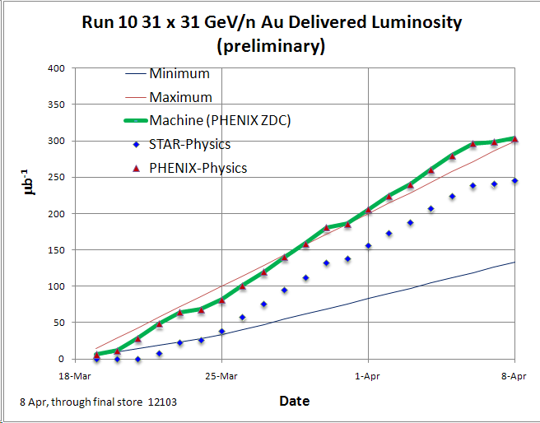
PHENIX Goal (400M min-bias events)
19 Mar
STAR Goal (100M min-bias events)

Slide 26
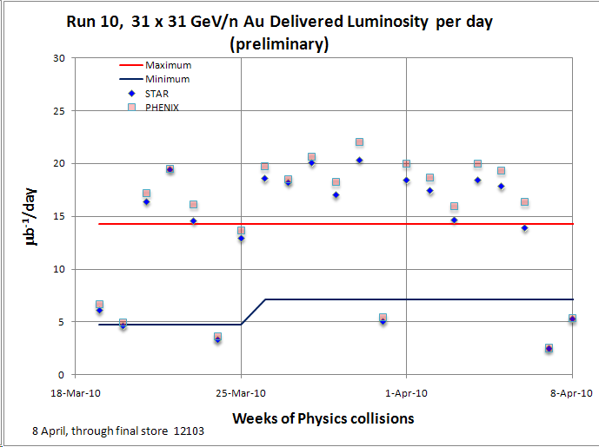

Slide 27
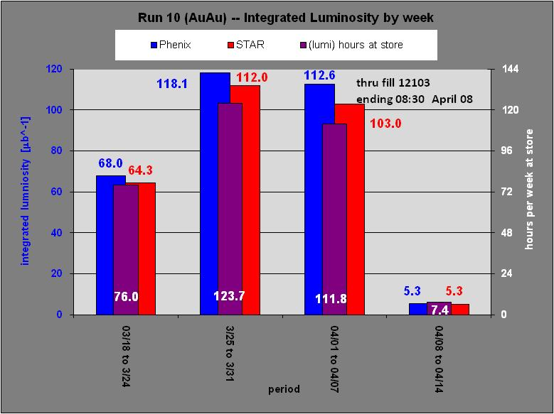
√s = 62 GeV/n
final

Slide 28
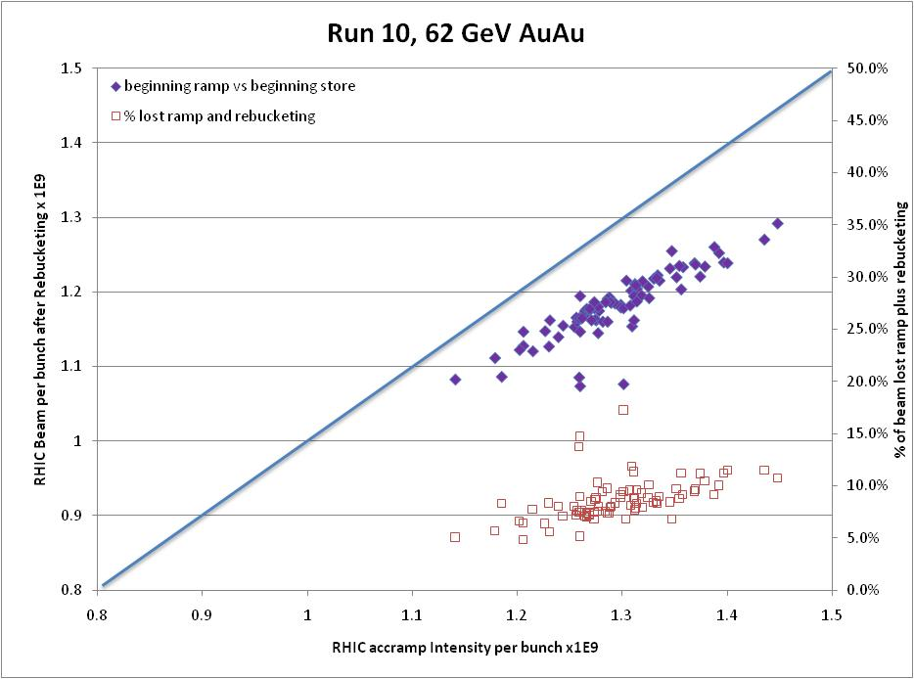

Slide 29
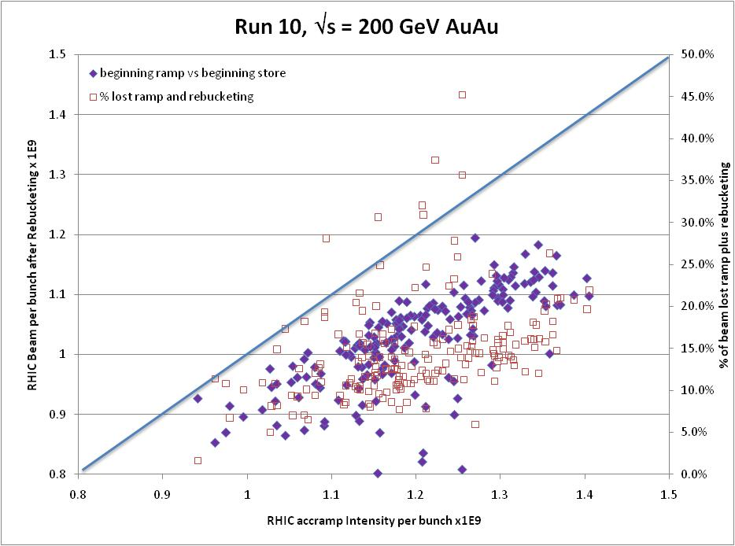

Slide 30
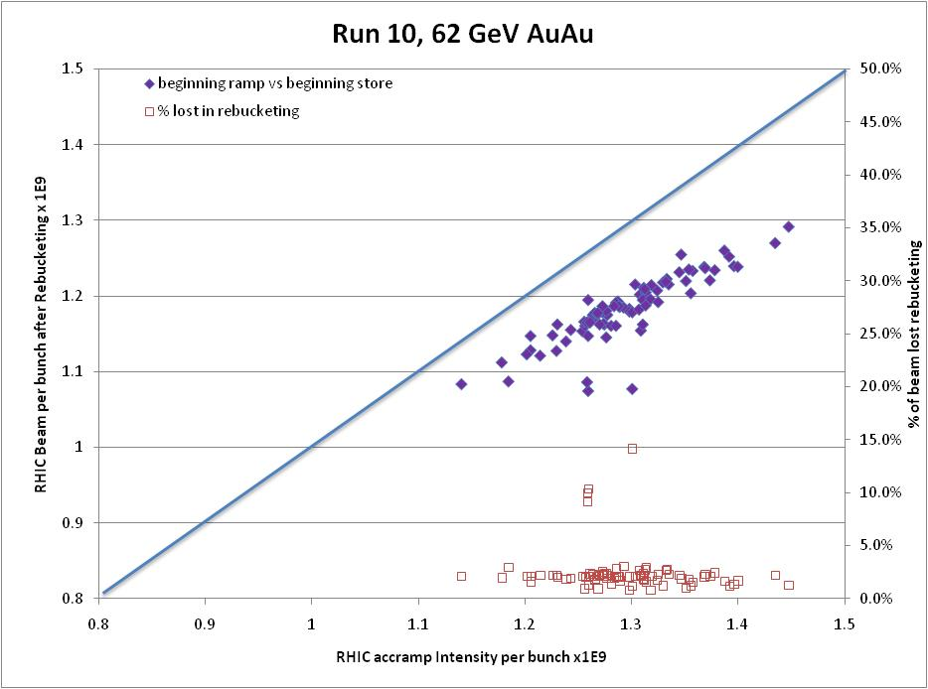

Slide 31
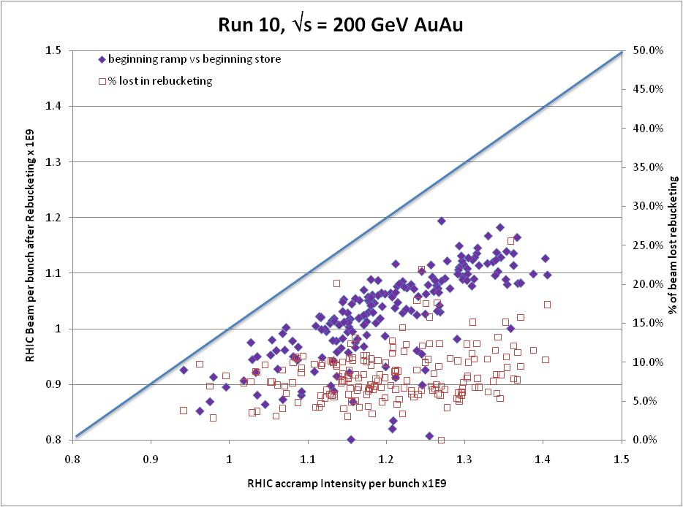

Slide 32
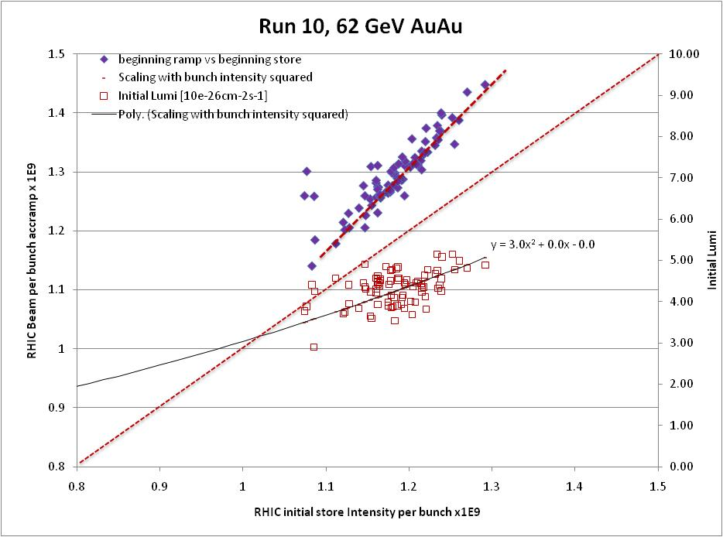

Slide 33
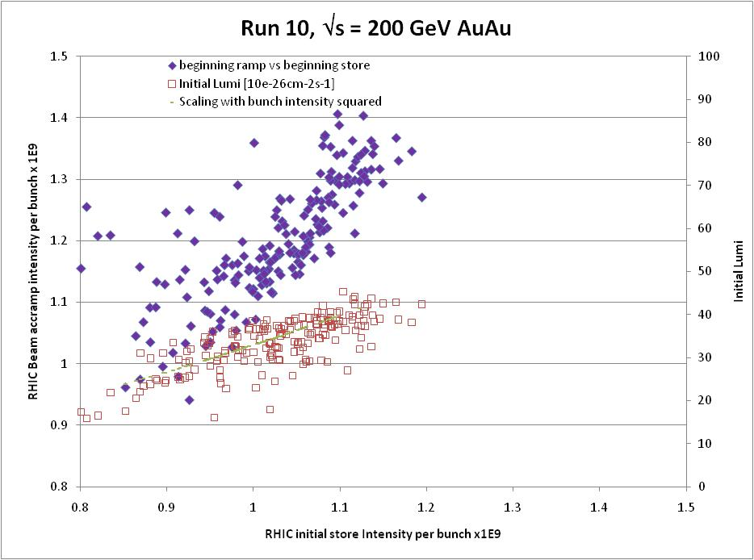

Slide 34
Run 10 Au-Au Goals
3/30/10
STAR
  √s = 62 GeV/n
    Luminosity Sampled/Delivered = ?/90 μb⁻¹
    100M Min-bias events
PHENIX
  √s = 62 GeV/n
    Luminosity Recorded/Delivered = 64/193 μb⁻¹
    400M Min-bias events

Slide 35
Through Feb 2010

Slide 36
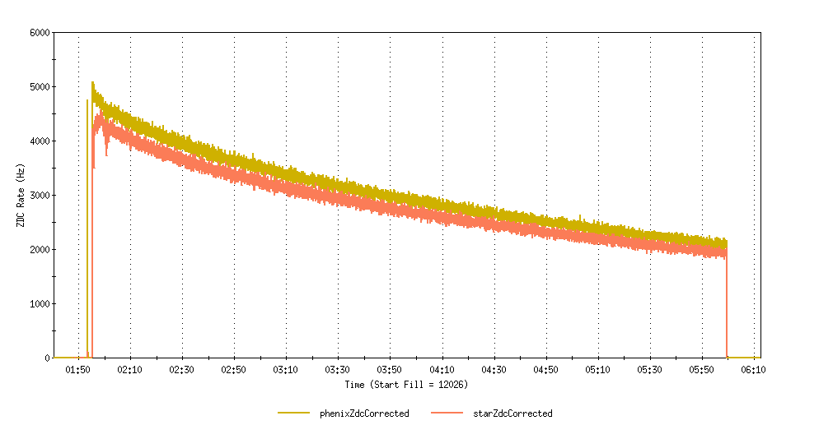
First Store Monday, 29 March, Store 12026

Slide 37
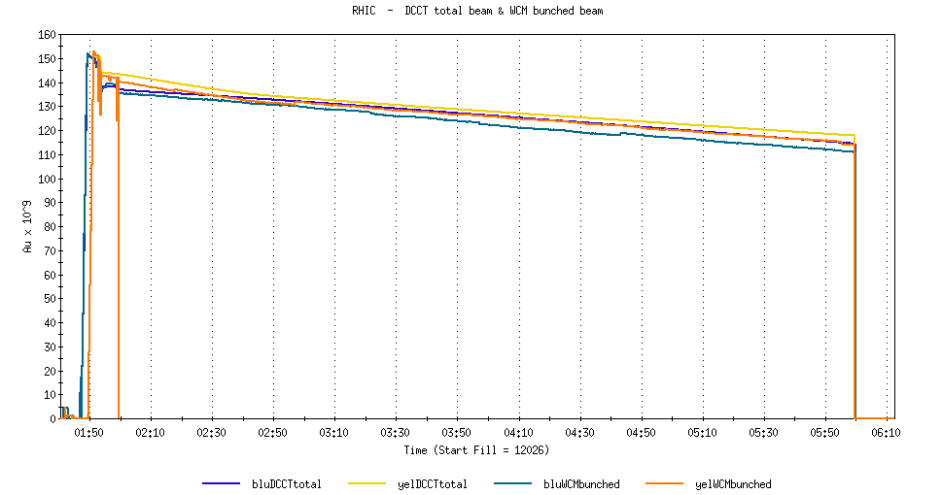
First Store Monday, 29 March, Store 12026

Slide 38
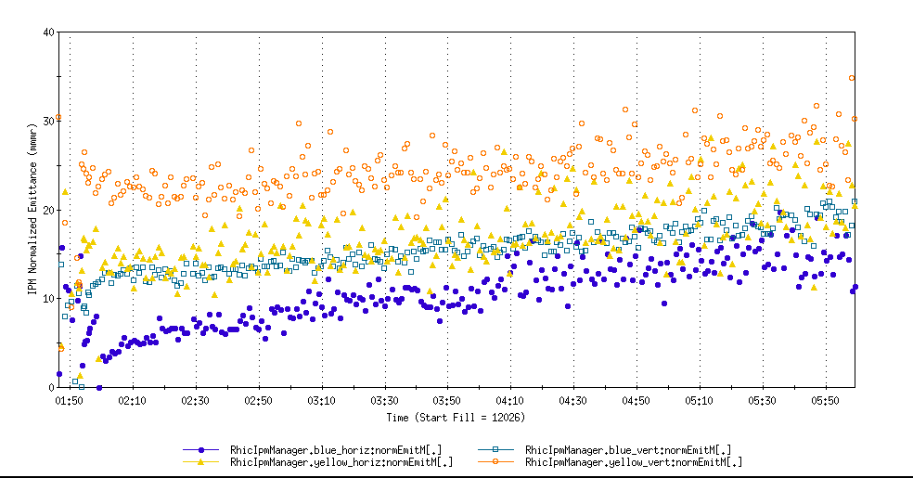
First Store Monday, 29 March, Store 12026

Slide 39
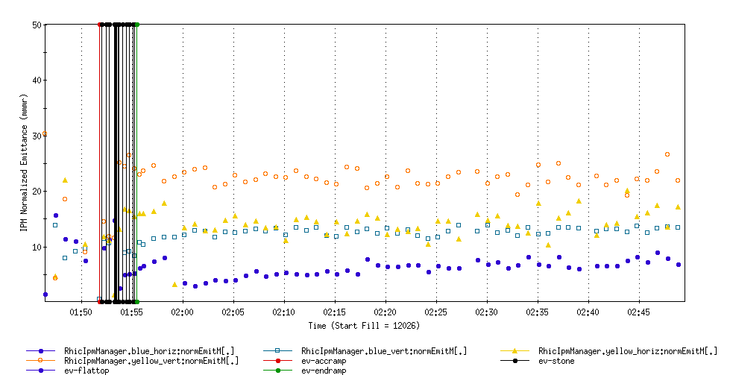
First Store Monday, 29 March, Store 12026

Slide 40
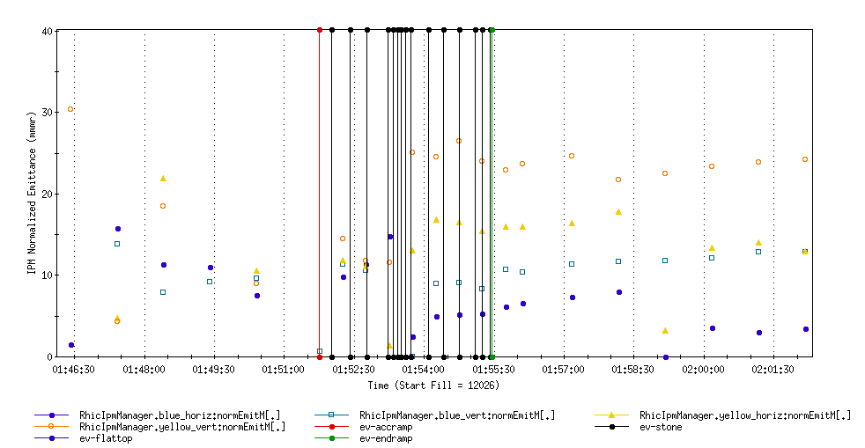
First Store Monday, 29 March, Store 12026

Slide 41
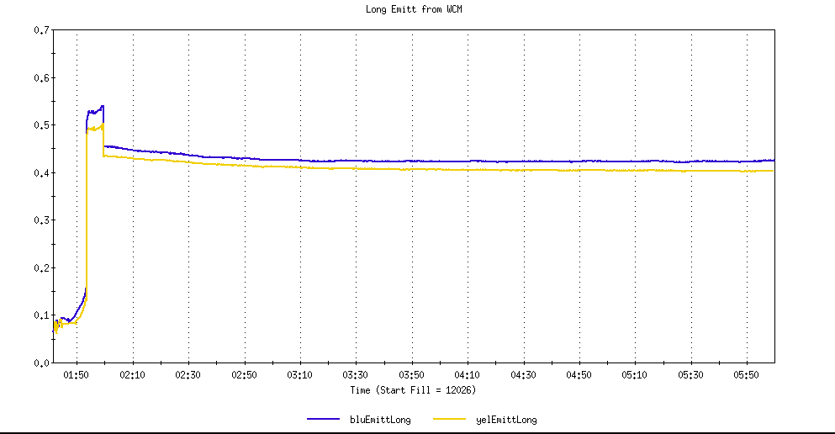
First Store Monday, 29 March, Store 12026
WCM Longitudal Emittance

Slide 42
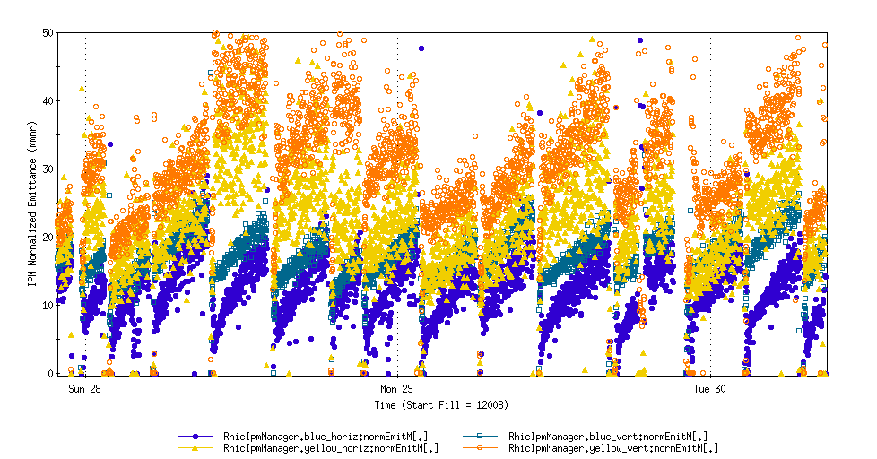
31 x 31 GeV/n Au horiz and vert emittances
Store 12026

Slide 43
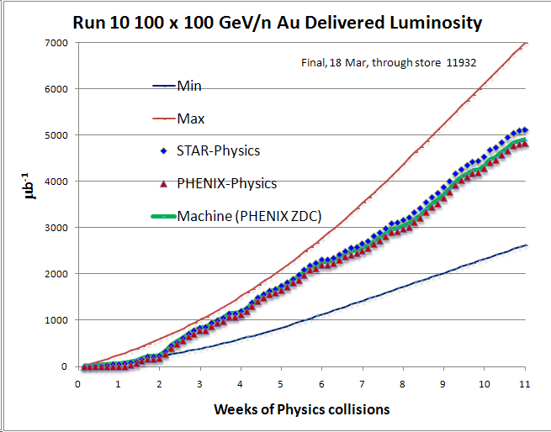
PHENIX Goal*
STAR Goal
PHENIX Minimum Goal*
* With 20 cm sigma IR diamond

Slide 44
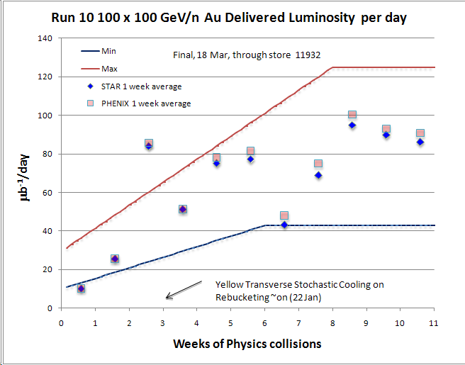

Slide 45
Average hours per week at store = 88.5

Slide 46
Through Jan 2010

Slide 47
Through 2/28/10

Slide 48
31 Dec 1st Physics Store 11340, 0.6 m β* No cooling or rebucketing, STAR 3.2 μb⁻¹, 2.6 hr store
Ring | Bunches/Cycles | Avg Bunch in RHIC (10^6 ions) | Avg Efficiency XCBM to RHIC | XCBM to Uxf1 | Uxf1 to Wxf | Wxf to Arc | Arc to RHIC
Blue | 56/56 | 909 | 0.836 | 1.056 | 0.963 | 0.992 | 0.828
Yellow | 56/56 | 990 | 0.971 | 1.085 | 0.962 | 0.959 | 0.970
18 Jan Physics Store 11489, 0.6 m β* No cooling or rebucketing, STAR 22.6 μb⁻¹, 3.9 hr store
Ring
Bunches/Cycles
Avg Bunch in RHIC
(10^6 ions)
Avg Efficiency
XCBM to RHIC
XCBM to Uxf1
Uxf1 to Wxf
Wxf to Arc
Arc to RHIC
Blue
111/28
1196
0.911
1.024
0.961
0.999
0.927
Yellow
111/29
1168
0.879
1.023
0.961
0.989
0.905
28 Feb Physics Store 11824, 0.7 m β* with some cooling and with rebucketing, STAR 32.7 μb-1, 3.9 hr store
Ring | Bunches/Cycles | Avg Bunch in RHIC (10^6 ions) | Avg Efficiency XCBM to RHIC | XCBM to Uxf1 | Uxf1 to Wxf | Wxf to Arc | Arc to RHIC
Blue | 111/28 | 1262 | 0.917 | 0.975 | 0.961 | 1.001 | 0.977
Yellow | 111/28 | 1246 | 0.910 | 0.961 | 0.964 | 0.988 | 0.994
2 Mar Physics Store 11834, 0.7 m β* with some cooling and with rebucketing, STAR 29.4 μb⁻¹,3.9 hr store)
Ring | Bunches/Cycles | Avg Bunch in RHIC (10^6 ions) | Avg Efficiency XCBM to RHIC | XCBM to Uxf1 | Uxf1 to Wxf | Wxf to Arc | Arc to RHIC
Blue | 111/28 | 1354 | 0.927 | 0.990 | 0.965 | 1.003 | 0.968
Yellow | 111/28 | 1377 | 0.931 | 0.990 | 0.964 | 0.989 | 0.987

Slide 49
Through 2/28/10

Slide 50
Through 2/28/10

Slide 51
Revised Run 10 Plan, Nov 25, 2009
 | Physics production or beam studies weeks
√s_{NN} (GeV) | 25-cryoweek run | 27-cryoweek run
200 | 10 | 10
62.4 | 4 | 4
39 | 1.5 | 1.5
27 | 0 | 0
18 | 0 | 0
11.5 @ STAR | 0 | 2
7.7 | 4 | 4
Beam studies @ 5 GeV and @ ν≈ 0.67 | 0.5 | 0.5

Slide 52
Run 10 Au-Au Goals
11/19/09
STAR
  √s = 200 GeV/n
    Luminosity Sampled/Delivered = 2/4 nb⁻¹
    250M Central Events
    300M Min-bias events
PHENIX
  √s = 200 GeV/n
    Luminosity Recorded/Delivered = 1.4/>6 nb⁻¹
    Minimum Goal:
      Luminosity Recorded/Delivered = 1.1/3.9 nb⁻¹

