Slide 1
RHIC Status
Haixin Huang
Time Meeting
01/25/2011

Slide 2
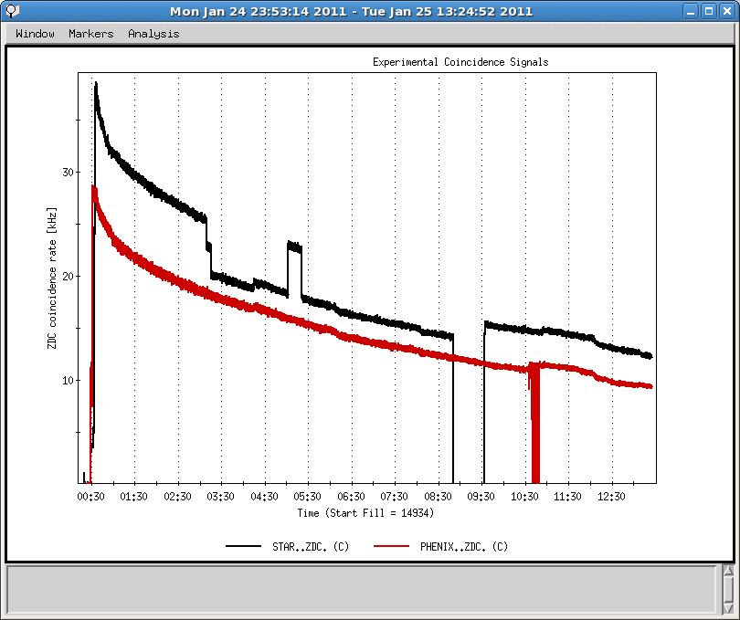
ZDC Collision Signals
Need stable signals for Vernier scan

Slide 3
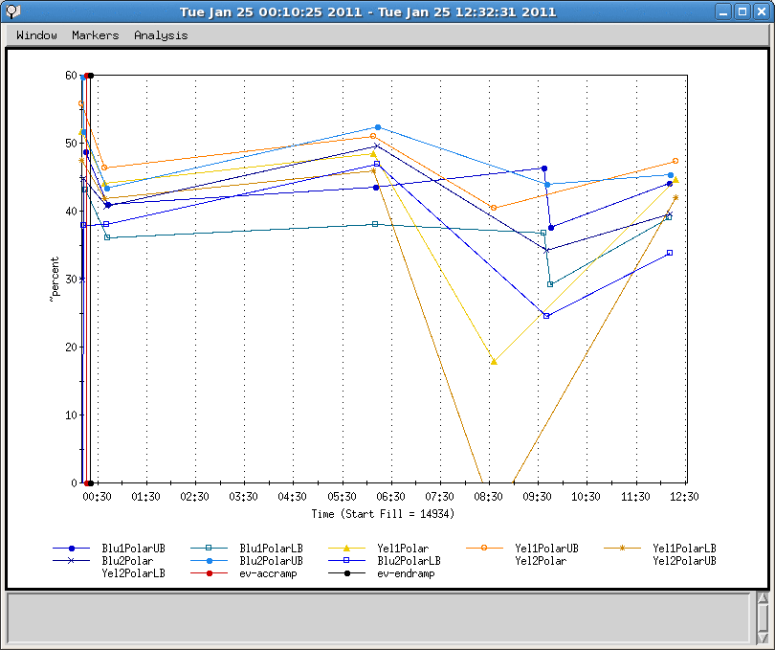
Polarization over Last Store
Injection measurements

Slide 4
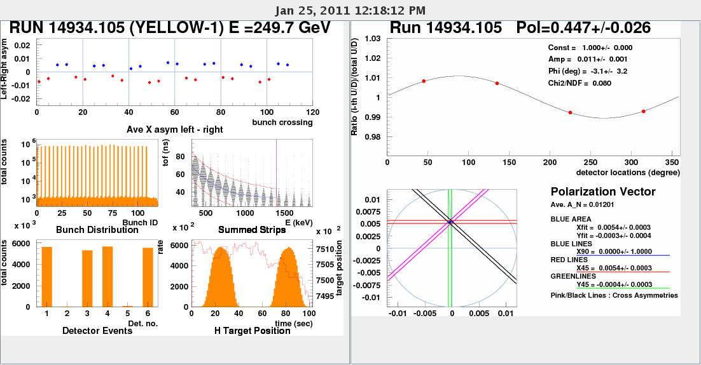
Yellow Polarization at End of Store

Slide 5
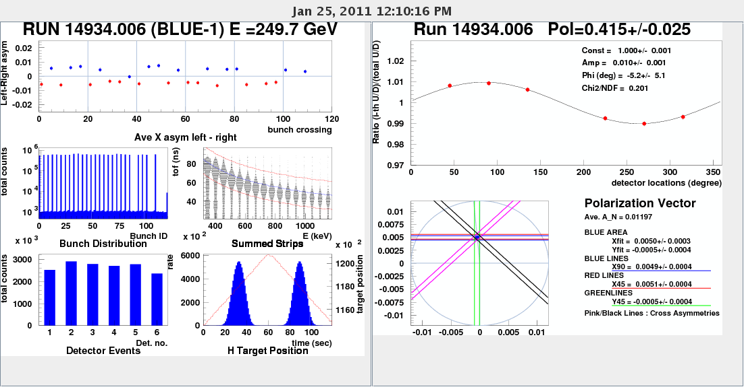
Blue Polarization at End of Store

Slide 6
A Few Issues with Long Term Impact
Need to address which rf cavity to use.
9MHz cavity development with higher bunch intensity, and rebucketing with 28MHz.
Need to check if we need the slower ramp or not (test with higher bunch number and higher bunch intensity).
Collimation on the ramp: contain beam loss at collimator to avoid permit pulling. This requires orbit feedback on every ramp.

Slide 7
Status as of 1/25/2011
Provide 28X28 stores overnight for past two days.
Successful 9MHz cavity ramps with 6x6. Longitudinal emittance is preserved.
Polarization measurements show ~45-50% polarization at store (using analyzing power at 100GeV).
Instrumentation not in operation mode yet: IPM blue horizontal, yellow2 polarimeter and jet.
Relaxed gamma_tr quads off by ten seconds, which improved the beam loss in the early part.
Tune/coupling/orbit feedback works, waiting for chromaticity feedback.
We have seen sextupoles ramp speed reached limits. We have a slower ramp ready for test (developed by Steve over weekend), but we have not done it yet.
We want to remove separation bumps in a different ramp (before rotator ramp turning on). It’s ready but not commissioned yet.
Vernier scans are done at IP8, IP6 and IP2.
Several attempts to ramp with 56x56 failed due to beam loss (chromaticity) near the end of ramp.

Slide 8
Plan for next A Few Days
Pseudo-rotator ramp development.
Set up collimation on ramp.
Rotator ramp development.
9MHz cavity development with higher bunch intensity.
Working on chromaticity. Increase bunch number and intensity.
Check polarization at AGS extraction, RHIC injection and store.
We need to evaluate the polarization transmission efficiency on the ramp, and ramp measurements.
Take polarization profile measurements (at fixed target locations) at store and injection.

Slide 9
Overall Schedule
Cool-Down Mode : one week (01/03-01/09)
Injection setup (6 days: first 4 days are blue only) (01/10-01/15).
Ramp development (6 days) (01/16-01/21)
Commissioning 9MHz at injection and on the ramp (5 days) (01/19-01/23)
Store development (6 days) (01/22-01/27)
Ramp development with intense beam (7 days) (01/28-02/03).

