Slide 1
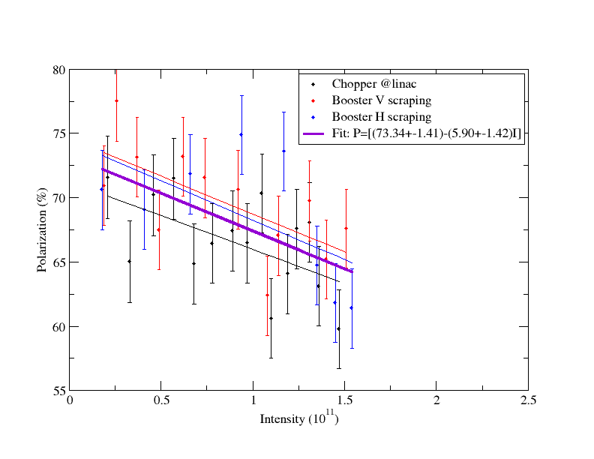
AGS Intensity Scan (12/22/10)

