Slide 1
PHENIX Start-up Status
Takao Sakaguchi (BNL), Run Coordinator
Kieran Boyle (RBRC), Spin Coordinator
Sasha Bazilevsky (RBRC), Trigger Coordinator
for the PHENIX Collaboration

Slide 2
Activity since last meeting
West VTX detector arm has been installed.
Electronics and DCMs are in place and being exercised to readout.
All of the new DCM II's needed to readout VTX are now available.
Standalone readout test of the pixel detector showed 99.4% of the detector alive.
Standalone readout test of the strip detector also succeeded. 100% (all of 112 modules) alive.
This afternoon, the East VTX detector will be installed.
Work on Muon Trigger Electronics and Resistive Plate Chamber No.3 are in good progress as planned.
On schedule to be done week of Dec 20. No delay is expected.
Roll-in East Carriage on or about Dec 3.
After the roll-in we need to reconnect EC, check-out all safety systems, build shield wall, final sign-off to start flammable gas flow.
Begin cosmic ray operations (~ Dec 21) for Muon Trigger timing setup.
Excellent support for 1008 work continues from Lab HVAC people, riggers, carpenters, C-AD surveyors and techs!

Slide 3
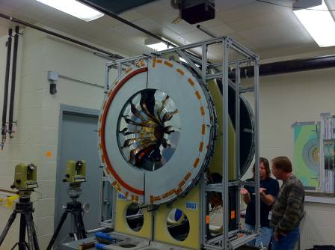
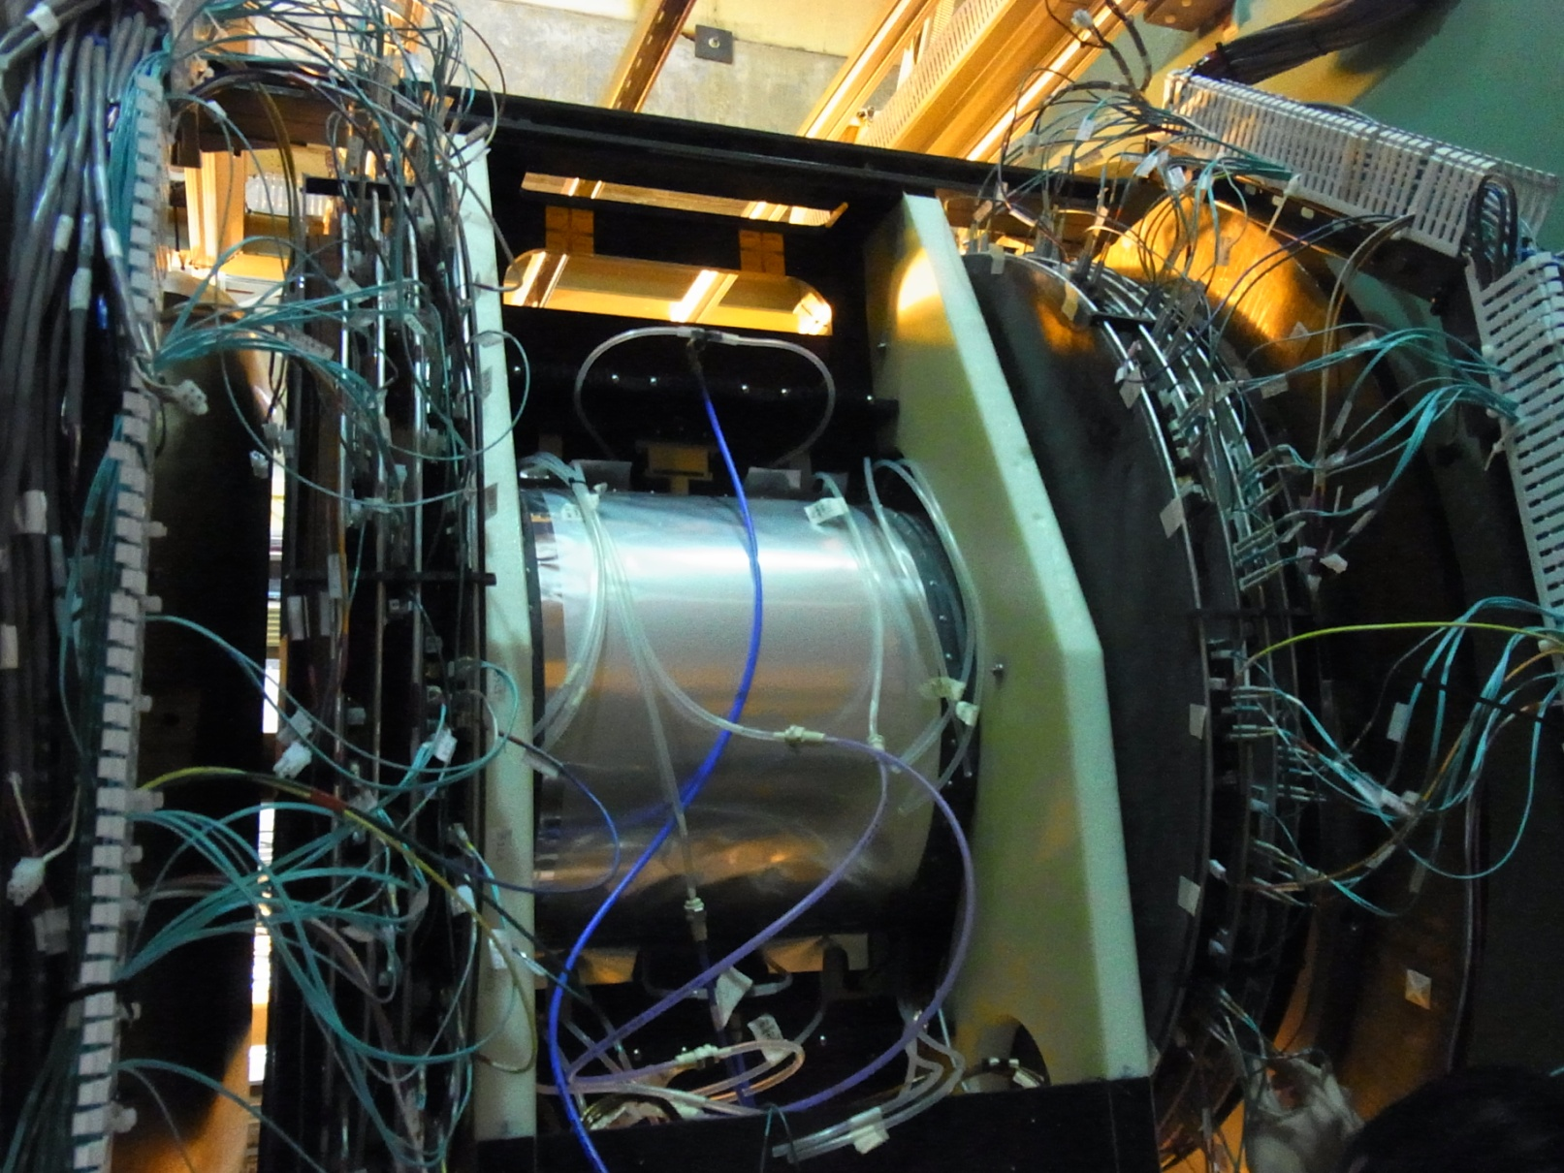
West VTX detector installed

Slide 4
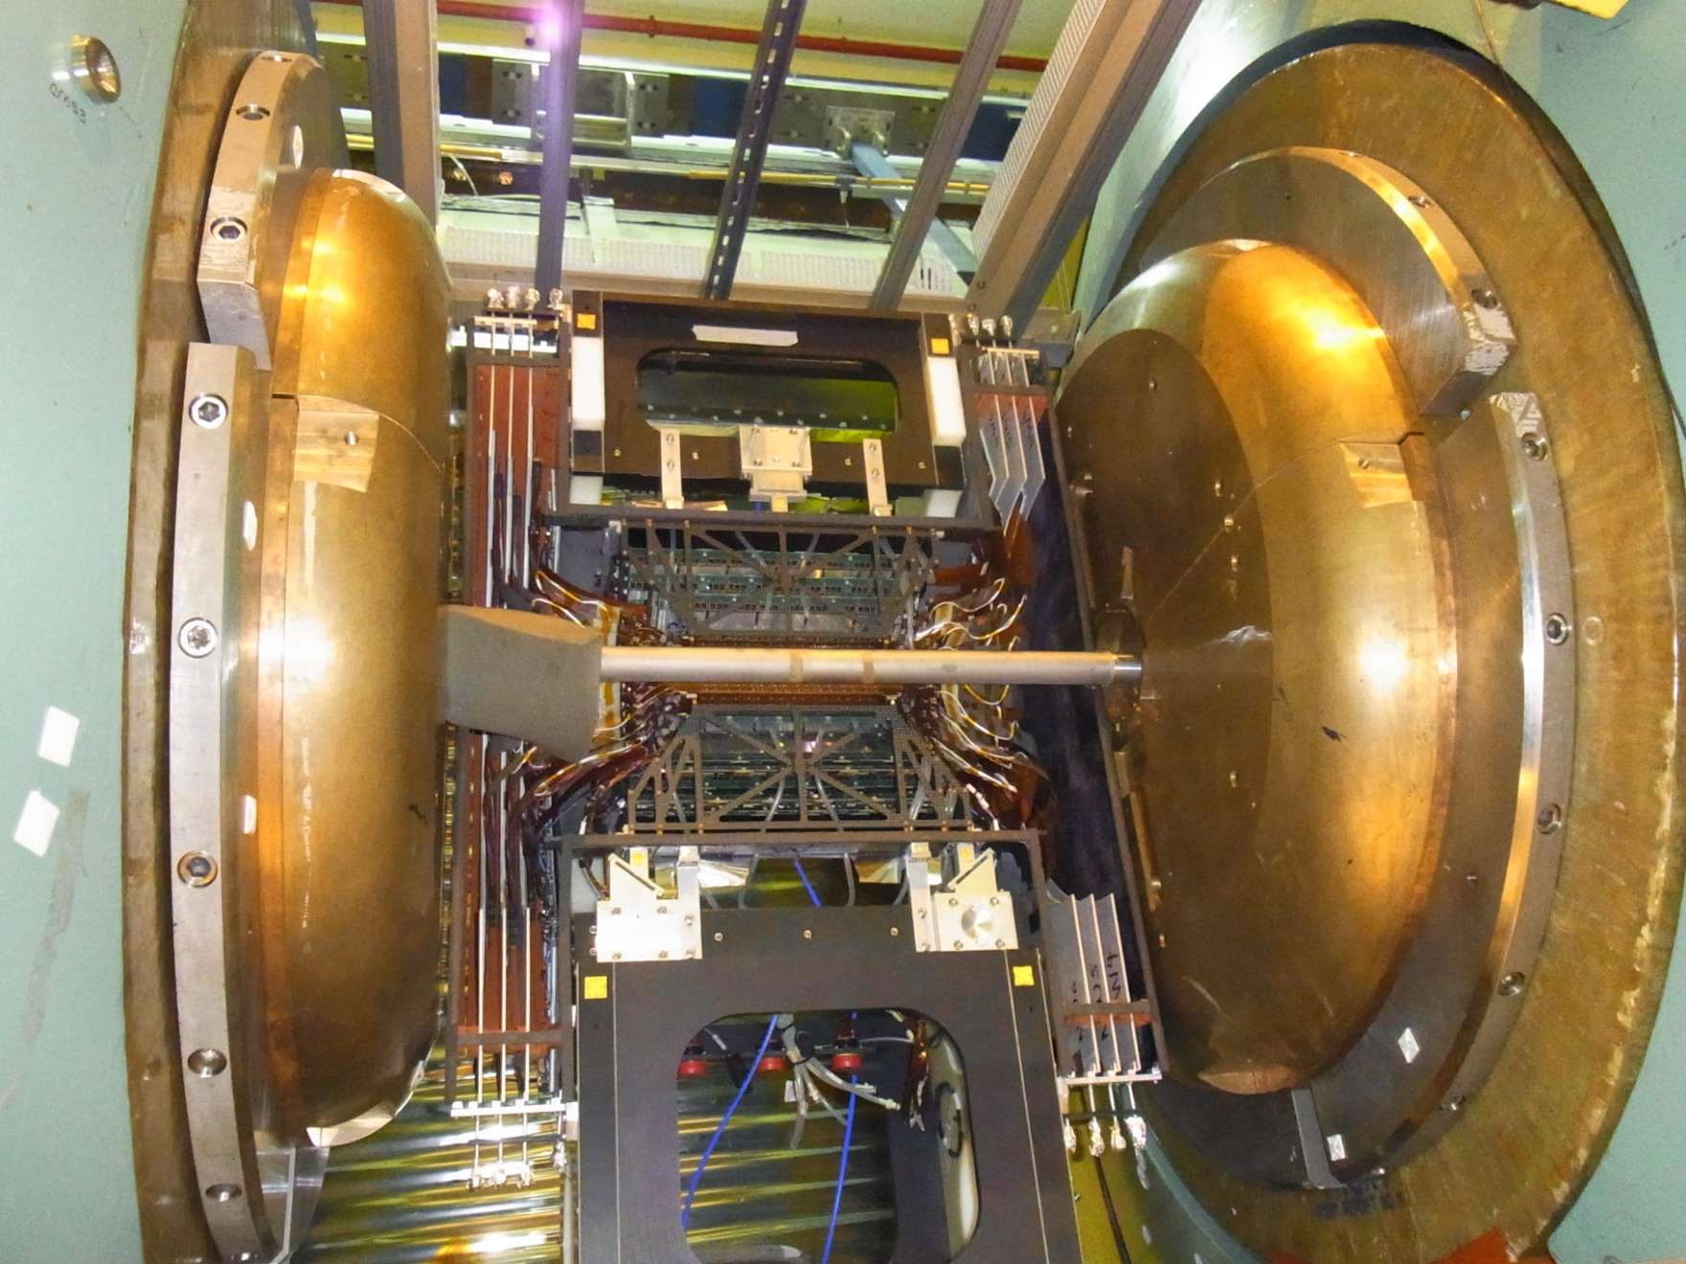
West VTX with beam pipe

