Slide 1
Run 10 As Run
Dec. 1, Begin cool down to 4.5K
Dec. 4, Cooldown to 4.5K complete in both rings!
Dec. 5, beam setup in RHIC begins.
Dec 16, 20 hr unplanned Maintenance day
Dec 20 (AM)-21(PM), blizzard 09 shut us down
Dec. 27, RHIC Setup complete, begin Ramp Up for Physics (was 14 Dec, late)
Dec 31 (midnight-store 11340), Machine, Physics declared (store 11340) √s=200 GeV/n Au-Au
Jan 2 (midnight) STAR in Physics Mode
Jan 8 (0600) PHENIX in Physics Mode
Jan 12, Rebucketing not yet routine, stochastic cooling still to come.
Jan 22, changed beta* from 0.6 to 0.7 meters, rebucketing ~established, yellow transverse stochastic cooling on
Mar. 18 (0556), End 10 week √s = 200 GeV/n Run, begin √s = 62.4 GeV/n setup
Mar. 19, Begin 4 week √s = 62.4 GeV/n run
Machine physics 19 March for stores ≥11954
PHENIX Physics 19 Mar for stores ≥11955
STAR Physics 22 March for stores ≥11976
Apr. 8, End 2.9 week √s = 62.4 GeV/n Run, begin √s = 39 GeV/n setup
Apr. 9, Begin 1.5 week √s = 39 GeV/n run
Machine physics 9 April for stores ≥12119
PHENIX and STAR Physics 9 April for stores ≥12122
Apr. 14, 24 hours APEX for n= 0.67 studies
Apr. 22, End 1.9 week √s = 39 GeV/n Run
Apr 22, Begin √s = 7.7 GeV/n setup (12 hr pol. switches)
Apr 24 (fill 12238, 2300 hrs), Begin 4 week √s = 7.7 GeV/n run
13 May ½ Sextupole Polarity Switch
May 17 √s = 5 GeV/n development, 8 hour block
May 27 End 4.7 week √s = 7.7 GeV/n Run, begin √s = 11.5 GeV/n setup (No polarity switch required)
May 28 (0630), begin √s = 11.5 GeV/n for STAR with store # 14266
Jun 7 (0800), end 2 (1.4 weeks) week √s = 11.5 GeV/n run
Jun 7, resume √s = 5 GeV development
Jun 8 (1800), end 5 GeV development, Begin Cryo Warm-up
Jun 11, Warm-up complete, Run 10 ends – 27.6 CRYO WEEKS
Last Week of June – Commissioned EBIS with He beam to booster

Slide 3
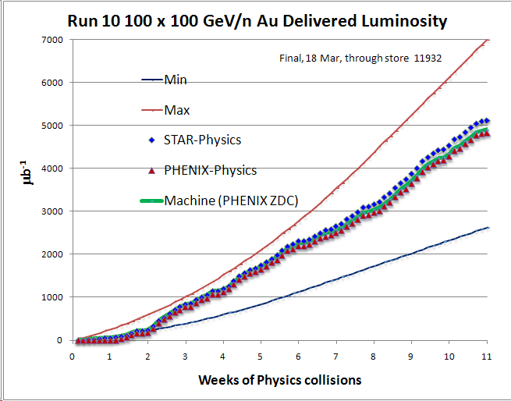
PHENIX Goal*
STAR Goal
PHENIX Minimum Goal*
* With 20 cm sigma IR diamond

Slide 4
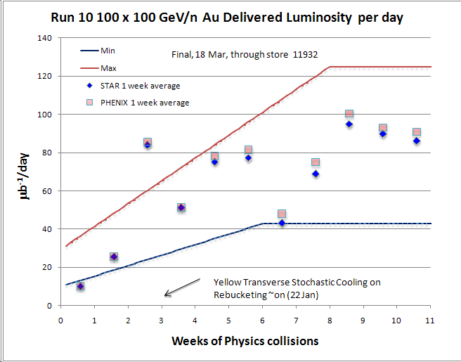

Slide 5
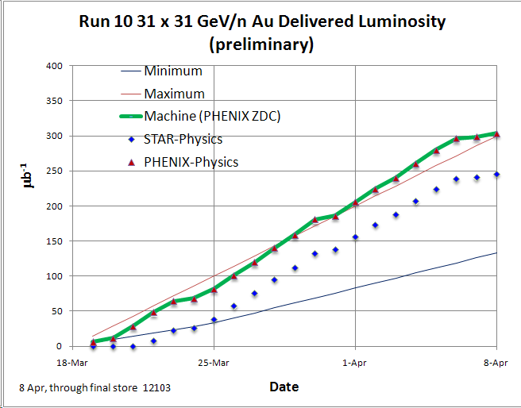
PHENIX Goal (400M min-bias events)
19 Mar
STAR Goal (100M min-bias events)

Slide 6
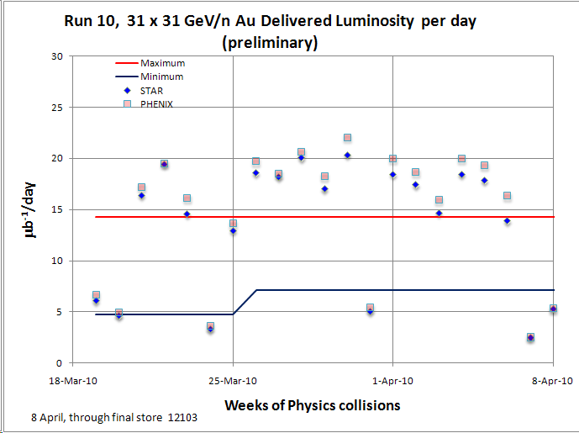

Slide 7
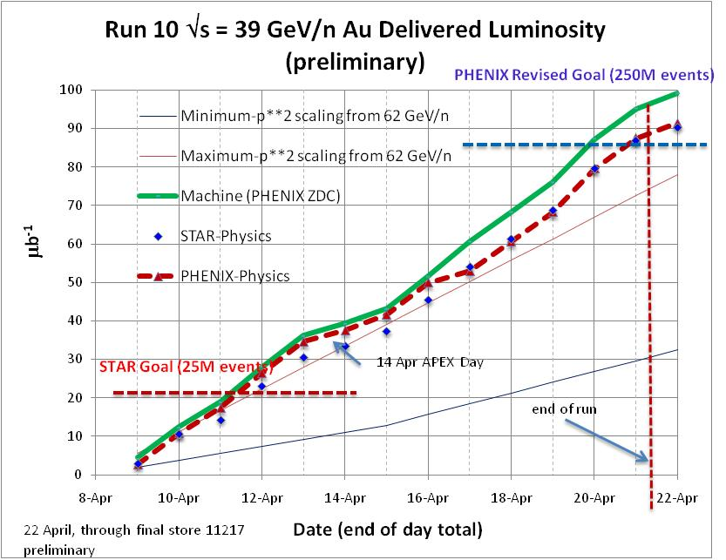

Slide 8
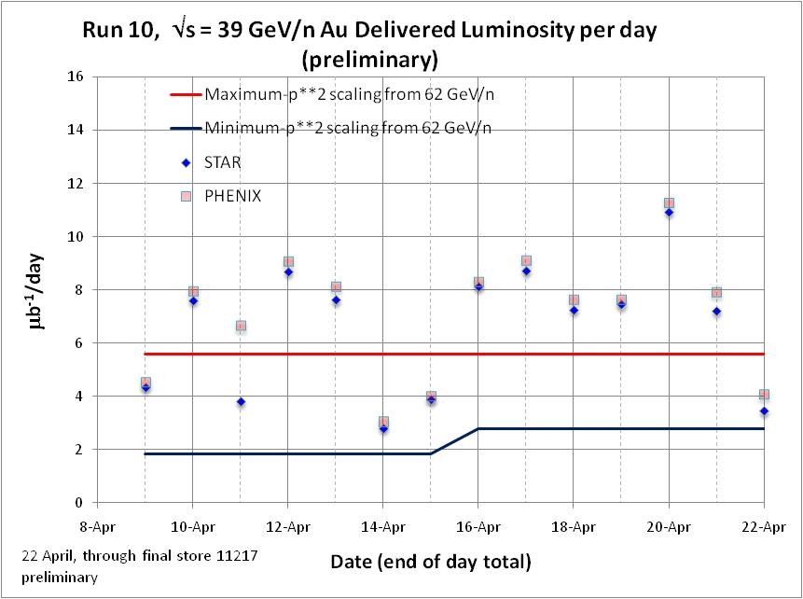

Slide 9
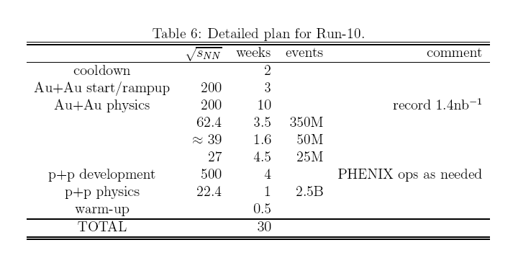
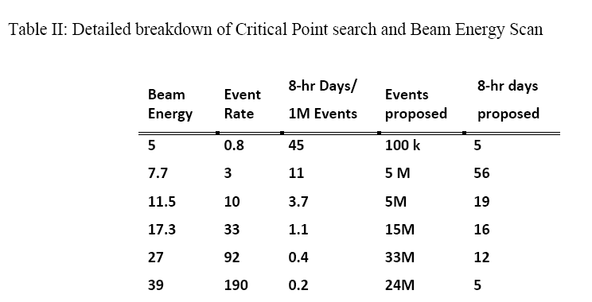
PHENIX BUR
(Actual 2.9 weeks, 660M)
(Actual 1.9 weeks, 250M)
STAR BUR
Actual Average good event
rate ~6 Hz
(Actual 4.7 weeks, ~5M)
Actual Average ZDC Rate ~1200 Hz
(Actual 1.9 weeks, ~250M)

