Slide 1
Run 11 RHIC Machine/Experiments Meeting
14 Jun 2011
Agenda:
√s = 200 GeV AuAu progress
ZDC Calibration for AnDY – the plan
Request from AnDY
√s = 27 GeV Run Readiness
√s = 19 GeV very preliminary results from STAR

Slide 2
Run 11 Plan based on PAC recommendation/ALD Guidance and available funds
6/14/10 update
3 Jan, Begin cool-down to 4.5K
8 Jan, Cool-down to 4.5K complete in both rings, preliminary setup begins
24 Jan, 1 week Ramp-up with 8 hr/night beam to experiments
11 Feb (machine and ~experiments), begin ~10 week physics run (√s = 500 GeV pp)
7 Mar, cryo troubles, extended maintenance, 0900 hrs till 2000 hrs 14 Mar – lost 7.5 days
17 Mar, power distribution problem, extended maintenance, 1930 hrs till 0315 hrs 20 Mar – lost 2.3 days
18 Apr, end 9.4 week physics run at √s = 500 GeV
18 Apr jet target polarization measurement at injection (<5%)
19 Apr, short maintenance followed by setup for √s = 18 GeV AuAu
23 Apr, begin ~1 week physics run (√s = 19.6 AuAu)
2 May 08:00, end 1.3 week physics run at √s = 19.6 GeV
2 May, begin setup for √s = 200 AuAu
5 May, begin 2 day Ramp-up with 8 hr/night beam to experiments
6 May 11:37, begin ~8 week physics run at (√s = 200 GeV/n AuAu)
14 Jun- TODAY
20 June 08:00, end 6.4 wk AuAu physics run at √s = 200 GeV/n, begin 8 hr APEX
20 -21 June, setup for √s = 27 GeV/n
22 June, begin 1 week √s = 27 GeV/n physics run
29 June, end 1 week √s = 27 GeV/n physics run, begin warm-up
30 June, cryo warm-up ~ complete, end 25.4 weeks cryo operation

Slide 3
PHENIX Goal
STAR Goal

Slide 4
~ 105 hrs/week at store
Goal

Slide 7
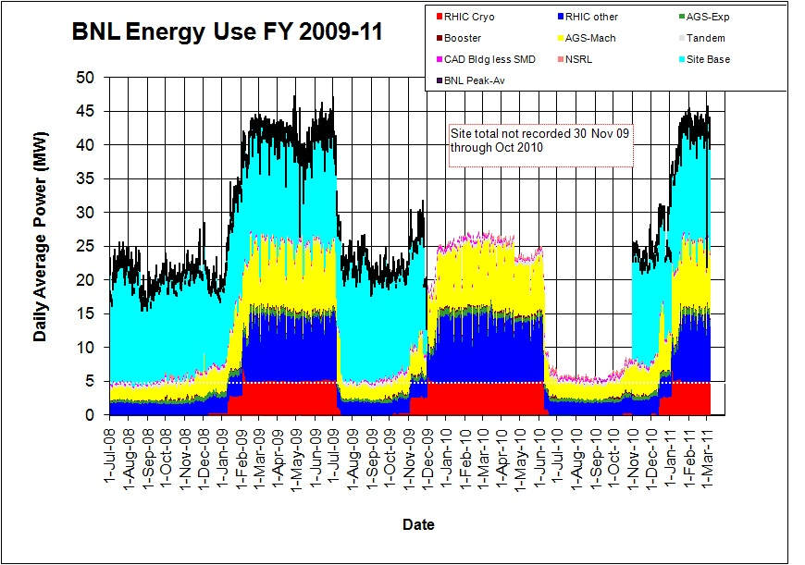
Through 31 May 2011

Slide 11
Old information

Slide 12
Singles Corrected (draft – another correction likely)
AnDY Revised 6/3/2011

Slide 13
√S = 200 GeV/n AuAu luminosity goals (24 May efficiencies)
STAR
2000 μb⁻¹ sampled / 60% = 3300 μb⁻¹ delivered
PHENIX
700 μb⁻¹ sampled / 14% = 5000 μb⁻¹ delivered
Estimate from PHENIX Beam Use Proposal – 15.8%
Live Time = 97%
Uptime = 65%
+/- 10 cm vertex = 25%

Slide 14
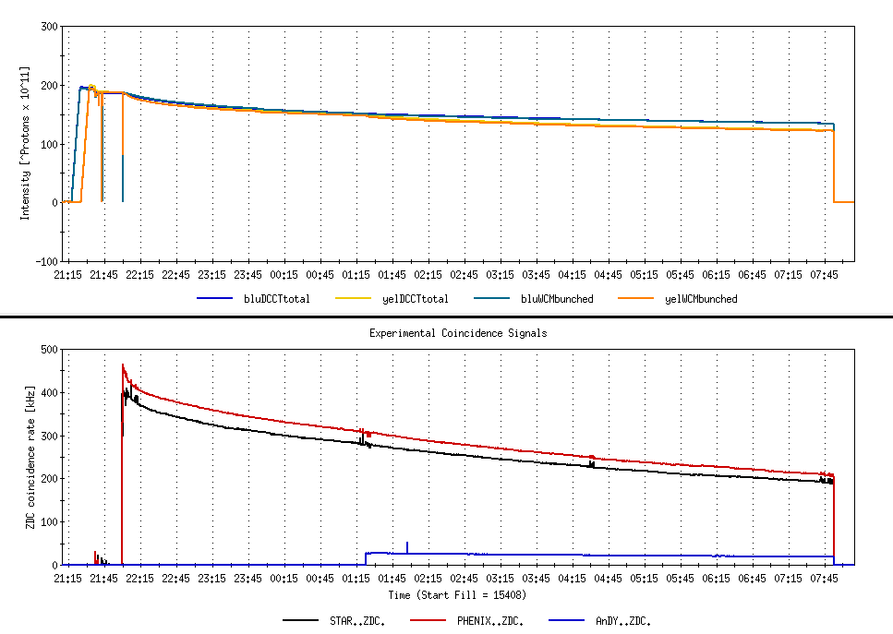
9.7 hour store comparing AnDY Lumi to STAR and PHENIX
Not singles corrected

Slide 15
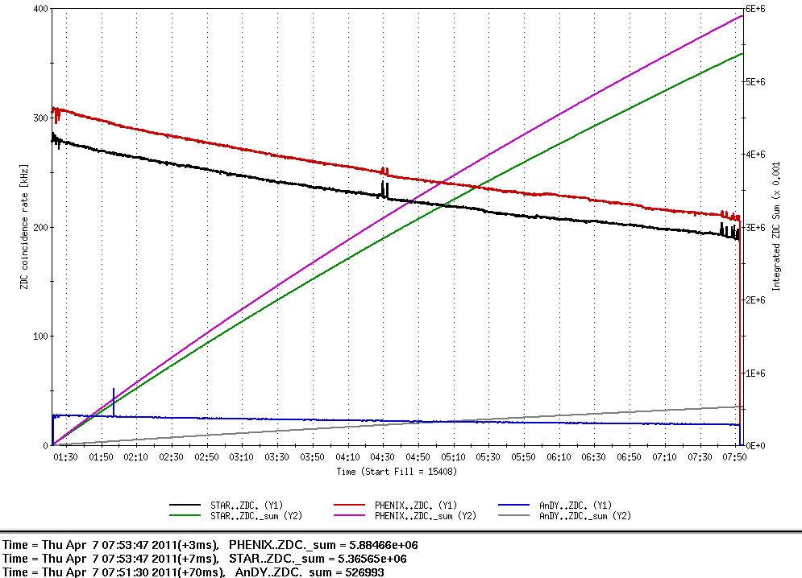
9.7 hour store comparing AnDY Lumi to STAR and PHENIX
β*’s
PHENIX ~0.7 m
STAR ~0.8 m
AnDY ~ 3 m
Not singles corrected
Lumi
PHENIX = 5.88E9/2.7mb = 2.18 pb⁻¹
STAR = 5.36E9/2.9 mb = 1.84 pb⁻¹
AnDY = 0.52E9/0.95 mb = 0.55 pb⁻¹
AnDY Lumi ~consistent with larger β* (x4 less Lumi)
PHENIX Lumi (singles corrected) for entire store = 3.09 pb⁻¹

Slide 16
Store 15408 – AnDY projection
2:00 β* = 3 meters
  AnDY fraction of store 15408 = 0.55/3.09 = 18%
With 2:00 β* = 1.5 meters
  AnDY fraction of store 15408 would have been 2x18%=36%
  using Fischer et.al. 11 May 2010 Table 7 lumi projections for Run12
  Physics Weeks Max Lumi Min Lumi AnDY Est (1.5 m β*)
  8 276 pb⁻¹ 98 pb⁻¹ 35-99 pb⁻¹
  10 388 pb⁻¹ 134 pb⁻¹ 48-140 pb⁻¹
  12 500 pb⁻¹ 170 pb⁻¹ 61-180 pb⁻¹
→ 100 pb⁻¹ is not an unreasonable expectation for a 10-12 week run

Slide 21
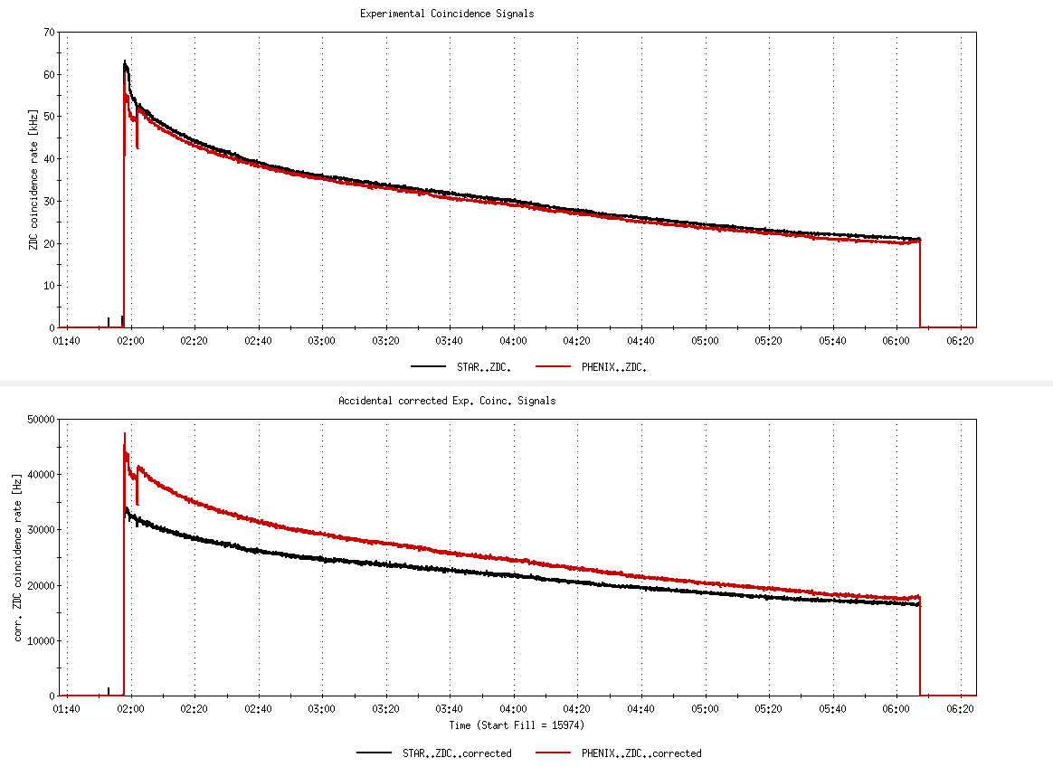
Fill 15974, not singles corrected
26%
Fill 15974, with singles correction
6%

Slide 22
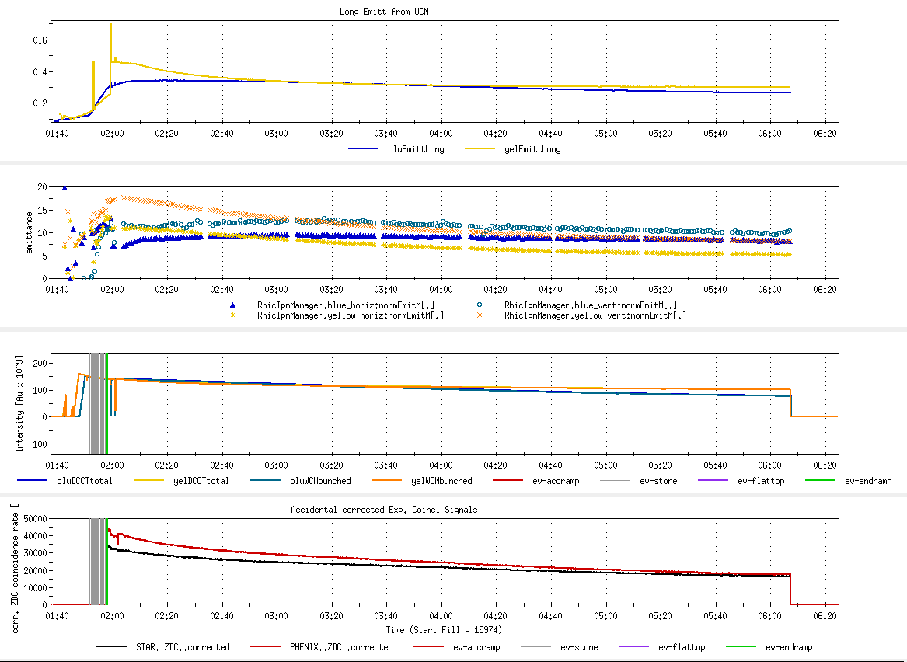
Fill 15974
Long emitt
Goal 17-20
x,y emitt
Goal 122
Blue/yellow ions
Peak Lumi goal 45 x 10²⁶ cm⁻²s⁻¹
Average Lumi goal 25 x 10²⁶ cm⁻²s⁻¹

Slide 23
Store 15408 – AnDY projection
2:00 β* = 3 meters
  AnDY fraction of store 15408 = 0.55/3.09 = 18%
With 2:00 β* = 1.5 meters
  AnDY fraction of store 15408 woulh have been 2x18%=36%
  using Fischer et.al. 11 May 2010 Table 7 lumi projections for Run12
  Physics Weeks Max Lumi Min Lumi AnDY Est (1.5 m β*)
  8 276 pb⁻¹ 98 pb⁻¹ 35-99 pb⁻¹
  10 388 pb⁻¹ 134 pb⁻¹ 48-140 pb⁻¹
  12 500 pb⁻¹ 170 pb⁻¹ 61-180 pb⁻¹
→ 100 pb⁻¹ is not an unreasonable expectation for a 10-12 week run

Slide 24
i.e. there’s still an issue with singles corrections.

Slide 26
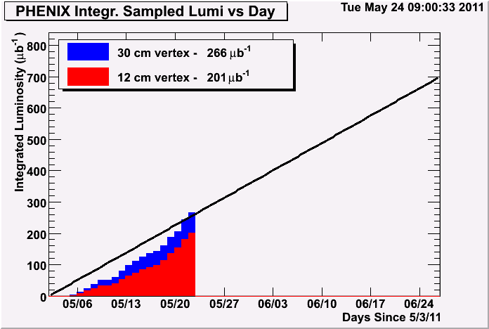
Through fill 15928 delivered 1474 μb⁻¹
201 ub^-1 of 700 ub^-1 accumulated in 12cm vertex
→ Efficiency = 201/1474 = 14%

Slide 27
Final Lumi should change as it appears there’s an issue with the singles correction

Slide 29
Run 11 Plan based on PAC recommendation/ALD Guidance and available funds
4/26/10 update (1/2)
3 Jan, Begin cool-down to 4.5K
8 Jan, Cool-down to 4.5K complete in both rings, preliminary setup begins
~11 Jan, 2 ⅟₂ weeks beam setup for √s = 500 GeV pp in RHIC begins.
15 Jan, power supply work/DX training complete
17 Jan, first successful ramp
19 Jan, 1st maint day
24 Jan, 1 week Ramp-up with 8 hr/night beam to experiments
11 Feb (machine and ~experiments), begin ~10 week physics run (√s = 500 GeV pp)
16 Feb, AGS Jump Quads in routine operation for RHIC injection
24 Feb, 9 MHz cavity in routine operation
7 Mar, cryo troubles, extended maintenance, 0900 hrs till 2000 hrs 14 Mar – lost 7.5 days
17 Mar, power distribution problem, extended maintenance, 1930 hrs till 0315 hrs 20 Mar – lost 2.3 days
28 March – 1 April, PAC 2011
15 April Continuing Resolution Ends, guidance to follow
18 Apr, end 9.4 week pp physics run at √s = 500 GeV
18 Apr jet target polarization measurement at injection (<5%)
19 Apr, short maintenance followed by setup for √s = 18 GeV AuAu
23 Apr, begin ~1 week physics run (√s = 19.6 AuAu)
2 May, end 1.3 week physics run at √s = 19.6 GeV

Slide 30
7 April Up-Down Ramp measurement
Blue Beam
Current CNI average analyzing powers are:
Energy AN
24 0.0144
100 0.0122
250 0.0147

Slide 31
7 April Up-Down Ramp measurement
Yellow Beam (only Yellow 1 was
used as Yellow 2 was acting up)
Current CNI average analyzing powers are:
Energy AN
24 0.0144
100 0.0122
250 0.0147

Slide 32
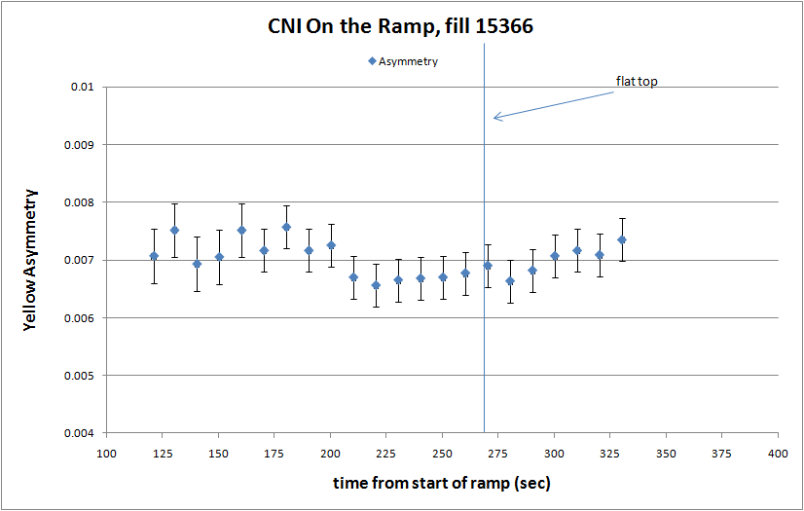

Slide 33
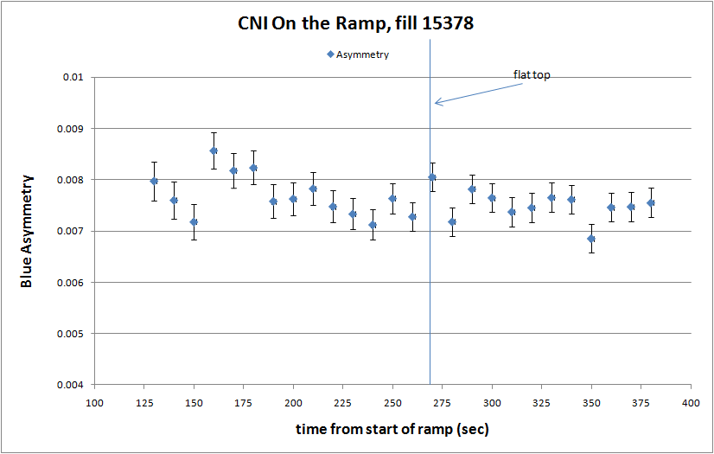

Slide 34
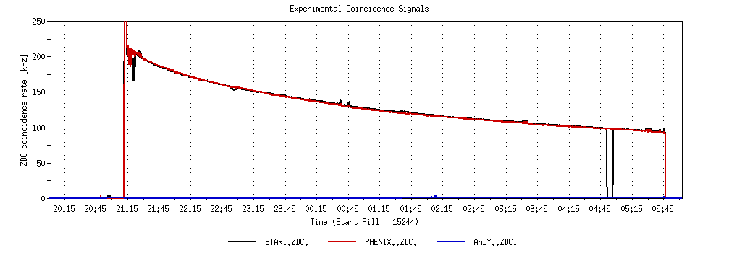
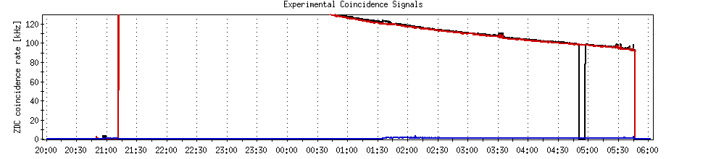
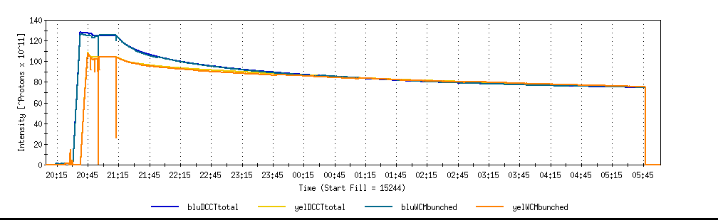
A good store with 9 MHz
Sat 2/26

Slide 35
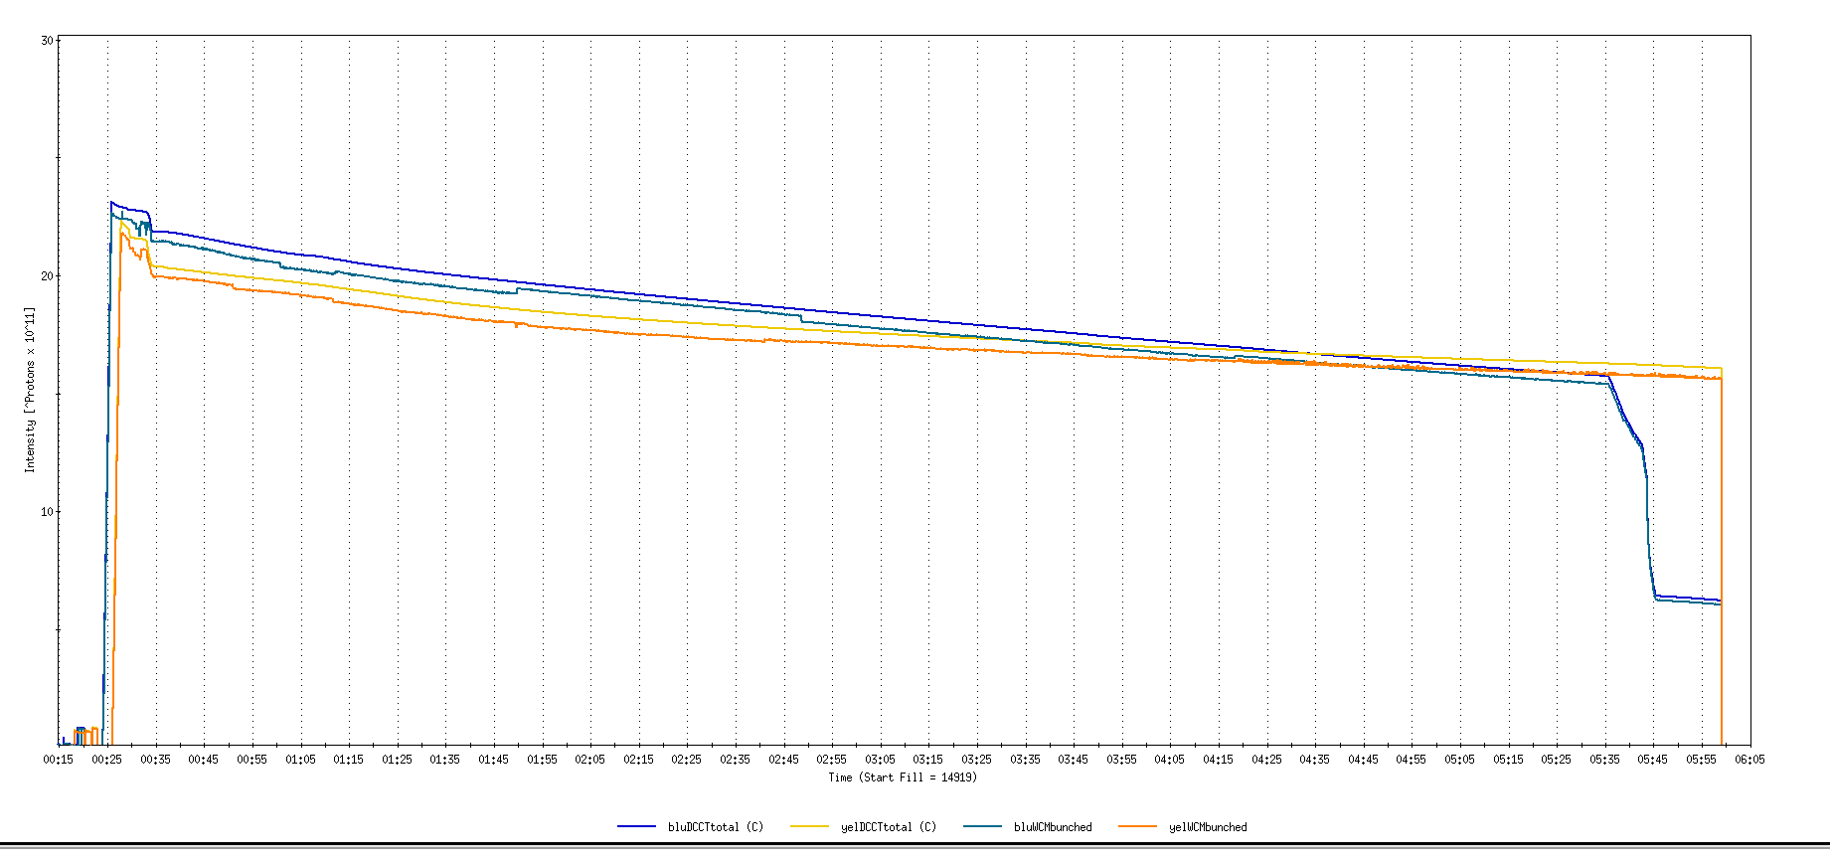
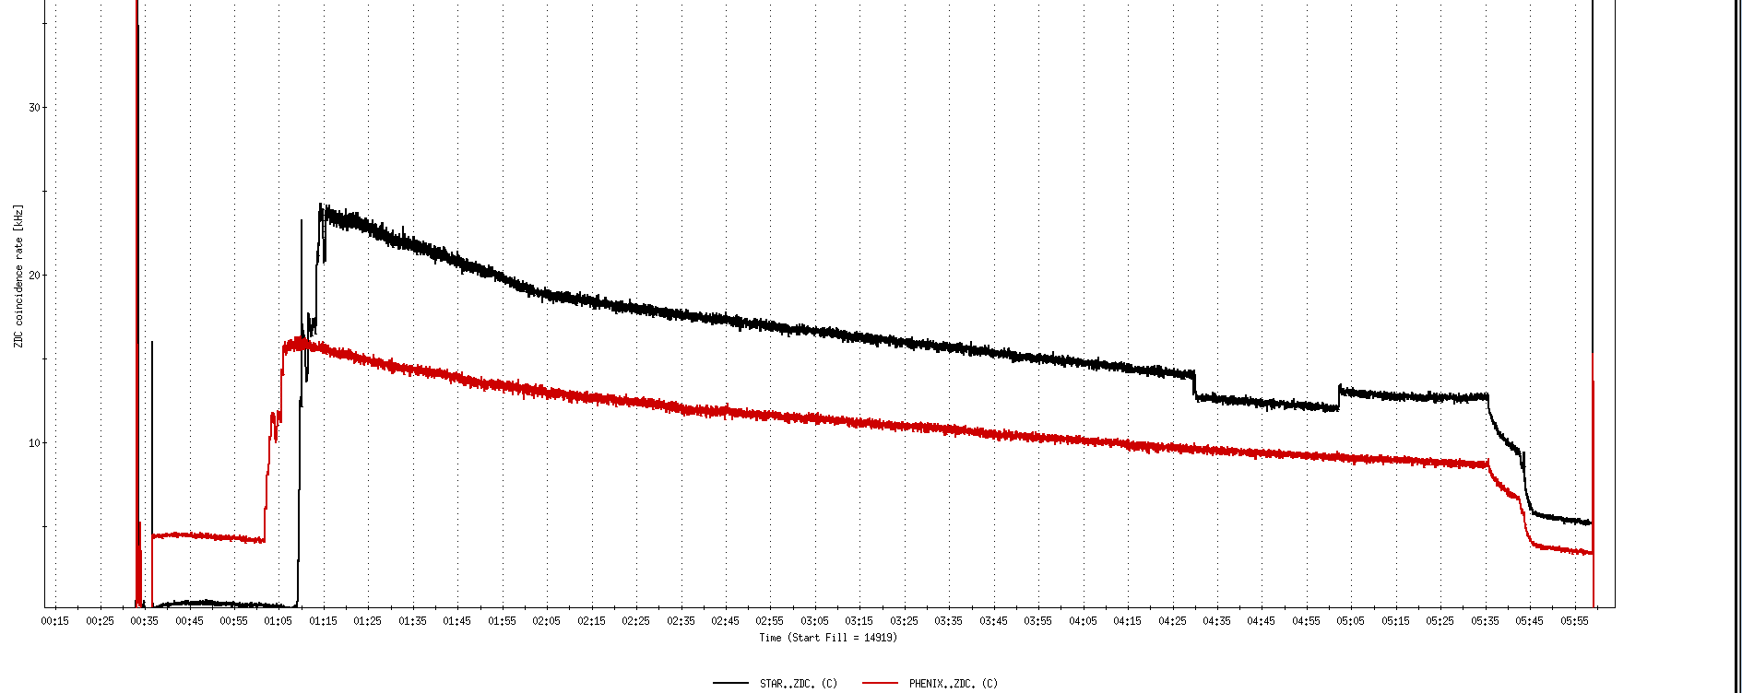
Run 11, First overnight store, Mon Jan 24 00:12
Fill number 14919,, √s=500 GeV
21 days since start of cool-down
28 x 27 bunches
β*=0.65 meters
20 x 10¹¹
For peak store lumi = 170 x 10³⁰ cm⁻²s⁻¹ (projected MAXIMUM)
ZDC Rate ~ 400K (assuming 2.4 mb n-pair xsection)
20K

Slide 36
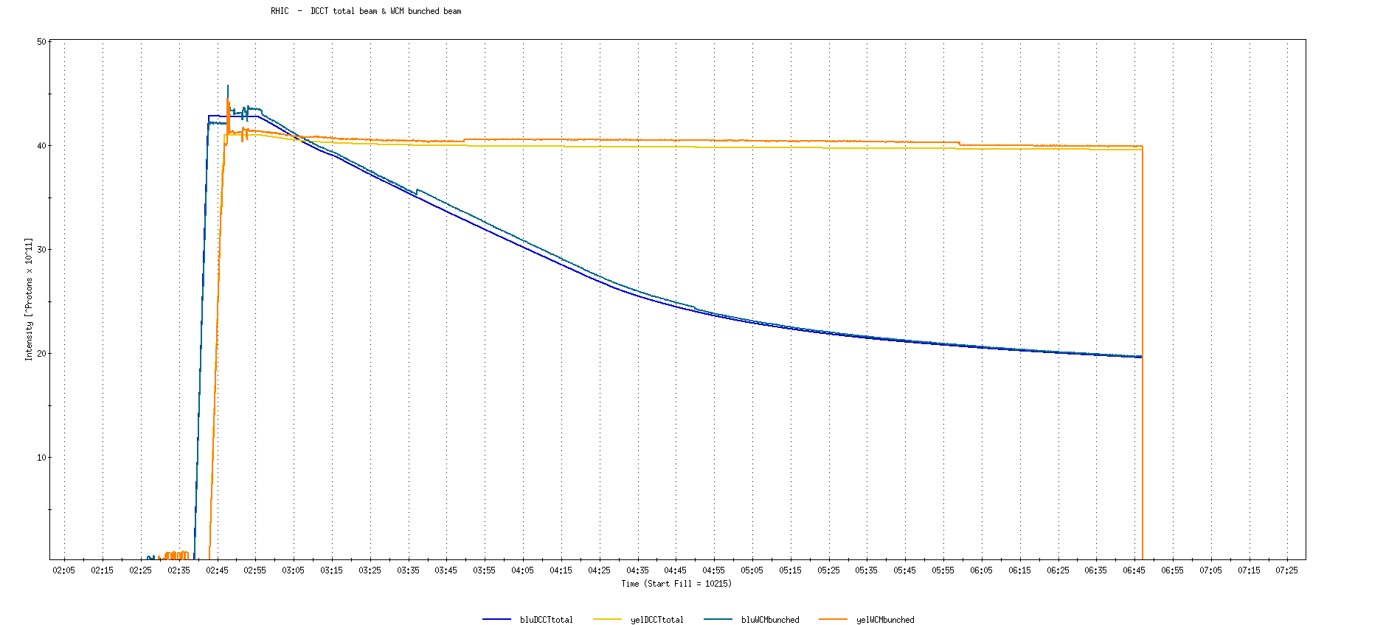
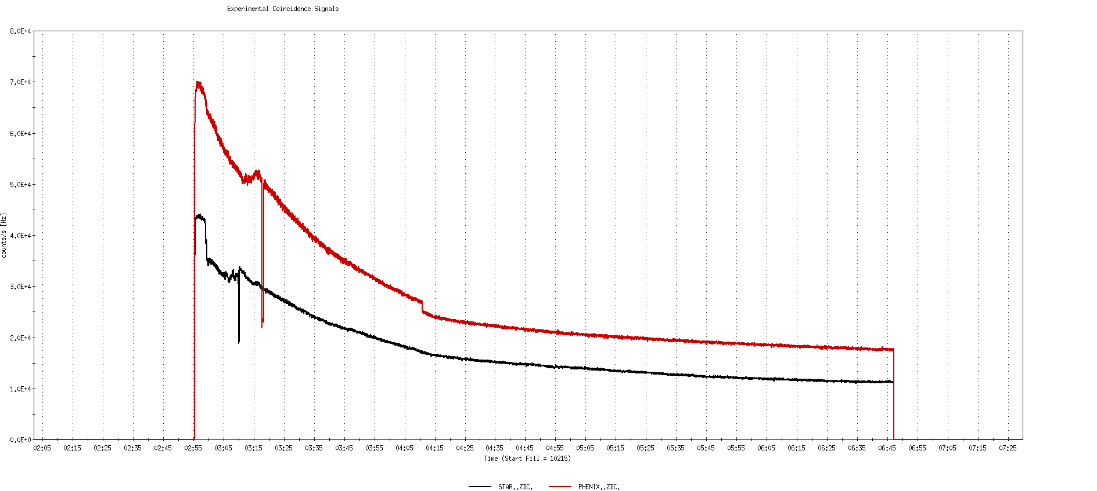
Run 9, First overnight store at √s=500 GeV
22 days after start of cool-down
56 x 56 bunches
β*=0.7 meters
40 x 10¹¹
40K

Slide 37
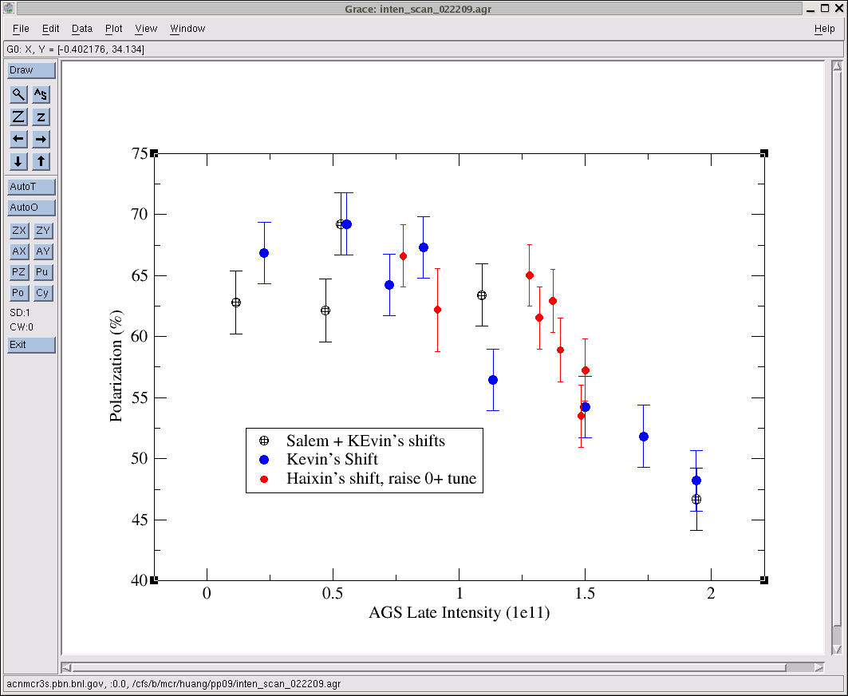
AGS pp log, 23 Feb 09, 00:26

Slide 38
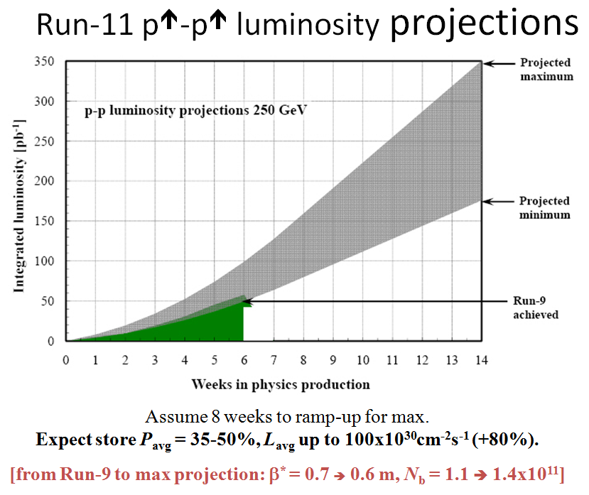
Goals to be updated/corrected
PHENIX Goal (50% pol)
STAR Goal (50% pol)

Slide 39
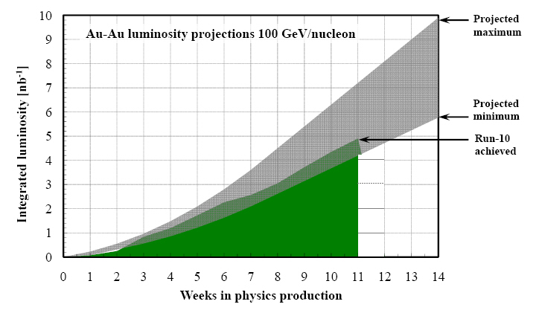
Run-11 Au-Au luminosity projections 100 GeV/nucleon
Goals to be updated/corrected
PHENIX Goal (0.7 recorded)
STAR Goal (TBD)
?? (complicated)
Assume 6 weeks to ramp-up for min, and 8 weeks for max (stoch. cooling re-commissioning).
Expect L_{avg} up to 25x10²⁶cm⁻²s⁻¹ (+25%).
[from Run-10 to max: β* = 0.75 ➔ 0.65 m, N_{b} = 1.1 ➔ 1.1x10⁹, more cooling]

