Slide 1
Run 11 RHIC Machine/Experiments Meeting
15 Feb 2011
Agenda:
Status –

Slide 2
Run 11 RHIC Machine/Experiments Meeting decisions
11/23/2010
Agreed to new APEX schedule, 12 hour sessions (0800-2400) every other week away from maintenance days.

Slide 3
Run 11 Plan based on PAC recommendation/ALD Guidance and 28.3 weeks cryo operation
2/15/10 update
3 Jan, Begin cool-down to 4.5K
8 Jan, Cool-down to 4.5K complete in both rings, preliminary setup begins
~11 Jan, 2 ⅟₂ weeks beam setup for √s = 500 GeV pp in RHIC begins.
15 Jan, power supply work/DX training complete
17 Jan, first successful ramp
19 Jan, 1st maint day
27 24 Jan, 1 week Ramp-up with 8 hr/night beam to experiments
3 11 Feb (machine), begin 10(?) week physics run (√s = 500 GeV pp)
4 March – Continuing Resolution Ends
28 March – 1 April, PAC 2011
14 Apr, end 10 week physics run at √s = 500 GeV pp run
14 Apr, begin 1 week setup for √s = 200 AuAu
21 Apr, begin 1 week Ramp-up with 8 hr/night beam to experiments
28 Apr, begin 8 week physics run at (√s = 200 AuAu)
23 Jun, end 8 week √s = 200 AuAu run
23 Jun, begin setup for √s = 192 GeV UU
30 Jun, begin 1⅟₂ week physics run (√s = 192 UU)
4 July – completed 26 weeks of cryo operation, may be out of $$’s
10 Jul, end 1⅟₂ week physics run at √s = 192 GeV
10 Jul, begin setup for √s = 18 GeV AuAu
11 Jul, begin 1 week physics run (√s = 18 AuAu)
18 Jul, end 1 week physics run at √s = 18 GeV
20 Jul, warm-up complete (28.3 weeks)
Possible additions:
Low energy test run

Slide 5
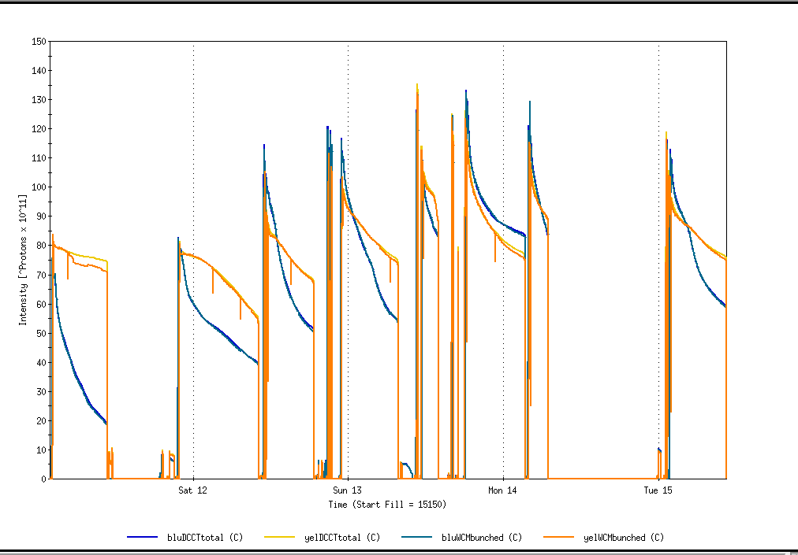
Physics Stores 15150 through 15170
Projected maximum

Slide 6
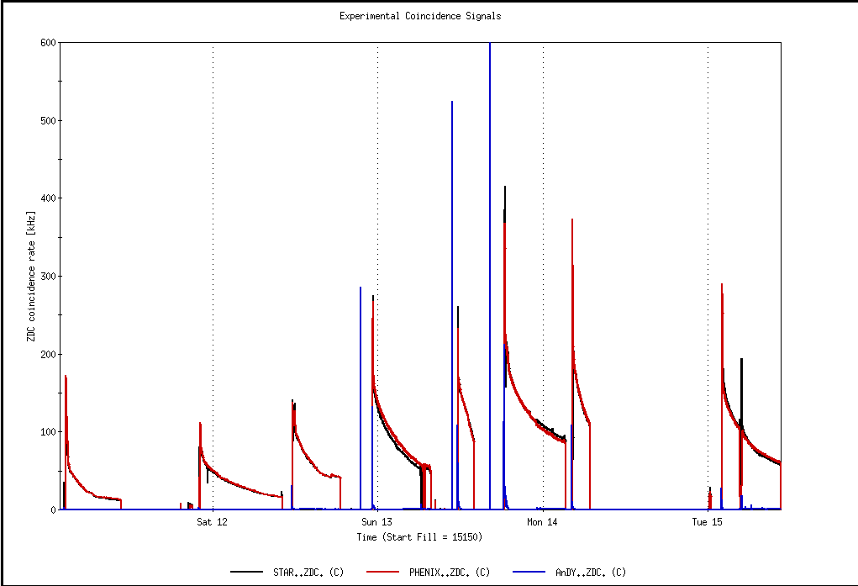
Physics Stores 15150 through 15170
L_{max} = 170 x 10³⁰ cm⁻²s⁻¹ (with 2.4 mb xsection – Run 9)
1st Physics Store

Slide 7
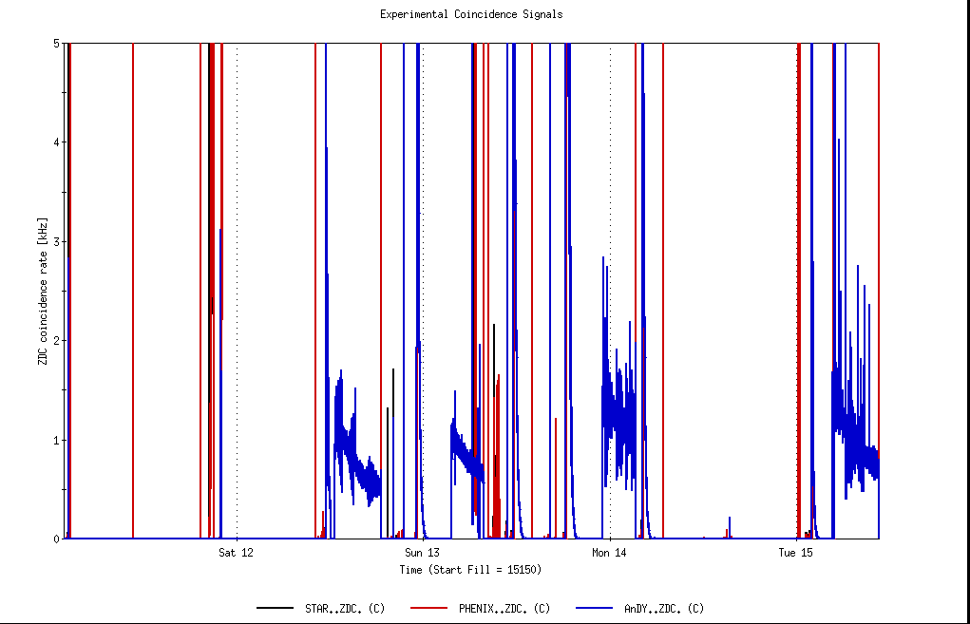
ANDY Physics Stores

Slide 8
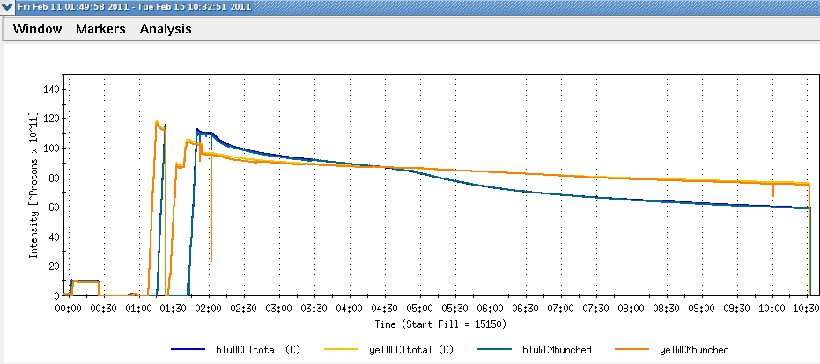
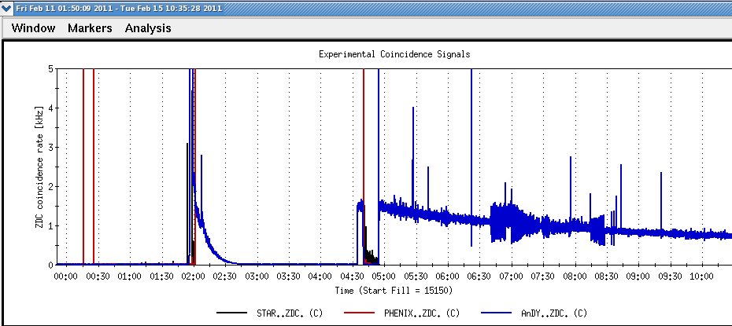
ANDY

Slide 9
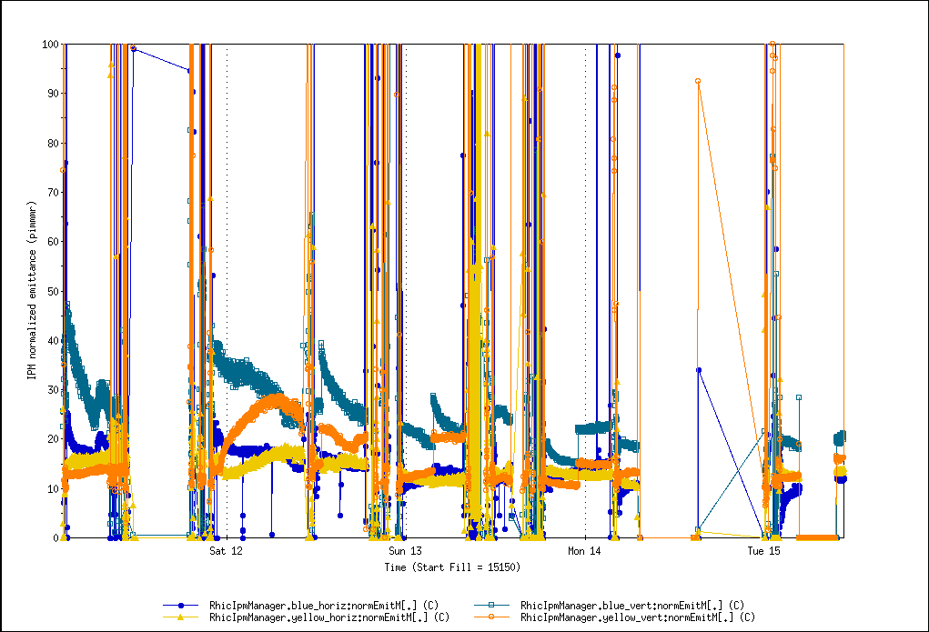
Physics Stores 15150 through 15170

Slide 10
Through 14 Feb 2011
maint days
Cryo recovery!

Slide 12
Through 14 Feb 2011

Slide 13
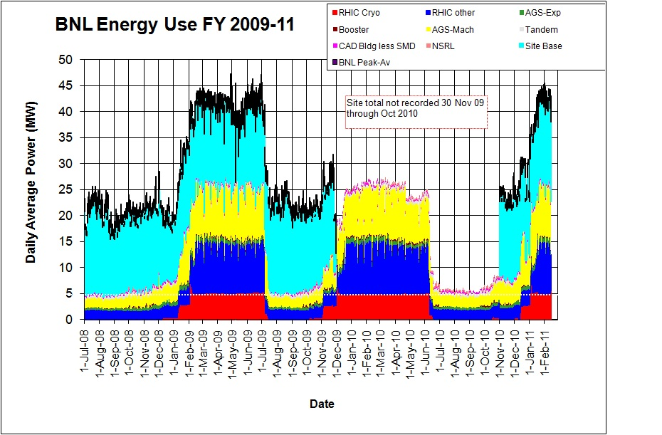
Through 14 Feb 2011

Slide 14
Old information

Slide 16
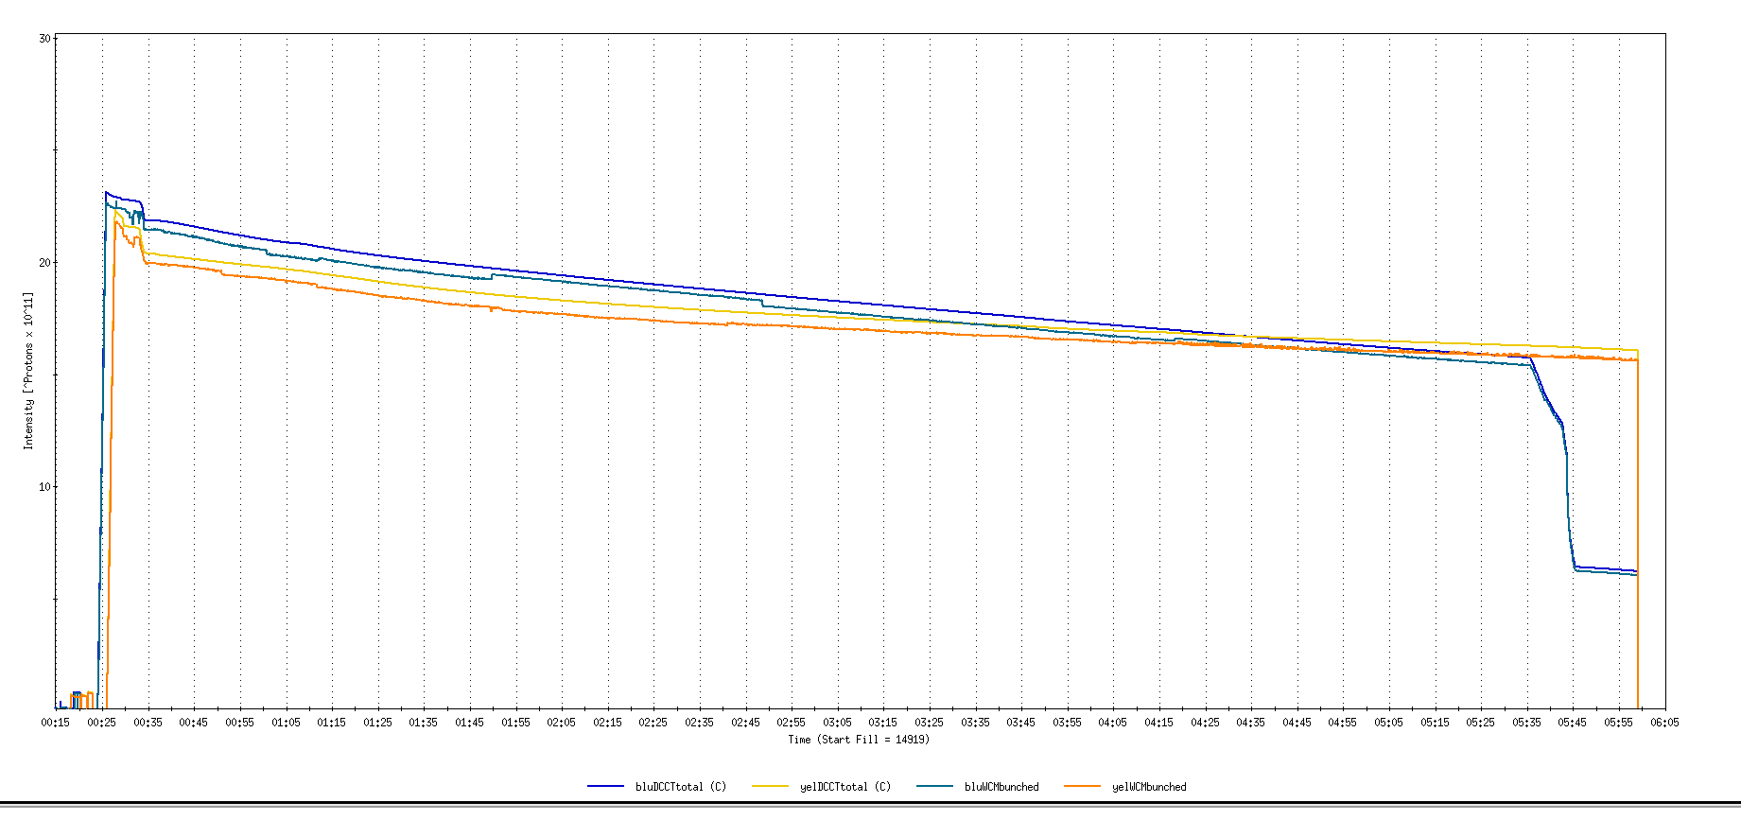
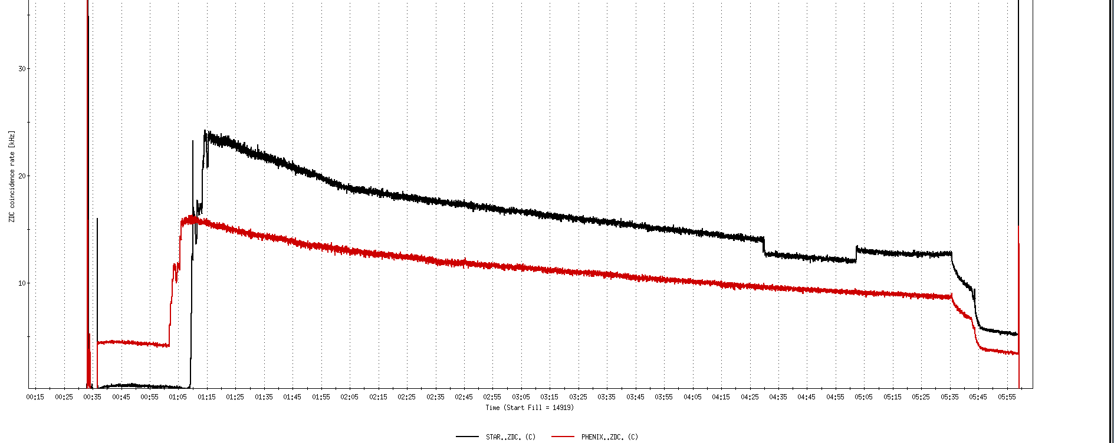
Run 11, First overnight store, Mon Jan 24 00:12
Fill number 14919,, √s=500 GeV
21 days since start of cool-down
28 x 27 bunches
β*=0.65 meters
20 x 10¹¹
For peak store lumi = 170 x 10³⁰ cm⁻²s⁻¹ (projected MAXIMUM)
ZDC Rate ~ 400K (assuming 2.4 mb n-pair xsection)
20K

Slide 17
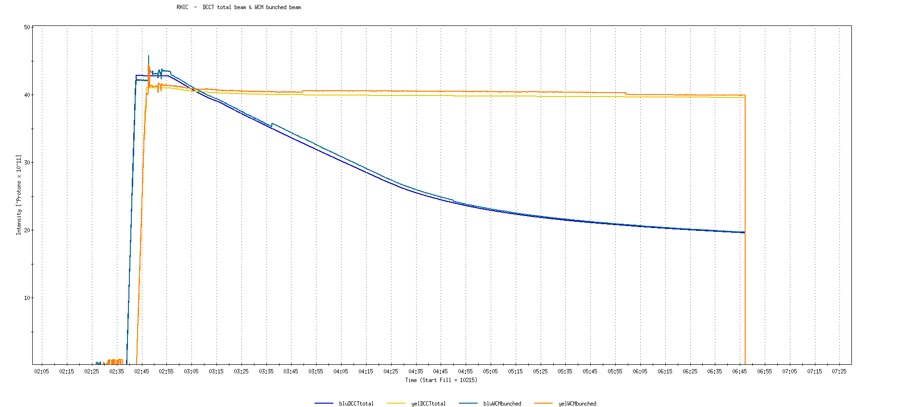
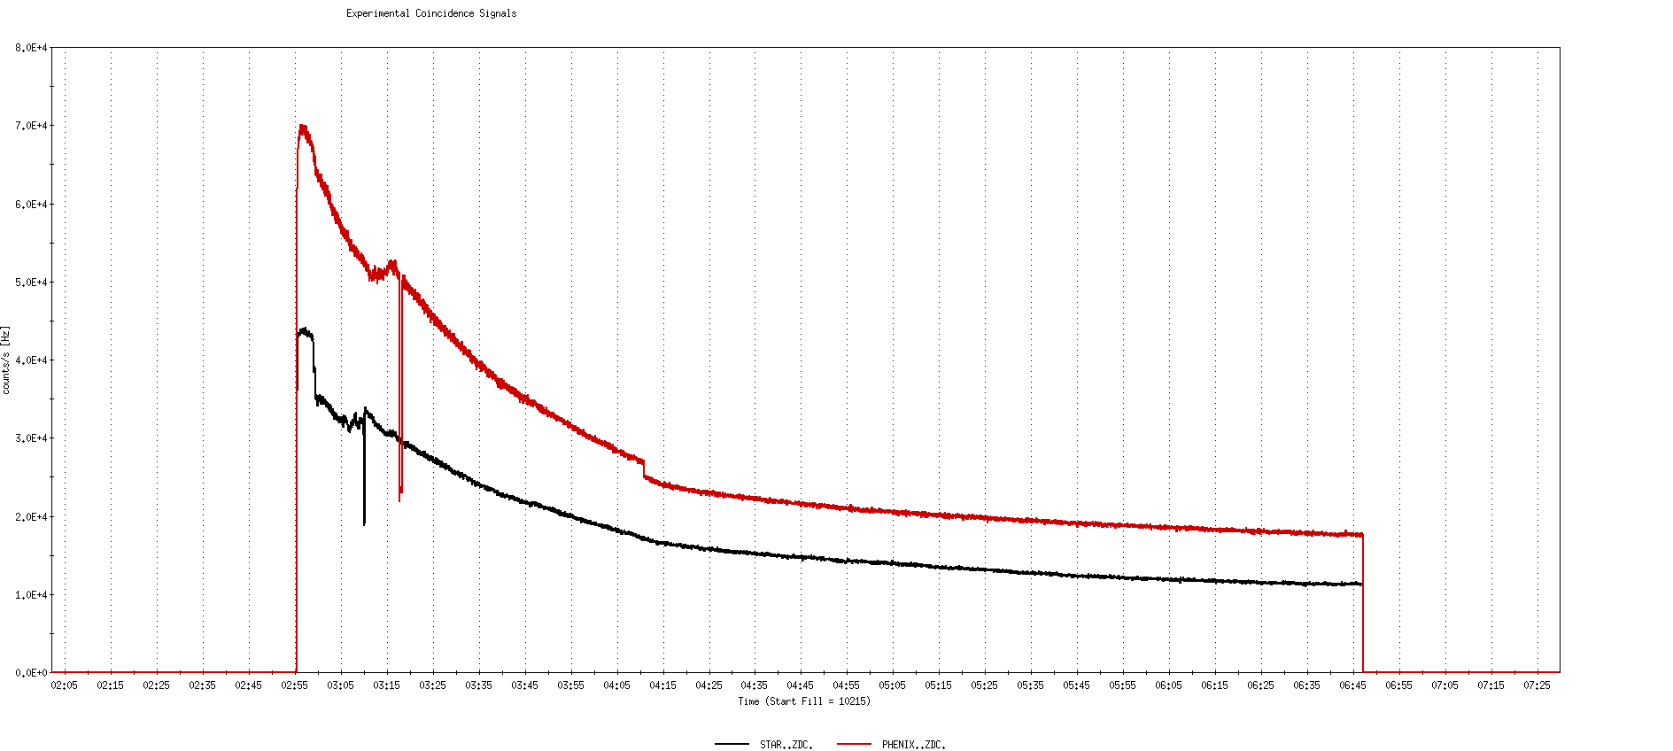
Run 9, First overnight store at √s=500 GeV
22 days after start of cool-down
56 x 56 bunches
β*=0.7 meters
40 x 10¹¹
40K

Slide 18
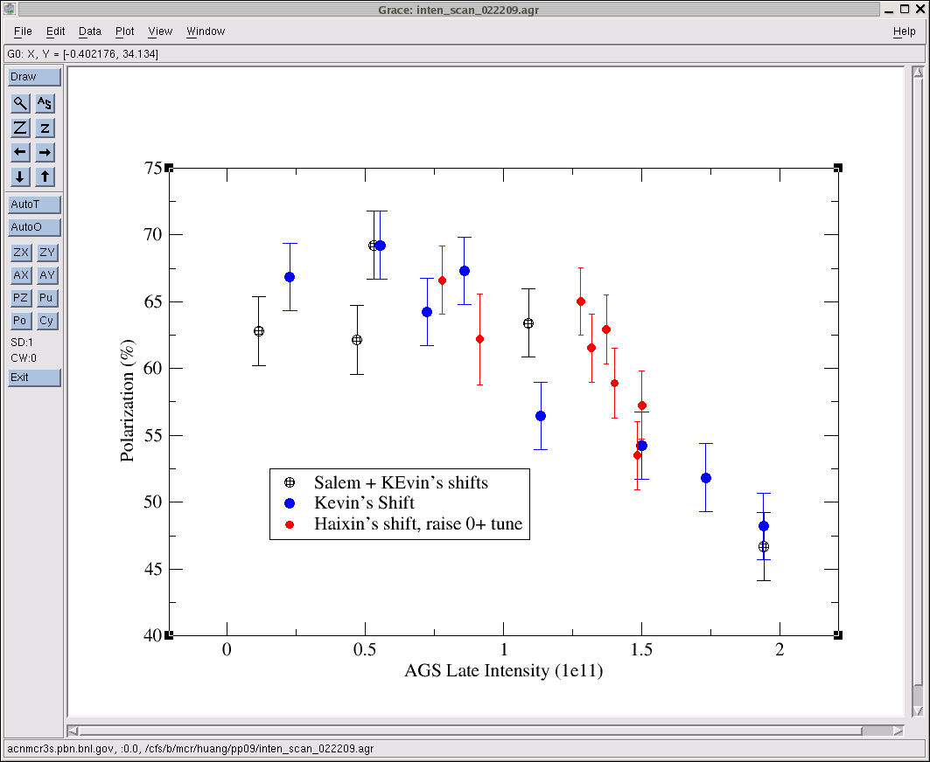
AGS pp log, 23 Feb 09, 00:26

Slide 19
26 weeks

Slide 20
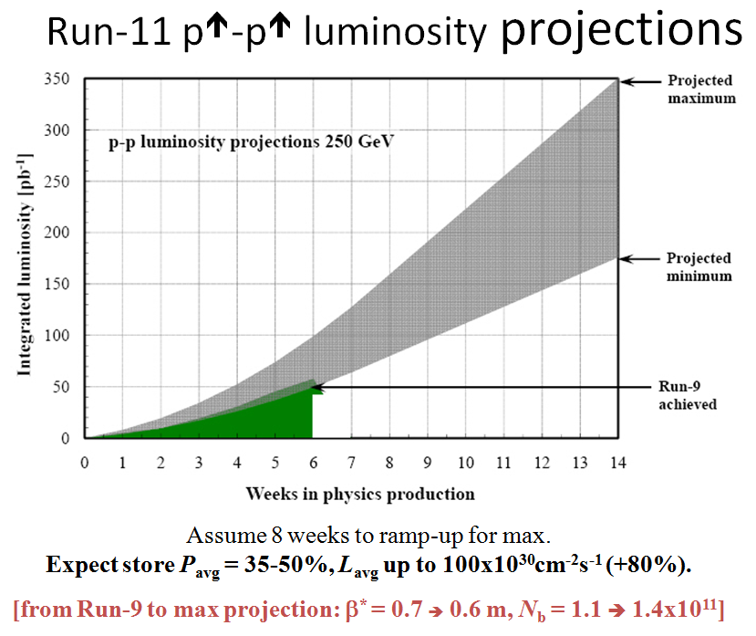
Goals to be updated/corrected
PHENIX Goal (50% pol)
STAR Goal (50% pol)

Slide 21
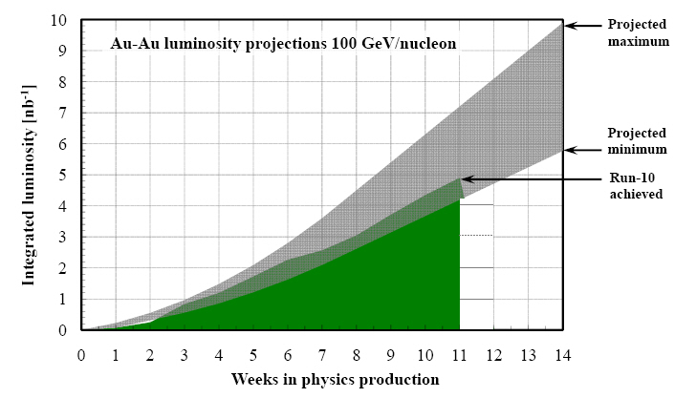
Run-11 Au-Au luminosity projections 100 GeV/nucleon
Goals to be updated/corrected
PHENIX Goal (0.7 recorded)
STAR Goal (TBD)
?? (complicated)
Assume 6 weeks to ramp-up for min, and 8 weeks for max (stoch. cooling re-commissioning).
Expect L_{avg} up to 25x10²⁶cm⁻²s⁻¹ (+25%).
[from Run-10 to max: β* = 0.75 ➔ 0.65 m, N_{b} = 1.1 ➔ 1.1x10⁹, more cooling]

