Slide 1
Run 11 RHIC Machine/Experiments Meeting
17 May 2011
Agenda:
√s = 200 GeV AuAu progress

Slide 2
Run 11 Plan based on PAC recommendation/ALD Guidance and available funds
5/17/10 update
3 Jan, Begin cool-down to 4.5K
8 Jan, Cool-down to 4.5K complete in both rings, preliminary setup begins
24 Jan, 1 week Ramp-up with 8 hr/night beam to experiments
11 Feb (machine and ~experiments), begin ~10 week physics run (√s = 500 GeV pp)
7 Mar, cryo troubles, extended maintenance, 0900 hrs till 2000 hrs 14 Mar – lost 7.5 days
17 Mar, power distribution problem, extended maintenance, 1930 hrs till 0315 hrs 20 Mar – lost 2.3 days
18 Apr, end 9.4 week physics run at √s = 500 GeV
18 Apr jet target polarization measurement at injection (<5%)
19 Apr, short maintenance followed by setup for √s = 18 GeV AuAu
23 Apr, begin ~1 week physics run (√s = 19.6 AuAu)
2 May 08:00, end 1.3 week physics run at √s = 19.6 GeV
2 May, begin setup for √s = 200 AuAu
5 May, begin 2 day Ramp-up with 8 hr/night beam to experiments
6 May 11:37, begin ~8 week physics run at (√s = 200 GeV/n AuAu)
17 May- TODAY
29 June, end 7.7 week AuAu physics run at √s = 200 GeV/n , begin warm-up
30 June, cryo warm-up ~ complete, end 25.4 weeks cryo operation
What’s missing :
Run into July?
Uranium test/physics run
Low energy test run
only 2 days!

Slide 3
√S = 200 GeV/n AuAu luminosity goals (to be updated)
STAR
2000 μb⁻¹ sampled / 60% = 3300 μb⁻¹ delivered
PHENIX
700 μb⁻¹ sampled / ?% = ? μb⁻¹ delivered
Estimate from PHENIX Beam Use Proposal
Live Time = 97%
Uptime = 65%
+/- 10 cm vertex = 25%

Slide 4
(with corrected STAR singles correction)
STAR Goal

Slide 5
(with corrected STAR singles correction)

Slide 6
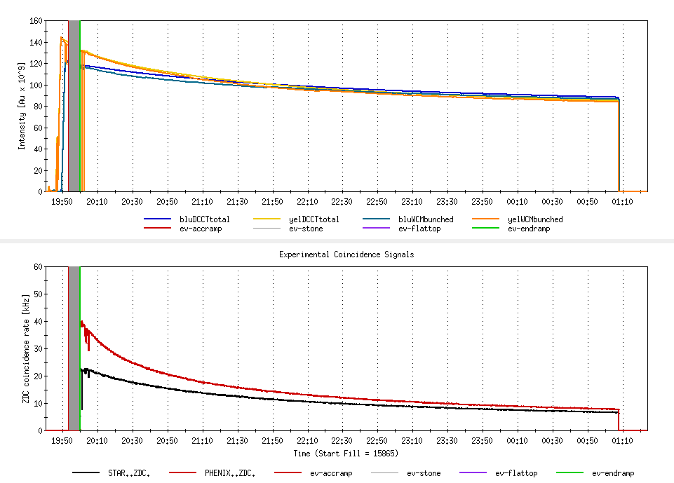
“Typical” Store 15865, 111/111 bunches, 0.75 (goal 0.65) m β*, Longitudal cooling only
1.1 x 10⁹/bunch (goal = 1.1 x 10⁹)
STAR SINGLES CORRECTION IS NOT RIGHT
(singles corrected)
42 x 10²⁶ s⁻¹cm⁻² (Goal = 45 x 10²⁶)
Assumes 9.6 barn ZDC xsection
Ratio=1.75
PHENIX L_{store avg} = 15 x 10²⁶ s⁻¹cm⁻² (Goal = 25 x 10²⁶ s⁻¹cm⁻²)
Ratio=1.18

Slide 7
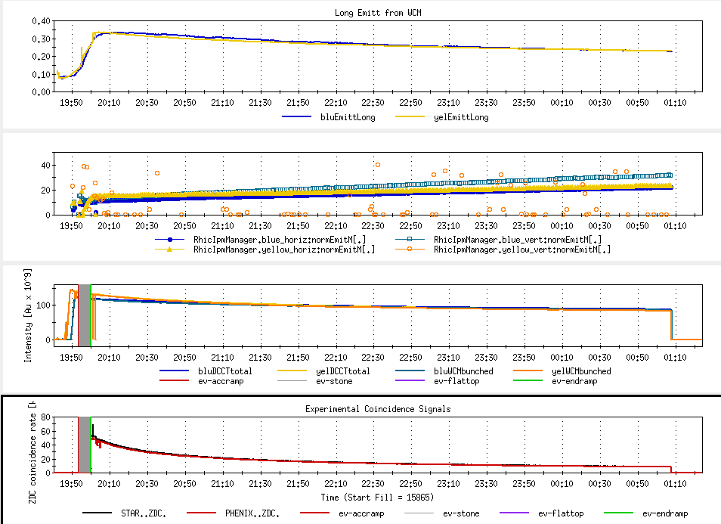
Goal 17-20
(not singles corrected)

Slide 8
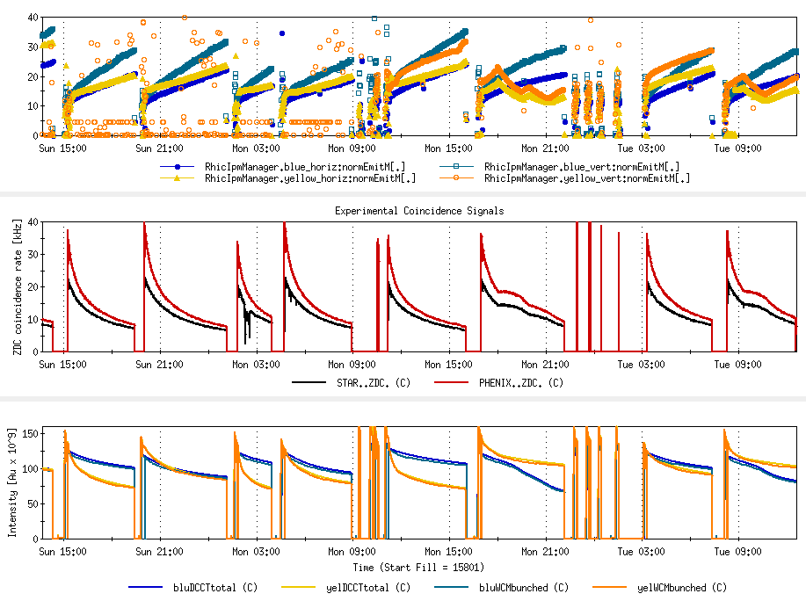
Latest Stores
goals
average
initial

Slide 9
Through 16 May 2011

Slide 10
Through 16 May 2011

Slide 11
Through 16 May 2011
Possible oil contamination in one of the heat exchangers

Slide 12
Through 16 May 2011

Slide 13
Old information

Slide 15
Final Lumi should change as it appears there’s an issue with the singles correction

Slide 17
Run 11 Plan based on PAC recommendation/ALD Guidance and available funds
4/26/10 update (1/2)
3 Jan, Begin cool-down to 4.5K
8 Jan, Cool-down to 4.5K complete in both rings, preliminary setup begins
~11 Jan, 2 ⅟₂ weeks beam setup for √s = 500 GeV pp in RHIC begins.
15 Jan, power supply work/DX training complete
17 Jan, first successful ramp
19 Jan, 1st maint day
24 Jan, 1 week Ramp-up with 8 hr/night beam to experiments
11 Feb (machine and ~experiments), begin ~10 week physics run (√s = 500 GeV pp)
16 Feb, AGS Jump Quads in routine operation for RHIC injection
24 Feb, 9 MHz cavity in routine operation
7 Mar, cryo troubles, extended maintenance, 0900 hrs till 2000 hrs 14 Mar – lost 7.5 days
17 Mar, power distribution problem, extended maintenance, 1930 hrs till 0315 hrs 20 Mar – lost 2.3 days
28 March – 1 April, PAC 2011
15 April Continuing Resolution Ends, guidance to follow
18 Apr, end 9.4 week pp physics run at √s = 500 GeV
18 Apr jet target polarization measurement at injection (<5%)
19 Apr, short maintenance followed by setup for √s = 18 GeV AuAu
23 Apr, begin ~1 week physics run (√s = 19.6 AuAu)
2 May, end 1.3 week physics run at √s = 19.6 GeV

Slide 18
7 April Up-Down Ramp measurement
Blue Beam
Current CNI average analyzing powers are:
Energy AN
24 0.0144
100 0.0122
250 0.0147

Slide 19
7 April Up-Down Ramp measurement
Yellow Beam (only Yellow 1 was
used as Yellow 2 was acting up)
Current CNI average analyzing powers are:
Energy AN
24 0.0144
100 0.0122
250 0.0147

Slide 20
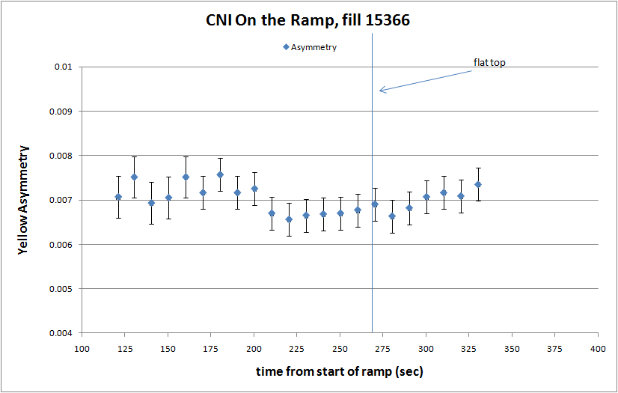

Slide 21
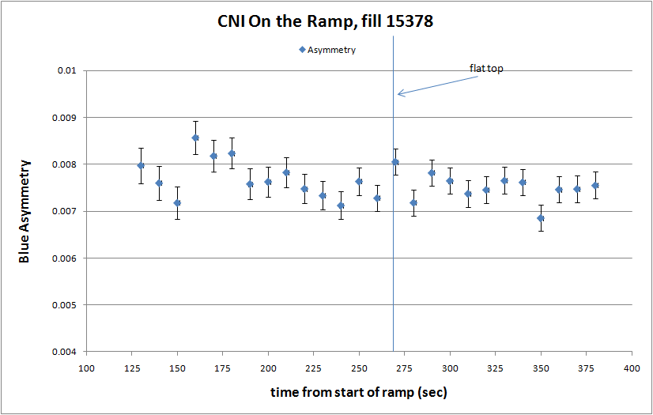

Slide 23
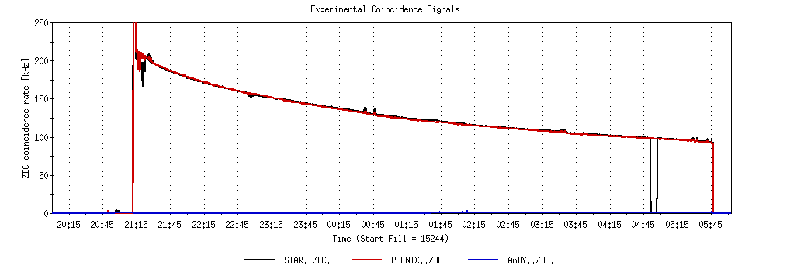
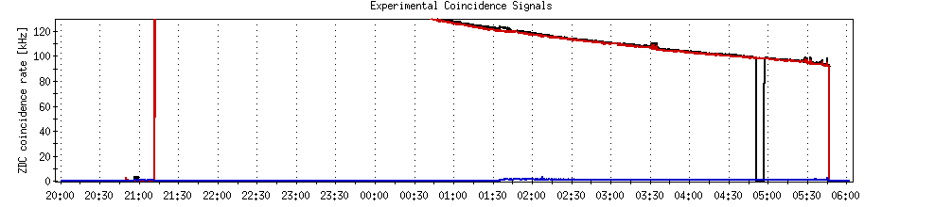
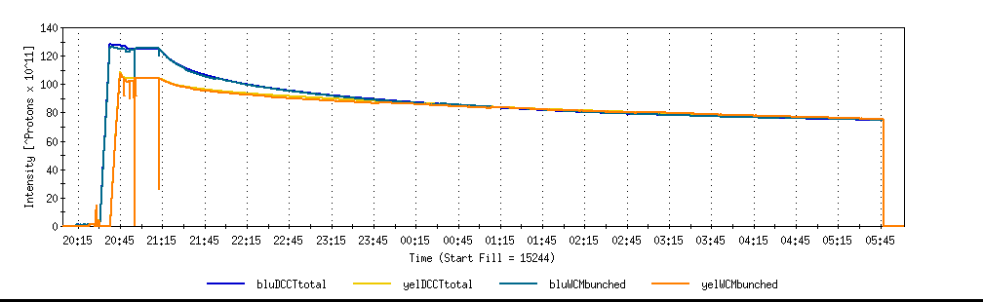
A good store with 9 MHz
Sat 2/26

Slide 24
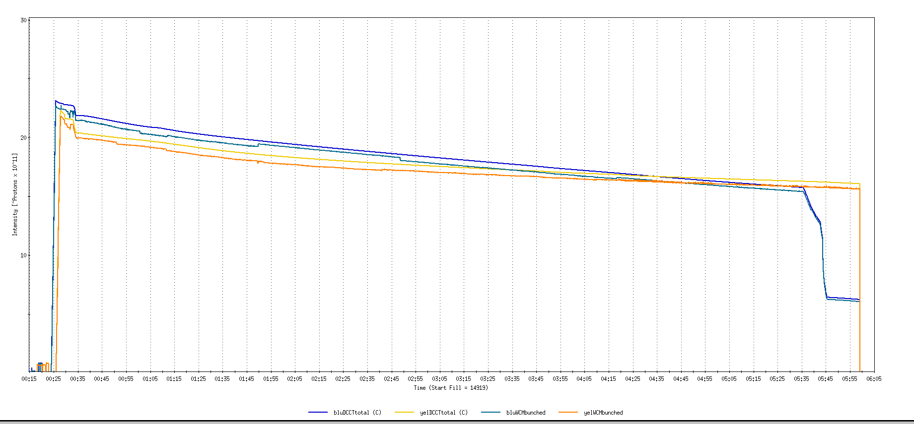
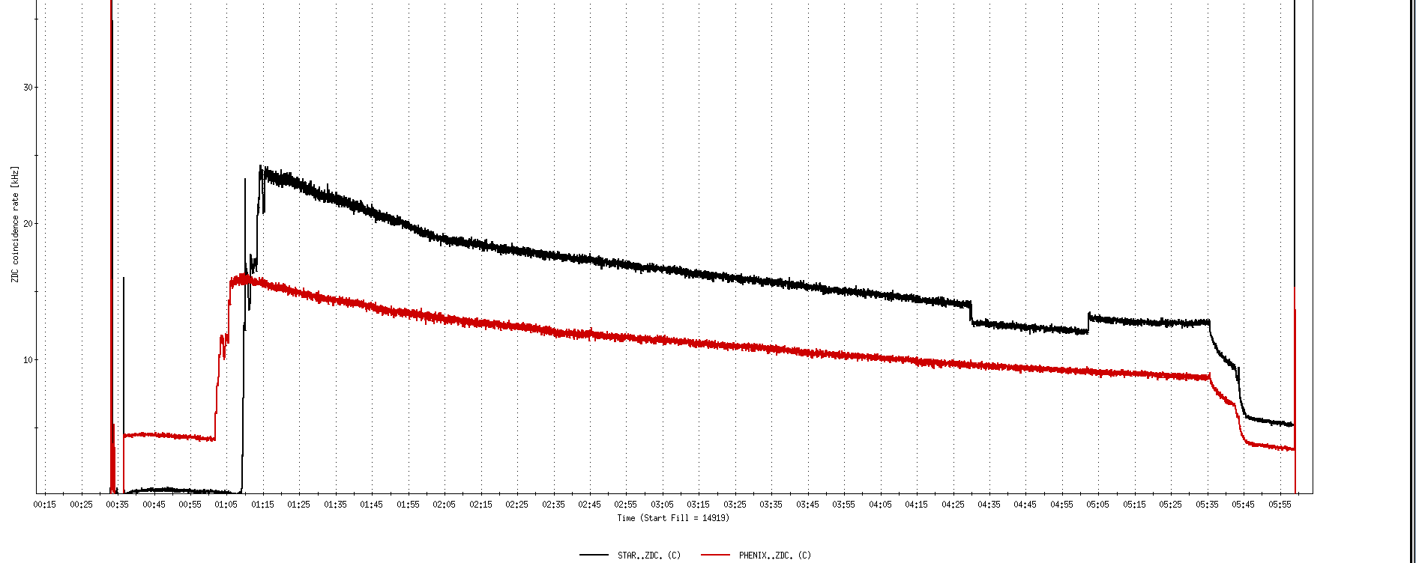
Run 11, First overnight store, Mon Jan 24 00:12
Fill number 14919,, √s=500 GeV
21 days since start of cool-down
28 x 27 bunches
β*=0.65 meters
20 x 10¹¹
For peak store lumi = 170 x 10³⁰ cm⁻²s⁻¹ (projected MAXIMUM)
ZDC Rate ~ 400K (assuming 2.4 mb n-pair xsection)
20K

Slide 25
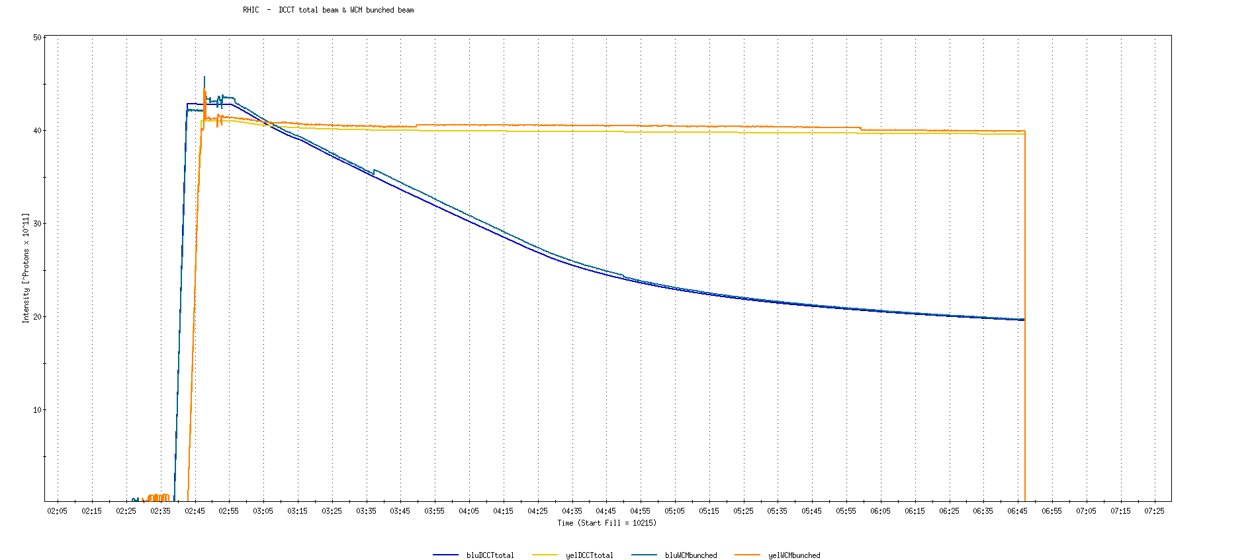
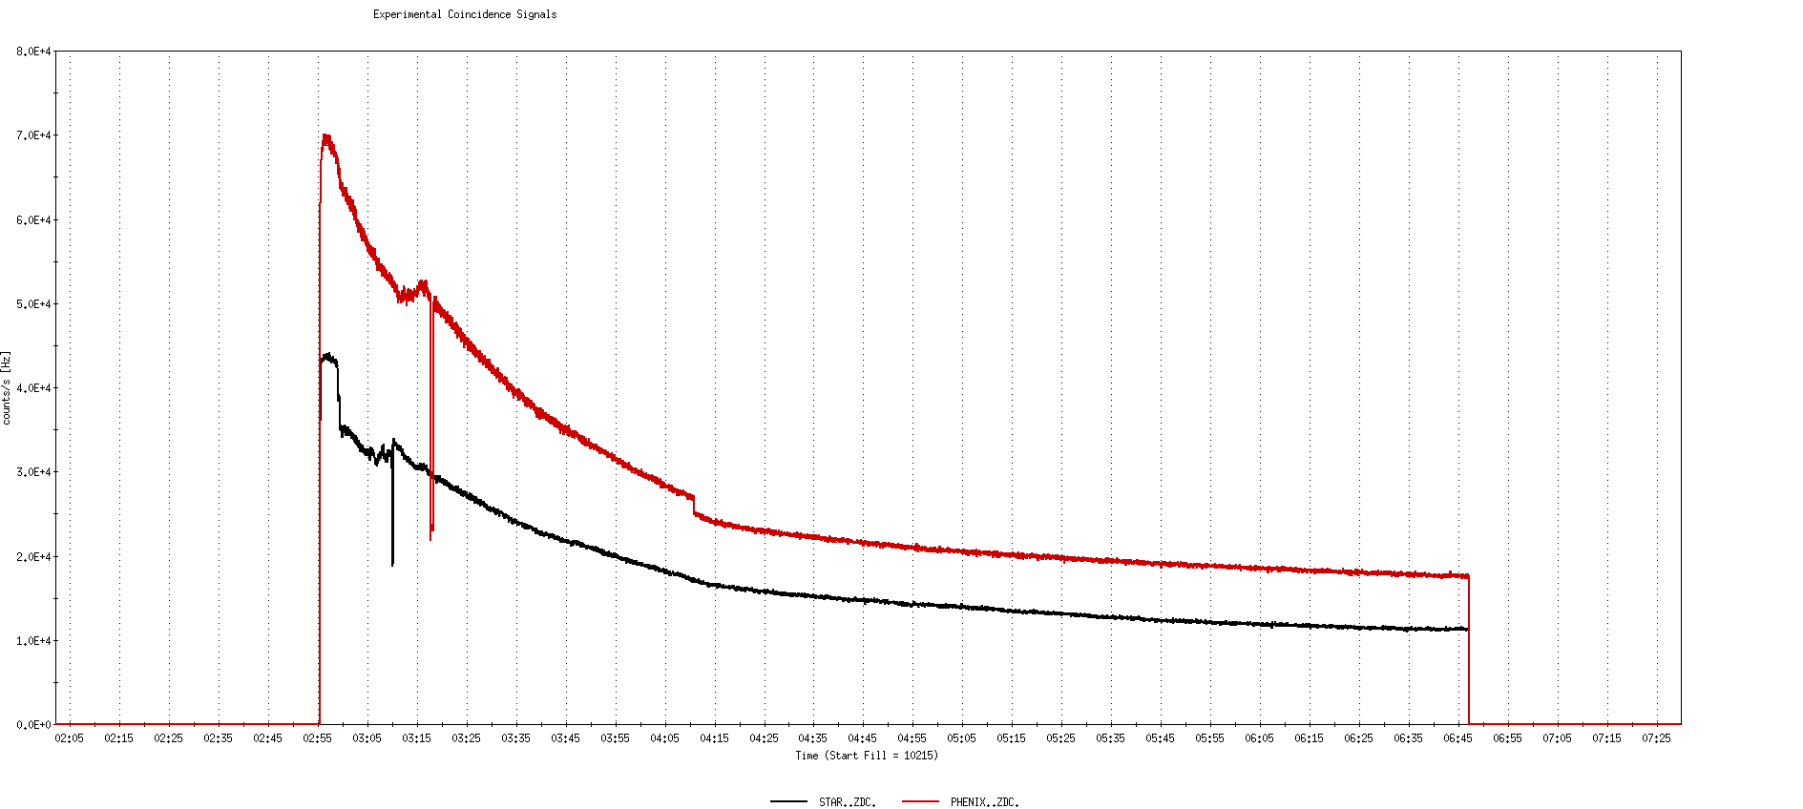
Run 9, First overnight store at √s=500 GeV
22 days after start of cool-down
56 x 56 bunches
β*=0.7 meters
40 x 10¹¹
40K

Slide 26
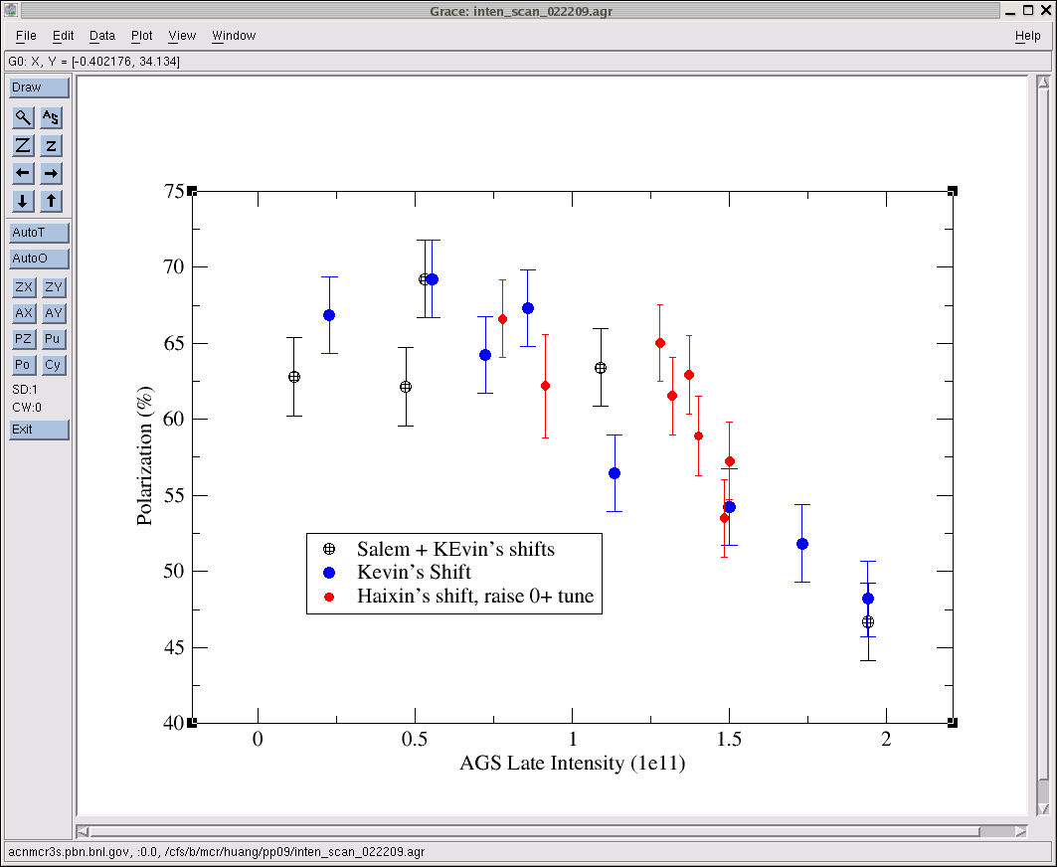
AGS pp log, 23 Feb 09, 00:26

Slide 27
26 weeks

Slide 28
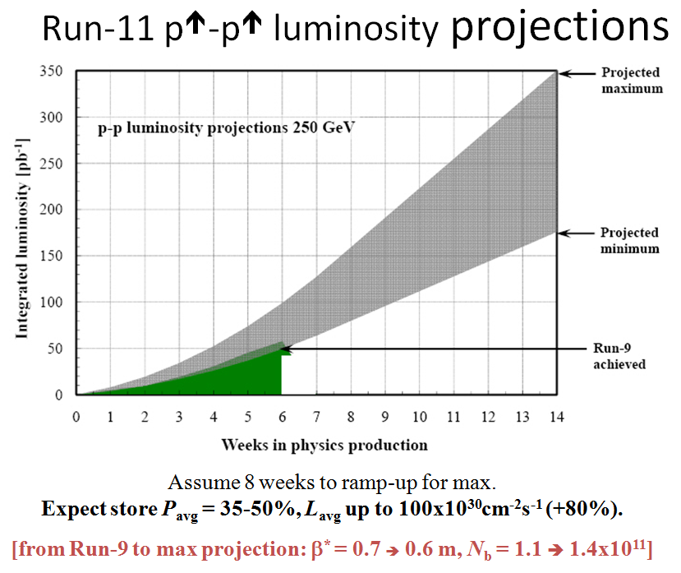
Goals to be updated/corrected
PHENIX Goal (50% pol)
STAR Goal (50% pol)

Slide 29
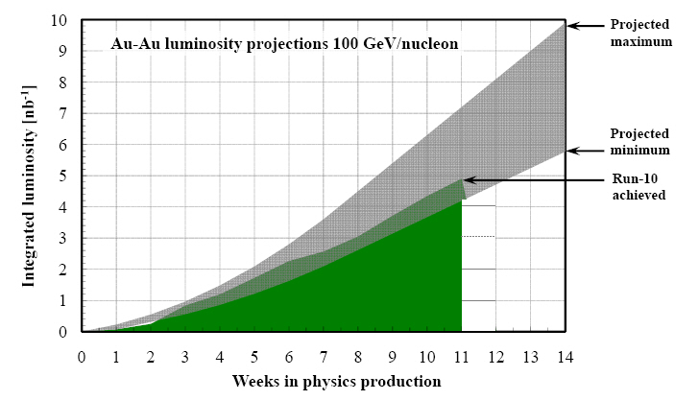
Run-11 Au-Au luminosity projections 100 GeV/nucleon
Goals to be updated/corrected
PHENIX Goal (0.7 recorded)
STAR Goal (TBD)
?? (complicated)
Assume 6 weeks to ramp-up for min, and 8 weeks for max (stoch. cooling re-commissioning).
Expect L_{avg} up to 25x10²⁶cm⁻²s⁻¹ (+25%).
[from Run-10 to max: β* = 0.75 ➔ 0.65 m, N_{b} = 1.1 ➔ 1.1x10⁹, more cooling]

