Slide 1
Run 11 RHIC Machine/Experiments Meeting
1 Mar 2011
Agenda:
Status –
Request from ANDY

Slide 2
Run 11 RHIC Machine/Experiments Meeting decisions
11/23/2010: Agreed to new APEX schedule, 12 hour sessions (0800-2400) every other week away from maintenance days.
2/25/2011: Beginning with physics store 15239, changed CNI Polarimeter analyzing power to agree with jet target polarization measurements …18% lower than before.

Slide 3
Run 11 Plan based on PAC recommendation/ALD Guidance and 28.3 weeks cryo operation
2/15/10 update
3 Jan, Begin cool-down to 4.5K
8 Jan, Cool-down to 4.5K complete in both rings, preliminary setup begins
~11 Jan, 2 ⅟₂ weeks beam setup for √s = 500 GeV pp in RHIC begins.
15 Jan, power supply work/DX training complete
17 Jan, first successful ramp
19 Jan, 1st maint day
27 24 Jan, 1 week Ramp-up with 8 hr/night beam to experiments
3 11 Feb (machine and ~experiments), begin 10(?) week physics run (√s = 500 GeV pp)
24 Feb, 9 MHz cavity in routine operation
4 March – Continuing Resolution Ends
28 March – 1 April, PAC 2011
14 Apr, end 10 week physics run at √s = 500 GeV pp run
14 Apr, begin 1 week setup for √s = 200 AuAu
21 Apr, begin 1 week Ramp-up with 8 hr/night beam to experiments
28 Apr, begin 8 week physics run at (√s = 200 AuAu)
23 Jun, end 8 week √s = 200 AuAu run
23 Jun, begin setup for √s = 192 GeV UU
30 Jun, begin 1⅟₂ week physics run (√s = 192 UU)
4 July – completed 26 weeks of cryo operation, may be out of $$’s
10 Jul, end 1⅟₂ week physics run at √s = 192 GeV
10 Jul, begin setup for √s = 18 GeV AuAu
11 Jul, begin 1 week physics run (√s = 18 AuAu)
18 Jul, end 1 week physics run at √s = 18 GeV
20 Jul, warm-up complete (28.3 weeks)
Possible additions:
Low energy test run

Slide 6
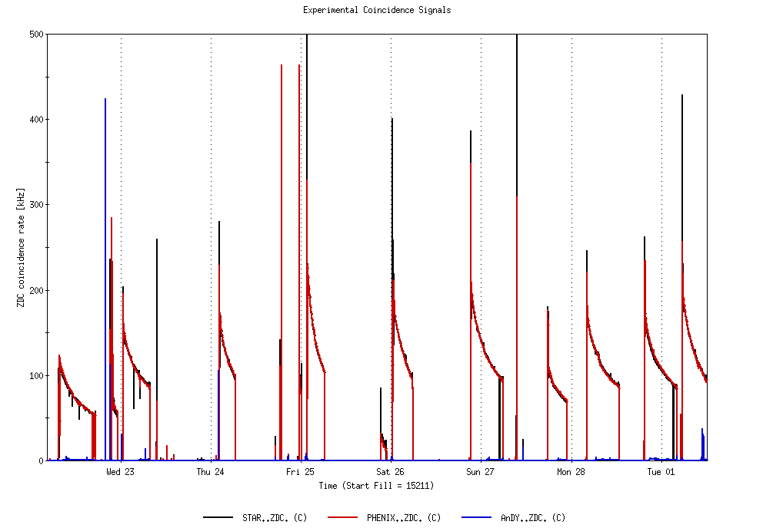
Physics Stores 15211 through 15255
L_{max} = 170 x 10³⁰ cm⁻²s⁻¹ (projection with 2.8 mb xsection)
L_{max} achieved Run 9, 85 x 10³⁰ cm⁻²s⁻¹
9 MHz operational

Slide 7
Physics Stores 15211 through 15255
Run 11 Projected maximum
Achieved Run 9

Slide 8
Physics Stores 15211 through 15255
9 MHz operational

Slide 9
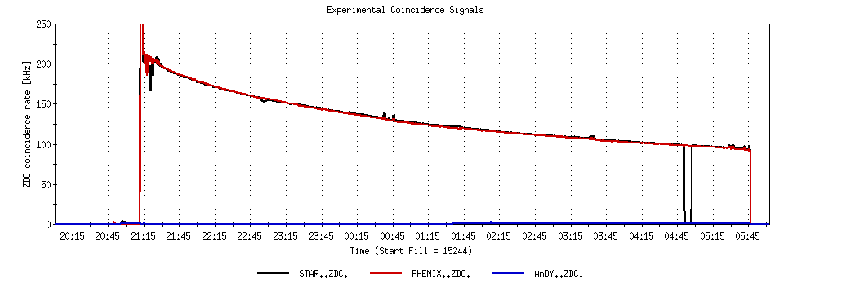
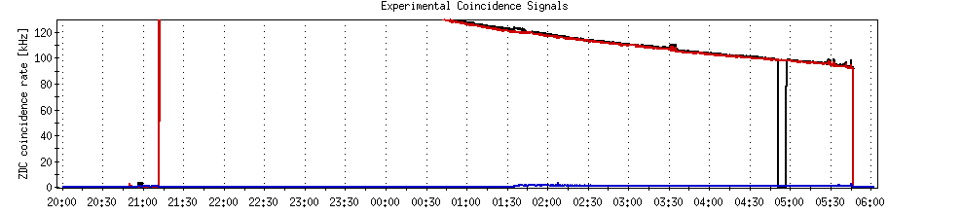
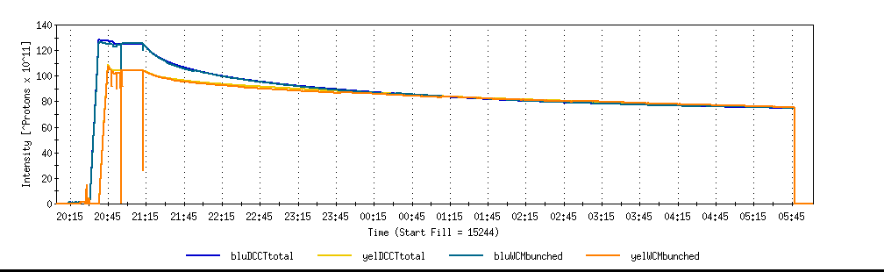
A good store with 9 MHz
Sat 2/26

Slide 10
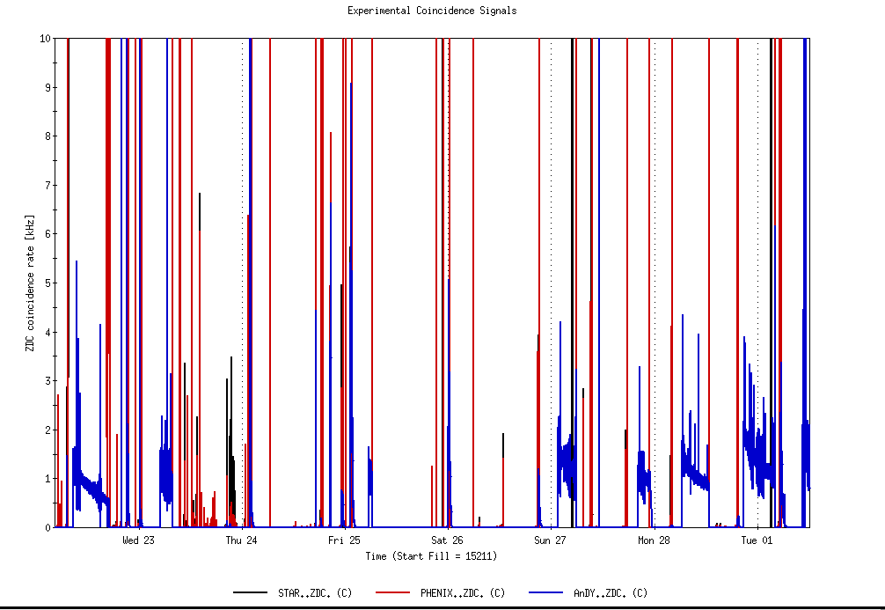
ANDY Physics Stores 15211 through 15255
ANDY Physics Stores

Slide 11
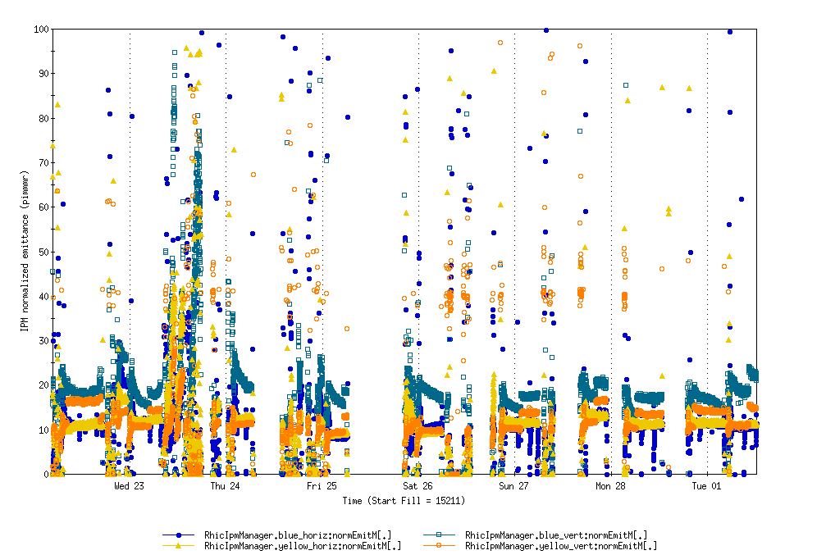
Physics Stores 15211 through 15255

Slide 12
Through 27 Feb 2011
maint days
Cryo recovery!

Slide 13
Through 27 Feb 2011

Slide 15
Through 27 Feb 2011

Slide 16
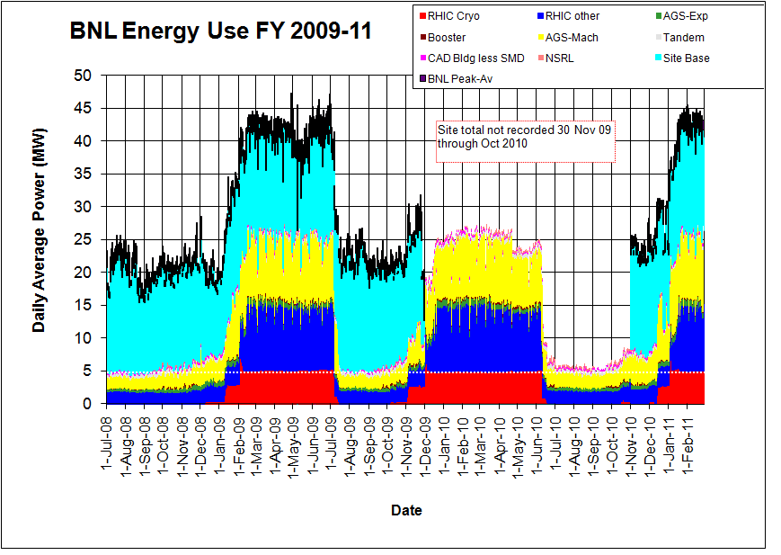
Through 27 Feb 2011

Slide 17
Old information

Slide 18
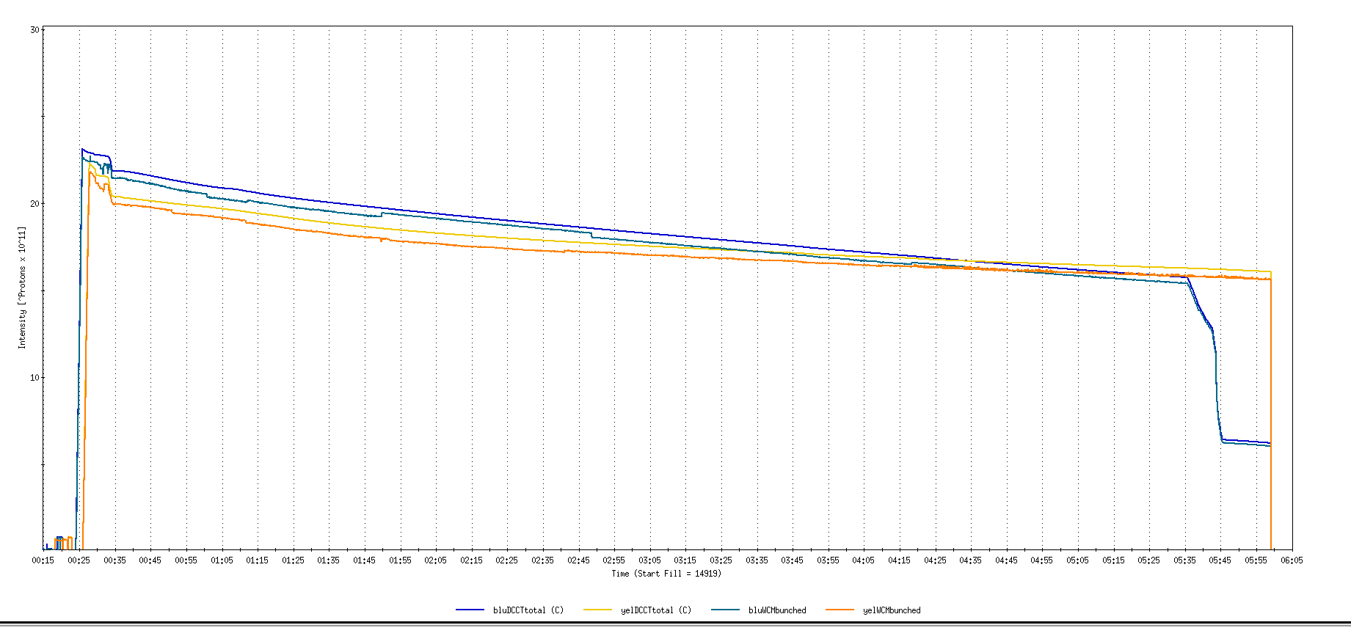
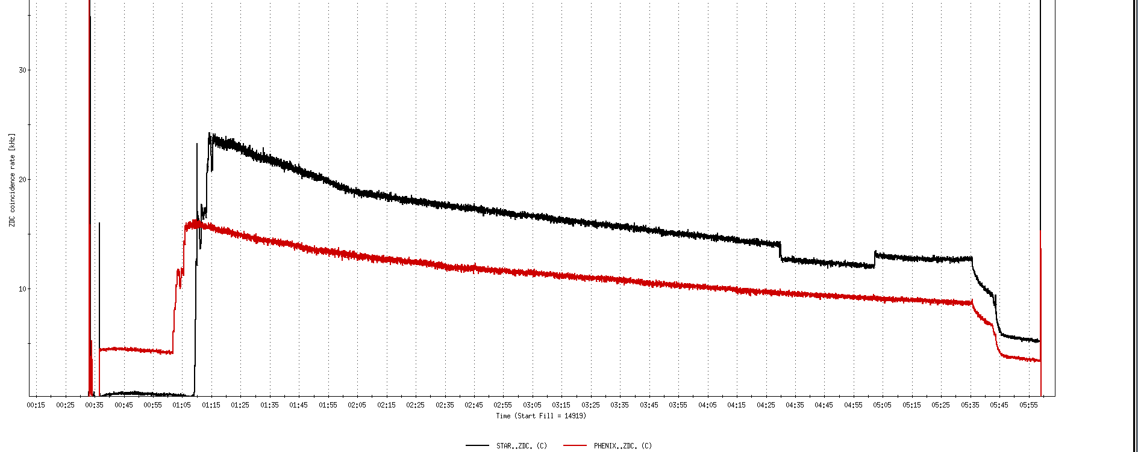
Run 11, First overnight store, Mon Jan 24 00:12
Fill number 14919,, √s=500 GeV
21 days since start of cool-down
28 x 27 bunches
β*=0.65 meters
20 x 10¹¹
For peak store lumi = 170 x 10³⁰ cm⁻²s⁻¹ (projected MAXIMUM)
ZDC Rate ~ 400K (assuming 2.4 mb n-pair xsection)
20K

Slide 19
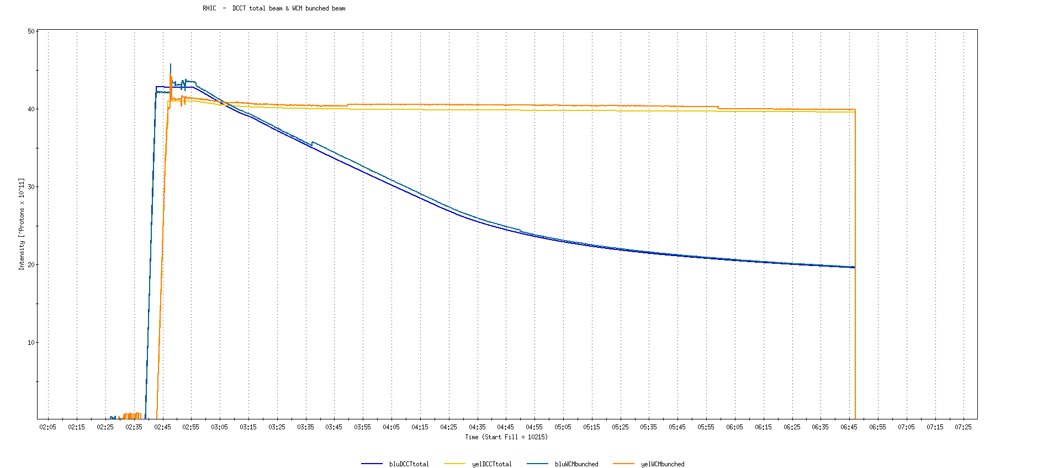
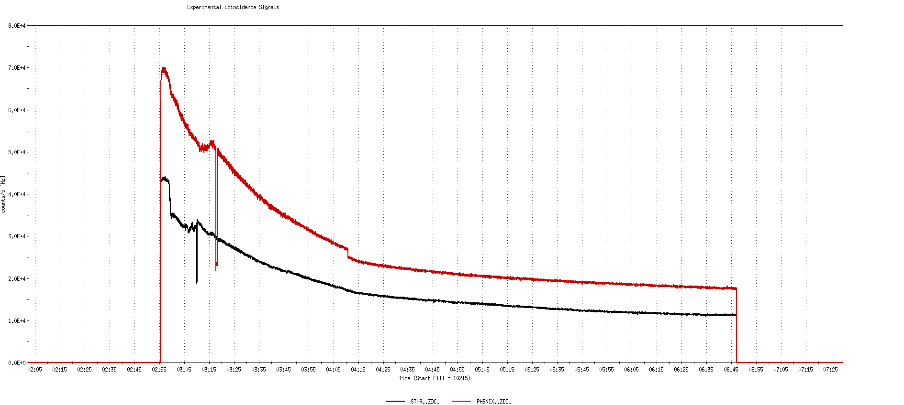
Run 9, First overnight store at √s=500 GeV
22 days after start of cool-down
56 x 56 bunches
β*=0.7 meters
40 x 10¹¹
40K

Slide 20
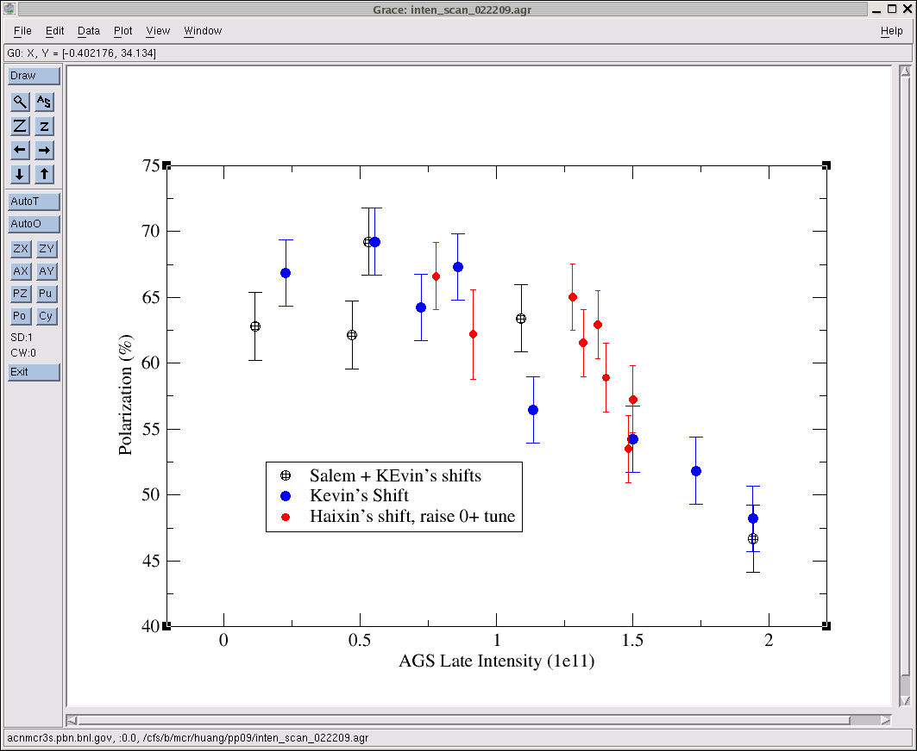
AGS pp log, 23 Feb 09, 00:26

Slide 21
26 weeks

Slide 22
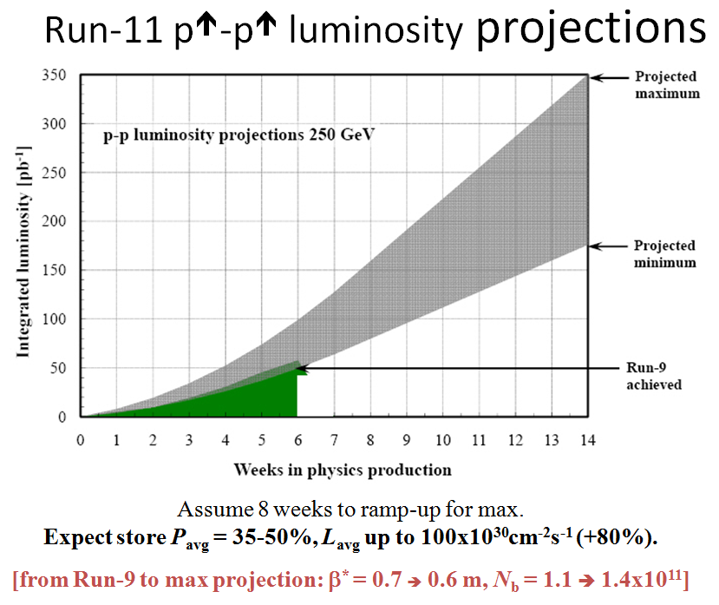
Goals to be updated/corrected
PHENIX Goal (50% pol)
STAR Goal (50% pol)

Slide 23
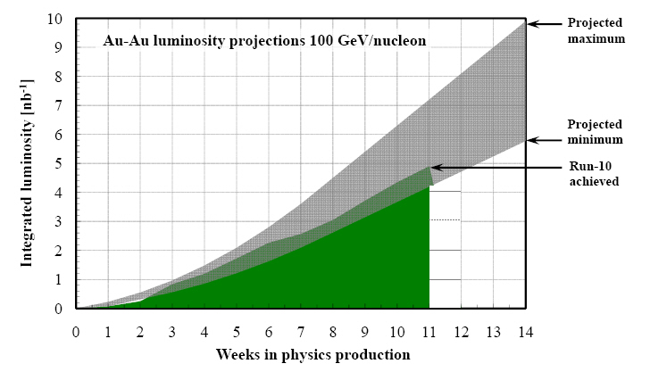
Run-11 Au-Au luminosity projections 100 GeV/nucleon
Goals to be updated/corrected
PHENIX Goal (0.7 recorded)
STAR Goal (TBD)
?? (complicated)
Assume 6 weeks to ramp-up for min, and 8 weeks for max (stoch. cooling re-commissioning).
Expect L_{avg} up to 25x10²⁶cm⁻²s⁻¹ (+25%).
[from Run-10 to max: β* = 0.75 ➔ 0.65 m, N_{b} = 1.1 ➔ 1.1x10⁹, more cooling]

