Slide 1
Run 11 RHIC Machine/Experiments Meeting
22 Mar 2011
Agenda: Open

Slide 2
Run 11 RHIC Machine/Experiments Meeting decisions
Pending Decision (3/15/2011)
11/23/2010: Agreed to new APEX schedule, 12 hour sessions (0800-2400) every other week away from maintenance days.
2/25/2011: Beginning with physics store 15239, changed CNI Polarimeter analyzing power to agree with jet target polarization measurements …18% lower than before.
If CR budget not favorably resolved, should we switch to 18 GeV AuAu or continue with 500 GeV pp?
  STAR proposal – switch to 18 GeV AuAu on 28 March
  PHENIX Proposal – continue with 500 GeV pp till ~ 14 April

Slide 3
Run 11 Plan based on PAC recommendation/ALD Guidance and 28.3 weeks cryo operation
3/22/10 update
3 Jan, Begin cool-down to 4.5K
8 Jan, Cool-down to 4.5K complete in both rings, preliminary setup begins
~11 Jan, 2 ⅟₂ weeks beam setup for √s = 500 GeV pp in RHIC begins.
15 Jan, power supply work/DX training complete
17 Jan, first successful ramp
19 Jan, 1st maint day
27 24 Jan, 1 week Ramp-up with 8 hr/night beam to experiments
3 11 Feb (machine and ~experiments), begin 10(?) week physics run (√s = 500 GeV pp)
16 Feb, AGS Jump Quads in routine operation for RHIC injection
24 Feb, 9 MHz cavity in routine operation
7 Mar, cryo troubles, extended maintenance, 0900 hrs till 2000 hrs 14 Mar – lost 7.5 days
17 Mar, power distribution problem, extended maintenance, 1930 hrs till 0315 hrs 20 Mar – lost 3.3 days
28 March – 1 April, PAC 2011
4 18 March – 8 April Continuing Resolution Ends
14 Apr(?), end 10 week physics run at √s = 500 GeV pp run
14 Apr, begin 1 week setup for √s = 200 AuAu
21 Apr, begin 1 week Ramp-up with 8 hr/night beam to experiments
28 Apr, begin 8 week physics run at (√s = 200 AuAu)
23 Jun, end 8 week √s = 200 AuAu run
23 Jun, begin setup for √s = 192 GeV UU
30 Jun, begin 1⅟₂ week physics run (√s = 192 UU)
4 July – completed 26 weeks of cryo operation, may be out of $$’s
10 Jul, end 1⅟₂ week physics run at √s = 192 GeV
10 Jul, begin setup for √s = 18 GeV AuAu
11 Jul, begin 1 week physics run (√s = 18 AuAu)
18 Jul, end 1 week physics run at √s = 18 GeV
20 Jul, warm-up complete (28.3 weeks)
Possible additions:
Low energy test run

Slide 6
Fills 15166 through 15316 (21 Mar)

Slide 7
Fills 15166 through 15316 (21 Mar)
Projected maximum for Run 11
minimum for Run 11
Blue average = 44.8 +/- 1.3%
Yellow Average = 47.1 +/- 1.2%

Slide 8
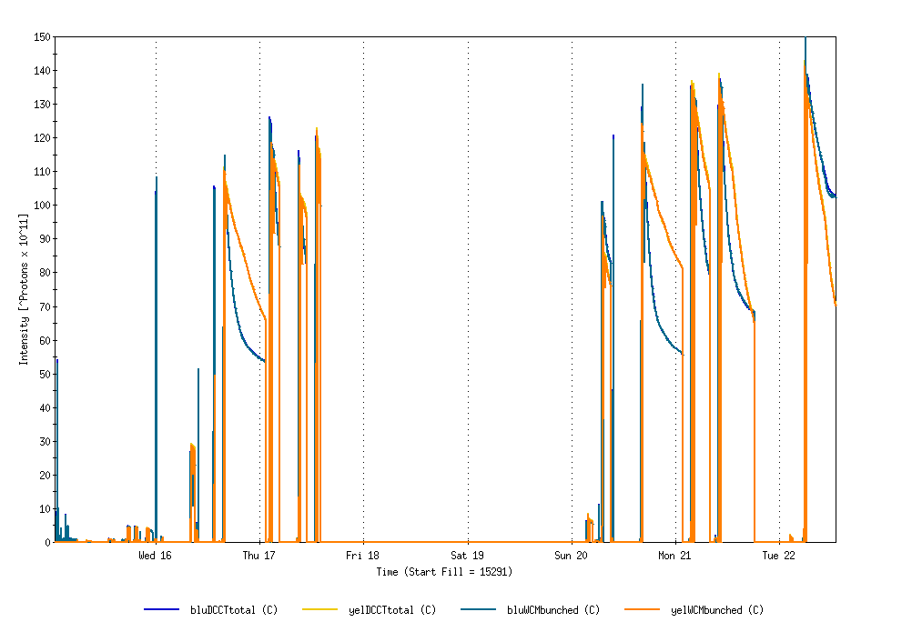
Physics Stores 15291 through 15322
Run 11 Projected maximum
Achieved Run 9

Slide 9
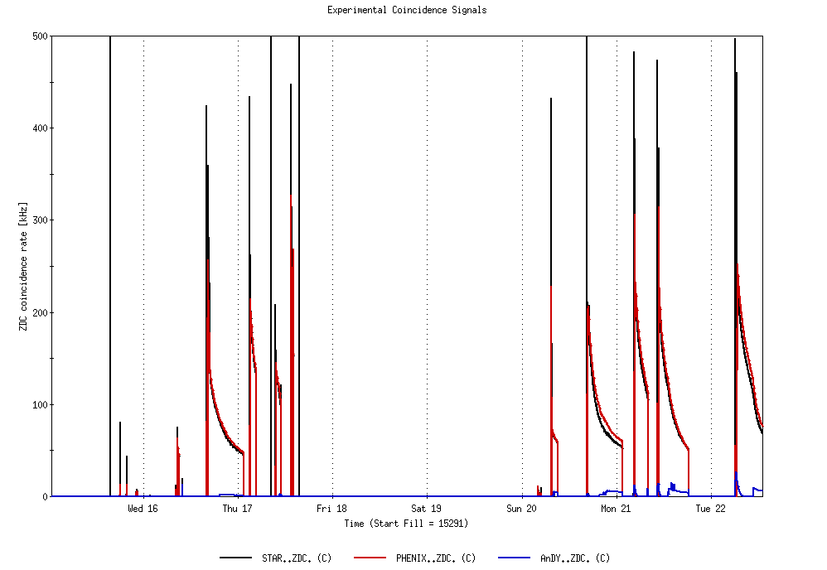
Physics Stores 15291 through 15322
L_{max} = 170 x 10³⁰ cm⁻²s⁻¹ (projection with 2.8 mb xsection)
L_{max} achieved Run 9, 85 x 10³⁰ cm⁻²s⁻¹

Slide 10
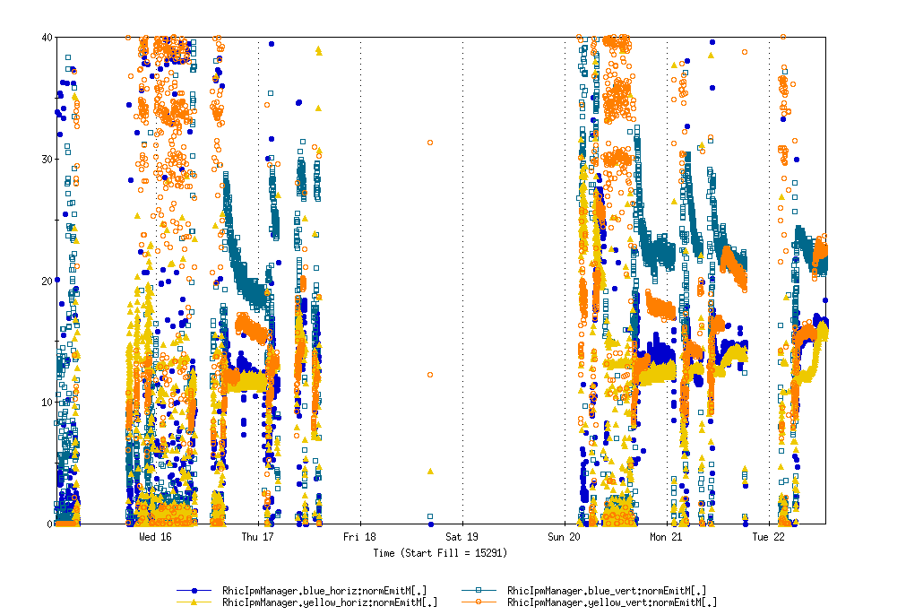
Physics Stores 15291 through 15322

Slide 11
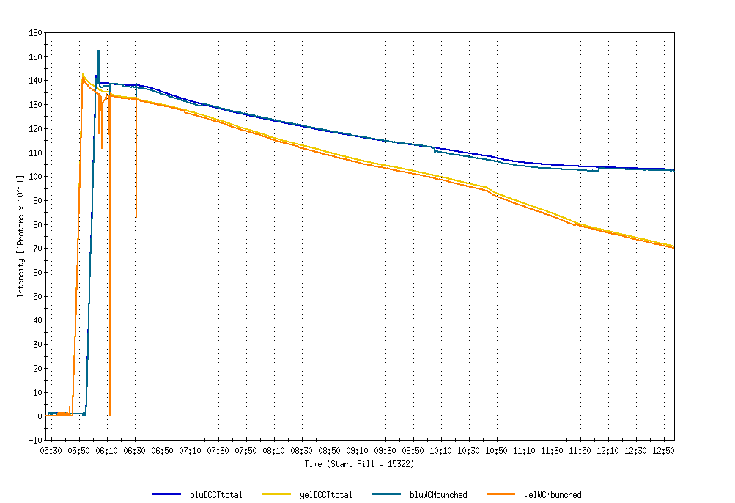
3/22 fill (in progress)
ANDY IN

Slide 12
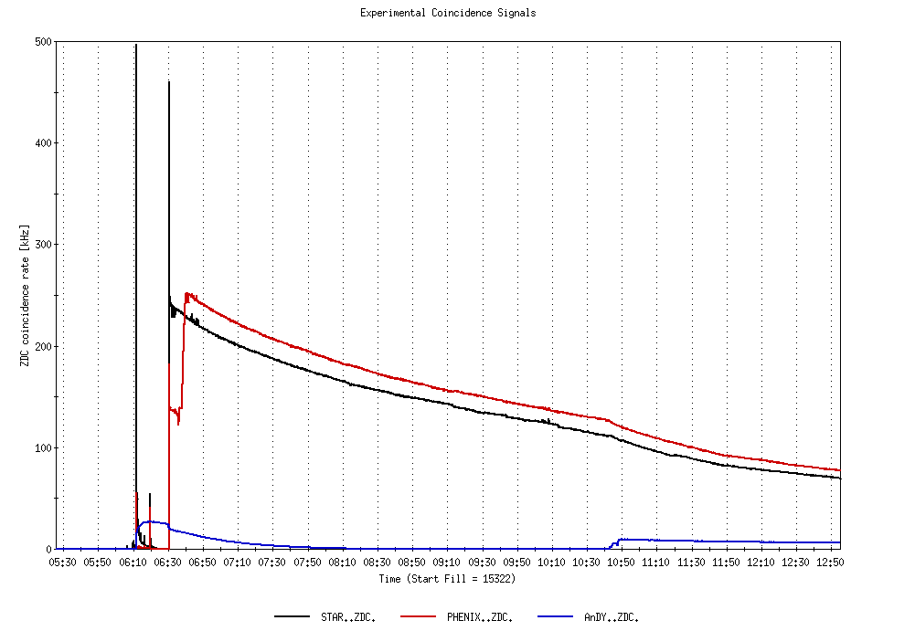
3/22 fill (in progress)
ANDY IN

Slide 13
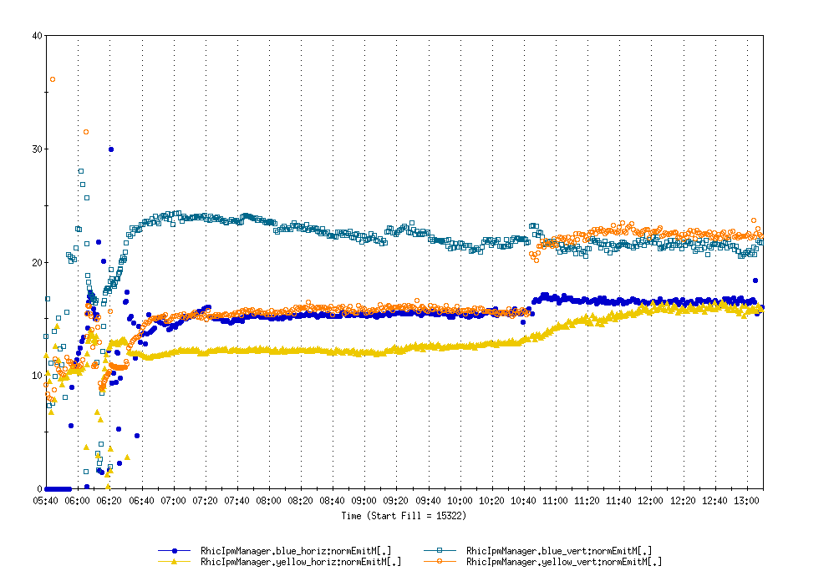
3/22 fill (in progress)
Horizontal and vertical emittance
ANDY IN

Slide 15
Old information

Slide 16
Through 13 Mar 2011
~ 21.5 MW above baseline
~28K$/day
Power savings
~ 5.4 MW/day
(~7K$/day))
baseline

Slide 17
Through 13 Mar 2011
Extended shutdown
maint days
Cryo recovery

Slide 18
Through 13 Mar 2011

Slide 19
Through 13 Mar 2011

Slide 21
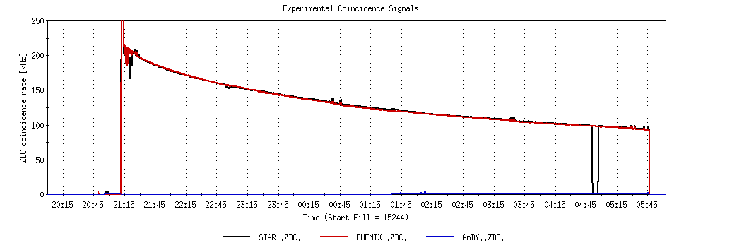
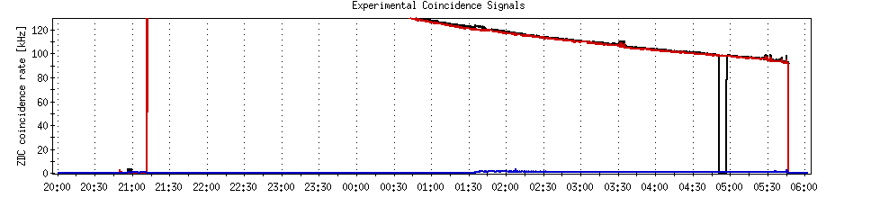
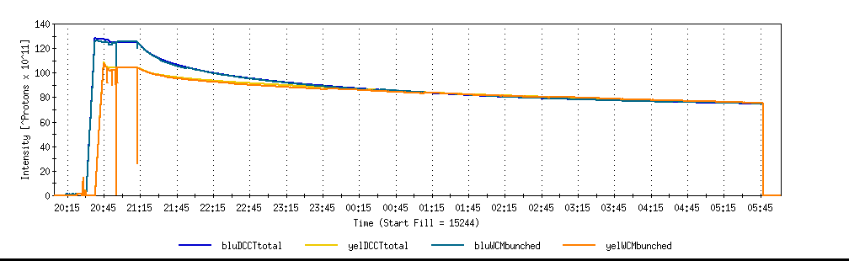
A good store with 9 MHz
Sat 2/26

Slide 22
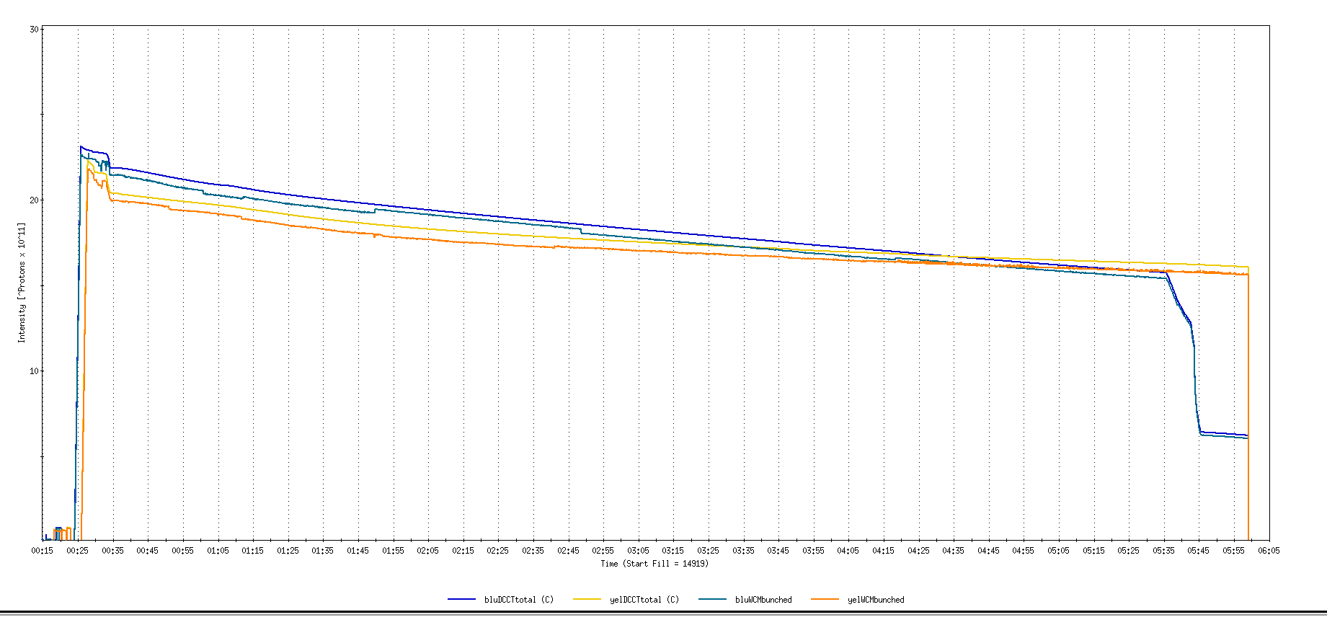
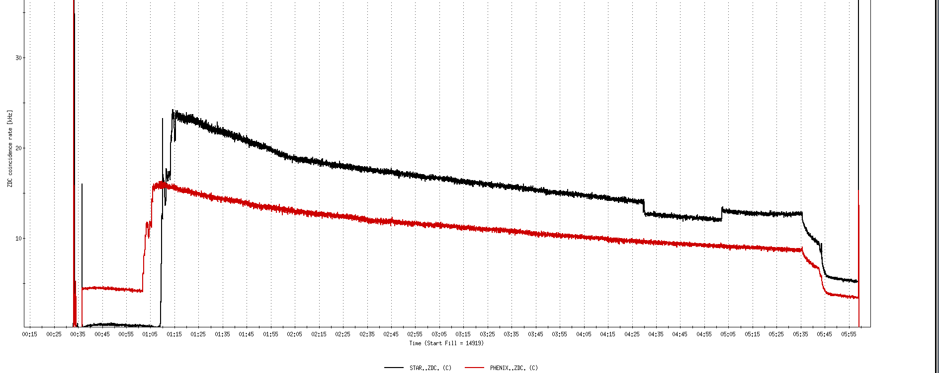
Run 11, First overnight store, Mon Jan 24 00:12
Fill number 14919,, √s=500 GeV
21 days since start of cool-down
28 x 27 bunches
β*=0.65 meters
20 x 10¹¹
For peak store lumi = 170 x 10³⁰ cm⁻²s⁻¹ (projected MAXIMUM)
ZDC Rate ~ 400K (assuming 2.4 mb n-pair xsection)
20K

Slide 23
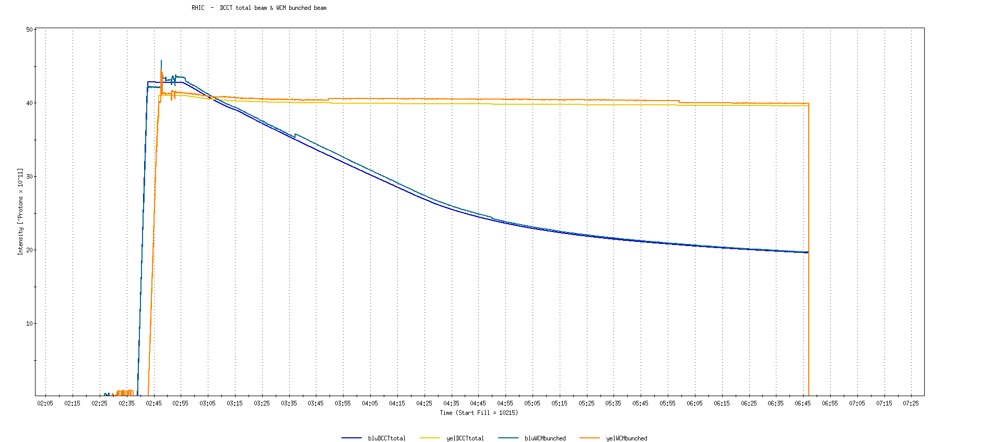
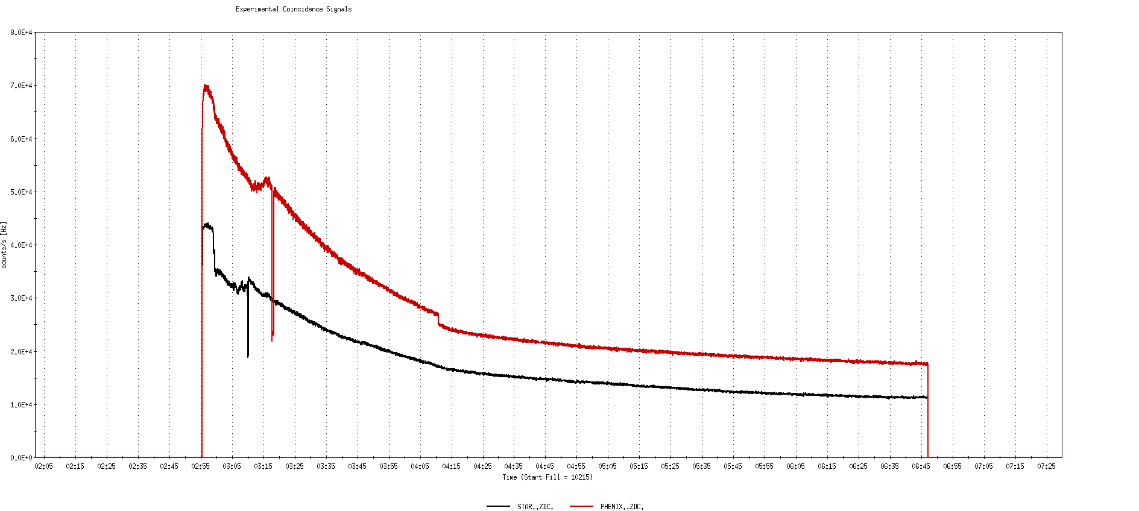
Run 9, First overnight store at √s=500 GeV
22 days after start of cool-down
56 x 56 bunches
β*=0.7 meters
40 x 10¹¹
40K

Slide 24
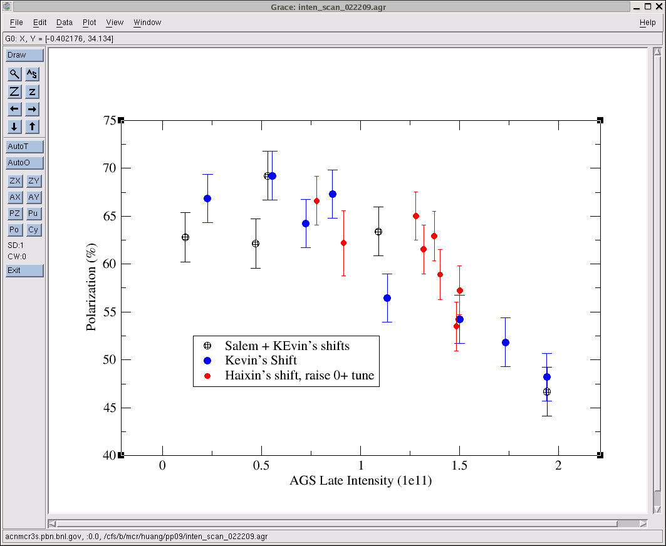
AGS pp log, 23 Feb 09, 00:26

Slide 25
26 weeks

Slide 26
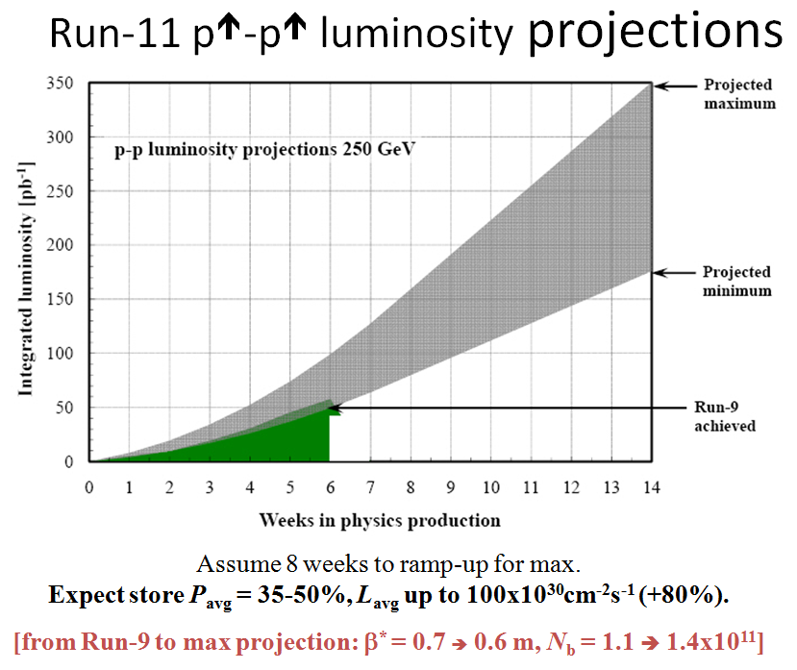
Goals to be updated/corrected
PHENIX Goal (50% pol)
STAR Goal (50% pol)

Slide 27
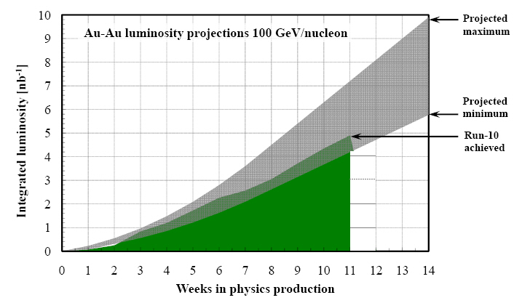
Run-11 Au-Au luminosity projections 100 GeV/nucleon
Goals to be updated/corrected
PHENIX Goal (0.7 recorded)
STAR Goal (TBD)
?? (complicated)
Assume 6 weeks to ramp-up for min, and 8 weeks for max (stoch. cooling re-commissioning).
Expect L_{avg} up to 25x10²⁶cm⁻²s⁻¹ (+25%).
[from Run-10 to max: β* = 0.75 ➔ 0.65 m, N_{b} = 1.1 ➔ 1.1x10⁹, more cooling]

