Slide 1
Run 11 RHIC Machine/Experiments Meeting
26 Apr 2011
Agenda:
Progress reports, √s = 18 GeV/n Au-Au run

Slide 2
Run 11 Plan based on PAC recommendation/ALD Guidance and available funds
4/26/10 update (2/2)
3 Jan, Begin cool-down to 4.5K
8 Jan, Cool-down to 4.5K complete in both rings, preliminary setup begins
24 Jan, 1 week Ramp-up with 8 hr/night beam to experiments
11 Feb (machine and ~experiments), begin ~10 week physics run (√s = 500 GeV pp)
7 Mar, cryo troubles, extended maintenance, 0900 hrs till 2000 hrs 14 Mar – lost 7.5 days
17 Mar, power distribution problem, extended maintenance, 1930 hrs till 0315 hrs 20 Mar – lost 2.3 days
18 Apr, end 9.4 week physics run at √s = 500 GeV
18 Apr jet target polarization measurement at injection (<5%)
19 Apr, short maintenance followed by setup for √s = 18 GeV AuAu
23 Apr, begin ~1 week physics run (√s = 19.6 AuAu)
26 April - TODAY
2 May, end 1.3 week physics run at √s = 19.6 GeV
2 May, begin 1 week setup for √s = 200 AuAu
9 May (or sooner), begin 1 week Ramp-up with 8 hr/night beam to experiments
16 May, begin ?? week physics run at (√s = 200 GeV/n AuAu)
29 June, end 6.3 week AuAu physics run at √s = 200 GeV/n , begin warm-up
30 June, cryo warm-up ~ complete, end 25.4 weeks cryo operation
What’s missing :
Run into July?
Uranium test/physics run
Low energy test run
only 2 days!

Slide 3
AuAu at √s = 19.6 GeV – all runs to date

Slide 4
Thru fill 15591

Slide 5
Thru fill 15591

Slide 6
Power demand penalty (part 1)
Run into July – an issue…
Transmission = $5,680/MW
NYPA administrative = $190/MW
  Total = $5,870/MW
  RHIC ON/OFF difference ~ 20 MW
  RHIC ON demand charge = 20x$5870 = $117,400
LIPA “wheeling” charge
  RHIC ON = $123,000
  RHIC OFF = $63,550
  Difference = $59,450
Total Demand Penalty = $117,400 + $59,450 = $176,850

Slide 7
Power demand penalty (part 2)
BNL is assessed another penalty based on the BNL power demand on the day of the NY state peak power demand for the summer
The penalty is assessed as a monthly charge during the next year.
Mark Toscano estimates the penalty would be about $27,000 x 20 MW = $544,000 but risk is low as the NY State peak in past years has occurred in August.
Plus balanced billing costs are $70/MWhr in June and July

Slide 8
Old information

Slide 9
Run 11 RHIC Machine/Experiments Meeting decisions
11/23/2010, APEX: Agreed to new APEX schedule, 12 hour sessions (0800-2400) every other week away from maintenance days.
2/25/2011, CNI Polarimeters Normalization: Beginning with physics store 15239, changed CNI Polarimeter analyzing power to agree with jet target polarization measurements …18% lower polarization than before.
4/11-15/2011, End 250 GeV pp on18 April, switch to 18 GeV AuAu on after jet target polarization measurement at injection is completed

Slide 10
Decisions (cont’)
3/25/2011: AnDY Collisions (W. Fischer, L. Bland, E. Aschenauer,
S. Vigdor):
  (1) A. Drees will test the sequence developed to address both orbit and tune effects of AnDY at the end of a store (or multiple stores if needed).
  (2) When the proper functioning of the sequence is demonstrated we will go back to a 1.05e11/bunch threshold, and increase every store by another 0.05e11/bunch until we reach a 10-20% luminosity impact on STAR and PHENIX. In the event the prescribed bunch intensity is not reached during the store then AnDY should be steered into collision during the last 30 minutes of the store.
  (3) When the tune scan on the ramp finishes (~2 more tune to test), we will increase the store length to 10h or more, (with PHENIX/STAR concurrence), with this AnDY will have more time available after turning on.

Slide 12
Final Lumi should change as it appears there’s an issue with the singles correction

Slide 14
Run 11 projected maximum
Store 15443 (12 Apr)

Slide 19
one store
Blue average = 45.3 +/- 0.6%
Yellow Average = 45.8 +/- 0.6%

Slide 21
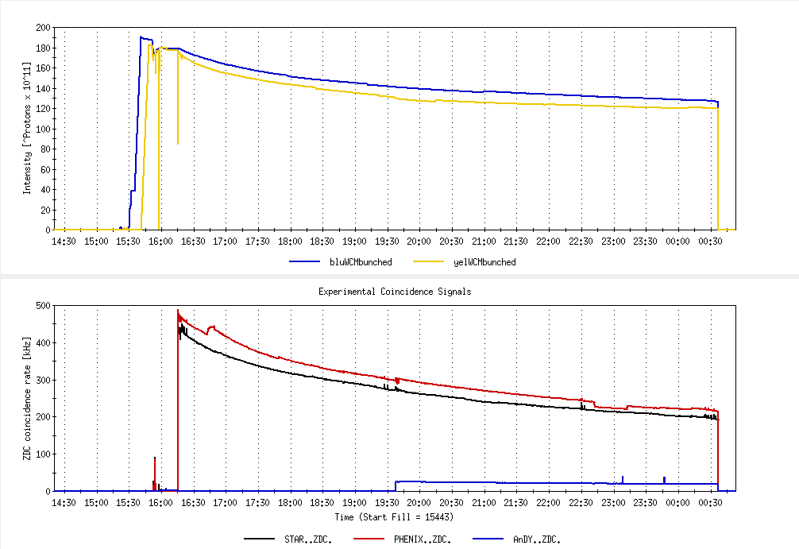
~ Best Store (scaling to 100 hrs at store), 12 April
8.2 hour store, 2.64 pb⁻¹, peak lumi 143 x 10³⁰ cm⁻²s⁻¹
Bunched intensity at beginning of physics 1.64/1.63 x 10 ¹¹
Run 11 Projected maximum

Slide 22
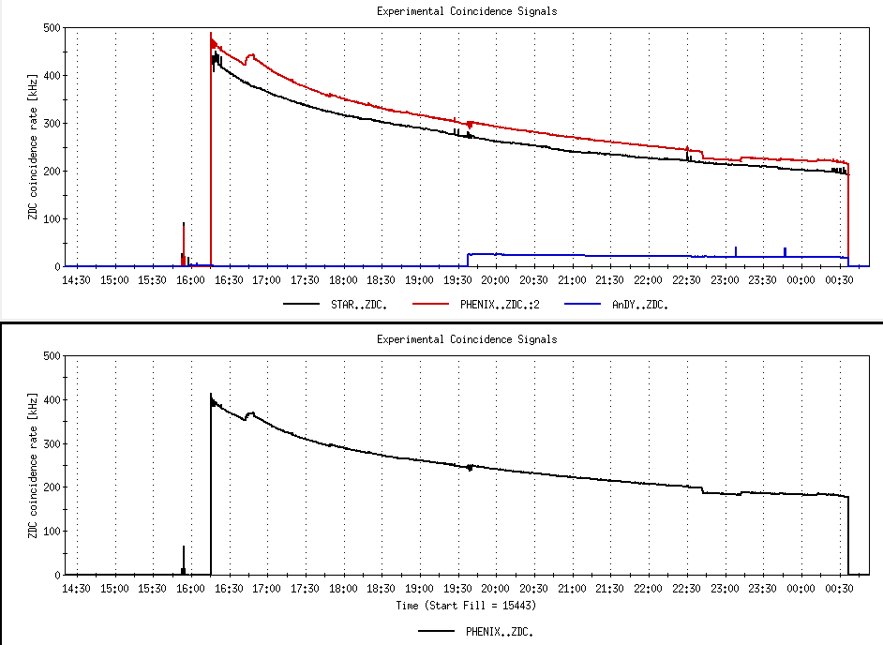
no singles correction
-16%
PHENIX with singles correction
-17%
-8%
Run 11 Projected maximum (170 x 10³⁰ cm⁻²s⁻¹)

Slide 23
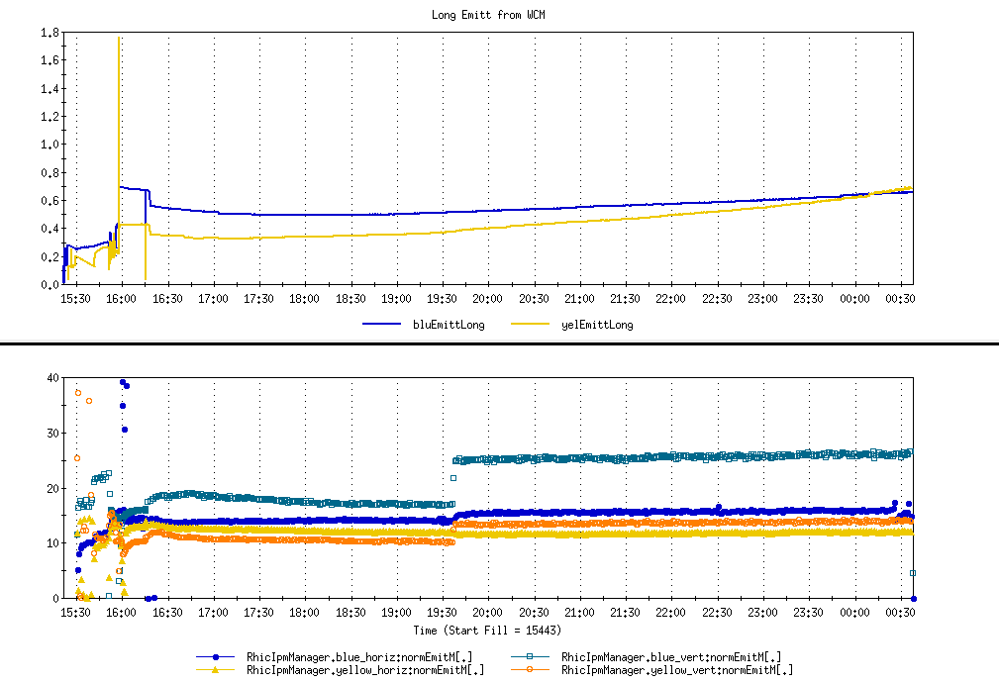
Inferred emittance = 20.7 πmmmr

Slide 24
Estimate for 18 GeV/n

Slide 25
Through 14 Apr 2011

Slide 26
Through 14 Apr 2011

Slide 27
Through 14 Apr 2011

Slide 28
Through 14 Apr 2011

Slide 29
Run 11 Plan based on PAC recommendation/ALD Guidance and available funds
4/26/10 update (1/2)
3 Jan, Begin cool-down to 4.5K
8 Jan, Cool-down to 4.5K complete in both rings, preliminary setup begins
~11 Jan, 2 ⅟₂ weeks beam setup for √s = 500 GeV pp in RHIC begins.
15 Jan, power supply work/DX training complete
17 Jan, first successful ramp
19 Jan, 1st maint day
24 Jan, 1 week Ramp-up with 8 hr/night beam to experiments
11 Feb (machine and ~experiments), begin ~10 week physics run (√s = 500 GeV pp)
16 Feb, AGS Jump Quads in routine operation for RHIC injection
24 Feb, 9 MHz cavity in routine operation
7 Mar, cryo troubles, extended maintenance, 0900 hrs till 2000 hrs 14 Mar – lost 7.5 days
17 Mar, power distribution problem, extended maintenance, 1930 hrs till 0315 hrs 20 Mar – lost 2.3 days
28 March – 1 April, PAC 2011
15 April Continuing Resolution Ends, guidance to follow
18 Apr, end 9.4 week pp physics run at √s = 500 GeV
18 Apr jet target polarization measurement at injection (<5%)
19 Apr, short maintenance followed by setup for √s = 18 GeV AuAu
23 Apr, begin ~1 week physics run (√s = 19.6 AuAu)
2 May, end 1.3 week physics run at √s = 19.6 GeV

Slide 30
7 April Up-Down Ramp measurement
Blue Beam
Current CNI average analyzing powers are:
Energy AN
24 0.0144
100 0.0122
250 0.0147

Slide 31
7 April Up-Down Ramp measurement
Yellow Beam (only Yellow 1 was
used as Yellow 2 was acting up)
Current CNI average analyzing powers are:
Energy AN
24 0.0144
100 0.0122
250 0.0147

Slide 32
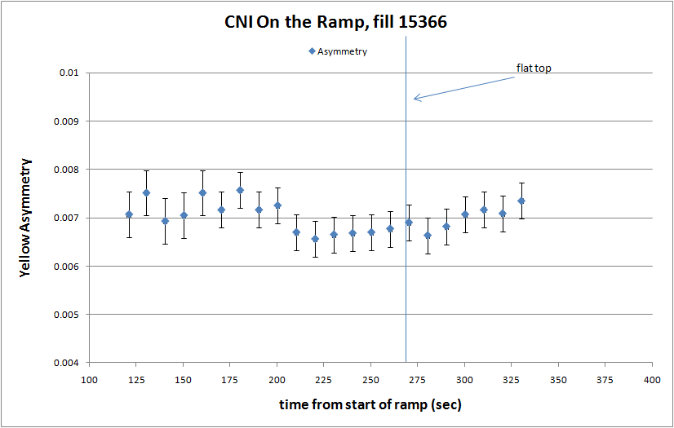

Slide 33
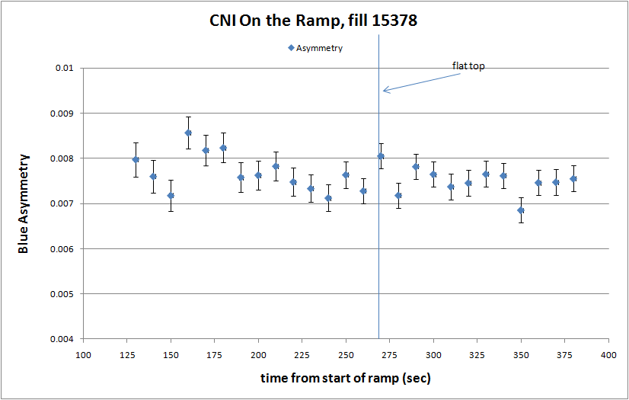

Slide 35
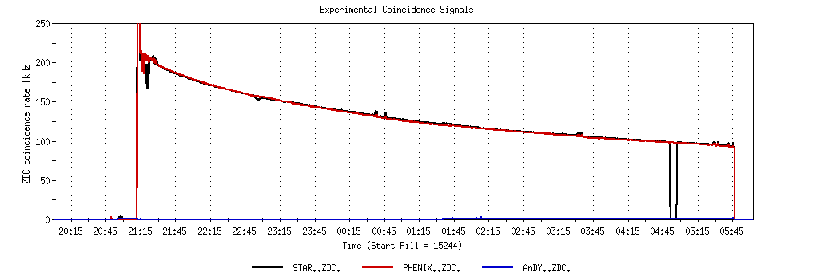
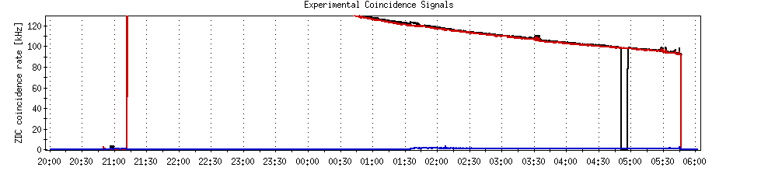
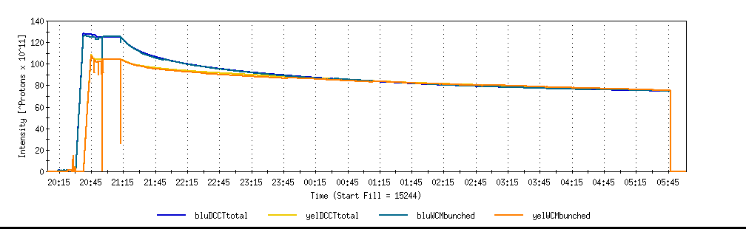
A good store with 9 MHz
Sat 2/26

Slide 36
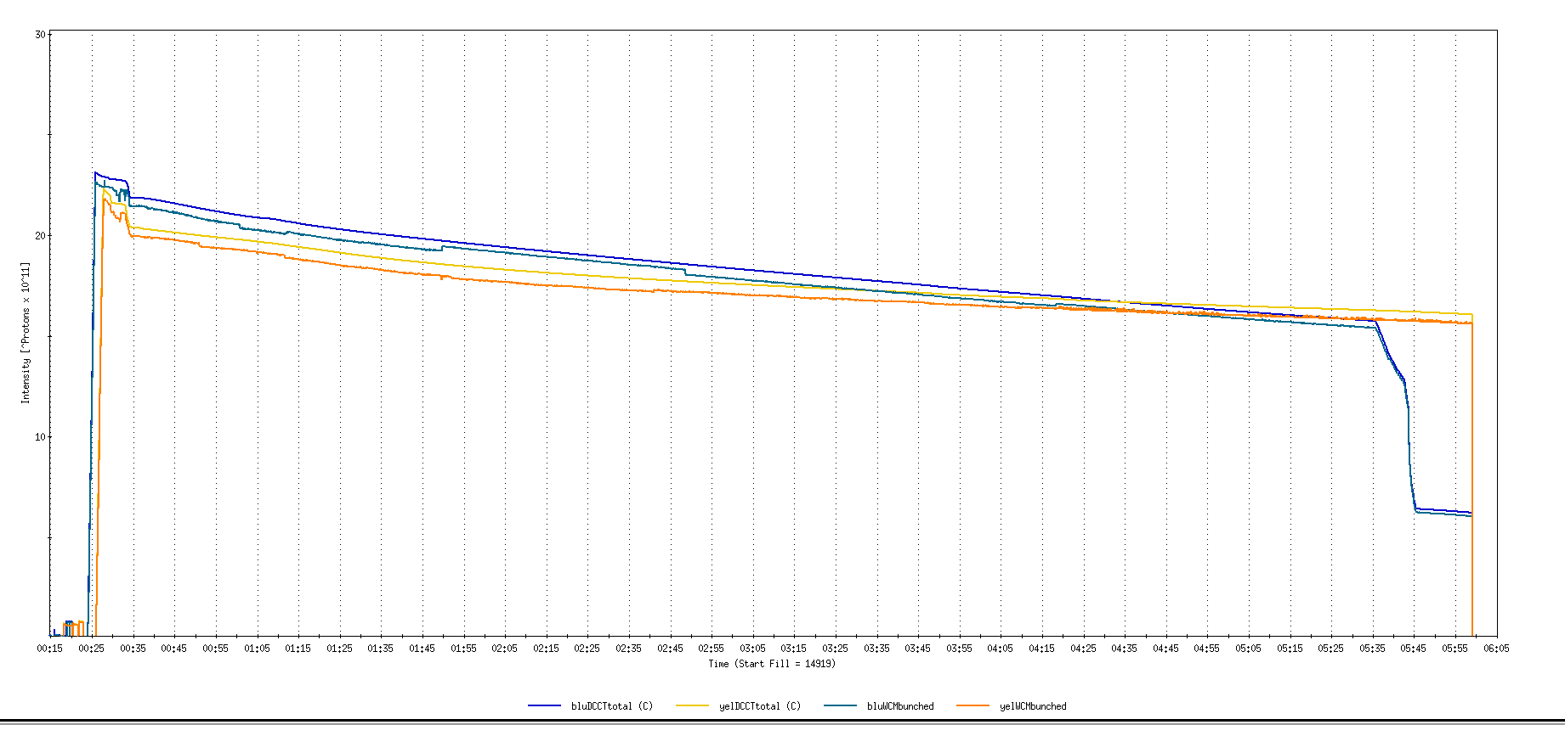
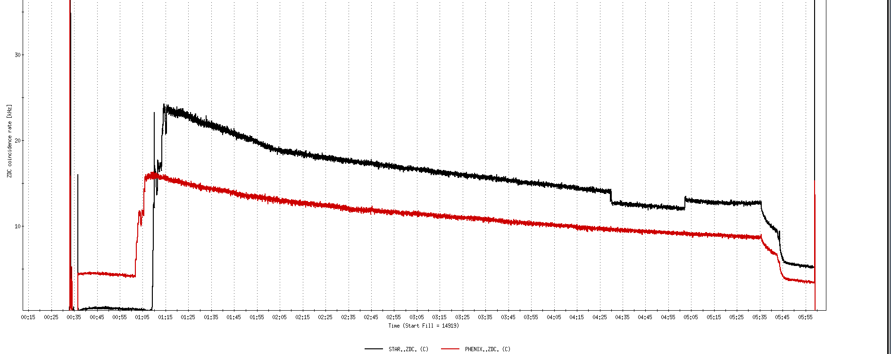
Run 11, First overnight store, Mon Jan 24 00:12
Fill number 14919,, √s=500 GeV
21 days since start of cool-down
28 x 27 bunches
β*=0.65 meters
20 x 10¹¹
For peak store lumi = 170 x 10³⁰ cm⁻²s⁻¹ (projected MAXIMUM)
ZDC Rate ~ 400K (assuming 2.4 mb n-pair xsection)
20K

Slide 37
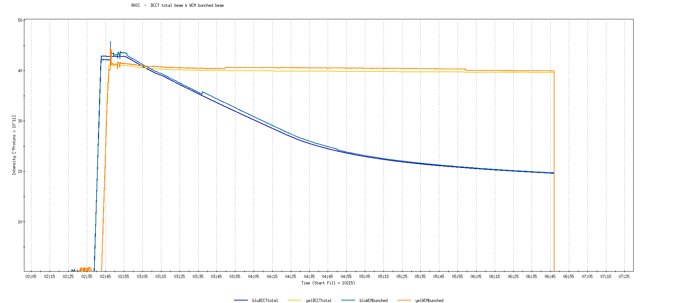
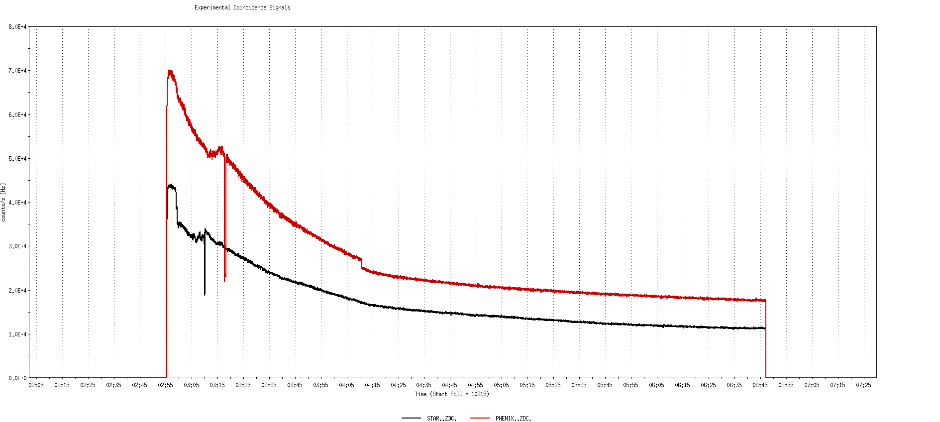
Run 9, First overnight store at √s=500 GeV
22 days after start of cool-down
56 x 56 bunches
β*=0.7 meters
40 x 10¹¹
40K

Slide 38
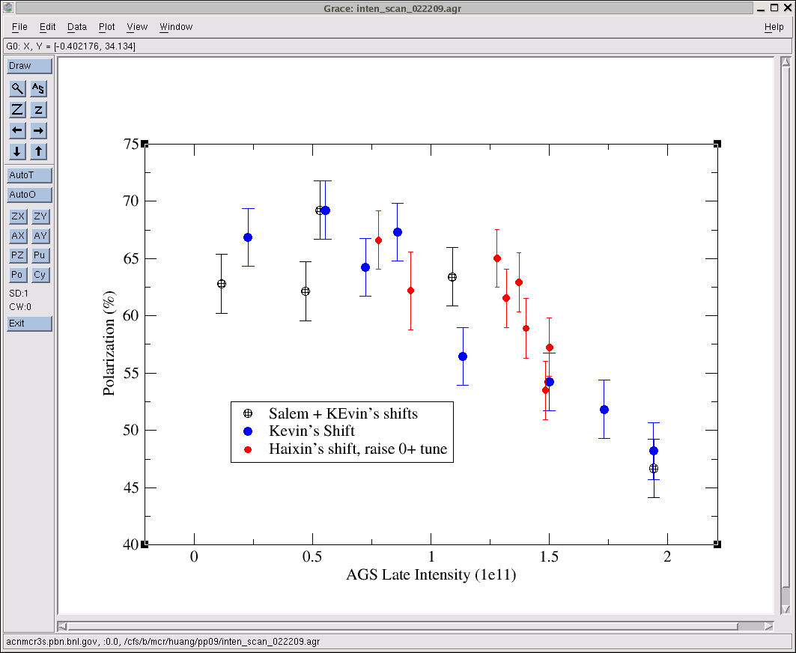
AGS pp log, 23 Feb 09, 00:26

Slide 39
26 weeks

Slide 40
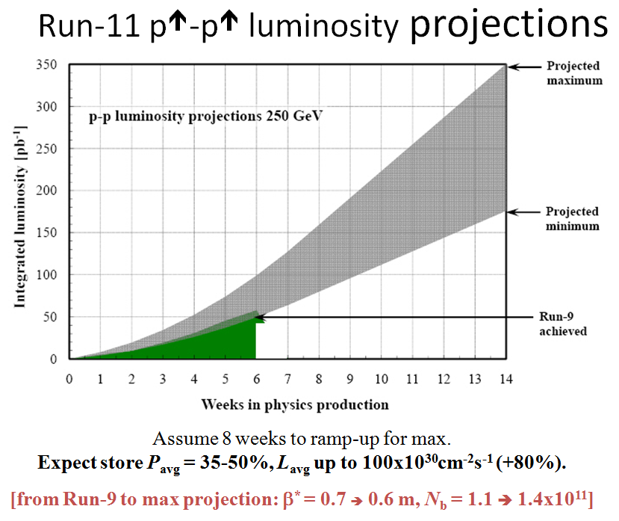
Goals to be updated/corrected
PHENIX Goal (50% pol)
STAR Goal (50% pol)

Slide 41
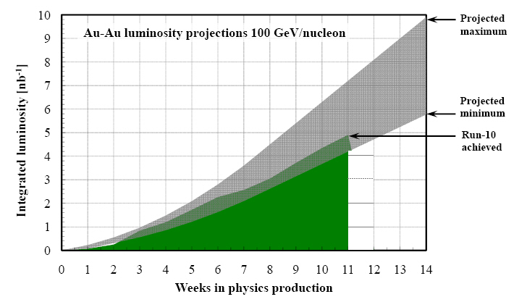
Run-11 Au-Au luminosity projections 100 GeV/nucleon
Goals to be updated/corrected
PHENIX Goal (0.7 recorded)
STAR Goal (TBD)
?? (complicated)
Assume 6 weeks to ramp-up for min, and 8 weeks for max (stoch. cooling re-commissioning).
Expect L_{avg} up to 25x10²⁶cm⁻²s⁻¹ (+25%).
[from Run-10 to max: β* = 0.75 ➔ 0.65 m, N_{b} = 1.1 ➔ 1.1x10⁹, more cooling]

