Slide 1
Run 11 RHIC Machine/Experiments Meeting
2 Nov 2010
Agenda:
Start Date for Run 11 - (all)
Low Energy Test Run – C. Montag

Slide 3
Run 11 Plan based on PAC recommendation/ALD Guidance and 28.5 weeks cryo operation DRAFT-DRAFT
Dec. 1, Begin cool-down to 4.5K
Dec. 7, Cool-down to 4.5K complete in both rings
Dec. 8, 2 ⅟₂ weeks beam setup for √s = 500 GeV pp in RHIC begins.
Dec 27 (Monday), 1 week Ramp-up with 8 hr/night beam to experiments
3 Jan, begin 10 week physics run (√s = 500 GeV pp)
14 Mar, end 10 week physics run at √s = 500 GeV pp run
14 Mar, begin 1 week setup for √s = 200 AuAu
21 Mar, begin 1 week Ramp-up with 8 hr/night beam to experiments
28 Mar, begin 8 week physics run at (√s = 200 AuAu)
28 March – 1 April, PAC 2011
23 May, end 8 week √s = 200 AuAu run
23 May, begin setup for √s = 192 GeV UU
30 May, begin 1⅟₂ week physics run (√s = 192 UU)
10 Jun, end 1⅟₂ week physics run at √s = 192 GeV
10 Jun, begin setup for √s = 18 GeV AuAu
10 Jun, begin 1 week physics run (√s = 18 AuAu)
17 Jun, end 1 week physics run at √s = 18 GeV
19 Jun, warm-up complete (28.6 weeks)
Possible additions:
Low energy test run

Slide 4
Goals to be updated/corrected
PHENIX Goal (50% pol)
STAR Goal (50% pol)

Slide 5
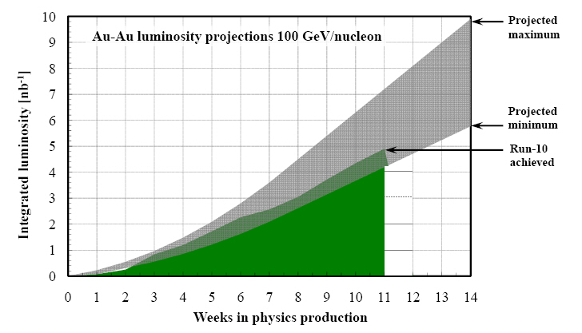
Run-11 Au-Au luminosity projections 100 GeV/nucleon
Goals to be updated/corrected
PHENIX Goal (0.7 recorded)
STAR Goal (TBD)
?? (complicated)
Assume 6 weeks to ramp-up for min, and 8 weeks for max (stoch. cooling re-commissioning). Expect L_{avg} up to 25x10²⁶cm⁻²s⁻¹ (+25%). [from Run-10 to max: β* = 0.75 ➔ 0.65 m, N_{b} = 1.1 ➔ 1.1x10⁹, more cooling]

