Slide 1
Run 11 RHIC Machine/Experiments Meeting
31 May 2011
Agenda:
√s = 200 GeV AuAu progress
Update on 250 GeV integrated Lumi

Slide 2
Run 11 Plan based on PAC recommendation/ALD Guidance and available funds
5/31/10 update
3 Jan, Begin cool-down to 4.5K
8 Jan, Cool-down to 4.5K complete in both rings, preliminary setup begins
24 Jan, 1 week Ramp-up with 8 hr/night beam to experiments
11 Feb (machine and ~experiments), begin ~10 week physics run (√s = 500 GeV pp)
7 Mar, cryo troubles, extended maintenance, 0900 hrs till 2000 hrs 14 Mar – lost 7.5 days
17 Mar, power distribution problem, extended maintenance, 1930 hrs till 0315 hrs 20 Mar – lost 2.3 days
18 Apr, end 9.4 week physics run at √s = 500 GeV
18 Apr jet target polarization measurement at injection (<5%)
19 Apr, short maintenance followed by setup for √s = 18 GeV AuAu
23 Apr, begin ~1 week physics run (√s = 19.6 AuAu)
2 May 08:00, end 1.3 week physics run at √s = 19.6 GeV
2 May, begin setup for √s = 200 AuAu
5 May, begin 2 day Ramp-up with 8 hr/night beam to experiments
6 May 11:37, begin ~8 week physics run at (√s = 200 GeV/n AuAu)
31 May- TODAY
29 June, end 7.7 wk AuAu physics run at √s = 200 GeV/n , begin warm-up
30 June, cryo warm-up ~ complete, end 25.4 weeks cryo operation
What’s missing :
Run into July?
Uranium test/physics run
Low energy test run
~2 days – PREP TIME REQ’D, NEED DECISION SOON!

Slide 3
√S = 200 GeV/n AuAu luminosity goals (24 May efficiencies)
STAR
2000 μb⁻¹ sampled / 60% = 3300 μb⁻¹ delivered
PHENIX
700 μb⁻¹ sampled / 14% = 5000 μb⁻¹ delivered
Estimate from PHENIX Beam Use Proposal – 15.8%
Live Time = 97%
Uptime = 65%
+/- 10 cm vertex = 25%

Slide 4
PHENIX Goal
STAR Goal

Slide 5
Goal
Goal

Slide 6
Goal
Fill 15974

Slide 7
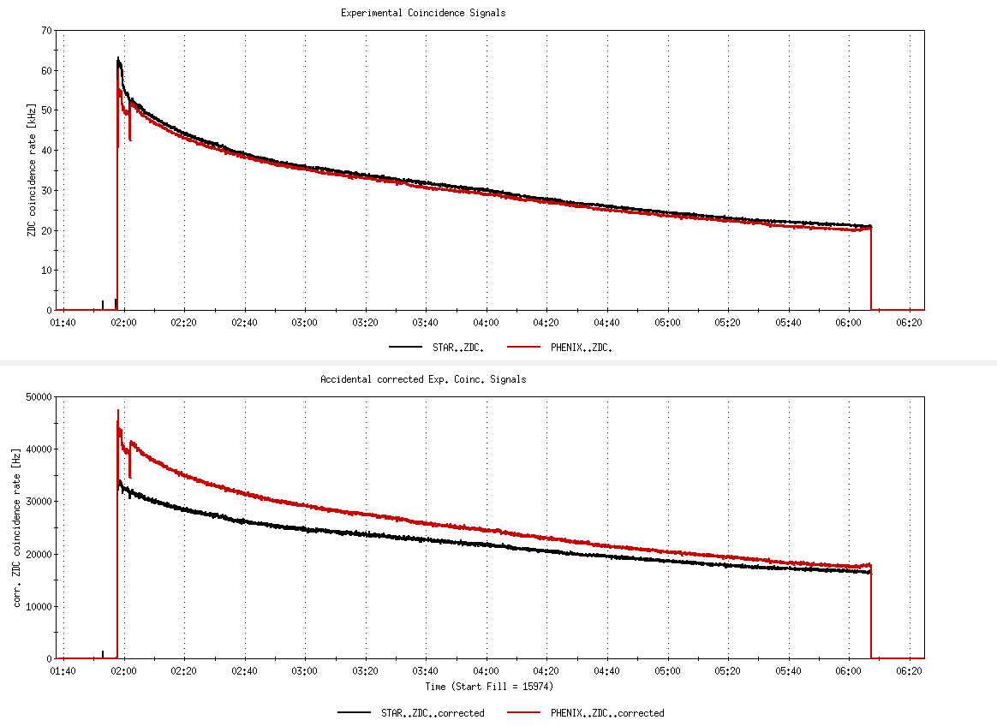
Fill 15974, not singles corrected
26%
Fill 15974, with singles correction
6%

Slide 8
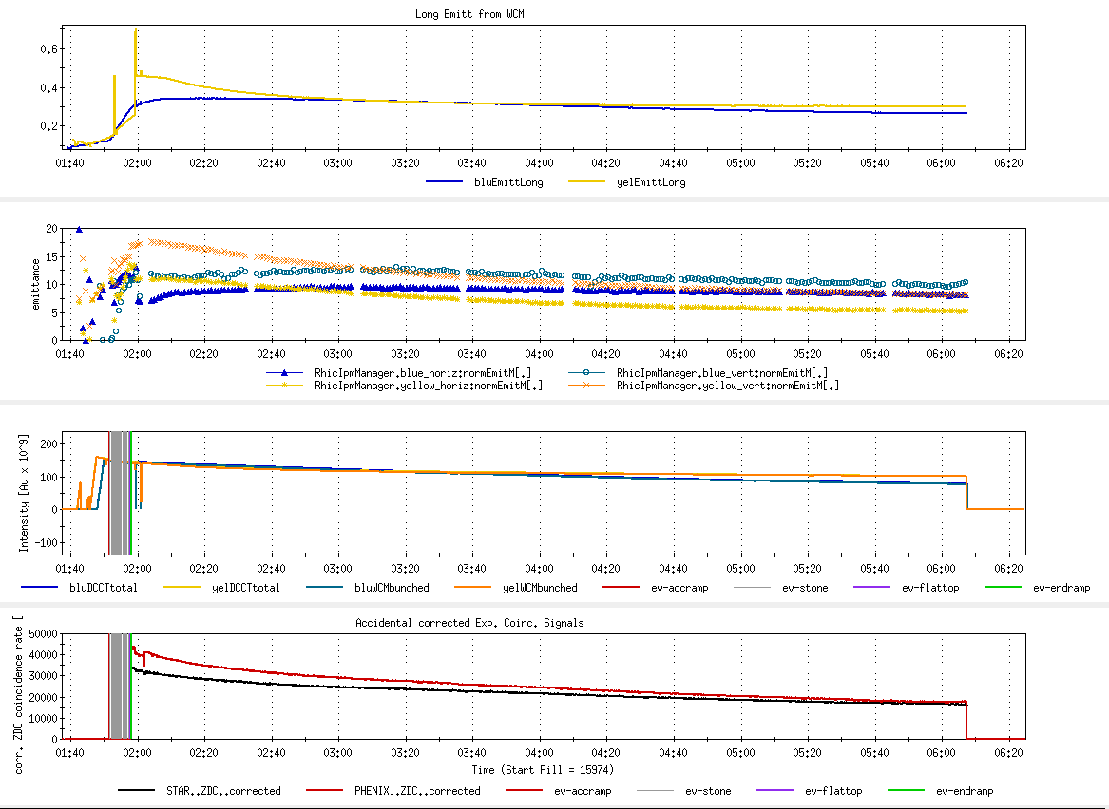
Fill 15974
Long emitt
Goal 17-20
x,y emitt
Goal 122
Blue/yellow ions
Peak Lumi goal 45 x 10²⁶ cm⁻²s⁻¹
Average Lumi goal 25 x 10²⁶ cm⁻²s⁻¹

Slide 9
Singles Corrected (STAR probably not right)
Revised 5/26/2011

Slide 10
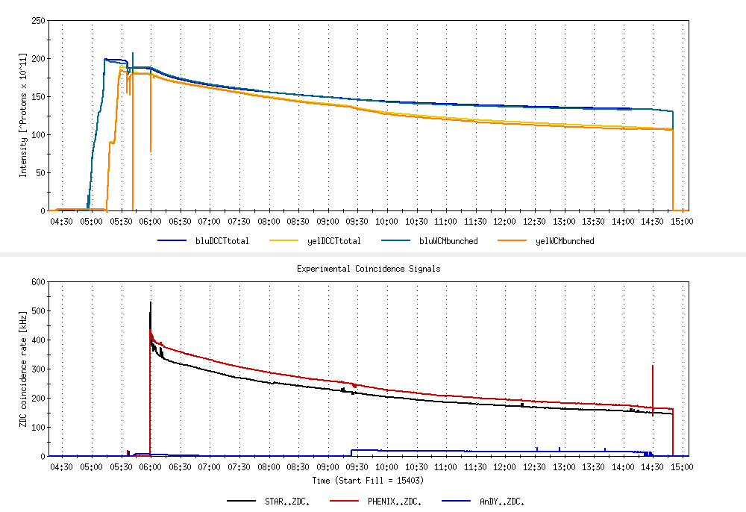
Example store comparing AnDY Lumi to STAR and PHENIX
Not singles corrected

Slide 11
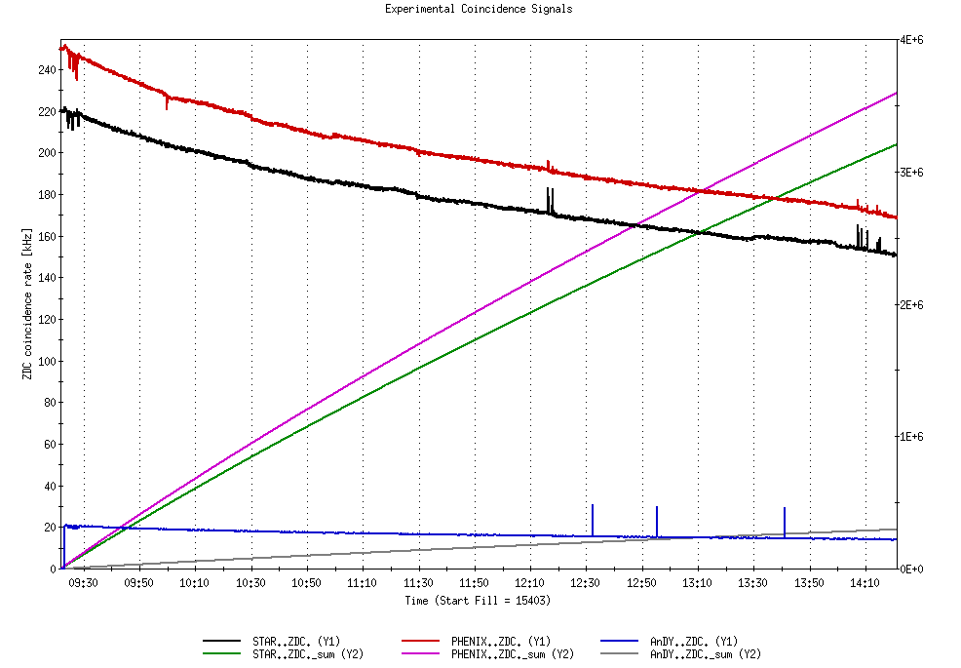
Example store comparing AnDY Lumi to STAR and PHENIX
β*’s
PHENIX ~0.7 m
STAR ~0.8 m
AnDY ~ 3 m
Not singles corrected
Lumi
PHENIX = 3.58E9/2.7mb = 1.32 pb⁻¹
STAR = 3.20E9/2.9 mb = 1.10 pb⁻¹
AnDY = 0.30E9/0.95 mb = 0.32 pb⁻¹
AnDY Lumi ~consistent with larger β* (x4 less Lumi)

Slide 12
i.e. there’s still an issue with singles corrections.

Slide 14
Old information

Slide 15
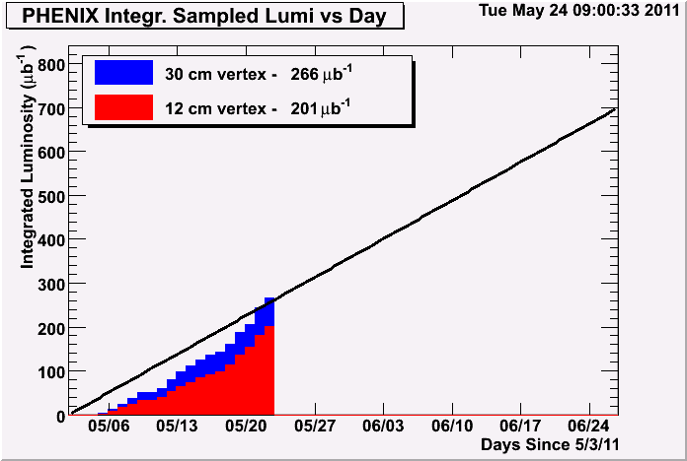
Through fill 15928 delivered 1474 μb⁻¹
201 ub^-1 of 700 ub^-1 accumulated in 12cm vertex
→ Efficiency = 201/1474 = 14%

Slide 16
Through 16 May 2011

Slide 17
Through 16 May 2011

Slide 18
Through 16 May 2011
Possible oil contamination in one of the heat exchangers

Slide 19
Through 16 May 2011

Slide 20
Final Lumi should change as it appears there’s an issue with the singles correction

Slide 22
Run 11 Plan based on PAC recommendation/ALD Guidance and available funds
4/26/10 update (1/2)
3 Jan, Begin cool-down to 4.5K
8 Jan, Cool-down to 4.5K complete in both rings, preliminary setup begins
~11 Jan, 2 ⅟₂ weeks beam setup for √s = 500 GeV pp in RHIC begins.
15 Jan, power supply work/DX training complete
17 Jan, first successful ramp
19 Jan, 1st maint day
24 Jan, 1 week Ramp-up with 8 hr/night beam to experiments
11 Feb (machine and ~experiments), begin ~10 week physics run (√s = 500 GeV pp)
16 Feb, AGS Jump Quads in routine operation for RHIC injection
24 Feb, 9 MHz cavity in routine operation
7 Mar, cryo troubles, extended maintenance, 0900 hrs till 2000 hrs 14 Mar – lost 7.5 days
17 Mar, power distribution problem, extended maintenance, 1930 hrs till 0315 hrs 20 Mar – lost 2.3 days
28 March – 1 April, PAC 2011
15 April Continuing Resolution Ends, guidance to follow
18 Apr, end 9.4 week pp physics run at √s = 500 GeV
18 Apr jet target polarization measurement at injection (<5%)
19 Apr, short maintenance followed by setup for √s = 18 GeV AuAu
23 Apr, begin ~1 week physics run (√s = 19.6 AuAu)
2 May, end 1.3 week physics run at √s = 19.6 GeV

Slide 23
7 April Up-Down Ramp measurement
Blue Beam
Current CNI average analyzing powers are:
Energy AN
24 0.0144
100 0.0122
250 0.0147

Slide 24
7 April Up-Down Ramp measurement
Yellow Beam (only Yellow 1 was
used as Yellow 2 was acting up)
Current CNI average analyzing powers are:
Energy AN
24 0.0144
100 0.0122
250 0.0147

Slide 25
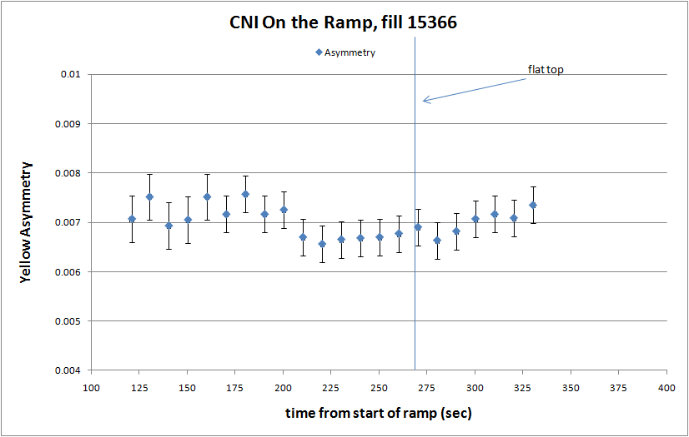

Slide 26
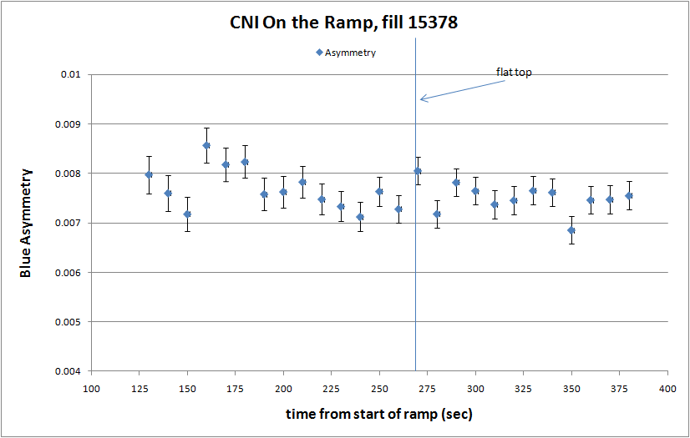

Slide 27
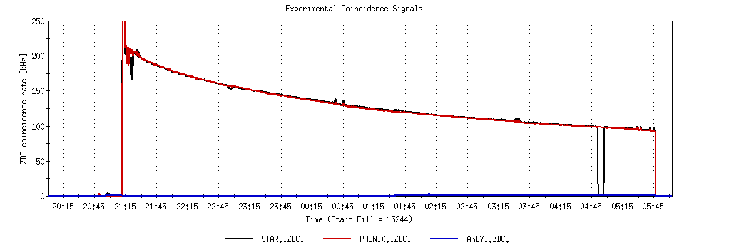
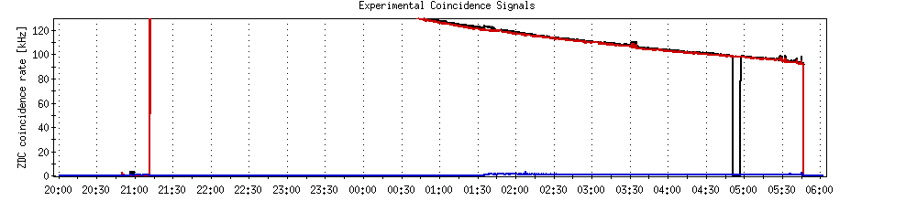
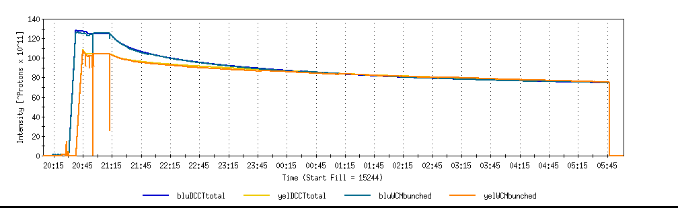
A good store with 9 MHz
Sat 2/26

Slide 28
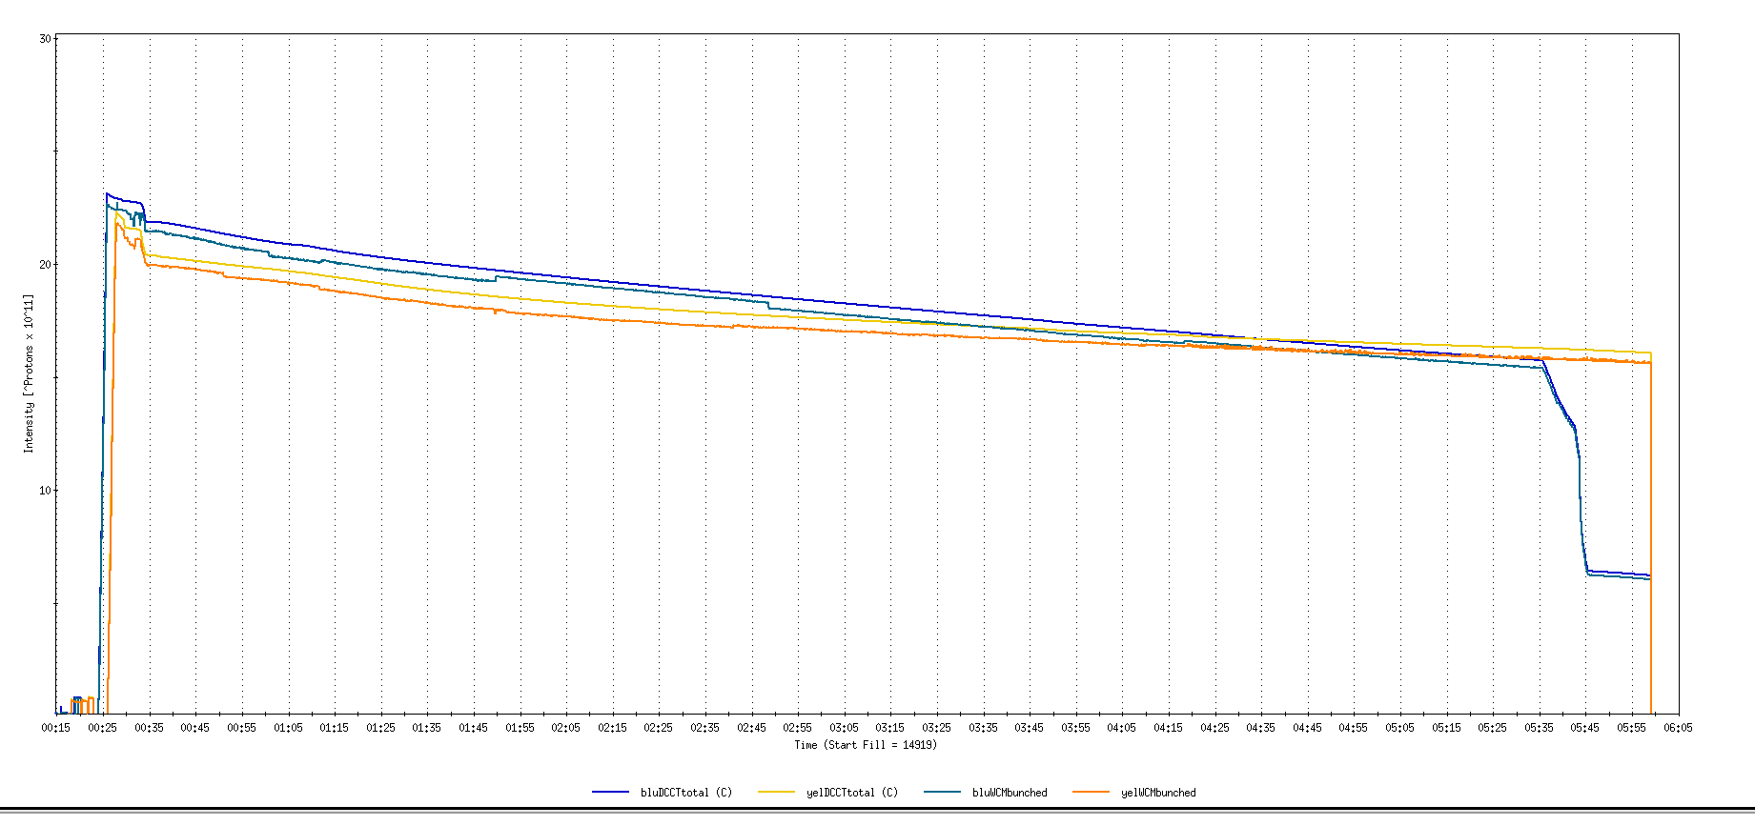
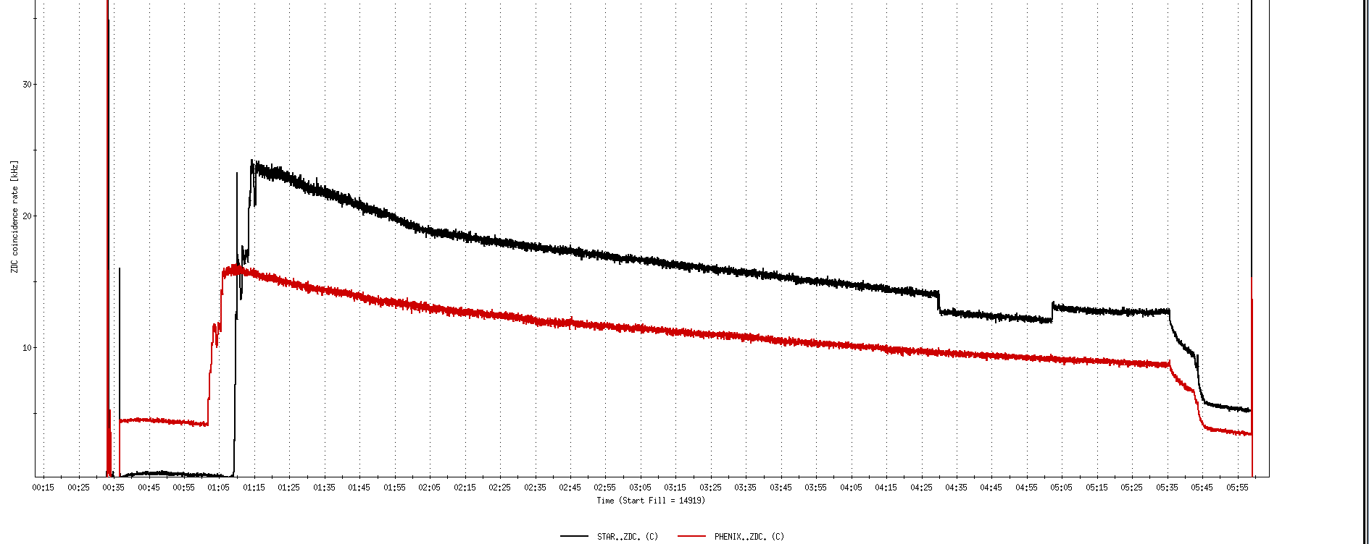
Run 11, First overnight store, Mon Jan 24 00:12
Fill number 14919,, √s=500 GeV
21 days since start of cool-down
28 x 27 bunches
β*=0.65 meters
20 x 10¹¹
For peak store lumi = 170 x 10³⁰ cm⁻²s⁻¹ (projected MAXIMUM)
ZDC Rate ~ 400K (assuming 2.4 mb n-pair xsection)
20K

Slide 29
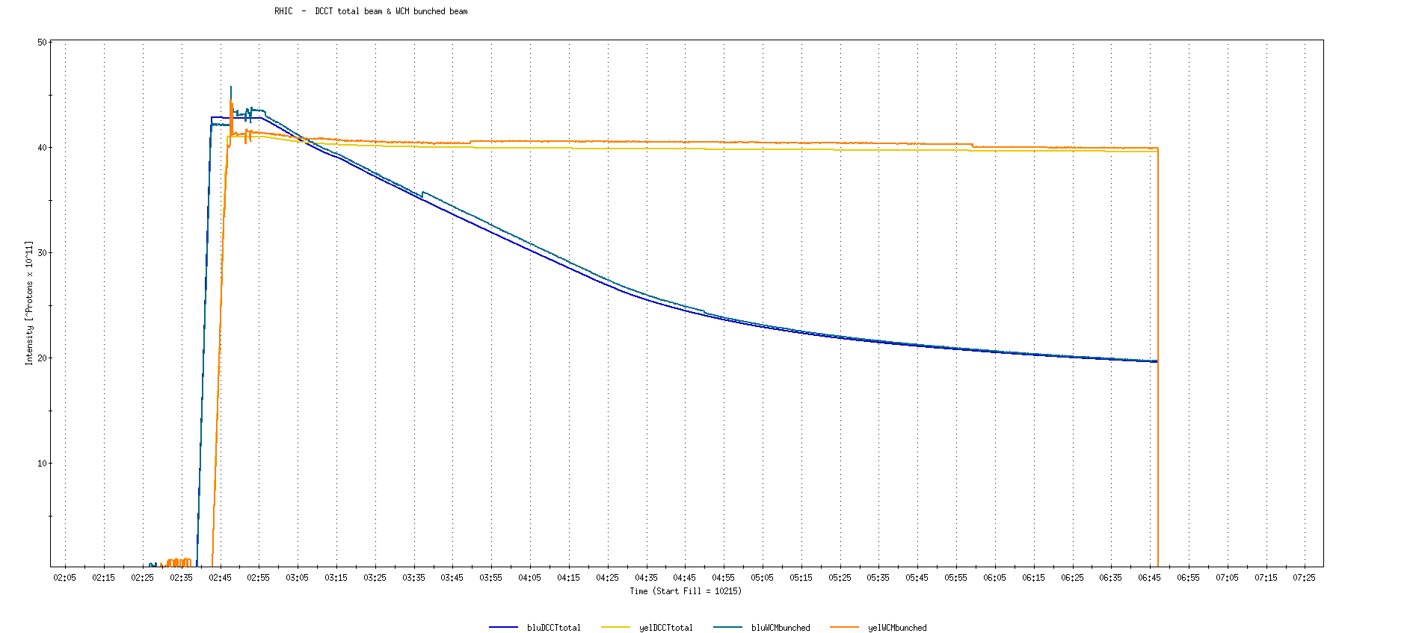
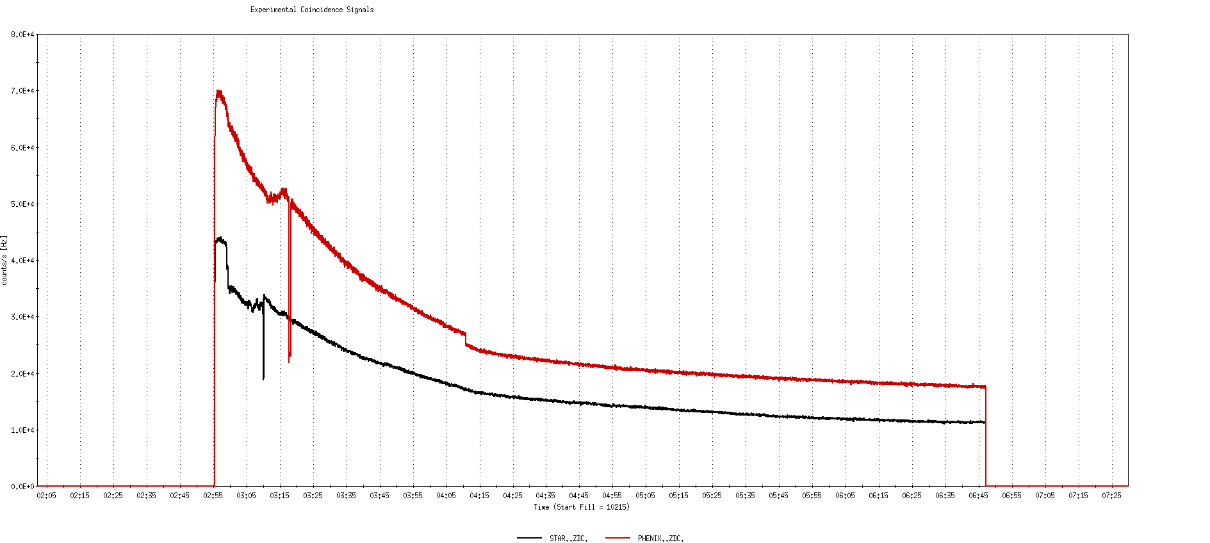
Run 9, First overnight store at √s=500 GeV
22 days after start of cool-down
56 x 56 bunches
β*=0.7 meters
40 x 10¹¹
40K

Slide 30
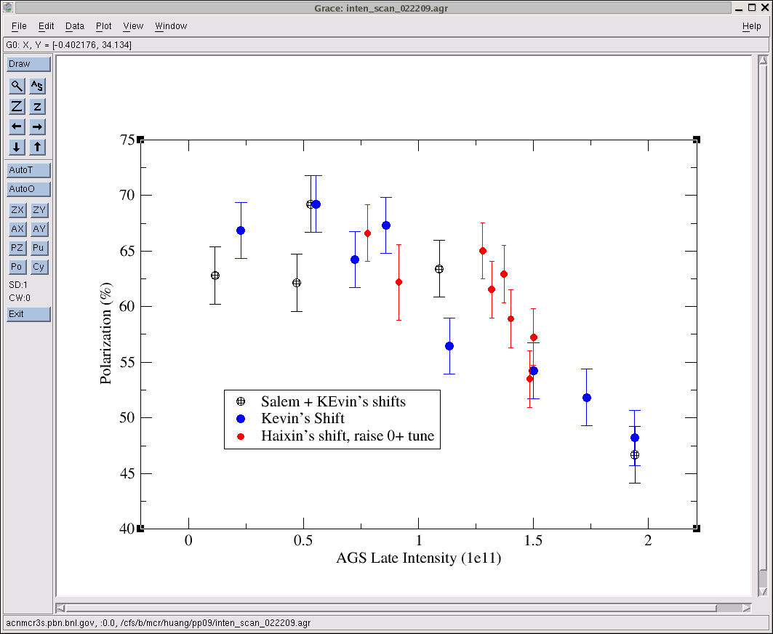
AGS pp log, 23 Feb 09, 00:26

Slide 31
26 weeks

Slide 32
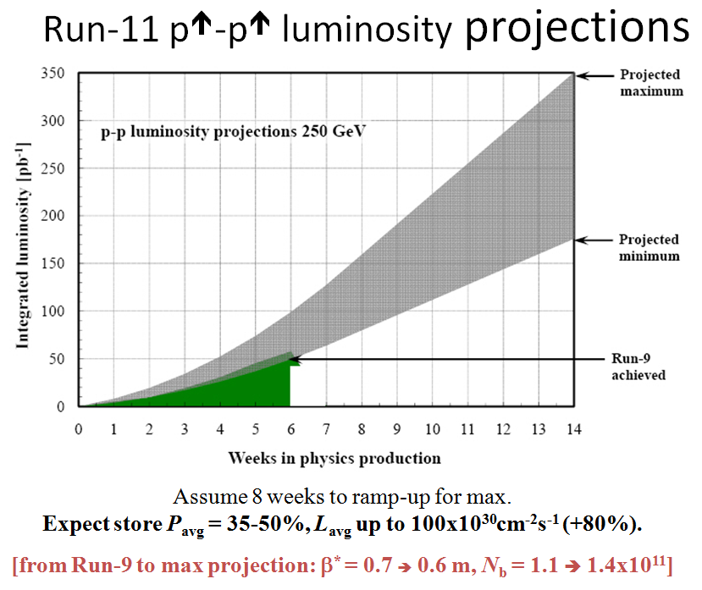
Goals to be updated/corrected
PHENIX Goal (50% pol)
STAR Goal (50% pol)

Slide 33
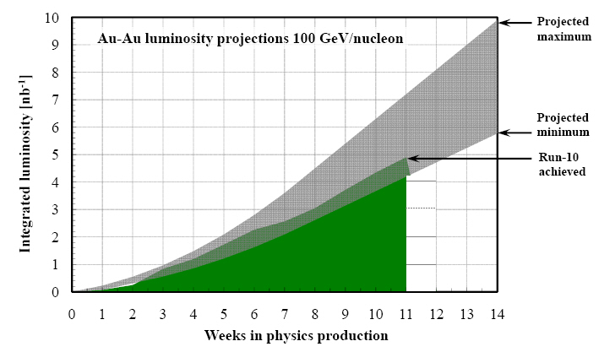
Run-11 Au-Au luminosity projections 100 GeV/nucleon
Goals to be updated/corrected
PHENIX Goal (0.7 recorded)
STAR Goal (TBD)
?? (complicated)
Assume 6 weeks to ramp-up for min, and 8 weeks for max (stoch. cooling re-commissioning).
Expect L_{avg} up to 25x10²⁶cm⁻²s⁻¹ (+25%).
[from Run-10 to max: β* = 0.75 ➔ 0.65 m, N_{b} = 1.1 ➔ 1.1x10⁹, more cooling]

