Slide 1
Run 11 RHIC Machine/Experiments Meeting
5 Apr 2011
Agenda: Open

Slide 2
Run 11 RHIC Machine/Experiments Meeting decisions
Pending Decision (3/15/2011)
11/23/2010, APEX: Agreed to new APEX schedule, 12 hour sessions (0800-2400) every other week away from maintenance days.
2/25/2011, CNI Polarimeters Normalization: Beginning with physics store 15239, changed CNI Polarimeter analyzing power to agree with jet target polarization measurements …18% lower polarization than before.
If CR budget not favorably resolved, should we switch to 18 GeV AuAu or continue with 500 GeV pp?
  STAR proposal – switch to 18 GeV AuAu on 28 March
  PHENIX Proposal – continue with 500 GeV pp till ~ 14 April

Slide 3
Decisions (cont’)
3/25/2011: AnDY Collisions (W. Fischer, L. Bland, E. Aschenauer,
S. Vigdor):
  (1) A. Drees will test the sequence developed to address both orbit and tune effects of AnDY at the end of a store (or multiple stores if needed).
  (2) When the proper functioning of the sequence is demonstrated we will go back to a 1.05e11/bunch threshold, and increase every store by another 0.05e11/bunch until we reach a 10-20% luminosity impact on STAR and PHENIX. In the event the prescribed bunch intensity is not reached during the store then AnDY should be steered into collision during the last 30 minutes of the store.
  (3) When the tune scan on the ramp finishes (~2 more tune to test), we will increase the store length to 10h or more, (with PHENIX/STAR concurrence), with this AnDY will have more time available after turning on.

Slide 4
Run 11 Plan based on PAC recommendation/ALD Guidance and 28.3 weeks cryo operation
3/22/10 update
3 Jan, Begin cool-down to 4.5K
8 Jan, Cool-down to 4.5K complete in both rings, preliminary setup begins
~11 Jan, 2 ⅟₂ weeks beam setup for √s = 500 GeV pp in RHIC begins.
15 Jan, power supply work/DX training complete
17 Jan, first successful ramp
19 Jan, 1st maint day
27 24 Jan, 1 week Ramp-up with 8 hr/night beam to experiments
3 11 Feb (machine and ~experiments), begin 10(?) week physics run (√s = 500 GeV pp)
16 Feb, AGS Jump Quads in routine operation for RHIC injection
24 Feb, 9 MHz cavity in routine operation
7 Mar, cryo troubles, extended maintenance, 0900 hrs till 2000 hrs 14 Mar – lost 7.5 days
17 Mar, power distribution problem, extended maintenance, 1930 hrs till 0315 hrs 20 Mar – lost 2.3 days
28 March – 1 April, PAC 2011
4 18 March – 8 April Continuing Resolution Ends
14 Apr(?), end less than 10 week physics run at √s = 500 GeV pp run
14 Apr, begin 1 week setup for √s = 200 AuAu
21 Apr, begin 1 week Ramp-up with 8 hr/night beam to experiments
28 Apr, begin 8 week physics run at (√s = 200 AuAu)
23 Jun, end 8 week √s = 200 AuAu run
23 Jun, begin setup for √s = 192 GeV UU
30 Jun, begin 1⅟₂ week physics run (√s = 192 UU)
4 July – completed 26 weeks of cryo operation, may be out of $$’s
10 Jul, end 1⅟₂ week physics run at √s = 192 GeV
10 Jul, begin setup for √s = 18 GeV AuAu
11 Jul, begin 1 week physics run (√s = 18 AuAu)
18 Jul, end 1 week physics run at √s = 18 GeV
20 Jul, warm-up complete (28.3 weeks)
Possible additions:
Low energy test run

Slide 5
10 Weeks (physics + downtime)

Slide 7
Online CNI (Ingrassia)
CNI average at store

Slide 8
Blue average = 46.6 +/- 0.8%
Yellow Average = 46.4 +/- 0.8%

Slide 9
Fills 15166 through 15338

Slide 10
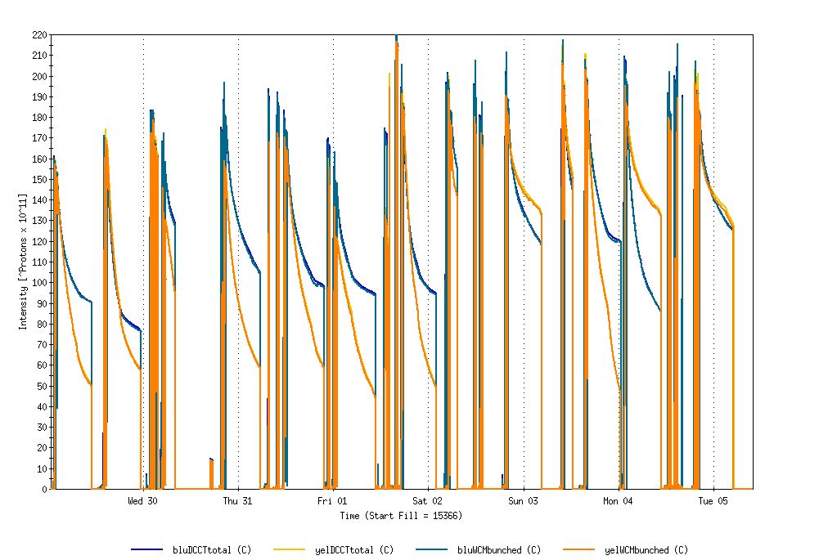
Physics Stores 15366 through 15397
Run 11 Projected maximum
Achieved Run 9

Slide 11
Physics Stores 15366 through 15397
Run 11 Projected maximum

Slide 12
Physics Stores 15366 through 15397
L_{max} = 170 x 10³⁰ cm⁻²s⁻¹ (projection with 2.7 mb xsection)
L_{max} achieved Run 9, 85 x 10³⁰ cm⁻²s⁻¹

Slide 13
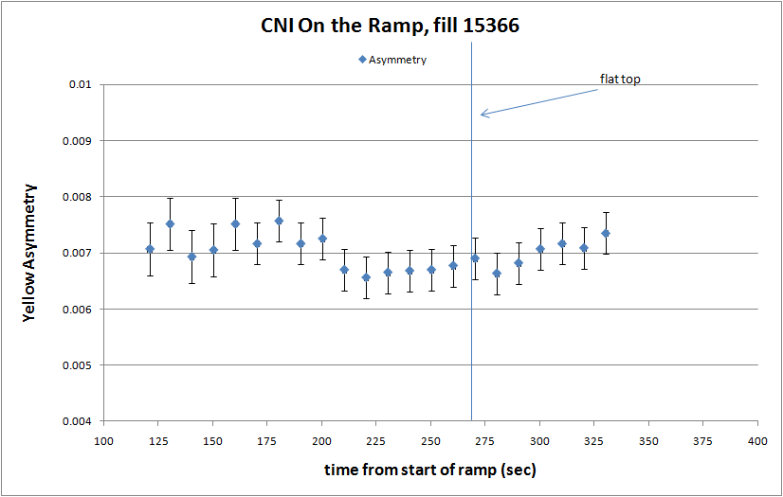

Slide 14
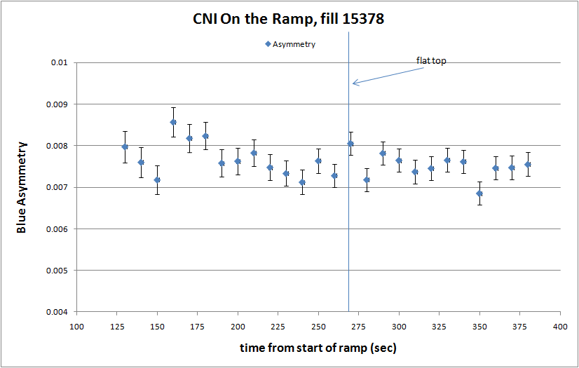

Slide 15
CNI Polarization asymmetry measurements on the ramp analysis
Assume the jet target measurements are correct, then:
Polarization at 100 GeV ~ 60%
Polarization at 250 GeV ~ 50%
Then:
Calculate effective analyzing power for the first 100 and first 250 GeV asymmetry points to force 60%/50% polarization at 100 GeV/250 GeV
Get:
100 GeV analyzing power = 0.0118
250 GeV analyzing power = 0.0138
Assume:
Analyzing power varies linearly from 100 GeV to 250 GeV
Then:
Calculate polarization for each point (Asymmetry/Analyzing Power)

Slide 16
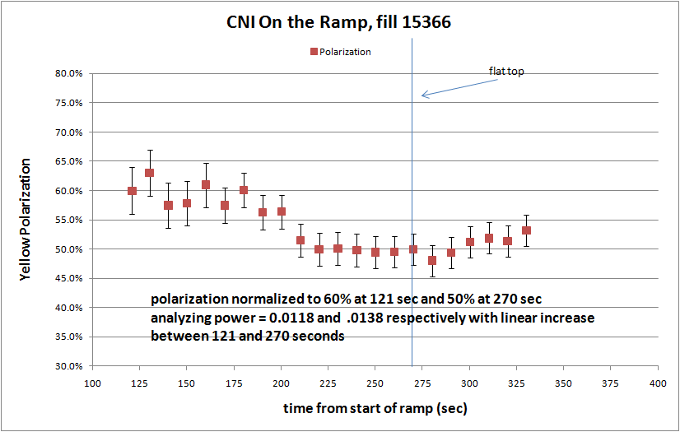
Yellow
100 GeV

Slide 17
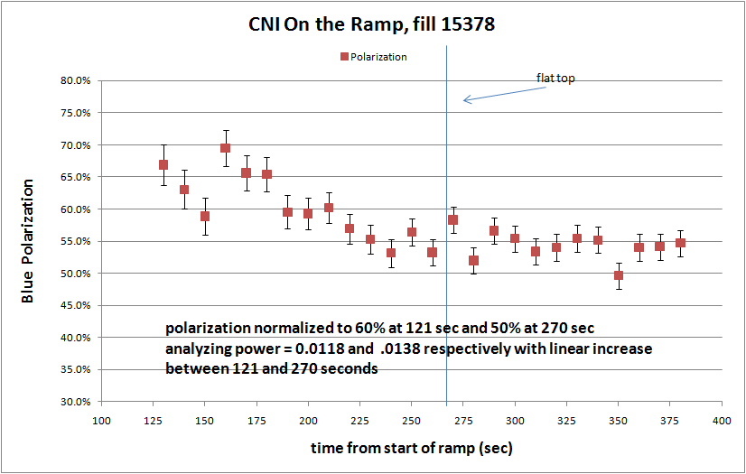
Blue
100 GeV

Slide 18
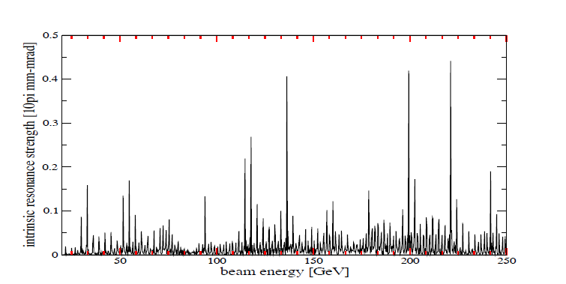
CNI Polarization asymmetry measurements on the ramp analysis
Possible Conclusion
Likely a localized polarization drop on the ramp for both Blue and Yellow around 200 MeV
Intrinsic spin resonances, PAC 09 paper, M. Bai et.al.

Slide 19
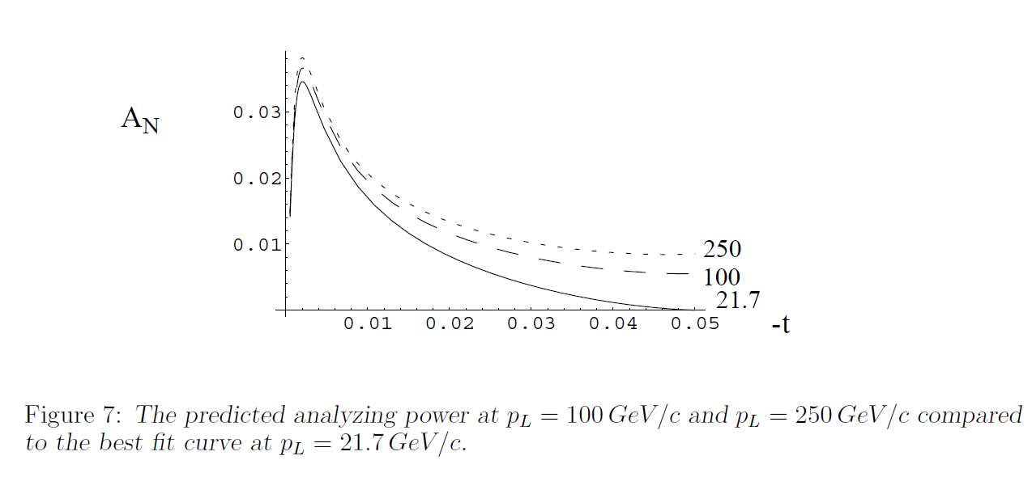
RHIC Spin Note Jan 2002
L. Trueman

Slide 20
Through 31 Mar 2011
baseline

Slide 21
Through 31 Mar 2011

Slide 22
Through 31 Mar 2011

Slide 23
Old information

Slide 25
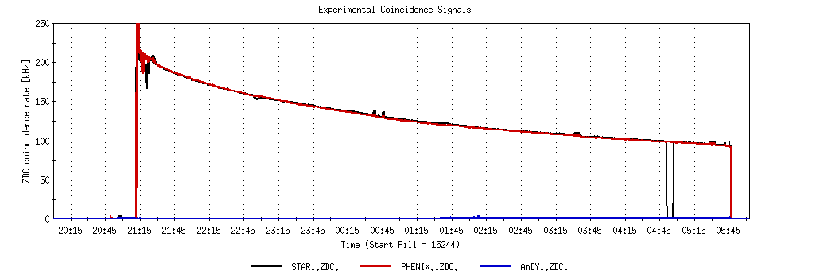
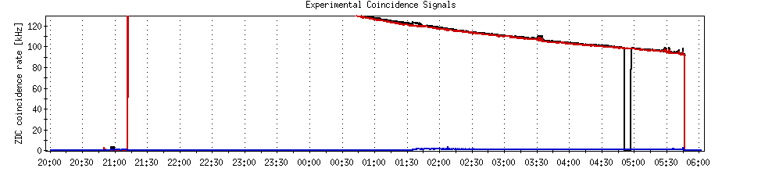
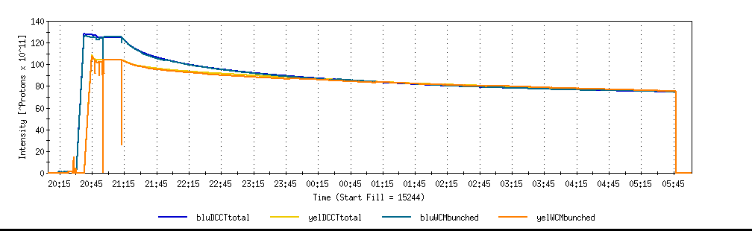
A good store with 9 MHz
Sat 2/26

Slide 26
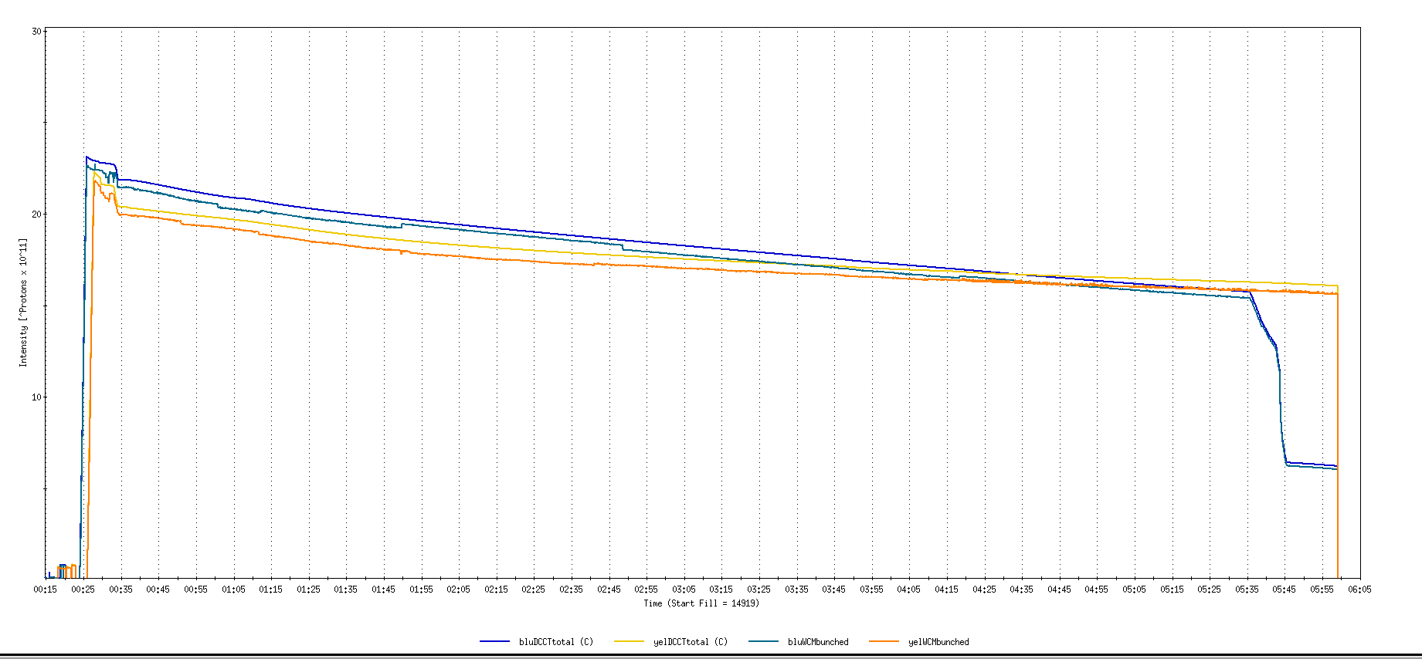
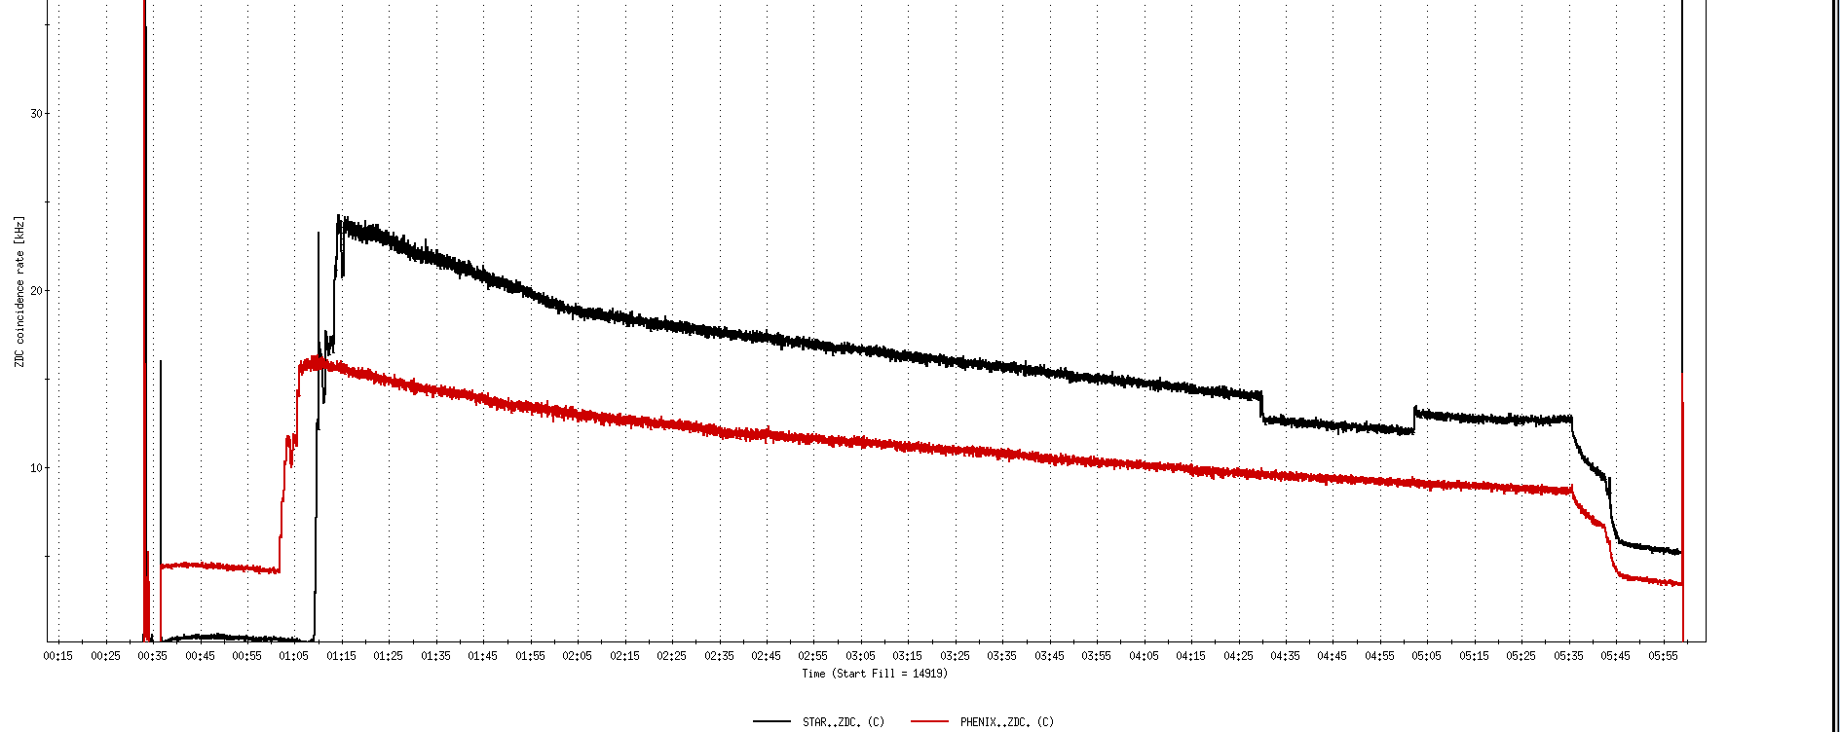
Run 11, First overnight store, Mon Jan 24 00:12
Fill number 14919,, √s=500 GeV
21 days since start of cool-down
28 x 27 bunches
β*=0.65 meters
20 x 10¹¹
For peak store lumi = 170 x 10³⁰ cm⁻²s⁻¹ (projected MAXIMUM)
ZDC Rate ~ 400K (assuming 2.4 mb n-pair xsection)
20K

Slide 27
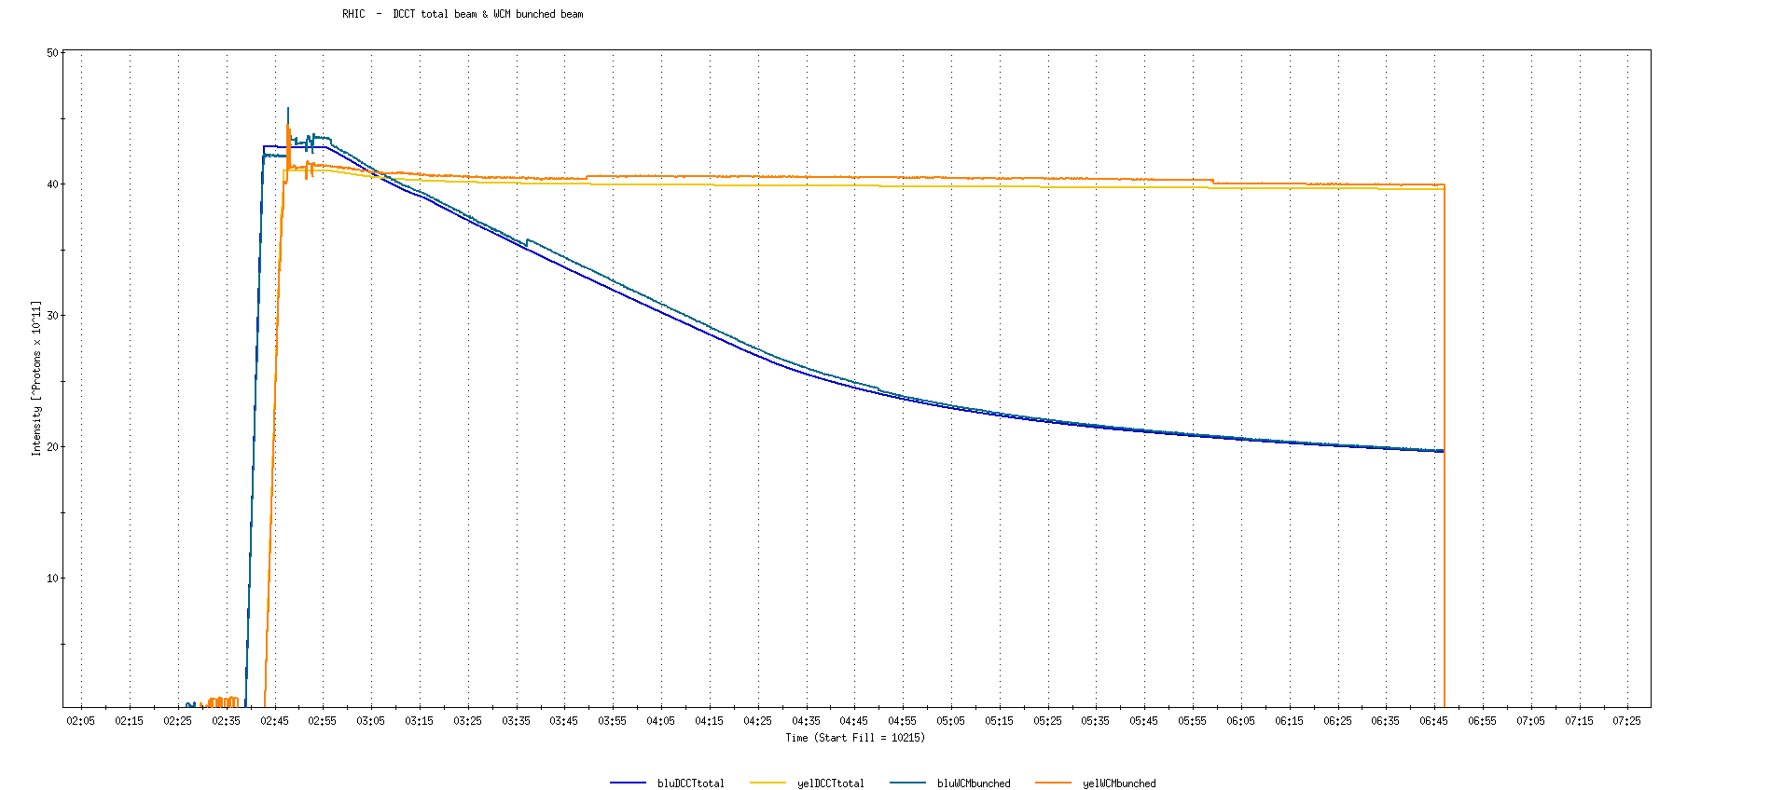
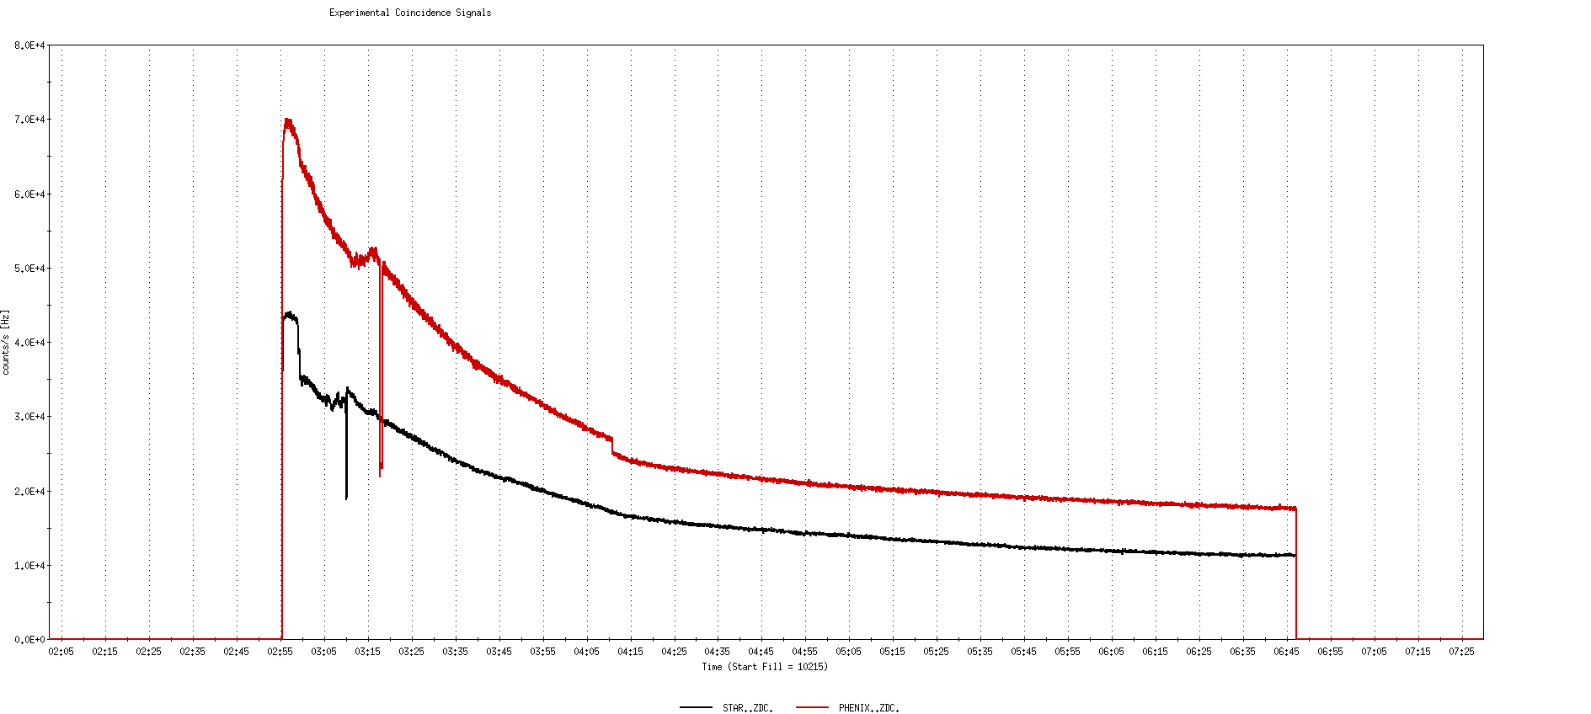
Run 9, First overnight store at √s=500 GeV
22 days after start of cool-down
56 x 56 bunches
β*=0.7 meters
40 x 10¹¹
40K

Slide 28
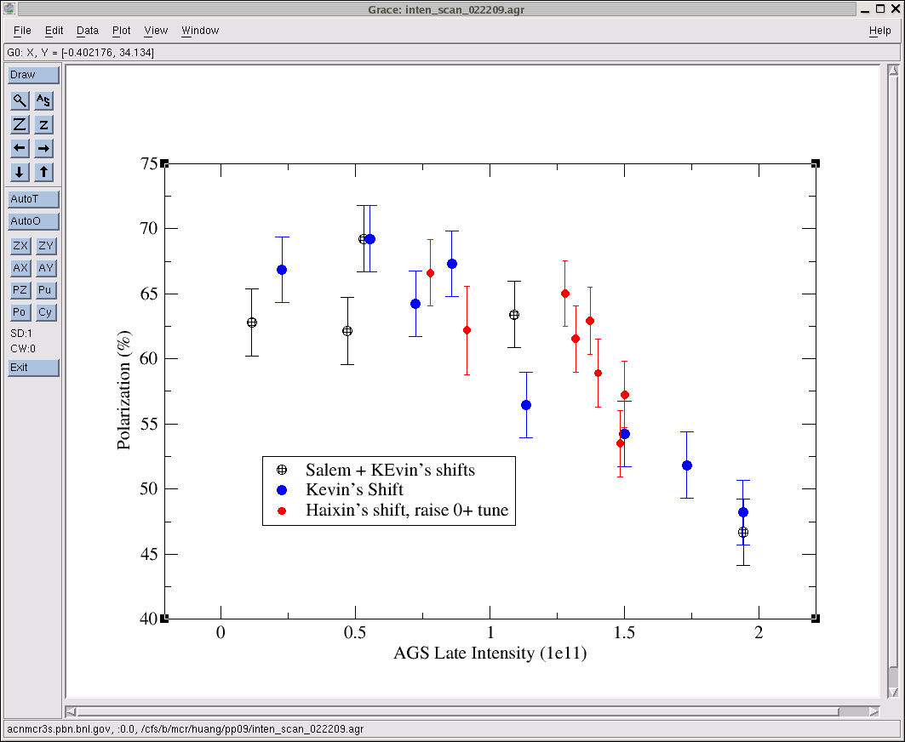
AGS pp log, 23 Feb 09, 00:26

Slide 29
26 weeks

Slide 30
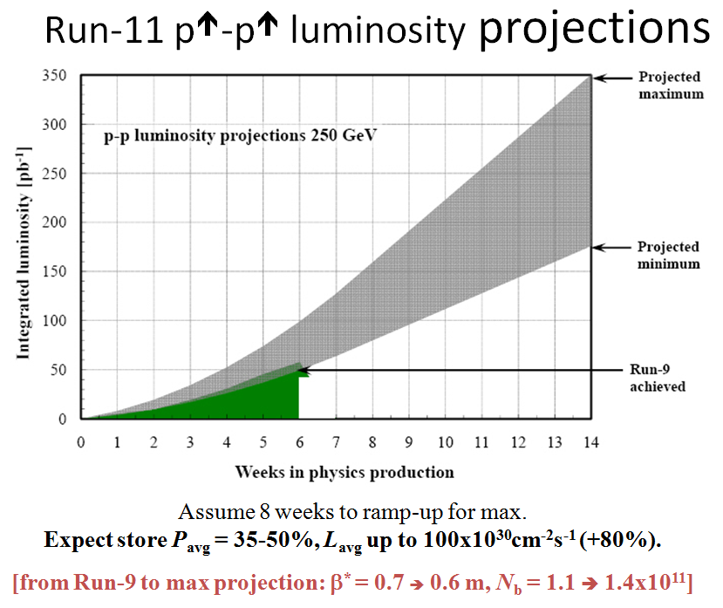
Goals to be updated/corrected
PHENIX Goal (50% pol)
STAR Goal (50% pol)

Slide 31
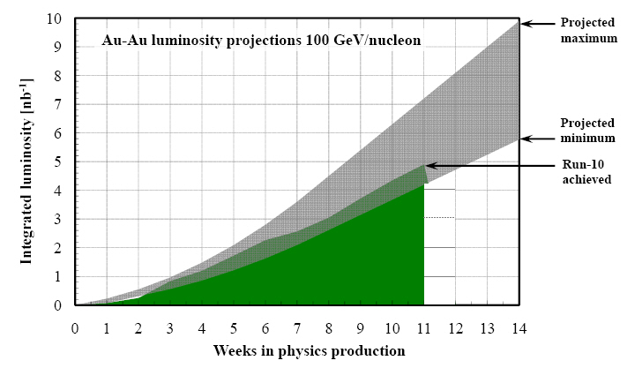
Run-11 Au-Au luminosity projections 100 GeV/nucleon
Goals to be updated/corrected
PHENIX Goal (0.7 recorded)
STAR Goal (TBD)
?? (complicated)
Assume 6 weeks to ramp-up for min, and 8 weeks for max (stoch. cooling re-commissioning).
Expect L_{avg} up to 25x10²⁶cm⁻²s⁻¹ (+25%).
[from Run-10 to max: β* = 0.75 ➔ 0.65 m, N_{b} = 1.1 ➔ 1.1x10⁹, more cooling]

