Slide 1
Run 11 RHIC Machine/Experiments Meeting
7 Jun 2011
Agenda:
√s = 200 GeV AuAu progress
27 GeV Run (or other)

Slide 2
Run 11 Plan based on PAC recommendation/ALD Guidance and available funds
6/7/10 update
3 Jan, Begin cool-down to 4.5K
8 Jan, Cool-down to 4.5K complete in both rings, preliminary setup begins
24 Jan, 1 week Ramp-up with 8 hr/night beam to experiments
11 Feb (machine and ~experiments), begin ~10 week physics run (√s = 500 GeV pp)
7 Mar, cryo troubles, extended maintenance, 0900 hrs till 2000 hrs 14 Mar – lost 7.5 days
17 Mar, power distribution problem, extended maintenance, 1930 hrs till 0315 hrs 20 Mar – lost 2.3 days
18 Apr, end 9.4 week physics run at √s = 500 GeV
18 Apr jet target polarization measurement at injection (<5%)
19 Apr, short maintenance followed by setup for √s = 18 GeV AuAu
23 Apr, begin ~1 week physics run (√s = 19.6 AuAu)
2 May 08:00, end 1.3 week physics run at √s = 19.6 GeV
2 May, begin setup for √s = 200 AuAu
5 May, begin 2 day Ramp-up with 8 hr/night beam to experiments
6 May 11:37, begin ~8 week physics run at (√s = 200 GeV/n AuAu)
7 Jun- TODAY
29 June, end 7.7 wk AuAu physics run at √s = 200 GeV/n , begin warm-up
30 June, cryo warm-up ~ complete, end 25.4 weeks cryo operation
What’s missing :
Run into July?
27 GeV AuAu; Uranium test/physics run
Low energy test run
PREP TIME REQ’D, NEED DECISION SOON!

Slide 3
PHENIX Goal
STAR Goal

Slide 4
Goal

Slide 5
Singles Corrected (draft – another correction likely)
AnDY Revised 6/3/2011

Slide 7
Old information

Slide 8
√S = 200 GeV/n AuAu luminosity goals (24 May efficiencies)
STAR
2000 μb⁻¹ sampled / 60% = 3300 μb⁻¹ delivered
PHENIX
700 μb⁻¹ sampled / 14% = 5000 μb⁻¹ delivered
Estimate from PHENIX Beam Use Proposal – 15.8%
Live Time = 97%
Uptime = 65%
+/- 10 cm vertex = 25%

Slide 9
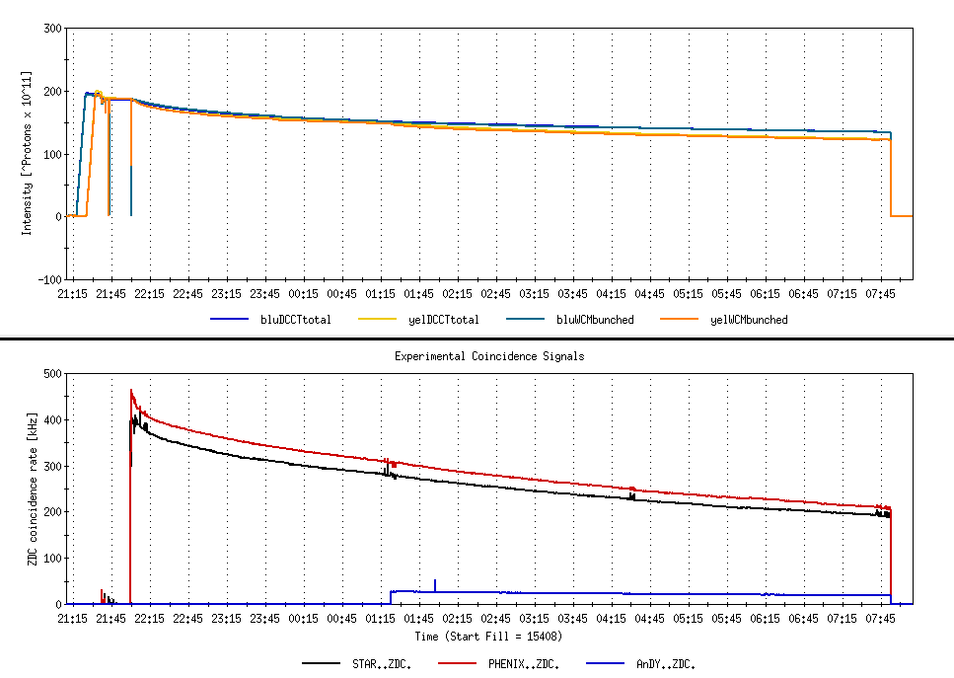
9.7 hour store comparing AnDY Lumi to STAR and PHENIX
Not singles corrected

Slide 10
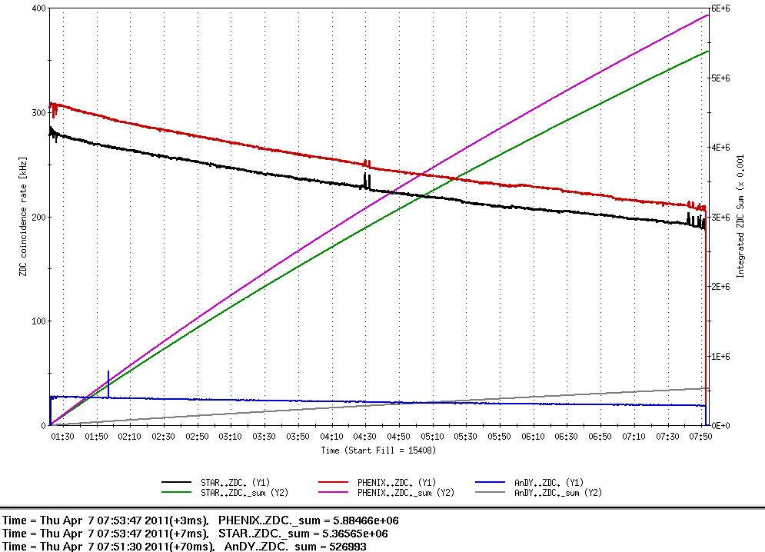
9.7 hour store comparing AnDY Lumi to STAR and PHENIX
β*’s
PHENIX ~0.7 m
STAR ~0.8 m
AnDY ~ 3 m
Not singles corrected
Lumi
PHENIX = 5.88E9/2.7mb = 2.18 pb⁻¹
STAR = 5.36E9/2.9 mb = 1.84 pb⁻¹
AnDY = 0.52E9/0.95 mb = 0.55 pb⁻¹
AnDY Lumi ~consistent with larger β* (x4 less Lumi)
PHENIX Lumi (singles corrected) for entire store = 3.09 pb⁻¹

Slide 11
Store 15408 – AnDY projection
2:00 β* = 3 meters
  AnDY fraction of store 15408 = 0.55/3.09 = 18%
With 2:00 β* = 1.5 meters
  AnDY fraction of store 15408 would have been 2x18%=36%
  using Fischer et.al. 11 May 2010 Table 7 lumi projections for Run12
  Physics Weeks Max Lumi Min Lumi AnDY Est (1.5 m β*)
  8 276 pb⁻¹ 98 pb⁻¹ 35-99 pb⁻¹
  10 388 pb⁻¹ 134 pb⁻¹ 48-140 pb⁻¹
  12 500 pb⁻¹ 170 pb⁻¹ 61-180 pb⁻¹
→ 100 pb⁻¹ is not an unreasonable expectation for a 10-12 week run

Slide 16
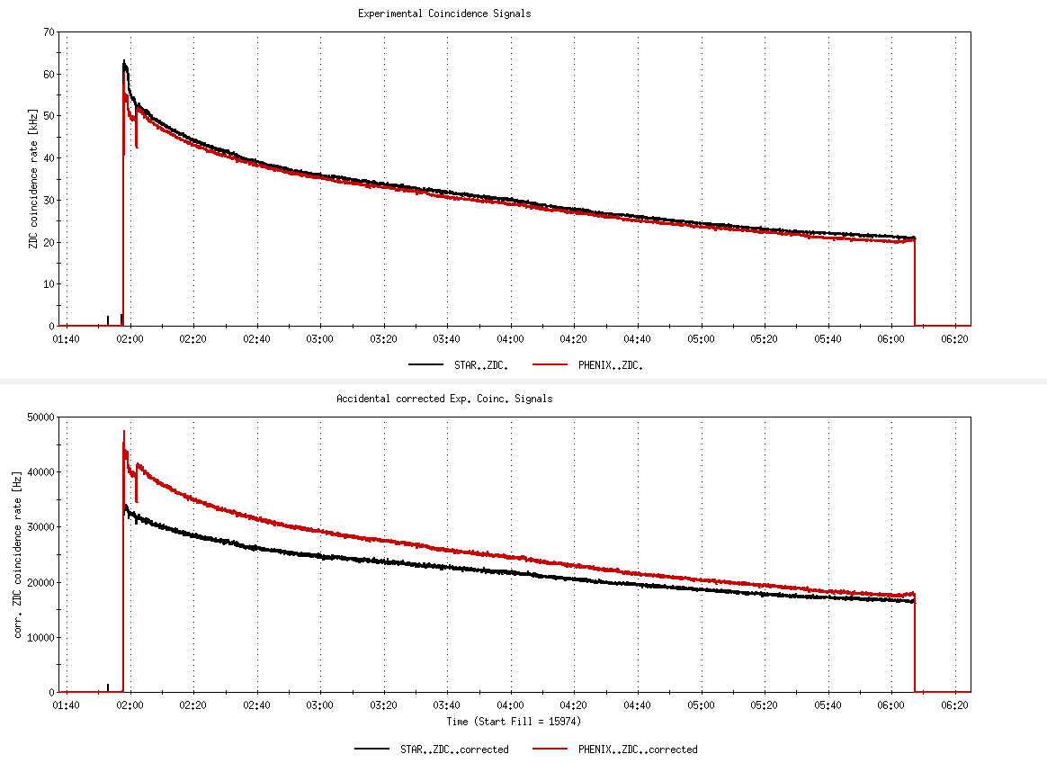
Fill 15974, not singles corrected
26%
Fill 15974, with singles correction
6%

Slide 17
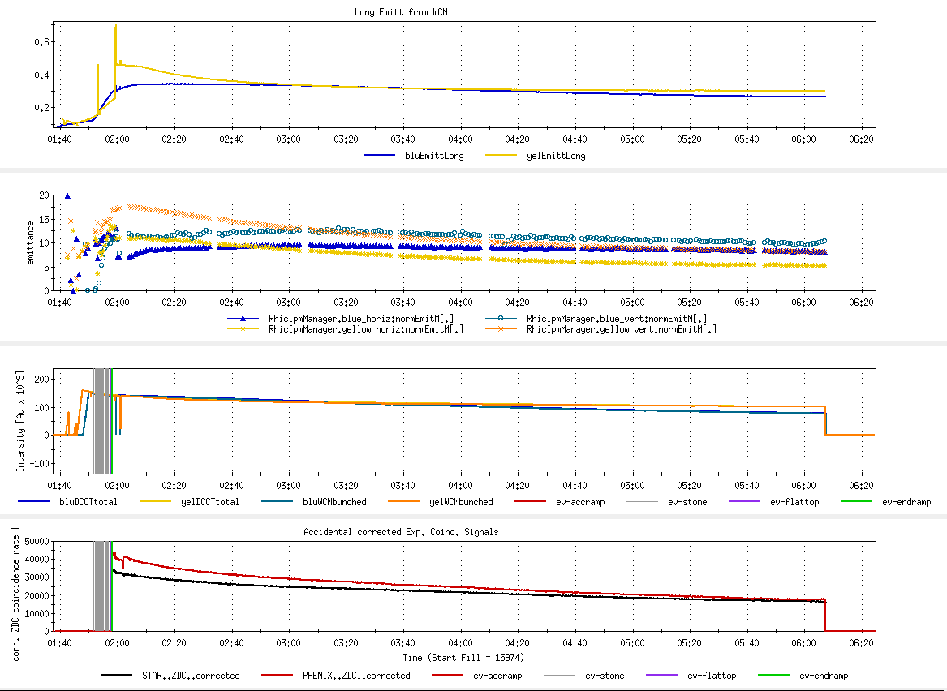
Fill 15974
Long emitt
Goal 17-20
x,y emitt
Goal 122
Blue/yellow ions
Peak Lumi goal 45 x 10²⁶ cm⁻²s⁻¹
Average Lumi goal 25 x 10²⁶ cm⁻²s⁻¹

Slide 18
Store 15408 – AnDY projection
2:00 β* = 3 meters
  AnDY fraction of store 15408 = 0.55/3.09 = 18%
With 2:00 β* = 1.5 meters
  AnDY fraction of store 15408 woulh have been 2x18%=36%
  using Fischer et.al. 11 May 2010 Table 7 lumi projections for Run12
  Physics Weeks Max Lumi Min Lumi AnDY Est (1.5 m β*)
  8 276 pb⁻¹ 98 pb⁻¹ 35-99 pb⁻¹
  10 388 pb⁻¹ 134 pb⁻¹ 48-140 pb⁻¹
  12 500 pb⁻¹ 170 pb⁻¹ 61-180 pb⁻¹
→ 100 pb⁻¹ is not an unreasonable expectation for a 10-12 week run

Slide 19
i.e. there’s still an issue with singles corrections.

Slide 21
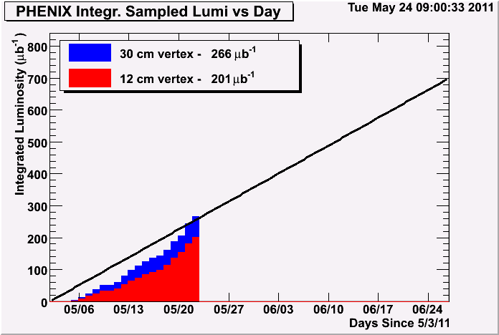
Through fill 15928 delivered 1474 μb⁻¹
201 ub^-1 of 700 ub^-1 accumulated in 12cm vertex
→ Efficiency = 201/1474 = 14%

Slide 22
Through 16 May 2011

Slide 23
Through 16 May 2011

Slide 24
Through 16 May 2011
Possible oil contamination in one of the heat exchangers

Slide 25
Through 16 May 2011

Slide 26
Final Lumi should change as it appears there’s an issue with the singles correction

Slide 28
Run 11 Plan based on PAC recommendation/ALD Guidance and available funds
4/26/10 update (1/2)
3 Jan, Begin cool-down to 4.5K
8 Jan, Cool-down to 4.5K complete in both rings, preliminary setup begins
~11 Jan, 2 ⅟₂ weeks beam setup for √s = 500 GeV pp in RHIC begins.
15 Jan, power supply work/DX training complete
17 Jan, first successful ramp
19 Jan, 1st maint day
24 Jan, 1 week Ramp-up with 8 hr/night beam to experiments
11 Feb (machine and ~experiments), begin ~10 week physics run (√s = 500 GeV pp)
16 Feb, AGS Jump Quads in routine operation for RHIC injection
24 Feb, 9 MHz cavity in routine operation
7 Mar, cryo troubles, extended maintenance, 0900 hrs till 2000 hrs 14 Mar – lost 7.5 days
17 Mar, power distribution problem, extended maintenance, 1930 hrs till 0315 hrs 20 Mar – lost 2.3 days
28 March – 1 April, PAC 2011
15 April Continuing Resolution Ends, guidance to follow
18 Apr, end 9.4 week pp physics run at √s = 500 GeV
18 Apr jet target polarization measurement at injection (<5%)
19 Apr, short maintenance followed by setup for √s = 18 GeV AuAu
23 Apr, begin ~1 week physics run (√s = 19.6 AuAu)
2 May, end 1.3 week physics run at √s = 19.6 GeV

Slide 29
7 April Up-Down Ramp measurement
Blue Beam
Current CNI average analyzing powers are:
Energy AN
24 0.0144
100 0.0122
250 0.0147

Slide 30
7 April Up-Down Ramp measurement
Yellow Beam (only Yellow 1 was
used as Yellow 2 was acting up)
Current CNI average analyzing powers are:
Energy AN
24 0.0144
100 0.0122
250 0.0147

Slide 31
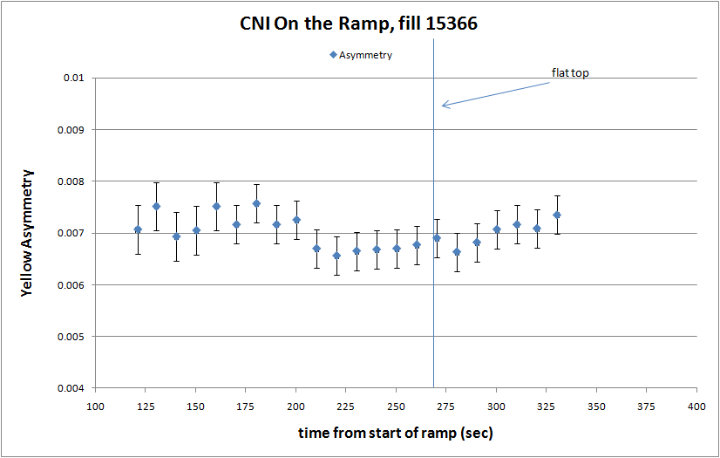

Slide 32
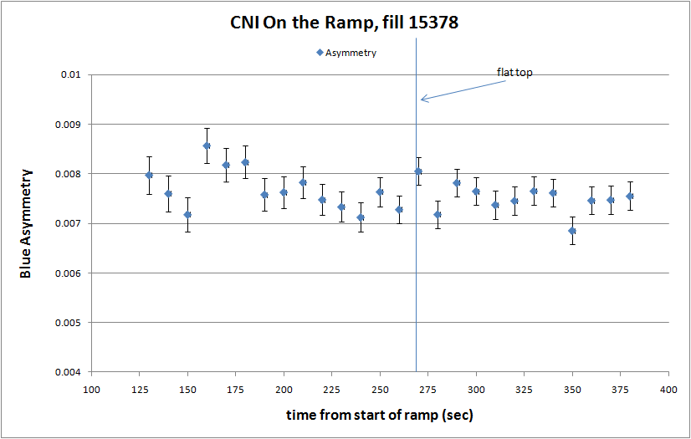

Slide 33
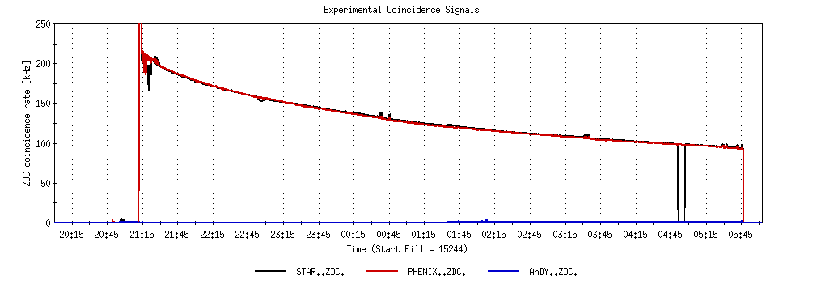
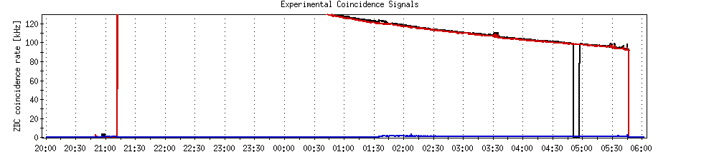
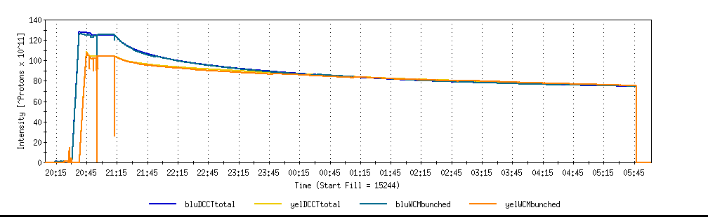
A good store with 9 MHz
Sat 2/26

Slide 34
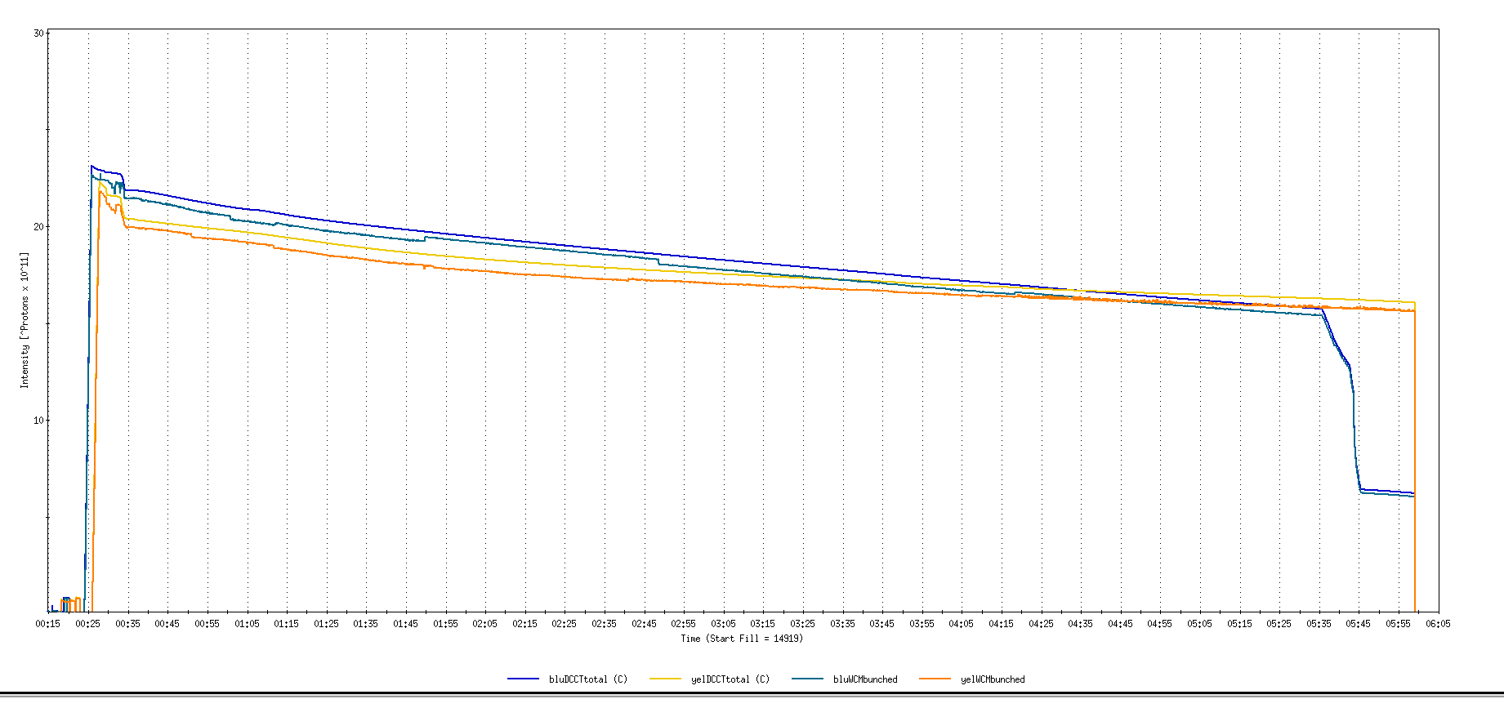
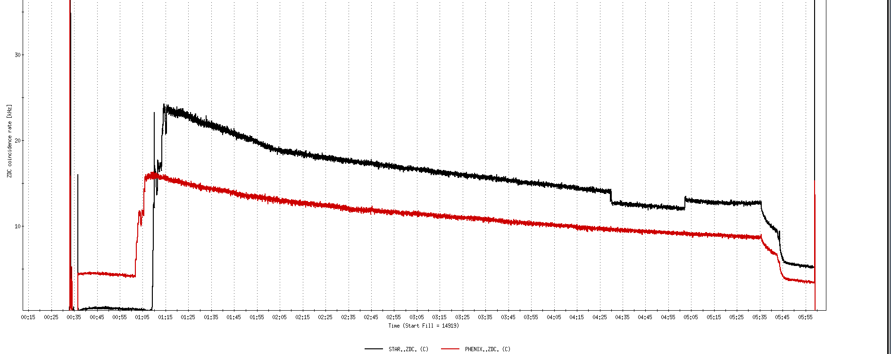
Run 11, First overnight store, Mon Jan 24 00:12
Fill number 14919,, √s=500 GeV
21 days since start of cool-down
28 x 27 bunches
β*=0.65 meters
20 x 10¹¹
For peak store lumi = 170 x 10³⁰ cm⁻²s⁻¹ (projected MAXIMUM)
ZDC Rate ~ 400K (assuming 2.4 mb n-pair xsection)
20K

Slide 35
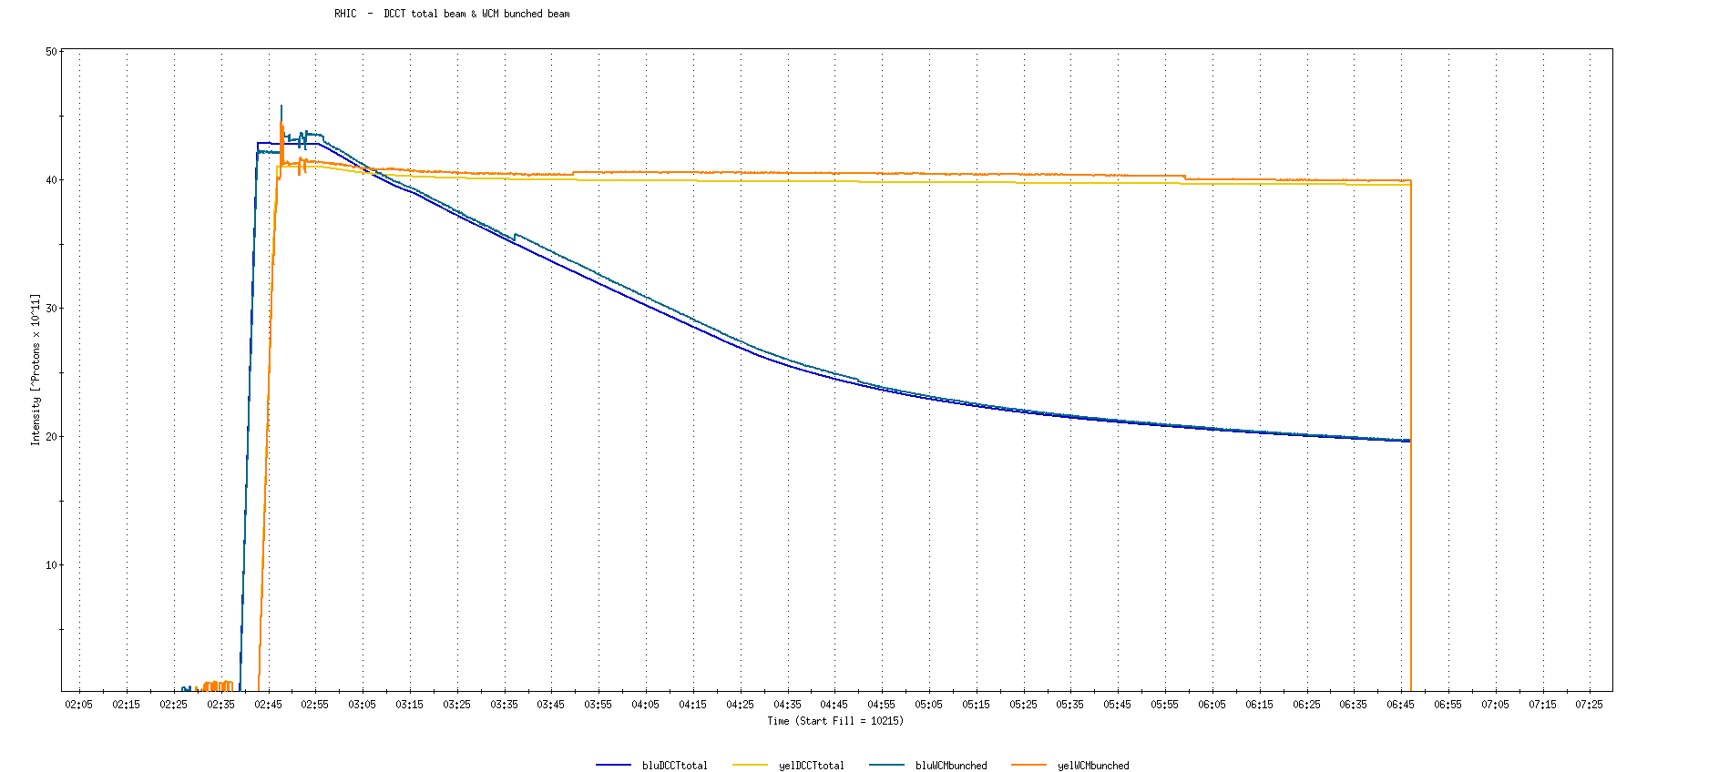
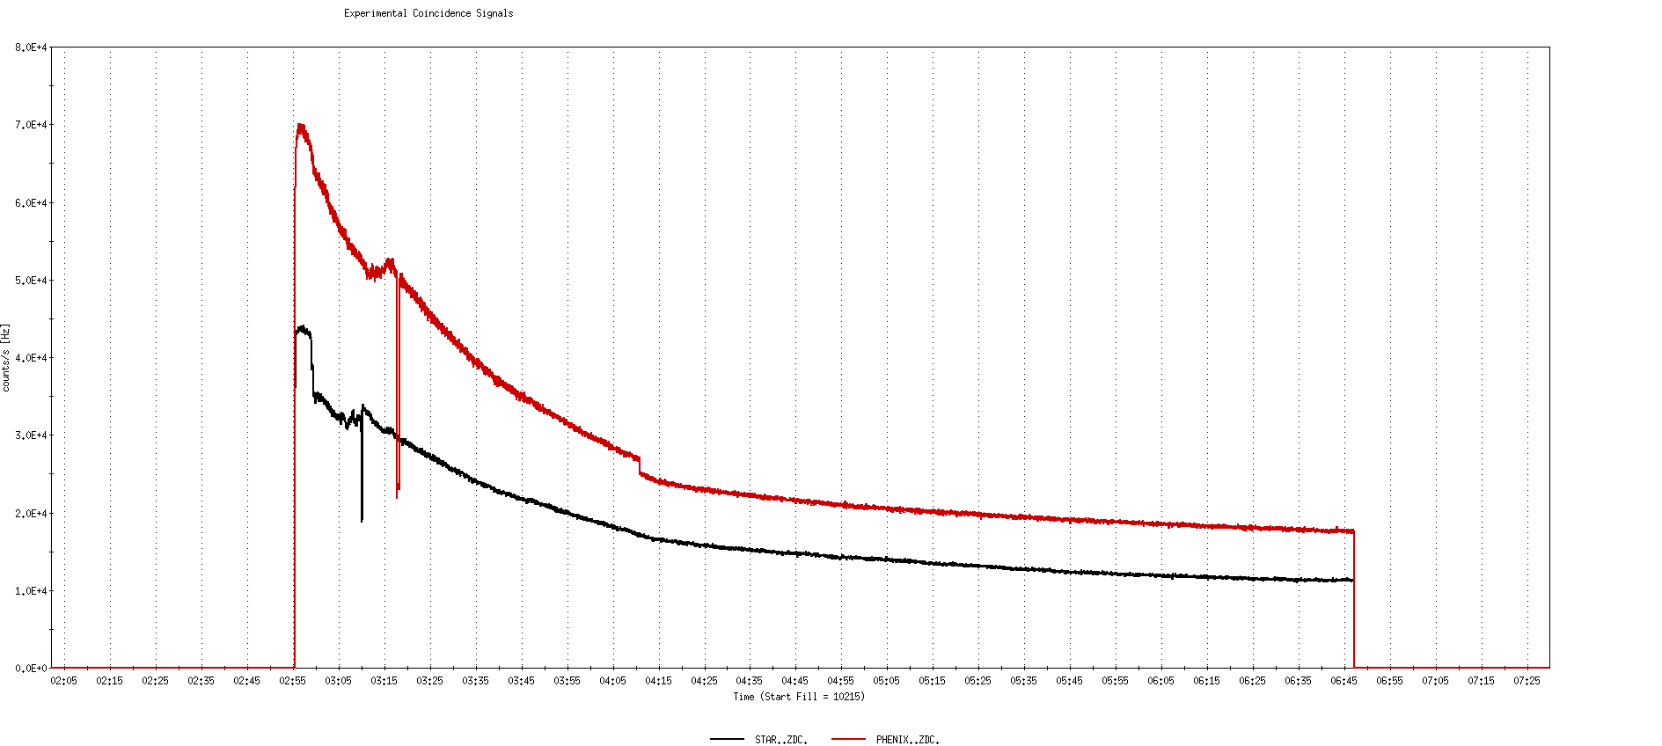
Run 9, First overnight store at √s=500 GeV
22 days after start of cool-down
56 x 56 bunches
β*=0.7 meters
40 x 10¹¹
40K

Slide 36
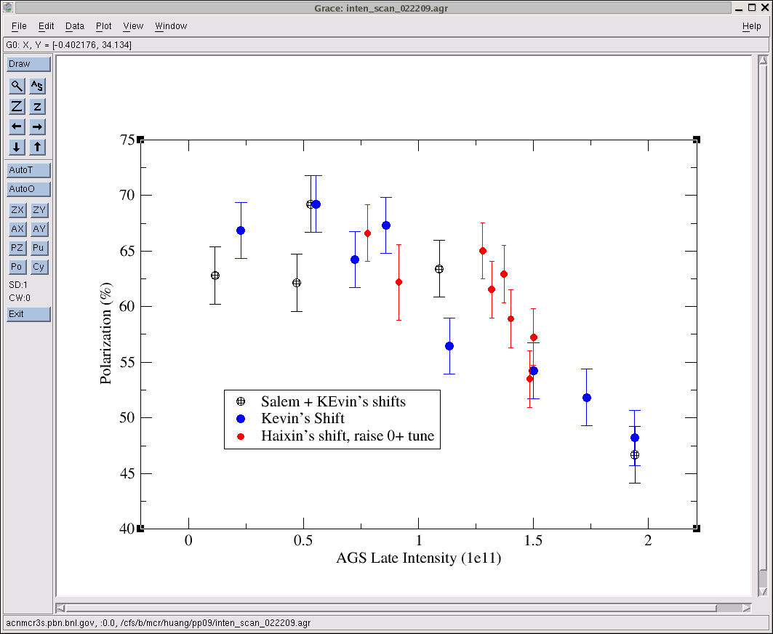
AGS pp log, 23 Feb 09, 00:26

Slide 37
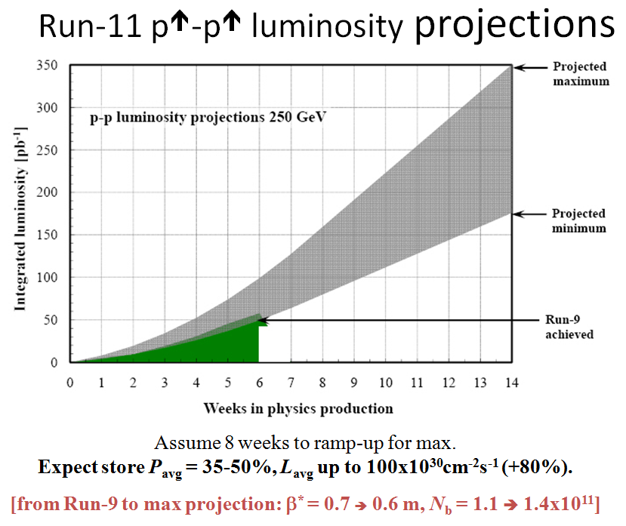
Goals to be updated/corrected
PHENIX Goal (50% pol)
STAR Goal (50% pol)

Slide 38
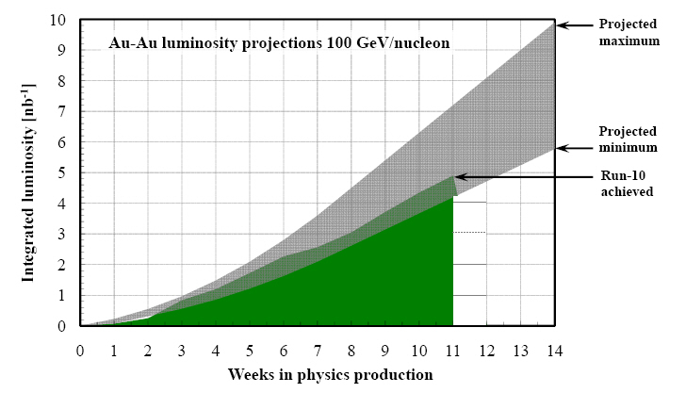
Run-11 Au-Au luminosity projections 100 GeV/nucleon
Goals to be updated/corrected
PHENIX Goal (0.7 recorded)
STAR Goal (TBD)
?? (complicated)
Assume 6 weeks to ramp-up for min, and 8 weeks for max (stoch. cooling re-commissioning).
Expect L_{avg} up to 25x10²⁶cm⁻²s⁻¹ (+25%).
[from Run-10 to max: β* = 0.75 ➔ 0.65 m, N_{b} = 1.1 ➔ 1.1x10⁹, more cooling]

