Slide 1
Recommendations following the June 21-22, 2010 PAC
For Run 11 the PAC recommends the following (in order of priority):
1. 8 weeks Au+Au heavy ion running at 200 GeV
2. 10 weeks p+p polarized proton running at 500 GeV
3. 1.5 weeks Au+Au heavy ion running at 18 GeV
4. 1.5 weeks U+U heavy ion running at 192 GeV (Au rigidity)
5. 1 week Au+Au heavy ion running at 27 GeV
Run 10 should start with proton-proton collisions to allow low-multiplicity commissioning of the PHENIX VTX.
PHENIX must demonstrate during this commissioning period that successful
operation of the VTX during full-energy Au+Au operation is likely.
If the likelihood of successful VTX operation in full energy Au+Au running is
not demonstrated, the PAC recommends full energy Au+Au running be
postponed until Run 12.

Slide 2
Run 11 Plan based on PAC recommendation/ALD Guidance and 28.5 weeks cryo operation DRAFT-DRAFT
Dec. 1, Begin cool-down to 4.5K
Dec. 7, Cool-down to 4.5K complete in both rings
Dec. 8, 2 ⅟₂ weeks beam setup for √s = 500 GeV pp in RHIC begins.
Dec 27 (Monday), 1 week Ramp-up with 8 hr/night beam to experiments
3 Jan, begin 10 week physics run (√s = 500 GeV pp)
14 Mar, end 10 week physics run at √s = 500 GeV pp run
14 Mar, begin 1 week setup for √s = 200 AuAu
21 Mar, begin 1 week Ramp-up with 8 hr/night beam to experiments
28 Mar, begin 8 week physics run at (√s = 200 AuAu)
28 March – 1 April, PAC 2011
23 May, end 8 week √s = 200 AuAu run
23 May, begin setup for √s = 192 GeV UU
30 May, begin 1⅟₂ week physics run (√s = 192 UU)
10 Jun, end 1⅟₂ week physics run at √s = 192 GeV
10 Jun, begin setup for √s = 18 GeV AuAu
10 Jun, begin 1 week physics run (√s = 18 AuAu)
17 Jun, end 1 week physics run at √s = 18 GeV
19 Jun, warm-up complete (28.6 weeks)

Slide 4
Goals to be updated/corrected
PHENIX Goal (50% pol)
STAR Goal (50% pol)

Slide 5
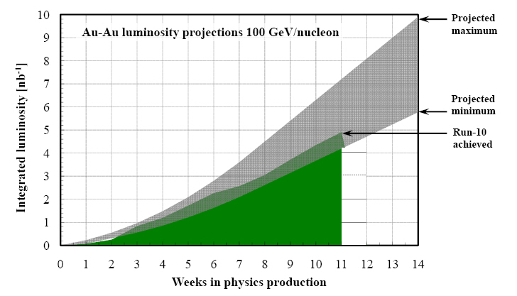
Run-11 Au-Au luminosity projections 100 GeV/nucleon
Goals to be updated/corrected
PHENIX Goal (0.7 recorded)
STAR Goal (TBD)
?? (complicated)
Assume 6 weeks to ramp-up for min, and 8 weeks for max (stoch. cooling re-commissioning). Expect L_{avg} up to 25x10²⁶cm⁻²s⁻¹ (+25%). [from Run-10 to max: β* = 0.75 ➔ 0.65 m, N_{b} = 1.1 ➔ 1.1x10⁹, more cooling]

