Slide 1
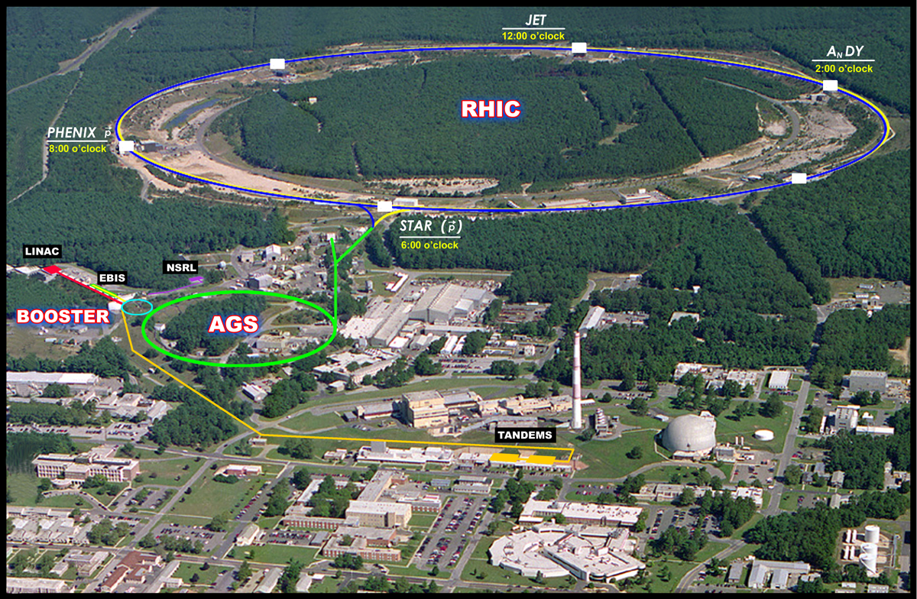
RHIC shut-down work 2011 Wolfram Fischer
18 October 2011
RHIC Planning Meeting
Notes:
30+10 min total

Slide 2
Plan to start cool-down on 3 January 2012.
So far no delay anticipated.

Slide 3
Finished items
AGS Sextupole Coil Replacement – 6 magnets/sectors (Badea)
AGS Siemens maintenance and inspection (Badea, Porqueddu)
AGS G17 Quadrupole Coil Repair (Lehn, Porqueddu)
ETB Beam Line Mods (Corrector and Quad)
RHIC e-lens installation prep: cryogenic DX tap and xfer line, cable tray, water, PS Racks (Hock, Pendzick, Phillips, Lederle, Seberg, )
RHIC 56 MHz installation prep: cable tray, cryogenic lines/compressor, PS Racks (Lederle, Seberg)
RHIC RF π wave length Acc Cavity – Tuner Travel inspection, Damper Loop Inspection (Weiss)
RHIC RF Stochastic Cooling – Yellow Long Kicker rebuild (Lehn)
RHIC Collimators Inspect for Beam Induced Damage (Lehn)
RHIC Tank Farm Piping/Bellow Repair (Lederle)
RHIC 2:00 CeC cryogenic tap installation at DX Magnet (Lederle, Seberg)

Slide 4
Items to be finished before 16 December
BLIP New Window Assembly (waiting for HP technicians)
ETB Inflector modification (if needed) (will be done by 1st week of December)
AGS Siemens Power Supply Bearing Oil System Maintenance (Porqueddu) (awaiting parts, will be done by 1st week of December)
AGS I5 Vacuum Chamber Replacement / I5&J5 Beam Absorber (Liaw) (parts due in beginning of November)
RHIC ODH install relief detector test system (Theisen, Sandberg, Tallerico) (complete middle of November and then testing, ODH zero will be delayed by testing and approval).
RHIC RF 9 MHz Cavity Upgrade (Liaw) new capacitor tuner drive (Mahler) (Will be ready for RF testing November 1, baked out by December 15).
RHIC RF Stochastic Cooling – horizontal kickers and PU’s installation (Liaw) (First of 4 kickers shipped to the tunnel yesterday – blue #1, Mike promises the blue #2 by next Friday, Yellow #1 and #2 are assembled but await RF testing they should both be in RHIC by the end of November)
RHIC RF Stochastic Cooling – Blue Long Kicker rebuild (Liaw) (Still have leaking feedthrough problems – we sprayed them before and we will spray them again if necessary – new motor drive mounting being designed and installed) should be back in the tunnel before the end of November.

Slide 5
http://www.rhichome.bnl.gov/RHIC/Runs/

Slide 6
Run-12 projections ph-ph at 100 GeV
ph-ph at 100 GeV last done in Run-9 higher L_{peak} (compared to Run-8) did not increase L_{avg}, limited by beam-beam and other nonlinear effects
Expect only few improvements compared to Run-9 orbit/Q/ΔQ_{min}/Q’ control, periodic orbit correction and 10 Hz orbit feedback in store, 9 MHz + bouncers, collimation on ramp
Polarization as least as good as in Run-9
 |  | Run-9 achieved | Max Run-12 projections
Polarization P | % | 57★ | 55-60★
Peak luminosity L_{peak} | 10³⁰ cm⁻²s⁻¹ | 50 | 52
Avg. store luminosty L_{avg} | 10³⁰ cm⁻²s⁻¹ | 28 | 30
Luminosity per week L_{week} | pb⁻¹ | 8 | 10
Time-in-store | % | 53 | 55
H-jet measurement (intensity-average over transverse and longitudinal profiles)

Slide 7
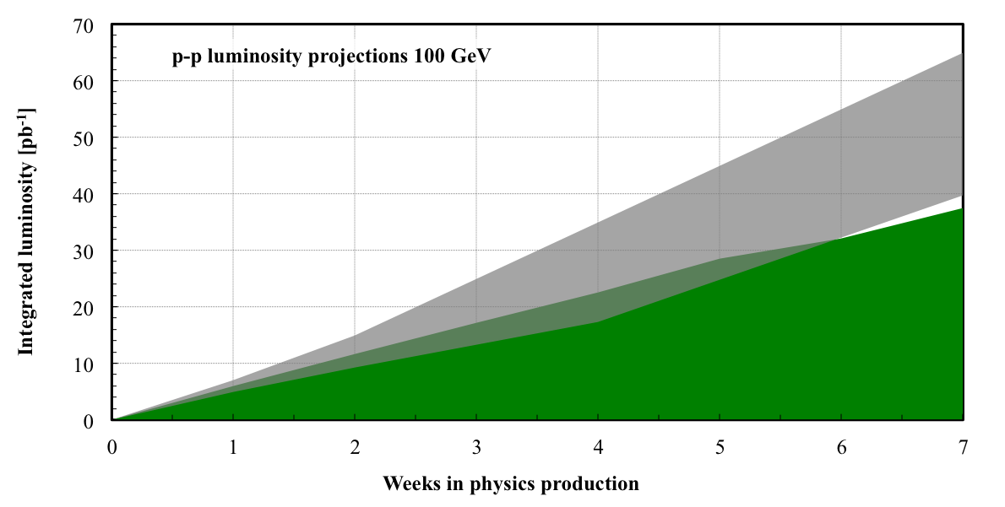
Run-12 projections ph-ph at 100 GeV

Slide 8
Run-12 projections ph-ph at 250 GeV
ph-ph at 250 GeV demonstrated full luminosity potential commissioned AGS tune jumps, 9 MHz rf, orbit/Q/ΔQ_{min}/Q’ control, periodic orbit correction and 10 Hz orbit feedback in store, collimation on ramp, dump upgrade, CNI upgrade, …
Fast ramp up to peak performance (i.e. faster than in Run-11) + better polarization + smaller emittances (in all dimension)
 |  | Run-11 achieved | Max Run-12 projections
Polarization P | % | 48★ | 50-55★
Peak luminosity L_{peak} | 10³⁰ cm⁻²s⁻¹ | 145* | 200
Avg. store luminosty L_{avg} | 10³⁰ cm⁻²s⁻¹ | 90* | 125
Luminosity per week L_{week} | pb⁻¹ | 25 | 40
Time-in-store | % | 37 | 55
H-jet measurement (intensity-average over transverse and longitudinal profiles)

Slide 9
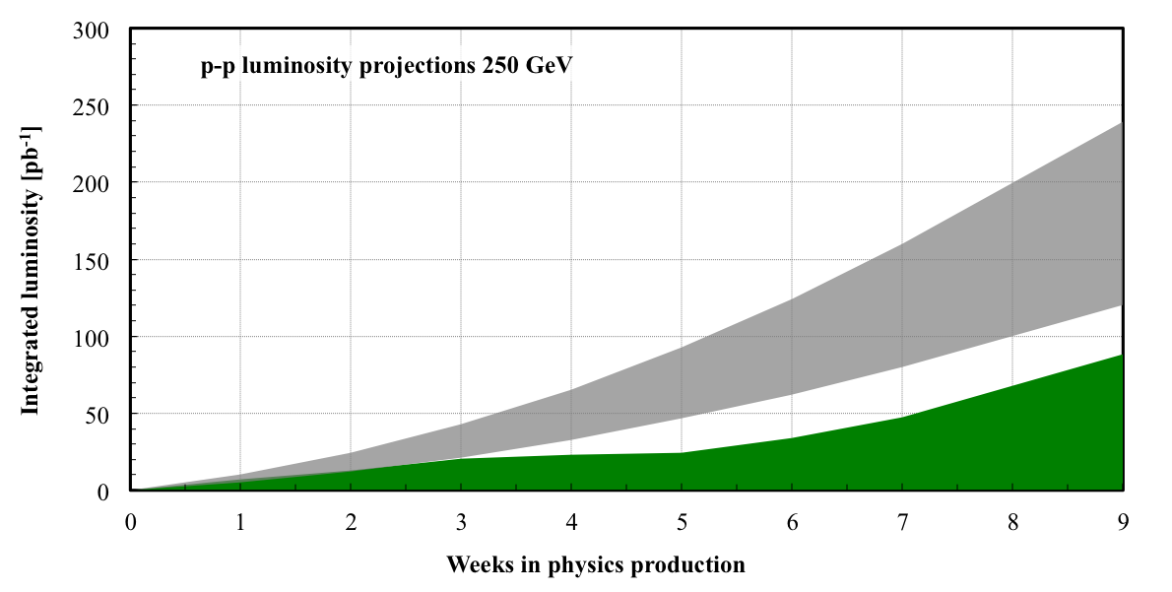
Run-12 projections ph-ph at 250 GeV

Slide 10
Polarization in Run-11 and Run-12
Run-11 store polarization as measured by H-jet (measures <P>): 48% in Run-10 vs. 35% in Run-9
(polarization has a profile R_{x} ≈ R_{y} ≈ 0.2, R = σ²/σ_{p}², P₀ in center up to 65%)
AGS horizontal tune jump system operational P +8% with high intensity, tested in Run-9,
Acceleration near Q_{v} = 2/3 in RHIC P +25%, measured P transmission as function of Q_{v} in Run-9, tested ramp with Au in Run-10, simulated differences between Au and p ramp last summer
Vertical orbit control on ramp 20 μm measured orbit rms late in ramp – real rms depends on BPM offsets
Smaller momentum spread on ramp
Run-12 incremental improvements:
Changes in source/LEBT/MEBT g P +6%
Smaller emittances, 24g18 mm.mrad (less P profiles in AGS and RHIC) g P +8%
Small change in store energy in RHIC (P lifetime reduction) g P +5%
Also need to prepare for further improvements in Run-13

Slide 11
A_{n}DY in Run-11 (250 GeV pp)
Beam envelope function β* = 3.0 m at IP2
Reduced IP2 crossing angle from initially 2.0 mrad to zero
Added 3rd collision with following criteria (last instruction):
N_{b} ≤ 1.5x10¹¹
Beam loss rate <15%/h in both beams
Not before first polarization measurement 3h into store
ξ/IP = 0.005
small impact
visible impact,
few percent loss to STAR/PHENIX
ξ/IP = 0.004
PHENIX
STAR
loss rates
AnDY
Notes:
Criteria in effect from 8 April 2011, 22:08

Slide 12
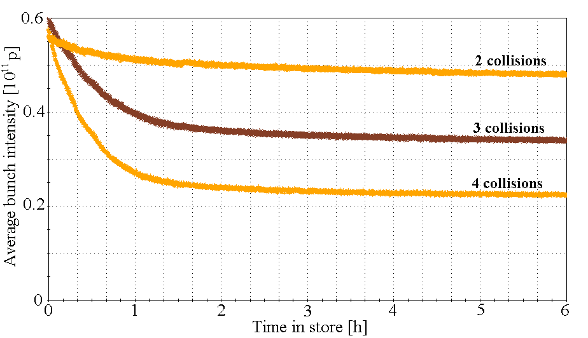
Future operation of A_{n}DY
Can reduce β* at IP2 have run with β* = 2.0 m previously for BRAHMS β* = 1.5 m probably ok, needs to be tested
Longer stores 10h instead of 8h in Run-11 (depends on luminosity lifetime and store-to-store time)
Collide earlier in store when conditions are met needs coordination with polarization measurement, PHENIX and STAR
Electron lenses (see later) if A_{n}DY runs beyond Run-13 increases max beam-beam tune spread, currently ΔQ_{max,bb} ≈ 0.015 can be used for to increase ξ~N_{b}/ε and/or number of collisions
Run-11 luminosity at A_{n}DY: max ~0.5 pb⁻¹/store
With improvements: ~3x increase, ~10 pb⁻¹/week (A_{n}DY sees stronger impact of prematurely aborted stores than STAR and PHENIX)
pp in Run-4 (100 GeV)
Notes:
Best store: 15408 with 0.165 pb^-1

Slide 13
Run-12 projections U-U at 96.4 GeV/nucleon
First RHIC U run, exploration for STAR/PHENIX need EBIS charge state ~40, Booster injection efficiency may be different, Booster bunch merge needed
RHIC luminosity largely determined bunch intensity and cooling same rigidity as 100 GeV/nucleon (no training) 3D stochastic cooling, increase in off-momentum DA
 |  | Run-11 Au-Au | Run-12 projections
Number of bunches N | … | 111 | 111
Bunch intensity N_{b} | 10⁹ | 1.3 | 0.6 – 0.85
β* | m | 0.75 | 0.75
Peak luminosity L_{peak} | 10²⁶ cm⁻²s⁻¹ | 50 | 11 – 21
Avg. store luminosty L_{avg} | 10²⁶ cm⁻²s⁻¹ | 30 | 7 – 14
Luminosity per week L_{week} | nb⁻¹ | 1.0 | 0.2 – 0.45
Time-in-store | % | 37 | 55

Slide 14
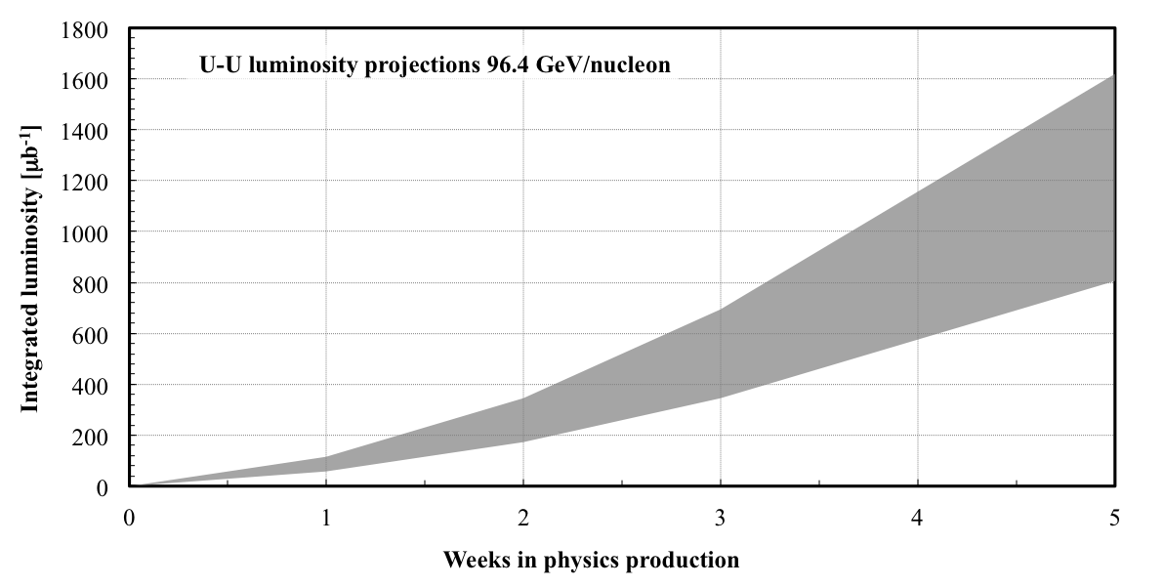
Run-12 projections U-U at 96.4 GeV/nucleon

Slide 15
Run-12 projections Cu-Au at 100 GeV/nucleon
First ion run with EBIS need both Cu and Au sources (only gases for NSRL), Booster bunch merge needed (no margin for longitudinal emittance increase in RHIC)
RHIC luminosity largely determined by bunch intensity and cooling Cu in Blue and Au in Yellow (like d-Au), ≈ same charge for Cu and Au horizontal stochastic cooling new (3D sc for Au and Cu) increase in off-momentum DA
 |  | Run-5 Cu-Cu | Run-11 Au-Au | Max Run-12 projections
Number of bunches N | … | 37 | 111 | 111
Bunch intensity N_{b} | 10⁹ | 4.5 | 1.3 | 4.0 / 1.3
β* | m | 0.9 | 0.75 | 0.85
Peak luminosity L_{peak} | 10²⁶ cm⁻²s⁻¹ | 200 | 50 | 170
Avg. store luminosty L_{avg} | 10²⁶ cm⁻²s⁻¹ | 80 | 30 | 100
Luminosity per week L_{week} | nb⁻¹ | 2.4 | 1.0 | 3.1
Time-in-store | % | 52 | 59 | 55

Slide 16
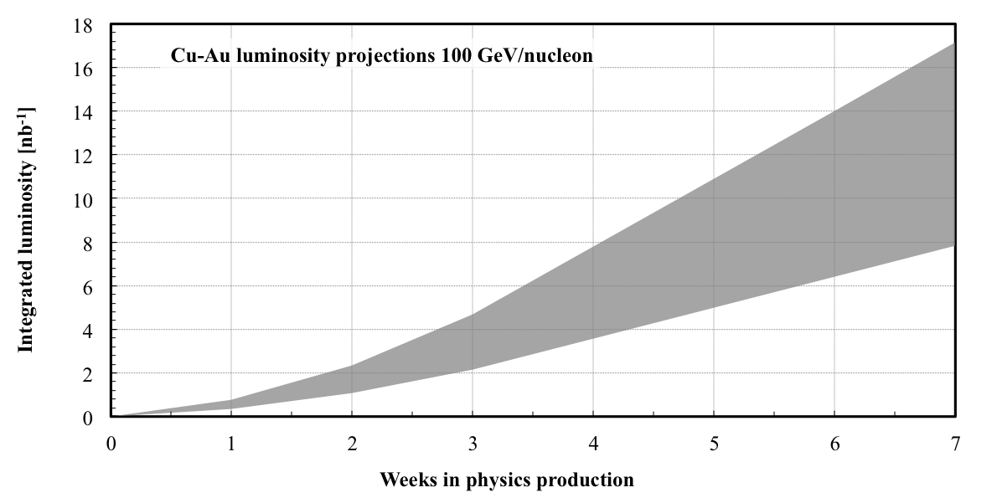
Run-12 projections Cu-Au at 100 GeV/nucleon

