Slide 1
Run 12 RHIC Machine/Experiments Meeting
12 Jun 2012
Agenda:
Status Reports
Other business

Slide 2
Run 12 Plan based on 20 weeks cryo operation
23 week schedule based on 4/10/12 Vigdor guidance, 6 June update
17 Jan, Begin cool-down to 4.5K
20 Jan, Cool-down to 4.5K in Blue and Yellow Ring complete, begin magnet setup
21-28 Jan, pp injection setup
28 Jan-3 Feb, LLRF, Ramp and store setup, begin 8 hr/night for experiments
3-10 Feb, 1 week ramp-up with 8 hrs/night for experiments
10 Feb, with store # 16397, begin 4 weeks pp physics with further ramp-up
16 Feb, 24/7 stores begin
12 (Monday) March, end 4.4 week pp physics √s = 200 GeV, begin ½ week setup for √s = 510 GeV pp
16 March, begin 5 week pp physics (machine only) √s = 510 GeV
17/18 March, STAR/PHENIX physics start with longitudal polarization
18 April (Wednesday 1300), end physics begin pp beam development/APEX
19 April (Thursday, 0800), end 4.9 week pp physics at √s = 510 GeV
19 April (Thursday, store 16580), begin 1 week setup for UU
22 April (evening) first overnight stores for experiments
25 April (Wednesday), begin 3 week UU physics run
15 May (Tuesday) end 2.9 week UU physics √s = 193 GeV/n, begin setup for √s = 200 GeV/n CuAu
18 May (Friday, store 16889) begin CuAu physics run
Today – 12 Jun
25 June (Monday, 08:00), end 5.5 week √s = 200 GeV/n CuAu run
25 June, begin √s = 5 GeV/n AuAu development
27 June (Wednesday, 08:00 – earlier if test complete) begin cryo warm-up
30 June, cryo warm-up complete (23.6 cryo-weeks)
Total Physics Weeks = 17.7

Slide 3
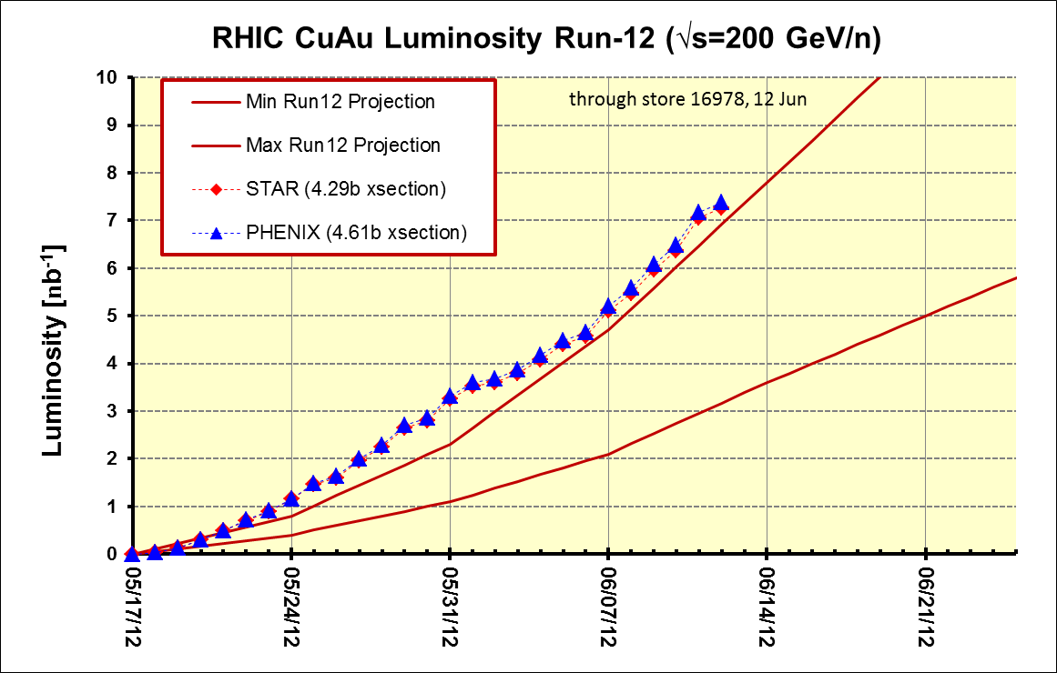
PHENIX BUR Goal = 2.4 nb⁻¹ sampled, ~11 delivered
STAR Goal = ~5 nb⁻¹ sampled, ~8 nb⁻¹ delivered
Goals

Slide 4
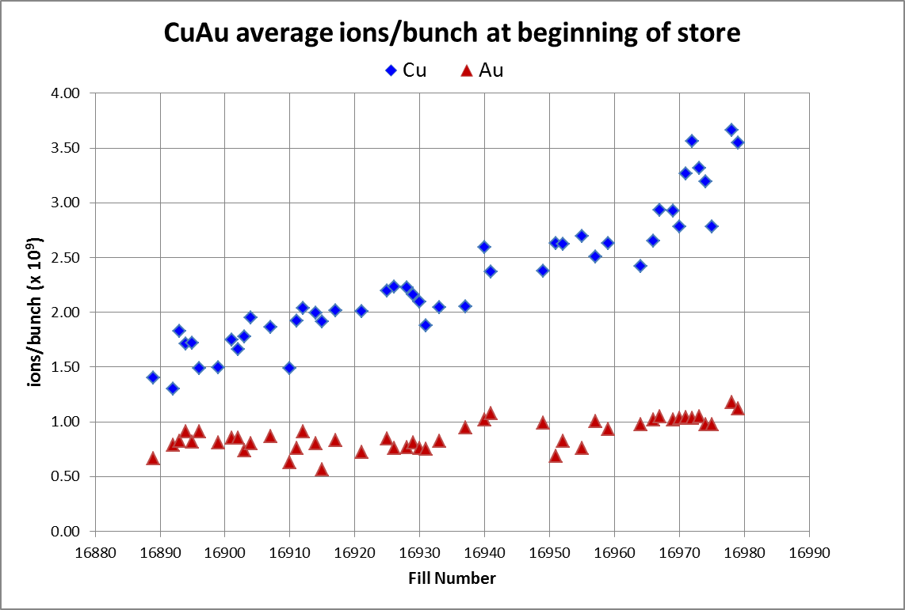
Through store 16979, 12 June
Cu goal
Au goal
http://www.rhichome.bnl.gov/AGS/Operations/Run12/Run12_Lumi_100Cu_100Au.xlsx
and LogView

Slide 5
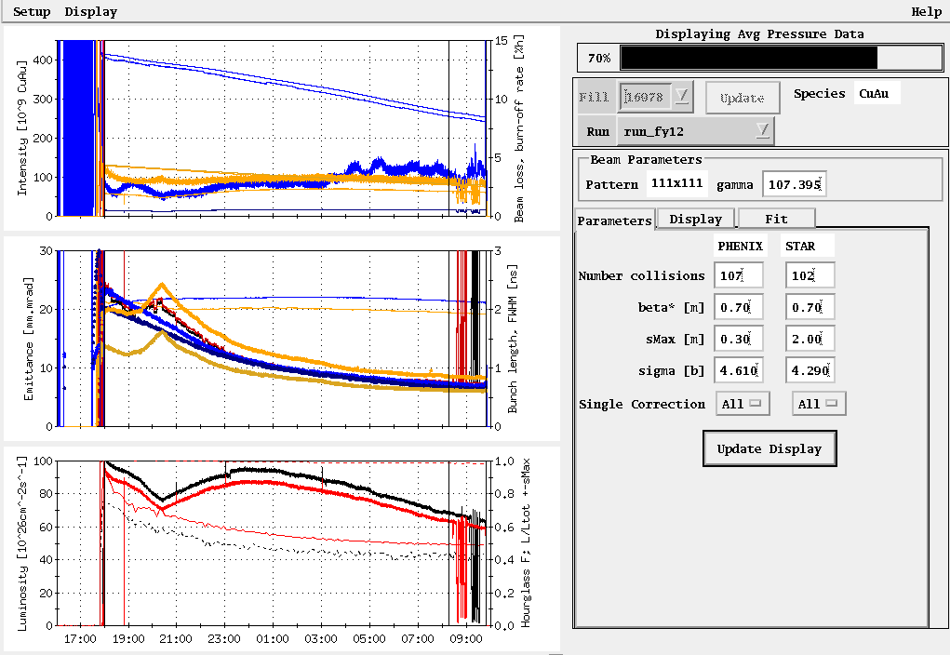
Store 16889, 18 May (first physics store)
Average Lumi (Max) Goal
Peak Lumi (Max) Goal = 1.7 x 10²⁸ cm⁻¹s⁻¹

Slide 7
Other Slides

Slide 8
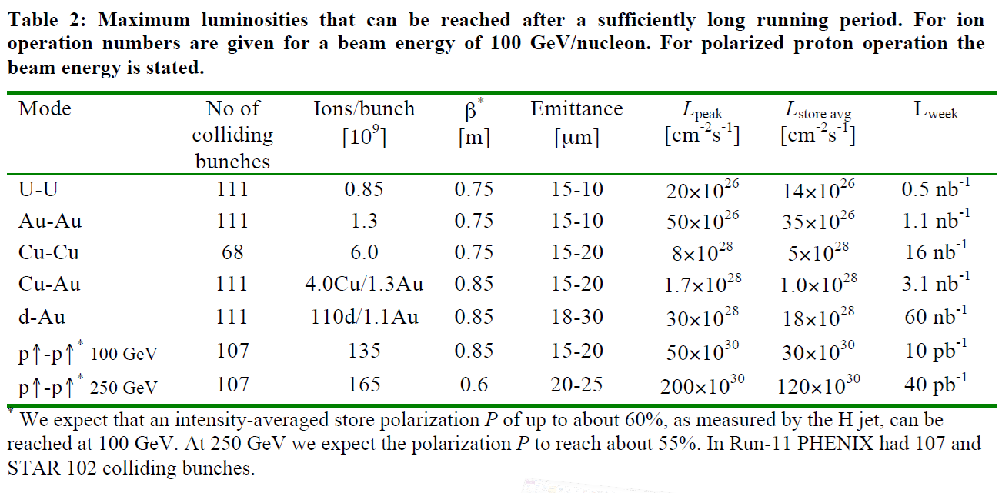

Slide 9
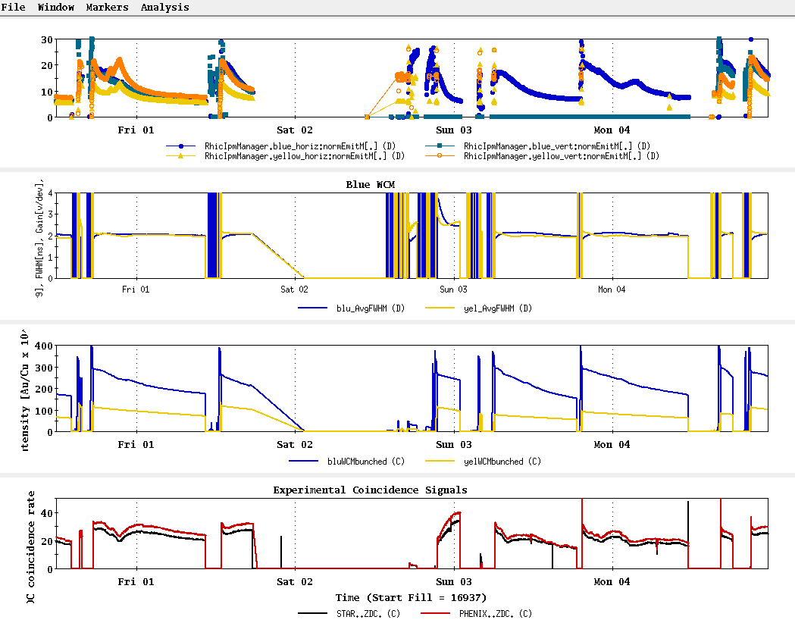
Stores 16940 thru 16959

Slide 10
PHENIX BUR Goal = 2.4 nb⁻¹ sampled, ~11 delivered
STAR Goal = ~5 nb⁻¹ sampled, ~8 nb⁻¹ delivered

Slide 11
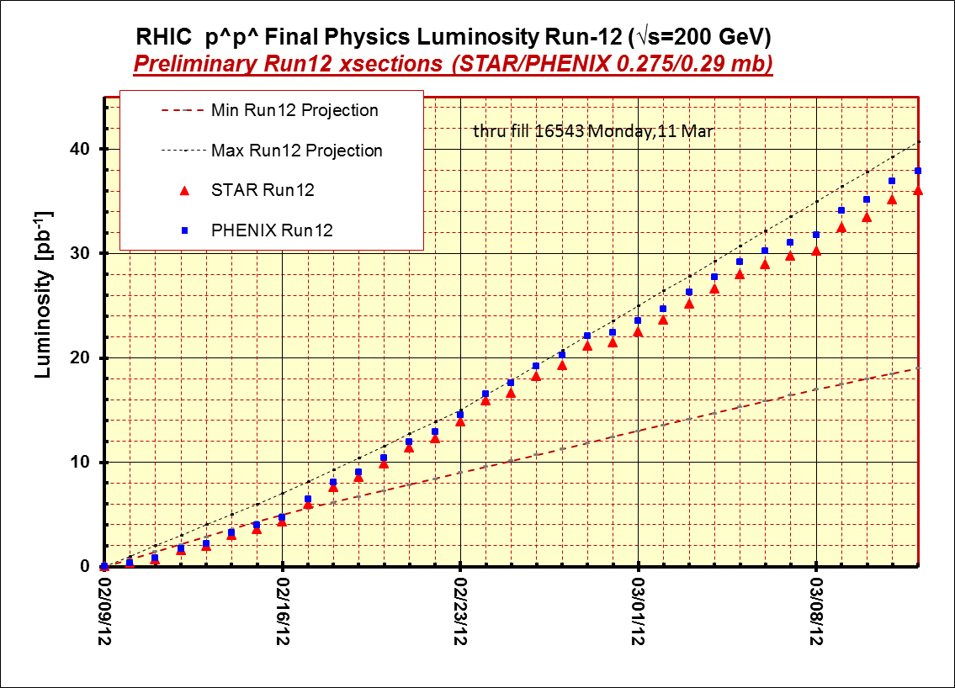

Slide 12
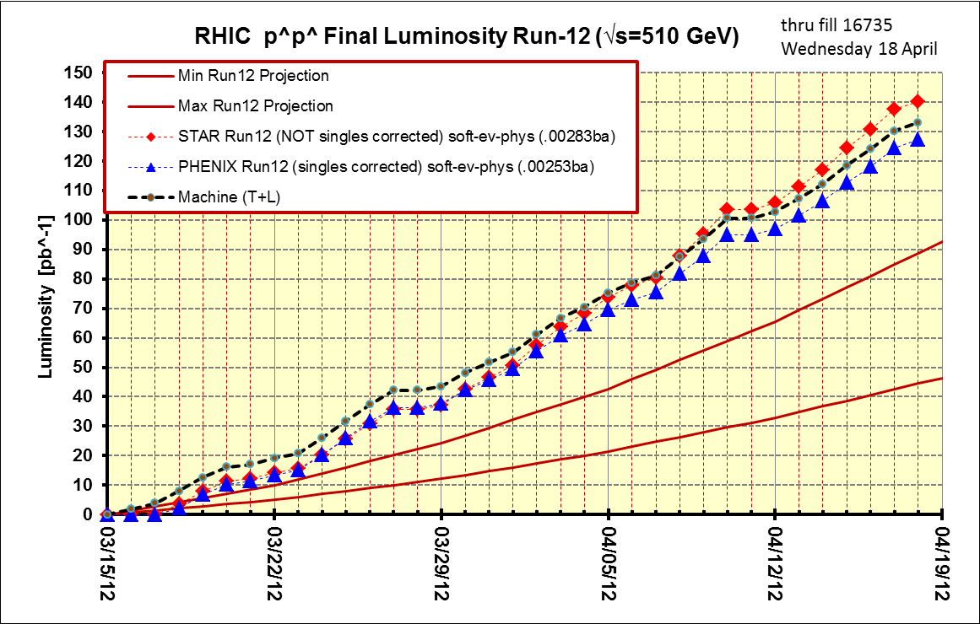
Thru final store, 16735, 18 Apr

Slide 13
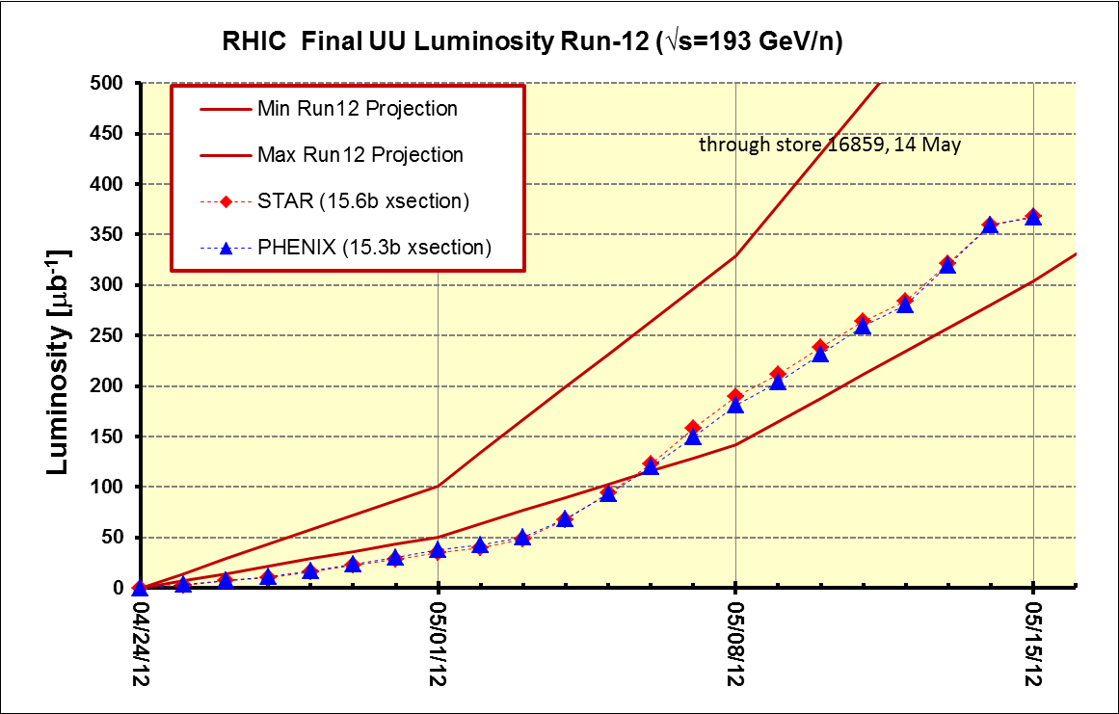

Slide 14
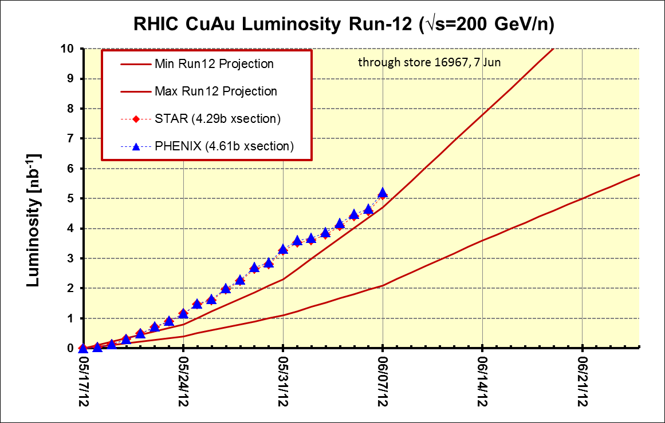
PHENIX BUR Goal = 2.4 nb⁻¹ sampled, ~11 delivered
STAR Goal = ~5 nb⁻¹ sampled, ~8 nb⁻¹ delivered

Slide 16
Thru final store, 16735, 18 Apr

Slide 17
368 μb⁻¹

Slide 18
STAR & PHENIX Goal

Slide 19
Thru final store, 16735, 18 Apr
PHENIX Goal
STAR Goal

Slide 20
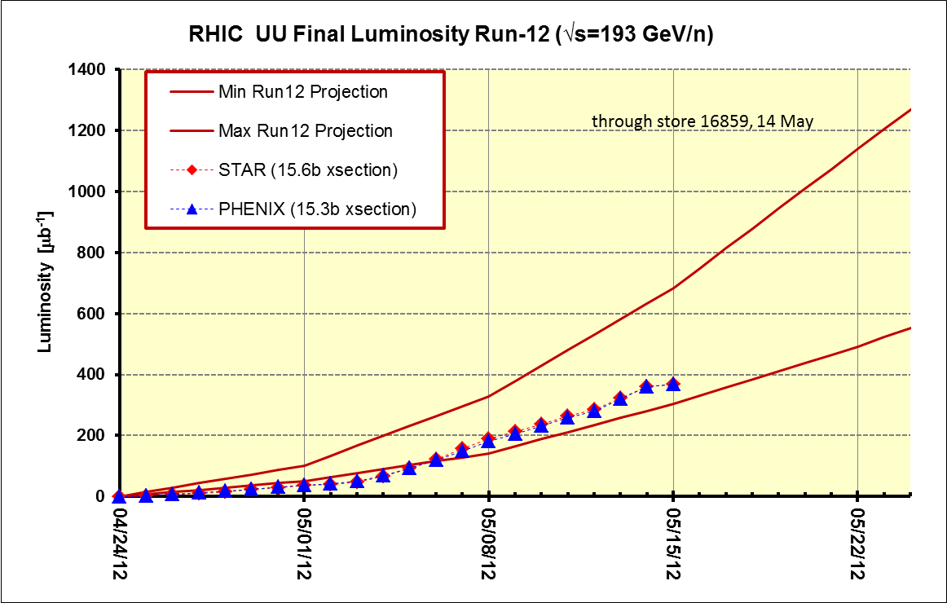
Best store (16857) = 3.0 x 10⁸ ions/bunch, blue/yellow beginning of store (physics)
~8.5 x 10⁸ ions/bunch
STAR and PHENIX ~Goals
~6 x 10⁸ ions/bunch
~3 x 10⁸ ions/bunch

Slide 21
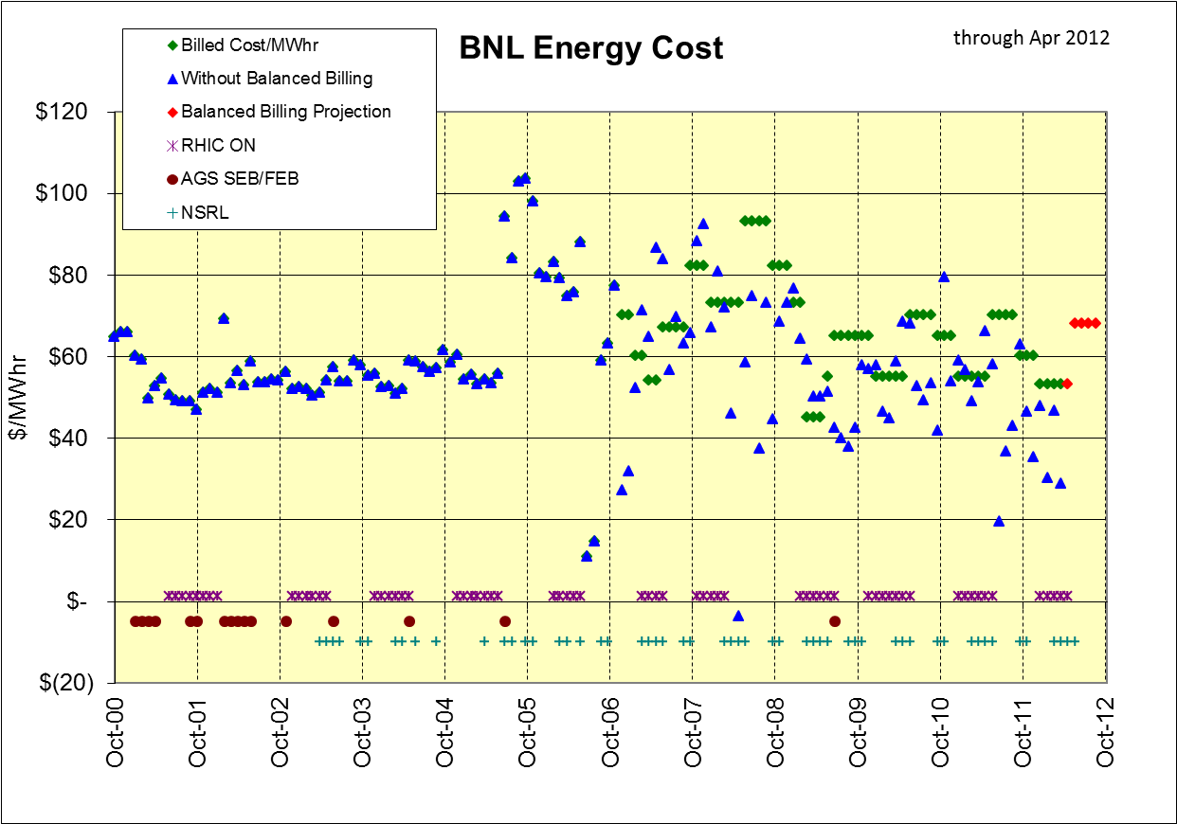
Total in bank through April = $2,781K (CAD contribution = $1,360K)
Total CAD rebate to date = $625K (owed $735K)

Slide 22
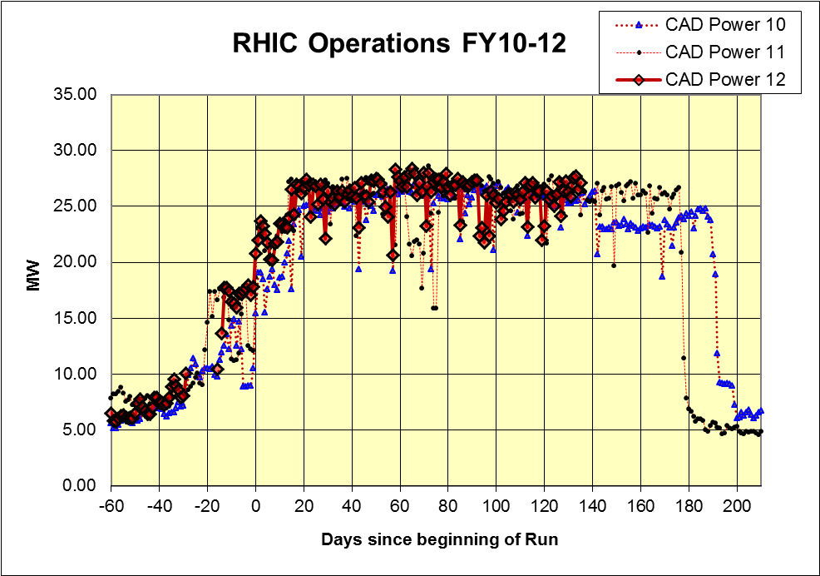
Thru 31 May

Slide 23
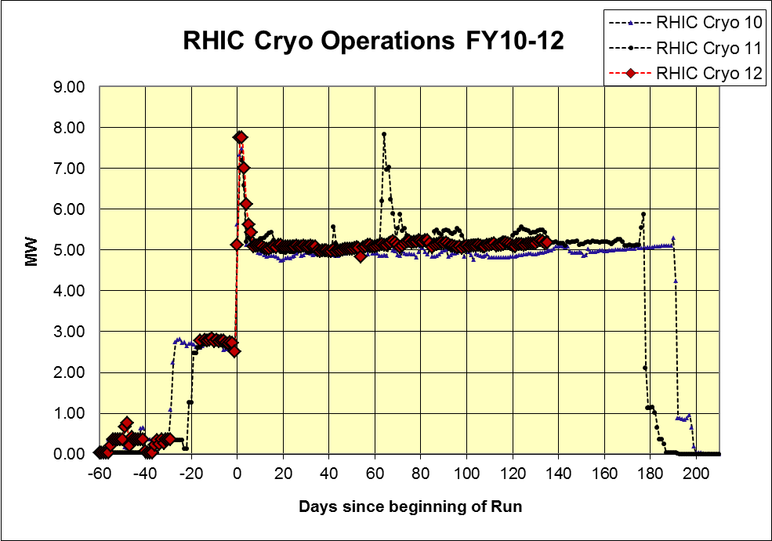
Thru 31 May

Slide 24
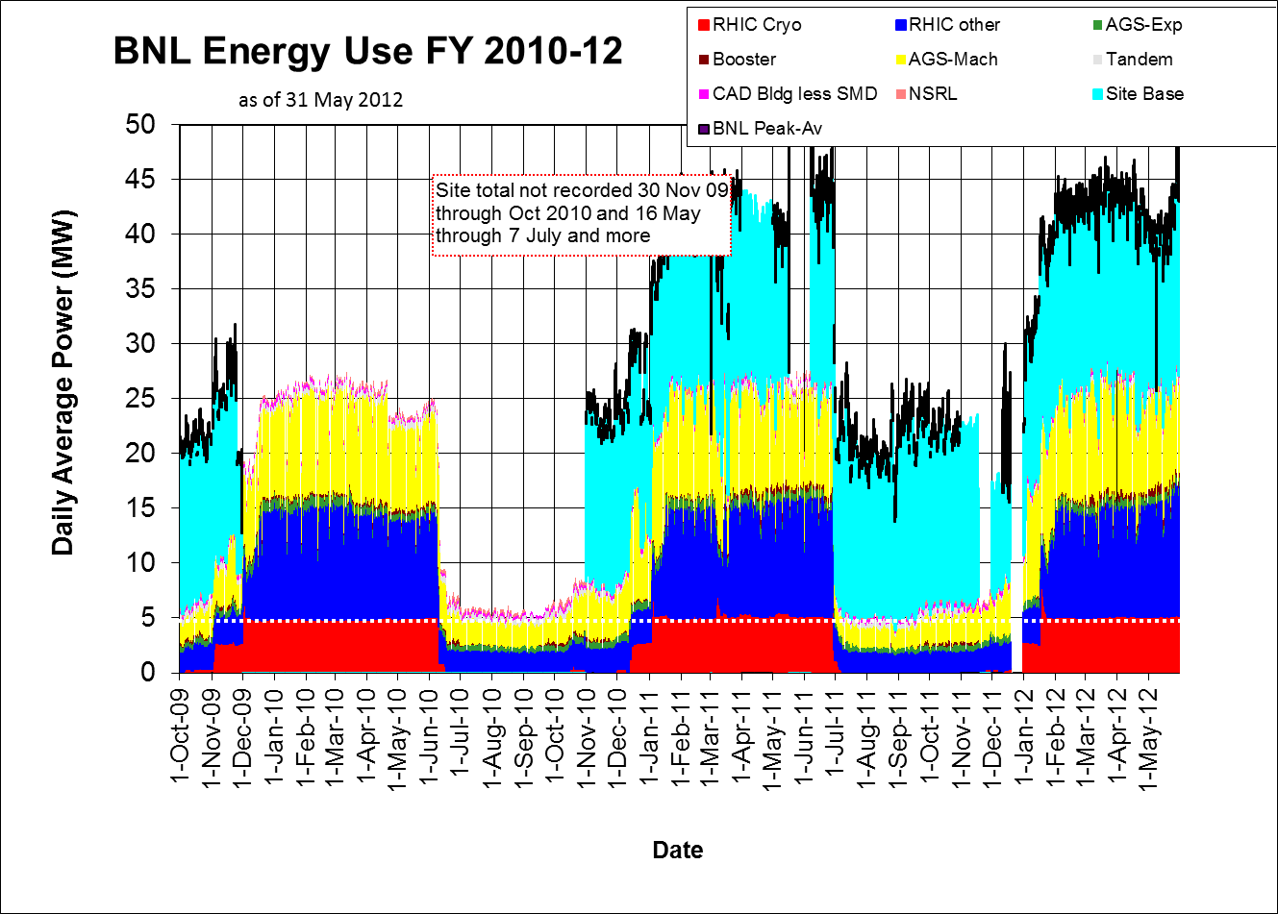

Slide 25
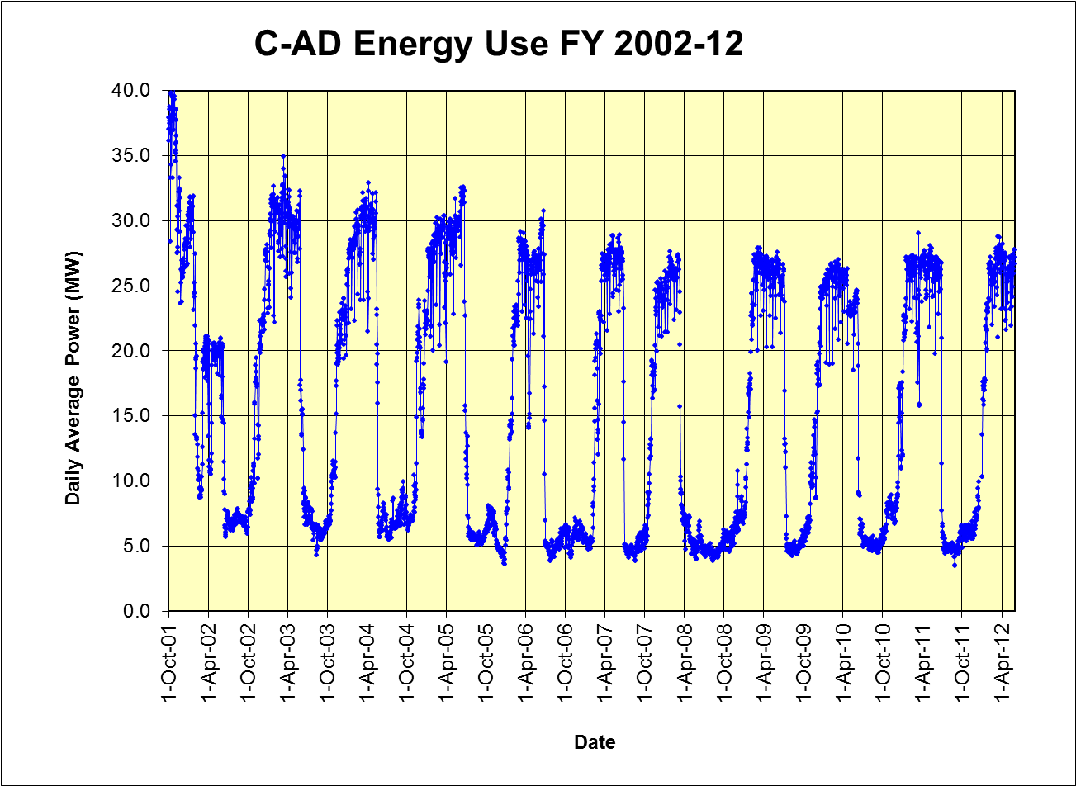
Thru 31 May

Slide 26
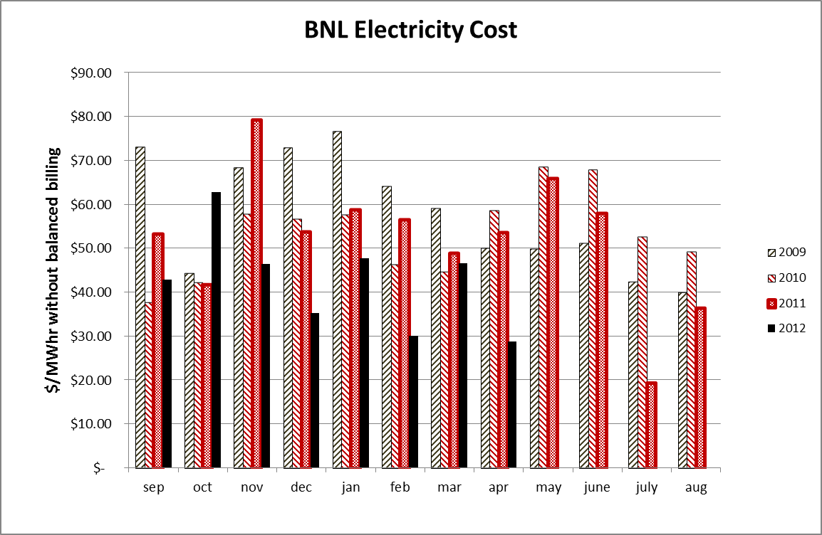

Slide 27
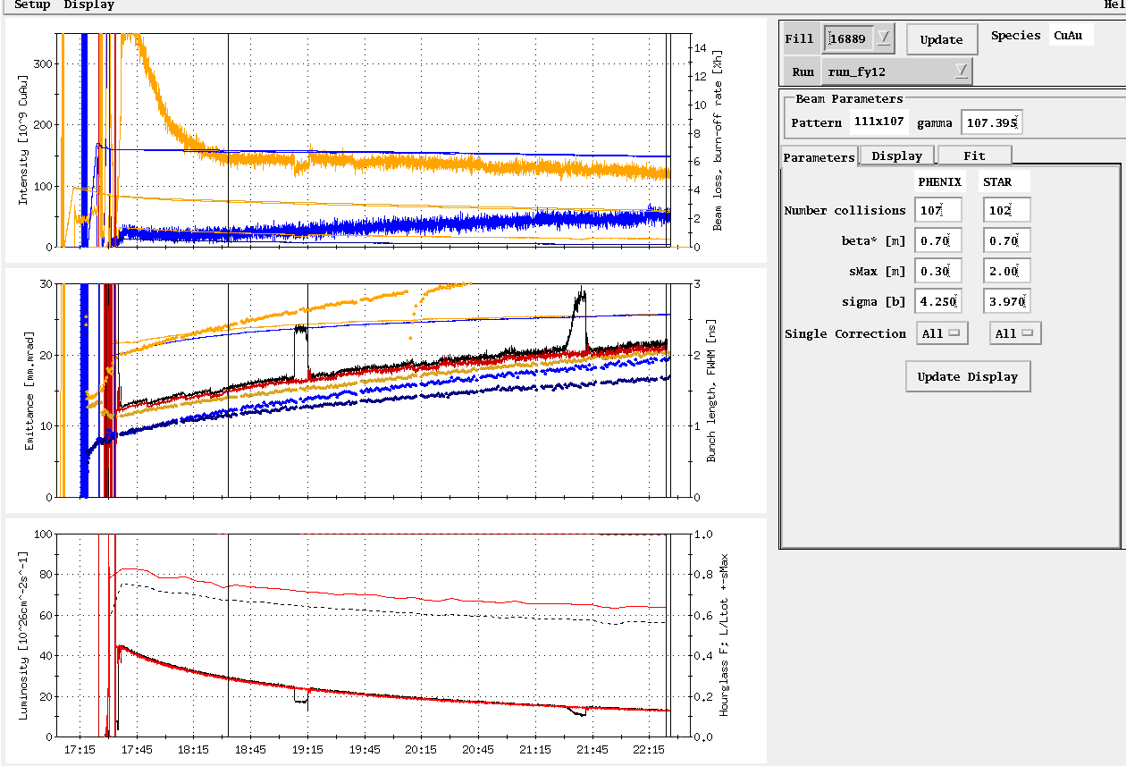
Store 16889, 18 May (first physics store)
Average Lumi Max Goal
Average Lumi Max Goal

Slide 28
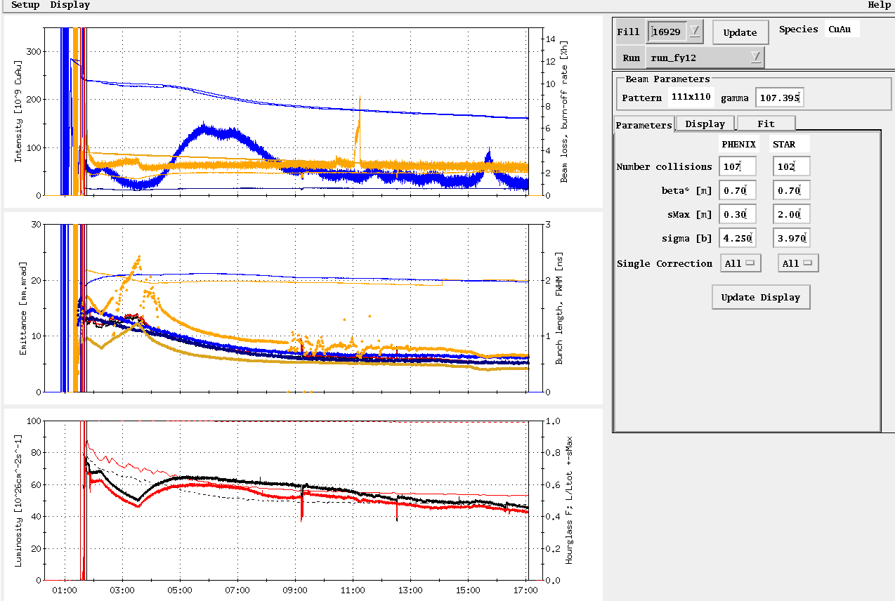
Store, 16929, 28 May
Average Lumi Max Goal

Slide 29
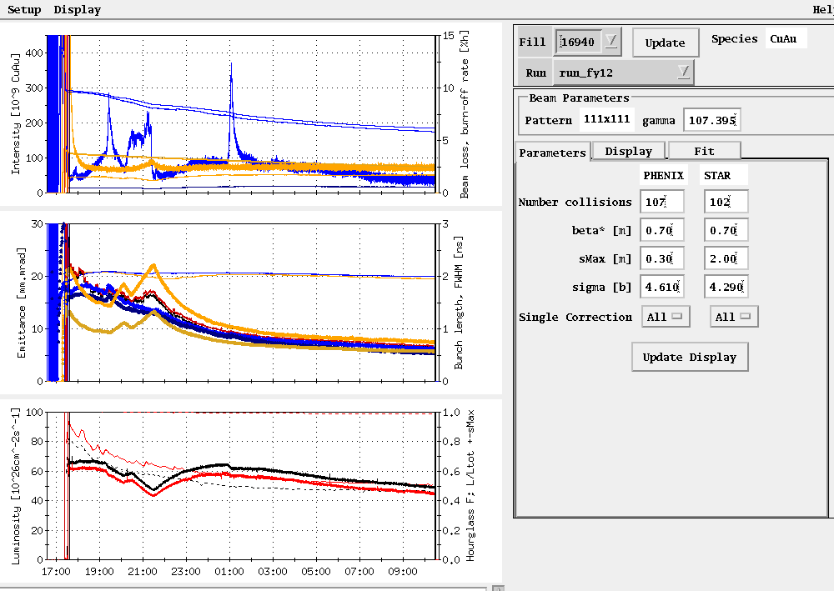
Store, 16940, 31 May
Average Lumi Max Goal

Slide 30
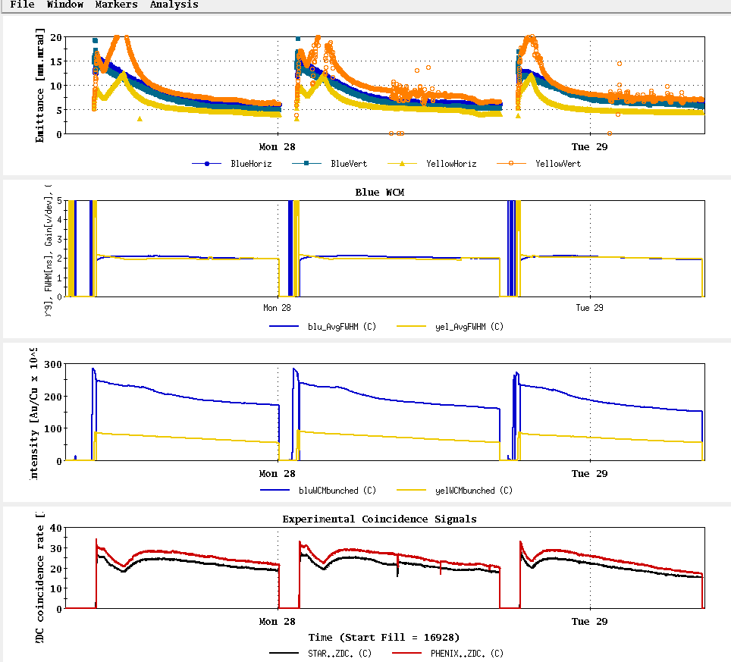
Stores, 16928-30, 27-28 May

Slide 31
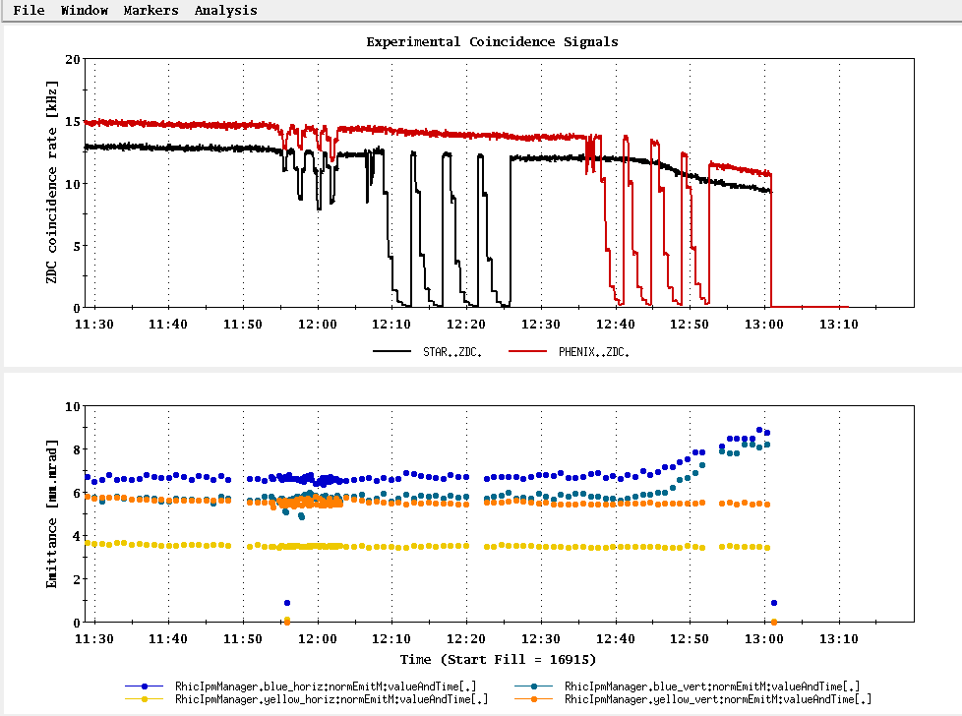
The last vernier scan – note emittance issue with the PHENIX scan

Slide 32
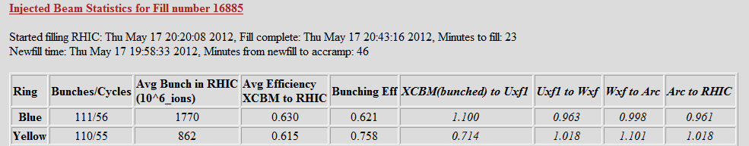
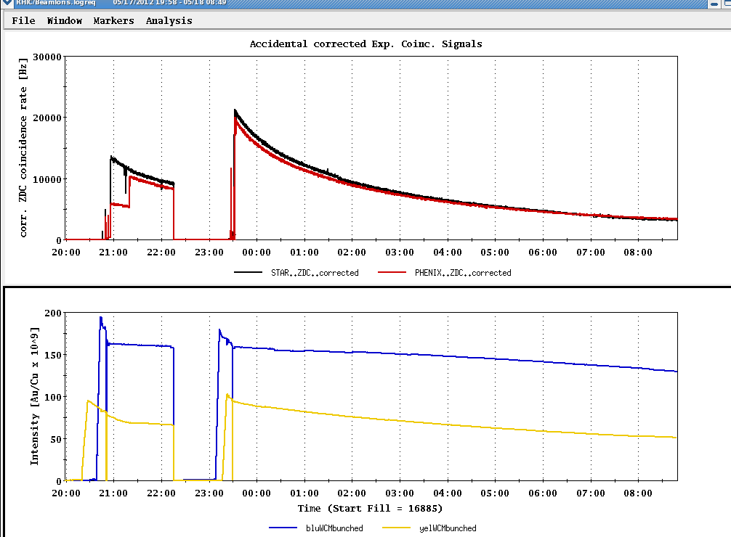
First store for detector tune-up

Slide 33
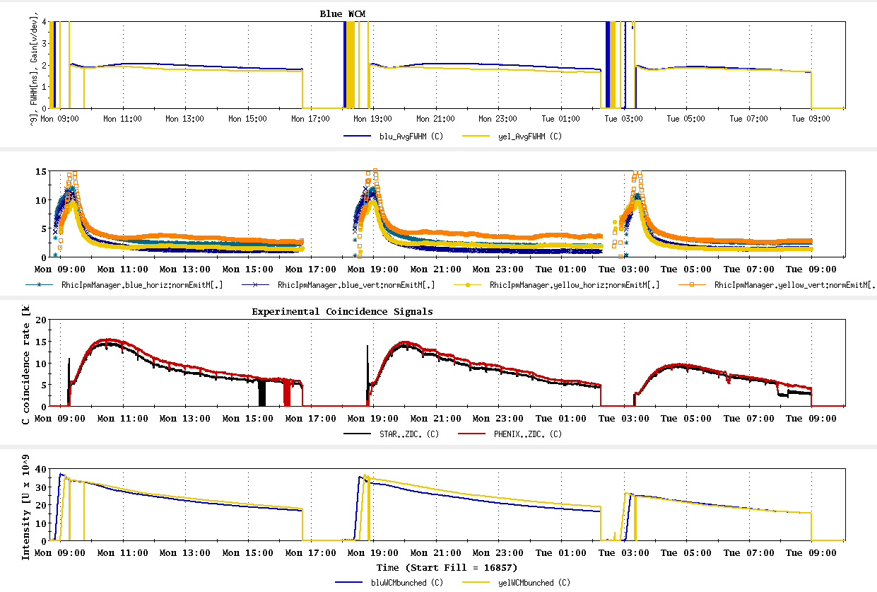
Last three UU physics stores
~best store

Slide 34
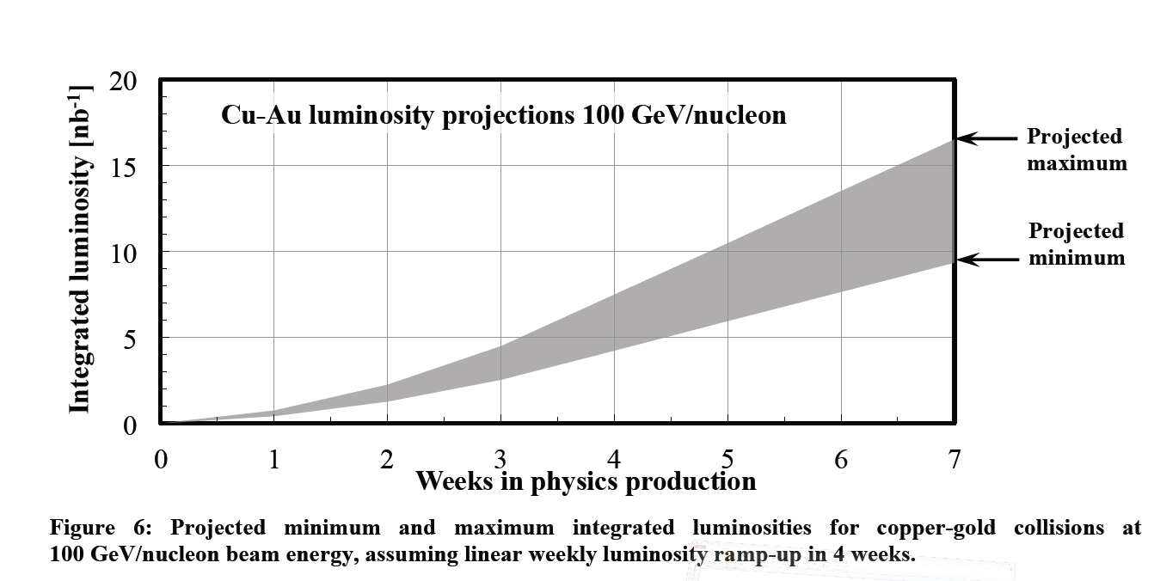
PHENIX BUR Goal = 2.4 nb⁻¹ sampled, ~8 delivered (?)
STAR Goal = ?
If 5 week run
~8 nb⁻¹

Slide 35
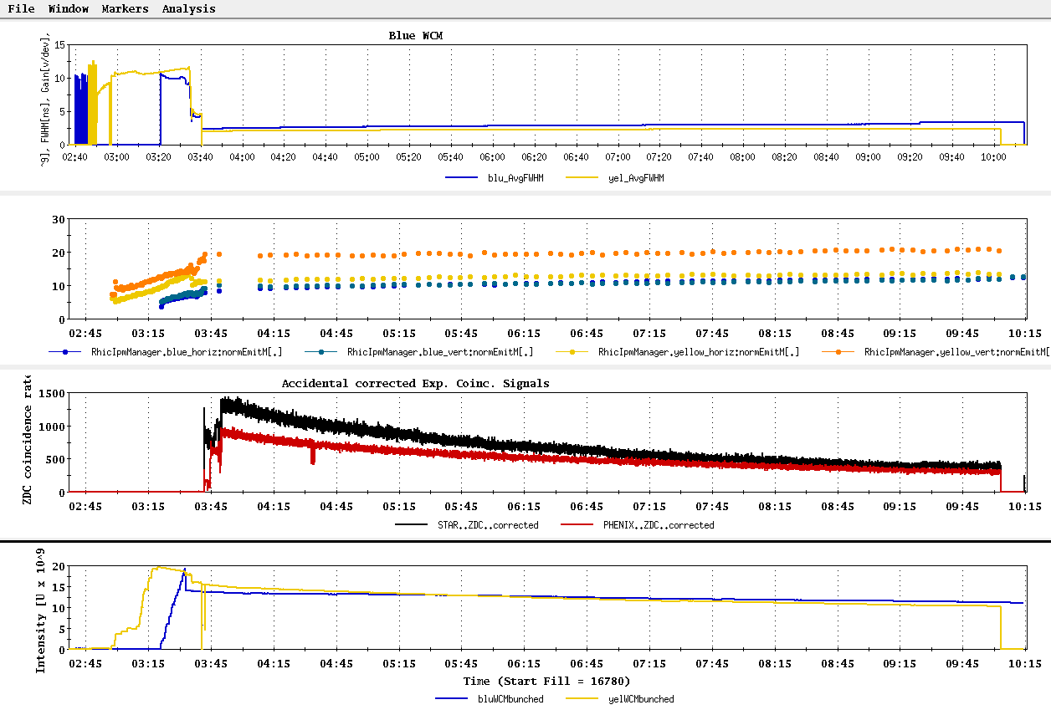
First UU physics store, 16780, 25 April

Slide 36
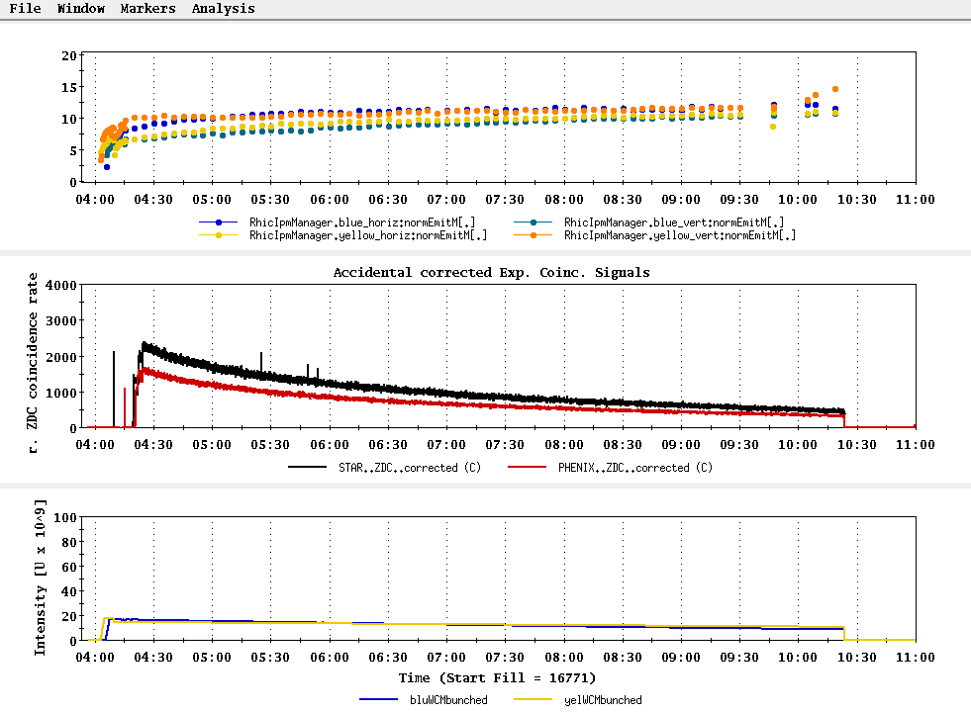
Setup Store, no rebucketing yet…
Transverse emittance projection
ion intensity maximum 111x8.5x10⁸
ion intensity minimum 111x6x10⁸
84/84bunches – 2.0/1.7 x 10⁸ U/bunch
23 April 2012

Slide 37
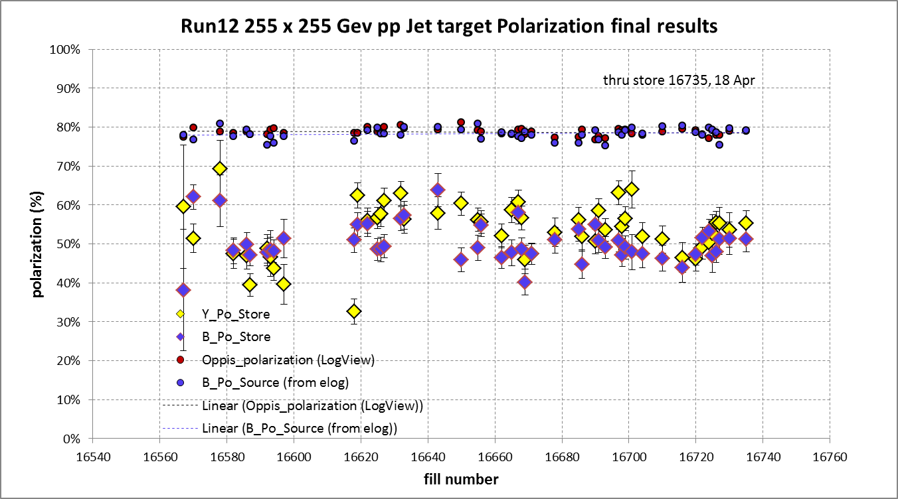
Blue beam at injection jet target result = ? %
average = 78.7%
Blue weighted average = 50.3% ± 0.5%
Yellow weighted average = 53.4% ± 0.5%

Slide 38
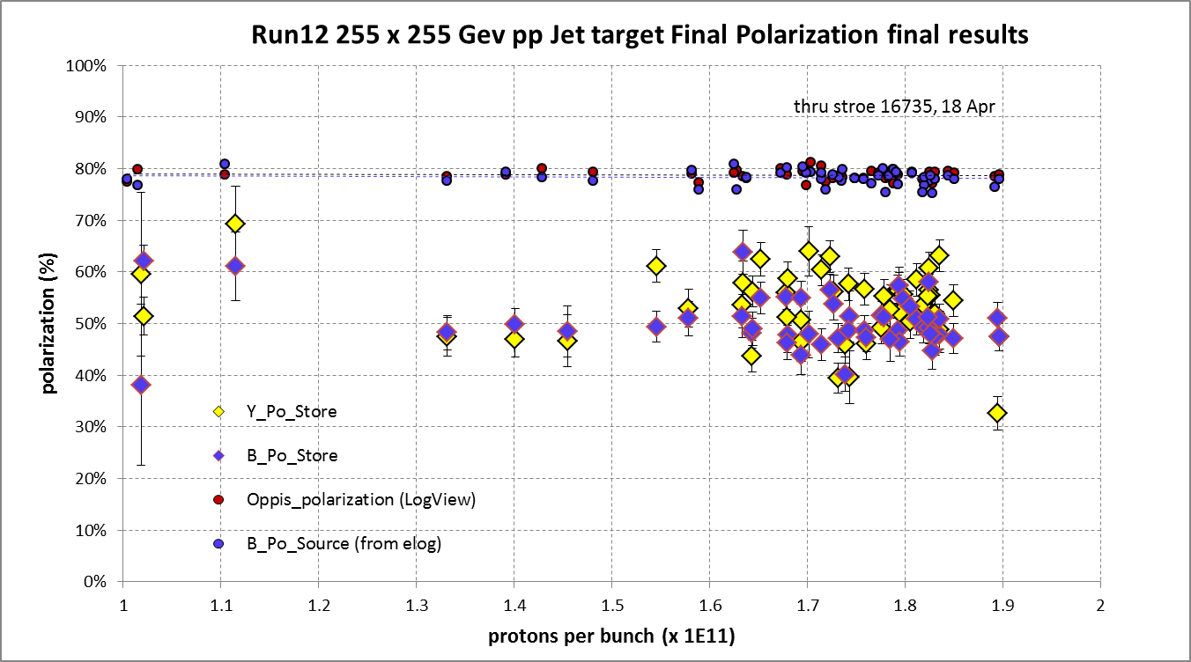

Slide 39
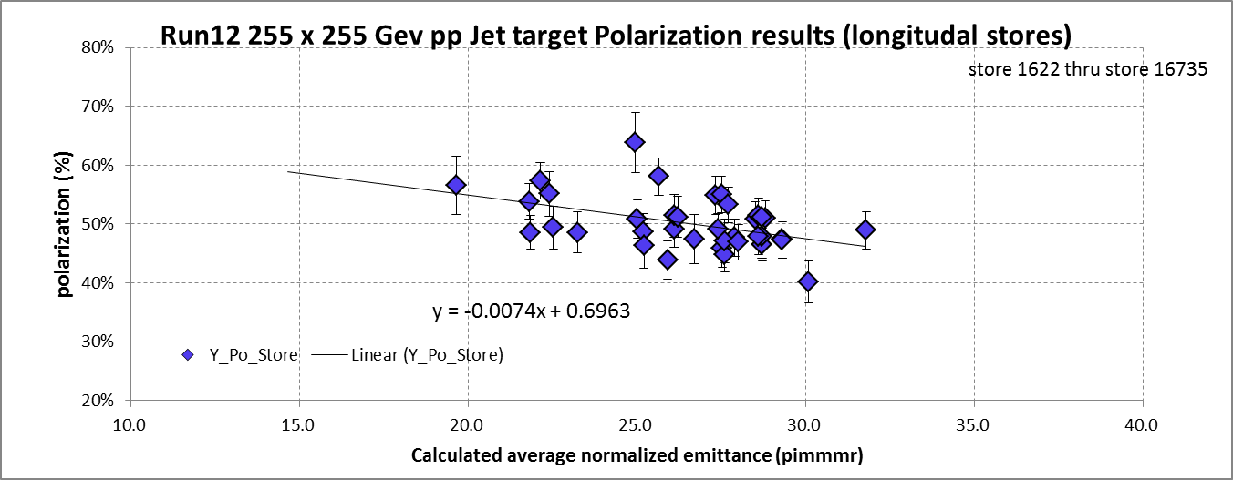
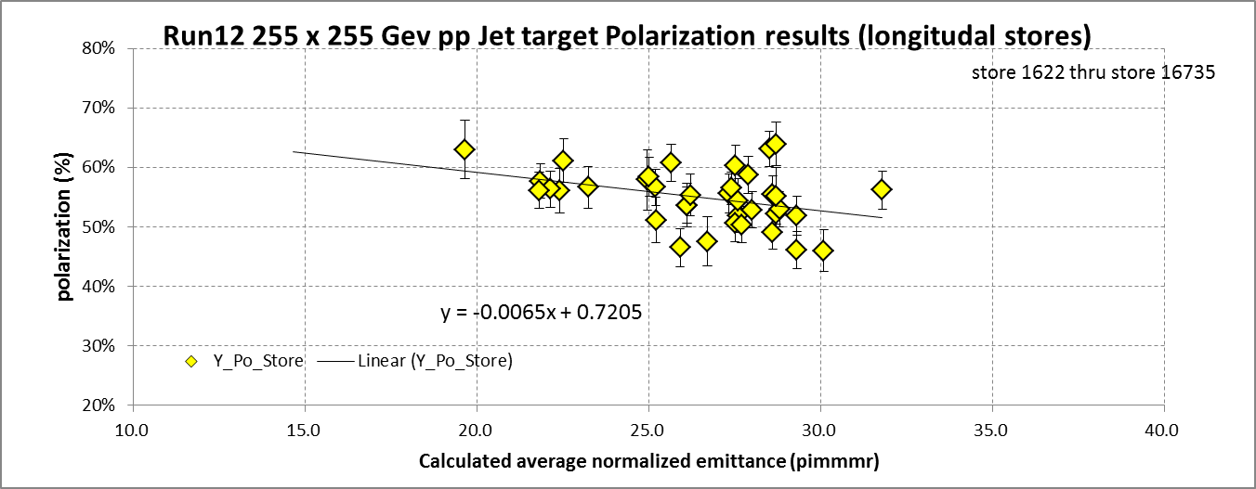

Slide 40
Where we are with Uranium (From K. Zeno)
Into the booster 8 x 10^8 in 4 bunches
These are then combined into one bunch
Booster extraction 6.5 x 10^8 / bunch
30% efficiency into the AGS
AGS extraction is at 2 x 10^8 / bunch
Desired (Wolfram) ~ 7 x 10^8 / bunch
>>> 6 x 10^8 / bunch in RHIC
17 April 2012

Slide 41
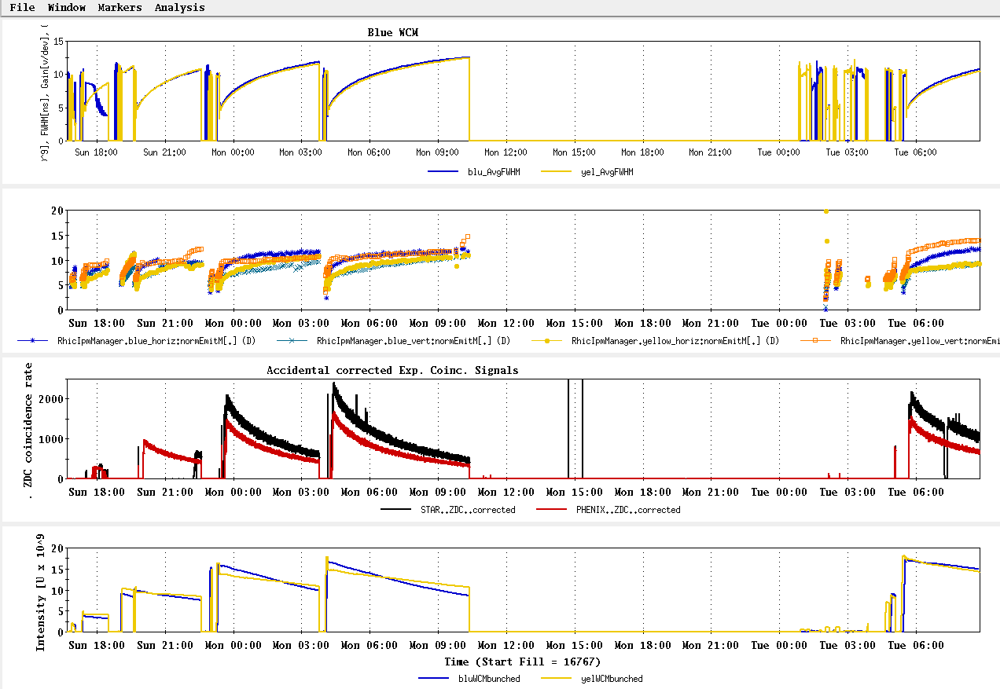
Setup Stores, no rebucketing yet…
√s = 193 GeV/n UU – stores 16769 through 16775

Slide 42
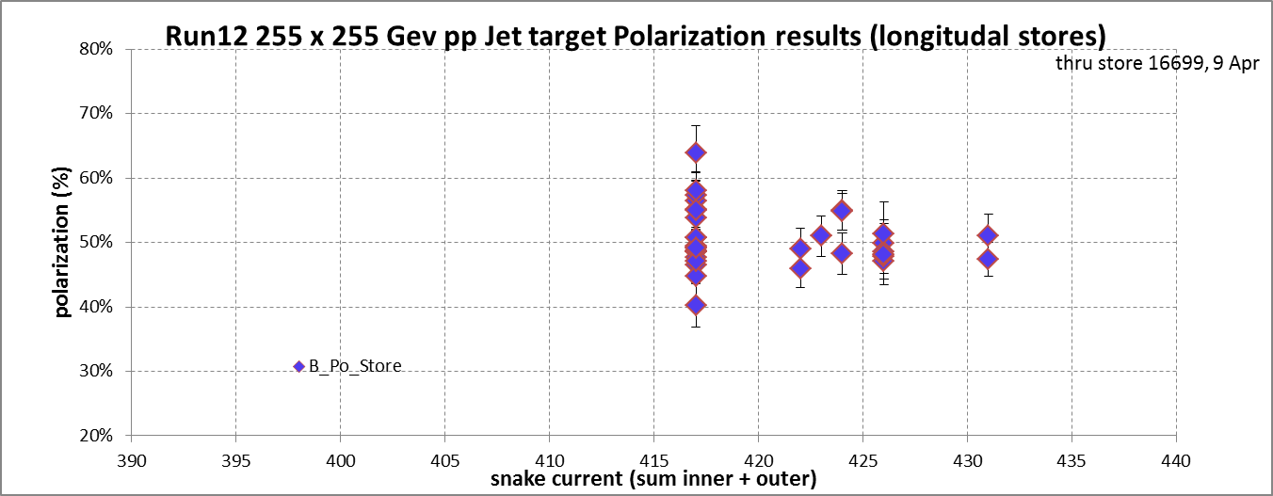
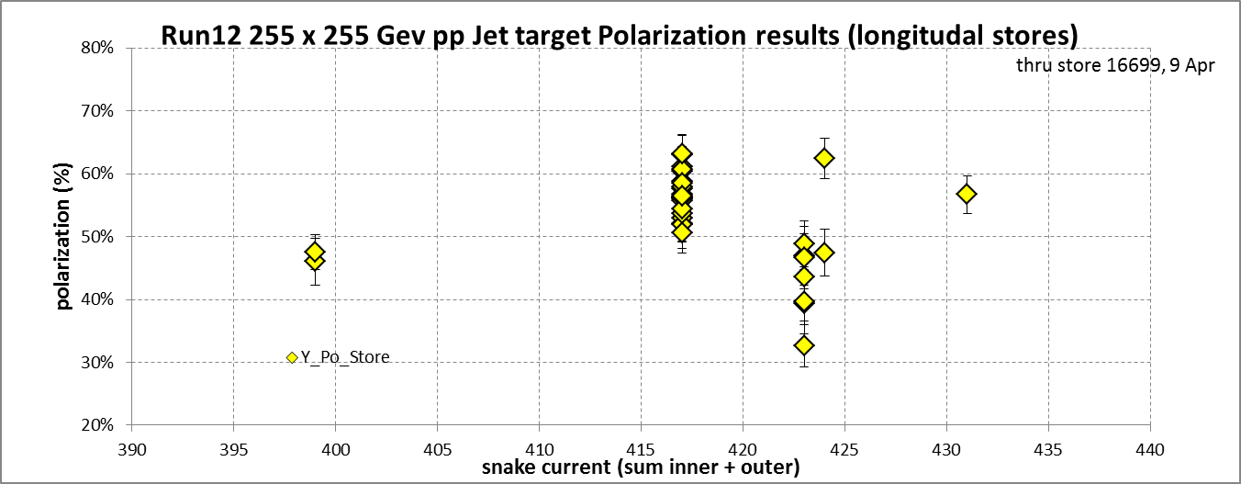

Slide 43
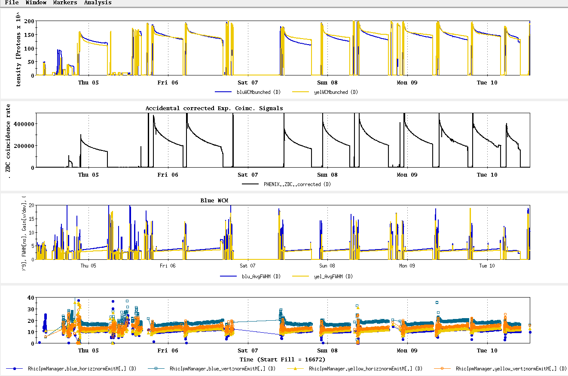
4 Apr – 10 Apr stores

Slide 44
Run 12, √s = 510 GeV polarized proton run – experiment goals
STAR Goal for 5 weeks longitudal polarization (50% polarization):
  Sampled Luminosity = 45 pb⁻¹ with 50% polarization
  Delivered Luminosity = 75 pb⁻¹
PHENIX Goal for 5 weeks longitudal polarization (50% polarization):
  Sampled Luminosity = 30 pb⁻¹ with |z| <30 cm
  = 10 pb⁻¹ with |z| <10 cm
  Delivered Luminosity = 75 pb⁻¹ changed to 120 pb⁻¹, 3/29/12, Ed O’Brien email

Slide 45
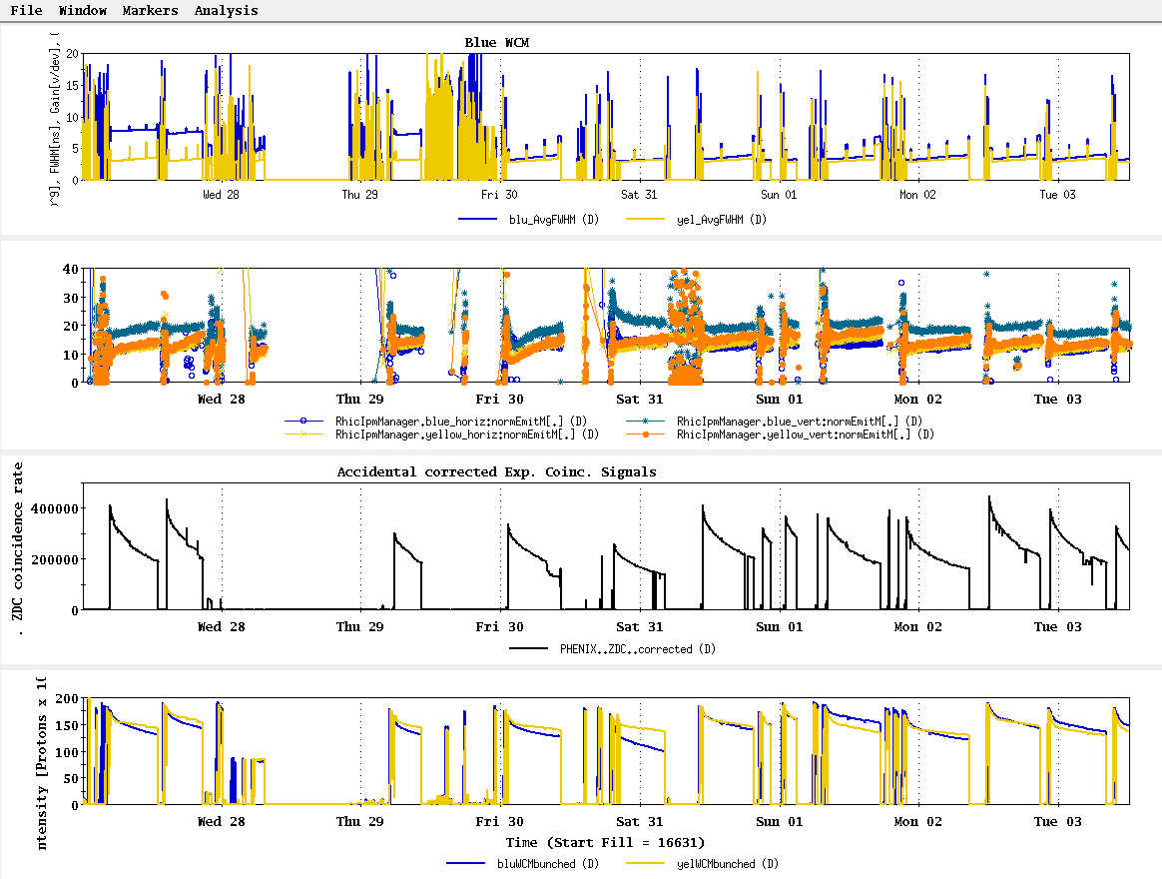
27 Mar – 3 Apr stores

Slide 46
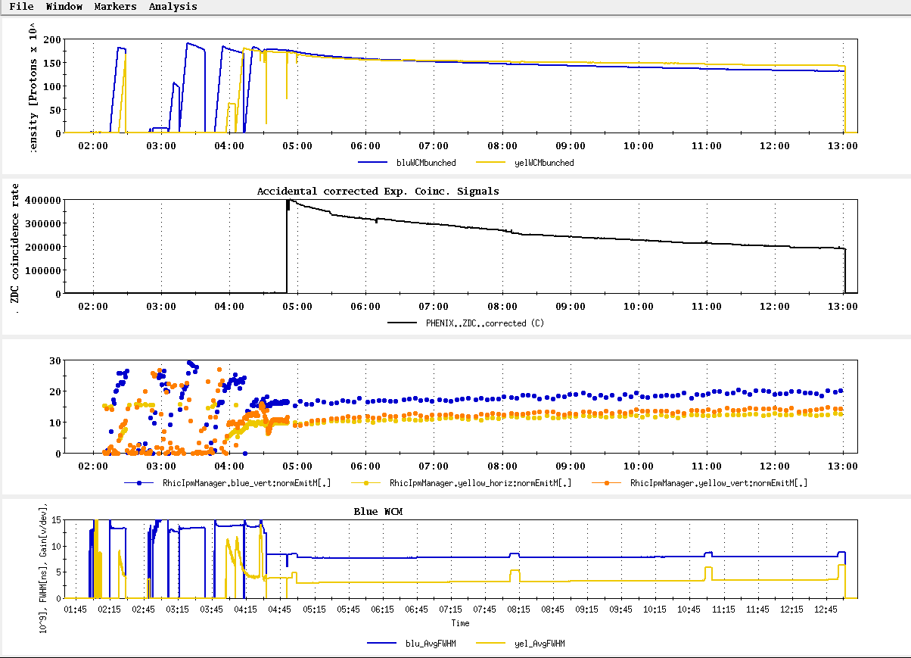
Store 16632, Blue jet = 56.5 +/- 3.0; Yellow jet = 63.0 +/- 3.1
Best average polarization measured by jet for store > 8 hrs

Slide 47
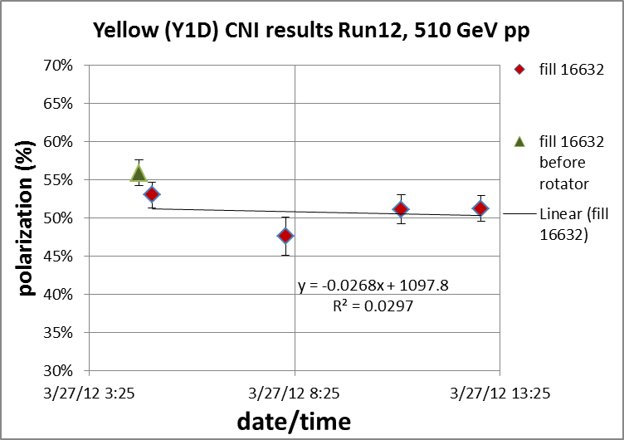
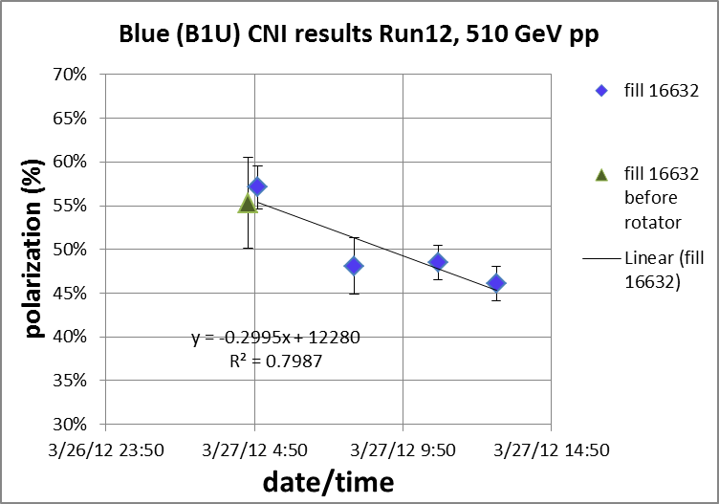
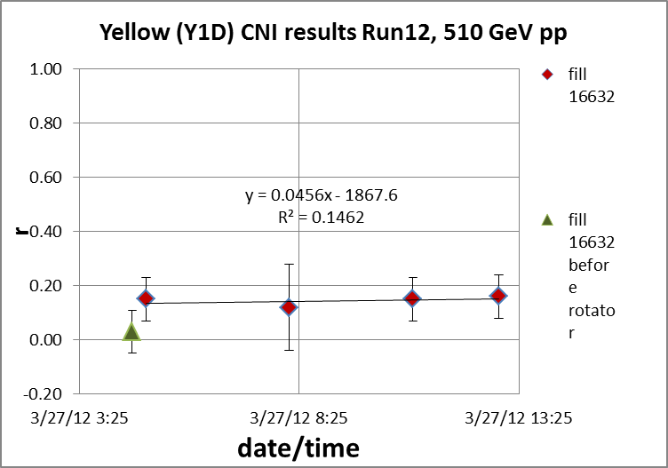
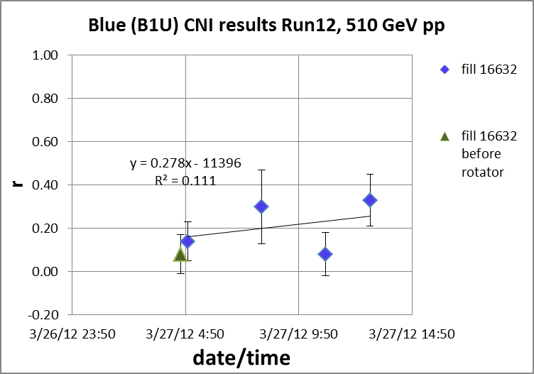

Slide 48
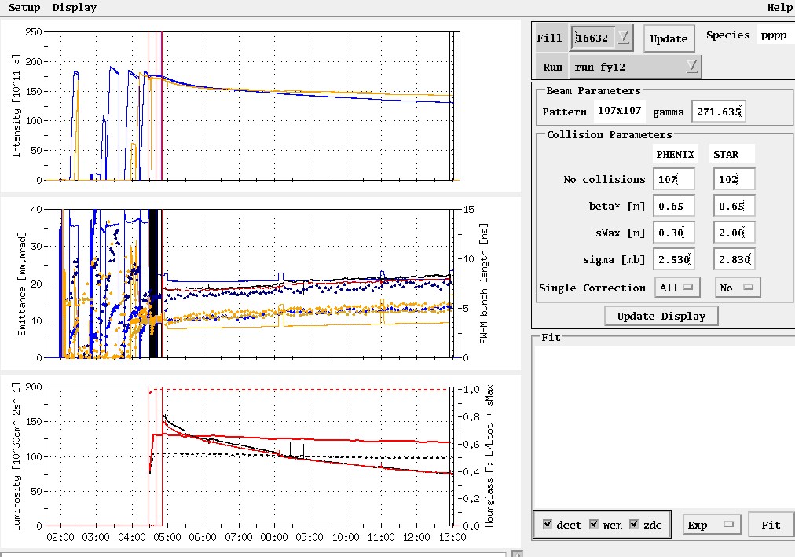
Store 16632
Peak lumi goal
Average lumi goal

Slide 49
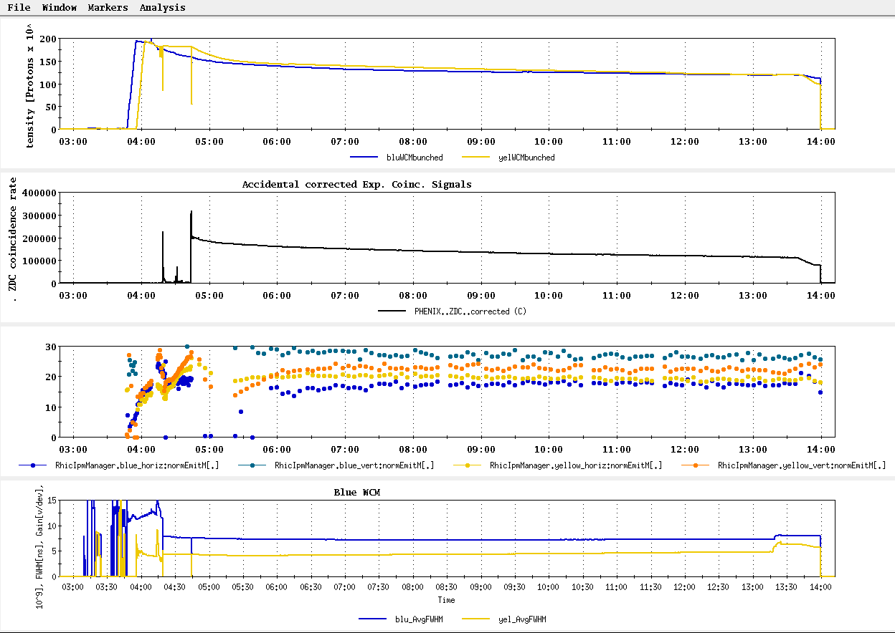
Store 16618, Blue jet = 51.0 +/- 3.2; Yellow jet = 32.6 +/- 3.3
Worst average polarization measured by jet for store > 8 hrs

Slide 50
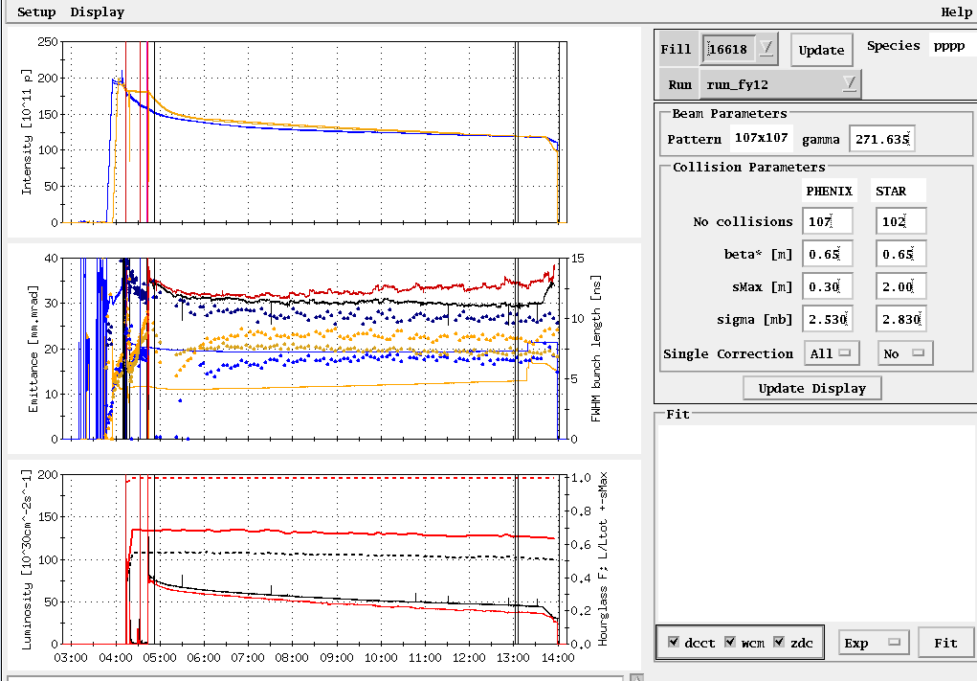
Store 16618

Slide 51
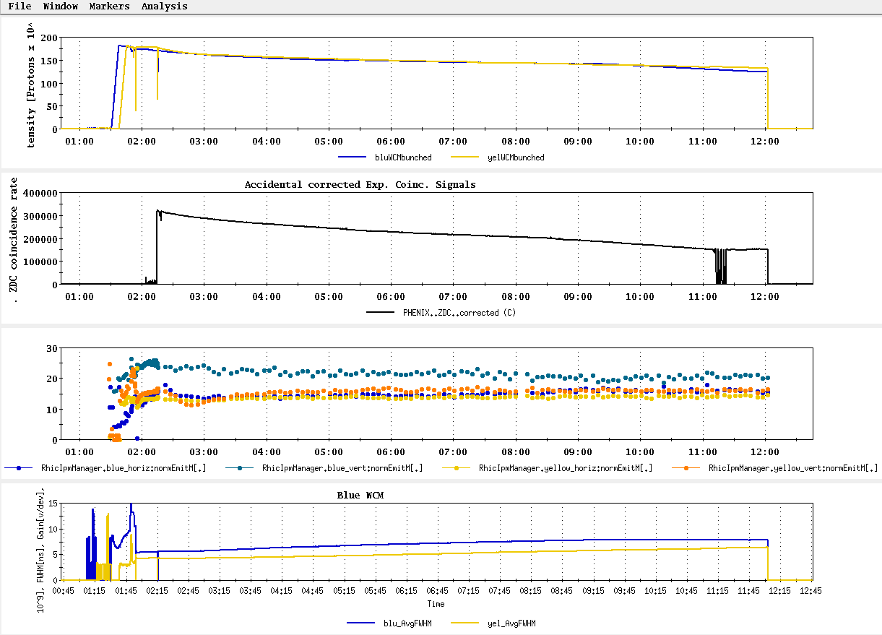
Store 16587, Blue jet = 47.2 +/- 2.8; Yellow jet = 39.4 +/- 2.9
Next to worst average polarization measured by jet for store > 8 hrs

Slide 52
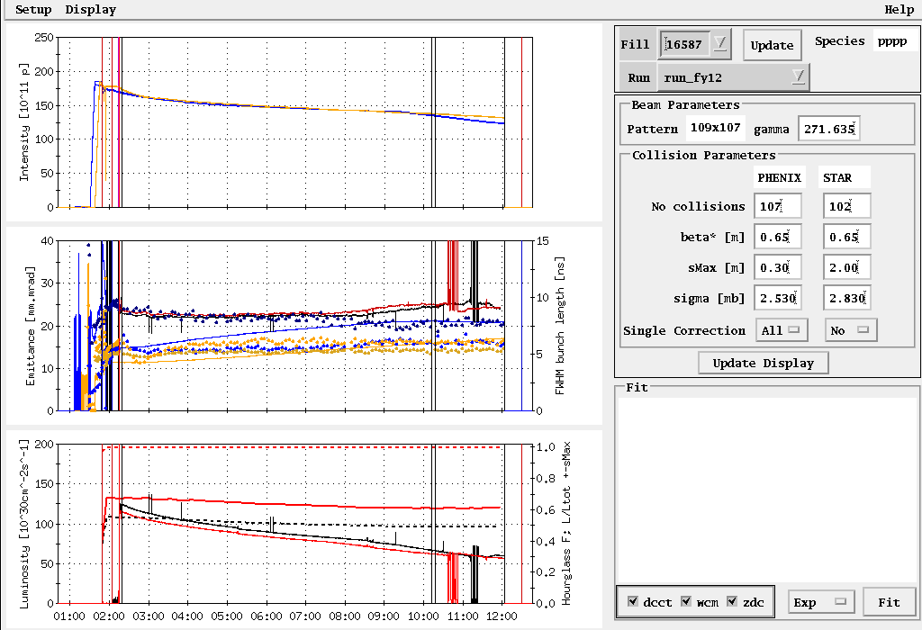
Store 16587

Slide 53
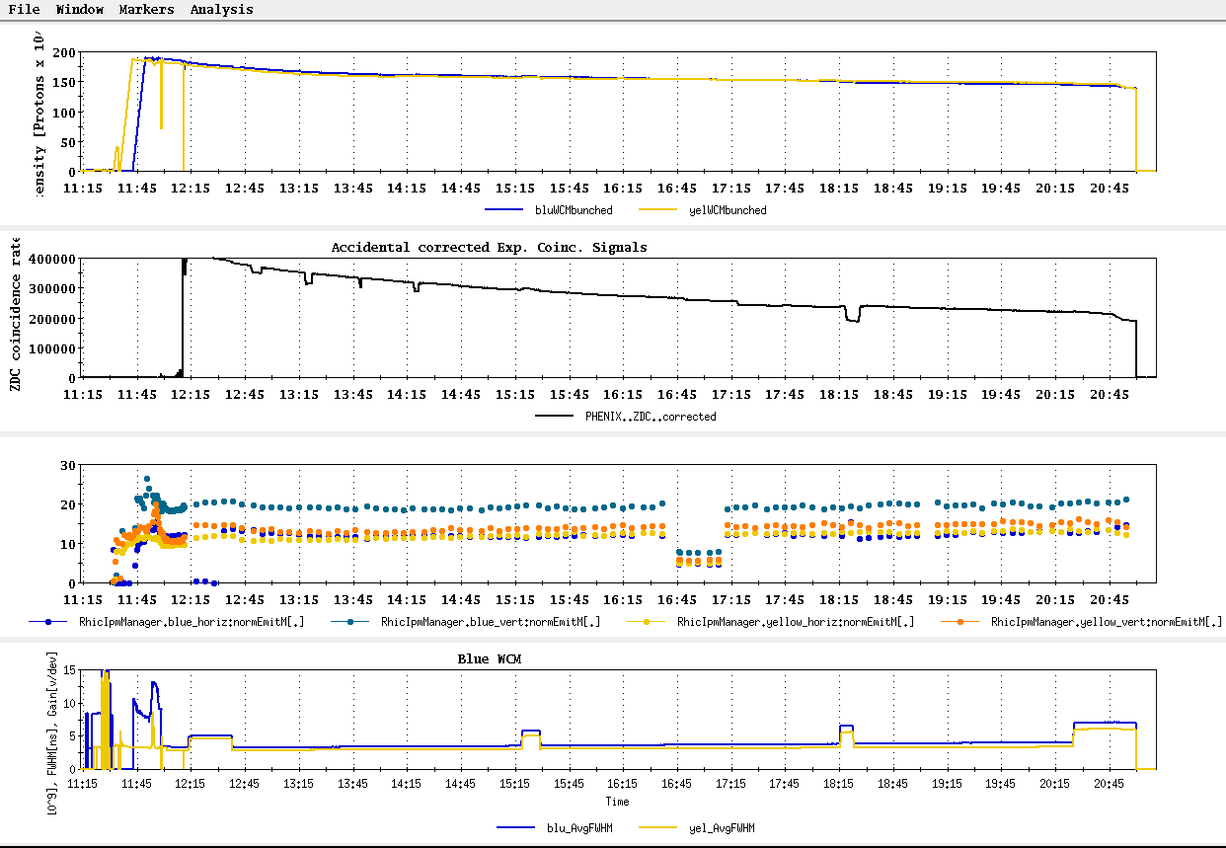
Store 16667, Blue jet = 58.1 +/- 2.9; Yellow jet = 60.7 +/- 3.1
Second best average polarization measured by jet for store > 8 hrs

Slide 54
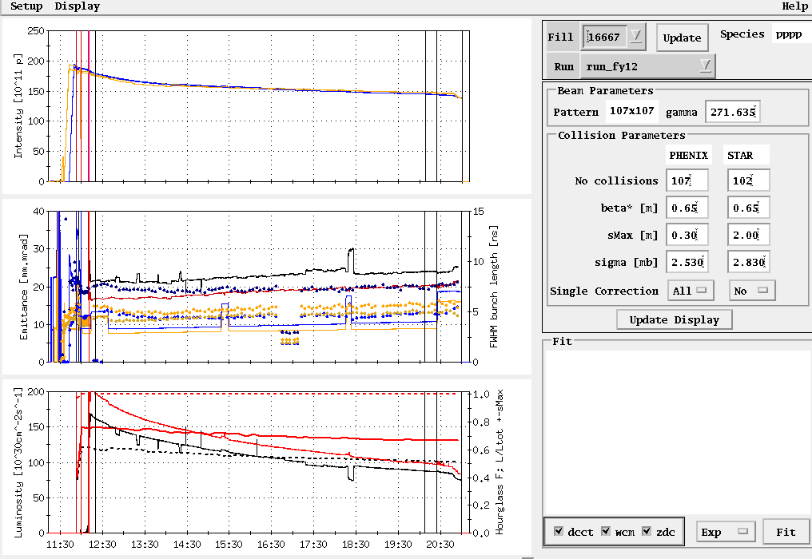
Store 16667
Peak lumi goal
Average lumi goal

Slide 55
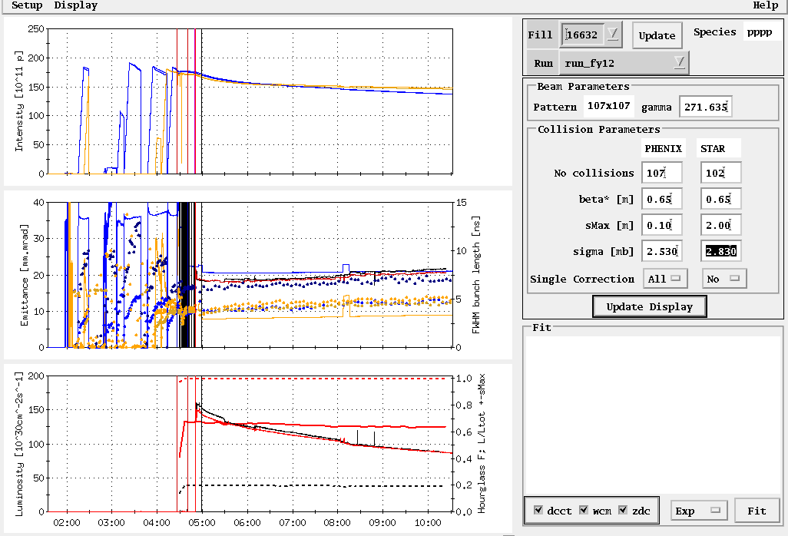
Store 16632, 3/27/12
Peak lumi goal
Average lumi goal
Table2: Max lumi parameters: 1.65x10⁹/bunch, 0.6 β*, 20-25 mmmr emitt → peak = 200x10³⁰ cm⁻²s⁻¹

Slide 56
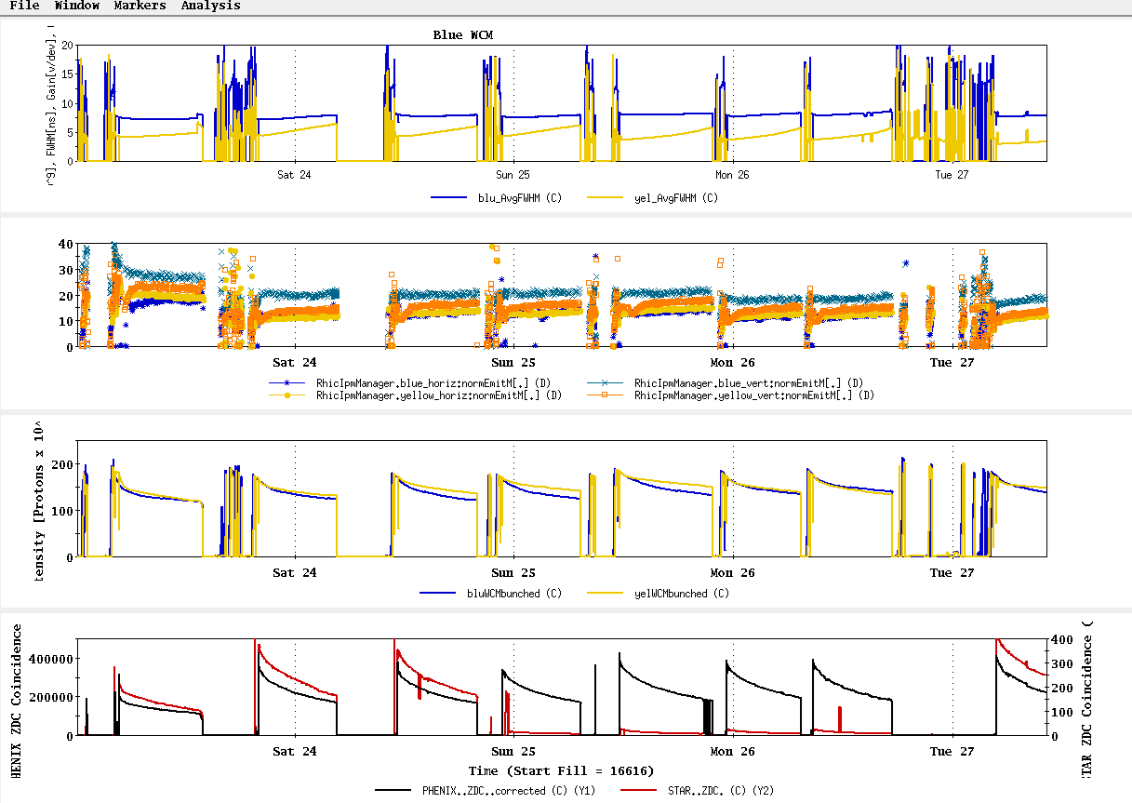
23 Mar – 27 Mar stores

Slide 57



Slide 58

All “physics” stores beginning with16570, 15 March
~L_{store avg} Goal

Slide 59



From “StoreAnalysis” program in “StartUp”
Polarization Goal
16578
16586
16592

Slide 60

Expectation for 5 weeks physics:
45-95 pb⁻¹ delivered luminosity with 45-50% polarization
P⁴L ~ 4 pb⁻¹

Slide 61

STAR & PHENIX Polarization Goals
Offline polarization is larger
Blue Jet weighted average = 61.2% ± 0.5%; source blue average = 77.5% → 20% lost
Yellow Jet weighted average = 55.8% ± 0.5%; source yellow average = 77.4% → 28% lost

Slide 62


Slide 63


Target (max projection)
Best stores, 16475 and 16534

Slide 64


Best stores, 16475 and 16534

Slide 65

Fill 16475, 27 Feb, 8.9 hours physics store (10 hour Lumi on Store), PHENIX 1.03 pb⁻¹

Slide 66


Fill 16475, 27 Feb, 8.9 hours physics store (10 hour Lumi on Store), PHENIX 1.03 pb⁻¹
beginning
end

Slide 67


Fill 16475, 27 Feb, 8.9 hours physics store (10 hour Lumi on Store), PHENIX 1.03 pb⁻¹
beginning
end

Slide 68

Fill 16534, 9 Mar, 8.1 hours physics store (9.1 hr Lumi on store), PHENIX 1.04 pb⁻¹

Slide 69


Fill 16534, 9 Mar, 8.1 hours physics store (9.1 hr Lumi on store), PHENIX 1.04 pb⁻¹
Beginning
End

Slide 70


Fill 16534, 9 Mar, 8.1 hours physics store (9.1 hr Lumi on store), PHENIX 1.04 pb⁻¹
Beginning
End

Slide 71


Slide 72

Past Week
L_{average}(max)
(0.29 mb xsection)
Ions/bunch (max)

Slide 73


Slide 74

Run 12 Physics Stores to 28 Feb
Absolute scale should not be trusted)
L_{average}(max)
(0.29 mb xsection)

Slide 75

Store 16480 (27 Feb) – typical background issues
PHENIX
STAR
ZDC without and
with singles correction
ZDC without and
with singles correction
Protons/bunch
Protons/bunch
ZDC Singles
ZDC Singles

Slide 76

Store 16480 (27 Feb) – typical background issues

Slide 77

Store 16480 (27 Feb) – typical background issues

Slide 78

Collision steering corrections background issues 26-27 Feb
ZDC Singles
ZDC Coincidence

Slide 79

Example -- Store 16445, Sat Feb 18
L_{peak}(max)
L_{store average}(max)

Slide 80
Blue Jet weighted average = 55.4 ± 0.5
Yellow Jet weighted average = 54.9 ± 0.5

Slide 81
Run 12 projection for √s = 200 GeV pp
STAR Goal: 27 pb-1 delivered with 55-60 % polarization
PHENIX Goal: 27 pb-1 delivered with 55-60 % polarization
p²L = 8.2 pb⁻¹ for 55% polarization
From Fischer et. Al. “RHIC Collider Projections (FY 2012 – FY 2016)” 14 October 2011

Slide 82

First Physics Store (#16397, 04:01, 10 Feb)

Slide 83

Today, 7 Feb 2012

Slide 84

Typical Store from Run 9, 100 x 100 GeV pp

Slide 85

As of 16:18 hrs 20 Jan
Start cooldown
3.5 days

Slide 86
Recommendations following the June 6-8, 2011 PAC
For Run 12 the PAC recommends the following (in order of priority):
5 weeks of running with polarized proton collisions at 200 GeV.
7 weeks of running with polarized proton collisions at 500 GeV.
5 weeks of running with Cu+Au collisions at 200 GeV.
3 weeks of running with U+U collisions at 193 GeV.
For Run13 the PAC recommends the following (not in order of priority):
12 weeks of running with polarized proton collisions at 500 GeV.
5 week of running with polarized proton collisions at 200 GeV.
7 weeks of running with Au+Au collisions at full energy.

Slide 87
Cryo Issue
D.L. November 23, 2011 update
Our helium supplier no longer able to meet our peek demand of 4 trailers in a one week period. They can give us one trailer a week starting on December 31st, so we expect to have all the helium we need, on time, but we will have to store most of it in the dewars outside 1006B. This will result in our 4K cooldown being a little less stable and predictable than it has been for the past few years when we received all of the helium at 1005R over a short period of time. Because of this, I expect the 4K cooldown will take a least one additional day.

Slide 88


Slide 89

From Fischer et. al. “RHIC Collider Projections (FY 2012 – FY 2016)” 14 October 2011

Slide 90
Run 12 projection for √s = 500 GeV pp
From Fischer et. Al. “RHIC Collider Projections (FY 2012 – FY 2016)” 14 October 2011

Slide 91
Run 12 projection for √s = 193 GeV/n UU
From Fischer et. Al. “RHIC Collider Projections (FY 2012 – FY 2016)” 14 October 2011

Slide 92
Run 12 projection for √s = 200 GeV/n CuAu
From Fischer et. Al. “RHIC Collider Projections (FY 2012 – FY 2016)” 14 October 2011

