Slide 1
Run 12 RHIC Machine/Experiments Meeting
19 Jun 2012
Agenda:
Status Reports
STAR/AnDY request for collisions at 2:00
Other business

Slide 2
Run 12 Plan based on 20 weeks cryo operation
23 week schedule based on 4/10/12 Vigdor guidance, 6 June update
17 Jan, Begin cool-down to 4.5K
20 Jan, Cool-down to 4.5K in Blue and Yellow Ring complete, begin magnet setup
21-28 Jan, pp injection setup
28 Jan-3 Feb, LLRF, Ramp and store setup, begin 8 hr/night for experiments
3-10 Feb, 1 week ramp-up with 8 hrs/night for experiments
10 Feb, with store # 16397, begin 4 weeks pp physics with further ramp-up
16 Feb, 24/7 stores begin
12 (Monday) March, end 4.4 week pp physics √s = 200 GeV, begin ½ week setup for √s = 510 GeV pp
16 March, begin 5 week pp physics (machine only) √s = 510 GeV
17/18 March, STAR/PHENIX physics start with longitudal polarization
18 April (Wednesday 1300), end physics begin pp beam development/APEX
19 April (Thursday, 0800), end 4.9 week pp physics at √s = 510 GeV
19 April (Thursday, store 16580), begin 1 week setup for UU
22 April (evening) first overnight stores for experiments
25 April (Wednesday), begin 3 week UU physics run
15 May (Tuesday) end 2.9 week UU physics √s = 193 GeV/n, begin setup for √s = 200 GeV/n CuAu
18 May (Friday, store 16889) begin CuAu physics run
Today – 19 Jun
25 June (Monday, 08:00), end 5.5 week √s = 200 GeV/n CuAu run
25 June, begin √s = 5 GeV/n AuAu development
27 June (Wednesday, 08:00 – earlier if test complete) begin cryo warm-up
30 June, cryo warm-up complete (23.6 cryo-weeks)
Total Physics Weeks = 17.7

Slide 3
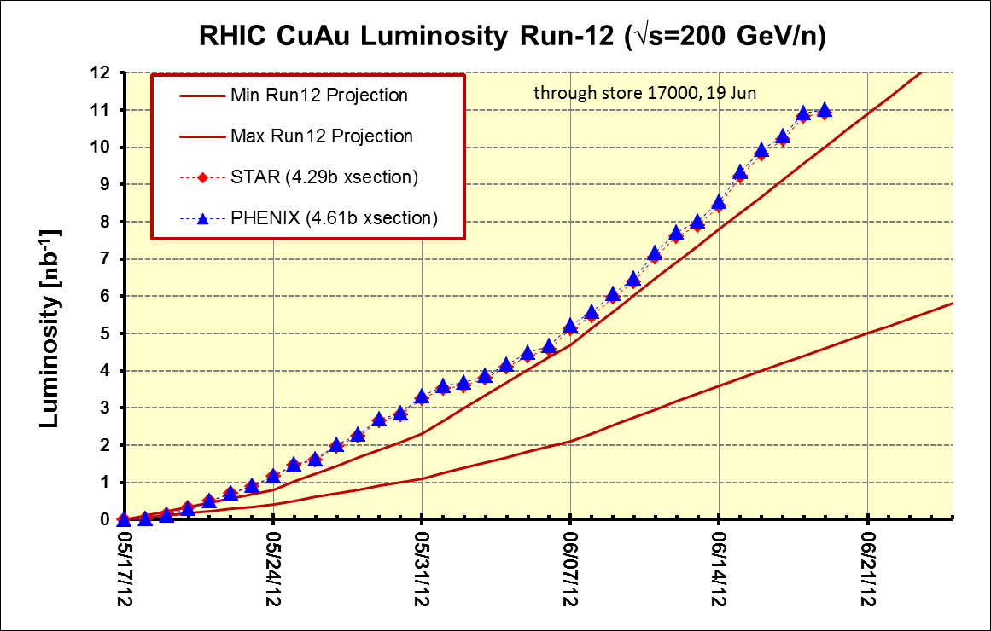
PHENIX BUR Goal = 2.4 nb⁻¹ sampled, ~11 delivered
STAR Goal = ~5 nb⁻¹ sampled, ~8 nb⁻¹ delivered
Goals
PHENIX
STAR

Slide 4
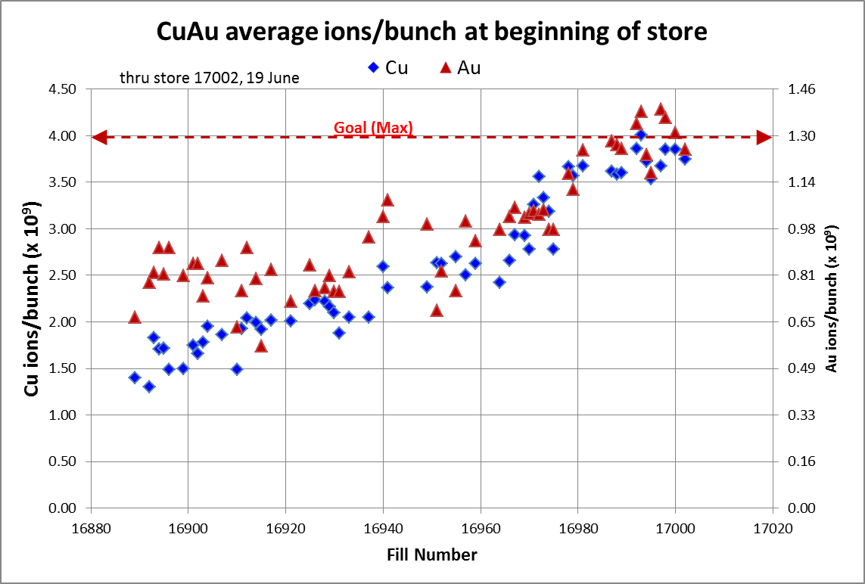
Through store 17002, 19 June
http://www.rhichome.bnl.gov/AGS/Operations/Run12/Run12_Lumi_100Cu_100Au.xlsx
and LogView

Slide 5
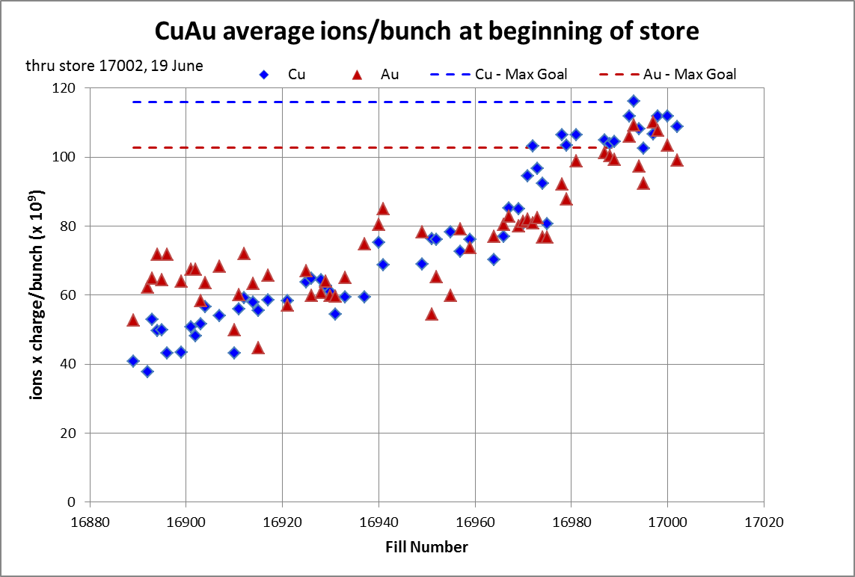

Slide 6
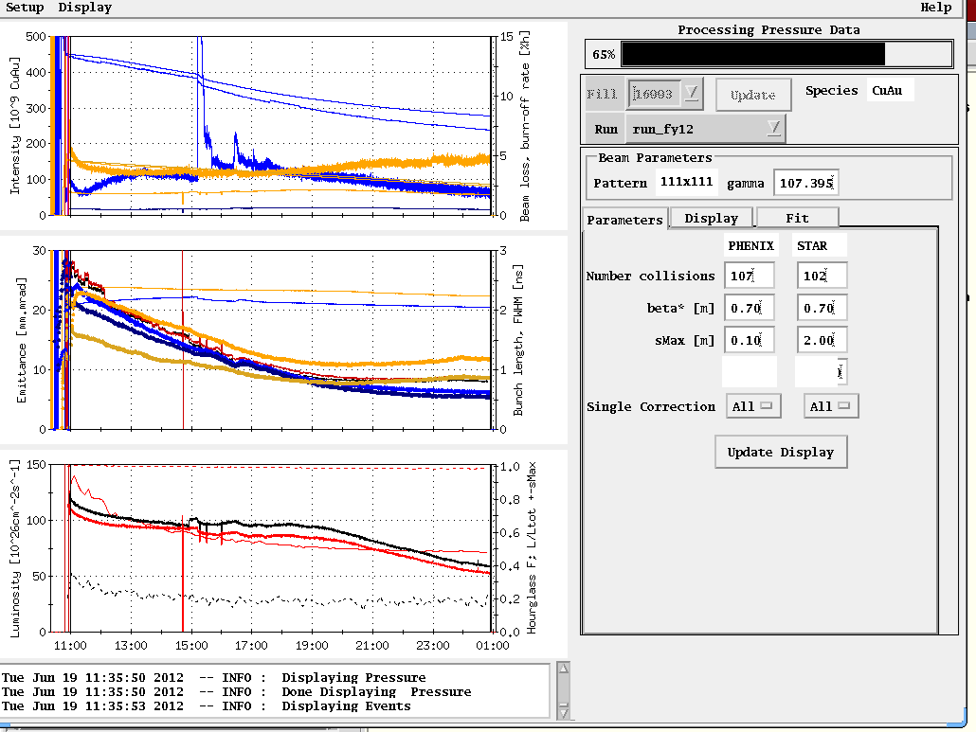
Store 16993, 15 Jun (both Cu and Au above Max!)
Average Lumi (Max) Goal

Slide 7
Other Slides

Slide 9
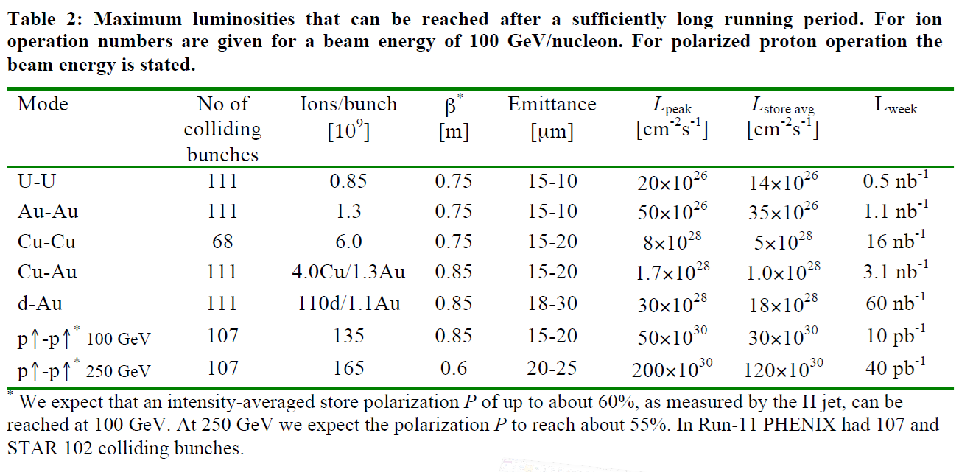

Slide 10
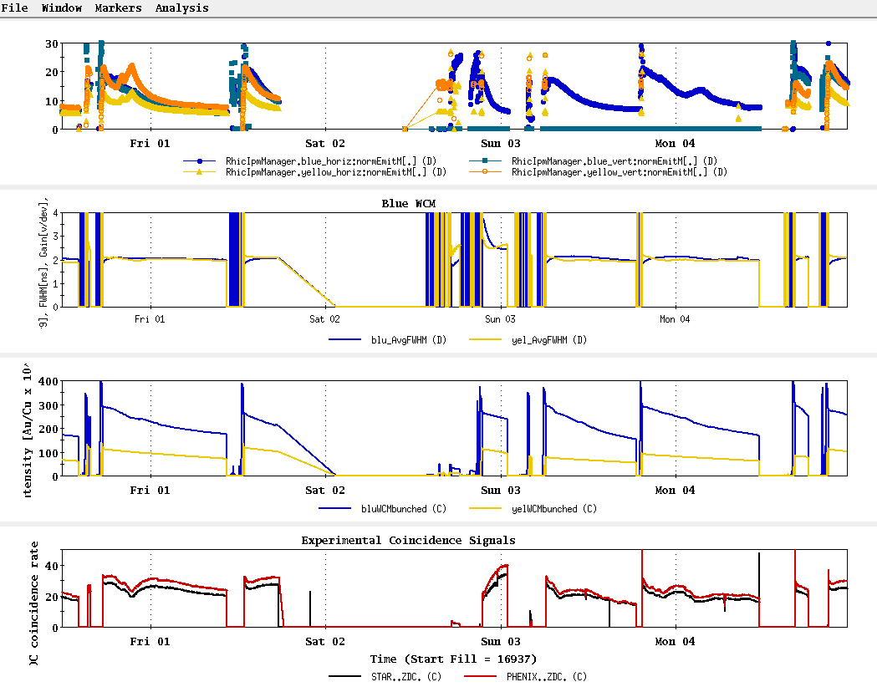
Stores 16940 thru 16959

Slide 11
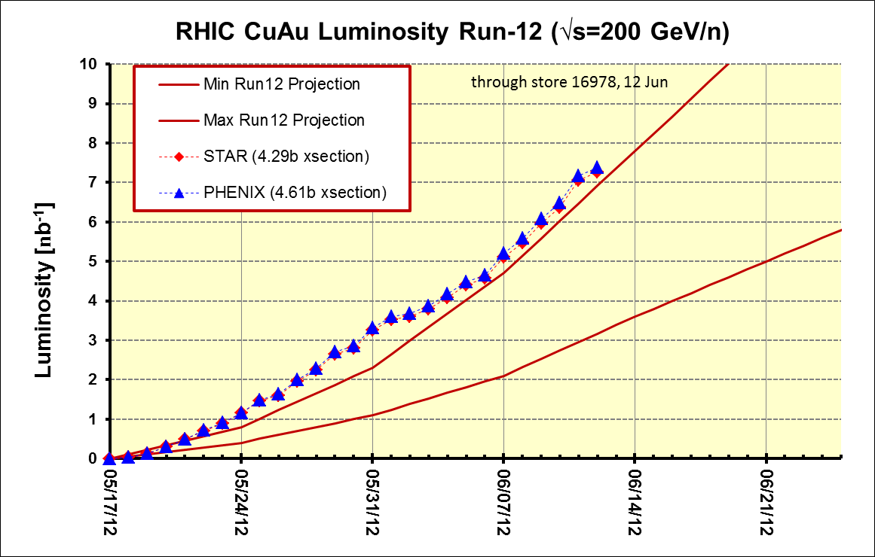
PHENIX BUR Goal = 2.4 nb⁻¹ sampled, ~11 delivered
STAR Goal = ~5 nb⁻¹ sampled, ~8 nb⁻¹ delivered

Slide 12
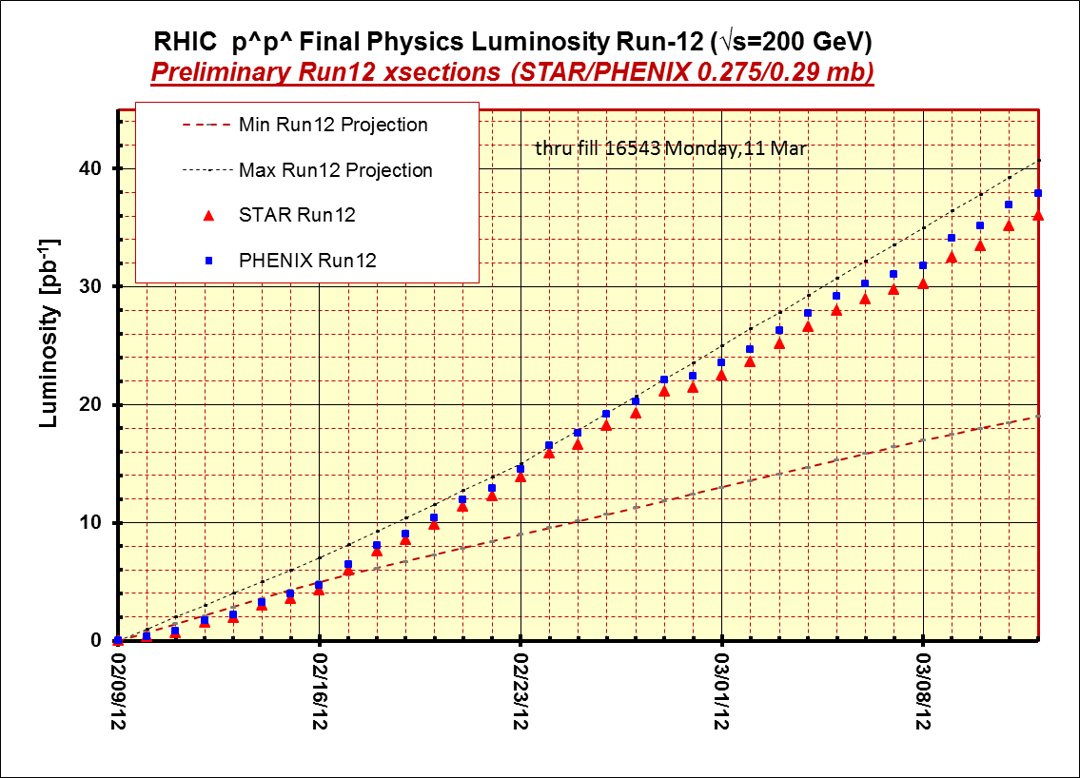

Slide 13
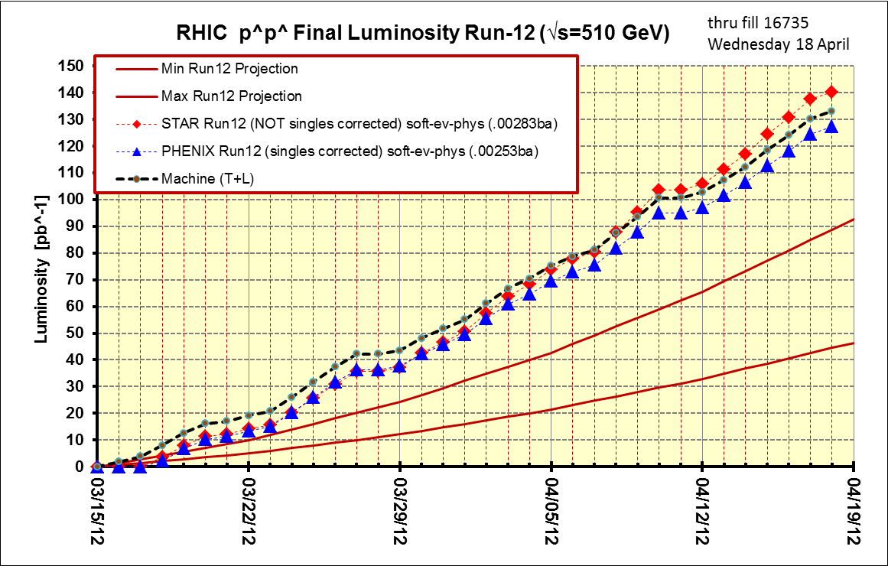
Thru final store, 16735, 18 Apr

Slide 14
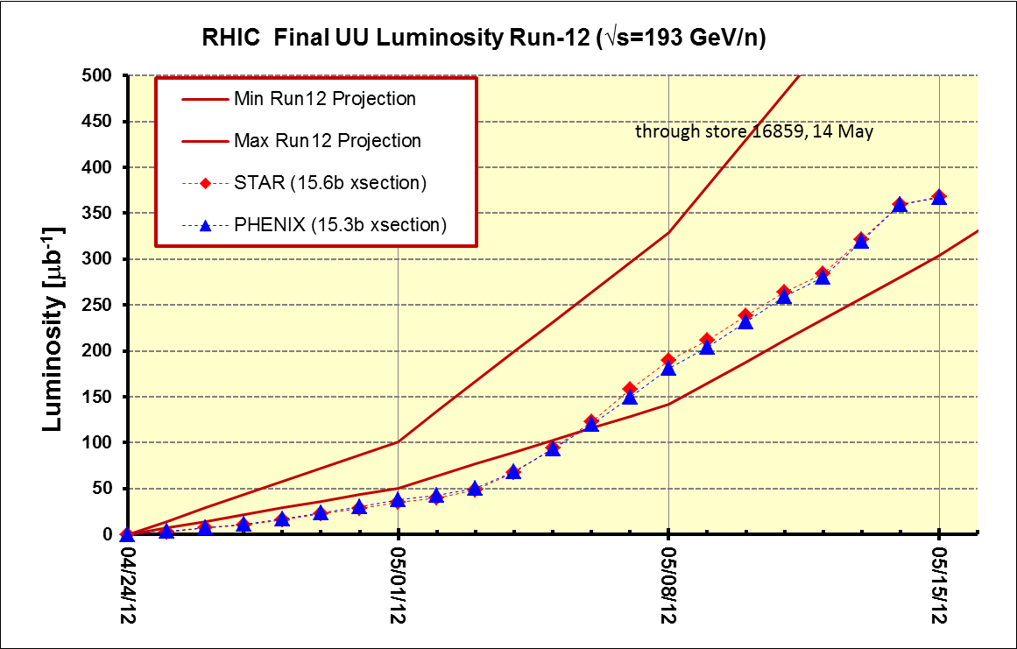

Slide 15
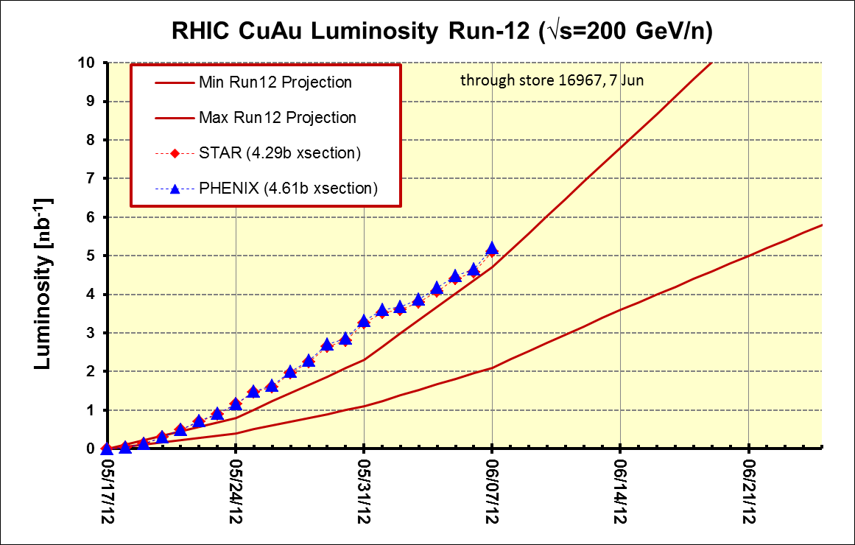
PHENIX BUR Goal = 2.4 nb⁻¹ sampled, ~11 delivered
STAR Goal = ~5 nb⁻¹ sampled, ~8 nb⁻¹ delivered

Slide 17
Thru final store, 16735, 18 Apr

Slide 18
368 μb⁻¹

Slide 19
STAR & PHENIX Goal

Slide 20
Thru final store, 16735, 18 Apr
PHENIX Goal
STAR Goal

Slide 21
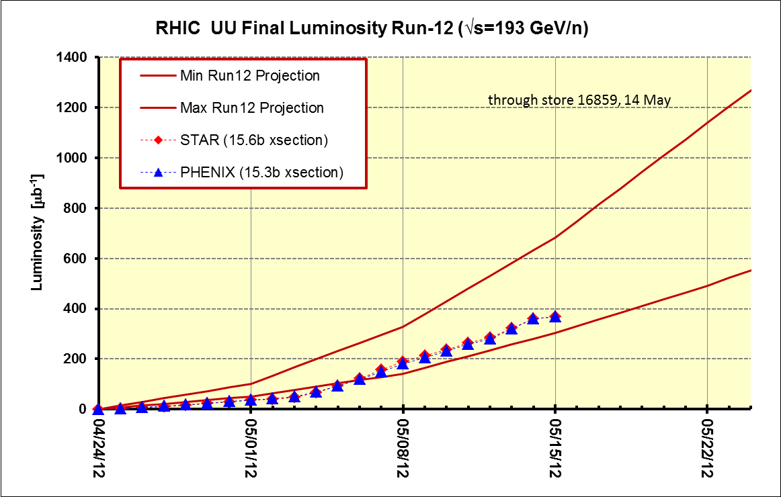
Best store (16857) = 3.0 x 10⁸ ions/bunch, blue/yellow beginning of store (physics)
~8.5 x 10⁸ ions/bunch
STAR and PHENIX ~Goals
~6 x 10⁸ ions/bunch
~3 x 10⁸ ions/bunch

Slide 22
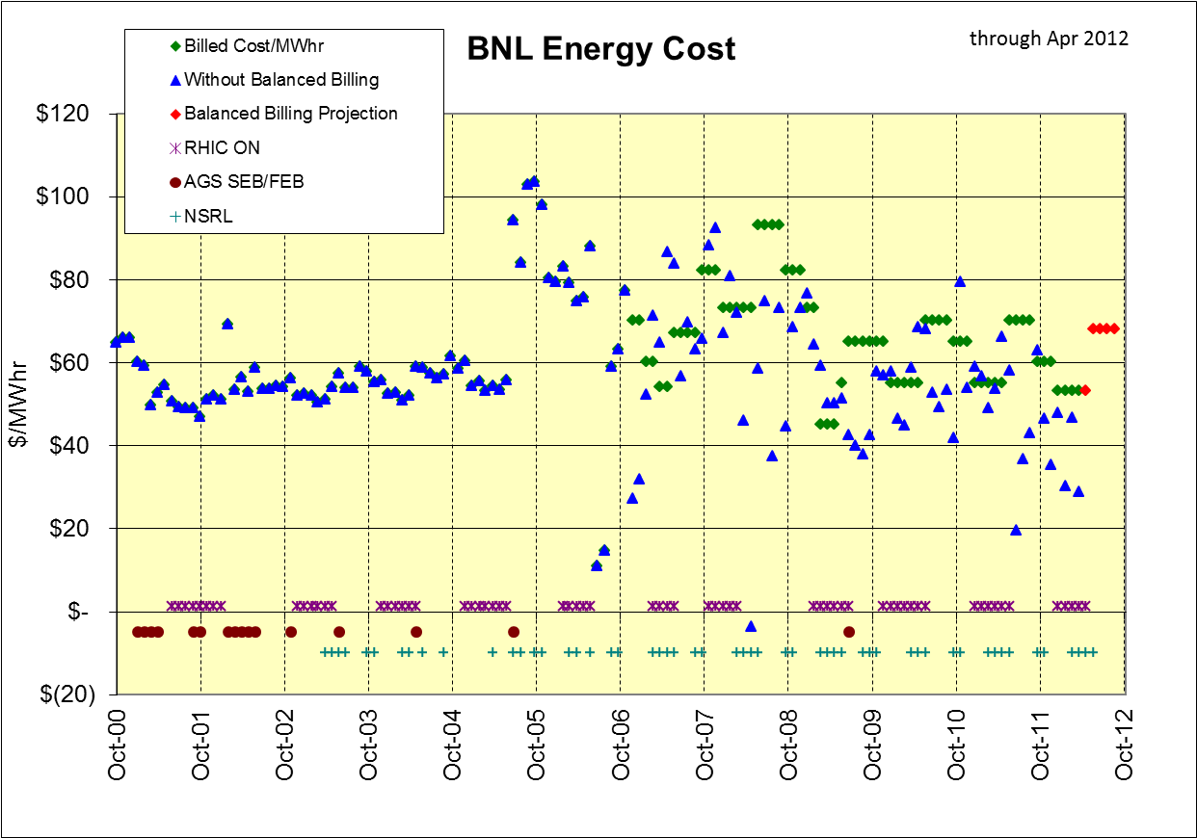
Total in bank through April = $2,781K (CAD contribution = $1,360K)
Total CAD rebate to date = $625K (owed $735K)

Slide 23
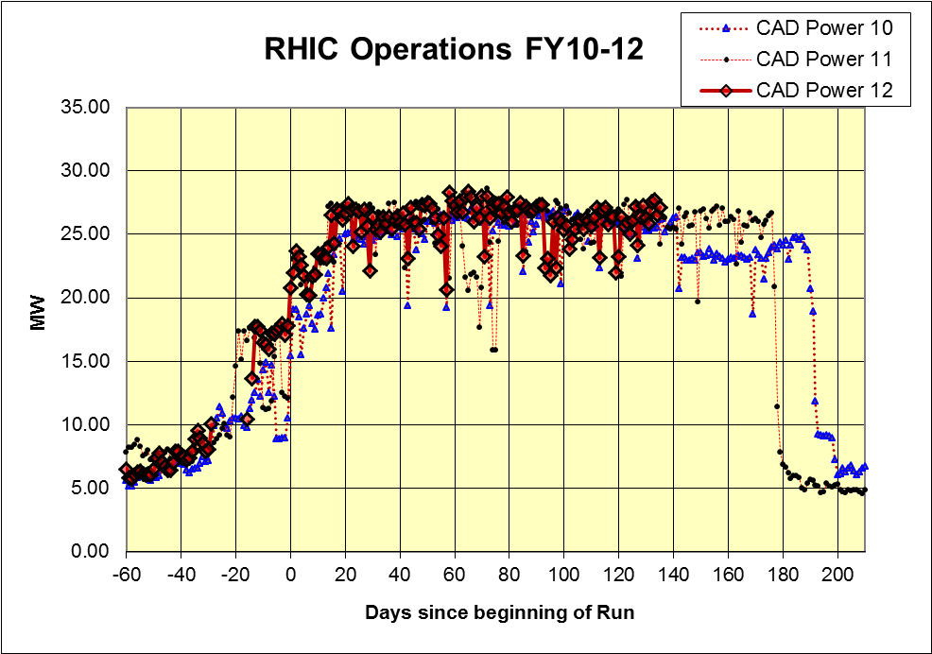
Thru 31 May

Slide 24
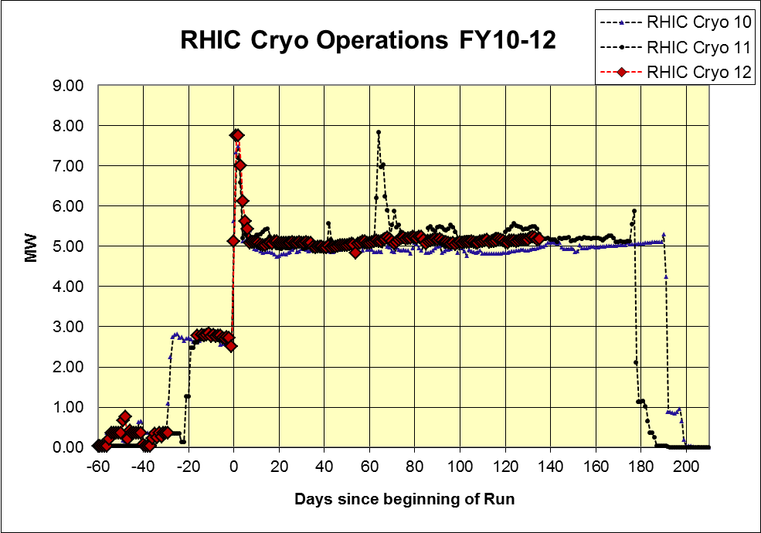
Thru 31 May

Slide 25
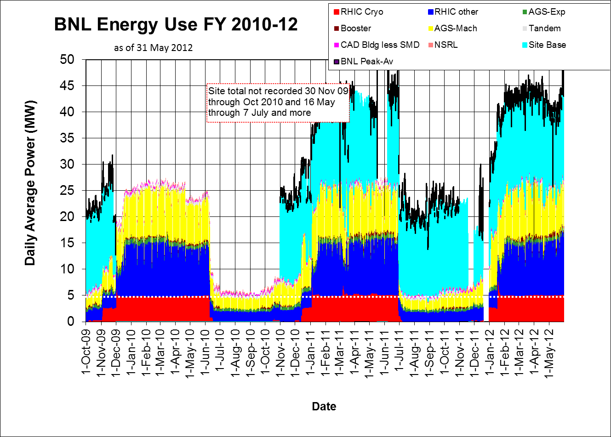

Slide 26
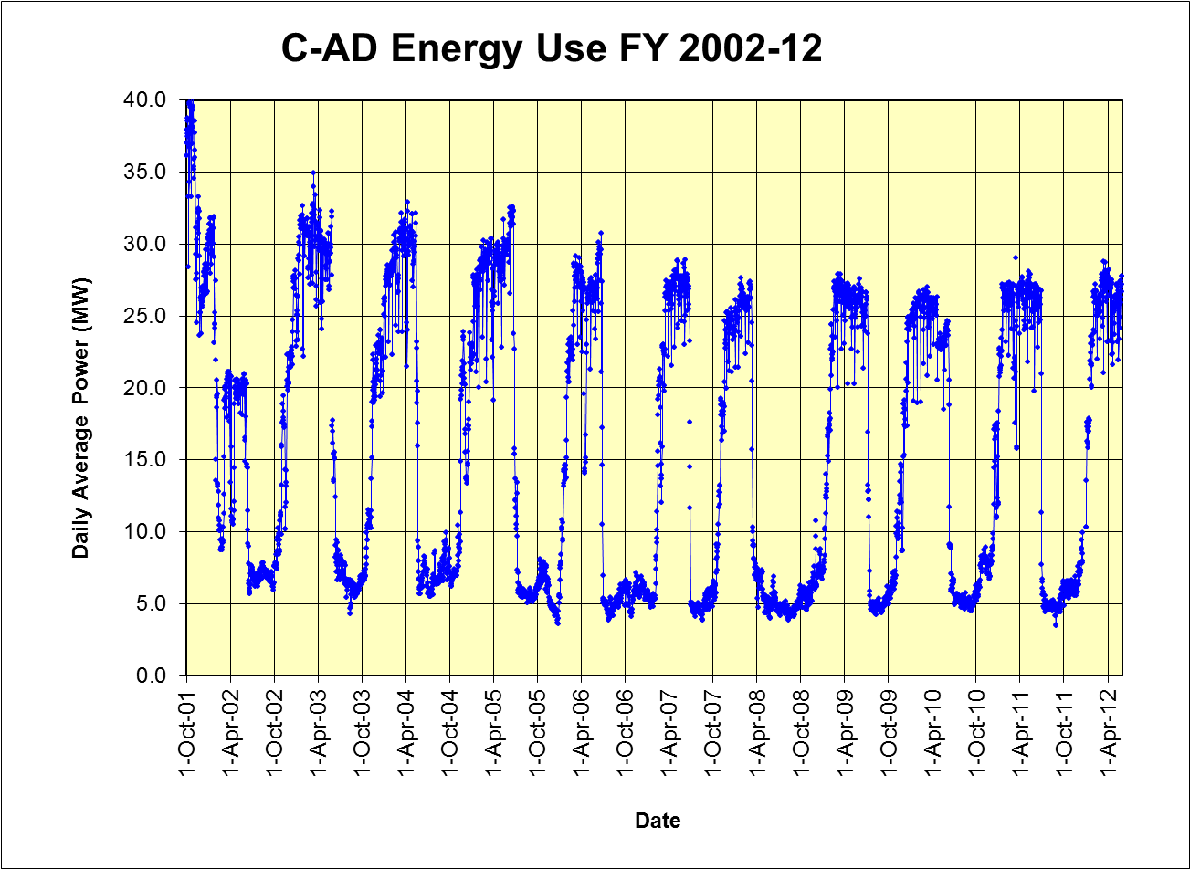
Thru 31 May

Slide 27
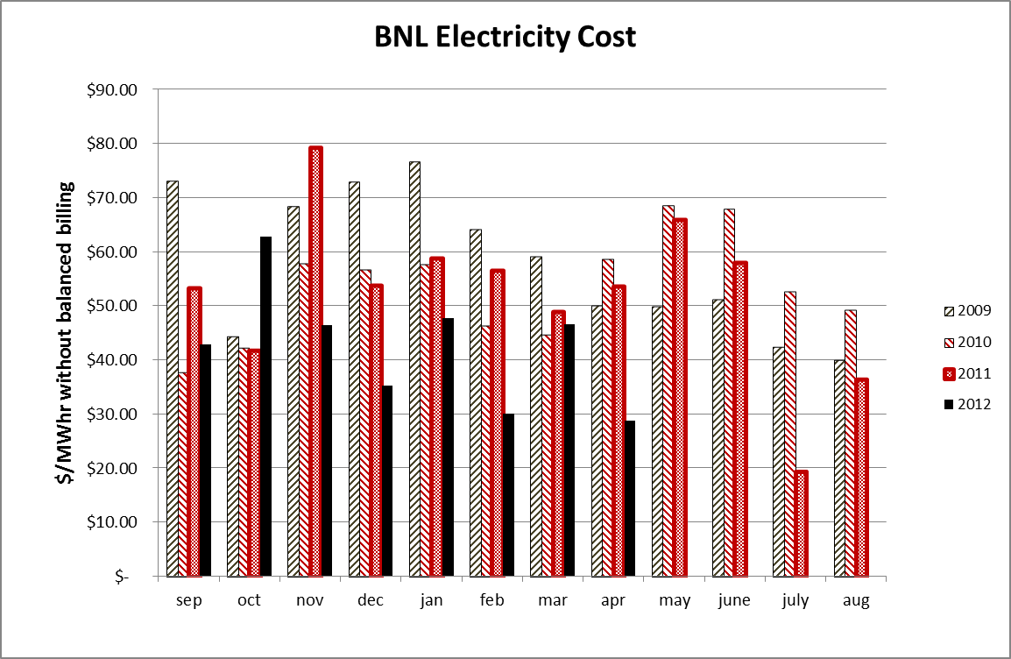

Slide 28
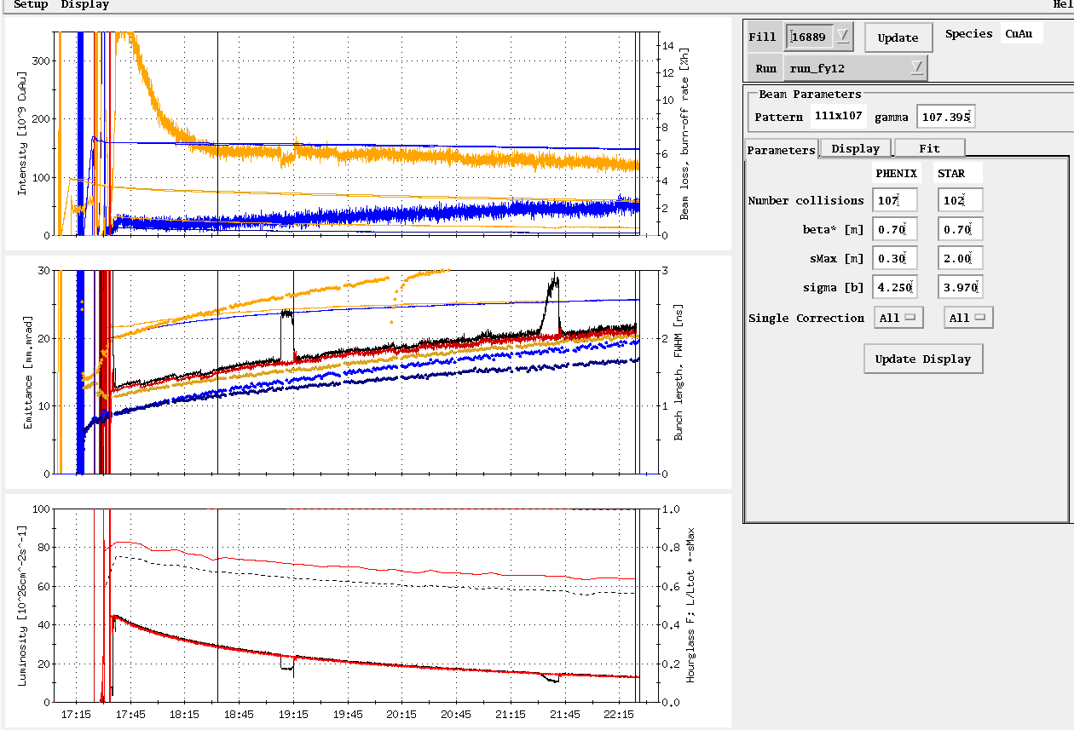
Store 16889, 18 May (first physics store)
Average Lumi Max Goal
Average Lumi Max Goal

Slide 29
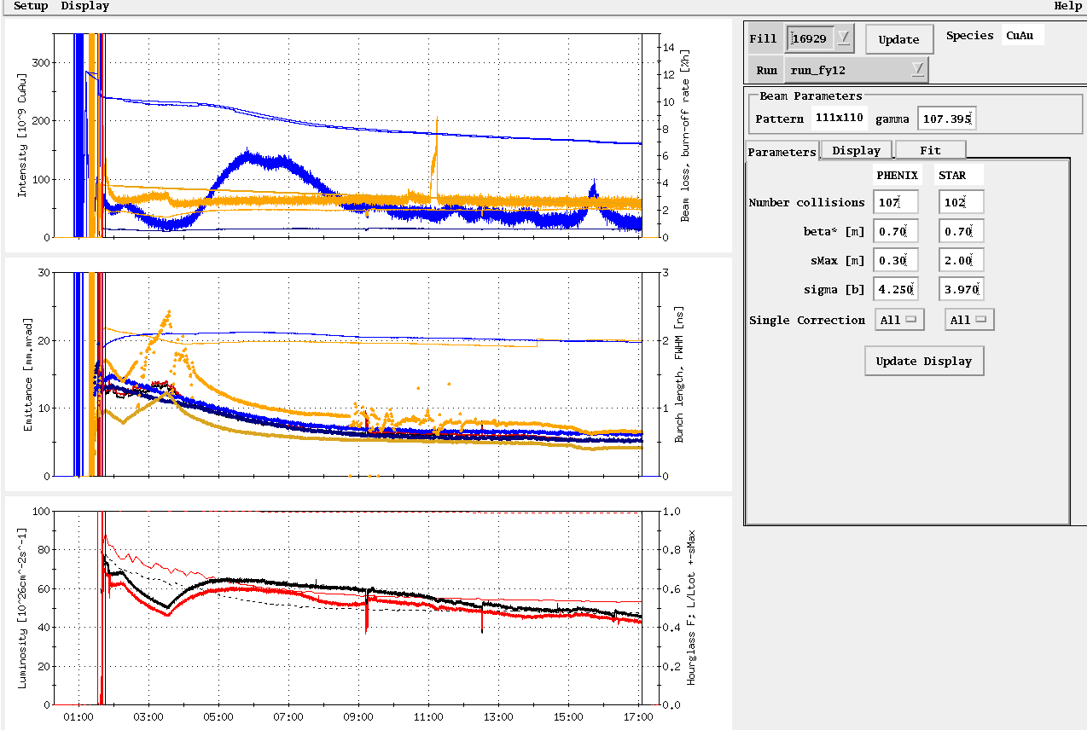
Store, 16929, 28 May
Average Lumi Max Goal

Slide 30
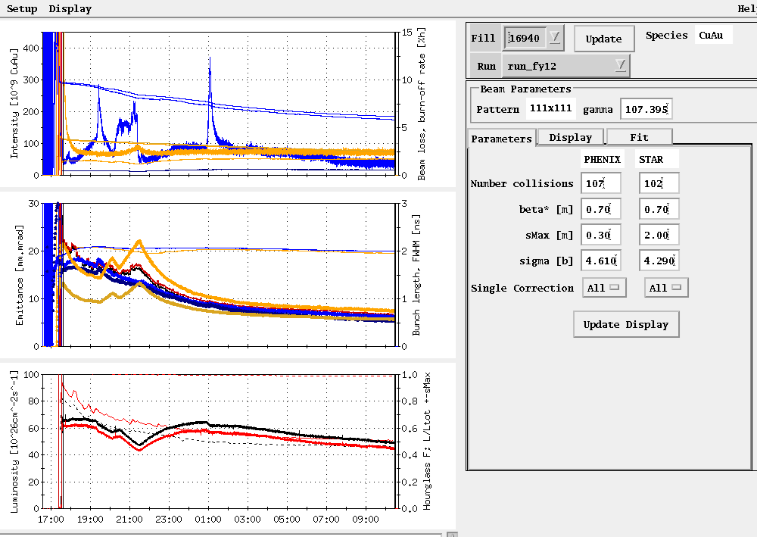
Store, 16940, 31 May
Average Lumi Max Goal

Slide 31
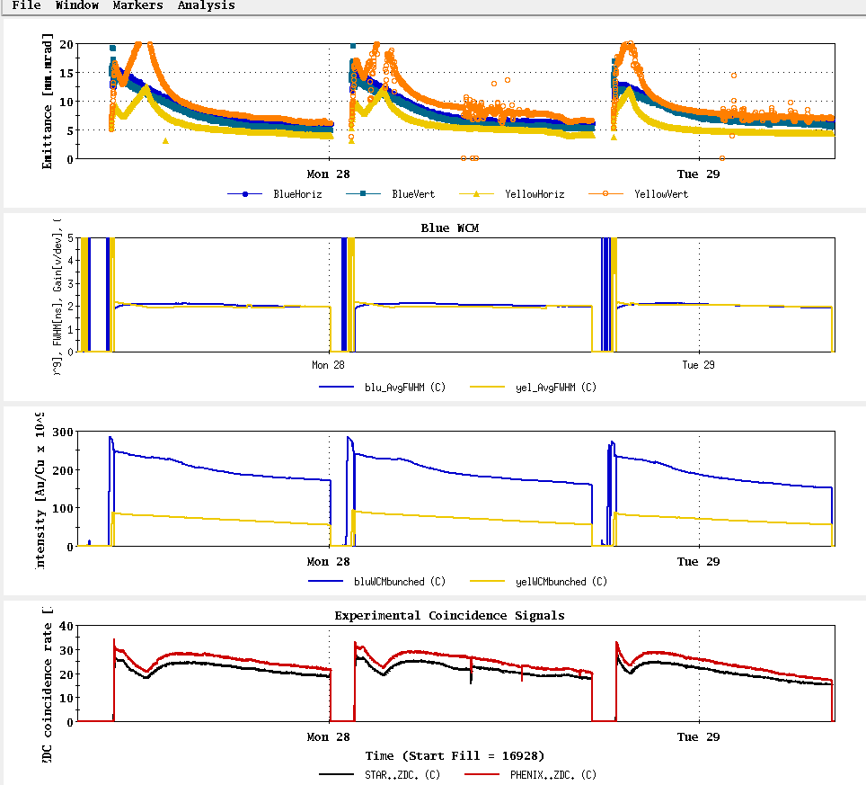
Stores, 16928-30, 27-28 May

Slide 32
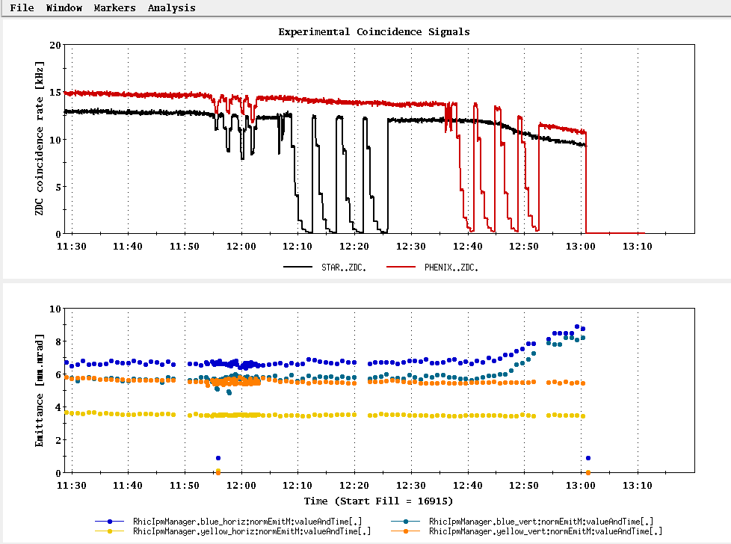
The last vernier scan – note emittance issue with the PHENIX scan

Slide 33
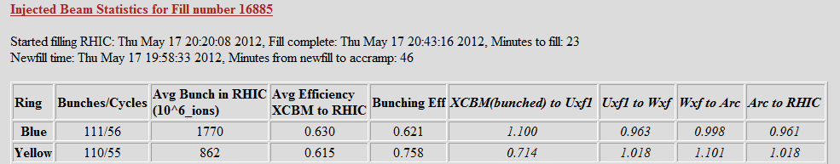
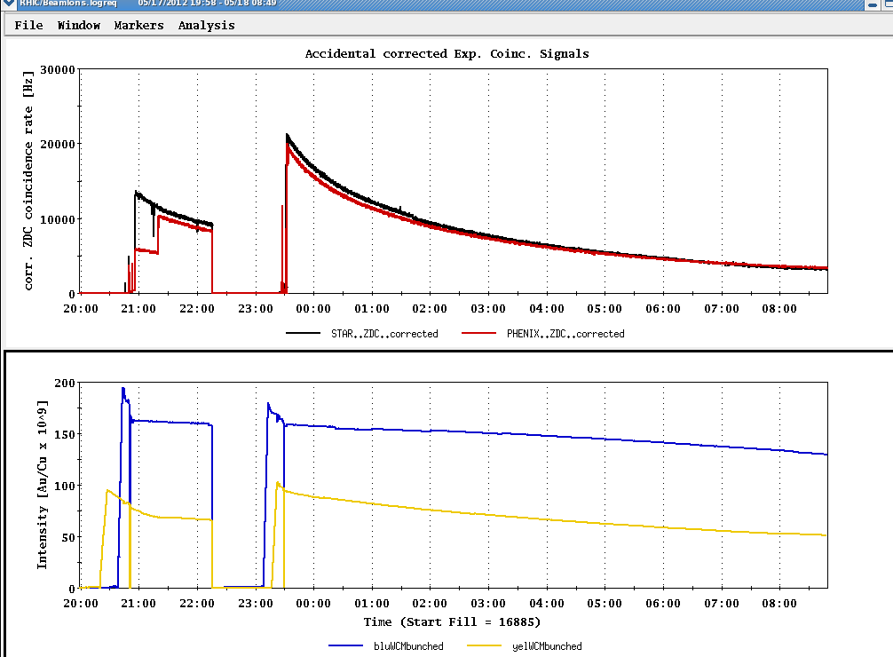
First store for detector tune-up

Slide 34
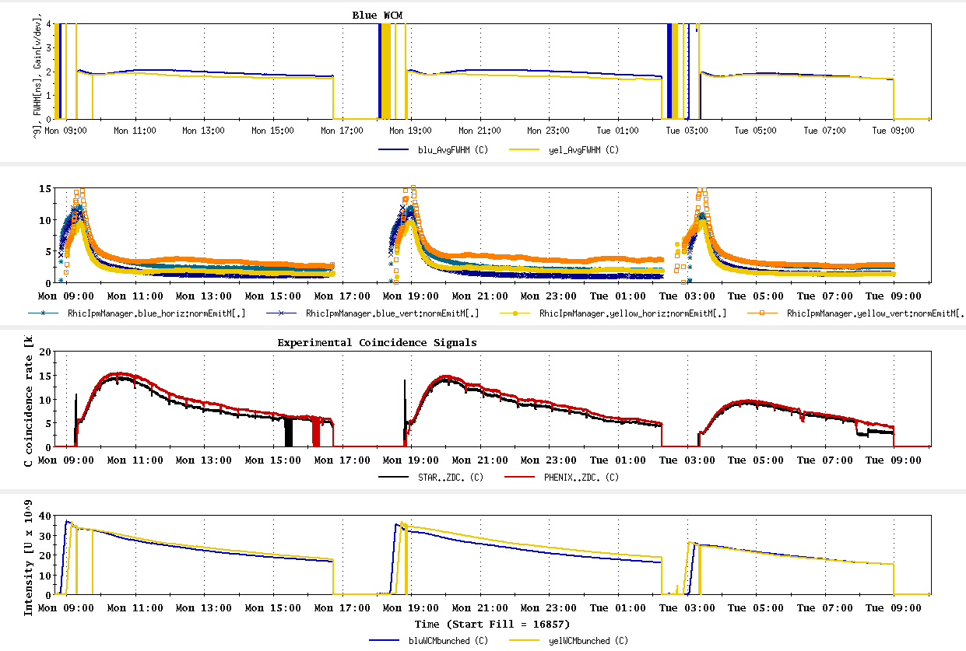
Last three UU physics stores
~best store

Slide 35
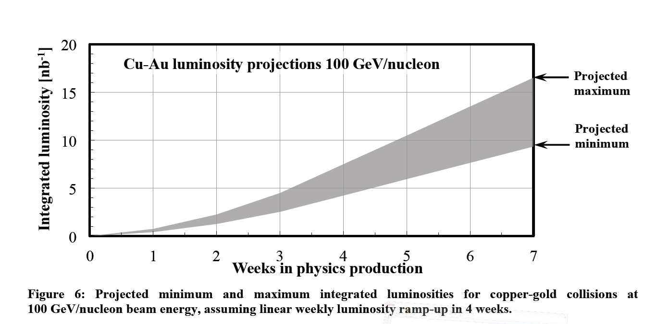
PHENIX BUR Goal = 2.4 nb⁻¹ sampled, ~8 delivered (?)
STAR Goal = ?
If 5 week run
~8 nb⁻¹

Slide 36
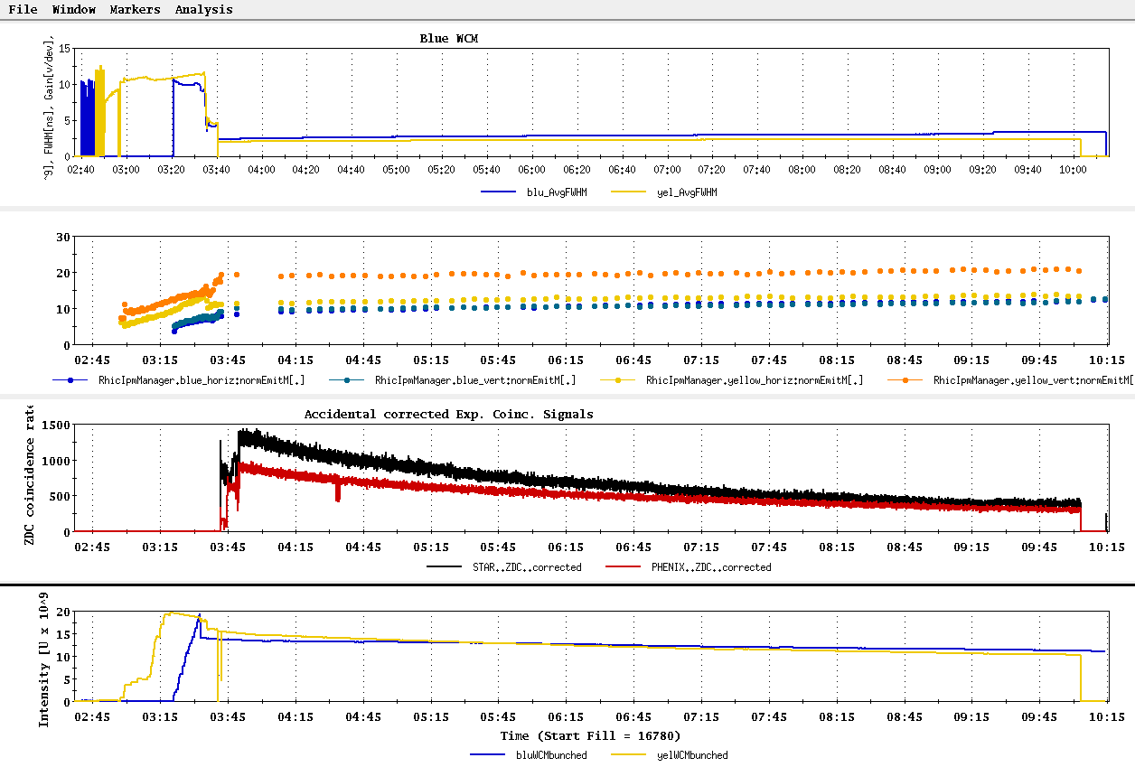
First UU physics store, 16780, 25 April

Slide 37
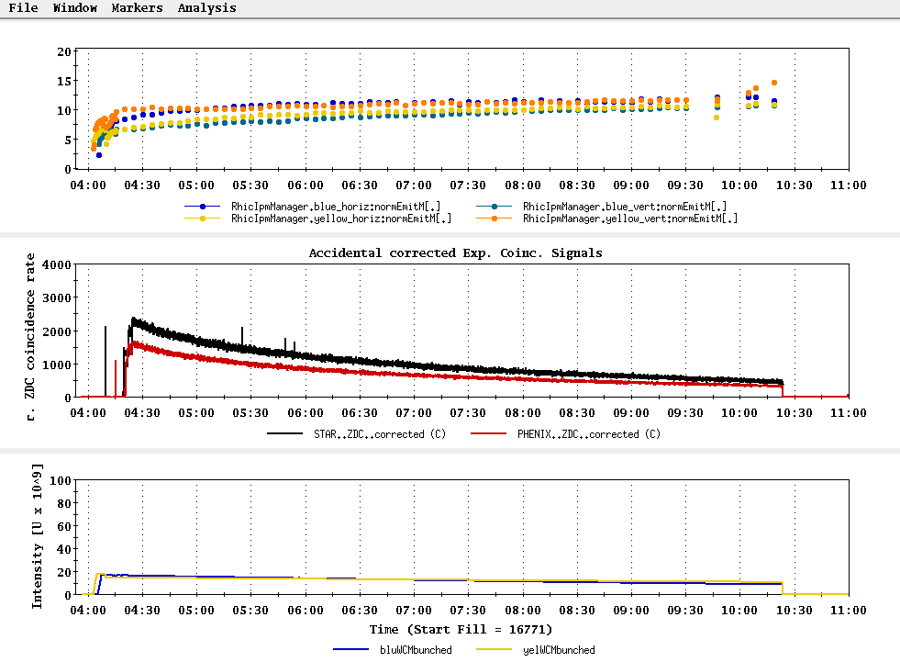
Setup Store, no rebucketing yet…
Transverse emittance projection
ion intensity maximum 111x8.5x10⁸
ion intensity minimum 111x6x10⁸
84/84bunches – 2.0/1.7 x 10⁸ U/bunch
23 April 2012

Slide 38
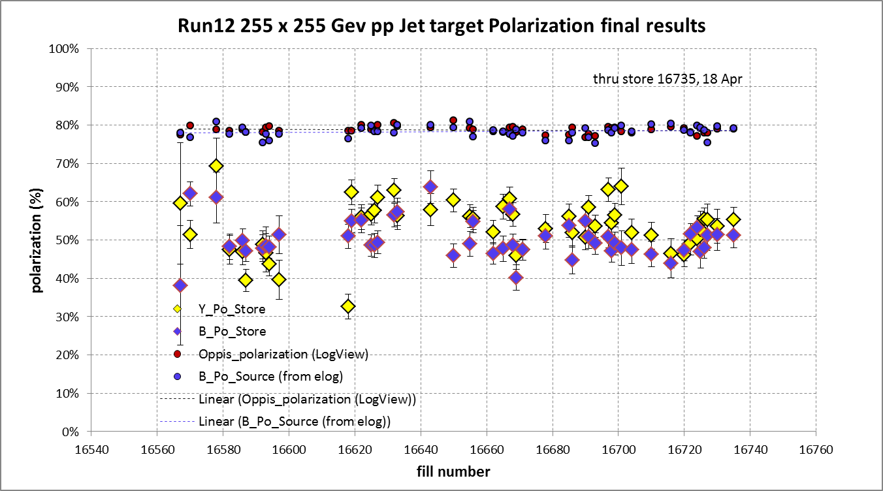
Blue beam at injection jet target result = ? %
average = 78.7%
Blue weighted average = 50.3% ± 0.5%
Yellow weighted average = 53.4% ± 0.5%

Slide 39
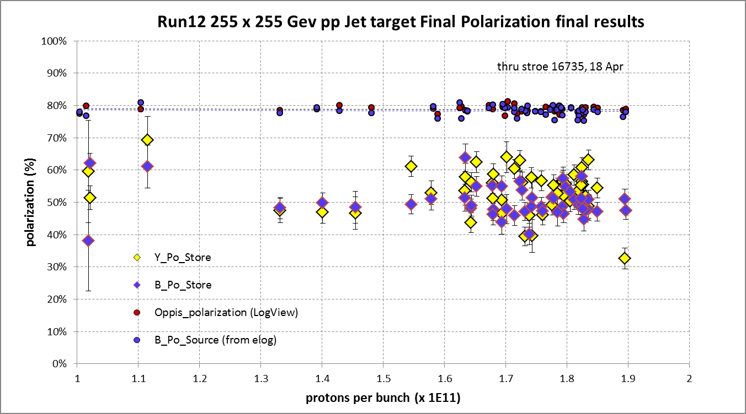

Slide 40
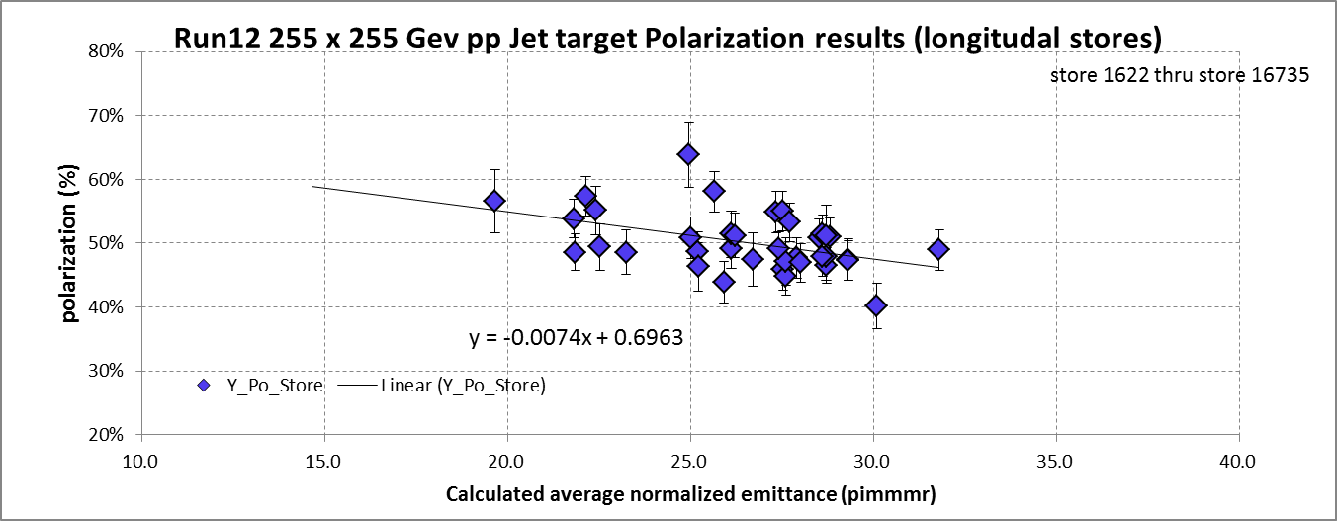
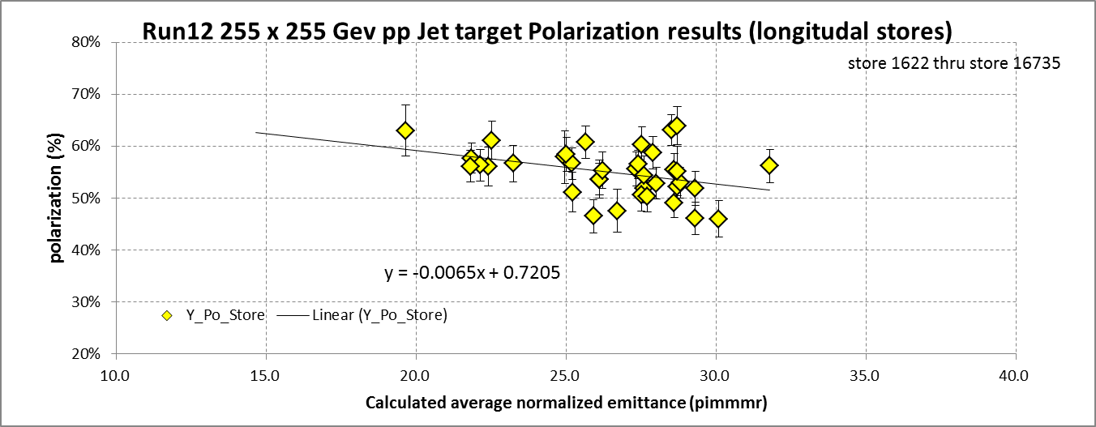

Slide 41
Where we are with Uranium (From K. Zeno)
Into the booster 8 x 10^8 in 4 bunches
These are then combined into one bunch
Booster extraction 6.5 x 10^8 / bunch
30% efficiency into the AGS
AGS extraction is at 2 x 10^8 / bunch
Desired (Wolfram) ~ 7 x 10^8 / bunch
>>> 6 x 10^8 / bunch in RHIC
17 April 2012

Slide 42
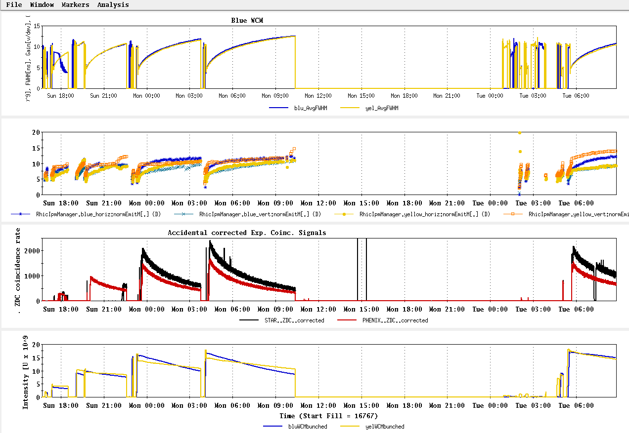
Setup Stores, no rebucketing yet…
√s = 193 GeV/n UU – stores 16769 through 16775

Slide 43
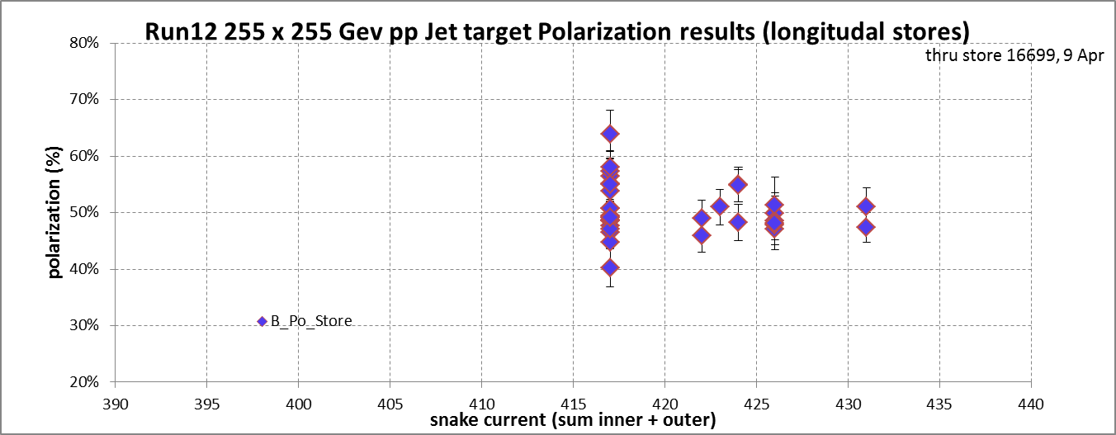
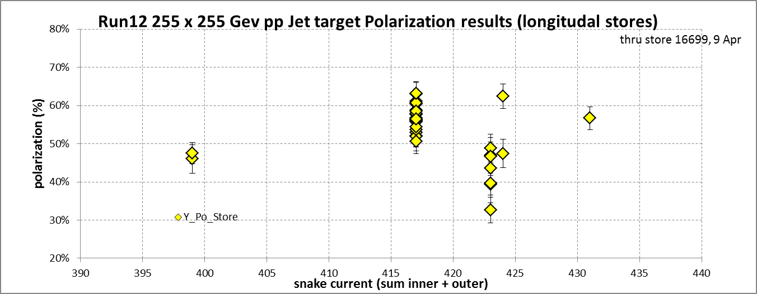

Slide 44
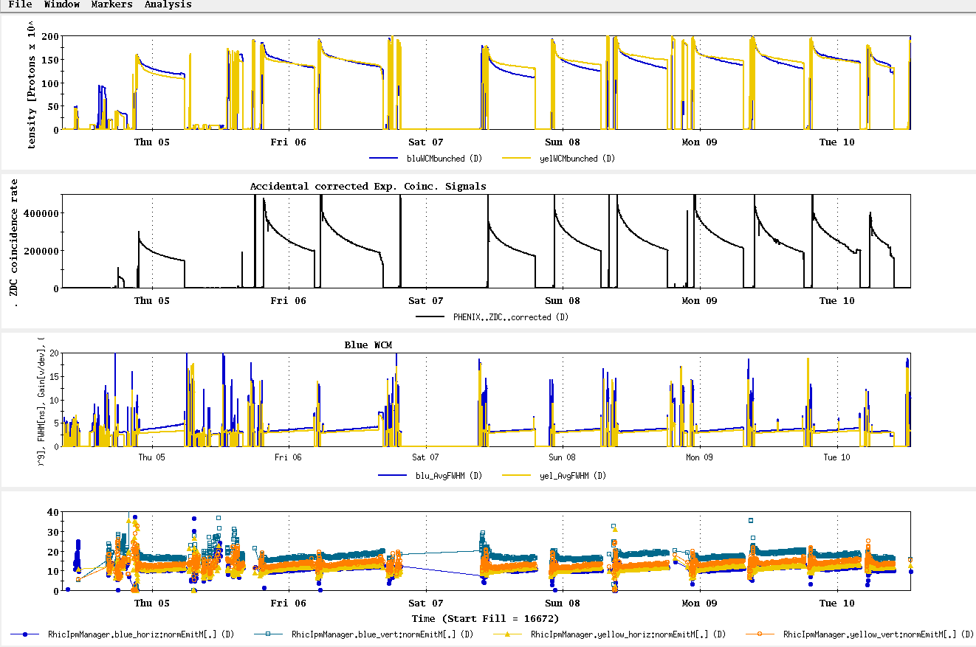
4 Apr – 10 Apr stores

Slide 45
Run 12, √s = 510 GeV polarized proton run – experiment goals
STAR Goal for 5 weeks longitudal polarization (50% polarization):
  Sampled Luminosity = 45 pb⁻¹ with 50% polarization
  Delivered Luminosity = 75 pb⁻¹
PHENIX Goal for 5 weeks longitudal polarization (50% polarization):
  Sampled Luminosity = 30 pb⁻¹ with |z| <30 cm
  = 10 pb⁻¹ with |z| <10 cm
  Delivered Luminosity = 75 pb⁻¹ changed to 120 pb⁻¹, 3/29/12, Ed O’Brien email

Slide 46
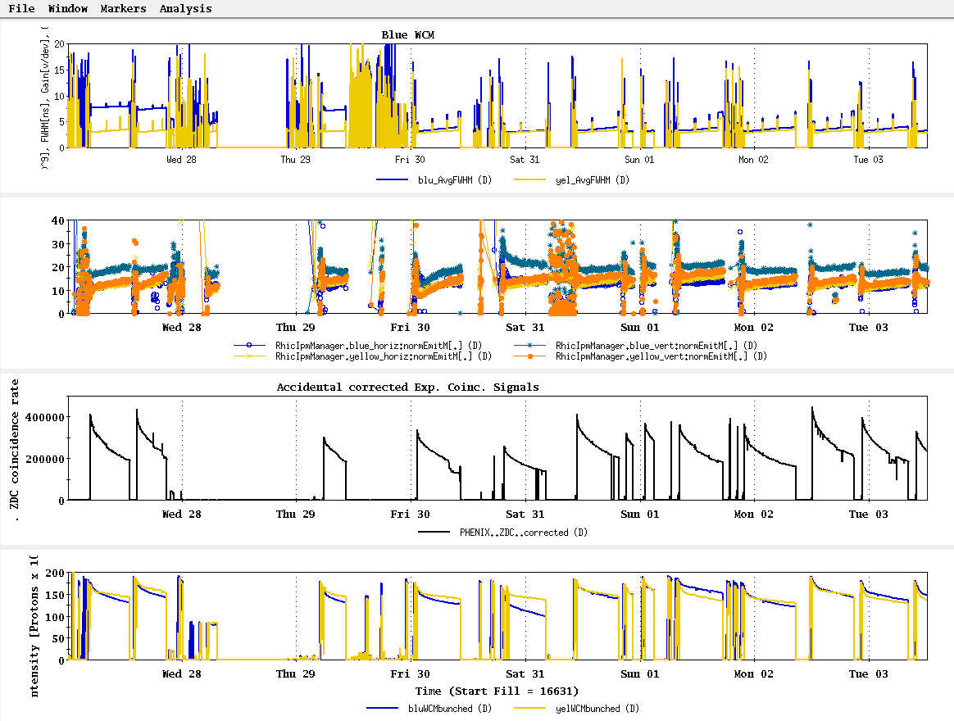
27 Mar – 3 Apr stores

Slide 47
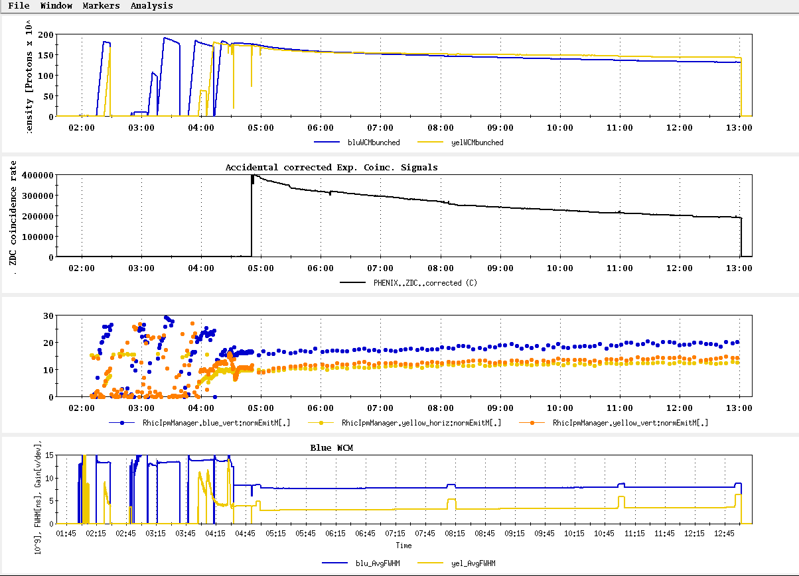
Store 16632, Blue jet = 56.5 +/- 3.0; Yellow jet = 63.0 +/- 3.1
Best average polarization measured by jet for store > 8 hrs

Slide 48
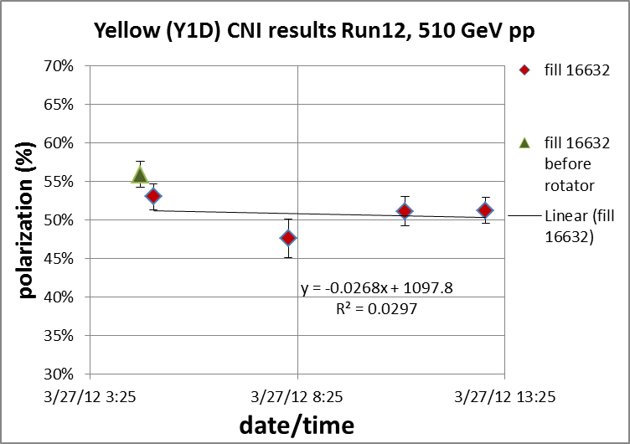
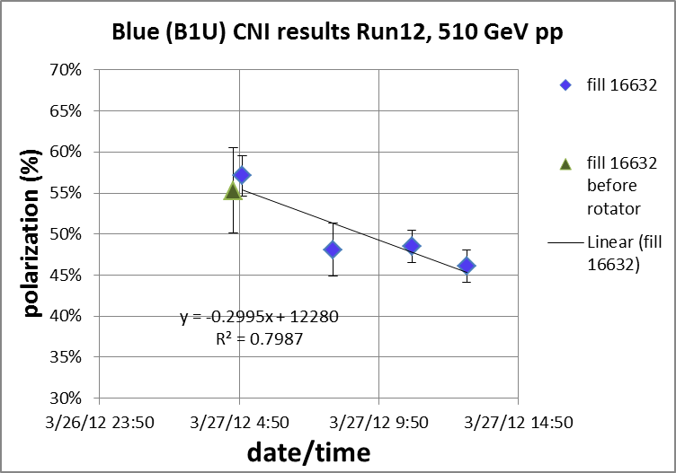
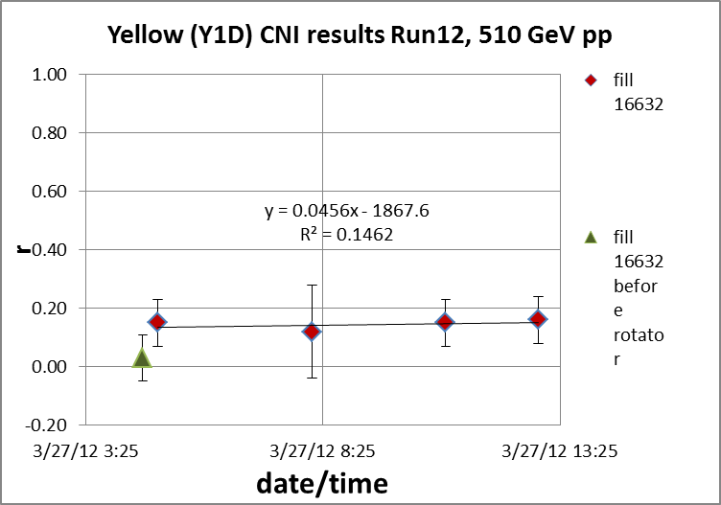
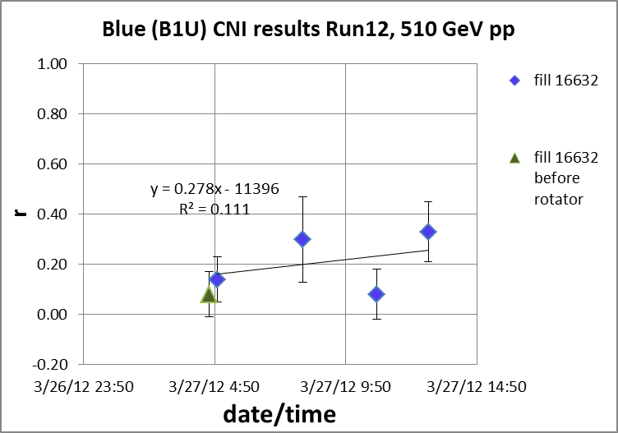

Slide 49
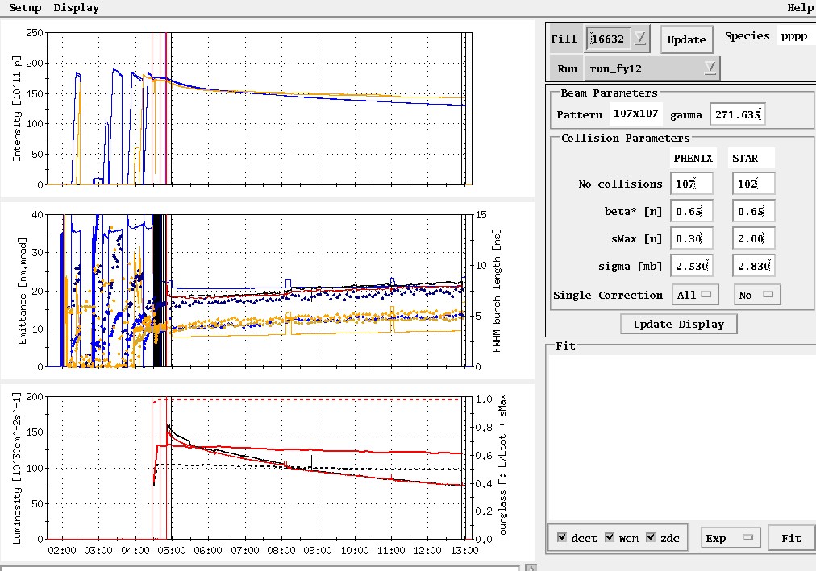
Store 16632
Peak lumi goal
Average lumi goal

Slide 50
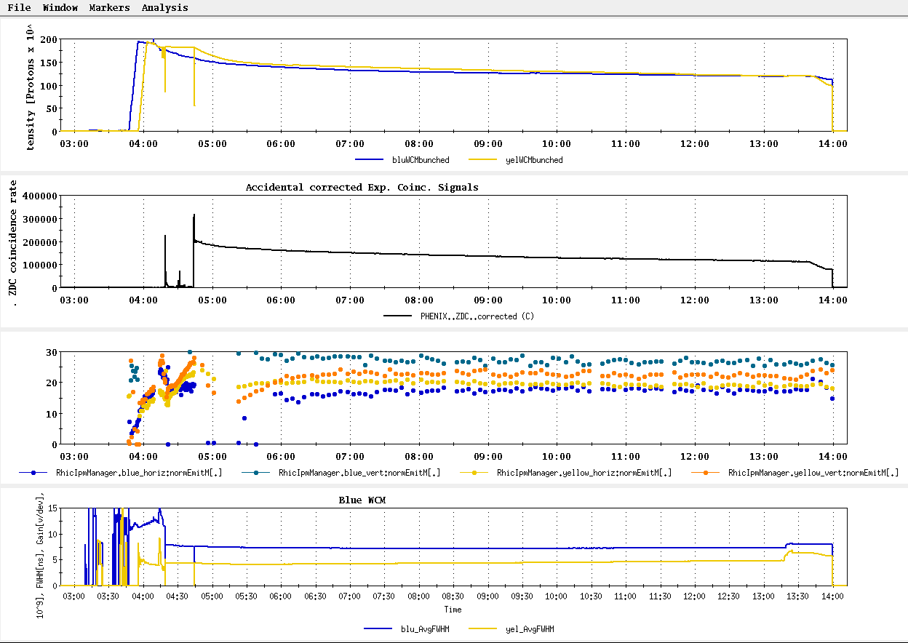
Store 16618, Blue jet = 51.0 +/- 3.2; Yellow jet = 32.6 +/- 3.3
Worst average polarization measured by jet for store > 8 hrs

Slide 51
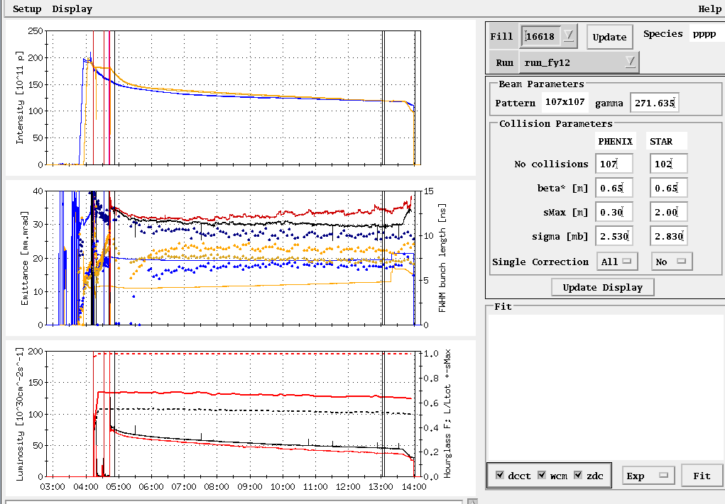
Store 16618

Slide 52
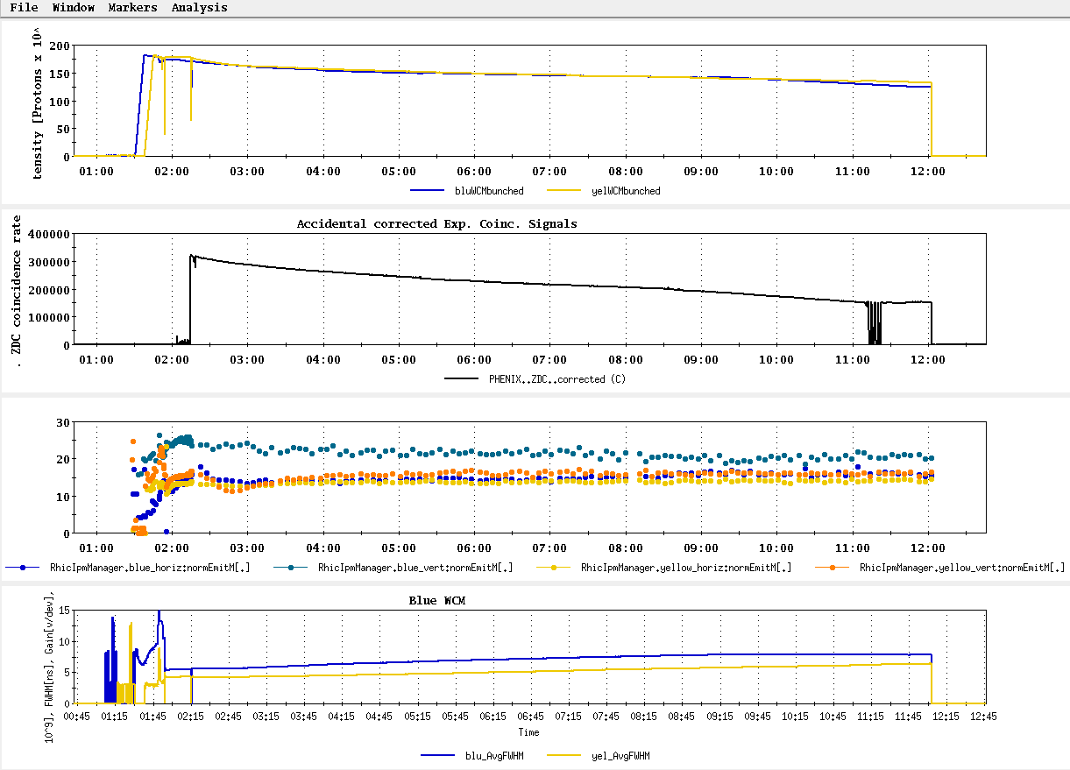
Store 16587, Blue jet = 47.2 +/- 2.8; Yellow jet = 39.4 +/- 2.9
Next to worst average polarization measured by jet for store > 8 hrs

Slide 53
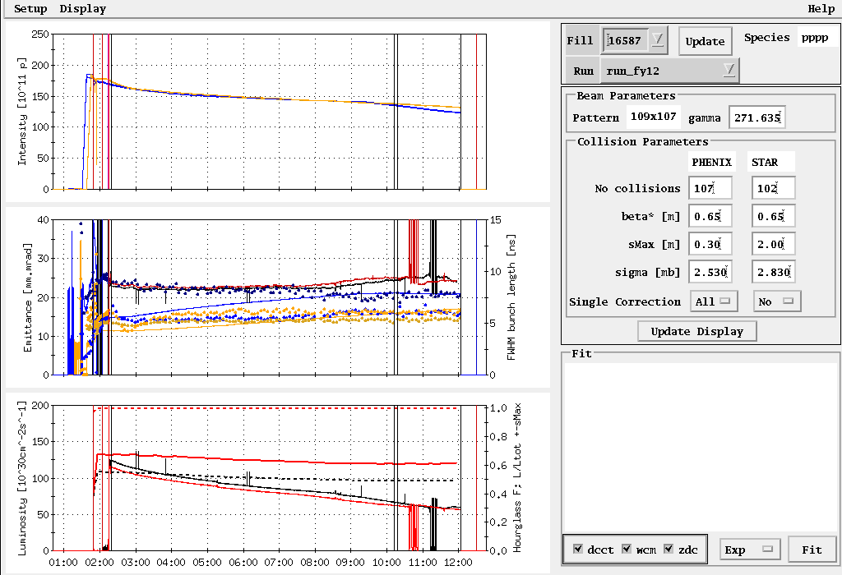
Store 16587

Slide 54
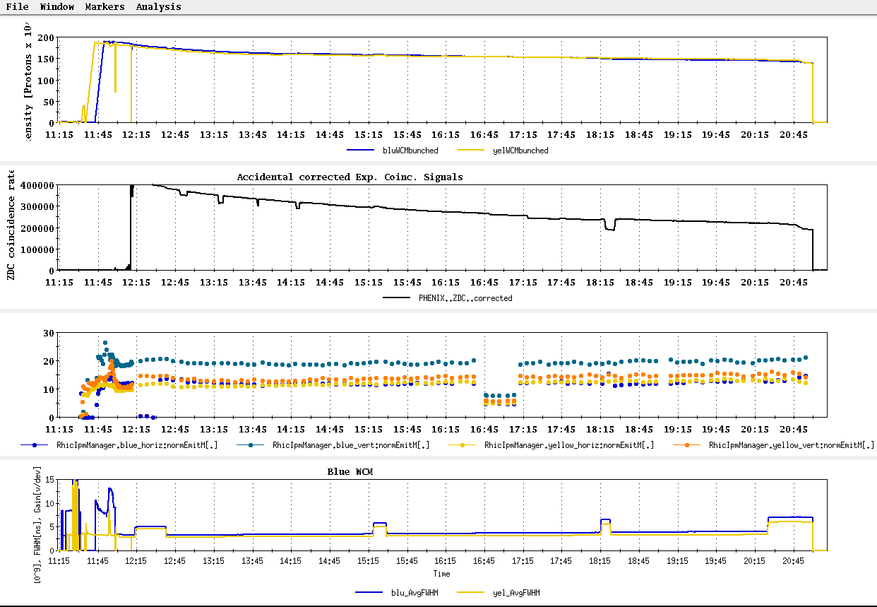
Store 16667, Blue jet = 58.1 +/- 2.9; Yellow jet = 60.7 +/- 3.1
Second best average polarization measured by jet for store > 8 hrs

Slide 55
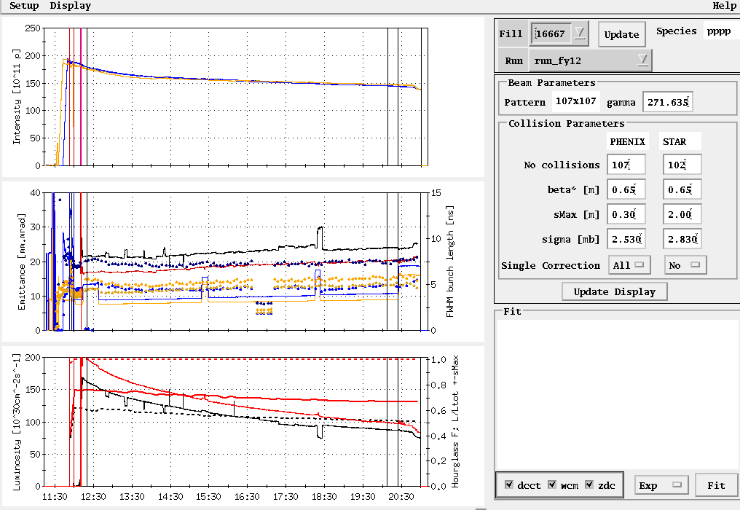
Store 16667
Peak lumi goal
Average lumi goal

Slide 56

Store 16632, 3/27/12
Peak lumi goal
Average lumi goal
Table2: Max lumi parameters: 1.65x10⁹/bunch, 0.6 β*, 20-25 mmmr emitt → peak = 200x10³⁰ cm⁻²s⁻¹

Slide 57

23 Mar – 27 Mar stores

Slide 58



Slide 59

All “physics” stores beginning with16570, 15 March
~L_{store avg} Goal

Slide 60



From “StoreAnalysis” program in “StartUp”
Polarization Goal
16578
16586
16592

Slide 61

Expectation for 5 weeks physics:
45-95 pb⁻¹ delivered luminosity with 45-50% polarization
P⁴L ~ 4 pb⁻¹

Slide 62

STAR & PHENIX Polarization Goals
Offline polarization is larger
Blue Jet weighted average = 61.2% ± 0.5%; source blue average = 77.5% → 20% lost
Yellow Jet weighted average = 55.8% ± 0.5%; source yellow average = 77.4% → 28% lost

Slide 63


Slide 64


Target (max projection)
Best stores, 16475 and 16534

Slide 65


Best stores, 16475 and 16534

Slide 66

Fill 16475, 27 Feb, 8.9 hours physics store (10 hour Lumi on Store), PHENIX 1.03 pb⁻¹

Slide 67


Fill 16475, 27 Feb, 8.9 hours physics store (10 hour Lumi on Store), PHENIX 1.03 pb⁻¹
beginning
end

Slide 68


Fill 16475, 27 Feb, 8.9 hours physics store (10 hour Lumi on Store), PHENIX 1.03 pb⁻¹
beginning
end

Slide 69

Fill 16534, 9 Mar, 8.1 hours physics store (9.1 hr Lumi on store), PHENIX 1.04 pb⁻¹

Slide 70


Fill 16534, 9 Mar, 8.1 hours physics store (9.1 hr Lumi on store), PHENIX 1.04 pb⁻¹
Beginning
End

Slide 71


Fill 16534, 9 Mar, 8.1 hours physics store (9.1 hr Lumi on store), PHENIX 1.04 pb⁻¹
Beginning
End

Slide 72


Slide 73

Past Week
L_{average}(max)
(0.29 mb xsection)
Ions/bunch (max)

Slide 74


Slide 75

Run 12 Physics Stores to 28 Feb
Absolute scale should not be trusted)
L_{average}(max)
(0.29 mb xsection)

Slide 76

Store 16480 (27 Feb) – typical background issues
PHENIX
STAR
ZDC without and
with singles correction
ZDC without and
with singles correction
Protons/bunch
Protons/bunch
ZDC Singles
ZDC Singles

Slide 77

Store 16480 (27 Feb) – typical background issues

Slide 78

Store 16480 (27 Feb) – typical background issues

Slide 79

Collision steering corrections background issues 26-27 Feb
ZDC Singles
ZDC Coincidence

Slide 80

Example -- Store 16445, Sat Feb 18
L_{peak}(max)
L_{store average}(max)

Slide 81
Blue Jet weighted average = 55.4 ± 0.5
Yellow Jet weighted average = 54.9 ± 0.5

Slide 82
Run 12 projection for √s = 200 GeV pp
STAR Goal: 27 pb-1 delivered with 55-60 % polarization
PHENIX Goal: 27 pb-1 delivered with 55-60 % polarization
p²L = 8.2 pb⁻¹ for 55% polarization
From Fischer et. Al. “RHIC Collider Projections (FY 2012 – FY 2016)” 14 October 2011

Slide 83

First Physics Store (#16397, 04:01, 10 Feb)

Slide 84

Today, 7 Feb 2012

Slide 85

Typical Store from Run 9, 100 x 100 GeV pp

Slide 86

As of 16:18 hrs 20 Jan
Start cooldown
3.5 days

Slide 87
Recommendations following the June 6-8, 2011 PAC
For Run 12 the PAC recommends the following (in order of priority):
5 weeks of running with polarized proton collisions at 200 GeV.
7 weeks of running with polarized proton collisions at 500 GeV.
5 weeks of running with Cu+Au collisions at 200 GeV.
3 weeks of running with U+U collisions at 193 GeV.
For Run13 the PAC recommends the following (not in order of priority):
12 weeks of running with polarized proton collisions at 500 GeV.
5 week of running with polarized proton collisions at 200 GeV.
7 weeks of running with Au+Au collisions at full energy.

Slide 88
Cryo Issue
D.L. November 23, 2011 update
Our helium supplier no longer able to meet our peek demand of 4 trailers in a one week period. They can give us one trailer a week starting on December 31st, so we expect to have all the helium we need, on time, but we will have to store most of it in the dewars outside 1006B. This will result in our 4K cooldown being a little less stable and predictable than it has been for the past few years when we received all of the helium at 1005R over a short period of time. Because of this, I expect the 4K cooldown will take a least one additional day.

Slide 89


Slide 90

From Fischer et. al. “RHIC Collider Projections (FY 2012 – FY 2016)” 14 October 2011

Slide 91
Run 12 projection for √s = 500 GeV pp
From Fischer et. Al. “RHIC Collider Projections (FY 2012 – FY 2016)” 14 October 2011

Slide 92
Run 12 projection for √s = 193 GeV/n UU
From Fischer et. Al. “RHIC Collider Projections (FY 2012 – FY 2016)” 14 October 2011

Slide 93
Run 12 projection for √s = 200 GeV/n CuAu
From Fischer et. Al. “RHIC Collider Projections (FY 2012 – FY 2016)” 14 October 2011

