Slide 1
Run 12 RHIC Machine/Experiments Meeting
22 Nov 2011 (2nd meeting)
Agenda:
Schedule/Power issues (Pile)
Machine Status
STAR Readiness
PHENIX Readiness

Slide 3
Run 12 Plan based on PAC recommendation/ALD Guidance and 22 weeks cryo operation
22 Nov 11 DRAFT
17 Jan, Begin cool-down to 4.5K
20 Jan, Cool-down to 4.5K in Blue Ring complete, begin magnet setup
24 Jan, Cool-down to 4.5K complete in both rings begin √s = 200 GeV pp setup
31 Jan, begin 2 week ramp-up with 8 hrs/night for experiments
14 Feb, begin 5 weeks physics with further ramp-up
20 March, end 5 week √s = 200 GeV pp run, begin ½ week setup for √s = 500 GeV pp
24 March, begin 1 week ramp-up to √s = 500 GeV with 8 hrs/night for experiments
31 March, begin 7 week pp physics run at √s = 500 GeV
19 May, end 7 week pp physics run at √s = 500 GeV
17.4 cryo-weeks to this point, schedule beyond this point to be determined
If Uranium…
19 May, begin 1 week setup for √s = 193 GeV/n UU (no overnight stores for experiments)
26 May, begin 3 week √s = 193 GeV/n UU physics run
16 Jun, end 3 week √s = 193 GeV/n UU physics run
19 June, cryo warm-up complete (22.0 cryo-weeks)
Consistent with Fischer et. al. “RHIC Collider Projections (FY 2012 – FY 2016)” 14 October 2011

Slide 4
Cryo Issue
D.L. November 22, 2011
I'm still waiting for confirmation from Linde for the liquid helium delivery schedule. They are no longer able to meet our peek demand of 4 trailers in a one week period. They should be able to give us one trailer a week starting on December 31st, so we expect to have all the helium we need, on time, but we will have to store most of it in the dewars outside 1006B. This will result in our 4K cooldown being a little less stable and predictable than it has been for the past few years when we received all of the helium at 1005R over a short period of time. Because of this, I expect the 4K cooldown will take a least one additional day.

Slide 5
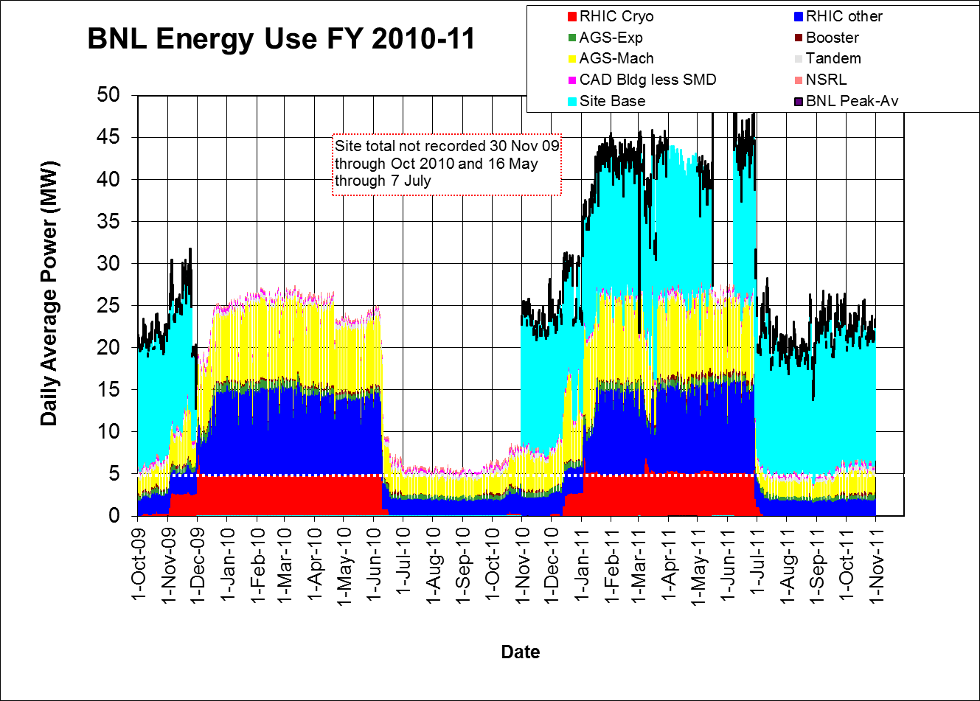

Slide 6
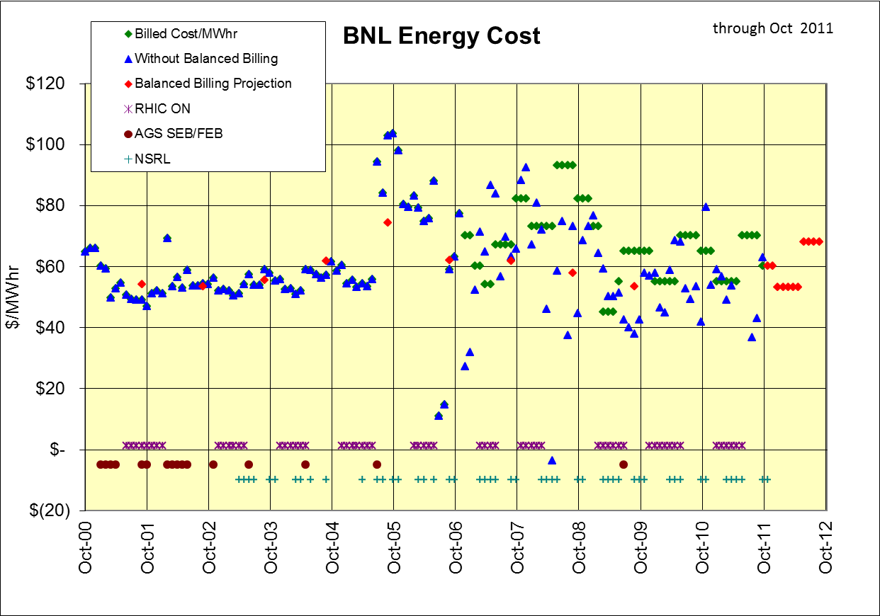

Slide 7
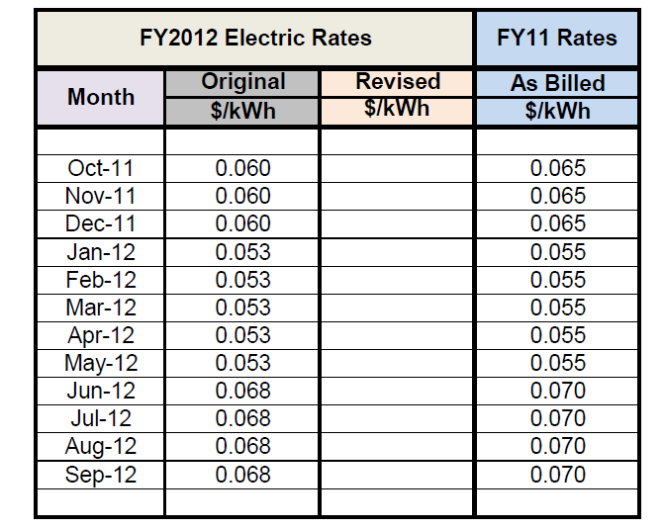

Slide 8
Other Slides

Slide 9
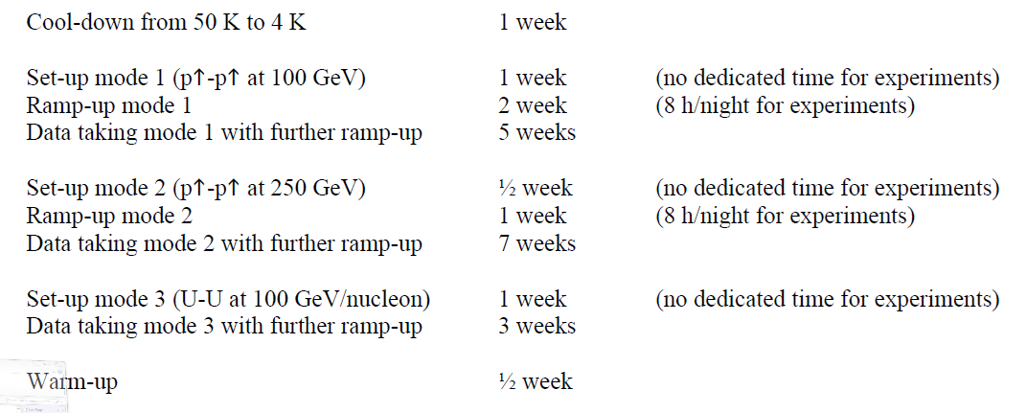
From Fischer et. al. “RHIC Collider Projections (FY 2012 – FY 2016)” 14 October 2011

Slide 10
Recommendations following the June 6-8, 2011 PAC
For Run 12 the PAC recommends the following (in order of priority):
5 weeks of running with polarized proton collisions at 200 GeV.
7 weeks of running with polarized proton collisions at 500 GeV.
5 weeks of running with Cu+Au collisions at 200 GeV.
3 weeks of running with U+U collisions at 193 GeV.
For Run13 the PAC recommends the following (not in order of priority):
12 weeks of running with polarized proton collisions at 500 GeV.
5 week of running with polarized proton collisions at 200 GeV.
7 weeks of running with Au+Au collisions at full energy.

Slide 11
Run 12 projection for √s = 200 GeV pp
From Fischer et. Al. “RHIC Collider Projections (FY 2012 – FY 2016)” 14 October 2011

Slide 12
Run 12 projection for √s = 500 GeV pp
From Fischer et. Al. “RHIC Collider Projections (FY 2012 – FY 2016)” 14 October 2011

Slide 13
Run 12 projection for √s = 193 GeV/n UU
From Fischer et. Al. “RHIC Collider Projections (FY 2012 – FY 2016)” 14 October 2011

Slide 14
Run 12 projection for √s = 200 GeV/n CuAu
From Fischer et. Al. “RHIC Collider Projections (FY 2012 – FY 2016)” 14 October 2011

