Slide 1
Run 12 RHIC Machine/Experiments Meeting
27 Mar 2012
Agenda:
Status reports
Other business

Slide 2
Run 12 Plan based on 20 weeks cryo operation
–an example 20 week schedule based on Vincent’s pp start-up plans*
Note physics weeks for 250 pp and HI are still to be determined
* http://www.cadops.bnl.gov/AGS/Operations/OpsWiki/index.php/RHIC_Setup:_Polarized_Protons
17 Jan, Begin cool-down to 4.5K
20 Jan, Cool-down to 4.5K in Blue and Yellow Ring complete, begin magnet setup
21-28 Jan, pp injection setup
28 Jan-3 Feb, LLRF, Ramp and store setup, begin 8 hr/night for experiments
3-10 Feb, 1 week ramp-up with 8 hrs/night for experiments
10 Feb, with store # 16397, begin 4 weeks pp physics with further ramp-up
16 Feb, 24/7 stores begin
12 (Monday) March, end 4.4 weeks √s = 200 GeV pp, begin ½ week setup for √s = 510 GeV pp
16 March, begin 5 week pp physics (machine only) √s = 510 GeV
17/18 March, STAR/PHENIX physics start with longitudal polarization
Today – 27 March
23 April (Monday), end 5.4 week pp physics run at √s = 500 GeV
If Cu-Au and/or Uranium-Uranium…
23 April (Monday), begin 1 week setup for UU or CuAu (no overnight stores for experiments)
30 April, begin 4.7 week UU or CuAu physics run
20-25 May: IPAC
2 June end 4.7 week UU or CuAu physics run
2 June, begin cryo warm-up
5 June, cryo warm-up complete (20.0 cryo-weeks)
Total Physics Weeks = 14.5

Slide 3
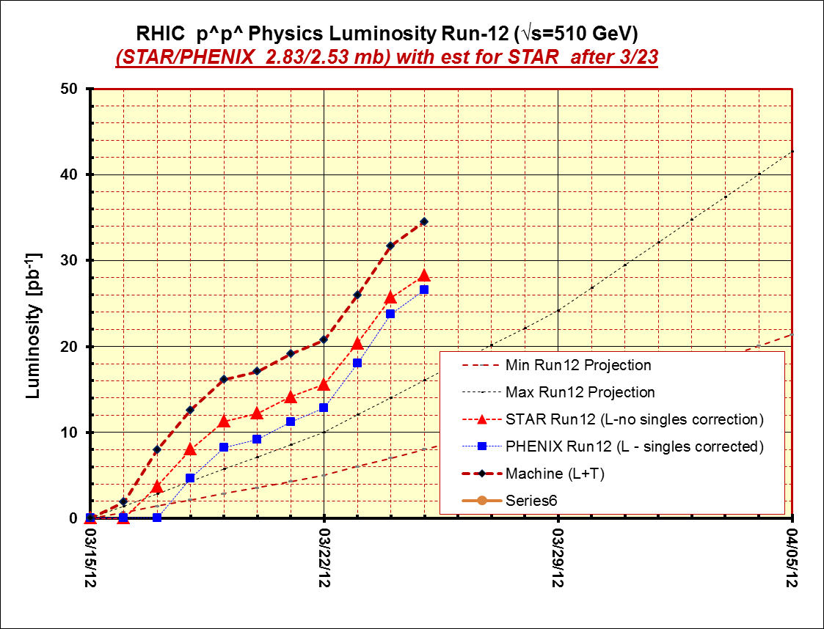
Thru fill 16626, 26 Mar

Slide 4
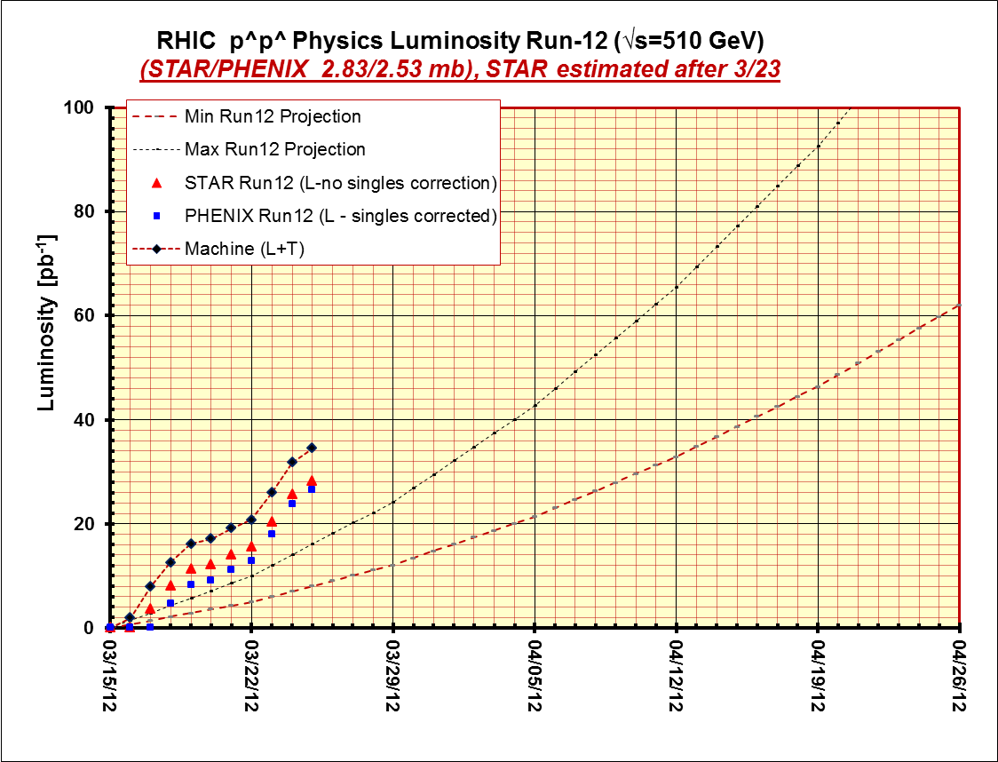
Thru fill 16626, 26 Mar
Exp goals
w/50%pol
~35% of goal

Slide 5
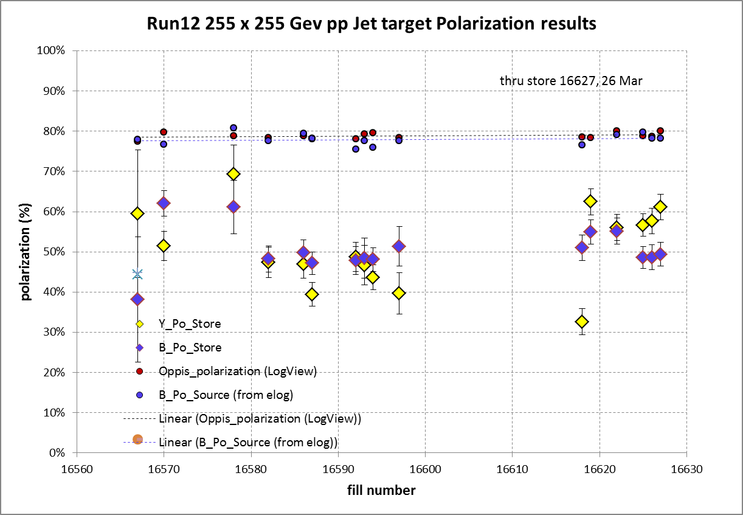
Blue weighted average = 50.8% ± 0.9%, 35% below source pol
Yellow weighted average = 50.4% ± 0.9%, 36% below source pol

Slide 6
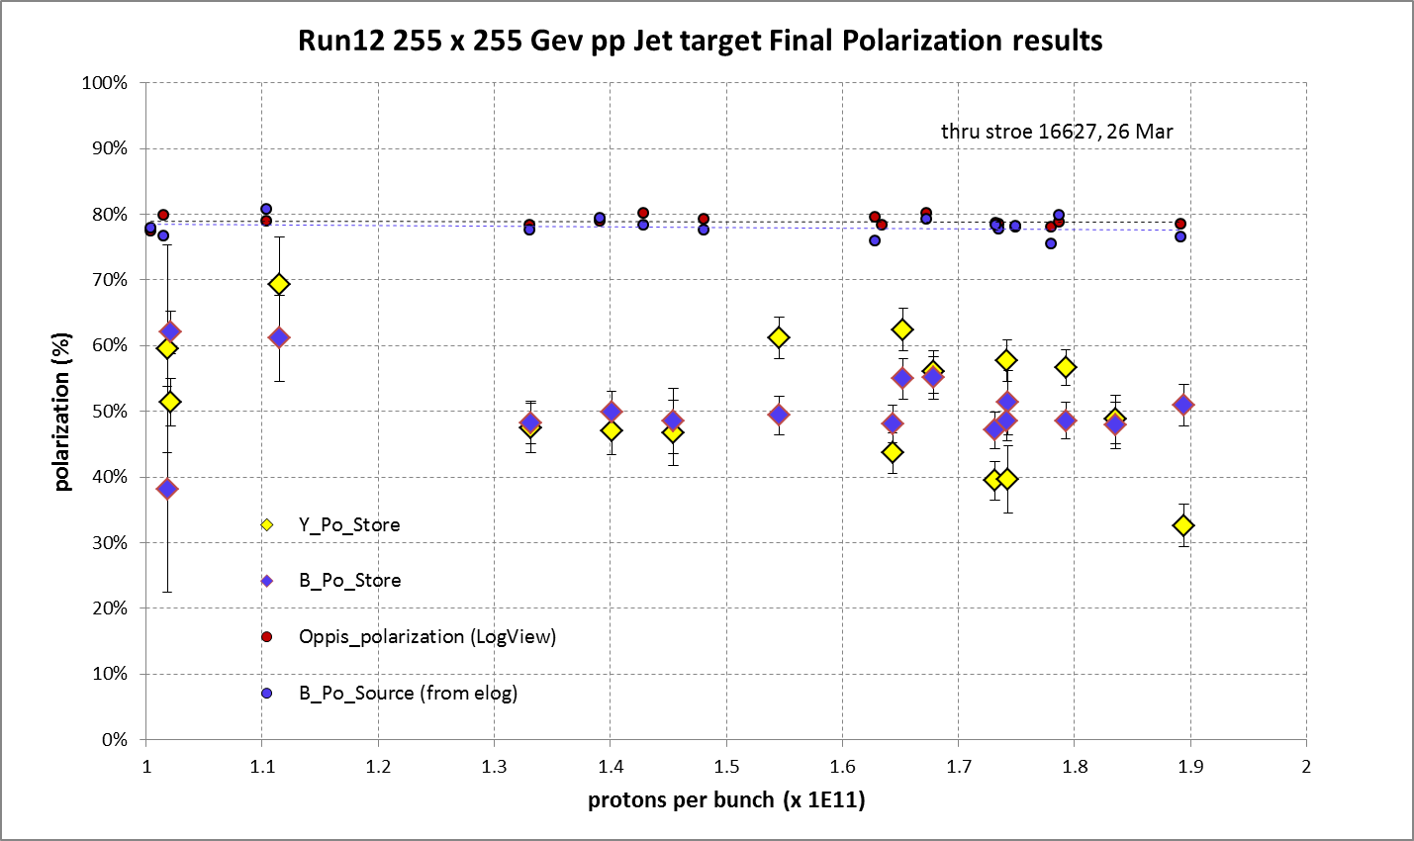

Slide 7
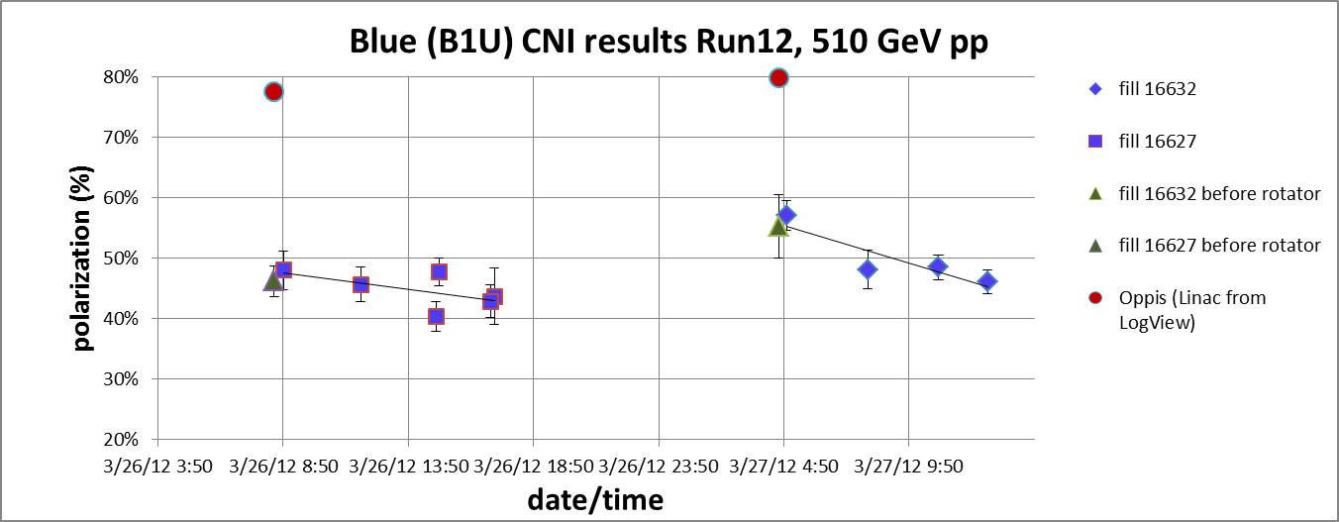
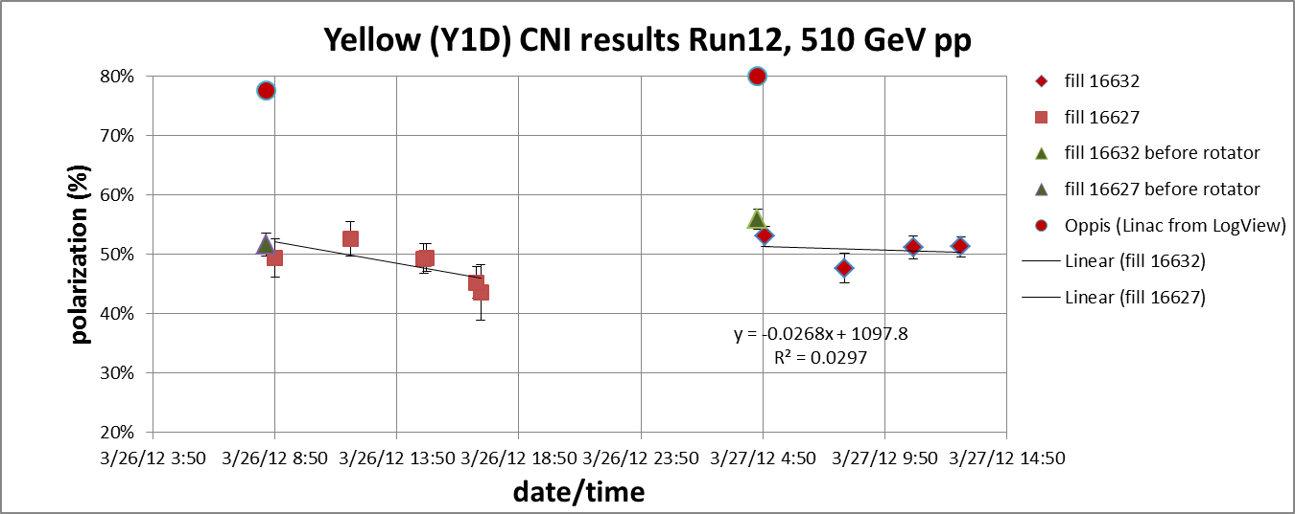

Slide 8
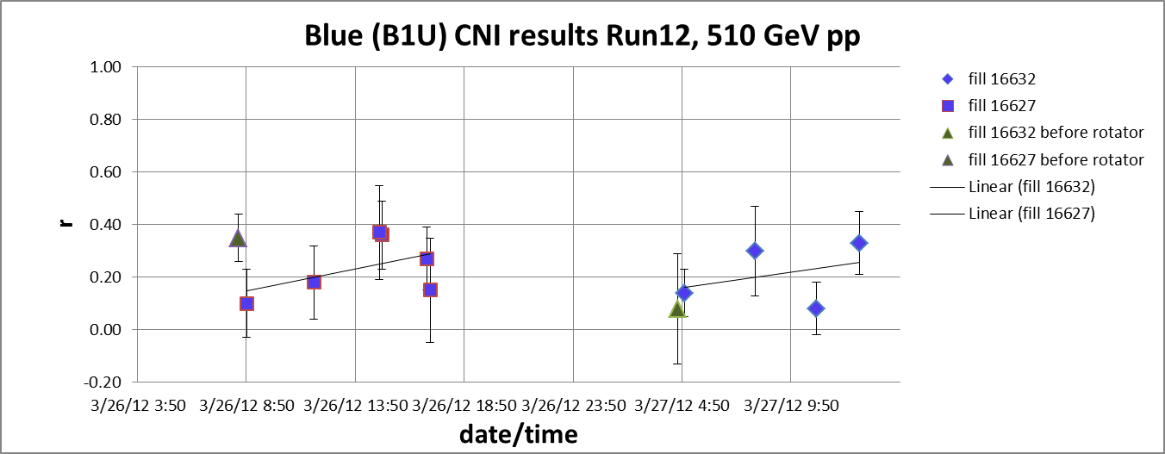
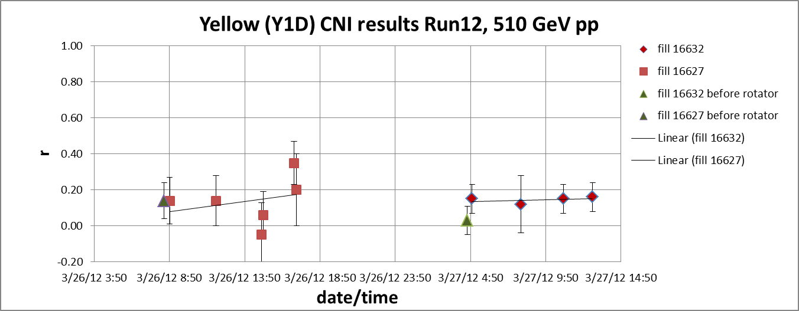

Slide 9
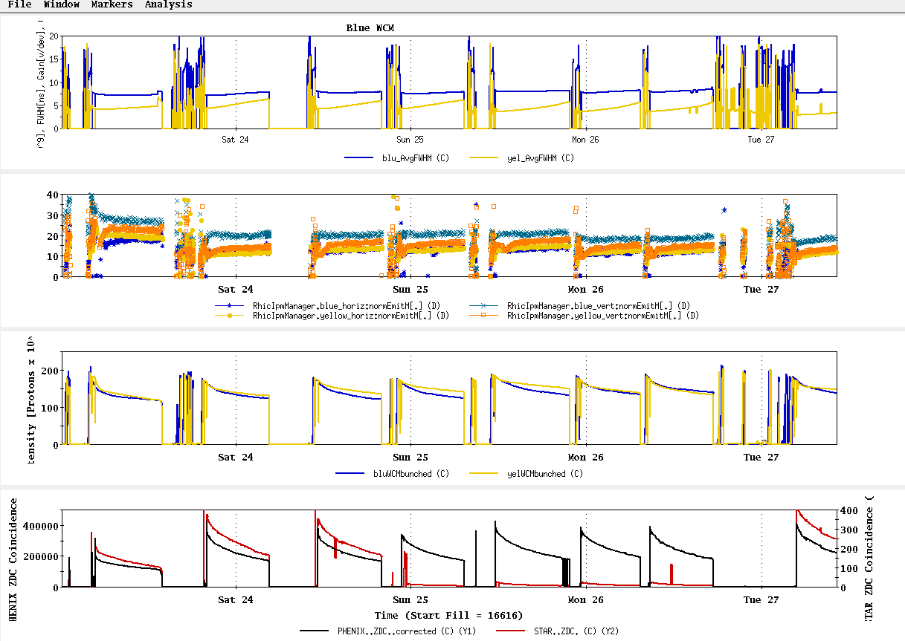

Slide 10
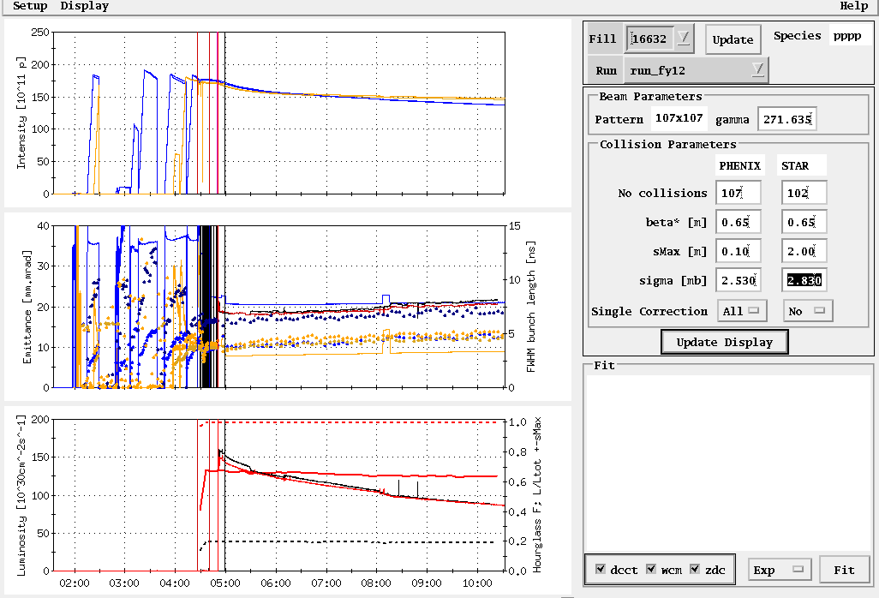
Store 16632, 3/27/12
Peak lumi goal
Average lumi goal
Table2: Max lumi parameters: 1.65x10⁹/bunch, 0.6 β*, 20-25 mmmr emitt → peak = 200x10³⁰ cm⁻²s⁻¹

Slide 11
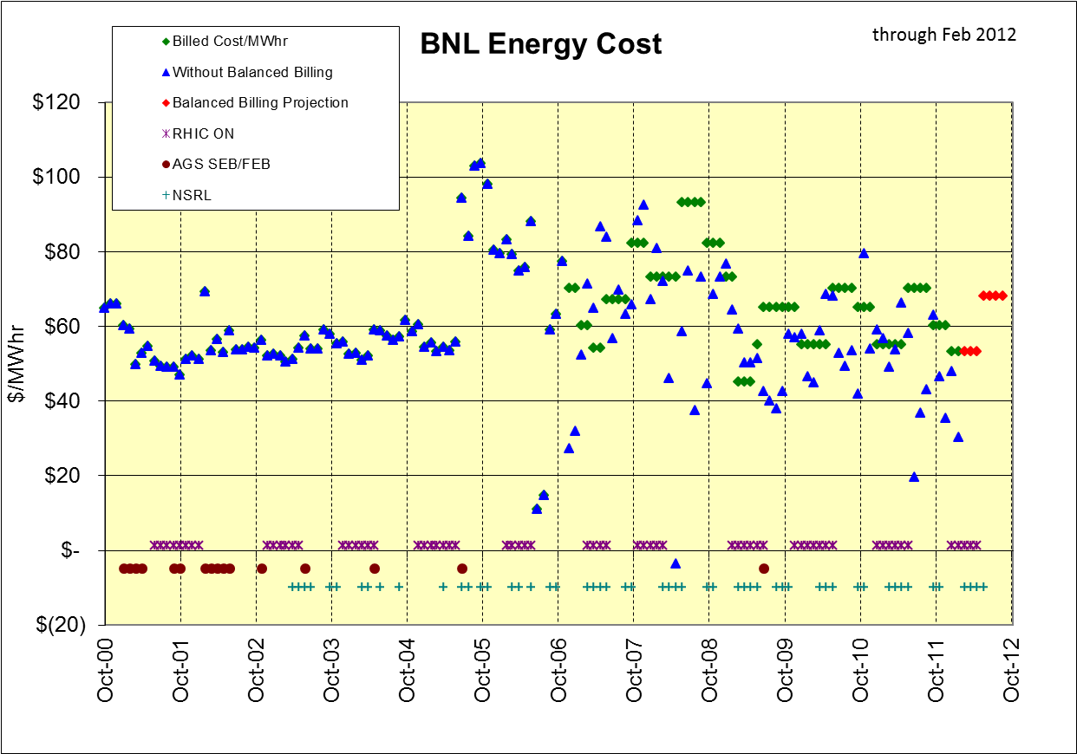
$ in BNL Balanced Billing Bank for FY12 (through Feb) = +$1,825K
$30/MWhr

Slide 12
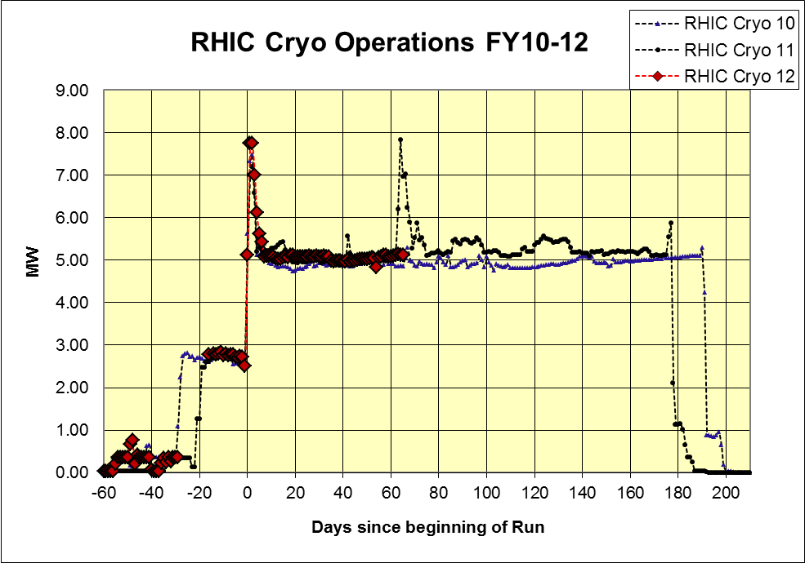
As of 22 Mar 2012

Slide 13
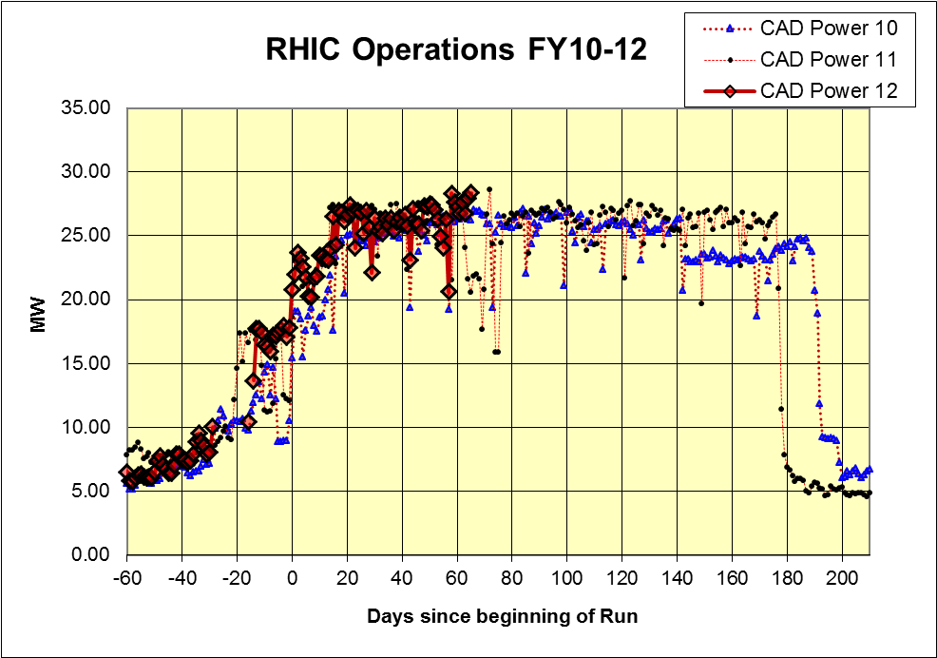
As of 22 Mar 2012

Slide 14
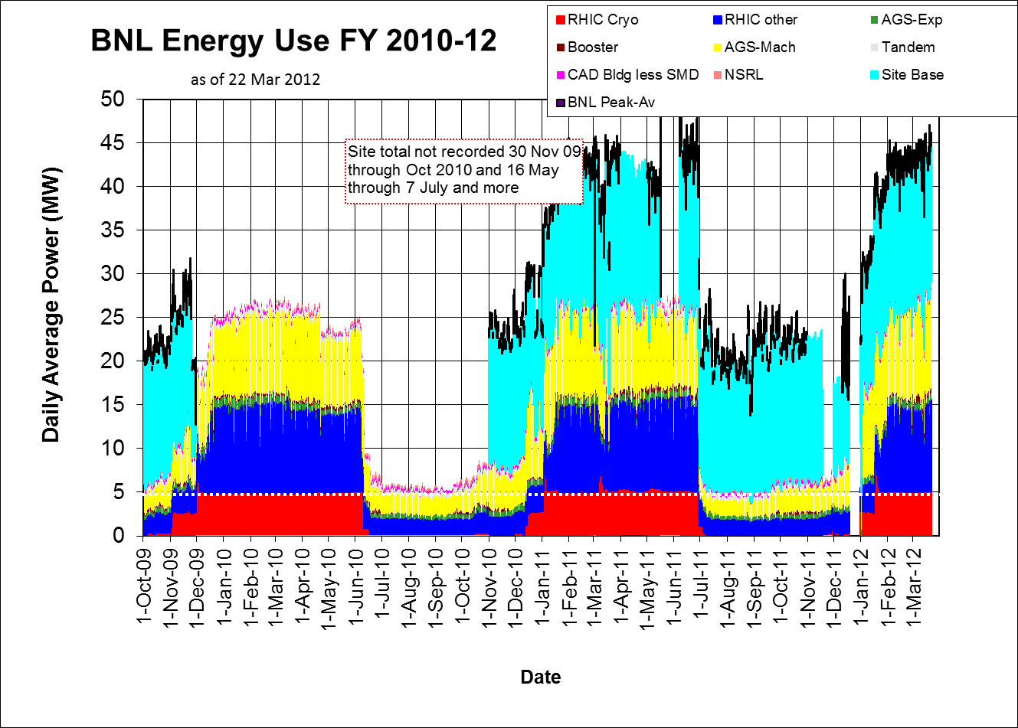

Slide 15
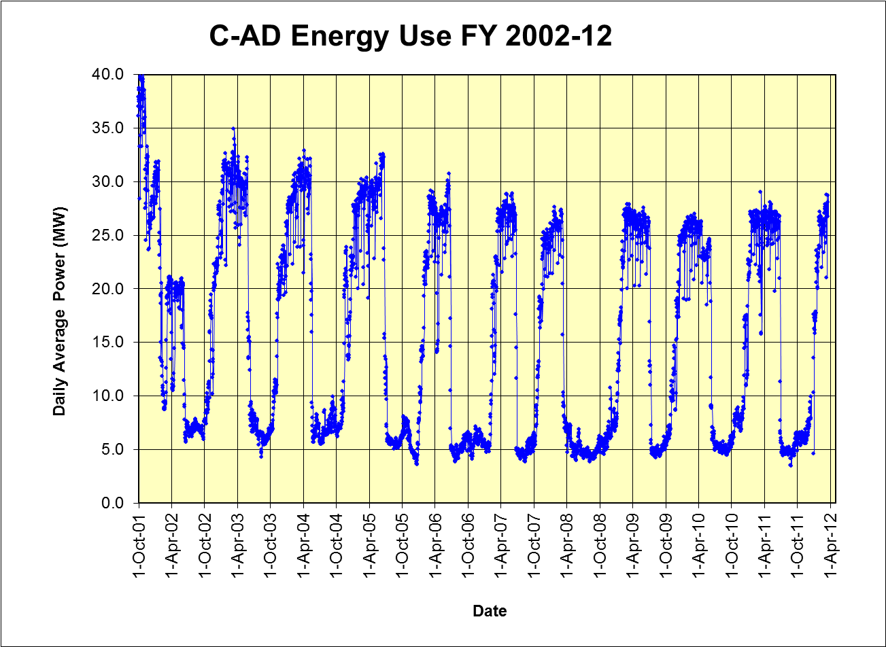

Slide 16
Other Slides

Slide 17
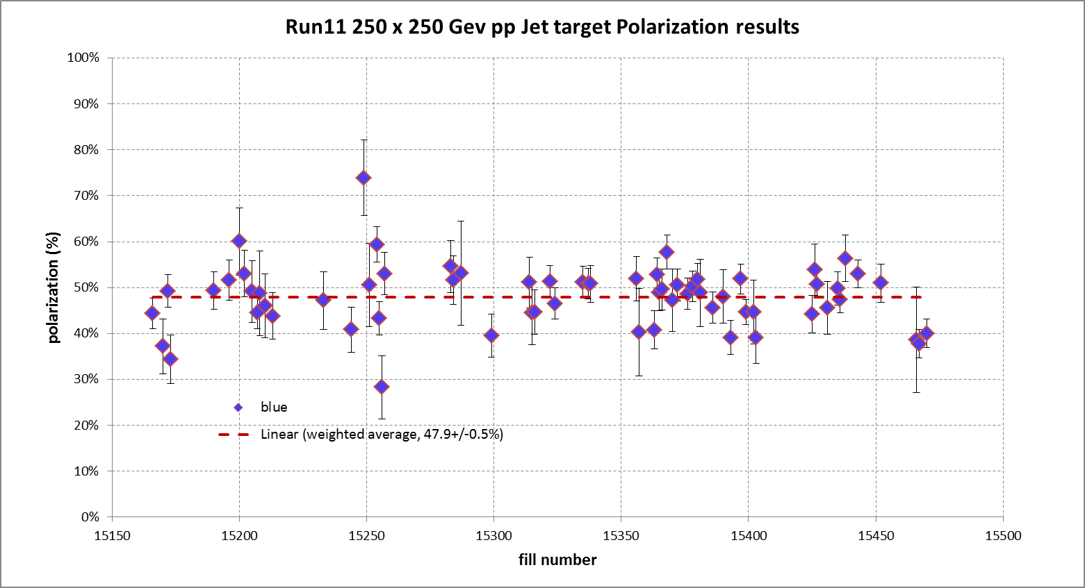
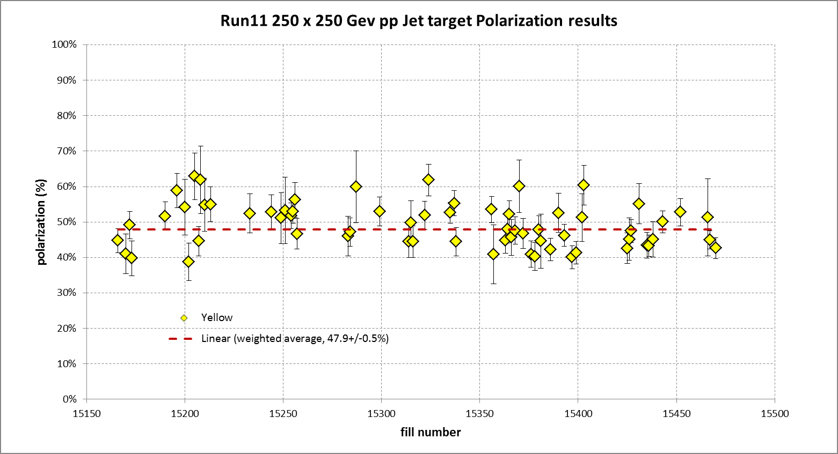

Slide 18
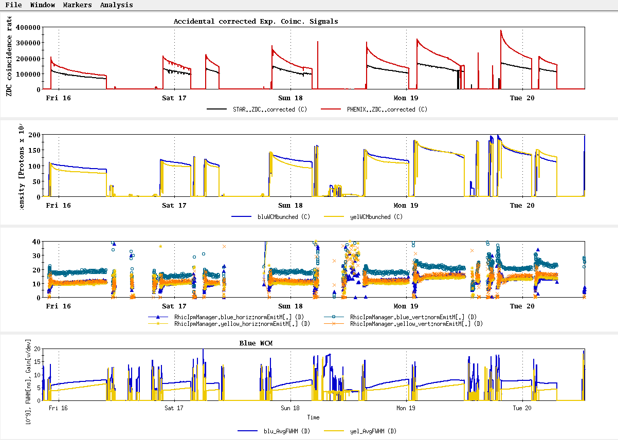
All “physics” stores beginning with16570, 15 March
~L_{store avg} Goal

Slide 19
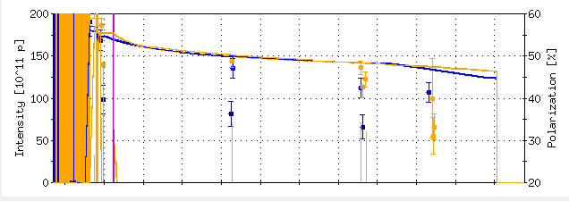
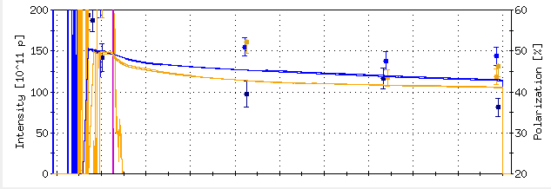
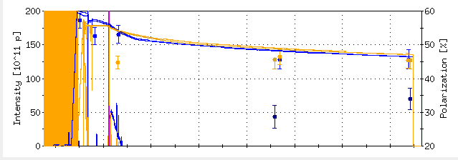
From “StoreAnalysis” program in “StartUp”
Polarization Goal
16578
16586
16592

Slide 20
Run 12, √s = 510 GeV polarized proton run – experiment goals
STAR Goal for 5 weeks longitudal polarization (50% polarization):
  Sampled Luminosity = 45 pb⁻¹ with 50% polarization
  Delivered Luminosity = 75 pb⁻¹
PHENIX Goal for 5 weeks longitudal polarization (50% polarization):
  Sampled Luminosity = 30 pb⁻¹ with |z| <30 cm
  = 10 pb⁻¹ with |z| <10 cm
  Delivered Luminosity = 75 pb⁻¹

Slide 21
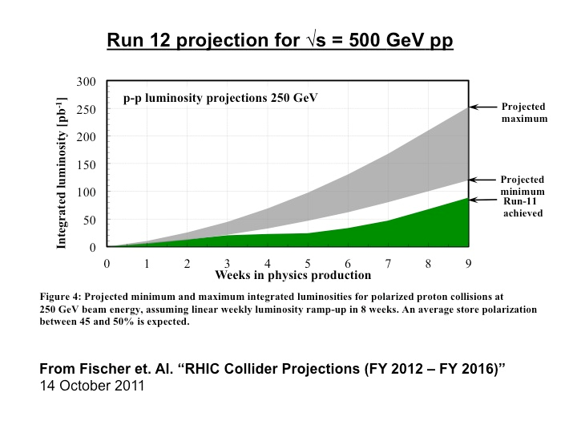
Expectation for 5 weeks physics:
45-95 pb⁻¹ delivered luminosity with 45-50% polarization
P⁴L ~ 4 pb⁻¹

Slide 22
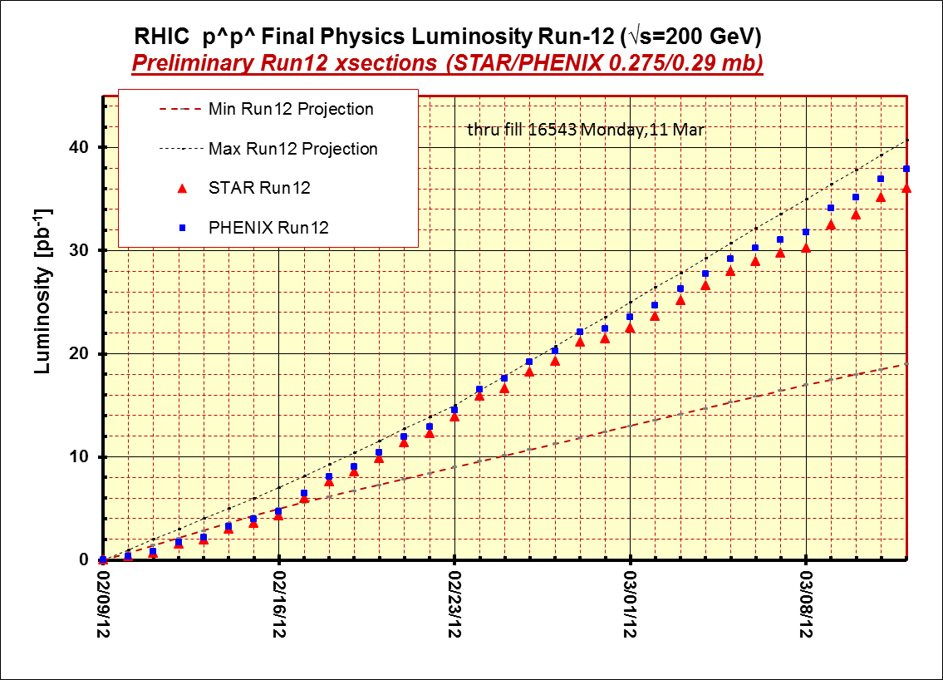
STAR & PHENIX Goal

Slide 23
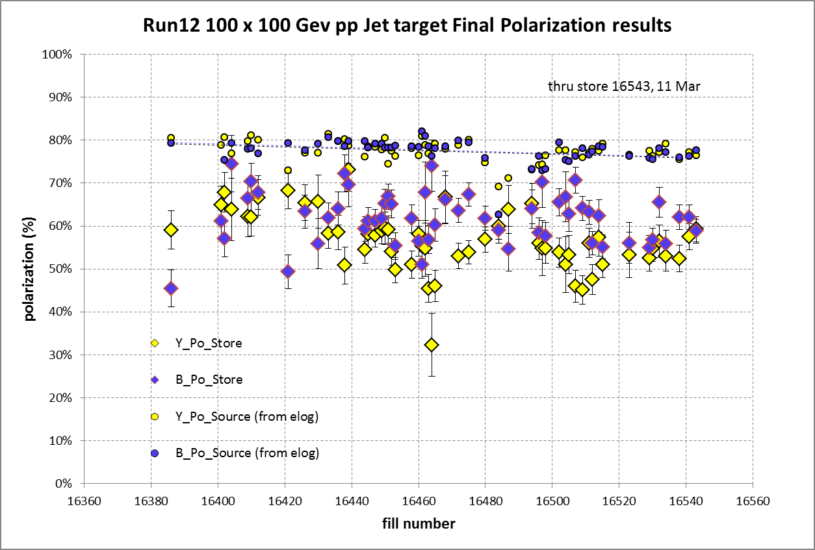
STAR & PHENIX Polarization Goals
Offline polarization is larger
Blue Jet weighted average = 61.2% ± 0.5%; source blue average = 77.5% → 20% lost
Yellow Jet weighted average = 55.8% ± 0.5%; source yellow average = 77.4% → 28% lost

Slide 24
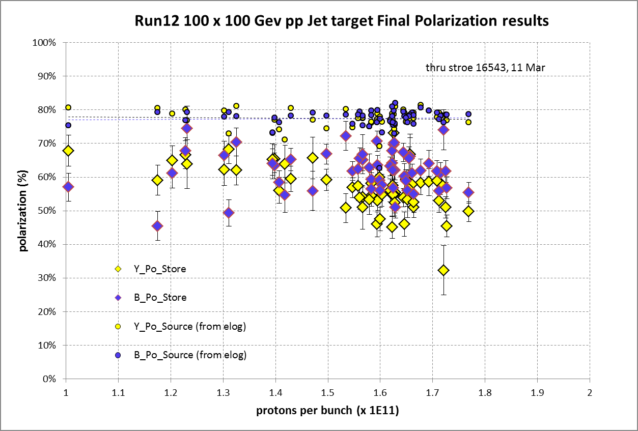

Slide 25
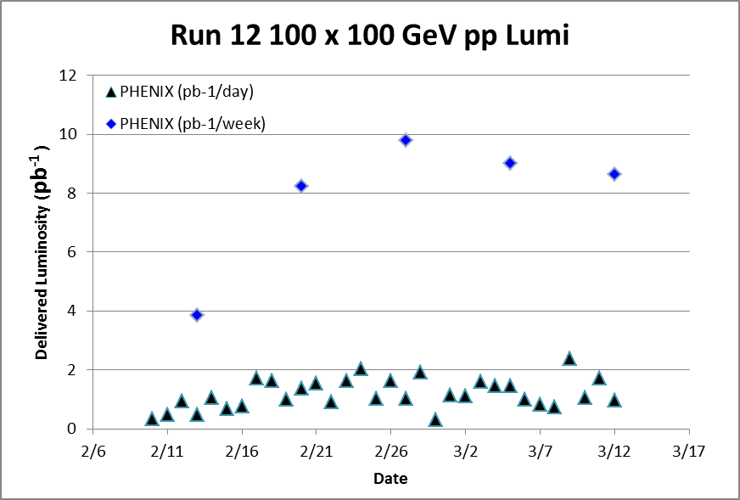
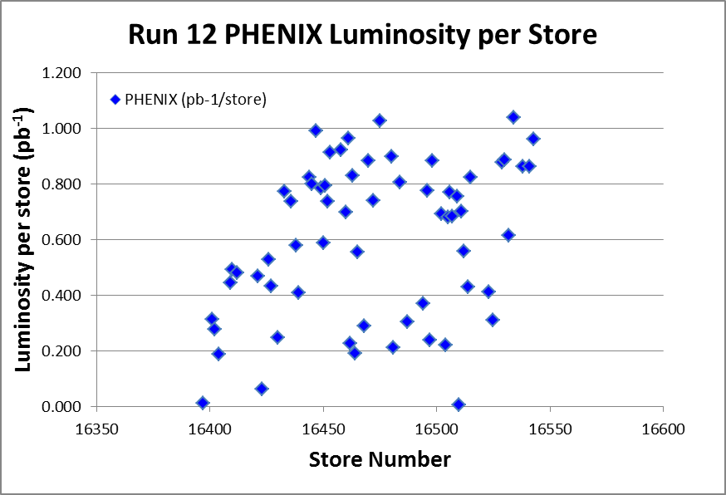
Target (max projection)
Best stores, 16475 and 16534

Slide 26
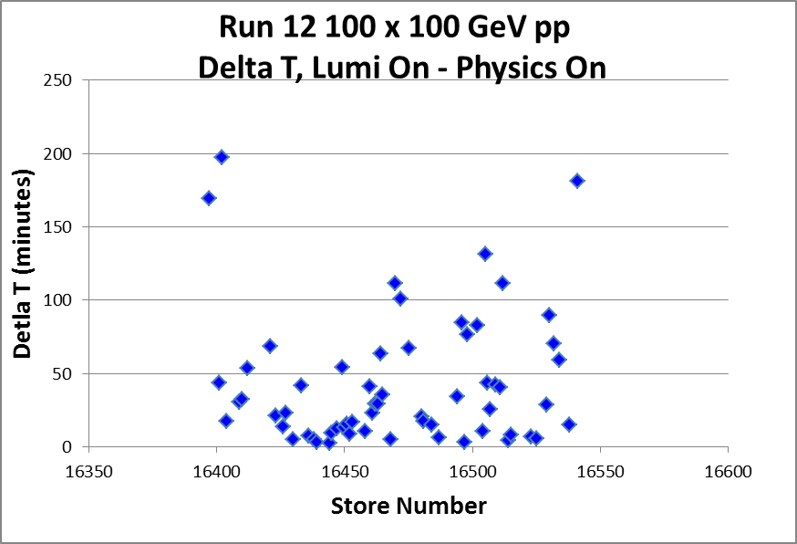
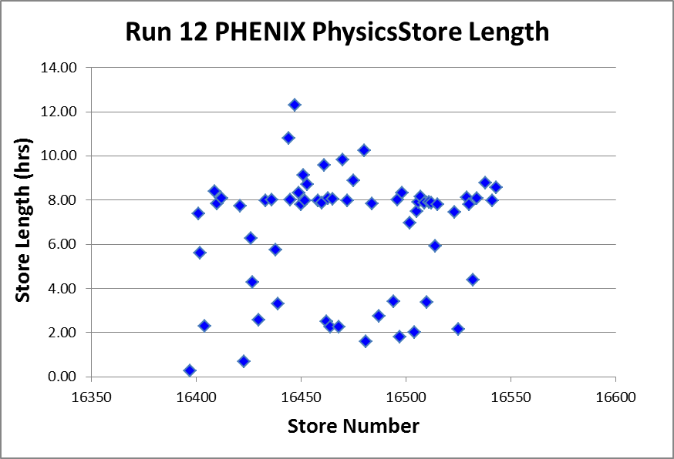
Best stores, 16475 and 16534

Slide 27
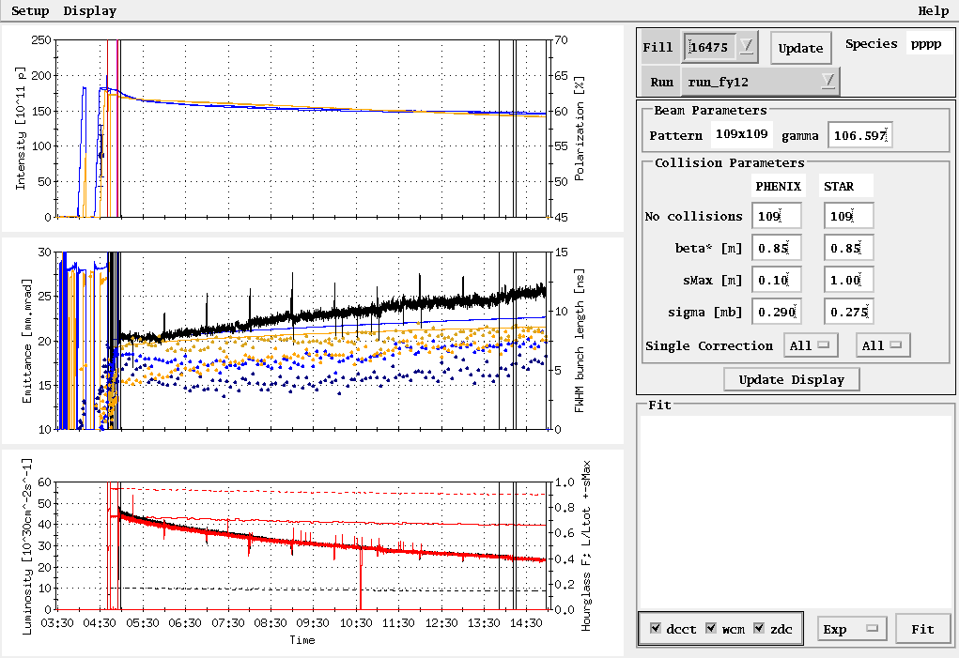
Fill 16475, 27 Feb, 8.9 hours physics store (10 hour Lumi on Store), PHENIX 1.03 pb⁻¹

Slide 28
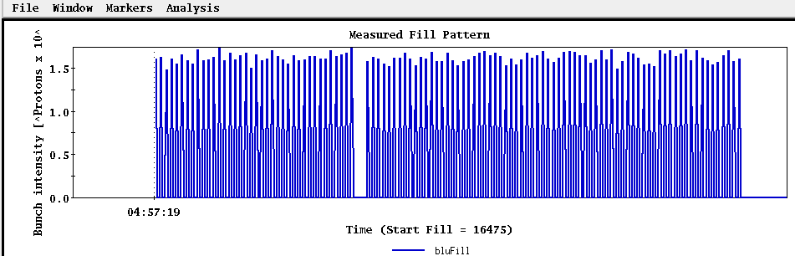
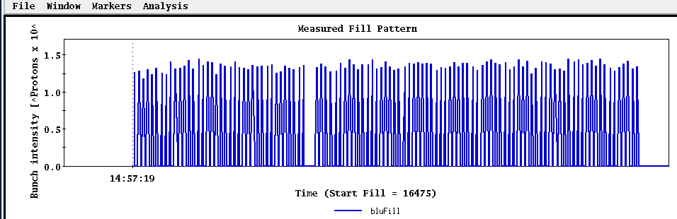
Fill 16475, 27 Feb, 8.9 hours physics store (10 hour Lumi on Store), PHENIX 1.03 pb⁻¹
beginning
end

Slide 29
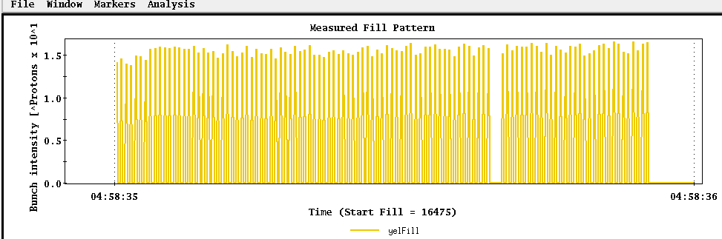
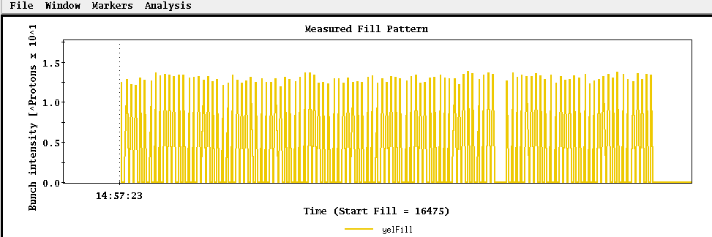
Fill 16475, 27 Feb, 8.9 hours physics store (10 hour Lumi on Store), PHENIX 1.03 pb⁻¹
beginning
end

Slide 30
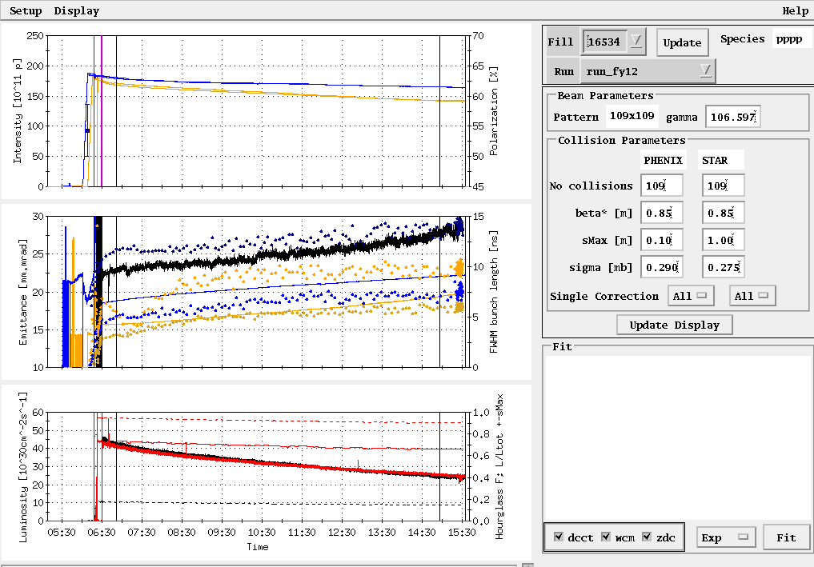
Fill 16534, 9 Mar, 8.1 hours physics store (9.1 hr Lumi on store), PHENIX 1.04 pb⁻¹

Slide 31
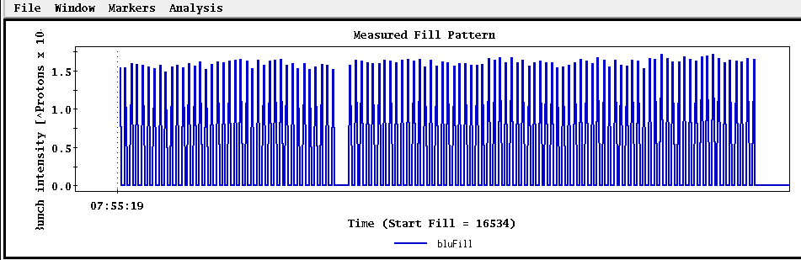
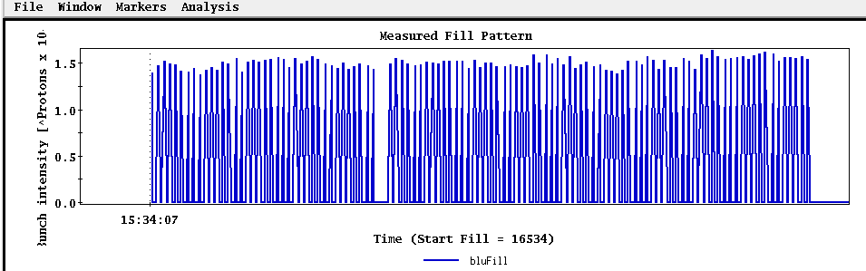
Fill 16534, 9 Mar, 8.1 hours physics store (9.1 hr Lumi on store), PHENIX 1.04 pb⁻¹
Beginning
End

Slide 32
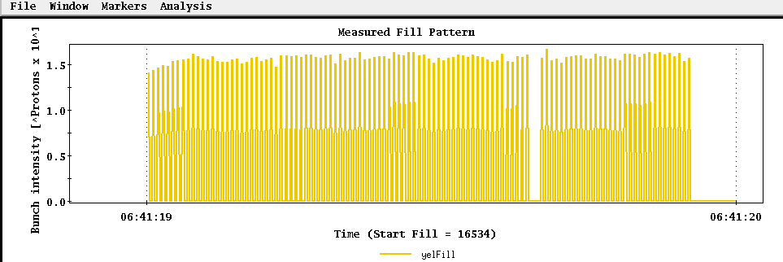
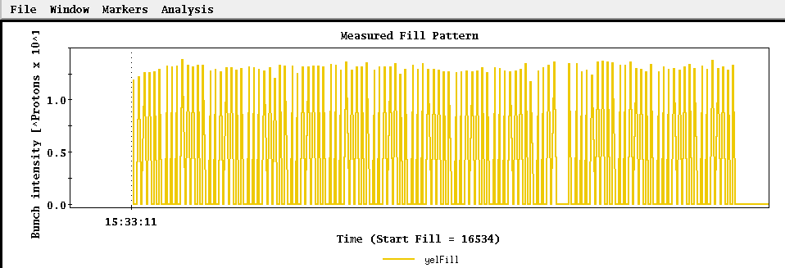
Fill 16534, 9 Mar, 8.1 hours physics store (9.1 hr Lumi on store), PHENIX 1.04 pb⁻¹
Beginning
End

Slide 34
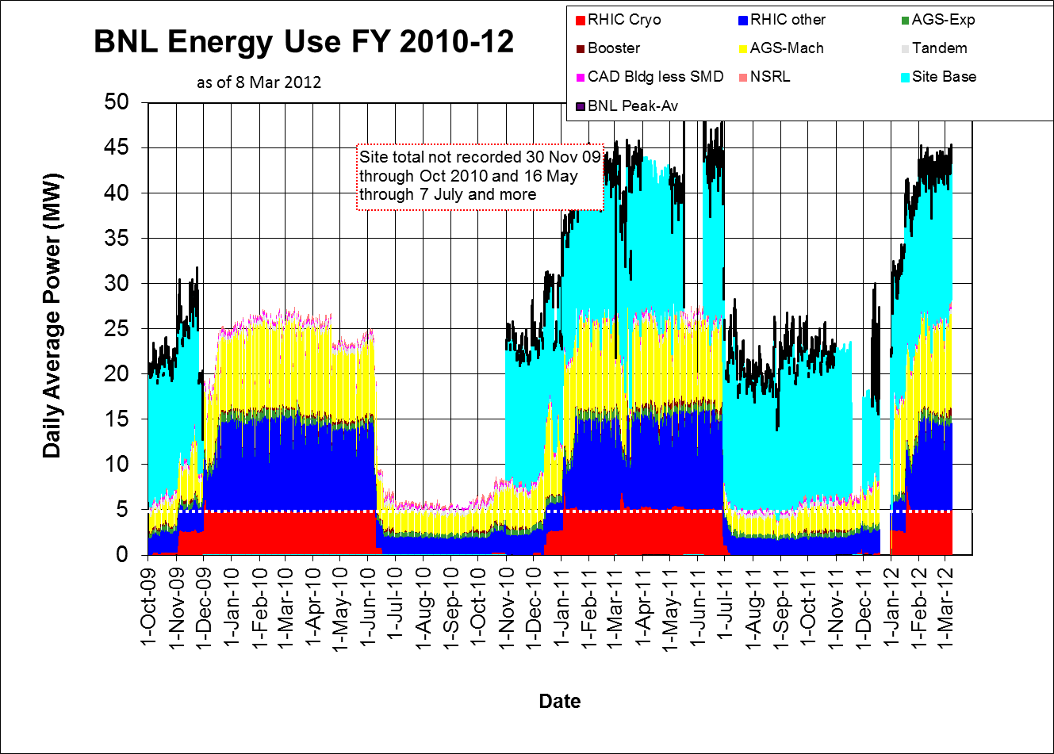

Slide 35
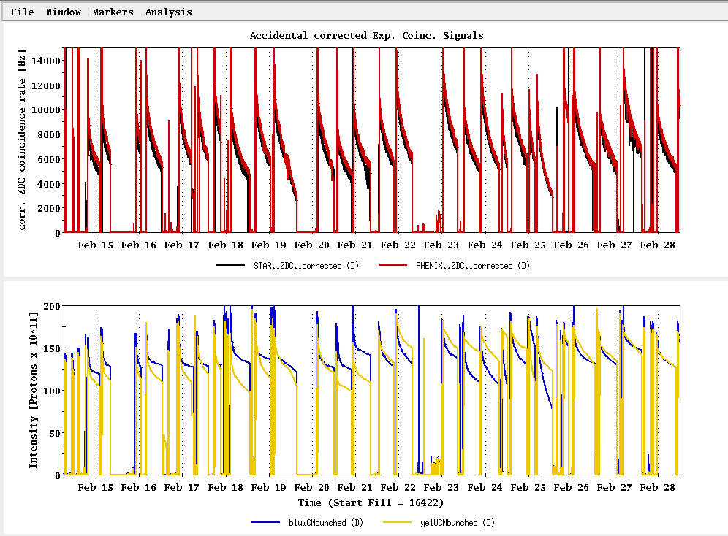
Past Week
L_{average}(max)
(0.29 mb xsection)
Ions/bunch (max)

Slide 36
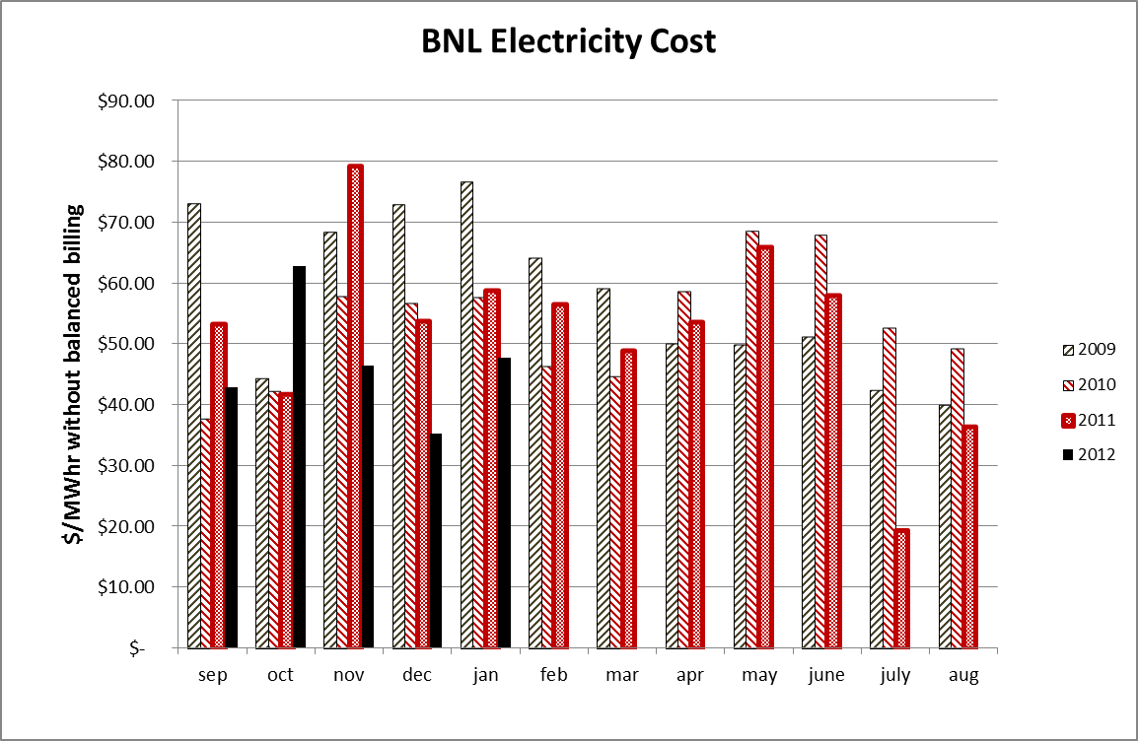

Slide 37
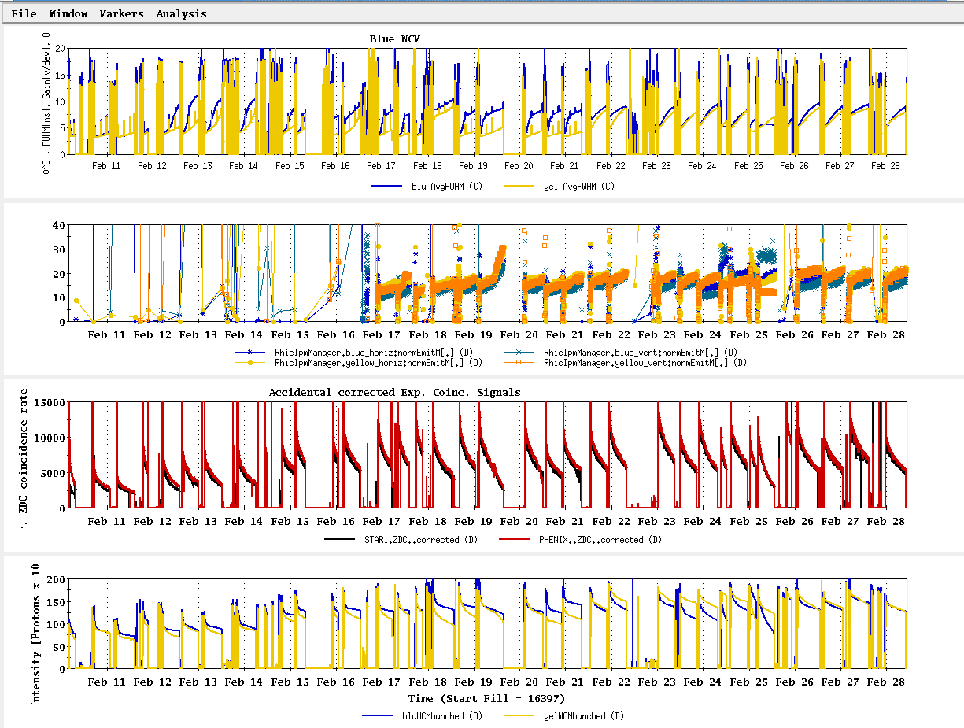
Run 12 Physics Stores to 28 Feb
Absolute scale should not be trusted)
L_{average}(max)
(0.29 mb xsection)

Slide 38
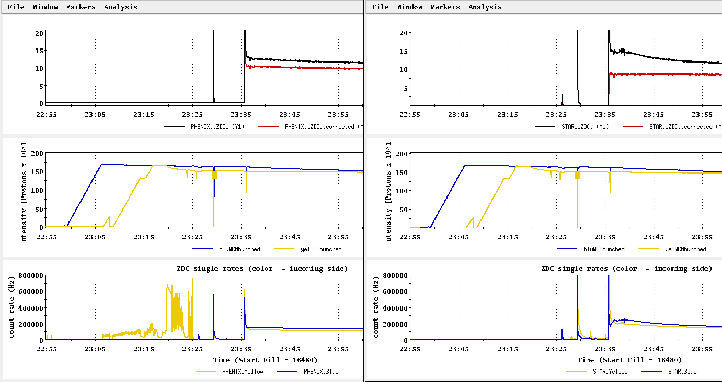
Store 16480 (27 Feb) – typical background issues
PHENIX
STAR
ZDC without and
with singles correction
ZDC without and
with singles correction
Protons/bunch
Protons/bunch
ZDC Singles
ZDC Singles

Slide 39
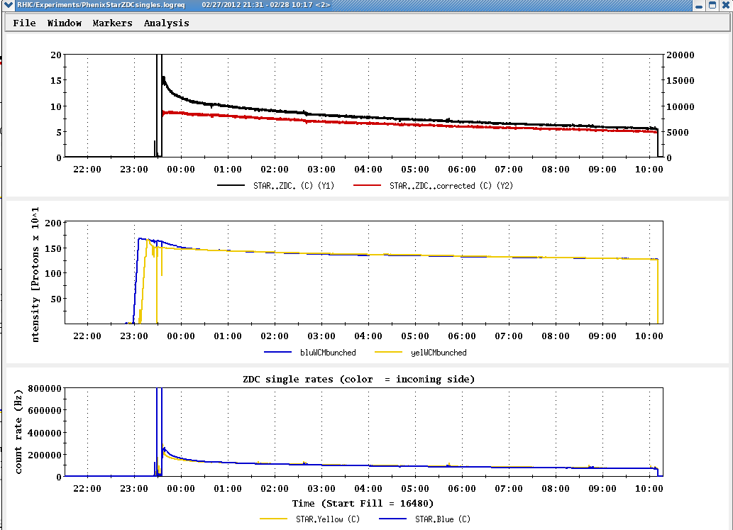
Store 16480 (27 Feb) – typical background issues

Slide 40
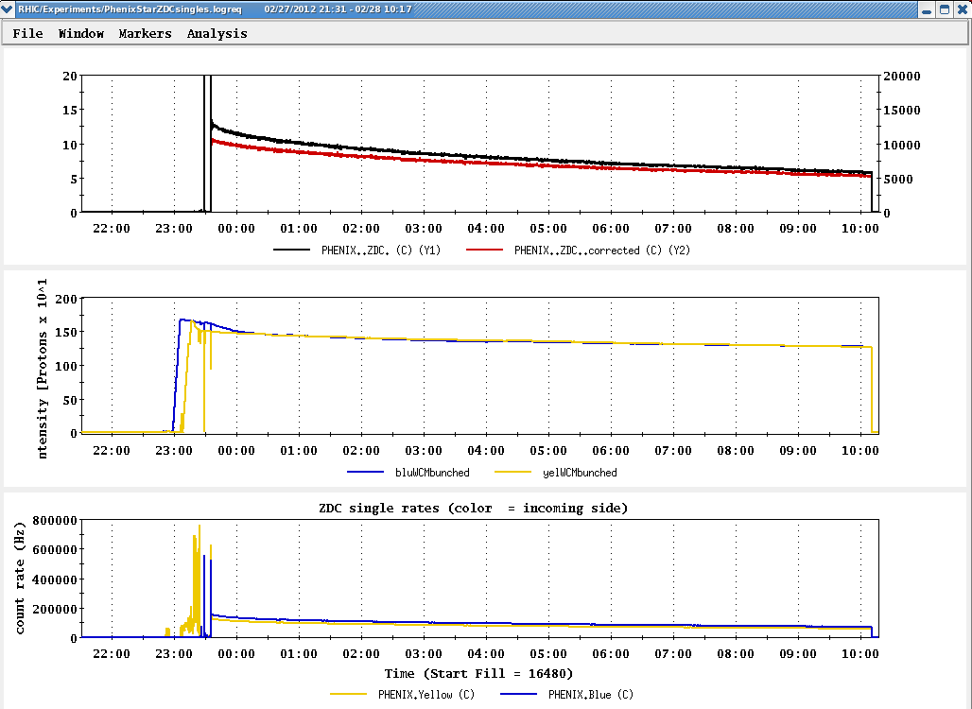
Store 16480 (27 Feb) – typical background issues

Slide 41
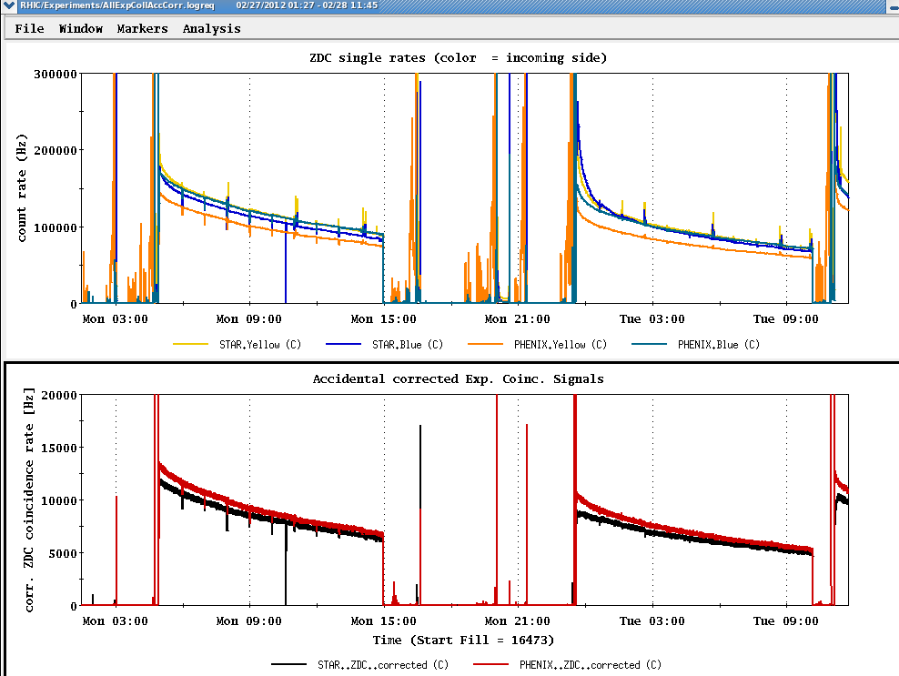
Collision steering corrections background issues 26-27 Feb
ZDC Singles
ZDC Coincidence

Slide 42
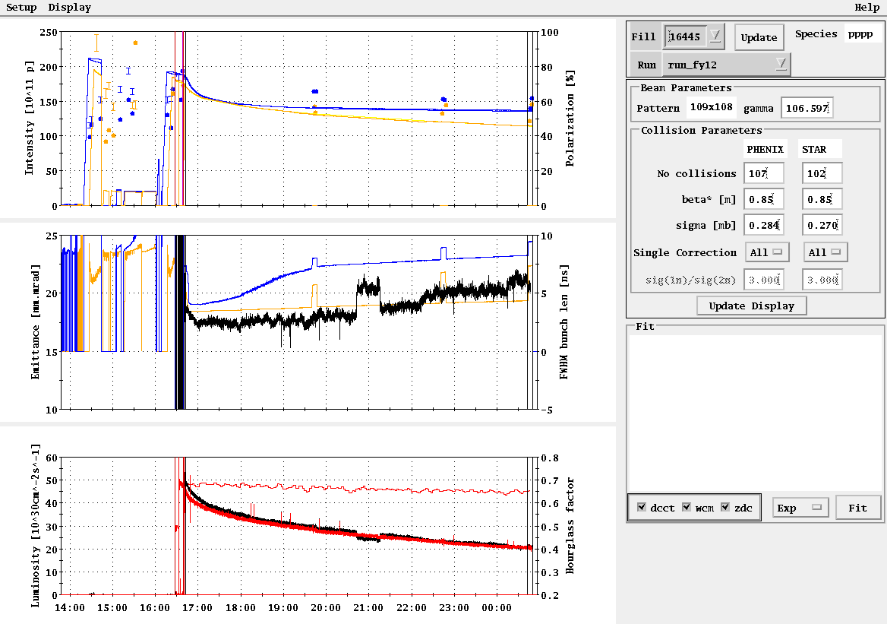
Example -- Store 16445, Sat Feb 18
L_{peak}(max)
L_{store average}(max)

Slide 43
Blue Jet weighted average = 55.4 ± 0.5
Yellow Jet weighted average = 54.9 ± 0.5

Slide 44
Run 12 projection for √s = 200 GeV pp
STAR Goal: 27 pb-1 delivered with 55-60 % polarization
PHENIX Goal: 27 pb-1 delivered with 55-60 % polarization
p²L = 8.2 pb⁻¹ for 55% polarization
From Fischer et. Al. “RHIC Collider Projections (FY 2012 – FY 2016)” 14 October 2011

Slide 45
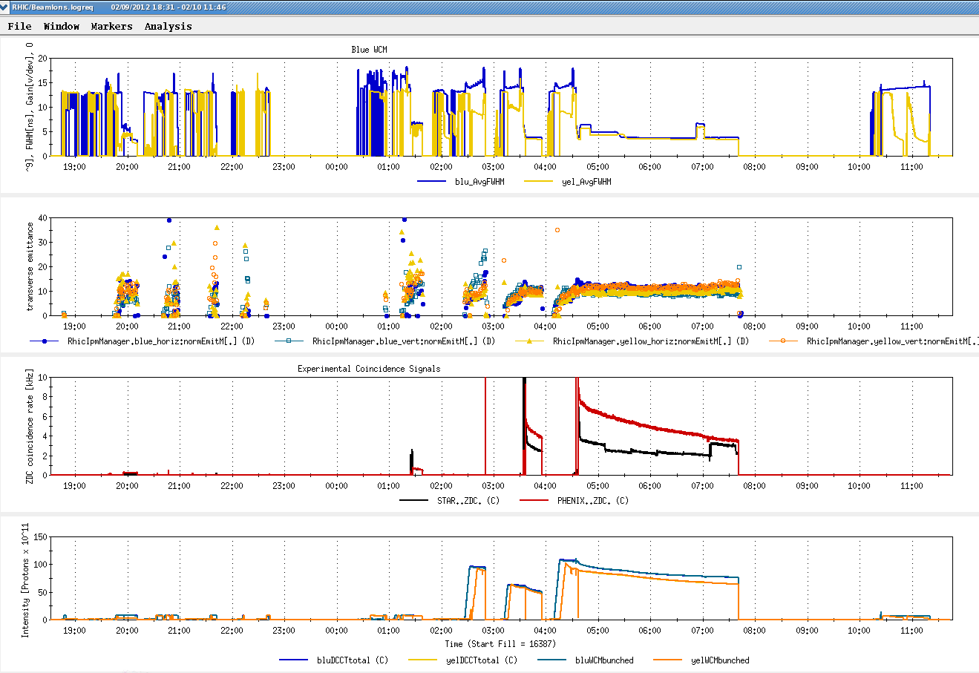
First Physics Store (#16397, 04:01, 10 Feb)

Slide 46
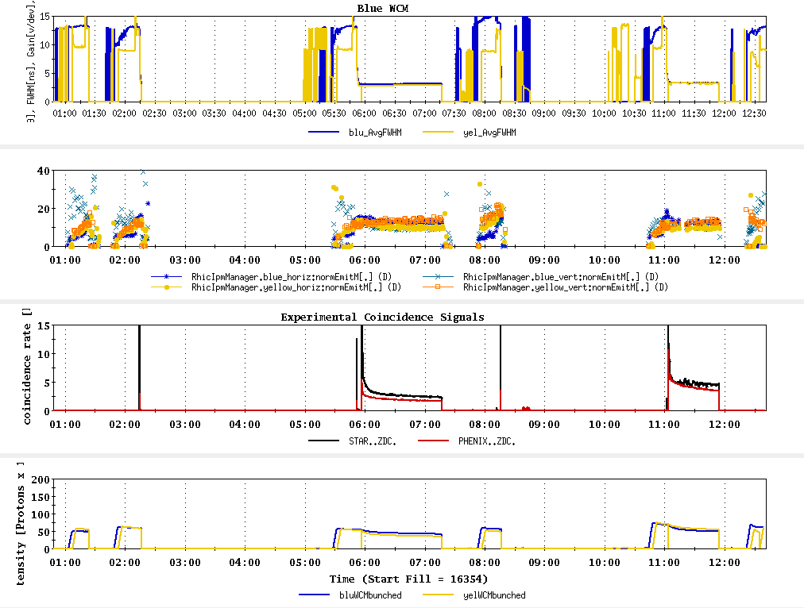
Today, 7 Feb 2012

Slide 47

Typical Store from Run 9, 100 x 100 GeV pp

Slide 48

As of 16:18 hrs 20 Jan
Start cooldown
3.5 days

Slide 49
Recommendations following the June 6-8, 2011 PAC
For Run 12 the PAC recommends the following (in order of priority):
5 weeks of running with polarized proton collisions at 200 GeV.
7 weeks of running with polarized proton collisions at 500 GeV.
5 weeks of running with Cu+Au collisions at 200 GeV.
3 weeks of running with U+U collisions at 193 GeV.
For Run13 the PAC recommends the following (not in order of priority):
12 weeks of running with polarized proton collisions at 500 GeV.
5 week of running with polarized proton collisions at 200 GeV.
7 weeks of running with Au+Au collisions at full energy.

Slide 50
Cryo Issue
D.L. November 23, 2011 update
Our helium supplier no longer able to meet our peek demand of 4 trailers in a one week period. They can give us one trailer a week starting on December 31st, so we expect to have all the helium we need, on time, but we will have to store most of it in the dewars outside 1006B. This will result in our 4K cooldown being a little less stable and predictable than it has been for the past few years when we received all of the helium at 1005R over a short period of time. Because of this, I expect the 4K cooldown will take a least one additional day.

Slide 51


Slide 52

From Fischer et. al. “RHIC Collider Projections (FY 2012 – FY 2016)” 14 October 2011

Slide 53
Run 12 projection for √s = 500 GeV pp
From Fischer et. Al. “RHIC Collider Projections (FY 2012 – FY 2016)” 14 October 2011

Slide 54
Run 12 projection for √s = 193 GeV/n UU
From Fischer et. Al. “RHIC Collider Projections (FY 2012 – FY 2016)” 14 October 2011

Slide 55
Run 12 projection for √s = 200 GeV/n CuAu
From Fischer et. Al. “RHIC Collider Projections (FY 2012 – FY 2016)” 14 October 2011

