Slide 1
Run 12 RHIC Machine/Experiments Meeting
3 Apr 2012
Agenda:
Status reports
Other business

Slide 2
Run 12 Plan based on 20 weeks cryo operation
23 week schedule based on 3/28/12 Vigdor guidance
17 Jan, Begin cool-down to 4.5K
20 Jan, Cool-down to 4.5K in Blue and Yellow Ring complete, begin magnet setup
21-28 Jan, pp injection setup
28 Jan-3 Feb, LLRF, Ramp and store setup, begin 8 hr/night for experiments
3-10 Feb, 1 week ramp-up with 8 hrs/night for experiments
10 Feb, with store # 16397, begin 4 weeks pp physics with further ramp-up
16 Feb, 24/7 stores begin
12 (Monday) March, end 4.4 weeks √s = 200 GeV pp, begin ½ week setup for √s = 510 GeV pp
16 March, begin 5 week pp physics (machine only) √s = 510 GeV
17/18 March, STAR/PHENIX physics start with longitudal polarization
Today – 3 April
19 April (Thursday), end 4.9 week pp physics run at √s = 500 GeV
Tentative Cu-Au and Uranium-Uranium plan
19 April (Thursday), begin 1 week setup for UU (with overnight stores for experiments late in week)
26 April (Thursday), begin 2-3 week UU physics run…if 3 weeks…
17 May (Thursday) end 3 week √s = 193 GeV/n UU run, begin setup for √s = 200 GeV/n CuAu
19 May (Saturday – my ambitious estimate) begin CuAu physics run
20-25 May: IPAC
25 June (Monday), end 5.3 week √s = 200 GeV/n CuAu run, begin cryo warm-up
28 June, cryo warm-up complete (23.3 cryo-weeks)
Total Physics Weeks = 17.6

Slide 4
Run 12, √s = 510 GeV polarized proton run – experiment goals
STAR Goal for 5 weeks longitudal polarization (50% polarization):
  Sampled Luminosity = 45 pb⁻¹ with 50% polarization
  Delivered Luminosity = 75 pb⁻¹
PHENIX Goal for 5 weeks longitudal polarization (50% polarization):
  Sampled Luminosity = 30 pb⁻¹ with |z| <30 cm
  = 10 pb⁻¹ with |z| <10 cm
  Delivered Luminosity = 75 pb⁻¹ changed to 120 pb⁻¹, 3/29/12, Ed O’Brien email

Slide 5
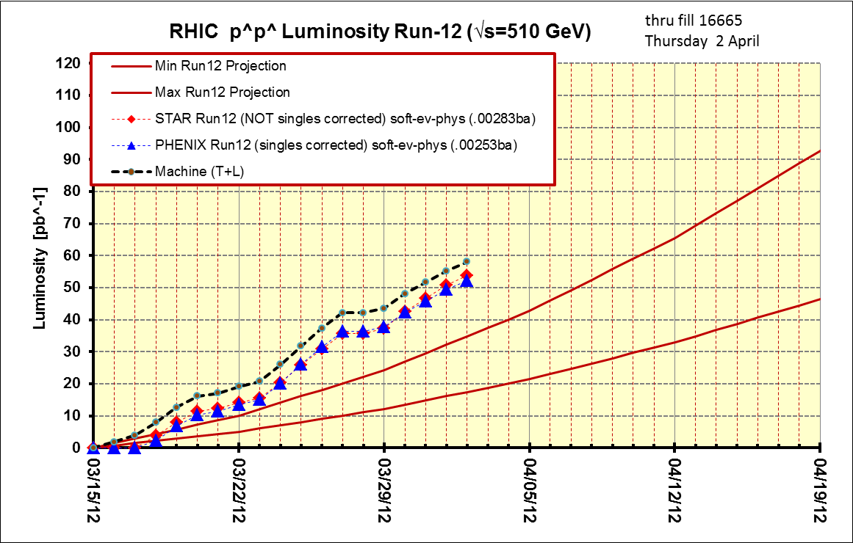
Thru fill 16665, 2 Apr
PHENIX Goal
STAR Goal

Slide 6
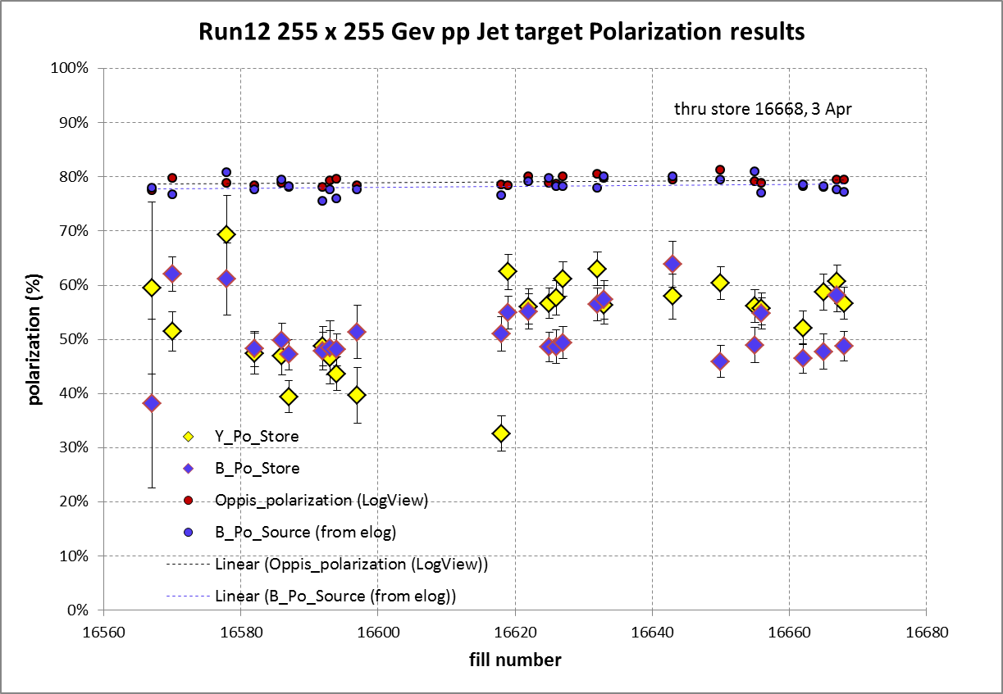
Blue weighted average = 51.4% ± 0.6%, 35% below source pol
Yellow weighted average = 53.7% ± 0.7%, 32% below source pol

Slide 7
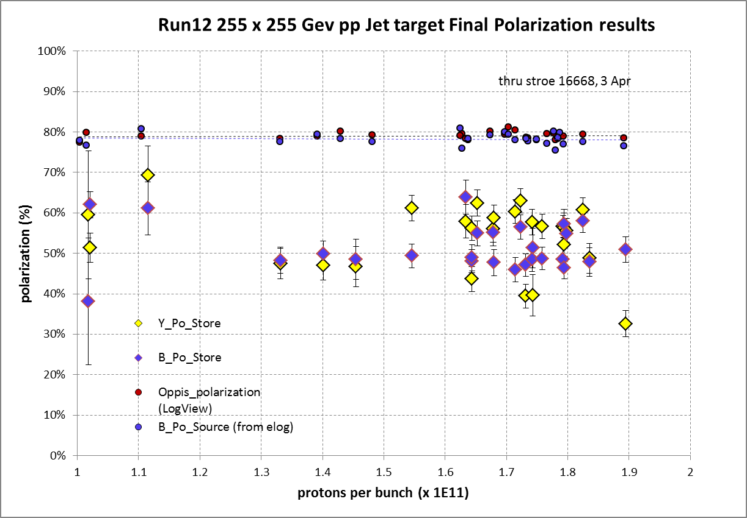

Slide 8
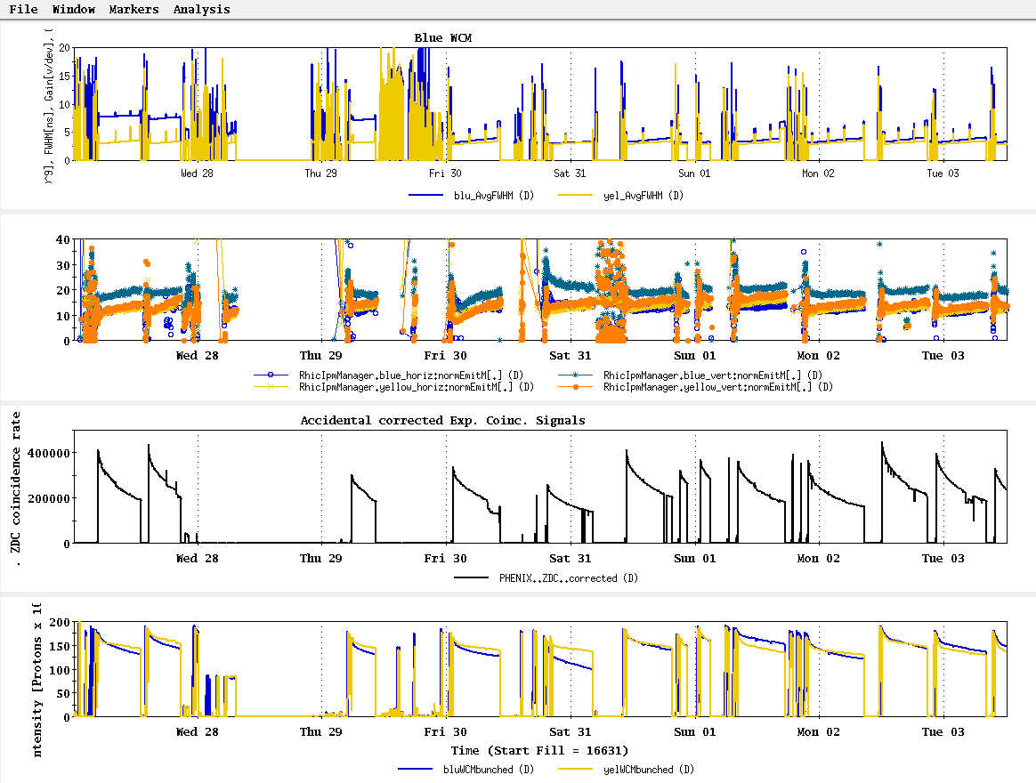
27 Mar – 3 Apr stores

Slide 9
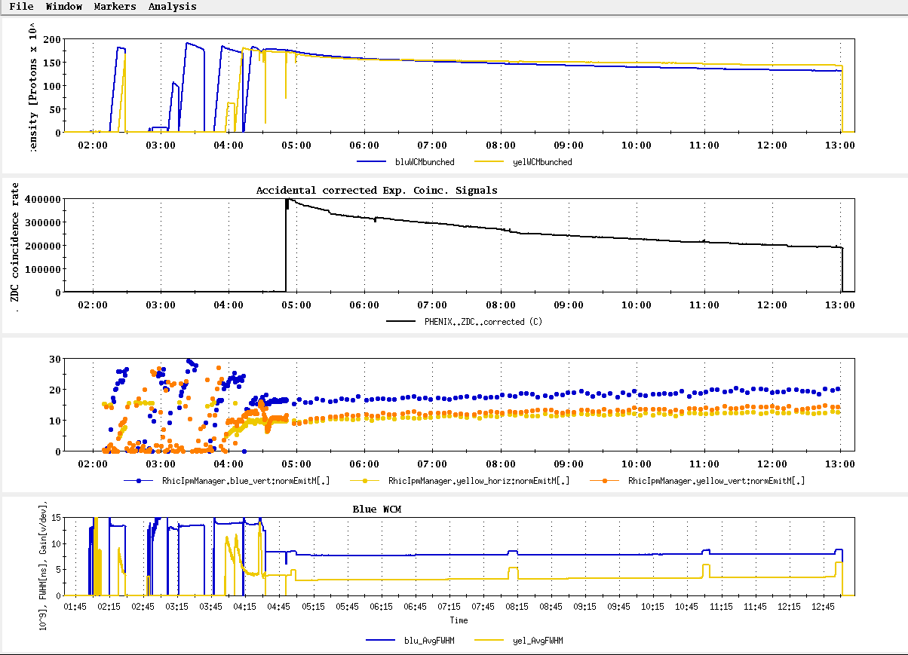
Store 16632, Blue jet = 56.5 +/- 3.0; Yellow jet = 63.0 +/- 3.1
Best average polarization measured by jet for store > 8 hrs

Slide 10
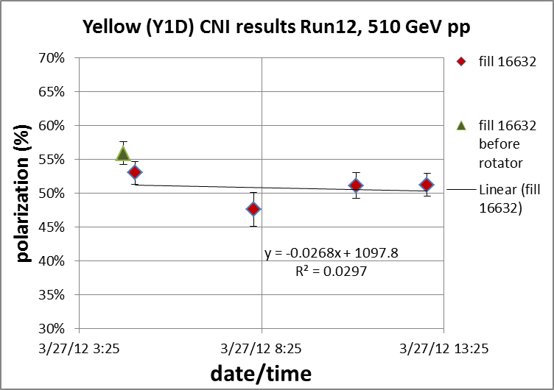
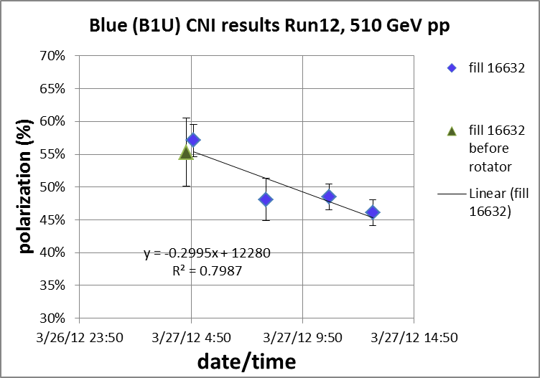
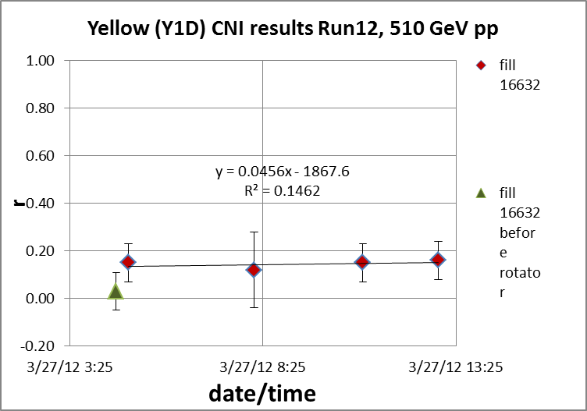
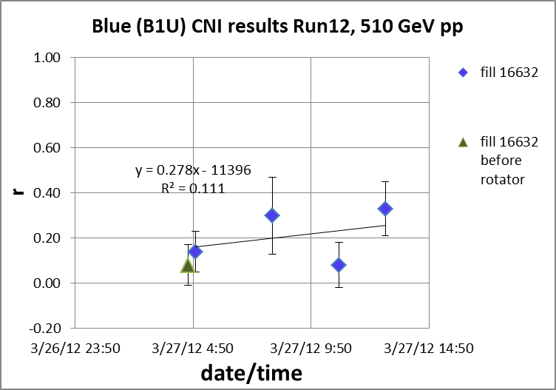

Slide 11
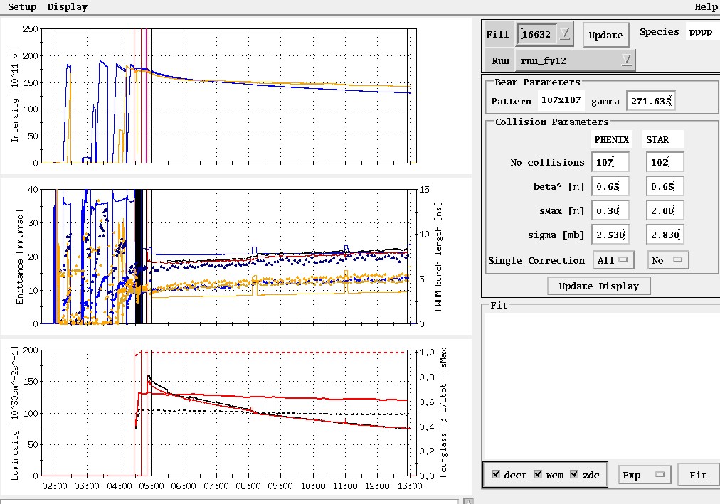
Store 16632
Peak lumi goal
Average lumi goal

Slide 12
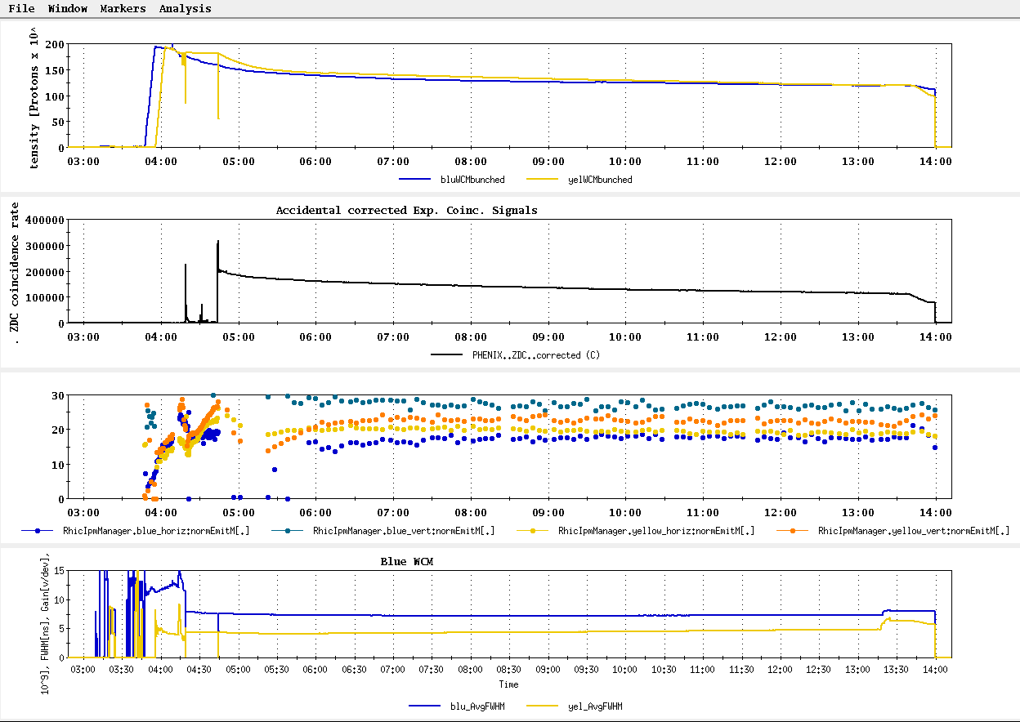
Store 16618, Blue jet = 51.0 +/- 3.2; Yellow jet = 32.6 +/- 3.3
Worst average polarization measured by jet for store > 8 hrs

Slide 13
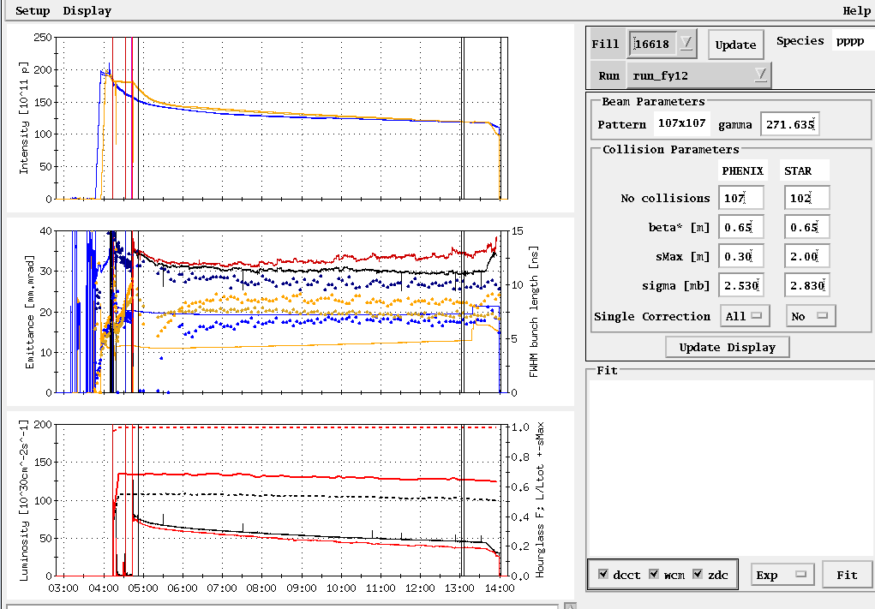
Store 16618

Slide 14
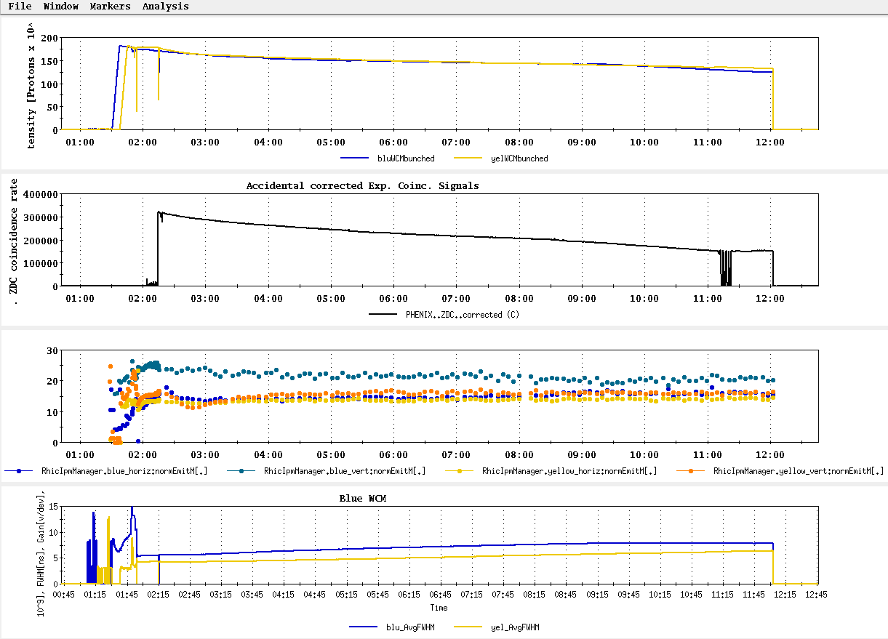
Store 16587, Blue jet = 47.2 +/- 2.8; Yellow jet = 39.4 +/- 2.9
Next to worst average polarization measured by jet for store > 8 hrs

Slide 15
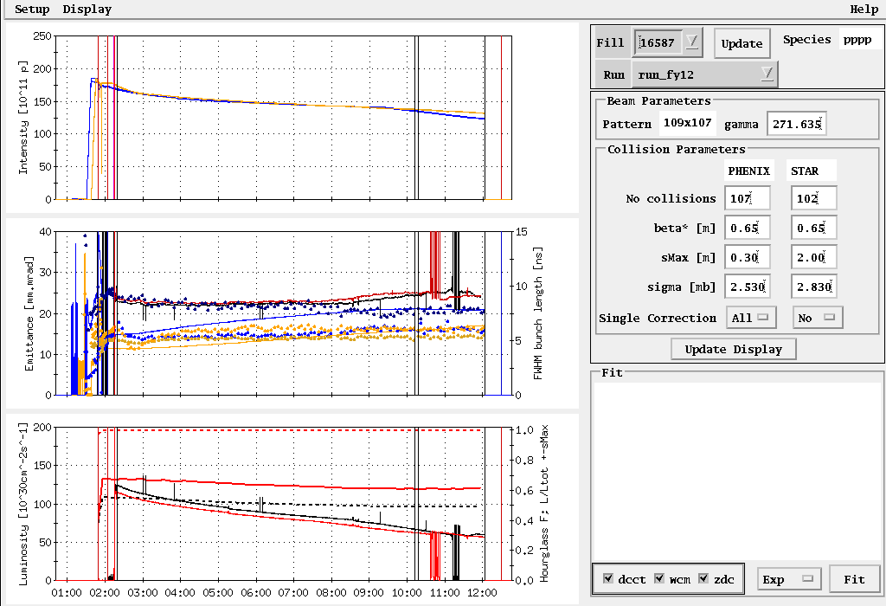
Store 16587

Slide 16
Other Slides

Slide 17
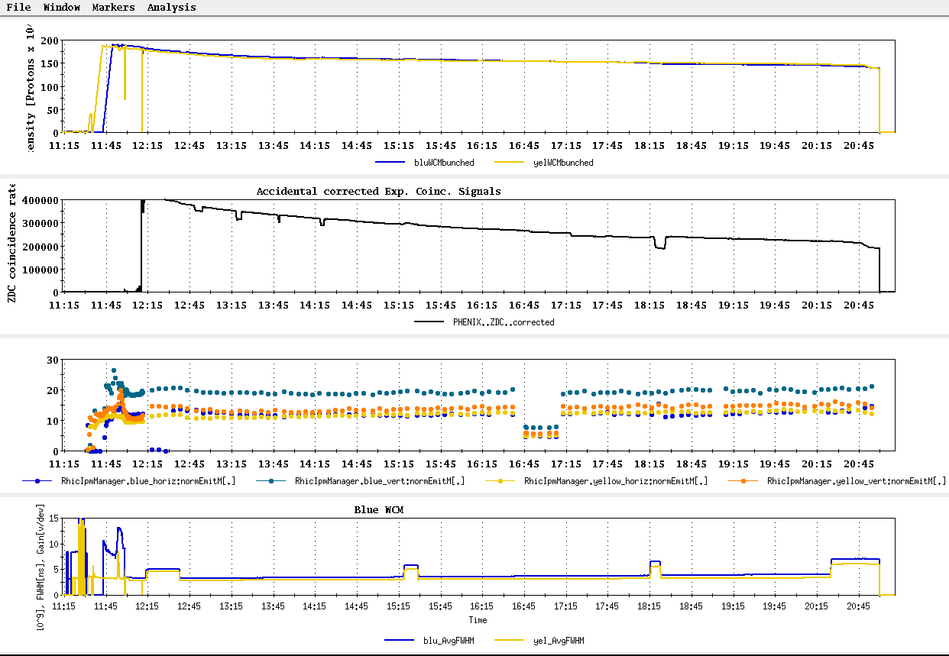
Store 16667, Blue jet = 58.1 +/- 2.9; Yellow jet = 60.7 +/- 3.1
Second best average polarization measured by jet for store > 8 hrs

Slide 18
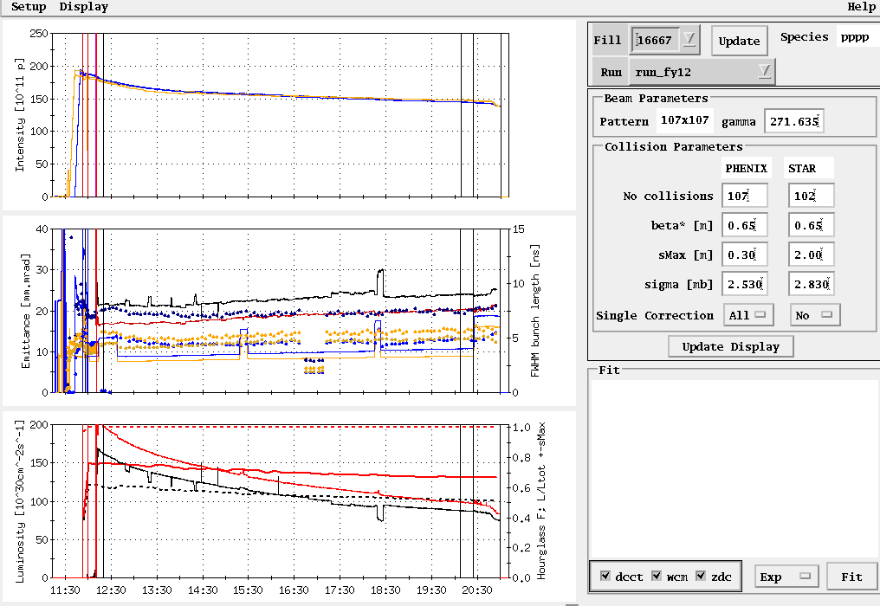
Store 16667
Peak lumi goal
Average lumi goal

Slide 19
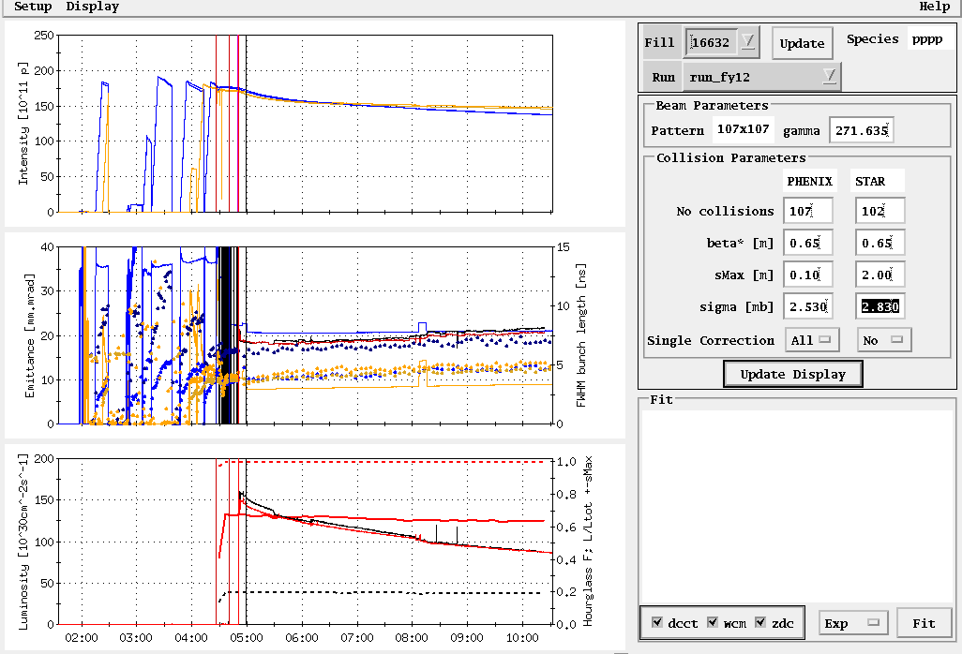
Store 16632, 3/27/12
Peak lumi goal
Average lumi goal
Table2: Max lumi parameters: 1.65x10⁹/bunch, 0.6 β*, 20-25 mmmr emitt → peak = 200x10³⁰ cm⁻²s⁻¹

Slide 20
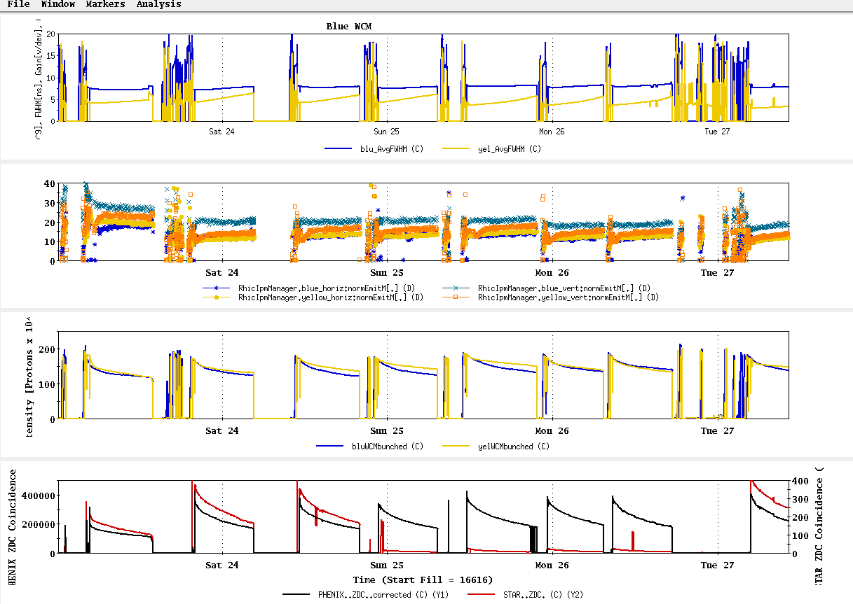
23 Mar – 27 Mar stores

Slide 21
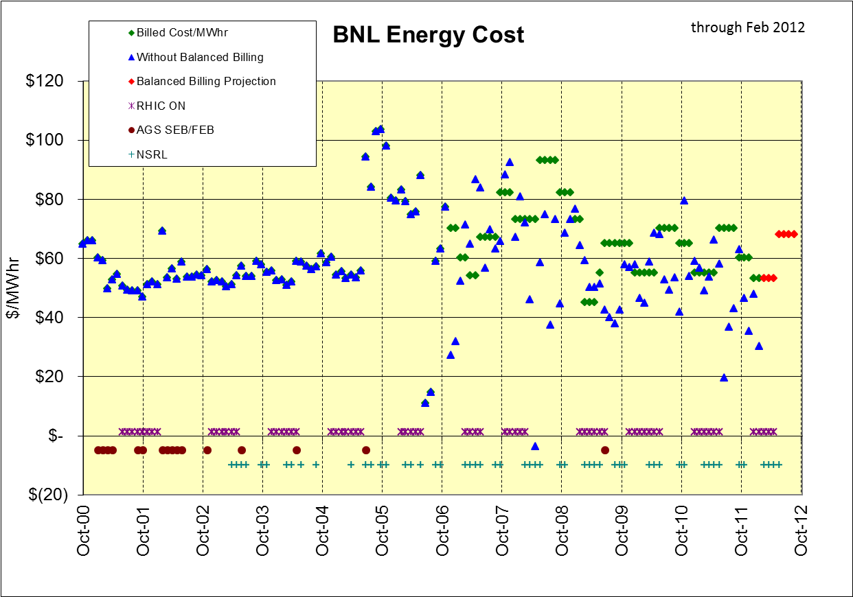
$ in BNL Balanced Billing Bank for FY12 (through Feb) = +$1,825K
$30/MWhr

Slide 22
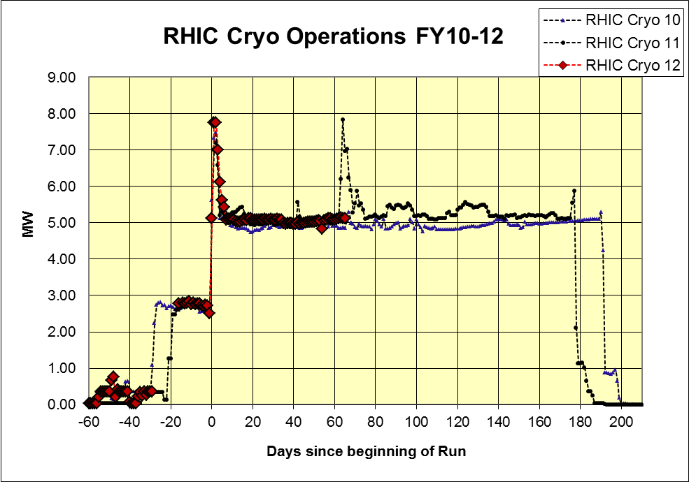
As of 22 Mar 2012

Slide 23
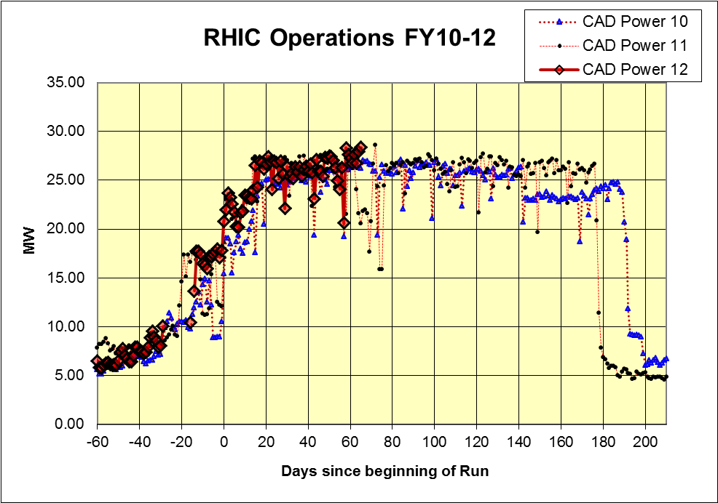
As of 22 Mar 2012

Slide 24
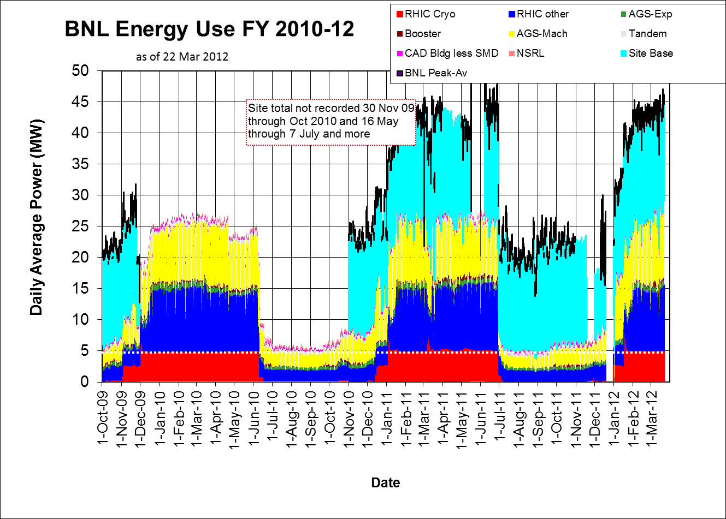

Slide 25
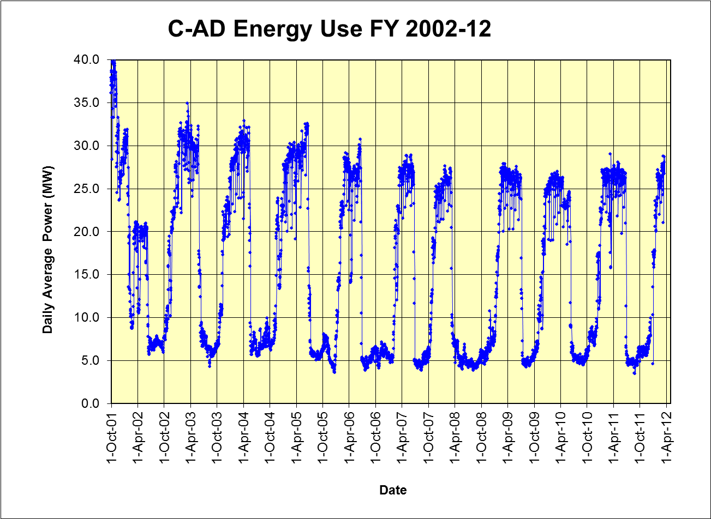

Slide 26
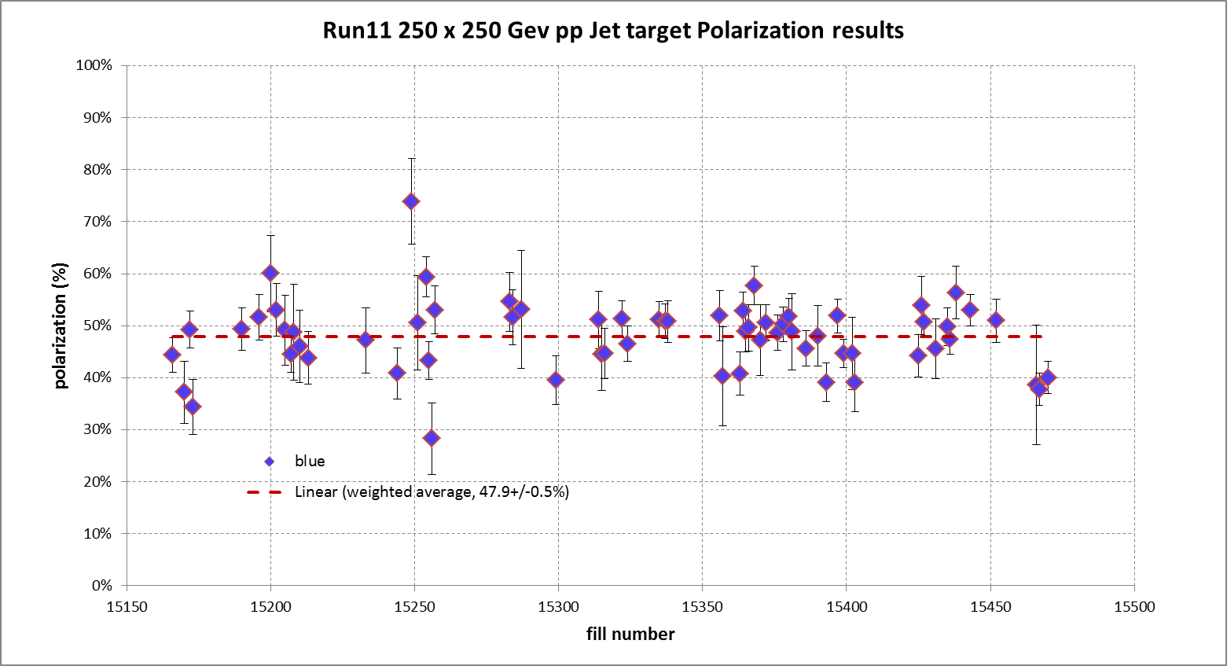
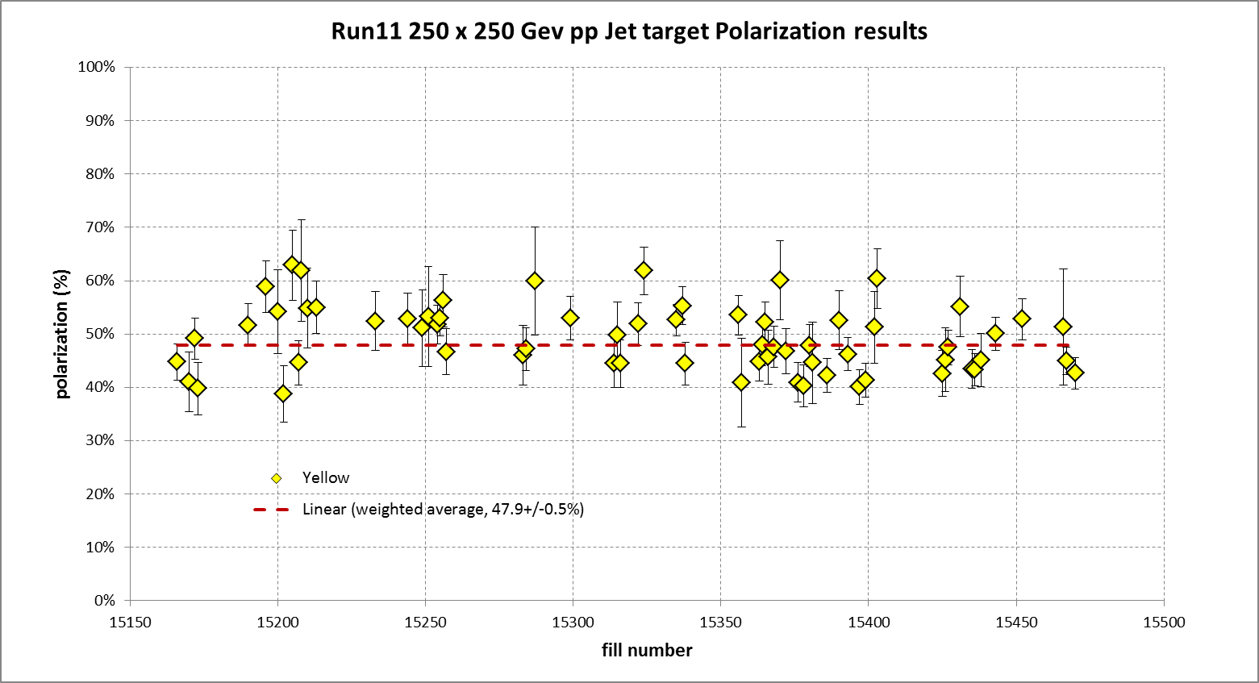

Slide 27
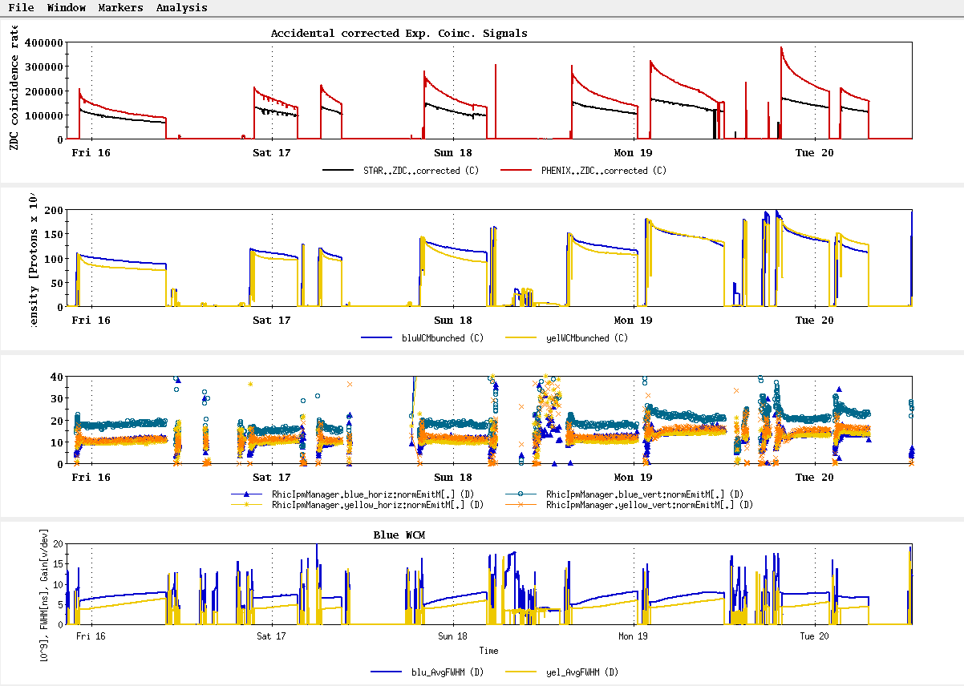
All “physics” stores beginning with16570, 15 March
~L_{store avg} Goal

Slide 28
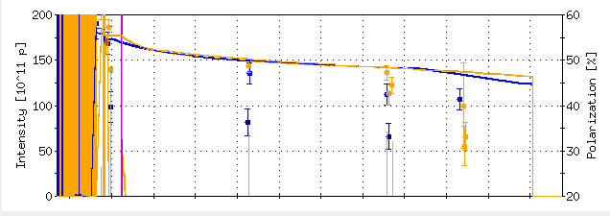
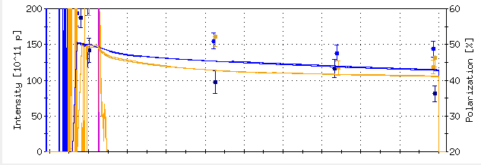
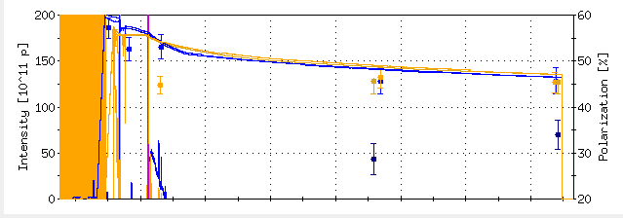
From “StoreAnalysis” program in “StartUp”
Polarization Goal
16578
16586
16592

Slide 29
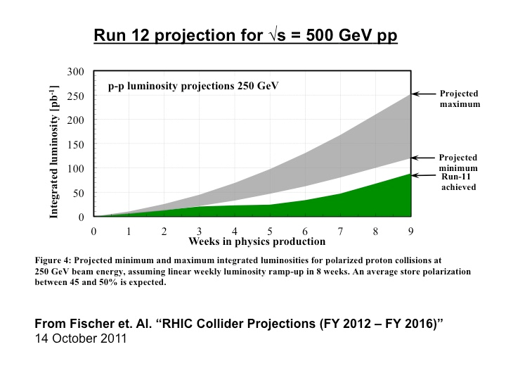
Expectation for 5 weeks physics:
45-95 pb⁻¹ delivered luminosity with 45-50% polarization
P⁴L ~ 4 pb⁻¹

Slide 30
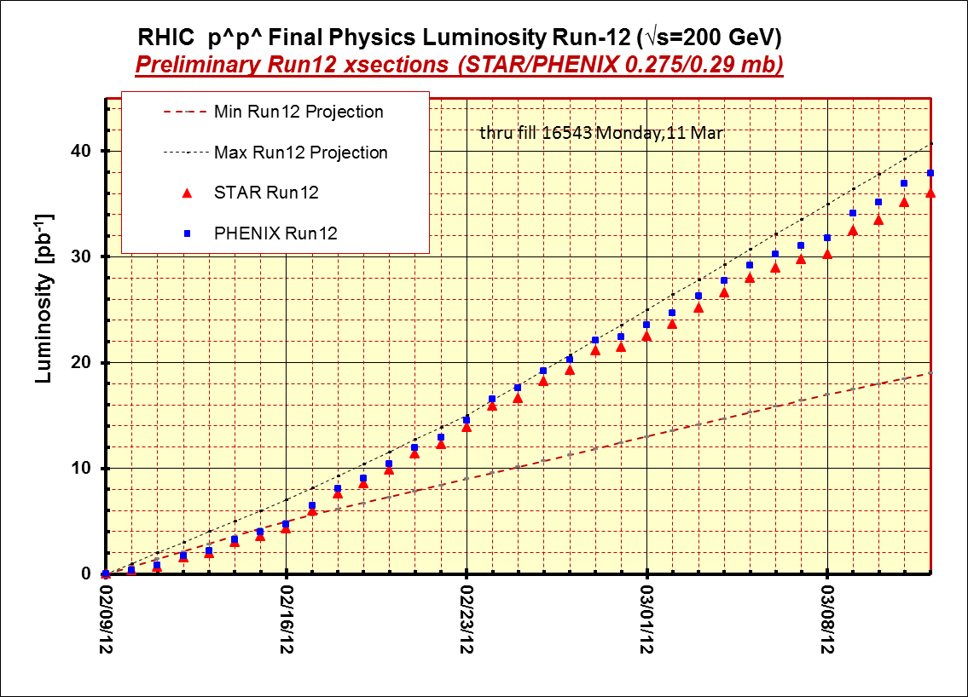
STAR & PHENIX Goal

Slide 31
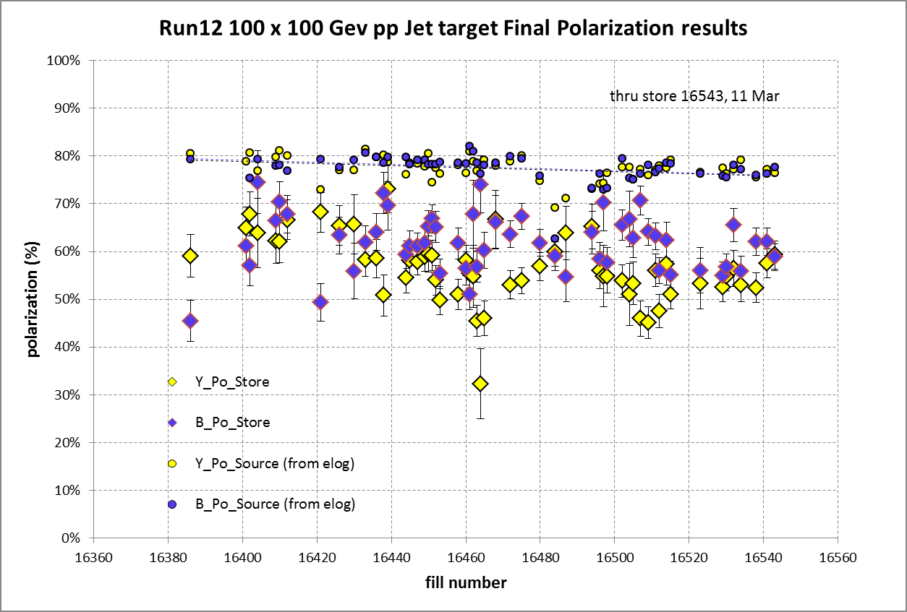
STAR & PHENIX Polarization Goals
Offline polarization is larger
Blue Jet weighted average = 61.2% ± 0.5%; source blue average = 77.5% → 20% lost
Yellow Jet weighted average = 55.8% ± 0.5%; source yellow average = 77.4% → 28% lost

Slide 32
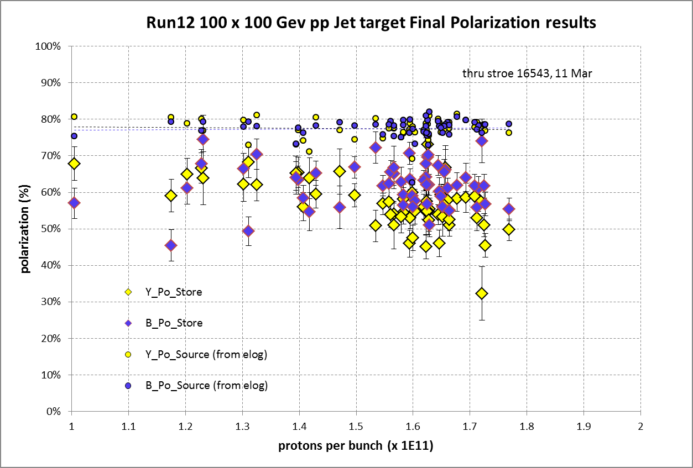

Slide 33
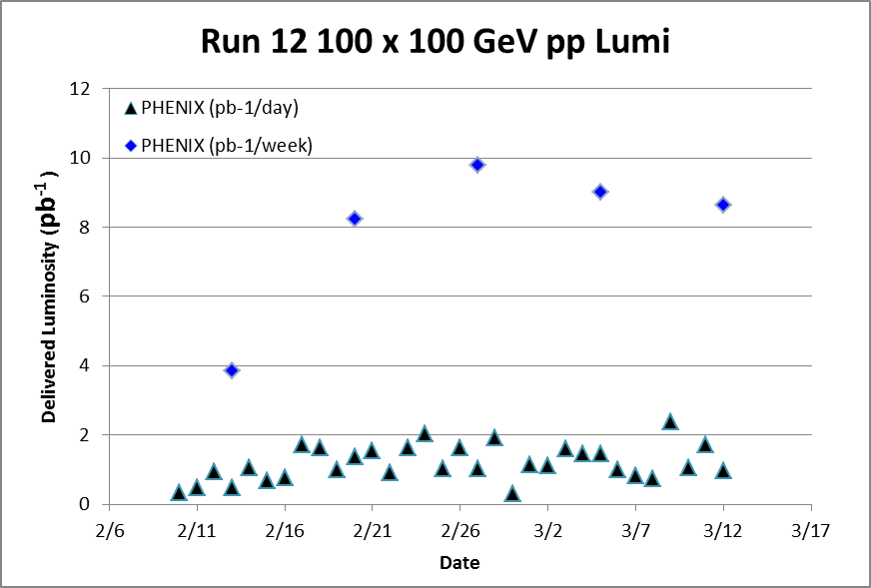
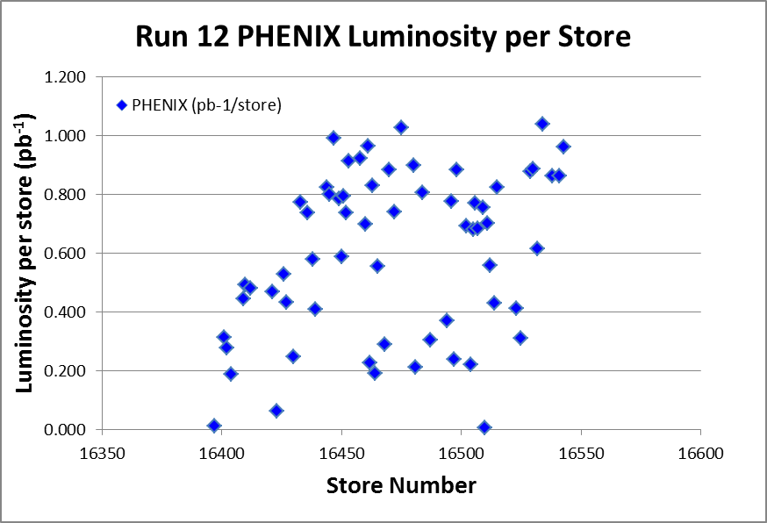
Target (max projection)
Best stores, 16475 and 16534

Slide 34
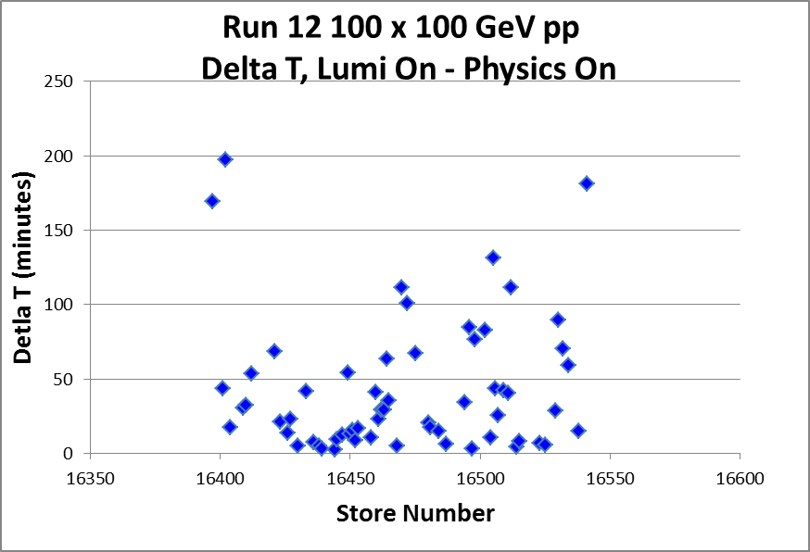
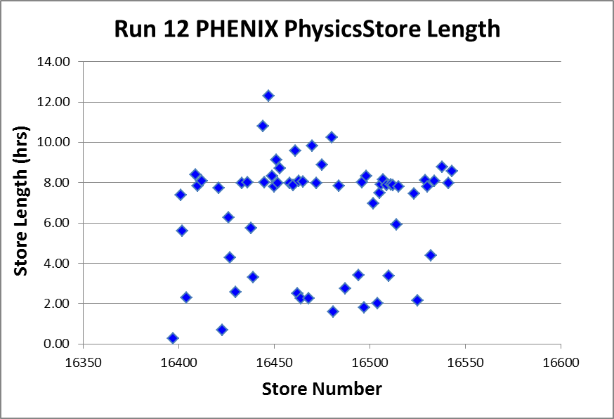
Best stores, 16475 and 16534

Slide 35
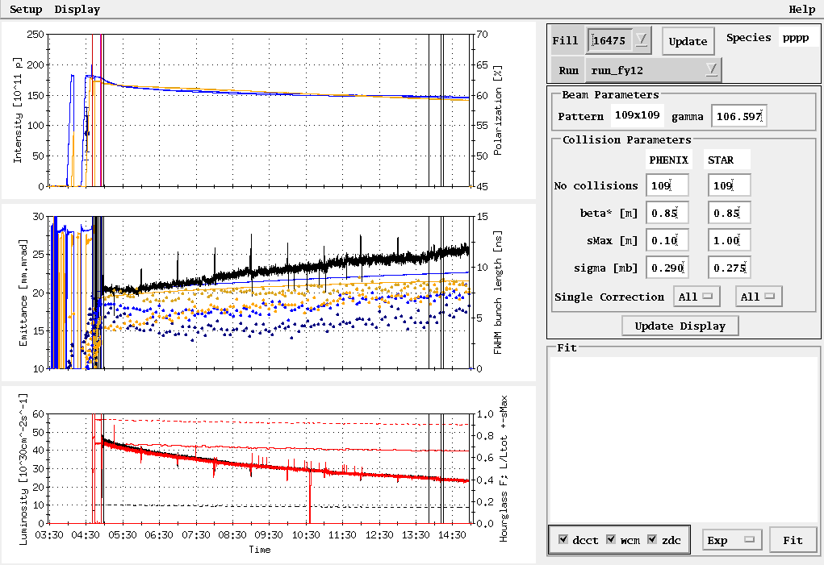
Fill 16475, 27 Feb, 8.9 hours physics store (10 hour Lumi on Store), PHENIX 1.03 pb⁻¹

Slide 36
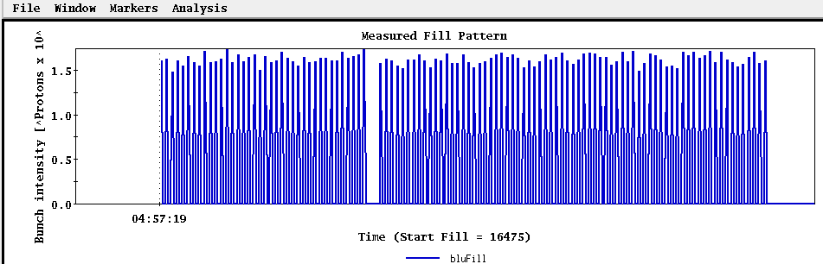
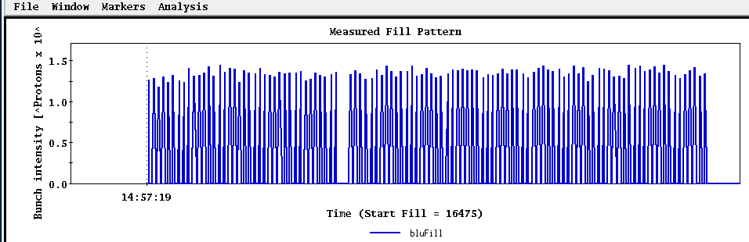
Fill 16475, 27 Feb, 8.9 hours physics store (10 hour Lumi on Store), PHENIX 1.03 pb⁻¹
beginning
end

Slide 37
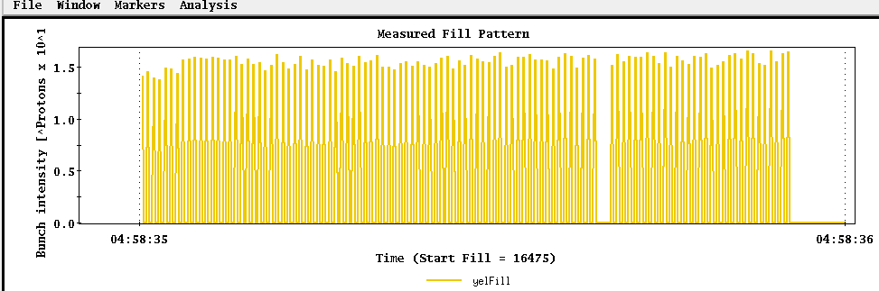
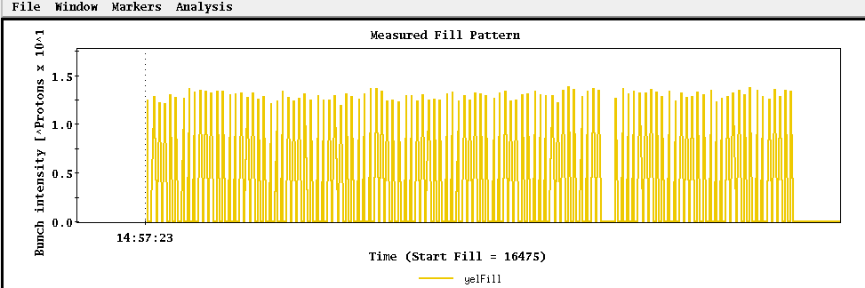
Fill 16475, 27 Feb, 8.9 hours physics store (10 hour Lumi on Store), PHENIX 1.03 pb⁻¹
beginning
end

Slide 38
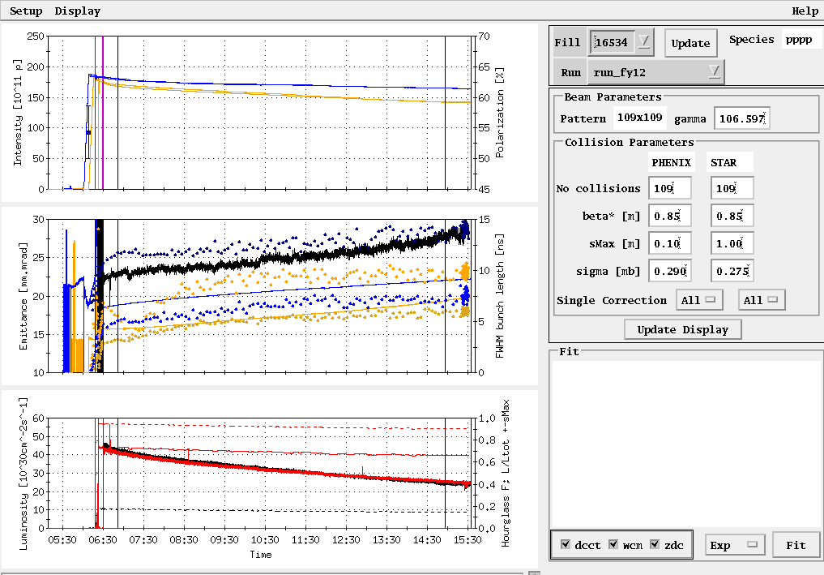
Fill 16534, 9 Mar, 8.1 hours physics store (9.1 hr Lumi on store), PHENIX 1.04 pb⁻¹

Slide 39
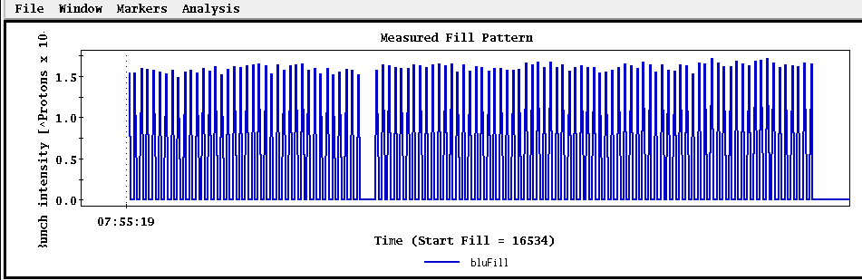
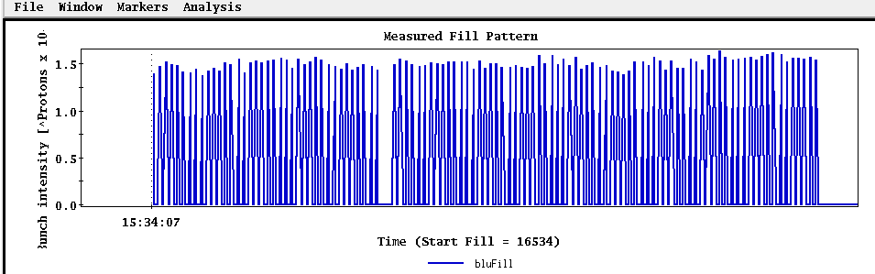
Fill 16534, 9 Mar, 8.1 hours physics store (9.1 hr Lumi on store), PHENIX 1.04 pb⁻¹
Beginning
End

Slide 40
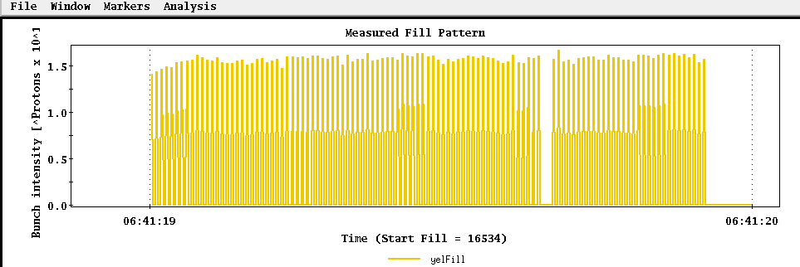
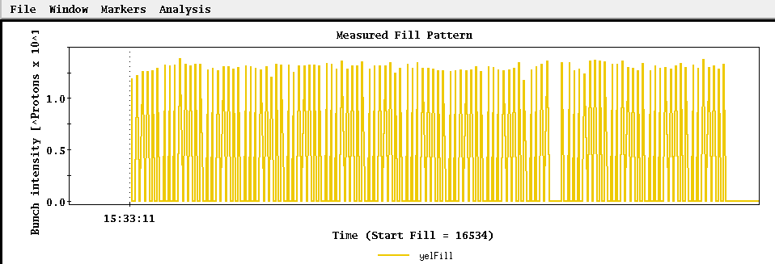
Fill 16534, 9 Mar, 8.1 hours physics store (9.1 hr Lumi on store), PHENIX 1.04 pb⁻¹
Beginning
End

Slide 41
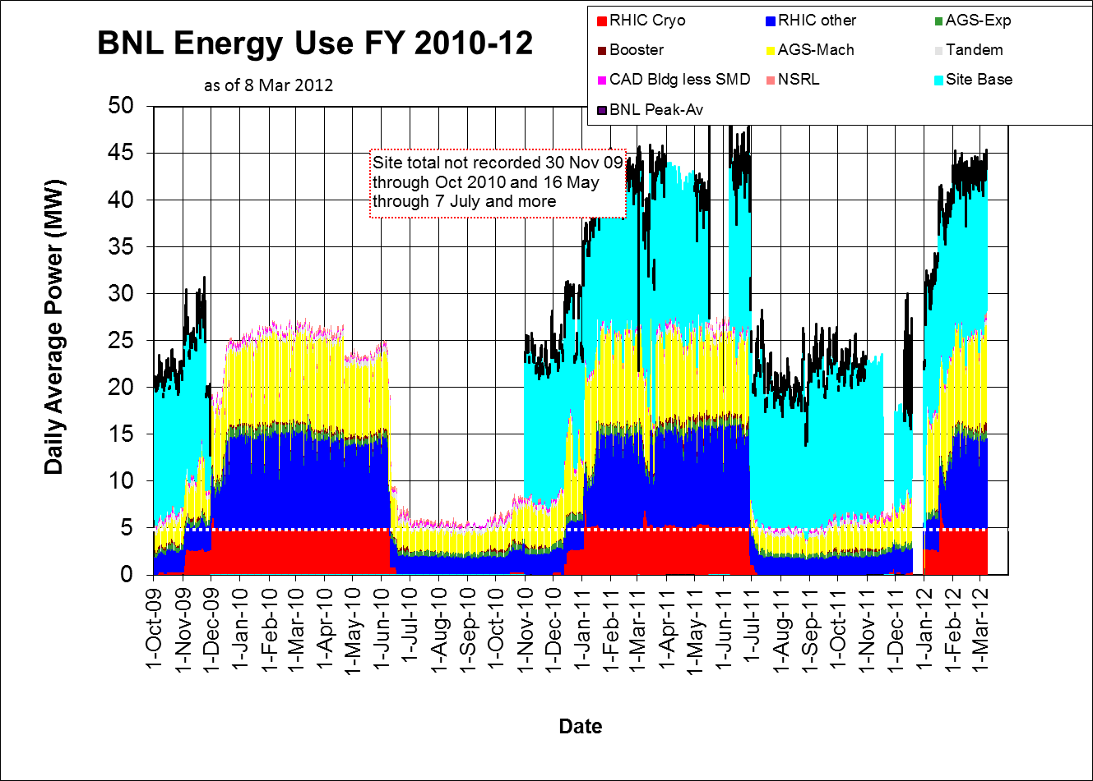

Slide 42
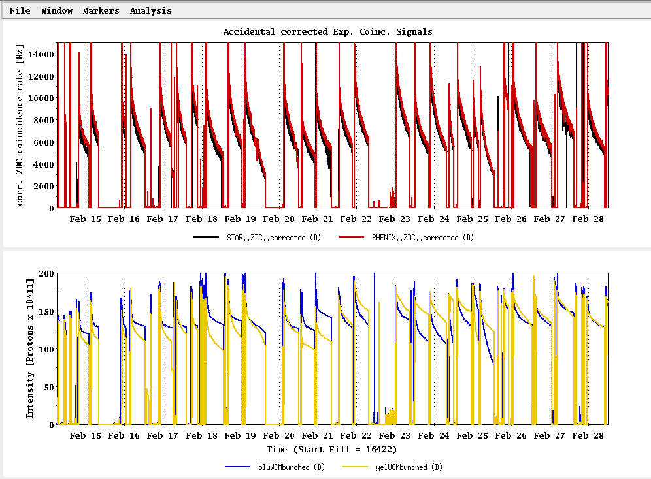
Past Week
L_{average}(max)
(0.29 mb xsection)
Ions/bunch (max)

Slide 43
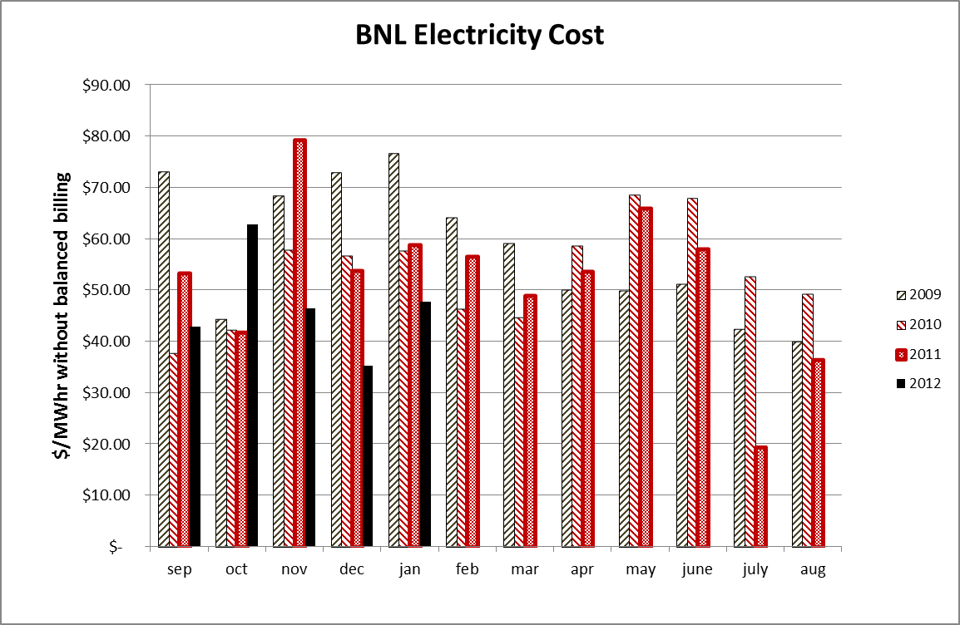

Slide 44

Run 12 Physics Stores to 28 Feb
Absolute scale should not be trusted)
L_{average}(max)
(0.29 mb xsection)

Slide 45

Store 16480 (27 Feb) – typical background issues
PHENIX
STAR
ZDC without and
with singles correction
ZDC without and
with singles correction
Protons/bunch
Protons/bunch
ZDC Singles
ZDC Singles

Slide 46

Store 16480 (27 Feb) – typical background issues

Slide 47

Store 16480 (27 Feb) – typical background issues

Slide 48

Collision steering corrections background issues 26-27 Feb
ZDC Singles
ZDC Coincidence

Slide 49

Example -- Store 16445, Sat Feb 18
L_{peak}(max)
L_{store average}(max)

Slide 50
Blue Jet weighted average = 55.4 ± 0.5
Yellow Jet weighted average = 54.9 ± 0.5

Slide 51
Run 12 projection for √s = 200 GeV pp
STAR Goal: 27 pb-1 delivered with 55-60 % polarization
PHENIX Goal: 27 pb-1 delivered with 55-60 % polarization
p²L = 8.2 pb⁻¹ for 55% polarization
From Fischer et. Al. “RHIC Collider Projections (FY 2012 – FY 2016)” 14 October 2011

Slide 52

First Physics Store (#16397, 04:01, 10 Feb)

Slide 53

Today, 7 Feb 2012

Slide 54

Typical Store from Run 9, 100 x 100 GeV pp

Slide 55

As of 16:18 hrs 20 Jan
Start cooldown
3.5 days

Slide 56
Recommendations following the June 6-8, 2011 PAC
For Run 12 the PAC recommends the following (in order of priority):
5 weeks of running with polarized proton collisions at 200 GeV.
7 weeks of running with polarized proton collisions at 500 GeV.
5 weeks of running with Cu+Au collisions at 200 GeV.
3 weeks of running with U+U collisions at 193 GeV.
For Run13 the PAC recommends the following (not in order of priority):
12 weeks of running with polarized proton collisions at 500 GeV.
5 week of running with polarized proton collisions at 200 GeV.
7 weeks of running with Au+Au collisions at full energy.

Slide 57
Cryo Issue
D.L. November 23, 2011 update
Our helium supplier no longer able to meet our peek demand of 4 trailers in a one week period. They can give us one trailer a week starting on December 31st, so we expect to have all the helium we need, on time, but we will have to store most of it in the dewars outside 1006B. This will result in our 4K cooldown being a little less stable and predictable than it has been for the past few years when we received all of the helium at 1005R over a short period of time. Because of this, I expect the 4K cooldown will take a least one additional day.

Slide 58


Slide 59

From Fischer et. al. “RHIC Collider Projections (FY 2012 – FY 2016)” 14 October 2011

Slide 60
Run 12 projection for √s = 500 GeV pp
From Fischer et. Al. “RHIC Collider Projections (FY 2012 – FY 2016)” 14 October 2011

Slide 61
Run 12 projection for √s = 193 GeV/n UU
From Fischer et. Al. “RHIC Collider Projections (FY 2012 – FY 2016)” 14 October 2011

Slide 62
Run 12 projection for √s = 200 GeV/n CuAu
From Fischer et. Al. “RHIC Collider Projections (FY 2012 – FY 2016)” 14 October 2011

