Slide 1
Run 12 RHIC Machine/Experiments Meeting
6 Mar 2012
Agenda:
Status reports
Other business

Slide 2
Run 12 Plan based on 20 weeks cryo operation
–an example 20 week schedule based on Vincent’s pp start-up plan*
Note physics weeks for 250 pp and HI are still to be determined
* http://www.cadops.bnl.gov/AGS/Operations/OpsWiki/index.php/RHIC_Setup:_Polarized_Protons
17 Jan, Begin cool-down to 4.5K
20 Jan, Cool-down to 4.5K in Blue and Yellow Ring complete, begin magnet setup
21-28 Jan, pp injection setup
28 Jan-3 Feb, LLRF, Ramp and store setup, begin 8 hr/night for experiments
3-10 Feb, 1 week ramp-up with 8 hrs/night for experiments
10 Feb, with store # 16397, begin 4 weeks pp physics with further ramp-up
16 Feb, 24/7 stores begin
Today – 6 Mar
12 (Monday) March, end 4 week √s = 200 GeV pp run, begin ½ week setup for √s = 500 GeV pp
16 March, begin 1 week ramp-up to √s = 500 GeV with 8 hrs/night for experiments
23 March, begin 5 week pp physics run at √s = 500 GeV
27 April, end 5 week pp physics run at √s = 500 GeV
If Uranium or Cu-Au…
27 April, begin 1 week setup for UU or CuAu (no overnight stores for experiments)
4 May, begin 4.1 week UU or CuAu physics run
20-25 May: IPAC
2 June end 4.1 week UU or CuAu physics run
2 June, begin cryo warm-up
5 June, cryo warm-up complete (20.0 cryo-weeks)
Total Physics Weeks = 13.5

Slide 3
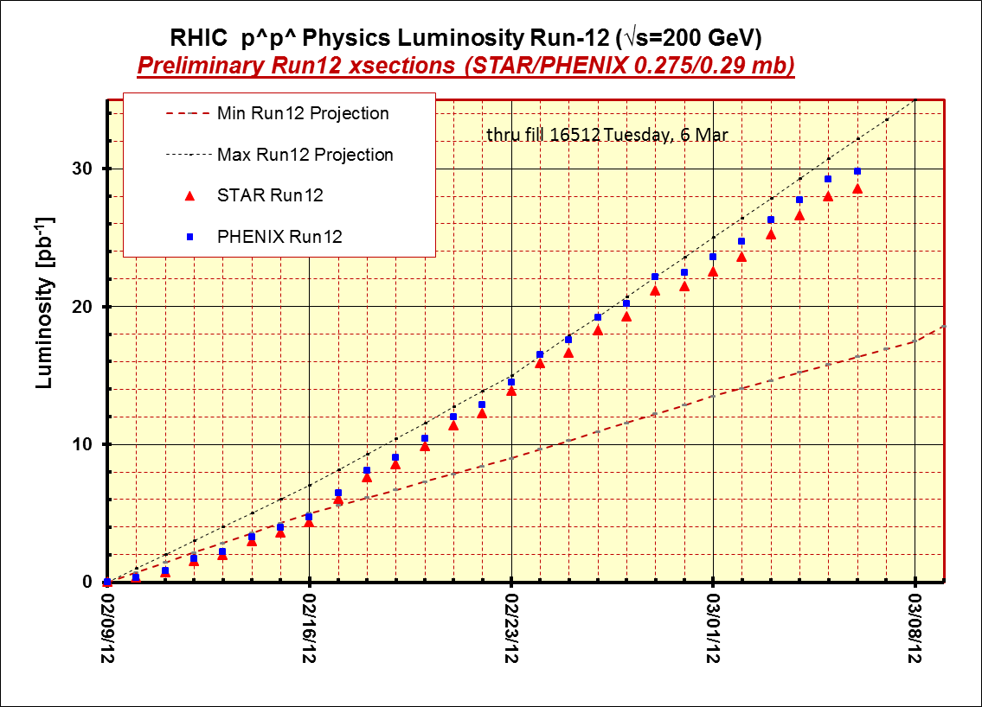
STAR & PHENIX Goal

Slide 4
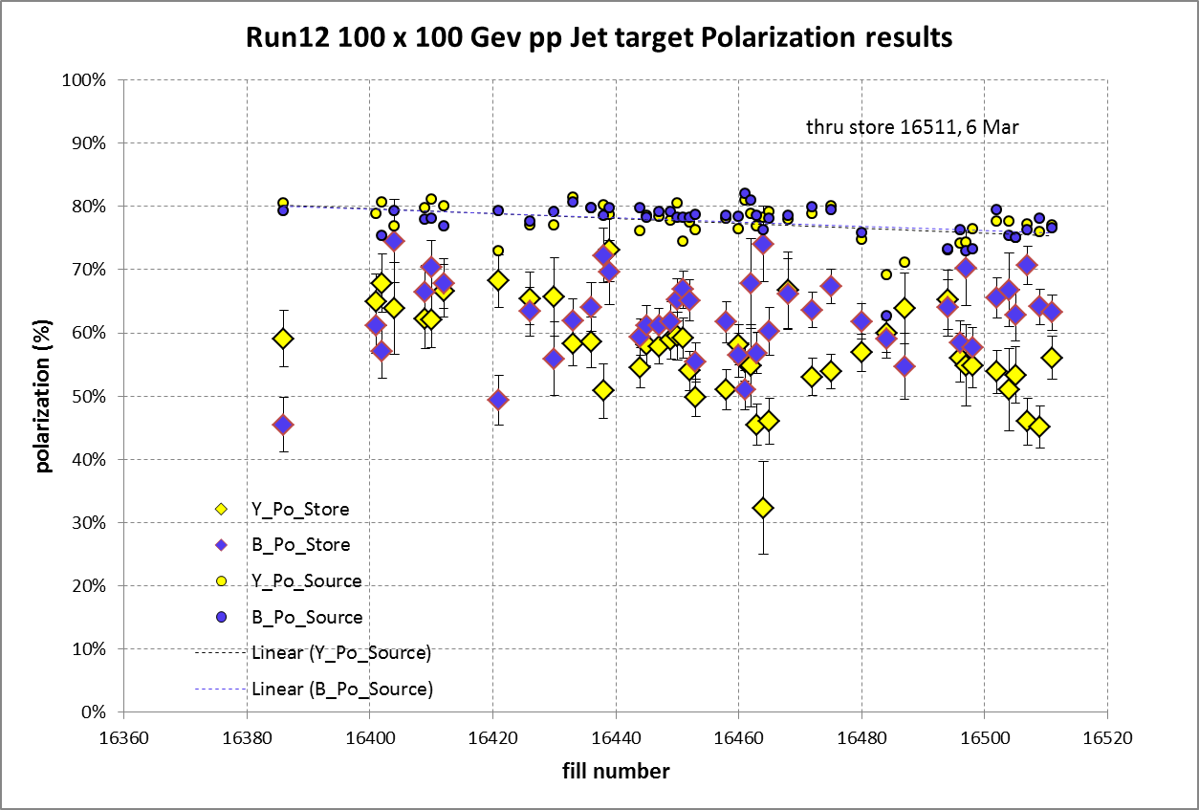
STAR & PHENIX Polarization Goals
Blue Jet weighted average = 62.1% ± 0.6%; source blue average = 77.6% → 20% lost
Yellow Jet weighted average = 56.3% ± 0.6%; source yellow average = 77.4% → 27% lost

Slide 5
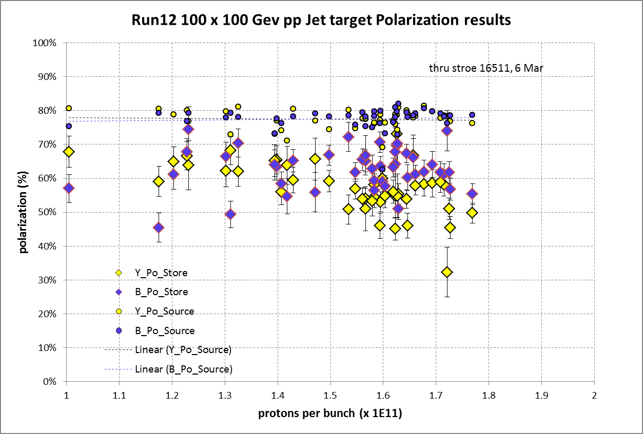

Slide 6
Other Slides

Slide 7
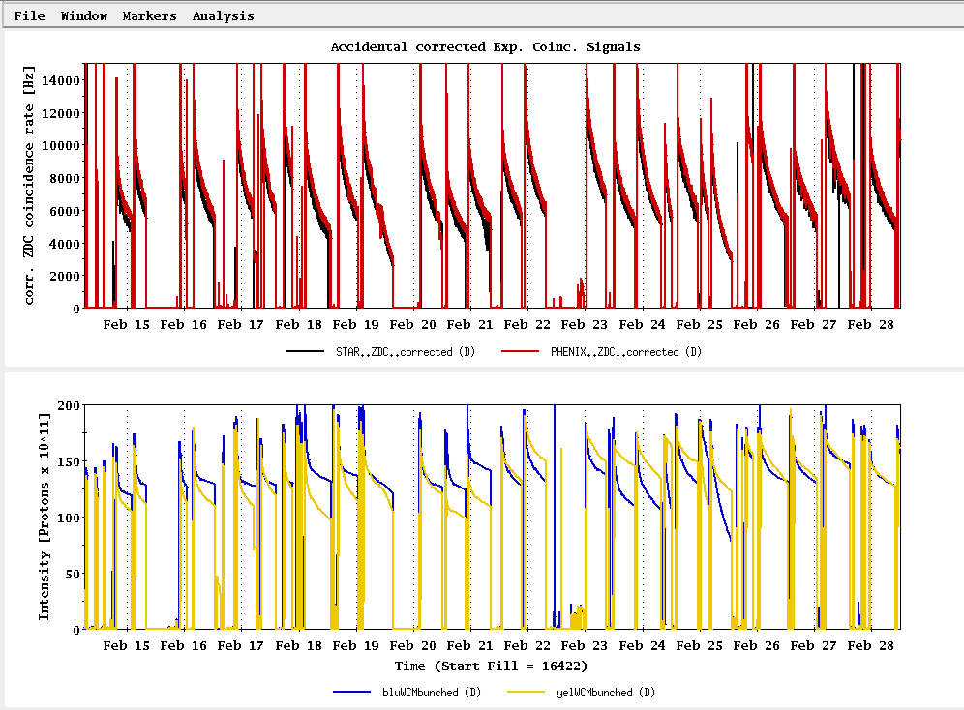
Past Week
L_{average}(max)
(0.29 mb xsection)
Ions/bunch (max)

Slide 8
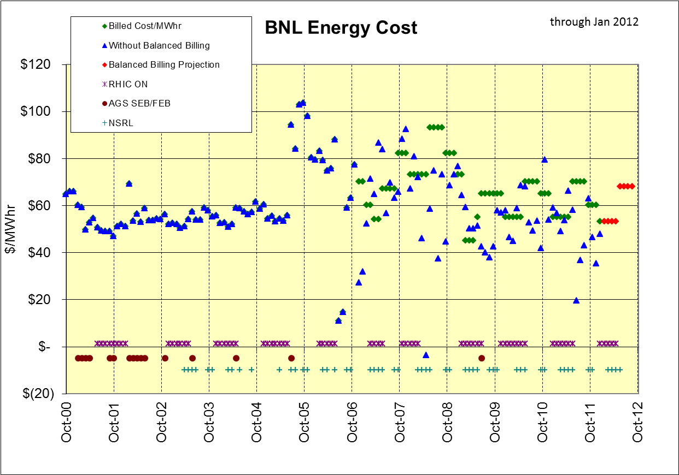
$ in BNL Balanced Billing Bank for FY12 (through Jan) = +$1,157K
$48/MWhr

Slide 9
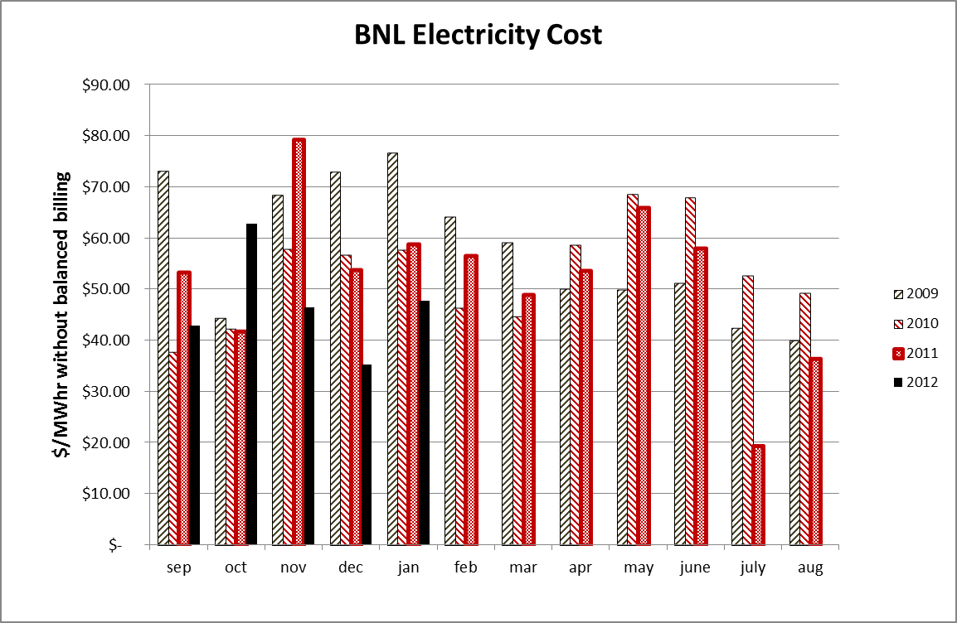

Slide 10
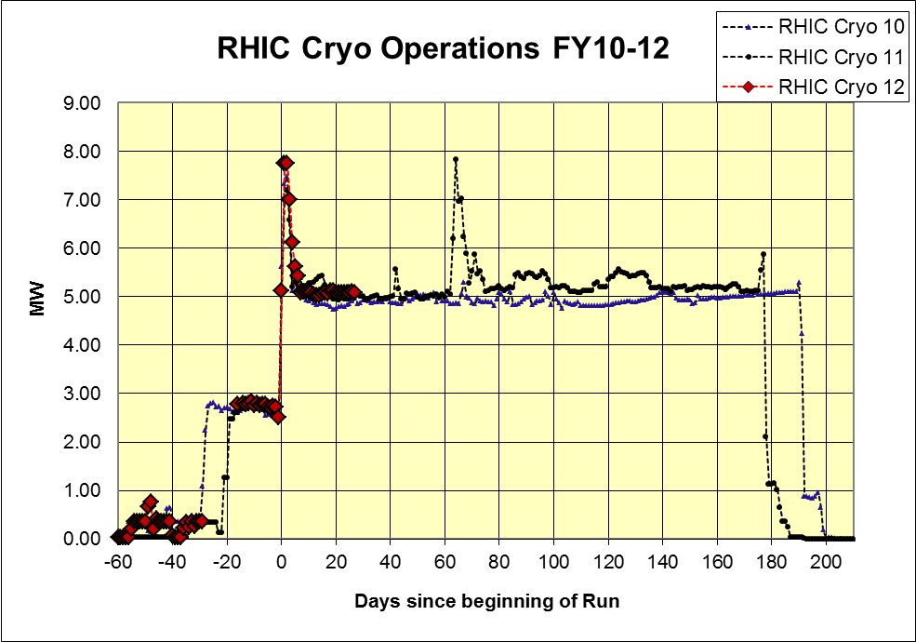
As of 13 Feb 2012

Slide 11
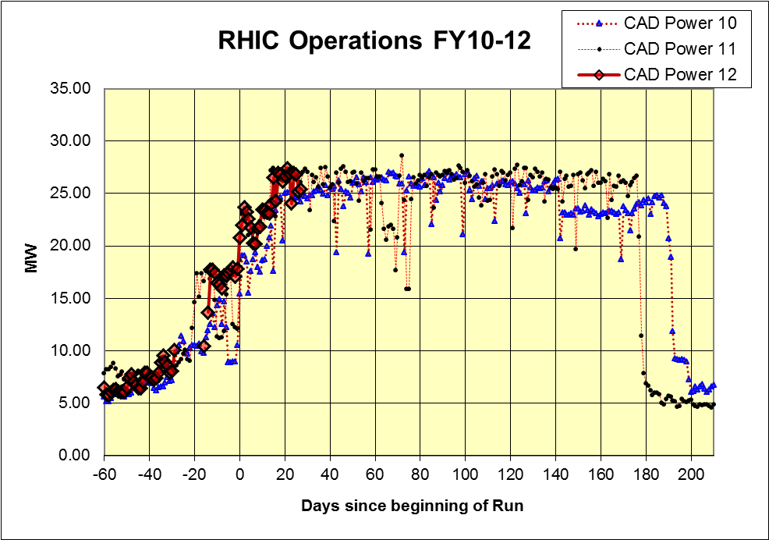
As of 13 Feb 2012

Slide 12
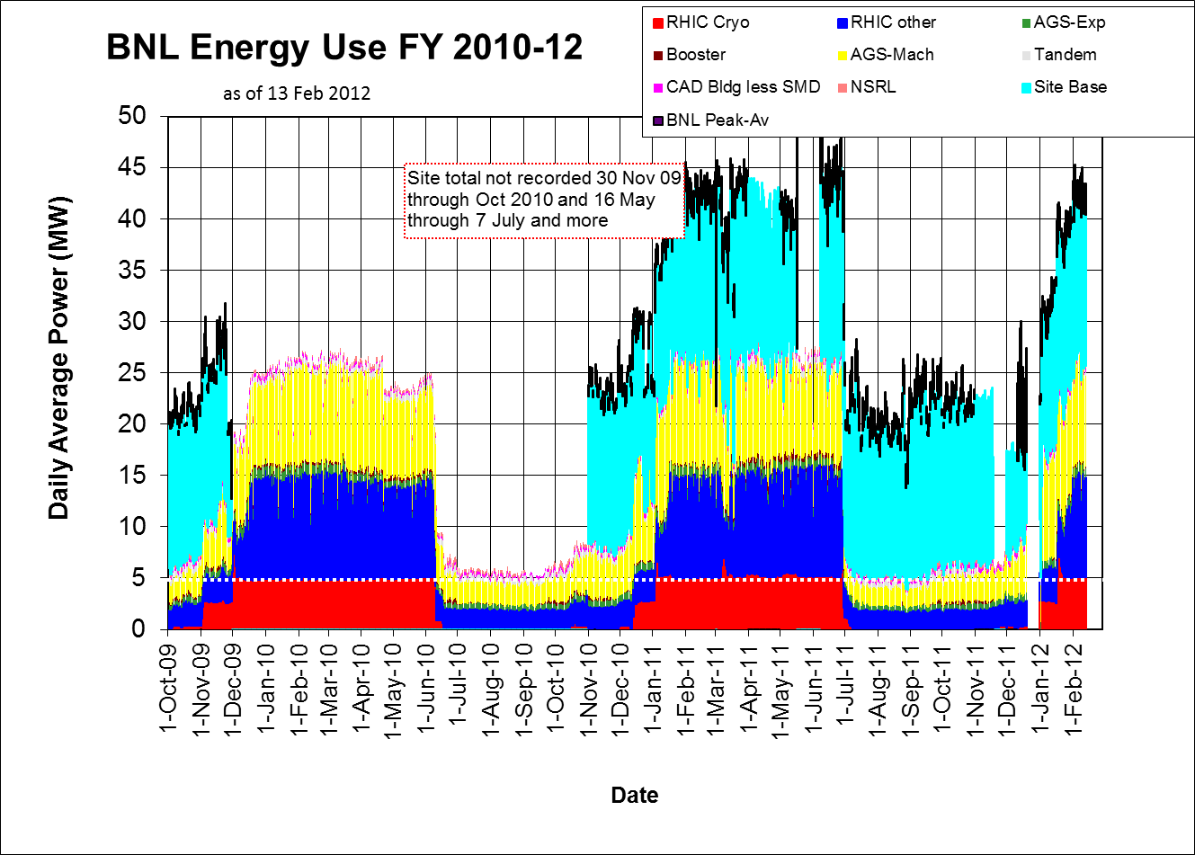

Slide 13
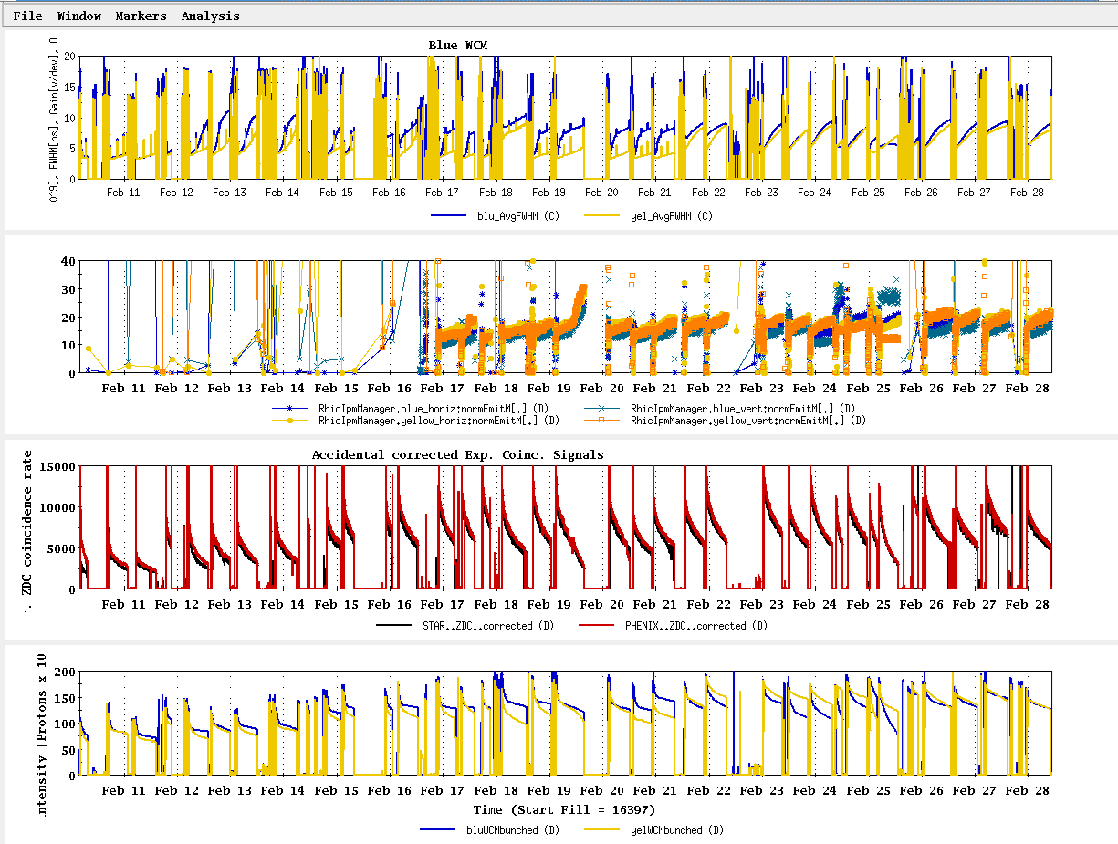
Run 12 Physics Stores to 28 Feb
Absolute scale should not be trusted)
L_{average}(max)
(0.29 mb xsection)

Slide 14
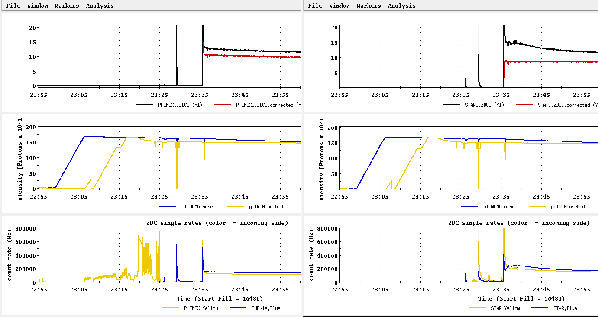
Store 16480 (27 Feb) – typical background issues
PHENIX
STAR
ZDC without and
with singles correction
ZDC without and
with singles correction
Protons/bunch
Protons/bunch
ZDC Singles
ZDC Singles

Slide 15
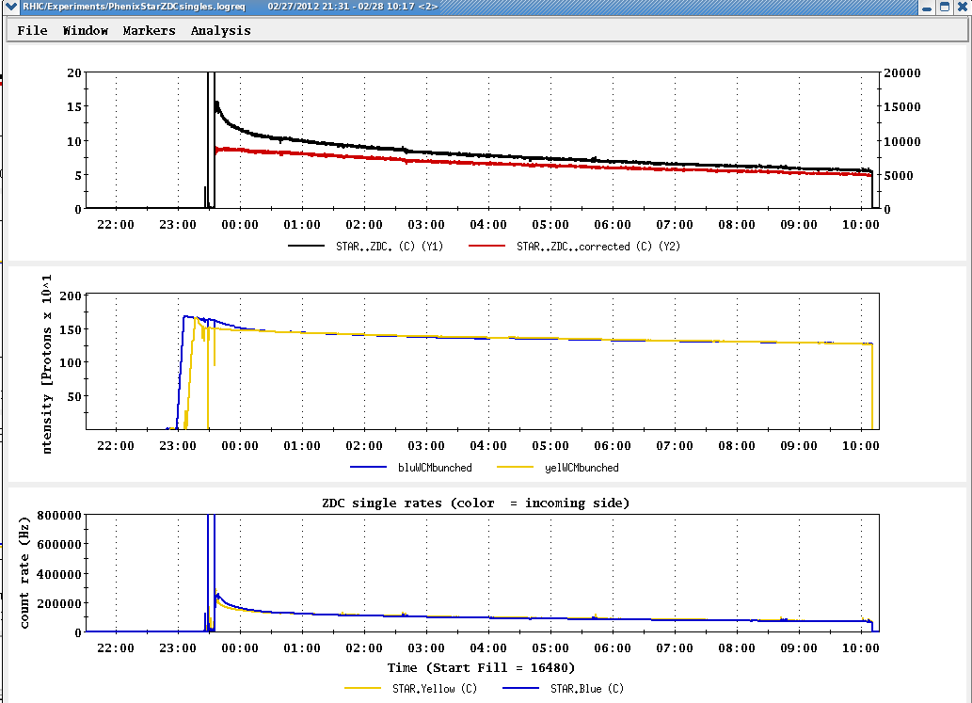
Store 16480 (27 Feb) – typical background issues

Slide 16
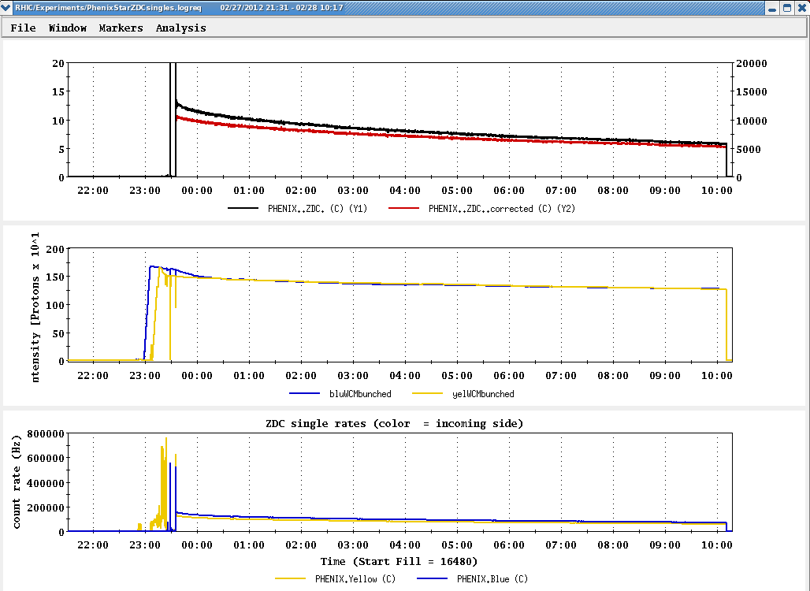
Store 16480 (27 Feb) – typical background issues

Slide 17
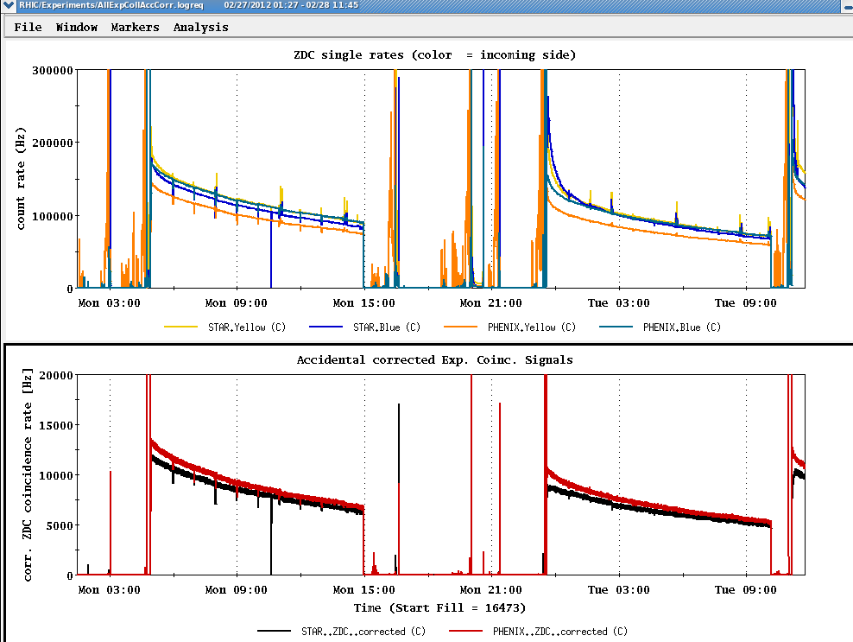
Collision steering corrections background issues 26-27 Feb
ZDC Singles
ZDC Coincidence

Slide 18
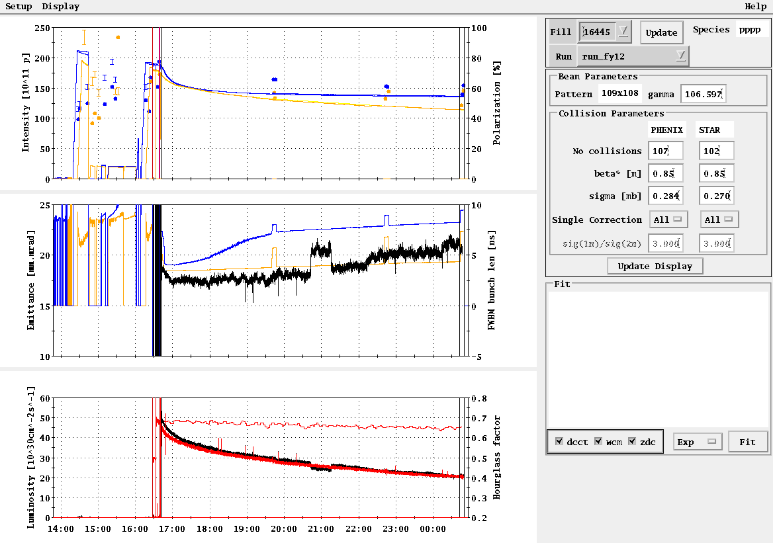
Example -- Store 16445, Sat Feb 18
L_{peak}(max)
L_{store average}(max)

Slide 19
Blue Jet weighted average = 55.4 ± 0.5
Yellow Jet weighted average = 54.9 ± 0.5

Slide 20
Run 12 projection for √s = 200 GeV pp
STAR Goal: 27 pb-1 delivered with 55-60 % polarization
PHENIX Goal: 27 pb-1 delivered with 55-60 % polarization
p²L = 8.2 pb⁻¹ for 55% polarization
From Fischer et. Al. “RHIC Collider Projections (FY 2012 – FY 2016)” 14 October 2011

Slide 21
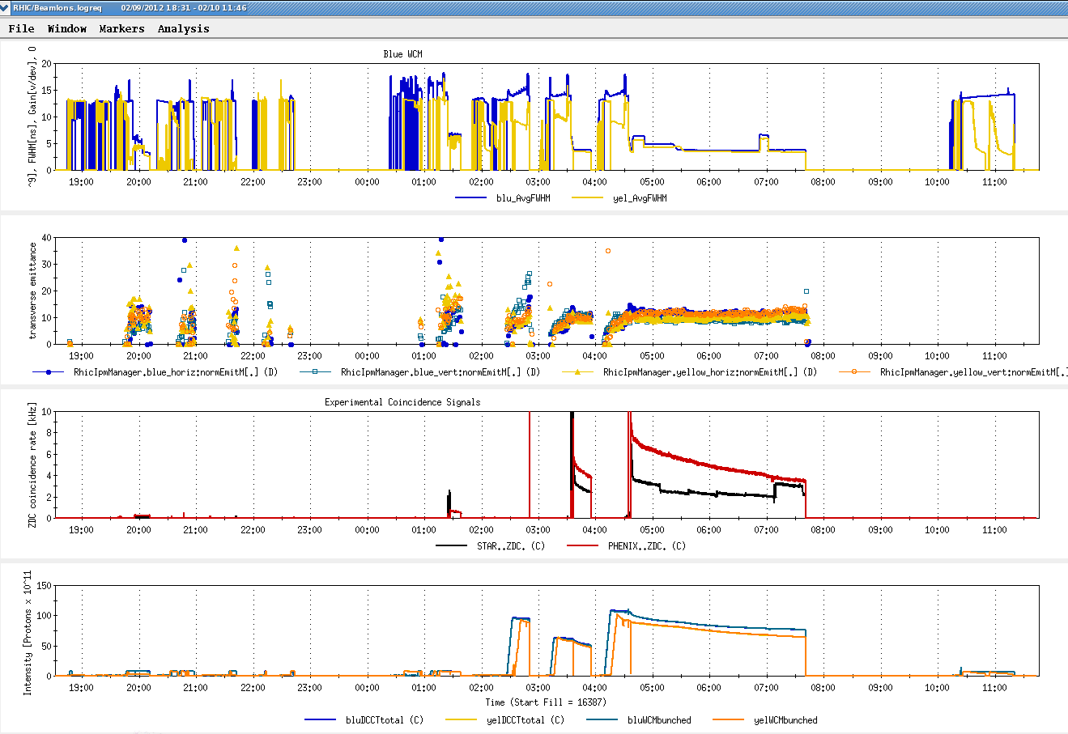
First Physics Store (#16397, 04:01, 10 Feb)

Slide 22
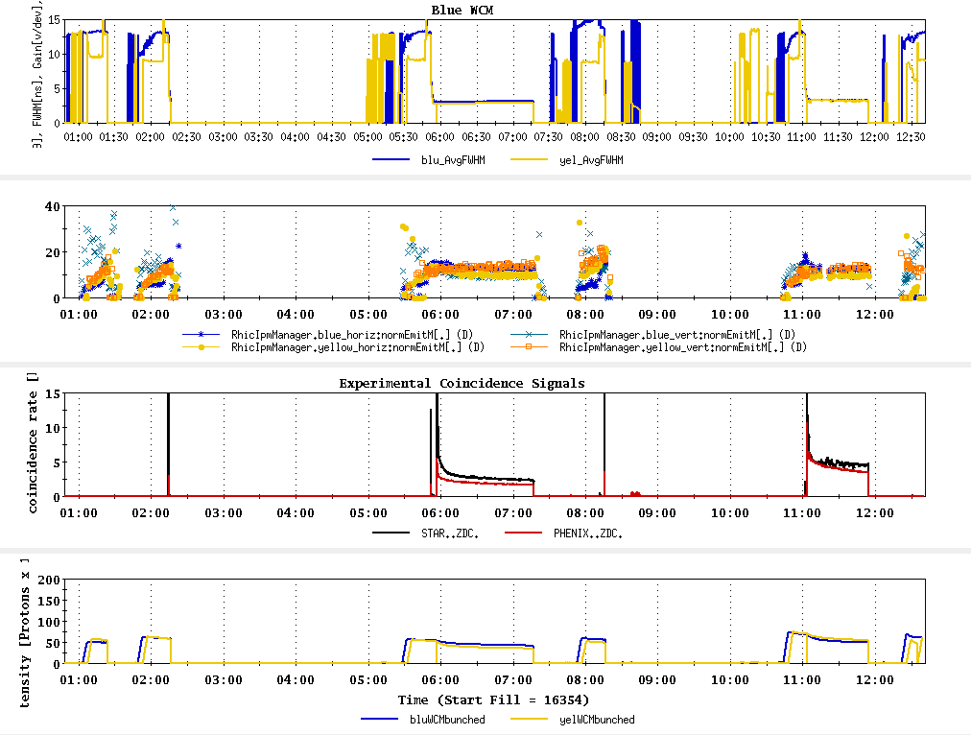
Today, 7 Feb 2012

Slide 23
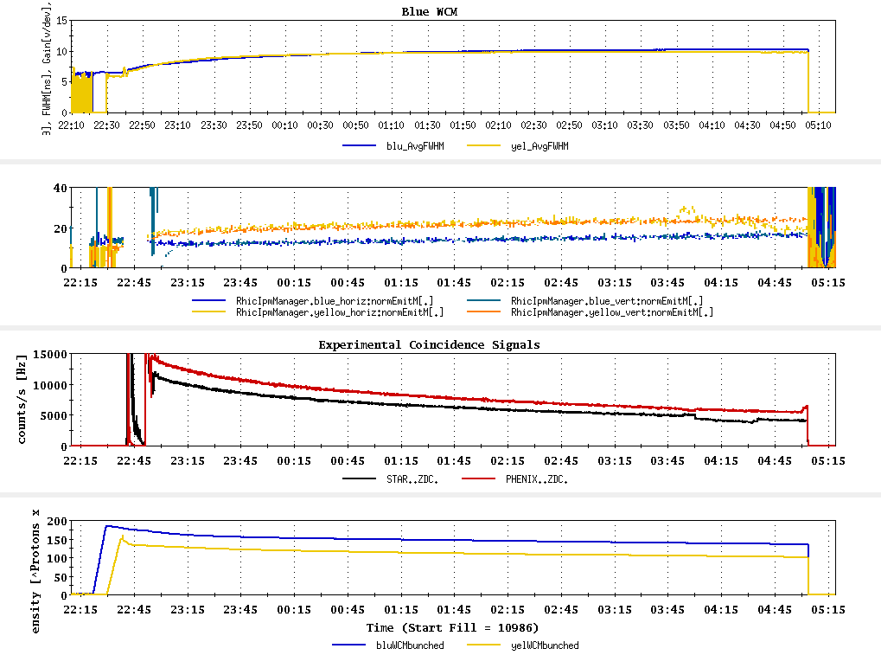
Typical Store from Run 9, 100 x 100 GeV pp

Slide 24
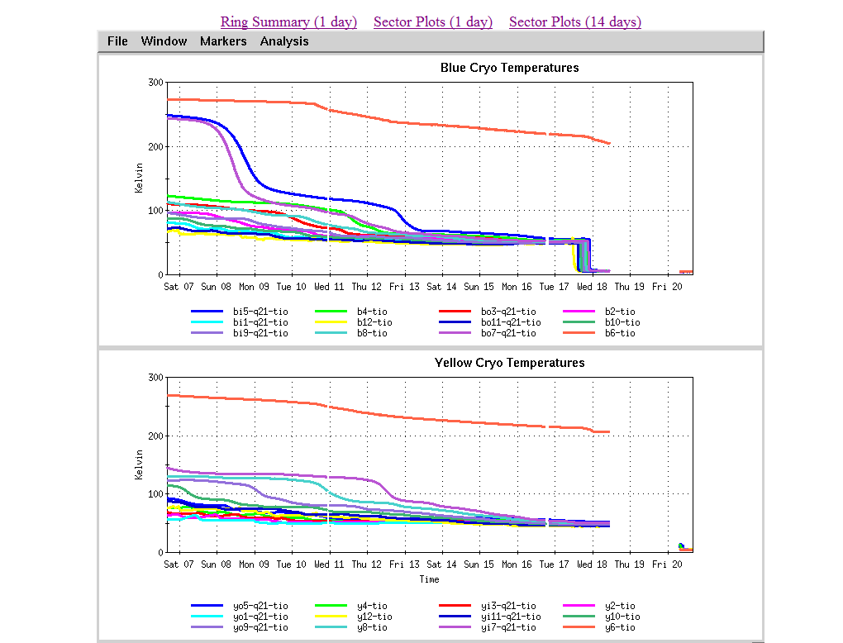
As of 16:18 hrs 20 Jan
Start cooldown
3.5 days

Slide 26
Recommendations following the June 6-8, 2011 PAC
For Run 12 the PAC recommends the following (in order of priority):
5 weeks of running with polarized proton collisions at 200 GeV.
7 weeks of running with polarized proton collisions at 500 GeV.
5 weeks of running with Cu+Au collisions at 200 GeV.
3 weeks of running with U+U collisions at 193 GeV.
For Run13 the PAC recommends the following (not in order of priority):
12 weeks of running with polarized proton collisions at 500 GeV.
5 week of running with polarized proton collisions at 200 GeV.
7 weeks of running with Au+Au collisions at full energy.

Slide 27
Cryo Issue
D.L. November 23, 2011 update
Our helium supplier no longer able to meet our peek demand of 4 trailers in a one week period. They can give us one trailer a week starting on December 31st, so we expect to have all the helium we need, on time, but we will have to store most of it in the dewars outside 1006B. This will result in our 4K cooldown being a little less stable and predictable than it has been for the past few years when we received all of the helium at 1005R over a short period of time. Because of this, I expect the 4K cooldown will take a least one additional day.

Slide 28
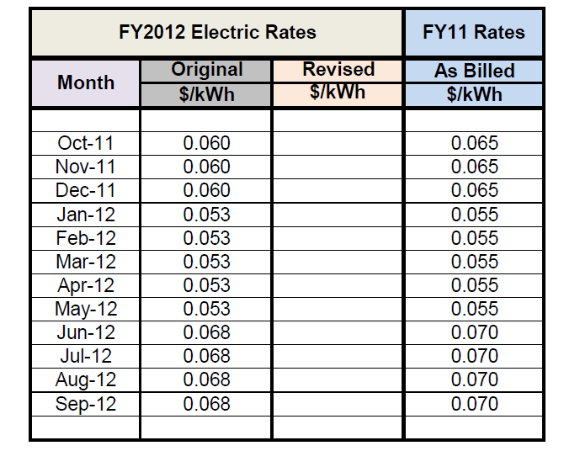

Slide 29
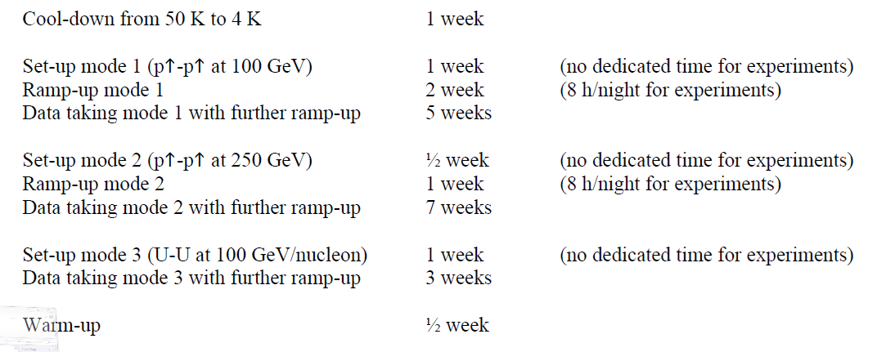
From Fischer et. al. “RHIC Collider Projections (FY 2012 – FY 2016)” 14 October 2011

Slide 30
Run 12 projection for √s = 500 GeV pp
From Fischer et. Al. “RHIC Collider Projections (FY 2012 – FY 2016)” 14 October 2011

Slide 31
Run 12 projection for √s = 193 GeV/n UU
From Fischer et. Al. “RHIC Collider Projections (FY 2012 – FY 2016)” 14 October 2011

Slide 32
Run 12 projection for √s = 200 GeV/n CuAu
From Fischer et. Al. “RHIC Collider Projections (FY 2012 – FY 2016)” 14 October 2011

