Slide 1
RHIC Store Energy Scan
Mei Bai
Collider Accelerator Dept.
Brookhaven National Laboratory

Slide 2
Motivation
To check whether our current store energy, i.e. Ggamma=477.5, is out of the influence of near-by strong intrinsic spin resonances. If not, find the store energy, which is and also yields the stable spin direction closest to vertical direction
The benefit of this is to mitigate the polarization lifetime issue, which was observed in RUN11. This should in turn give effective higher store average polarization

Slide 3
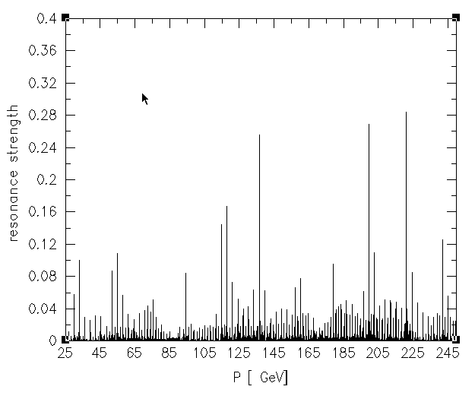
Spin depolarization resonance in RHIC
Energy: 23.8 GeV ~ 250 GeV (maximum store energy)
A total of 146 imperfection resonances and about 10 strong intrinsic resonances from injection to 100 GeV.

Slide 4
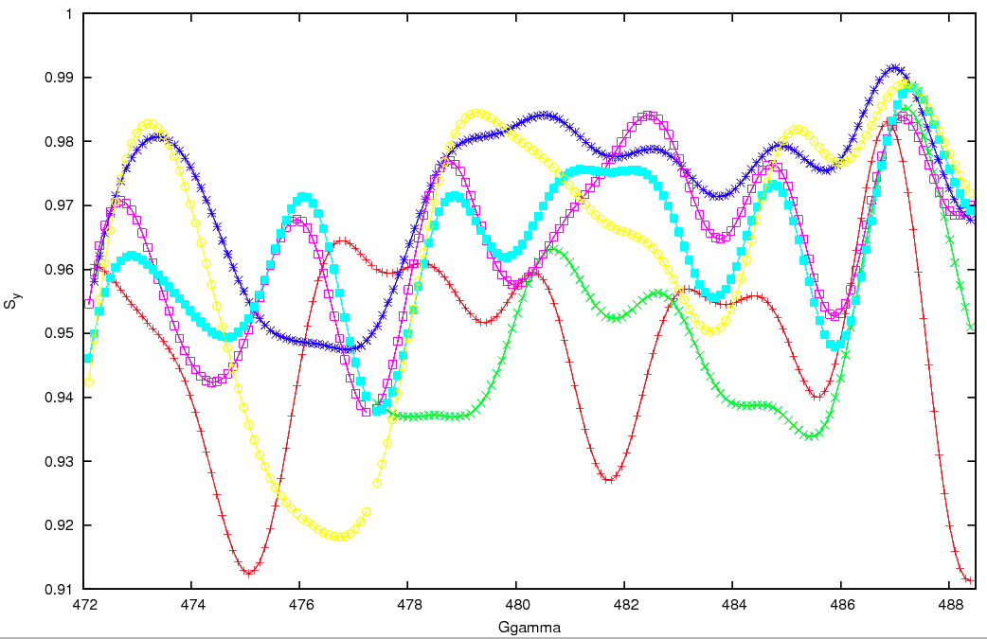
250 GeV Energy Scan
Averaged <Sy> over 1000 turns
Not stable spin direction

Slide 5
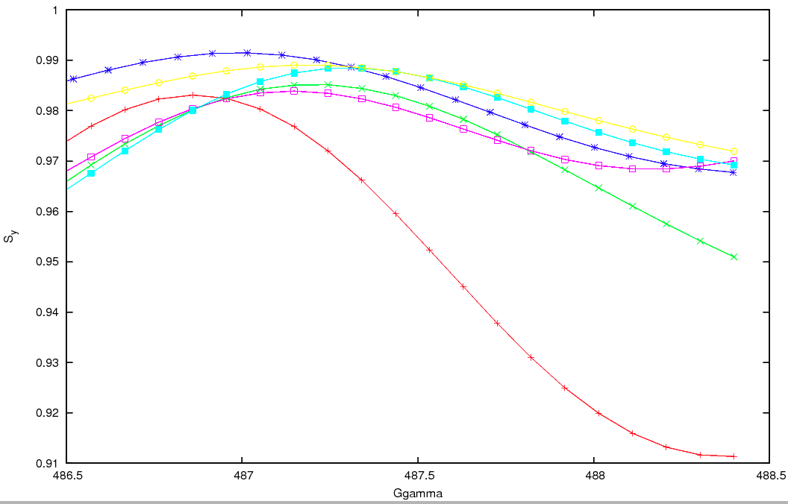
250 GeV Energy Scan (zoom in)
More vertically oriented
Less dependant on the betatron amplitude

Slide 6
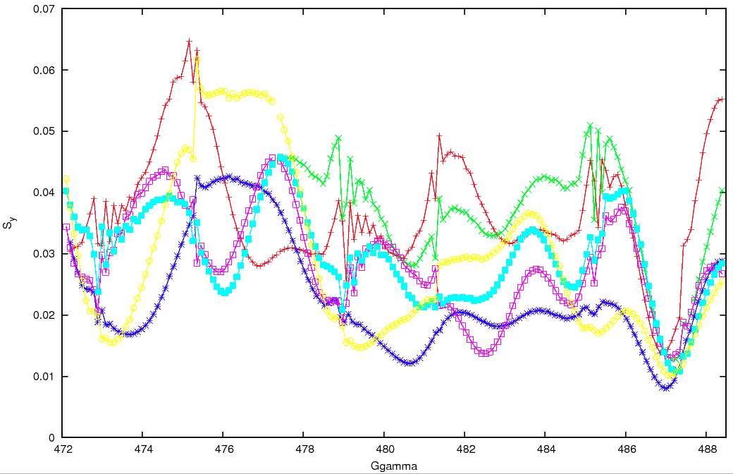
250 GeV Energy Scan
Spread of Sy over 1000 turns

Slide 7
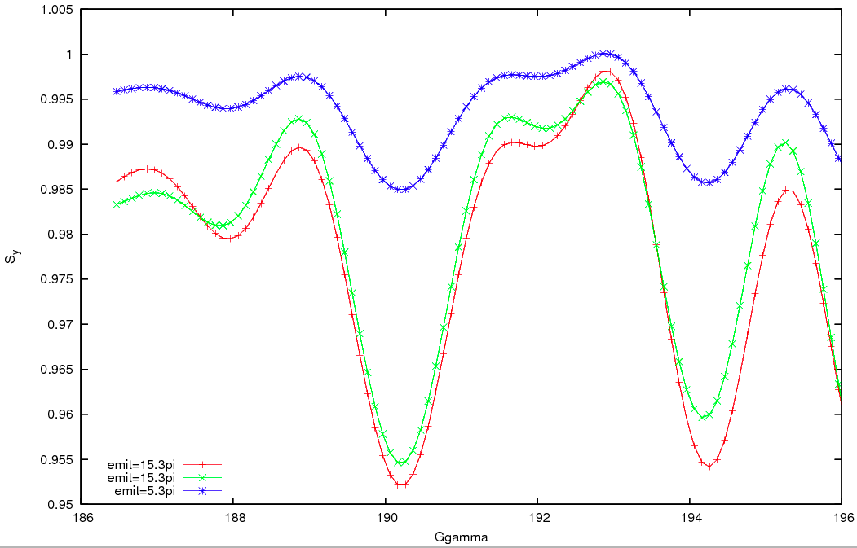
100 GeV Energy Scan
Averaged <Sy> over 1000 turns
Not stable spin direction

Slide 8
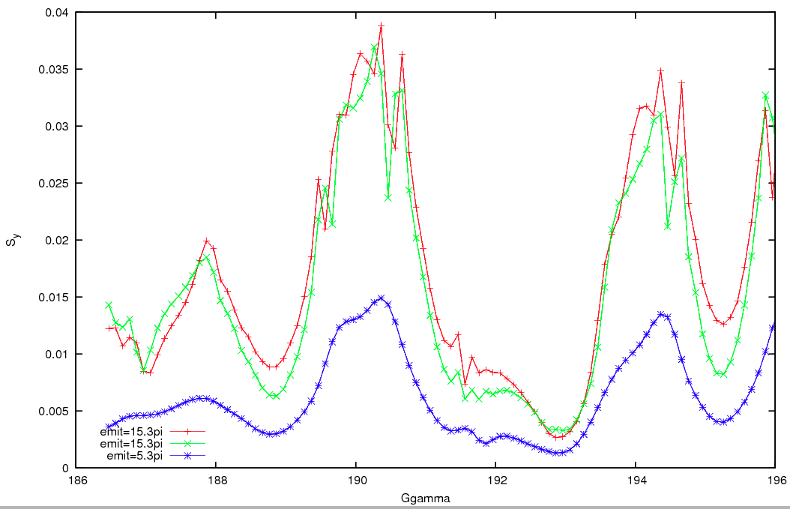
100 GeV Energy Scan
Spread of Sy over 1000 turns

Slide 9
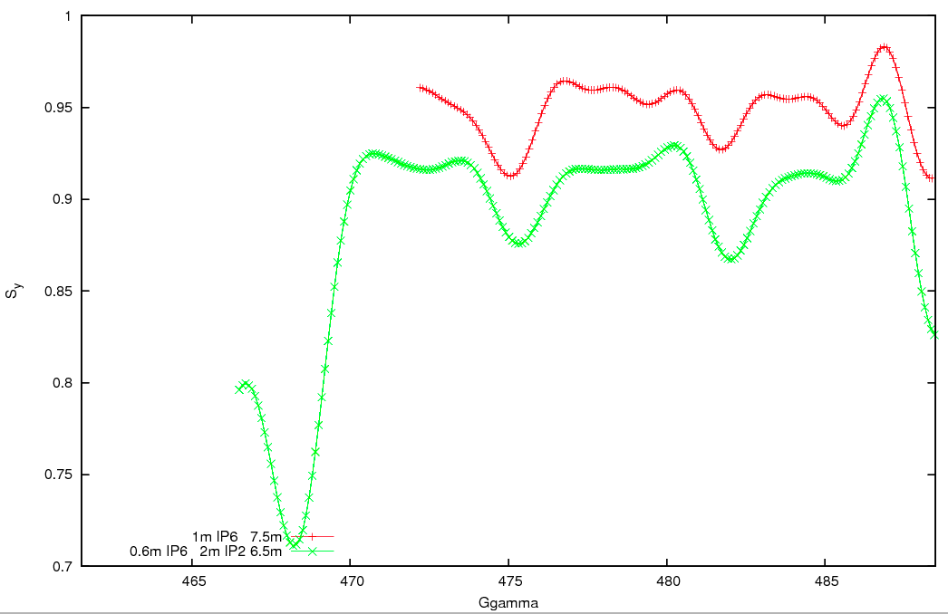
250 GeV Energy Scan
Blue with two different lattices

Slide 10
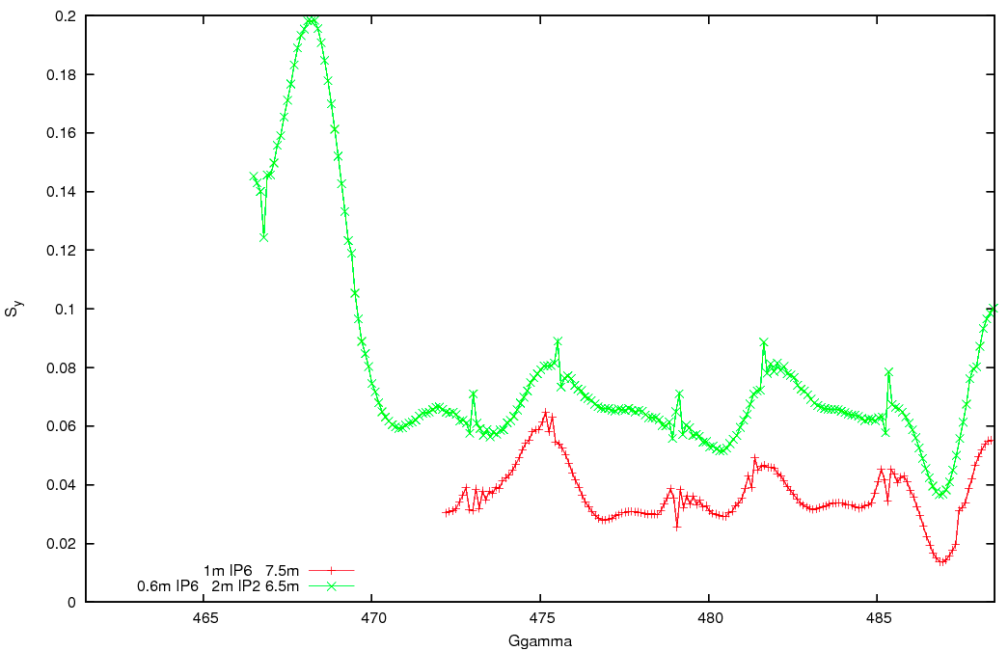
250 GeV Energy Scan
Blue with two different lattices

Slide 11
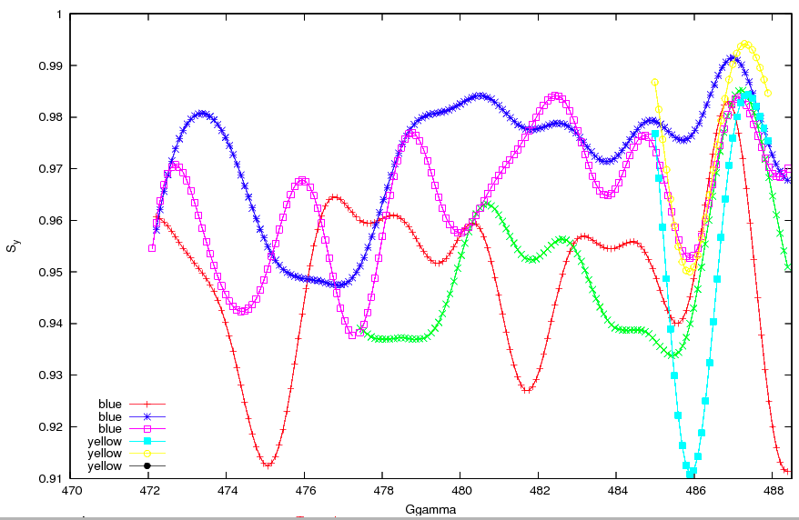
250 GeV Energy Scan
Yellow sweet spot is also around Gg=487. But about 0.5 unit away from Blue sweet spot

Slide 12
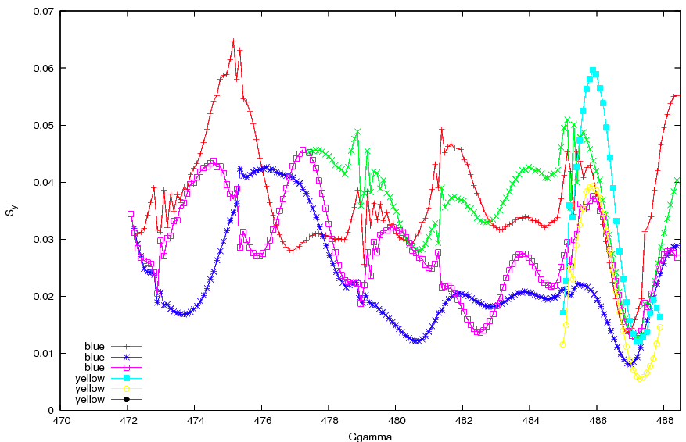
250 GeV Energy Scan: spread of spin vector
Blue vs. Yellow

Slide 13
Calculate Stable Spin Direction
Stable spin direction
Direction that spin vector returns to when particle returns to the same coordinate, i.e. it’s a function of phase space
The ideal case, all vertically aligned!
Can be calculated by stroboscopic averaging
Mapping out the stable spin direction of the phase space
Heavy computation power
In UAL spink by V. Ranjbar, but not user friendly yet
Not in zgoubi yet. In working progress
Calculate the stable spin direction for a phase space location
a code to post-process the zgoubi single pt tracking results(Mei)
Track two cases with initial spin vector in radial and longitudinal, respectively
Post-process the data
Disadvantage is this is very time consuming. Right now, each data point takes 1.5 hour. Can be parallized to map out the phase-space

Slide 14
Stable Spin Direction
Single particle tracking 10k turns
Calculate the SSD for the phase coordinate
Verify by re-launching the particle with SSD
Ggamma | radial | longitudinal | vertical
477.5: 5pi | -0.0238645 | 0.073279 | 0.9970259
487.0: 5pi | -0.0327464 | -0.032942 | 0.9989207
477.5: 30pi | -0.0660028 | 0.2040741 | 0.9767279
487.0: 30pi | -0.0983716 | -0.0941945 | 0.9906818

Slide 15
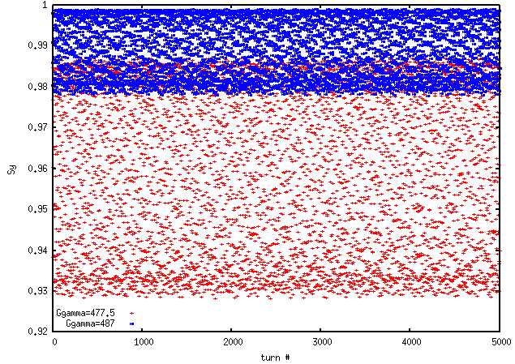
TbT Sy spread: 30pi
Particle launched with initial spin vector on the calculated stable spin direction

Slide 16
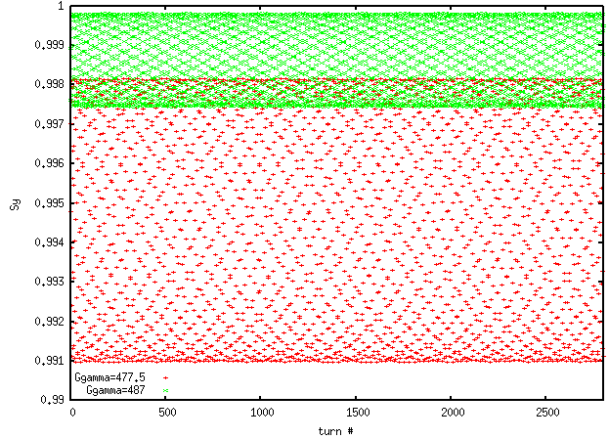
TbT Sy spread: 5pi
Particle launched with initial spin vector on the calculated stable spin direction

Slide 17
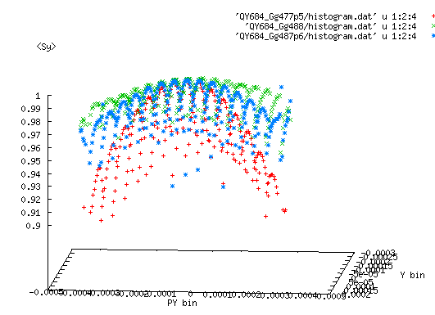
UAL SPINK Stable Spin Axes: V. Ranjbar
Launched 1024 pts in 4D
For a phase space bin, average the spin vectors for all particles

Slide 18
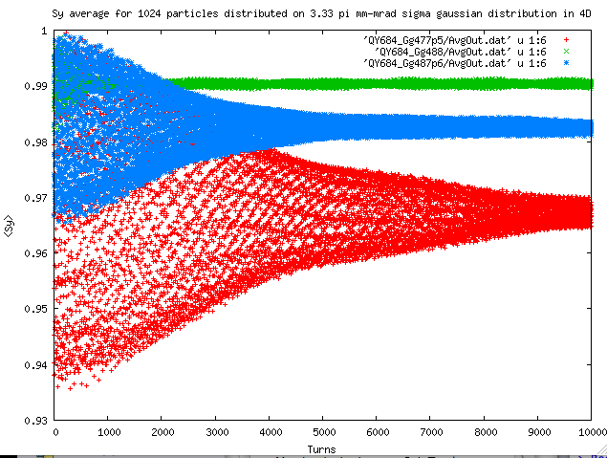
UAL SPINK Result: V. Ranjbar

Slide 19
Summary and Plan
Summary
250 GeV simulation yields at Ggamma=487, stable spin direction is closest to vertical, and less open
100 GeV simulation yields current store energy Ggamma=191.5 is close to optimized(Ggamma = 192.5)
Suggestion for the run
Raise 100 GeV store energy to Ggamma=192.5 if no significant effort
Similar polarization lifetime issues from CNI polarimetry group
Raise 250 GeV store energy to Ggamma=487. Scan store energy nearby if no improvement on polarization lifetime
Plan
Map out stable spin direction for the phase space
Ideal lattice
Lattice with closed orbit distortions

