Slide 1
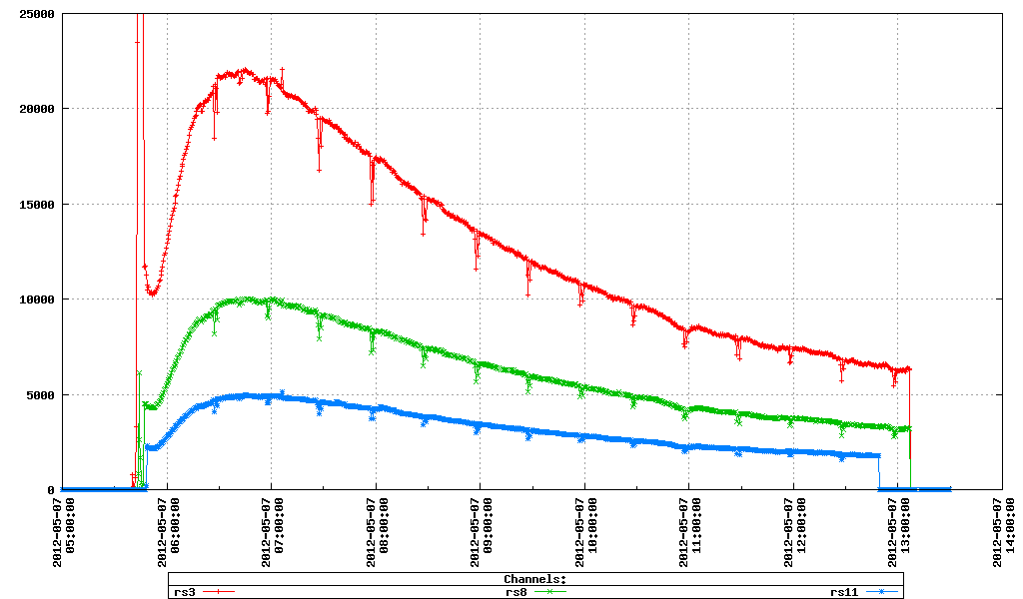
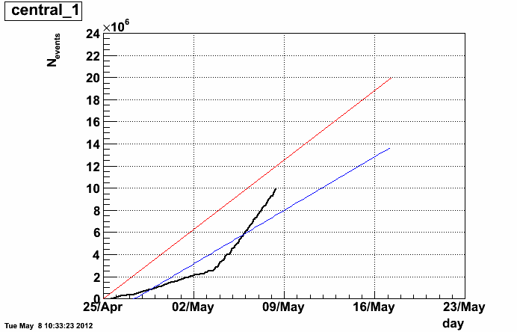
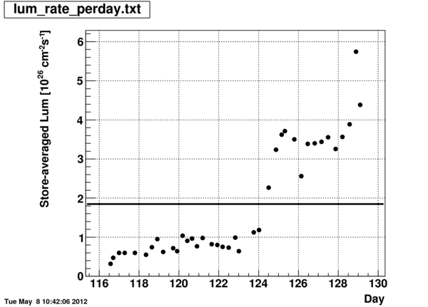
Some features of the Full Stochastic Cooling of RHIC Beams
RHIC Coordination mtg.
May 8, 2012.
Bill Christie
BBC_coincidence
ZDC_coincidence
VPD_coincidence
Very impressive success for the Stochastic Cooling system
~ factor of 4.5 or so increase in the store averaged luminosity!
Store averaged luminosity

Slide 2
Trigger Detector plots from ~ 3:15 am May 8, 2012, early in Fill
Shows rebucketing is working well.
Z Vertex (cm)

Slide 3
Trigger Detector plots from ~ 9:30 am May 8, 2012, late in Fill
Shows impact of cooling.
Z Vertex (cm)

Slide 4
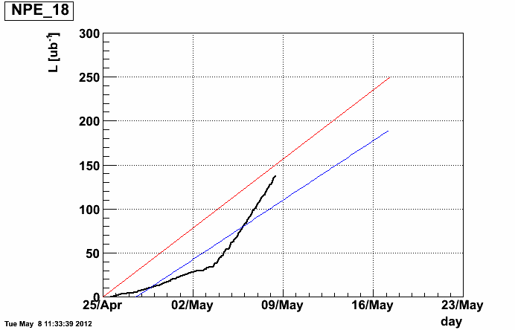
Summary
Stochastic Cooling is a great success!
Some of the luminosity increase, and collisions, resulting from the multiple satellite bunches won’t make it into the offline physics analysis.
Some optimization of how the powerful Stochastic Cooling capability available is likely in order.

