Slide 1
A summary on Polarisation in Run-12 for 255 geV
E.C. Aschenauer
presenting the work done by Alan, anders, Bill and Dima

Slide 2
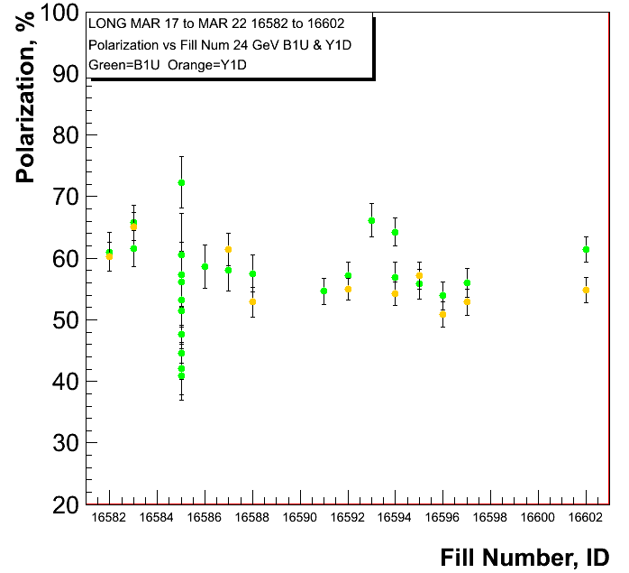
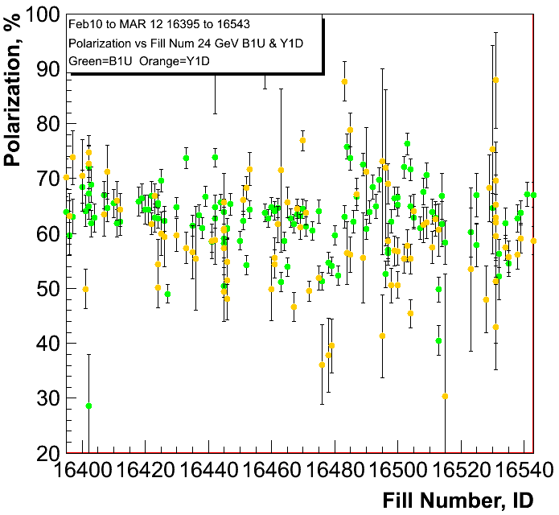
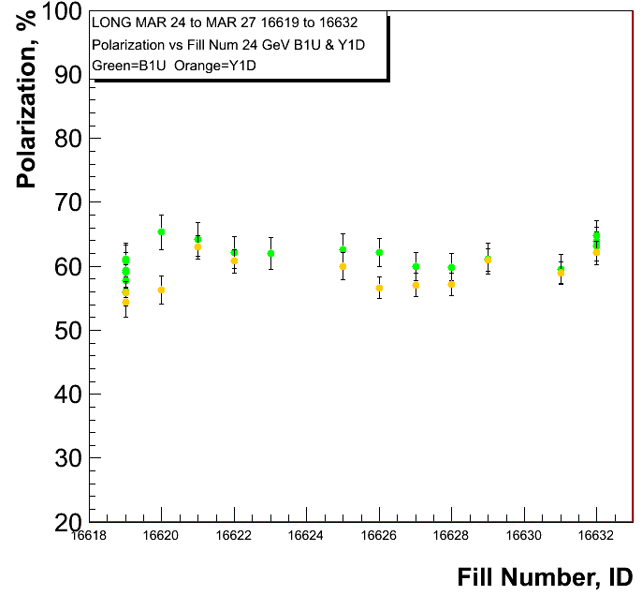
255 GeV Results
injections for 255 GeV
injections for 100 GeV
polarisation at injection
Blue and Yellow
Caveat:
pC numbers not normalized
to jet

Slide 3
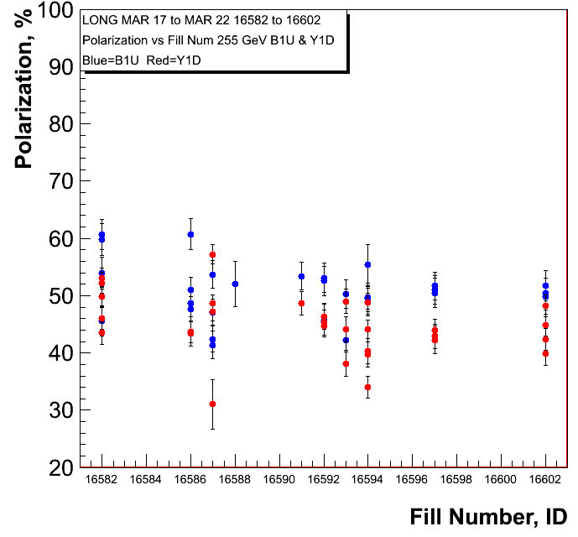
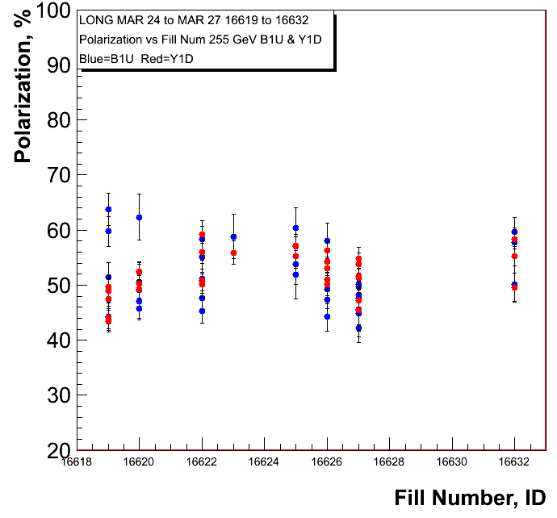
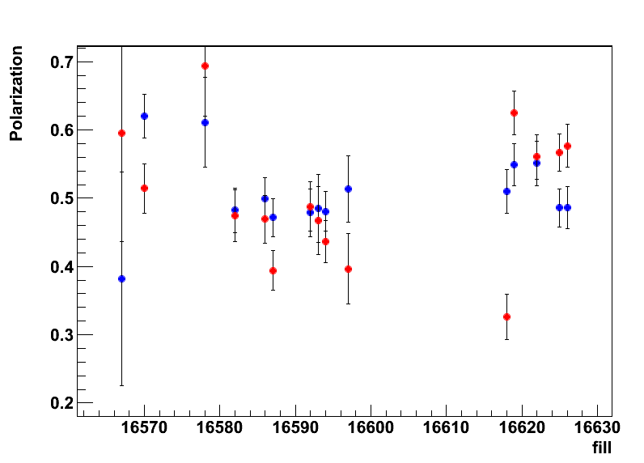
255 GeV Results
polarisation at flat top
Blue and Yellow
H-Jet
→ longitudinal

Slide 4
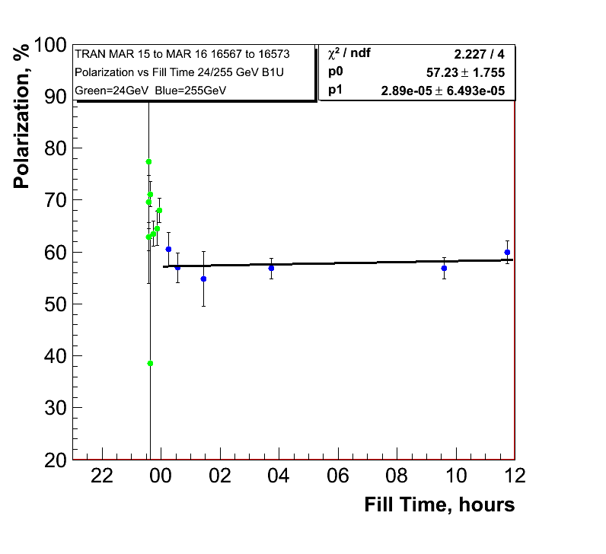
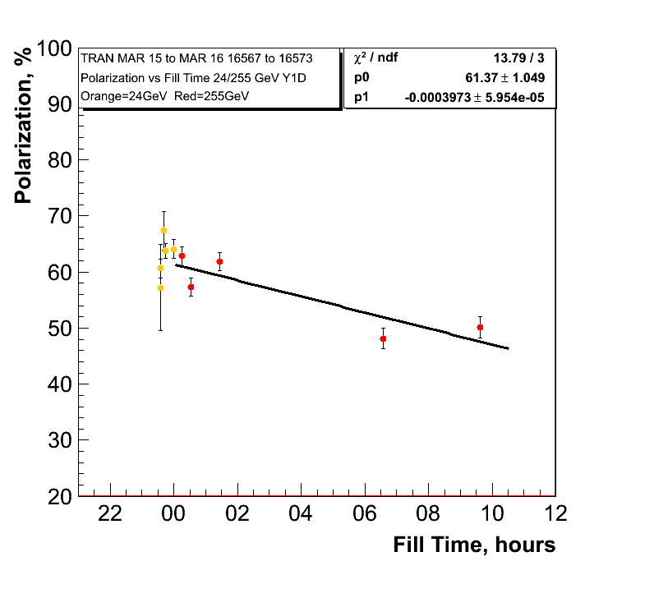
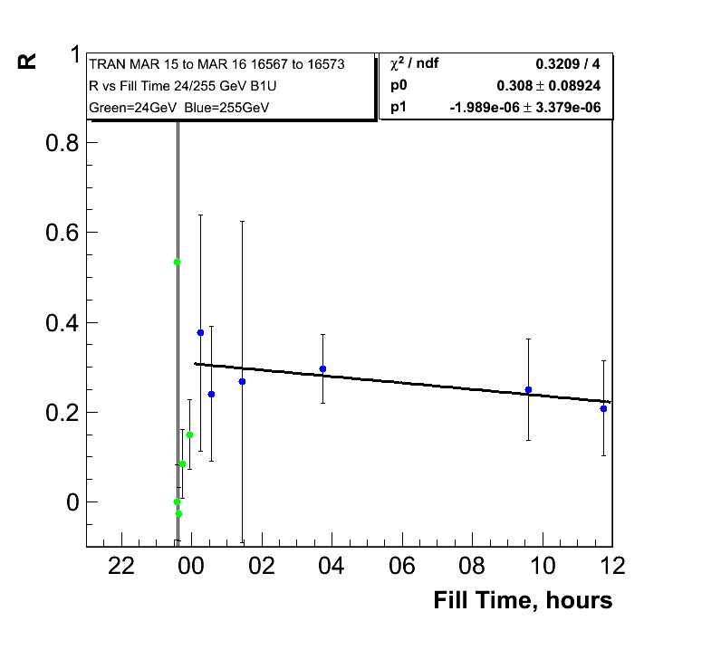
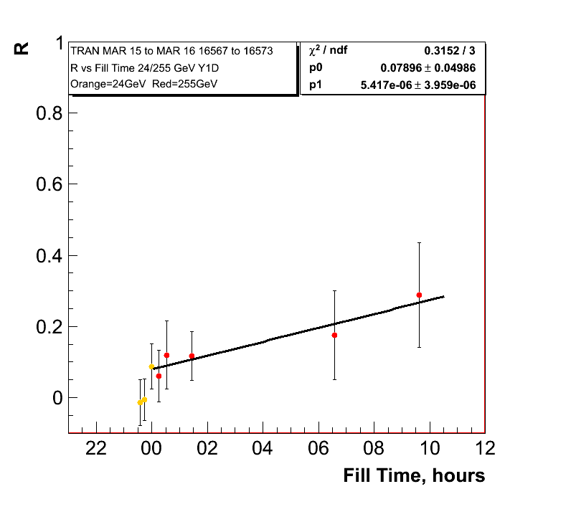
255 GeV Results Transverse Fills
0.10%±0.23/hour
Polarisation
lifetime in
yellow very
similar to
longitudinal
255 GeV fills
1.4%±0.21/hour

Slide 5
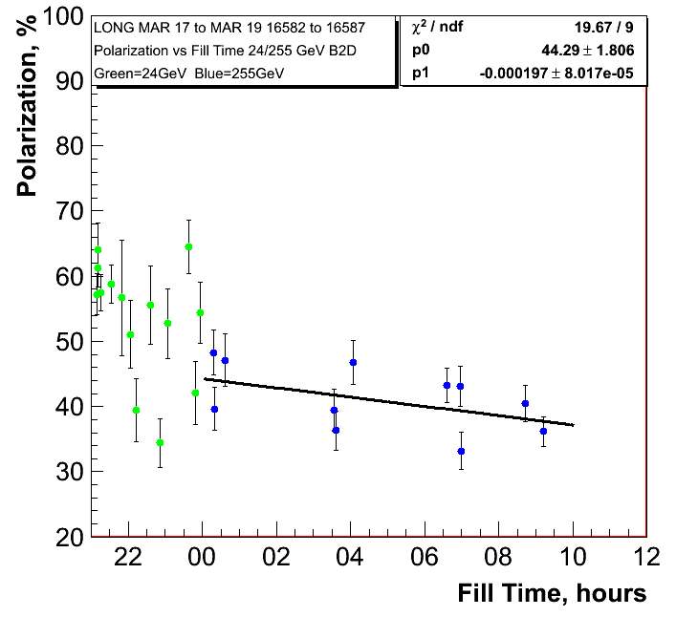
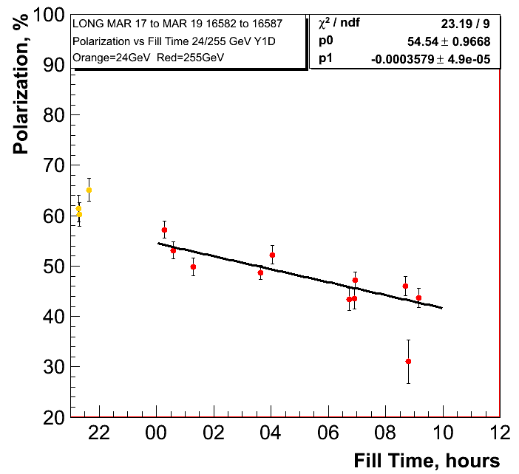
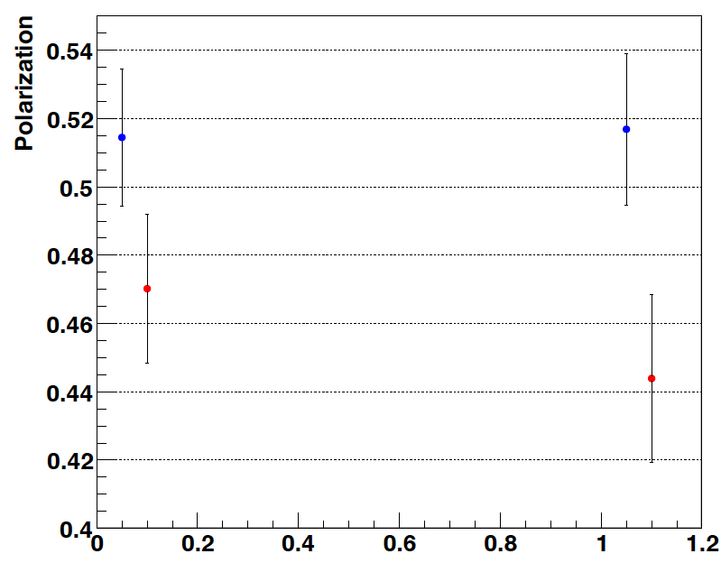
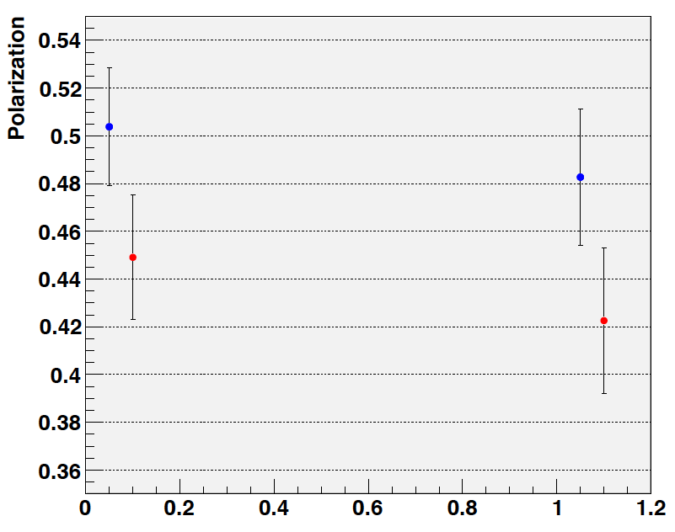
255 GeV Results
0.71%±0.28/hour
1.288%±0.18/hour
H-Jet:
Fills: 16570-16592
trans + longitudinal
H-Jet:
Fills: 16586-16592
longitudinal

Slide 6
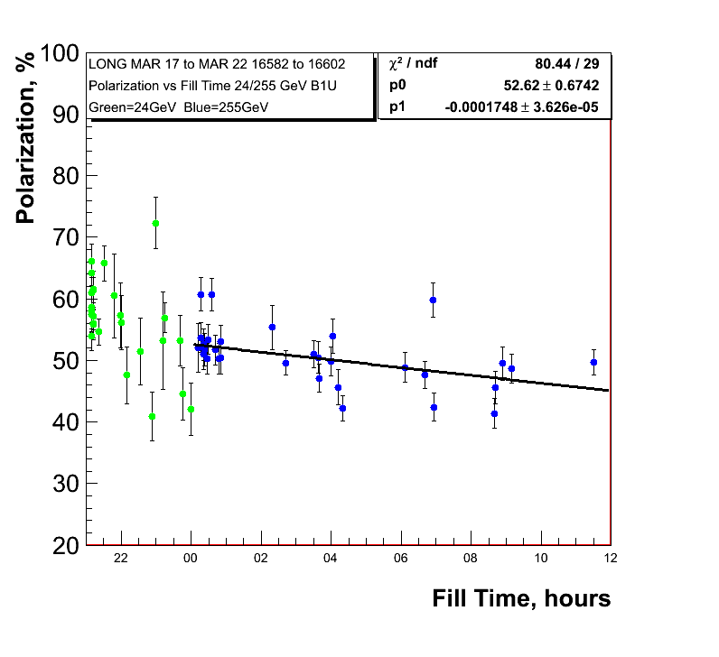
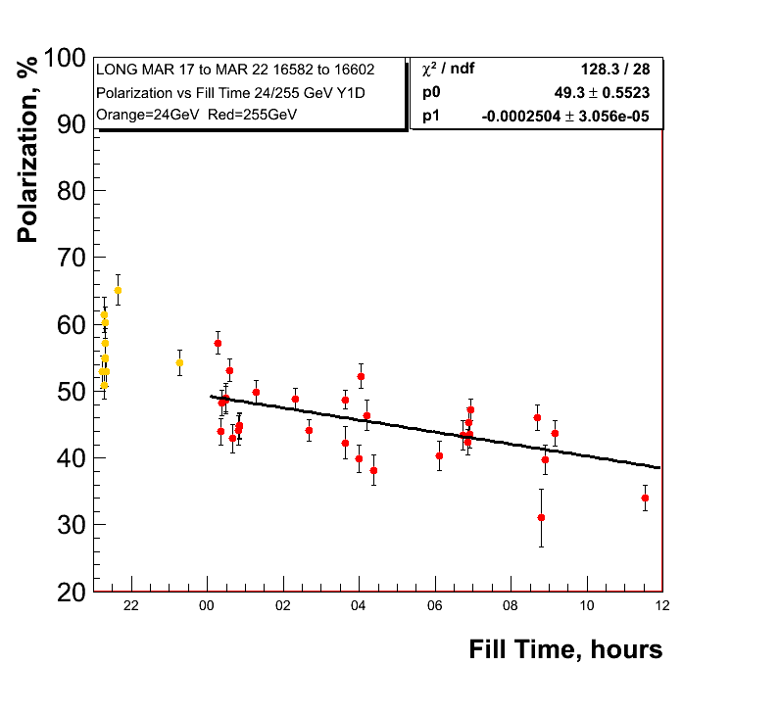
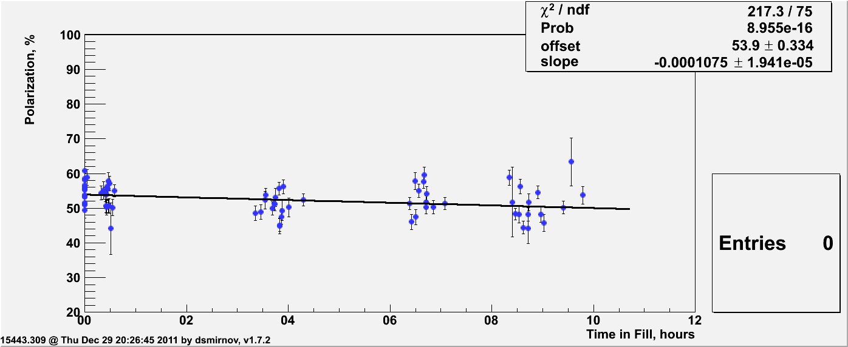
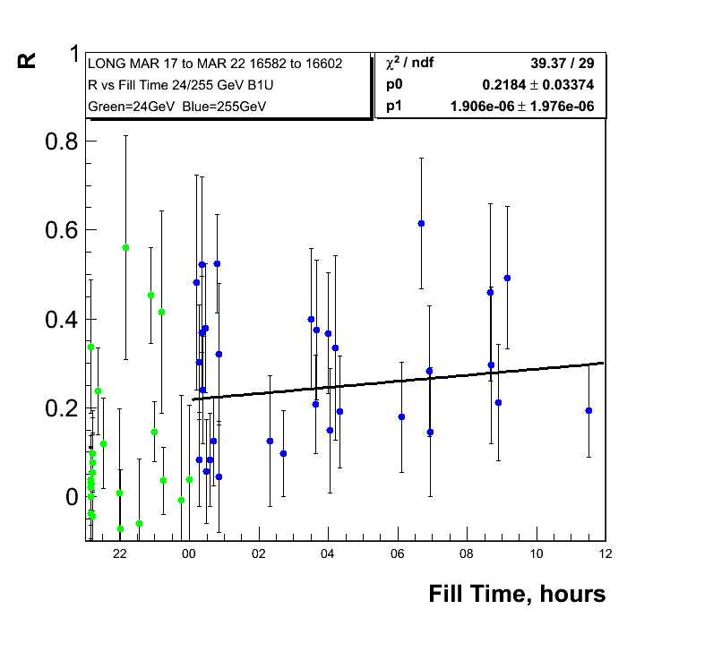
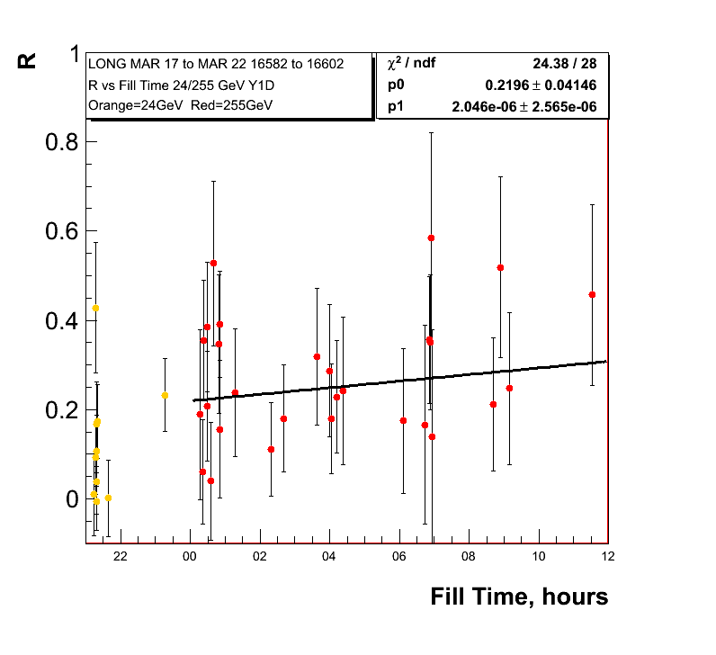
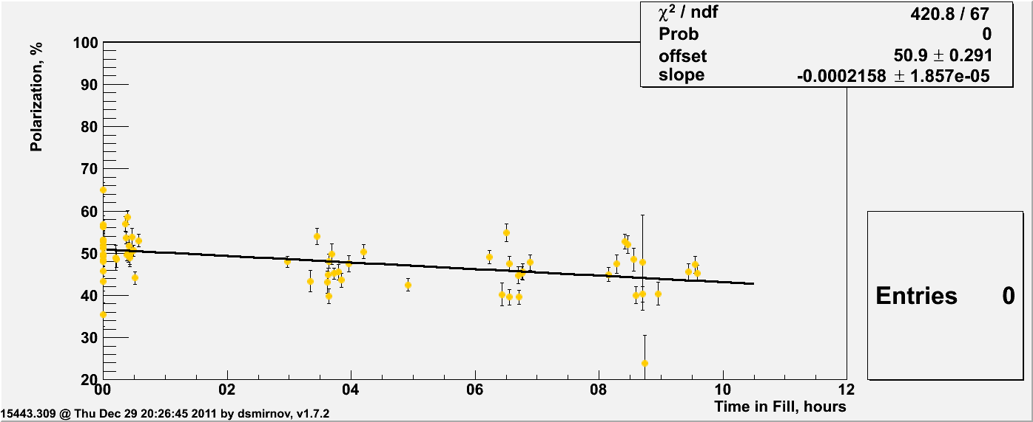
255 GeV Results
0.62%±0.13/hour
0.9%±0.11/hour
Polarisation
lifetime very
similar run-11
and run-12 so
255 GeV did not
do the trick
Run-11
0.39%±0.07/hour
Run-11
0.78%±0.07/hour

Slide 7
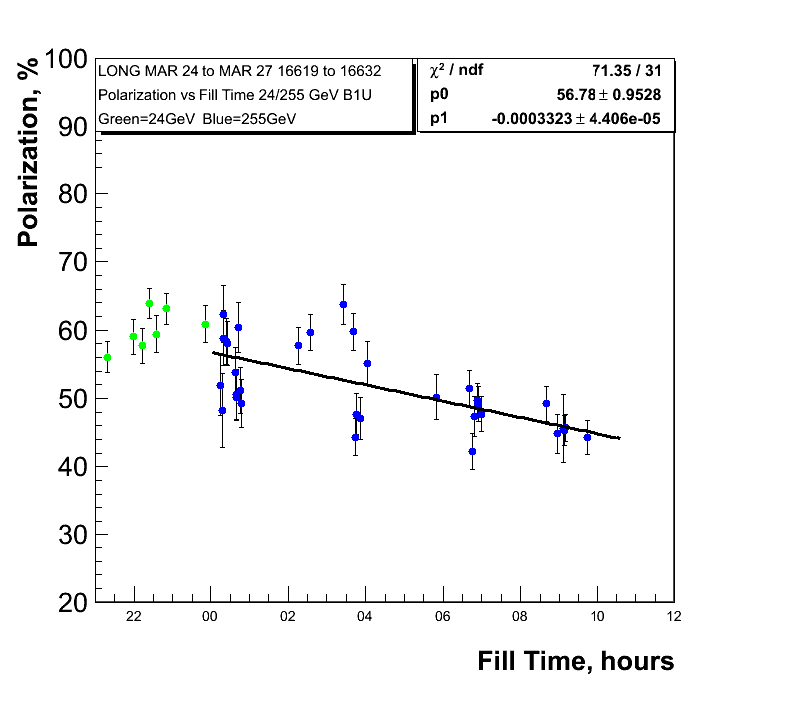
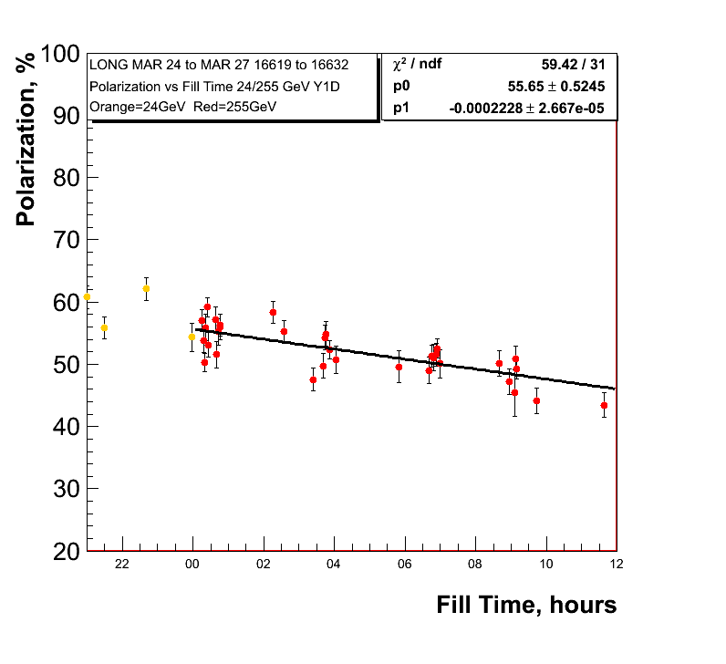
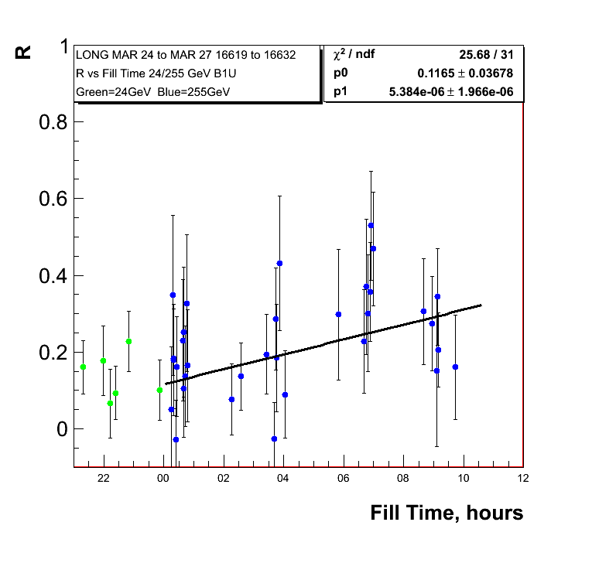
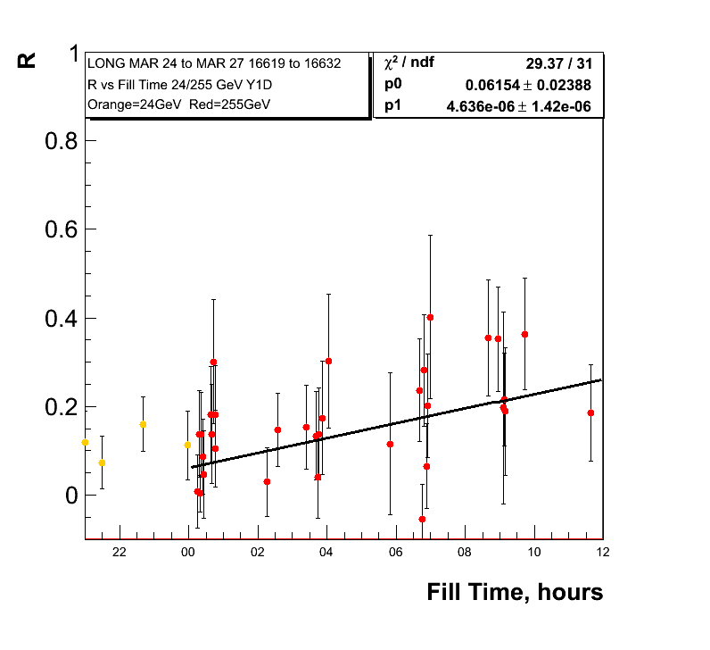
255 GeV Results
1.2%±0.16/hour
0.8%±0.096/hour
Polarisation
Lifetime for low
Emittance fills

Slide 8
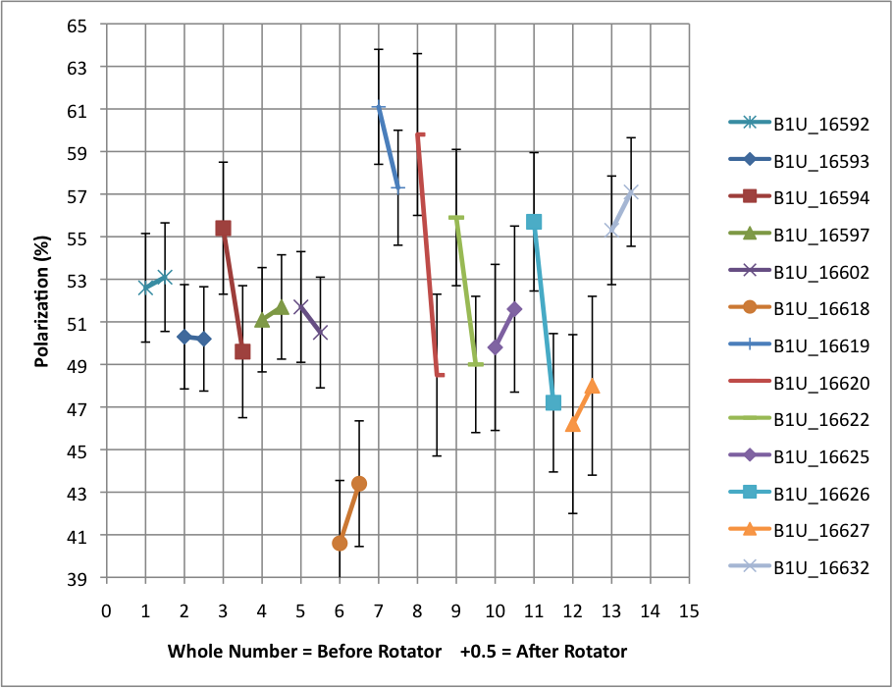
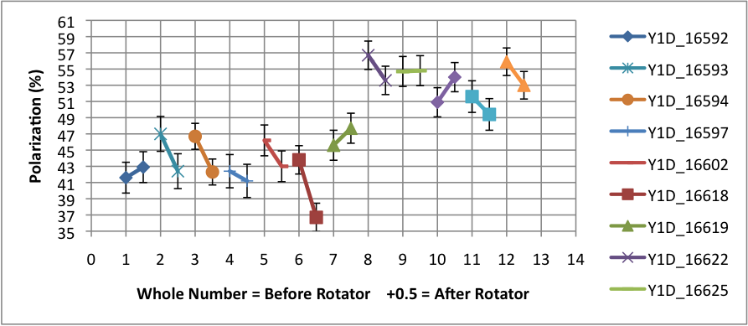
Polarisation loss through rotator ramp
Blue Beam
Shown are the polarisation
measurements before and
after the rotator ramp
at 255 GeV
Yellow Beam

Slide 9
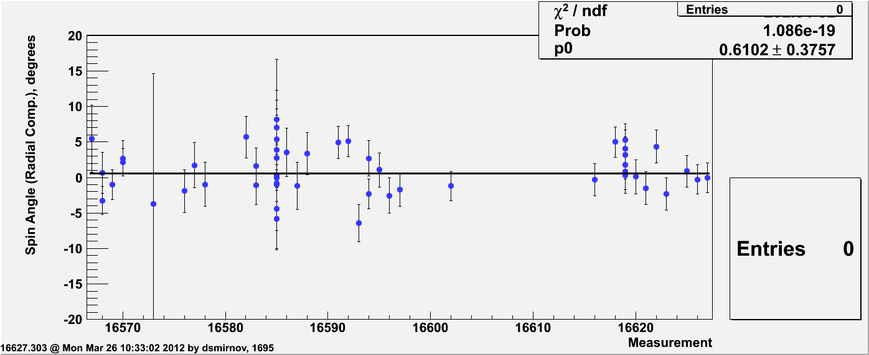
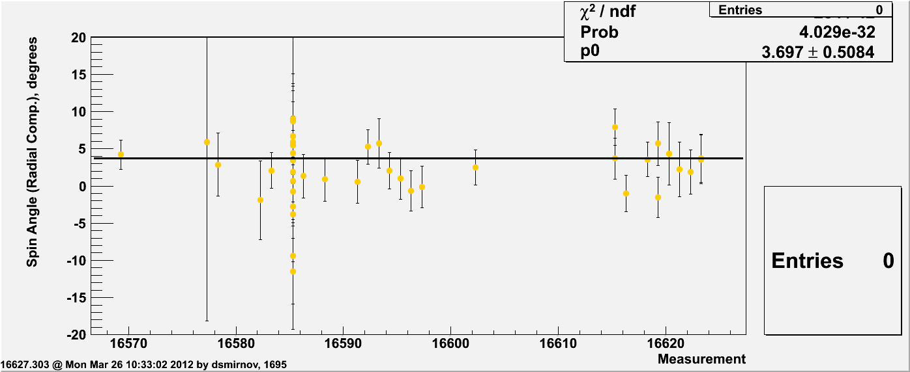
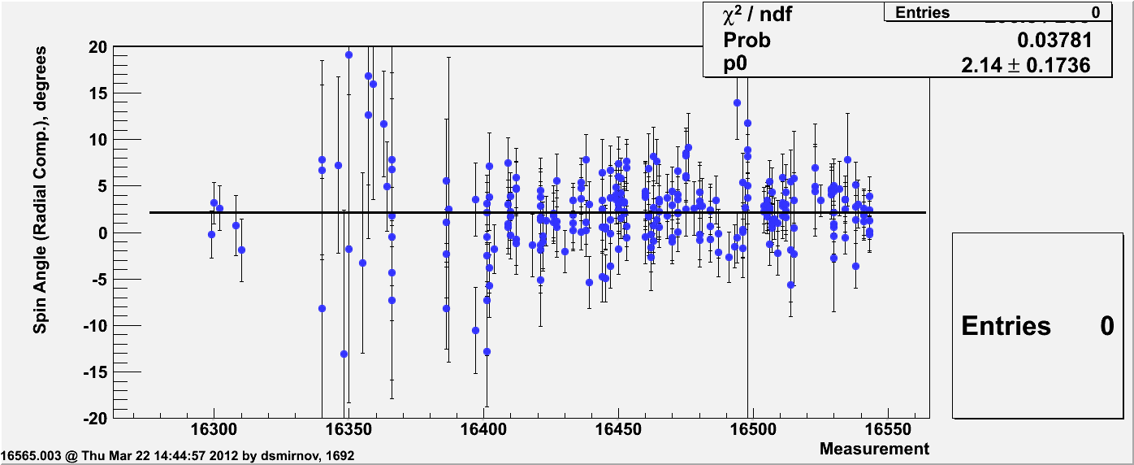
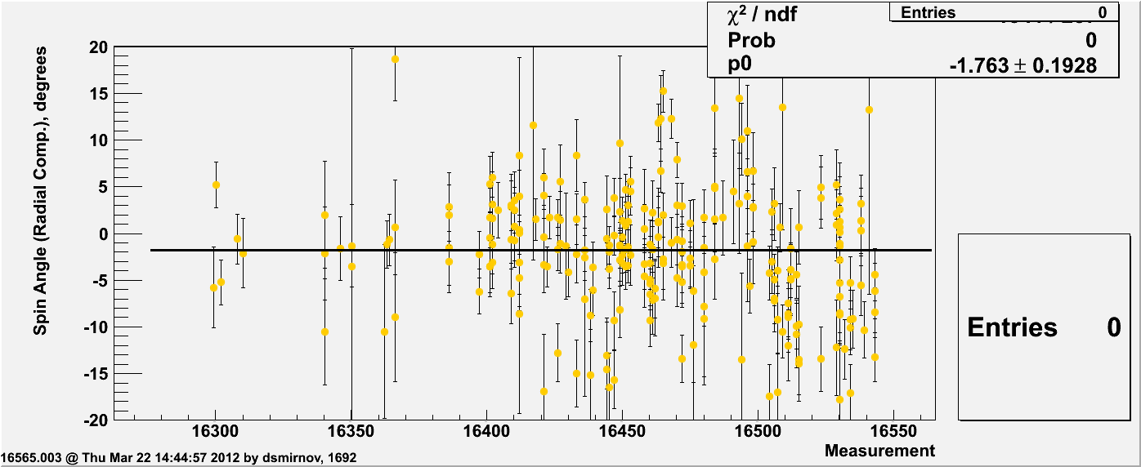
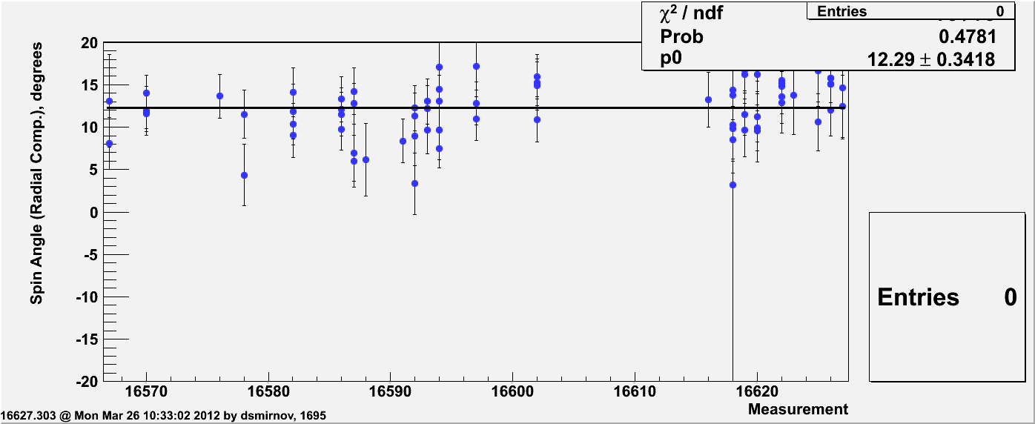
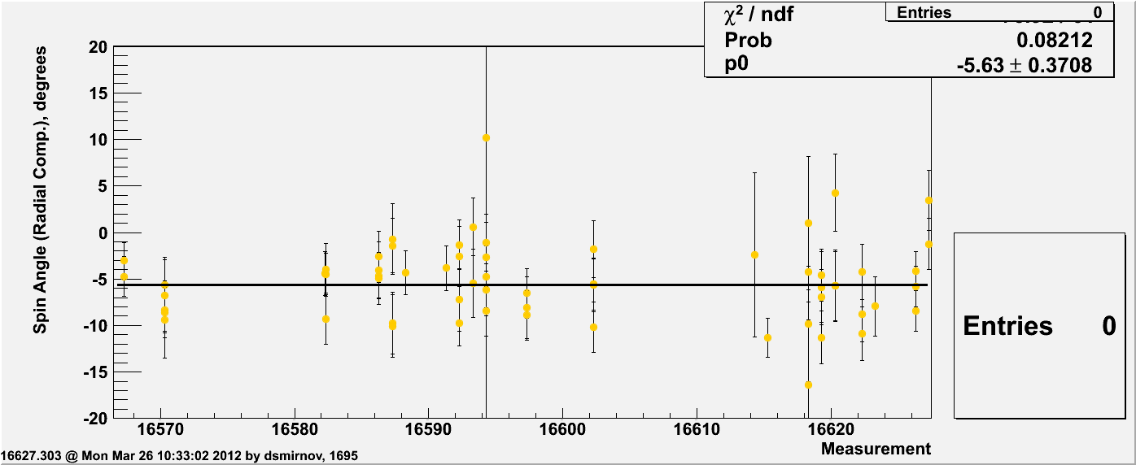
Radial SPIN Angle Measured by pC
24 GeV
100 GeV
255 GeV

Slide 10
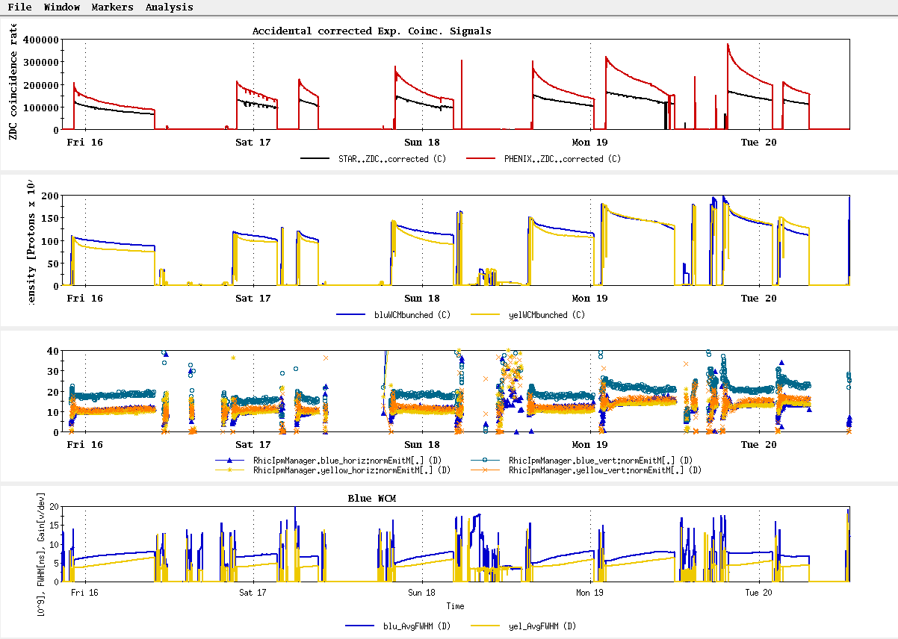
History
~L_{store avg} Goal

Slide 11
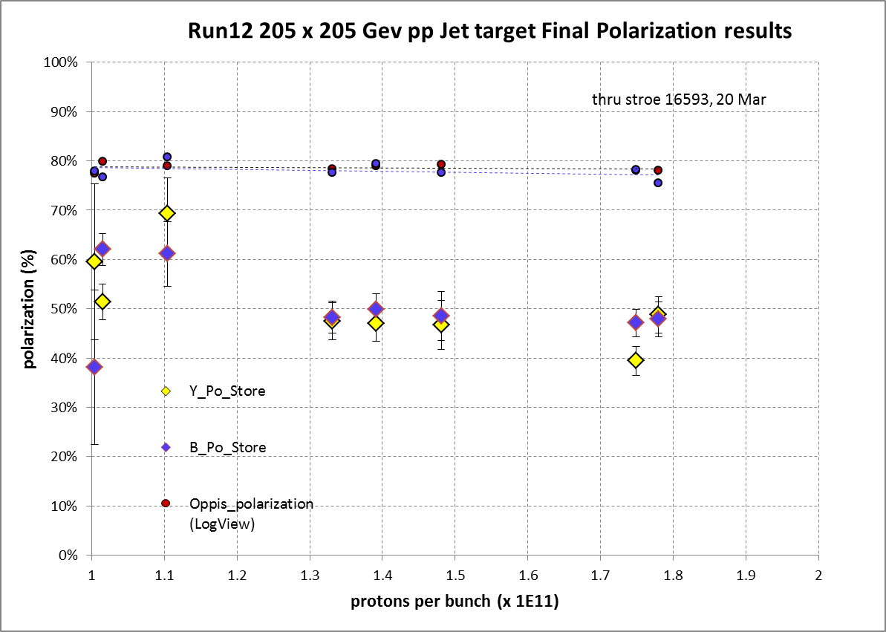
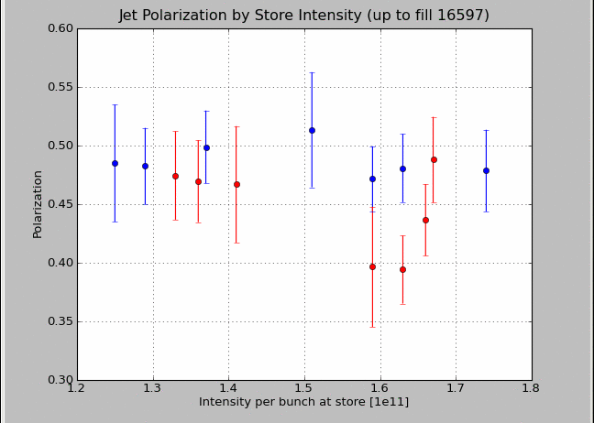
Intensity Dependence of Polarisation
transverse
longitudinal
longitudinal

