Slide 1
A summary on Polarisation in Run-12 for 255 geV
E.C. Aschenauer
presenting the work done by Alan, anders, Bill and Dima

Slide 2
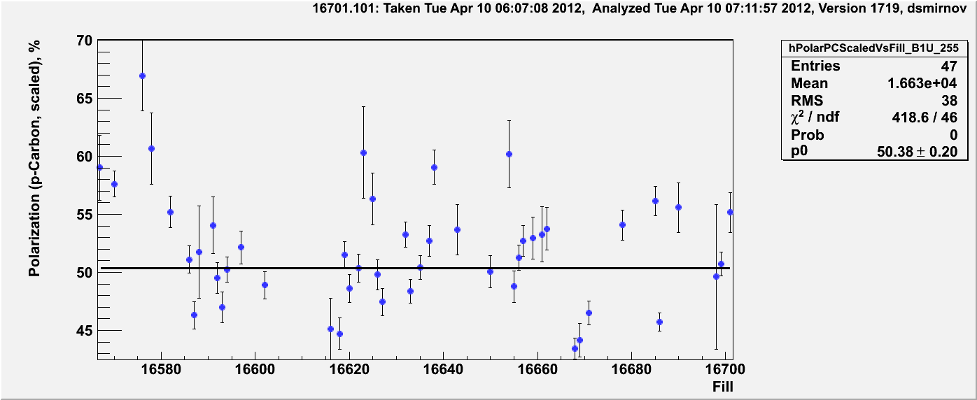
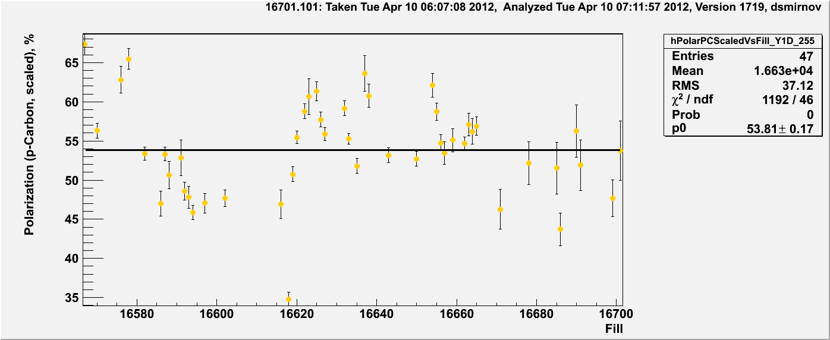
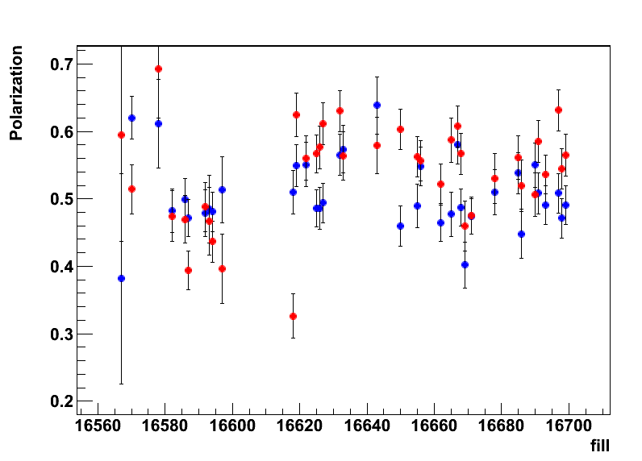
255 GeV Results
Blue-1
polarisation at flat top
Blue and Yellow
H-Jet
Yellow-1
→ longitudinal

Slide 3
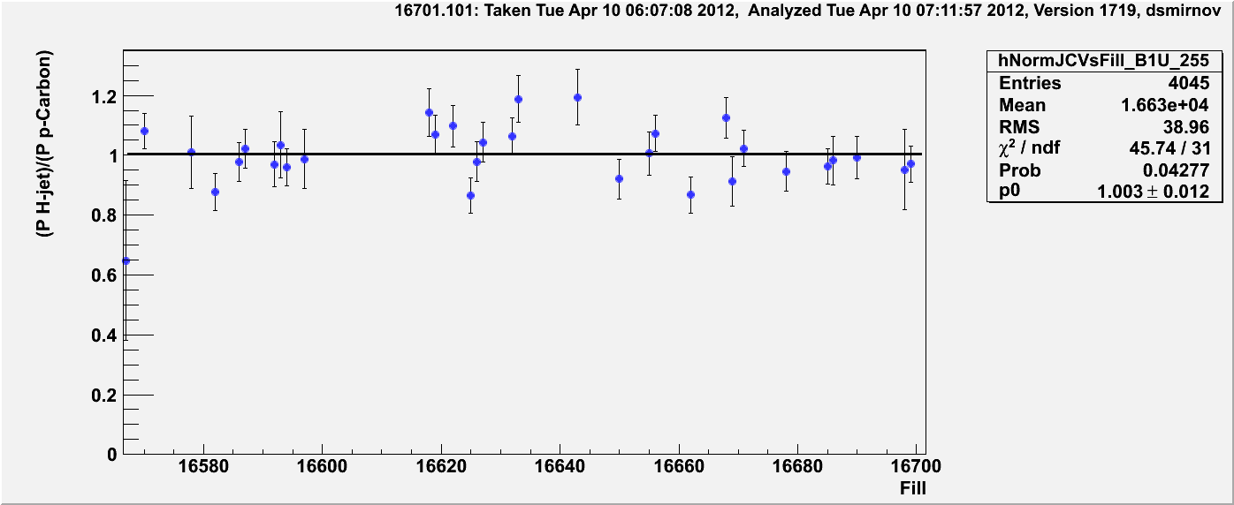
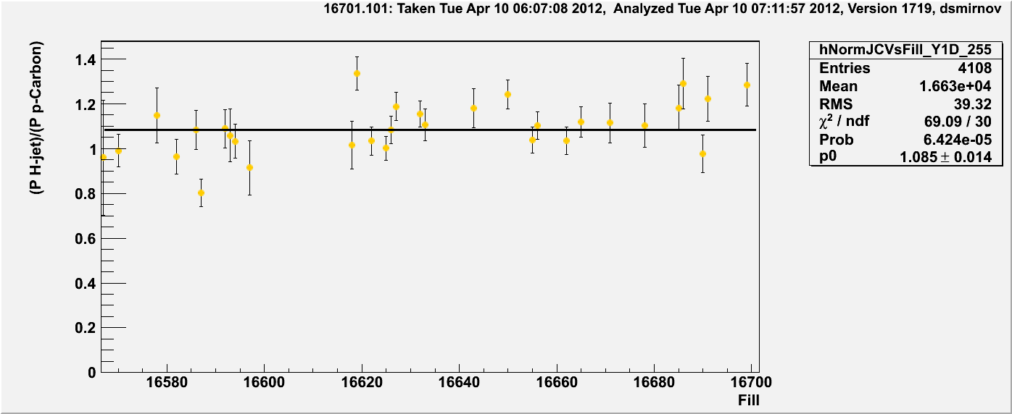
Normalization to H-Jet
Blue-1: in good agreement with jet
without normalisation
Yellow-1: normalized by 1.08
All measurements online and offline are normalized to jet now
CDEV was reloaded with new offline numbers

Slide 4
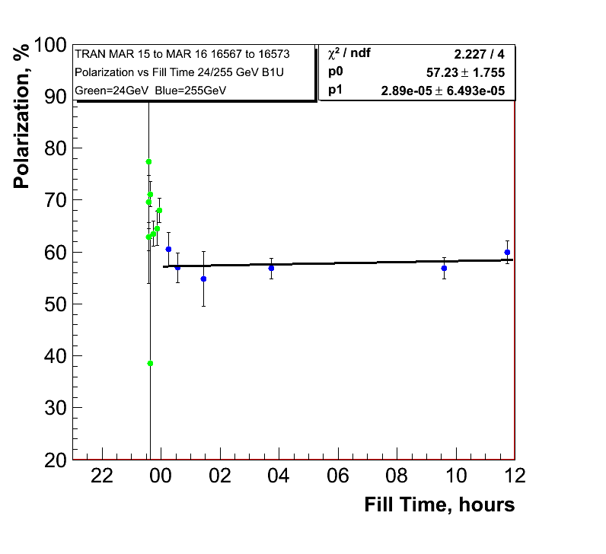
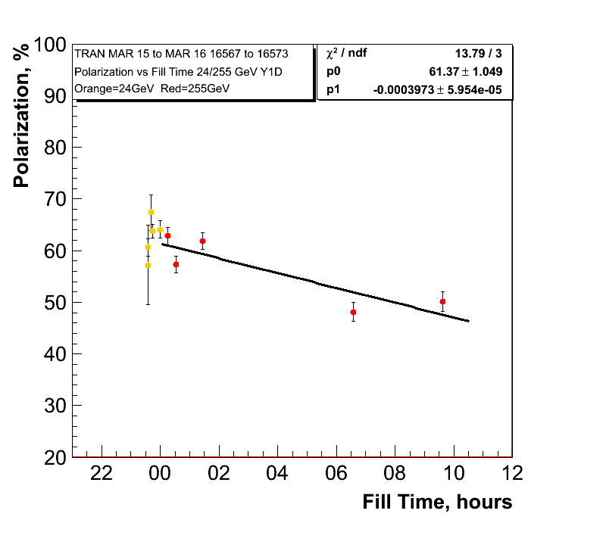
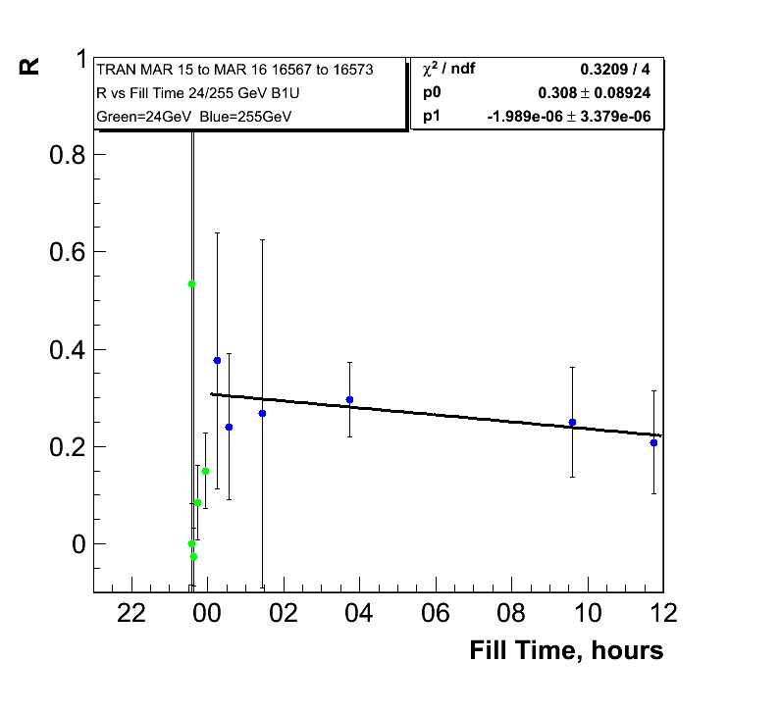
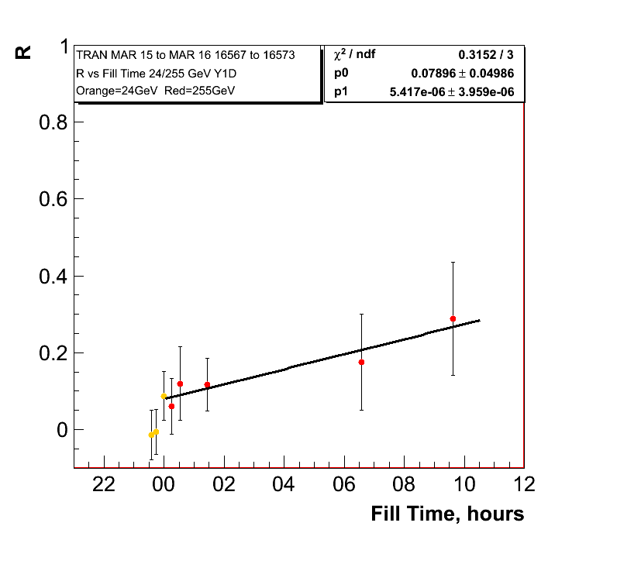
255 GeV Results Transverse Fills
0.10%±0.23/hour
Polarisation
lifetime in
yellow very
similar to
longitudinal
255 GeV fills
1.4%±0.21/hour

Slide 5
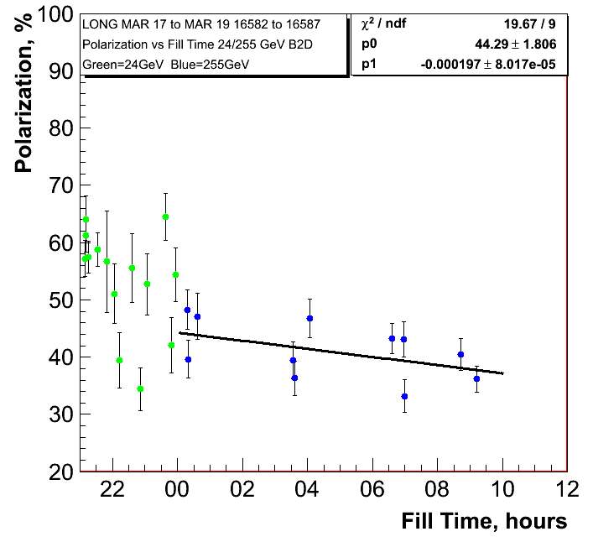
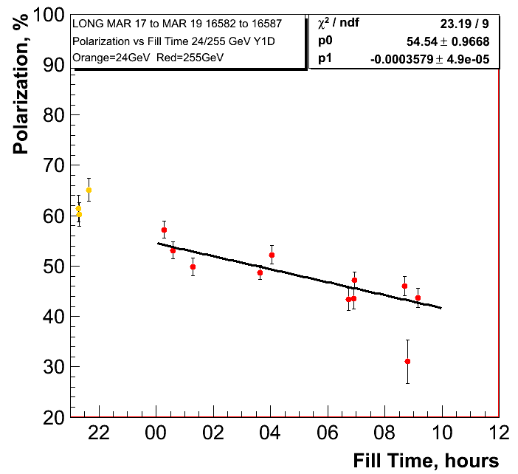
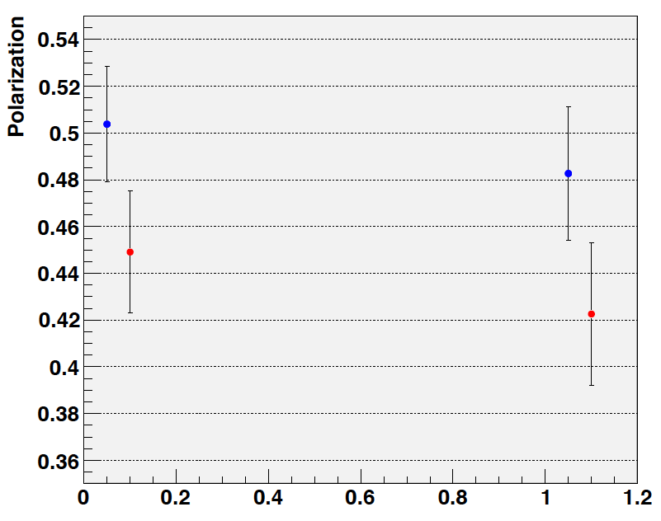
255 GeV Results
0.71%±0.28/hour
1.288%±0.18/hour
H-Jet:
Fills: 16586-16592
longitudinal

Slide 6
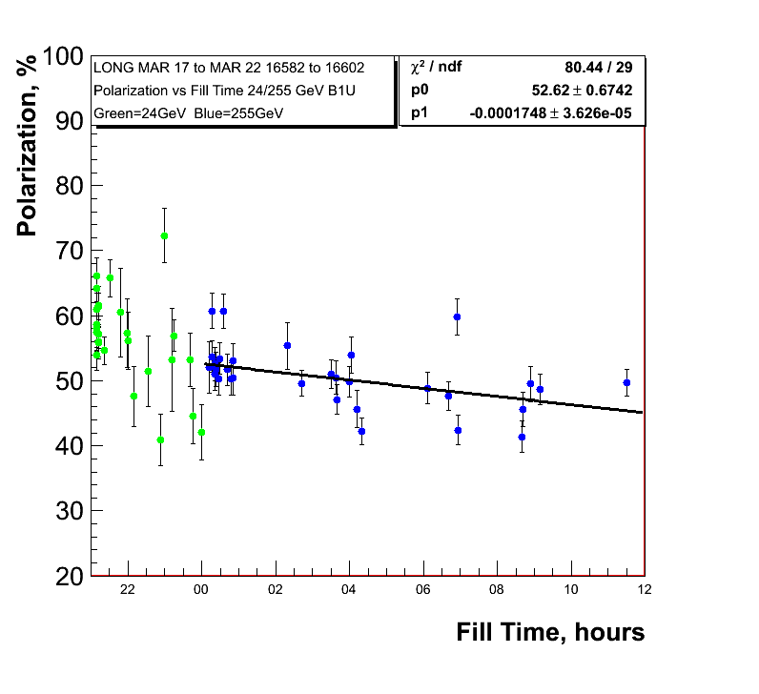
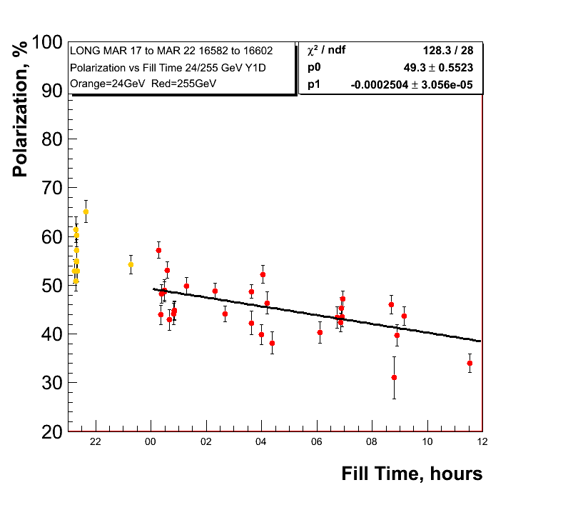
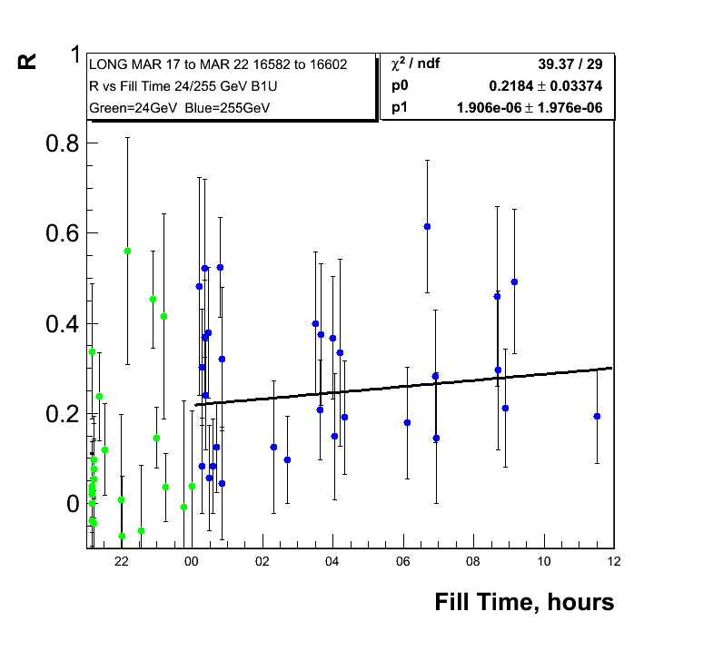
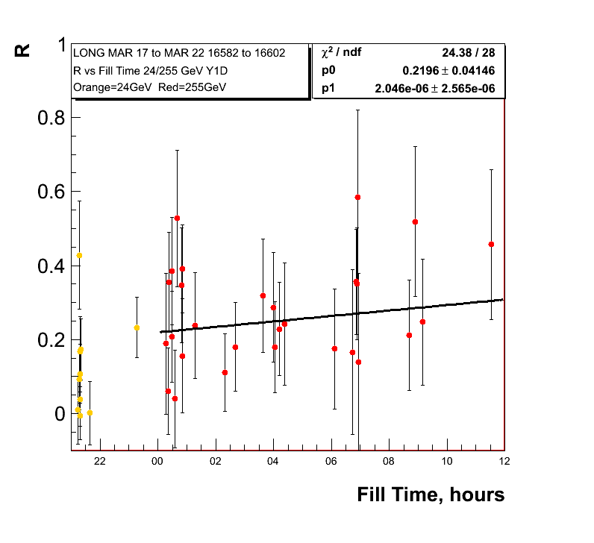
255 GeV Results
0.62%±0.13/hour
0.9%±0.11/hour
Polarisation
lifetime very
similar run-11
and run-12 so
255 GeV did not
do the trick

Slide 7
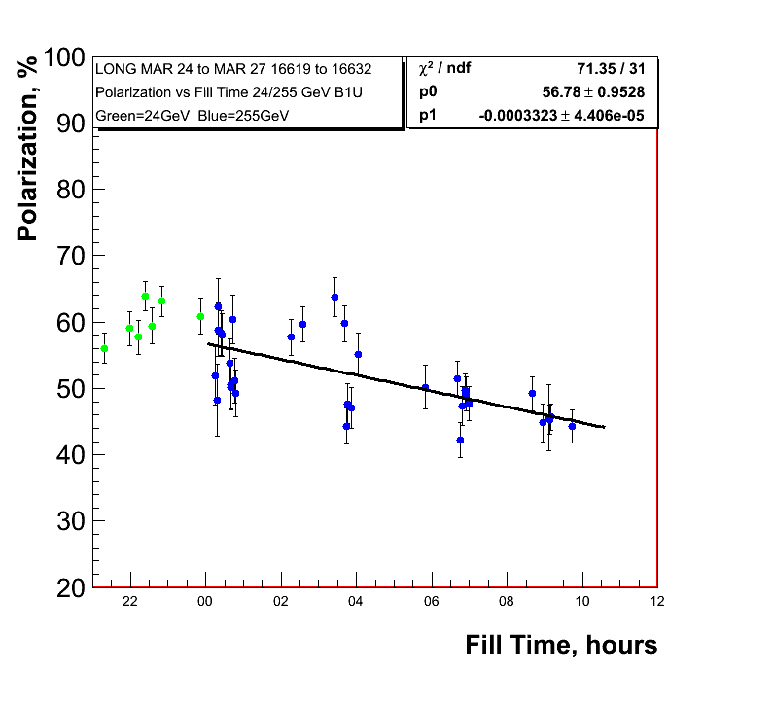
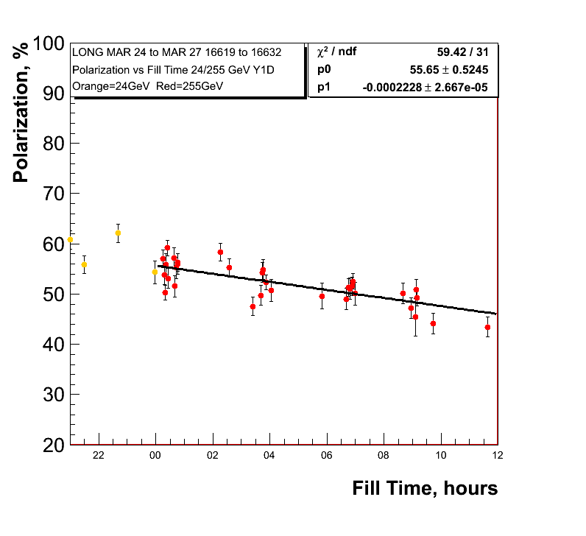
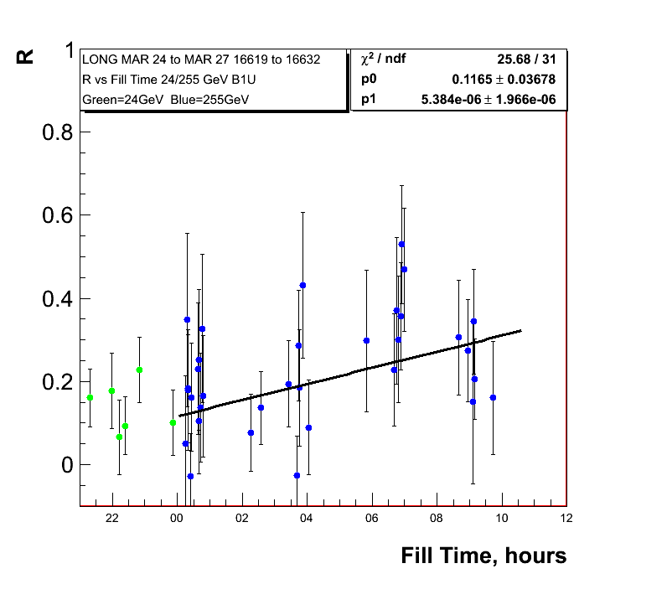
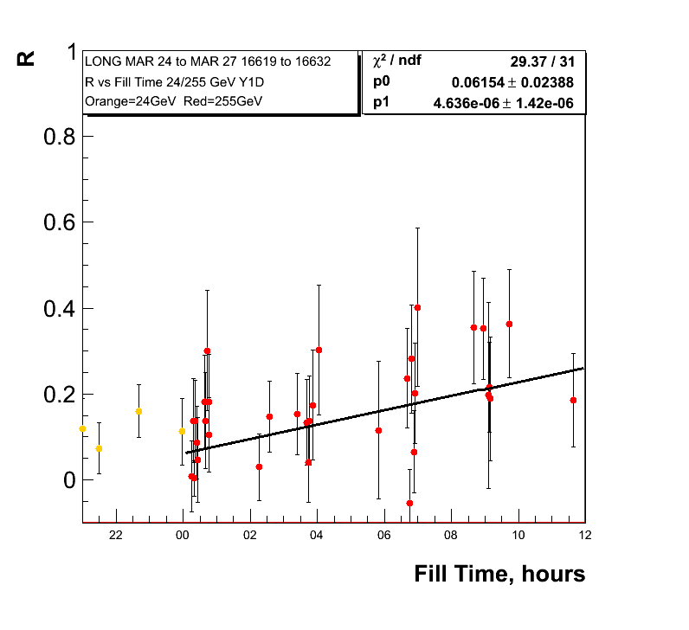
255 GeV Results
1.2%±0.16/hour
0.8%±0.096/hour
Polarisation
Lifetime for low
Emittance fills

Slide 8
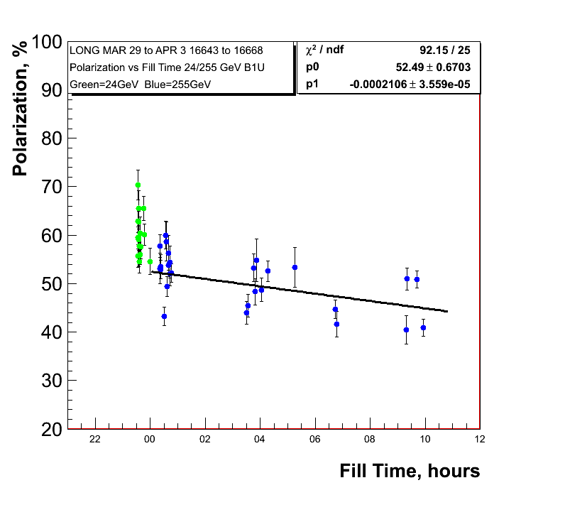
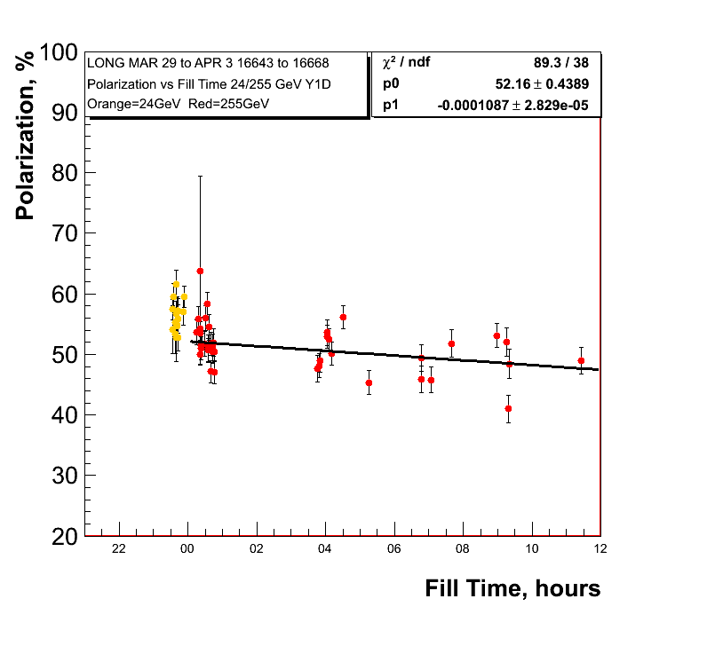
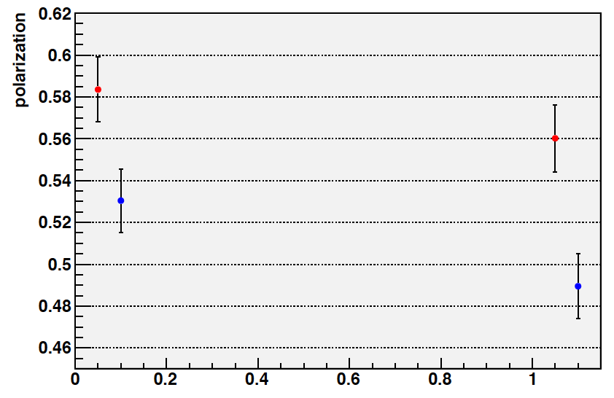
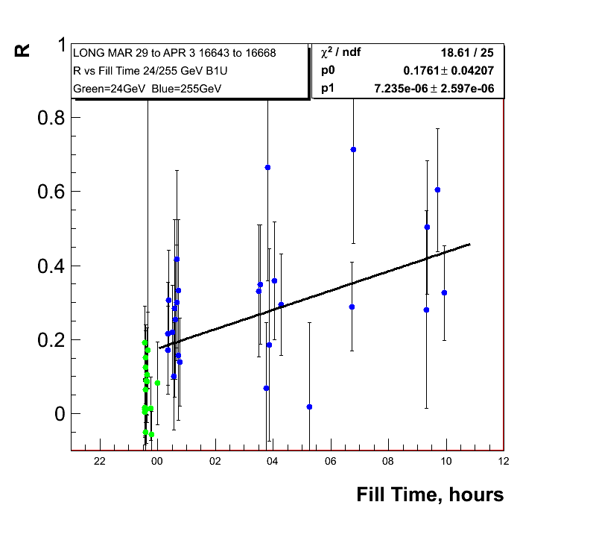
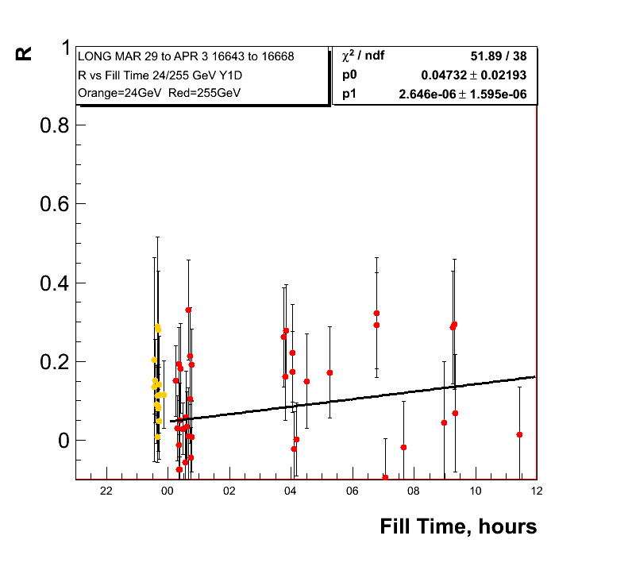
255 GeV Results
0.75%±0.13/hour
0.39%±0.10/hour
Jet same fill range

Slide 9
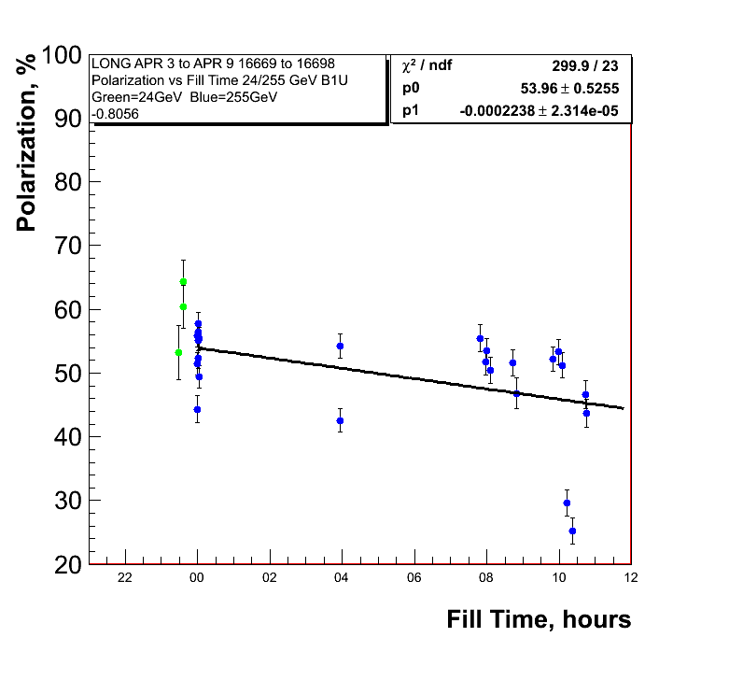
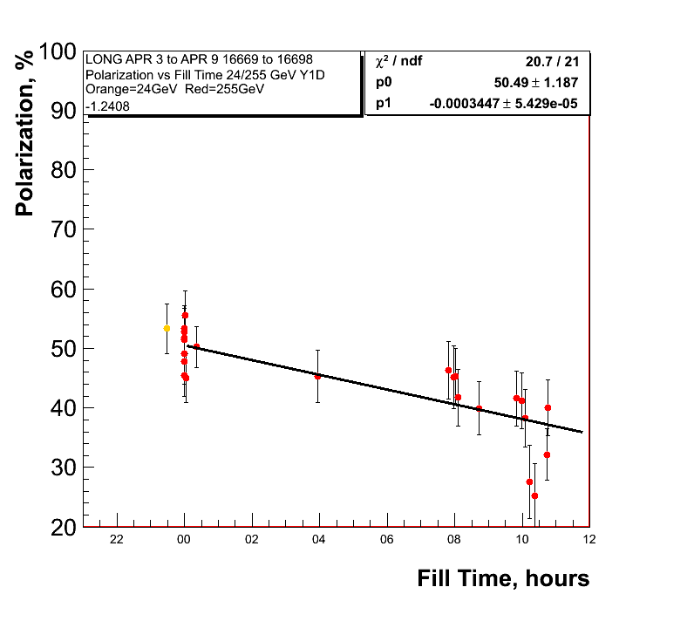
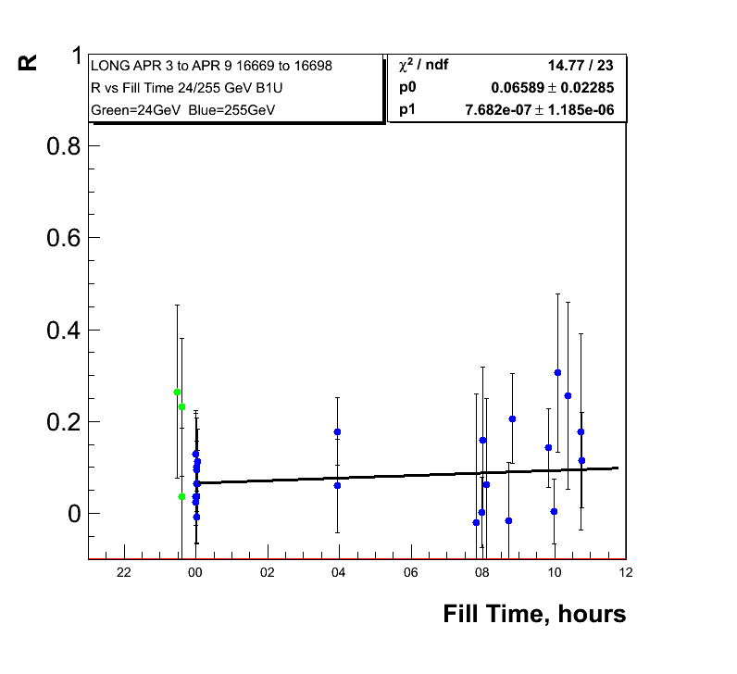
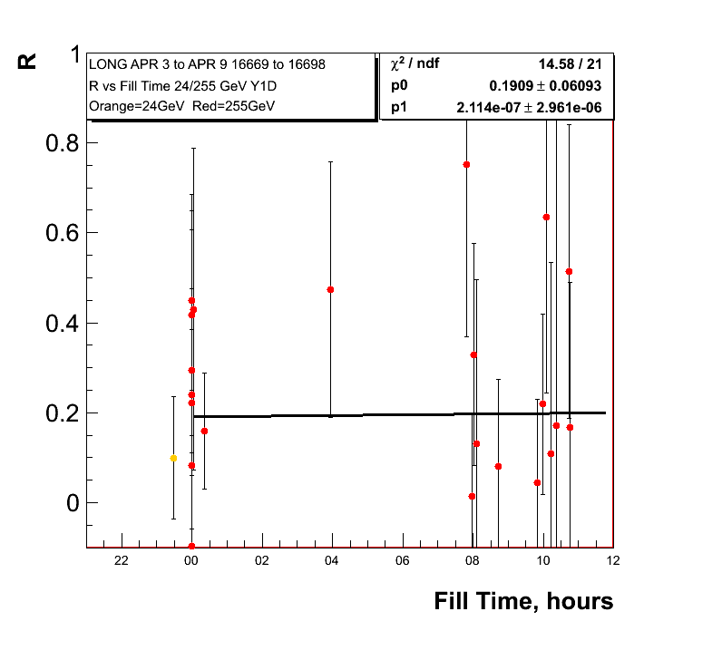
255 GeV Results
0.8%±0.08/hour
1.24%±0.19/hour
Polarisation
Lifetime since
last week

Slide 10
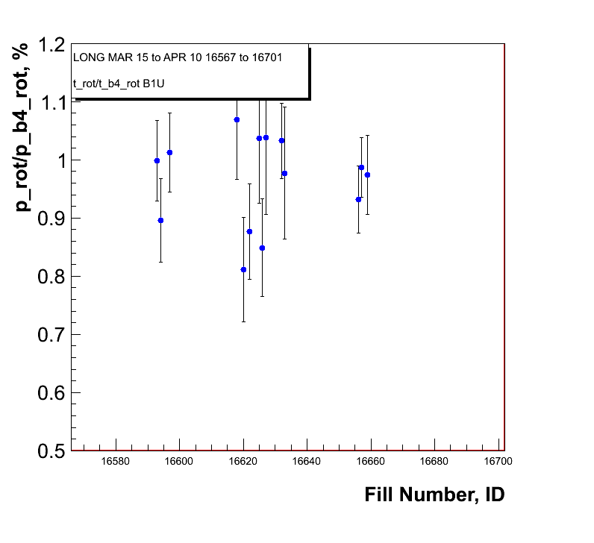
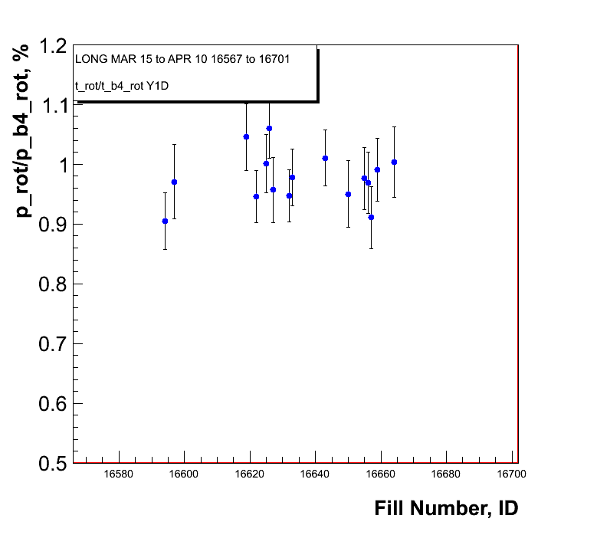
Polarisation loss through rotator ramp
Shown is the ratio of the
polarisation measurements
before and
after the rotator ramp
at 255 GeV
Blue Beam
Yellow Beam

Slide 11
Big Problem
Reinstall new target in Blue and Yellow on Wednesday
Work on RHIC AGS injection measurement comparisons and loss on the ramp
After that should go back to normal measurement routine
measure at injection
before and after rotator ramp
in the middle of the fill ← only this impacts PHENIX
at the end of the fill
Have a scheme how to provide to the experiments a polarisation, which allows to calculate for each trigger the correct luminosity weighted, polarisation profile corrected and to the jet normalized value
might apply it also 2011 data and
investigate it for 2009 100 GeV

