Slide 1
A summary on Polarisation in Run-12 for 255 geV
E.C. Aschenauer
presenting the work done by Alan, anders, Bill and Dima

Slide 2
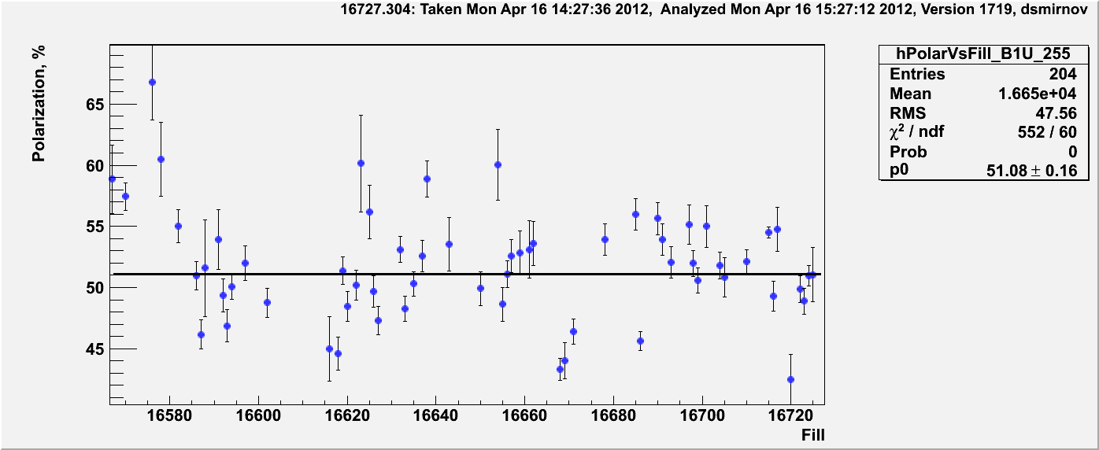
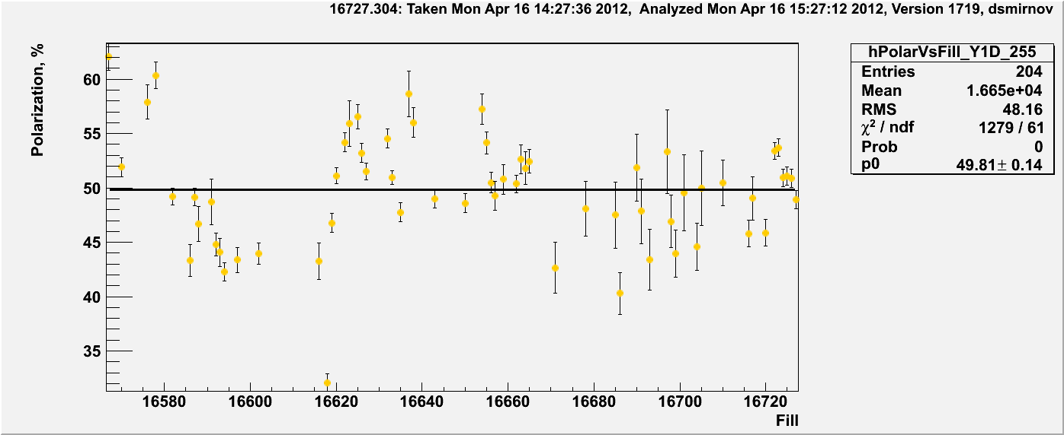
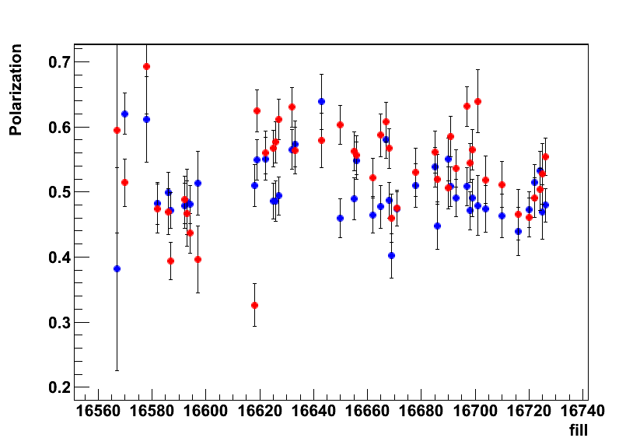
255 GeV Results
Blue-1
polarisation at flat top
Blue and Yellow
H-Jet
Yellow-1
→ longitudinal

Slide 3
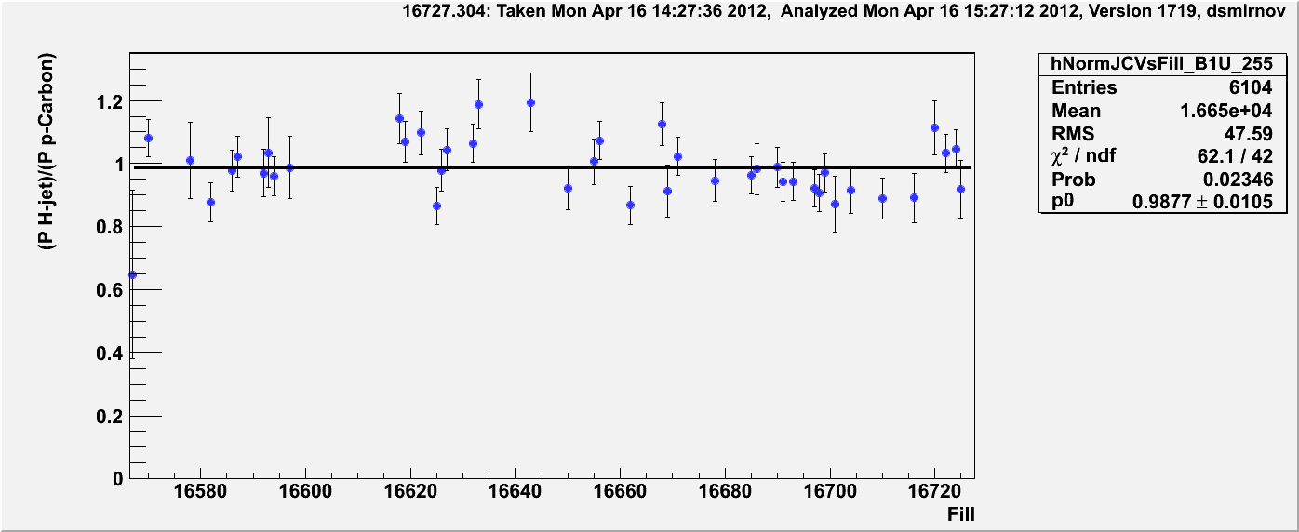
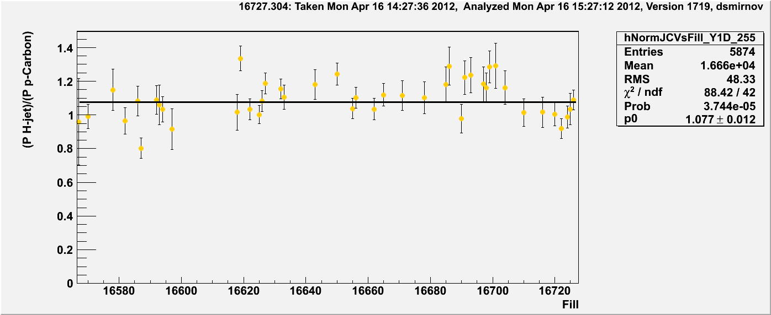
Normalization to H-Jet
Blue-1: in good agreement with jet
without normalisation
Yellow-1: normalized by 1.08
All measurements online and offline are normalized to jet now since already
more than a week
CDEV was reloaded with new offline numbers

Slide 4
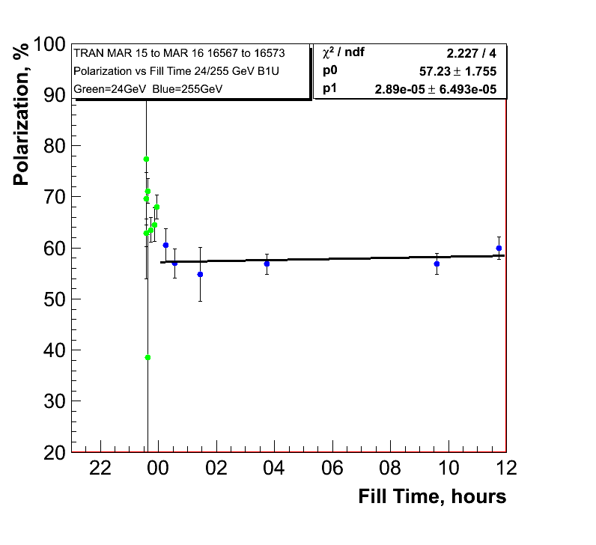
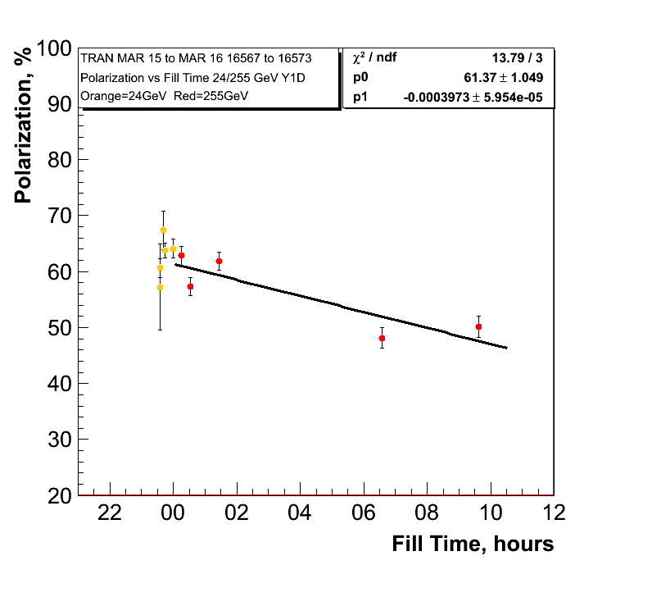
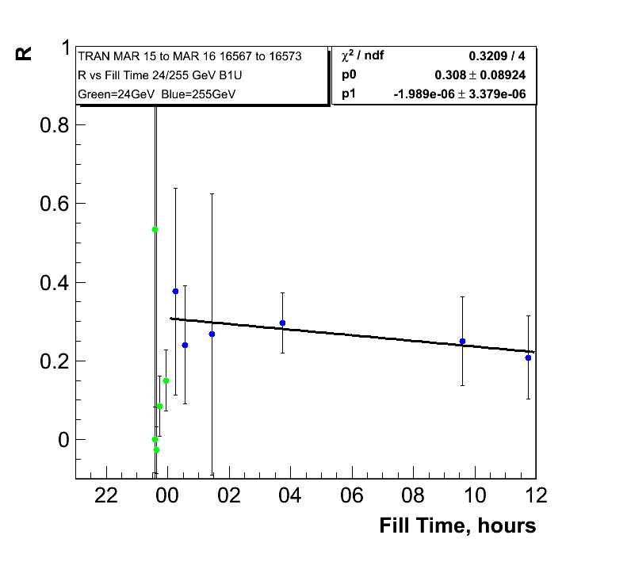
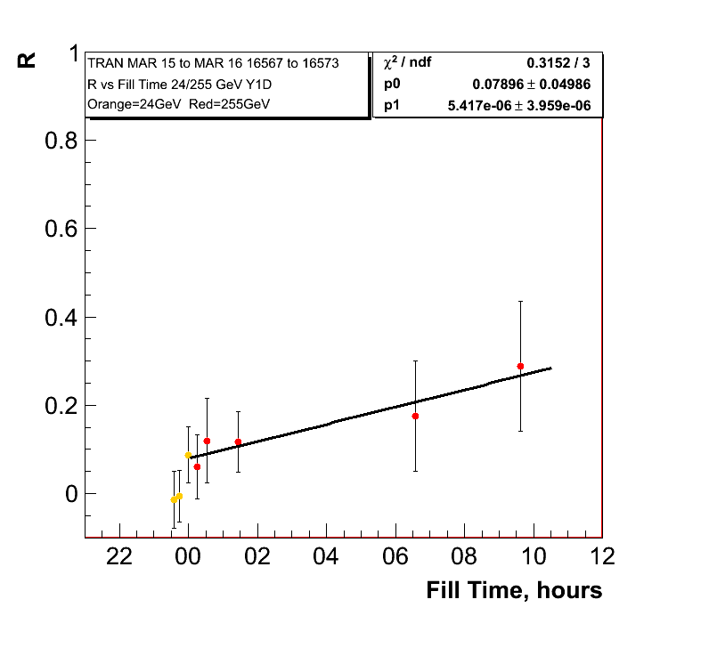
255 GeV Results Transverse Fills
0.10%±0.23/hour
Polarisation
lifetime in
yellow very
similar to
longitudinal
255 GeV fills
1.4%±0.21/hour

Slide 5
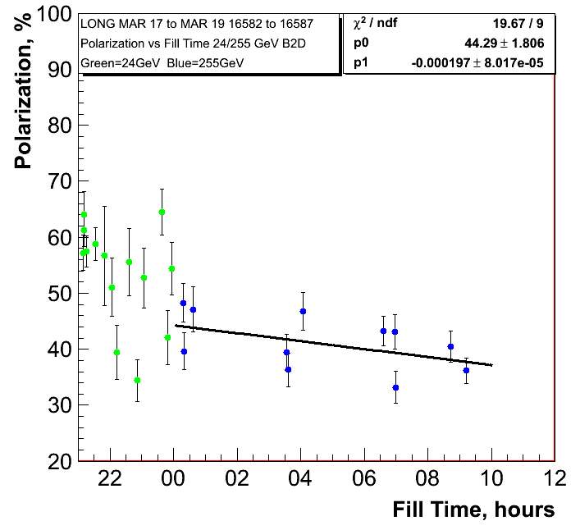
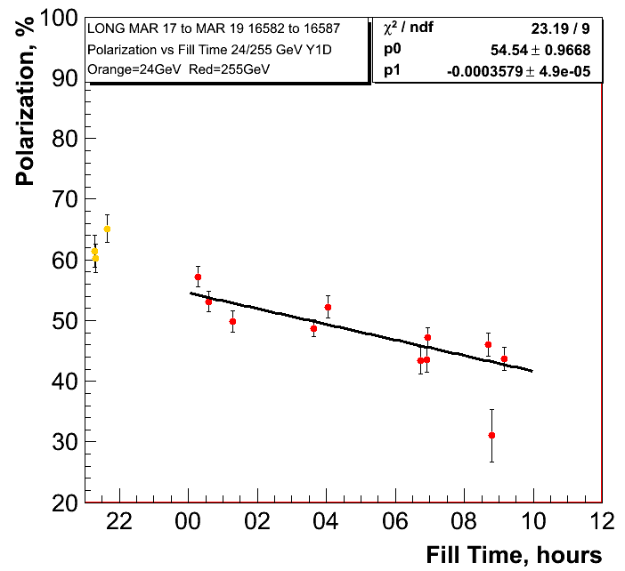
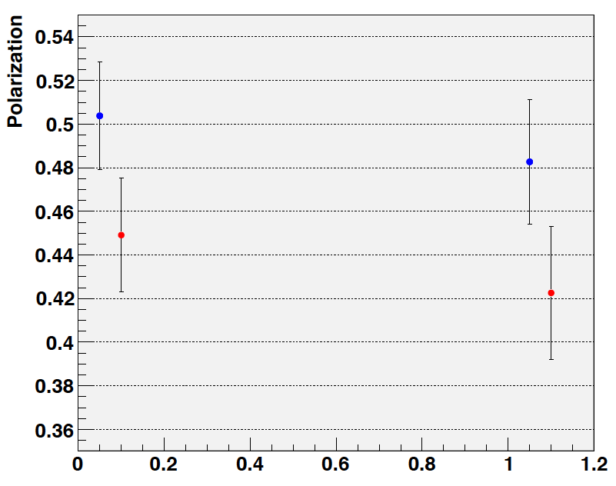
255 GeV Results
0.71%±0.28/hour
1.288%±0.18/hour
H-Jet:
Fills: 16586-16592
longitudinal

Slide 6
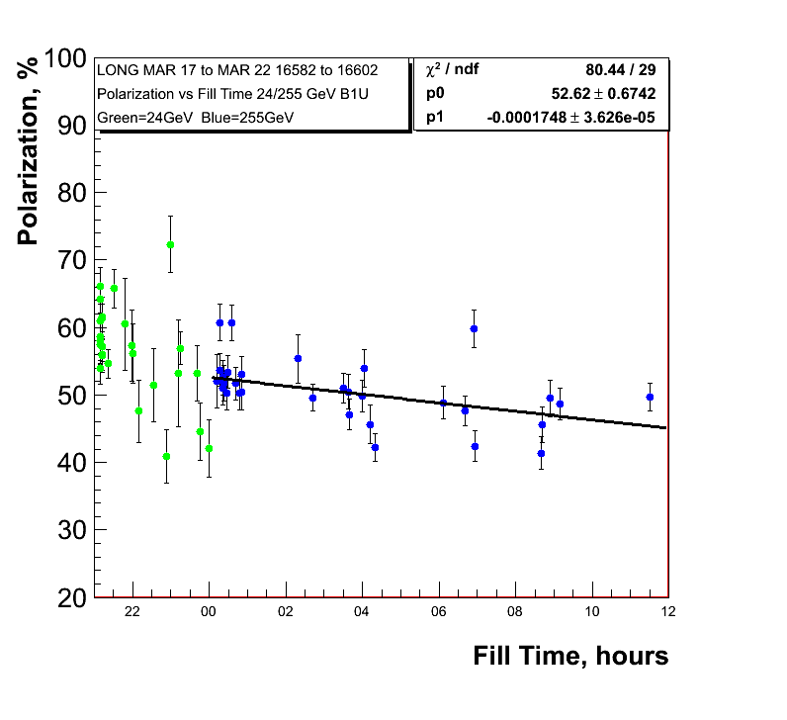
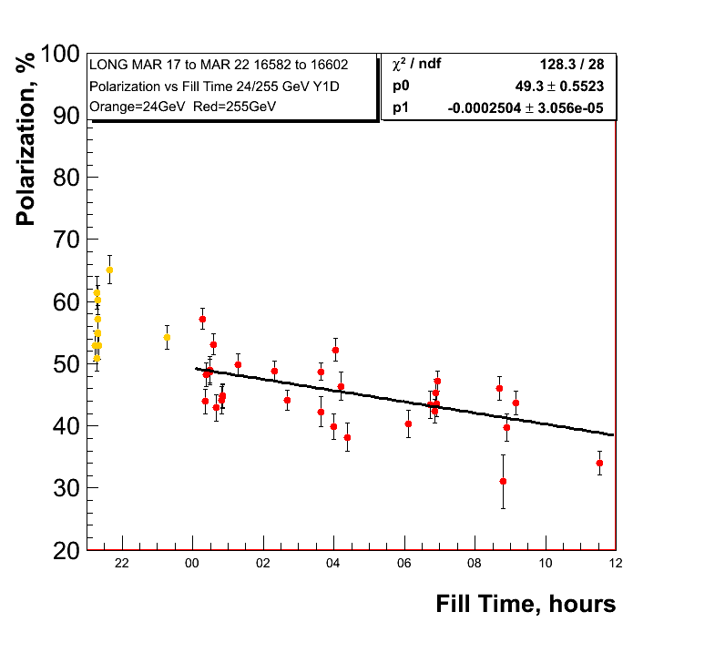
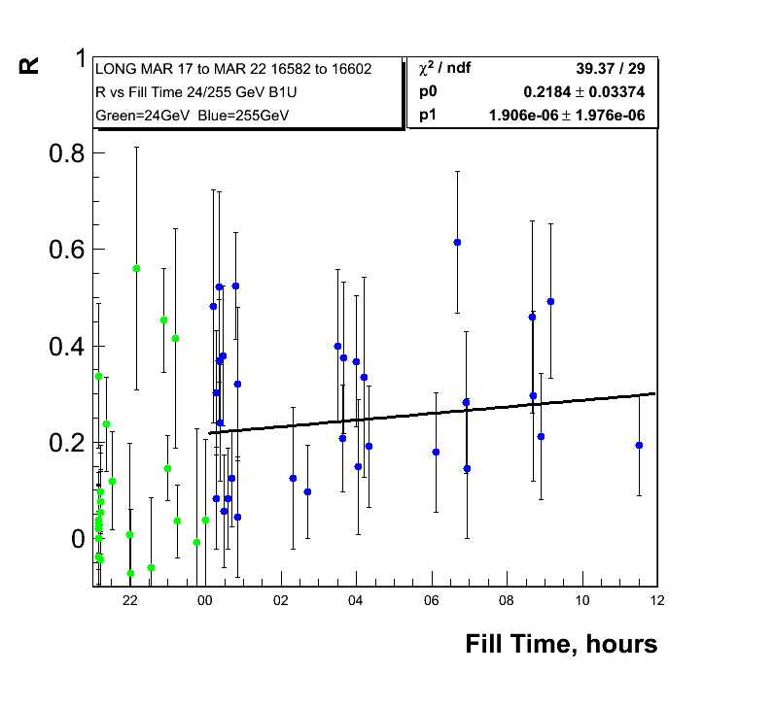
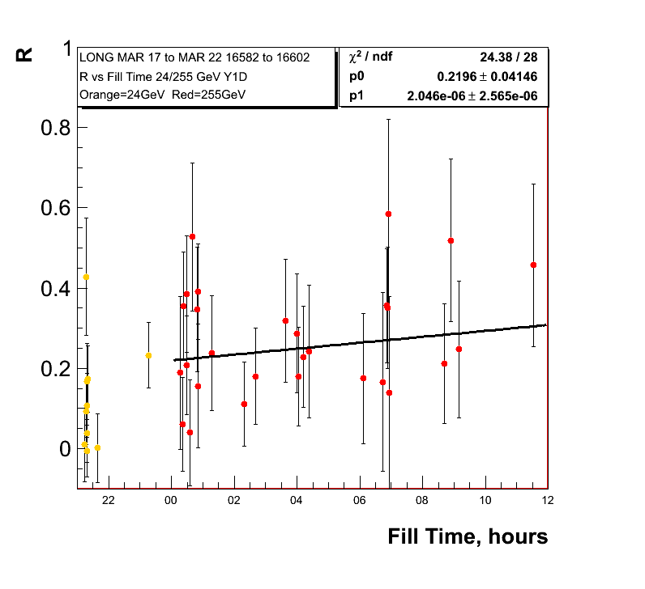
255 GeV Results
0.62%±0.13/hour
0.9%±0.11/hour
Polarisation
lifetime very
similar run-11
and run-12 so
255 GeV did not
do the trick

Slide 7
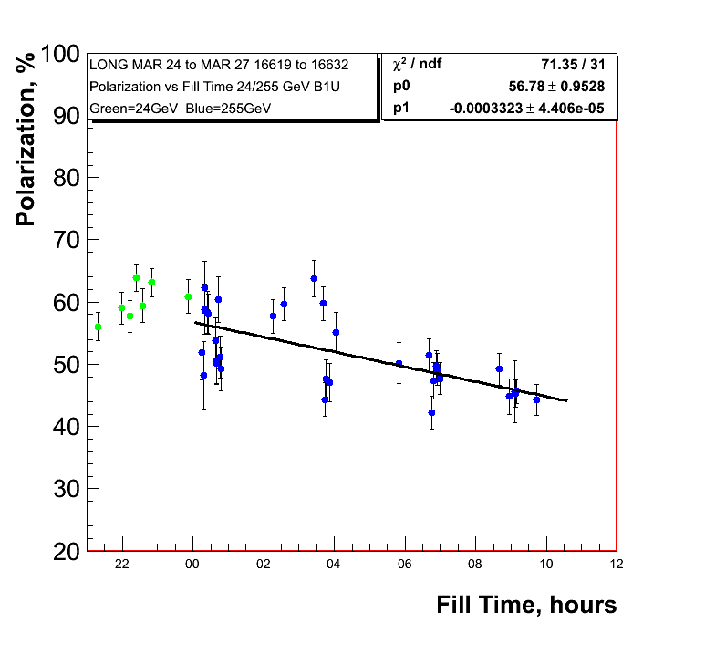
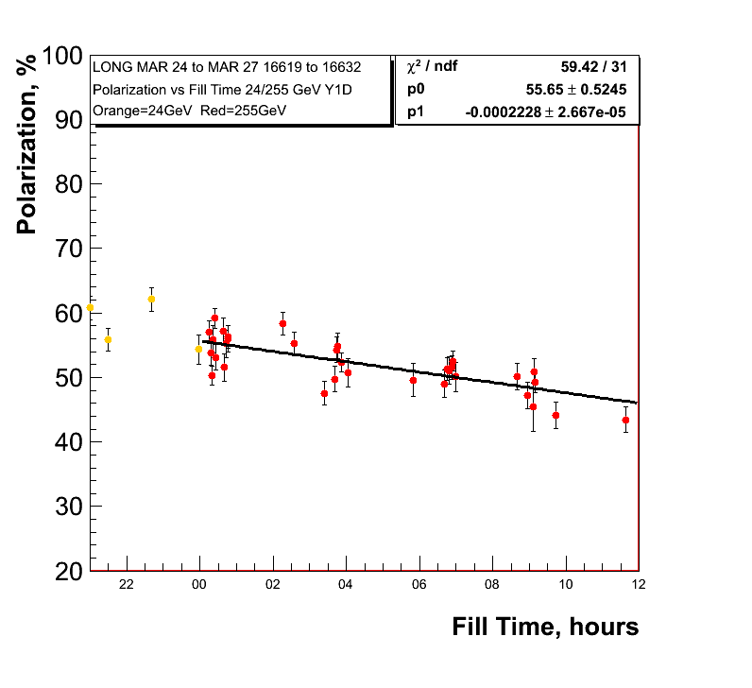
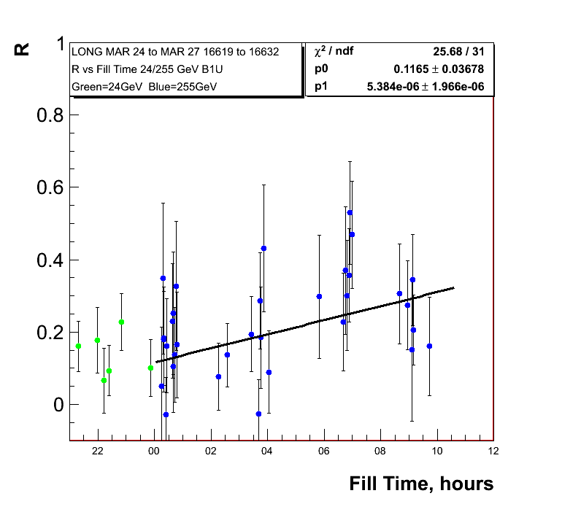
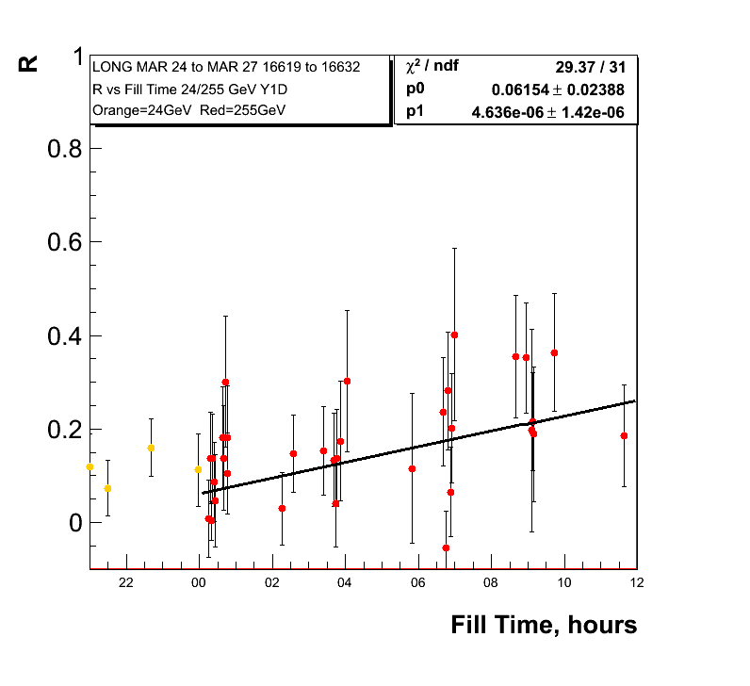
255 GeV Results
1.2%±0.16/hour
0.8%±0.096/hour
Polarisation
Lifetime for low
Emittance fills

Slide 8
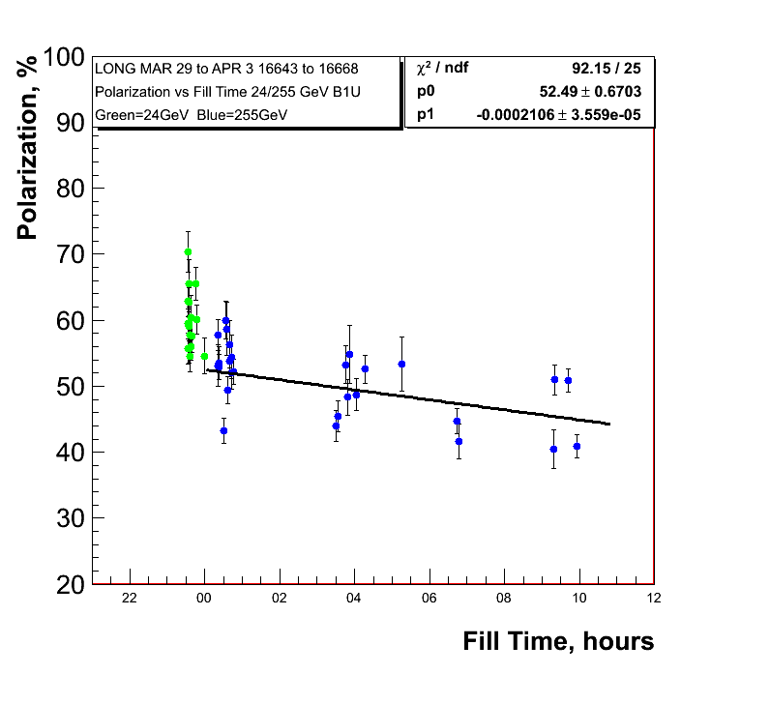
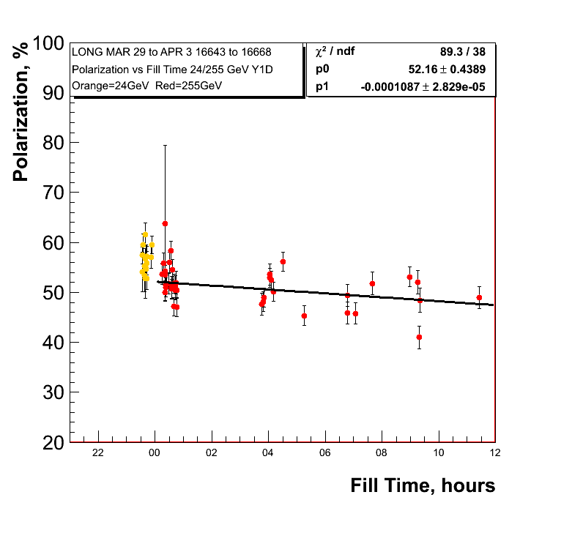
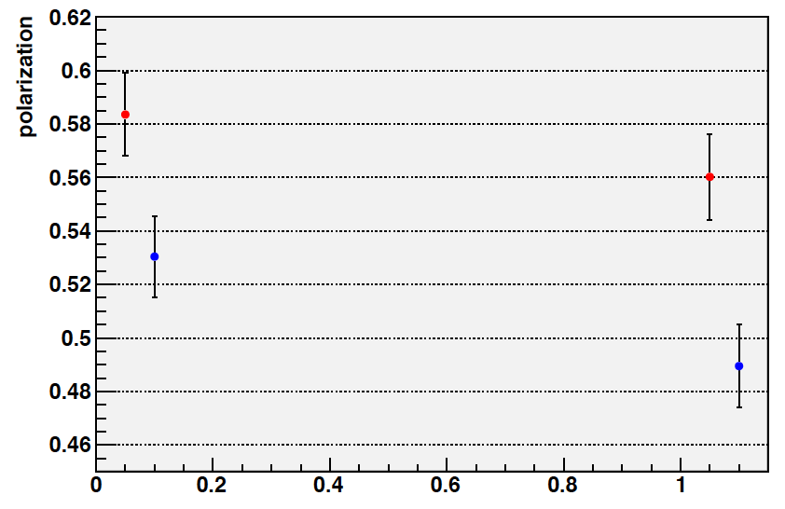
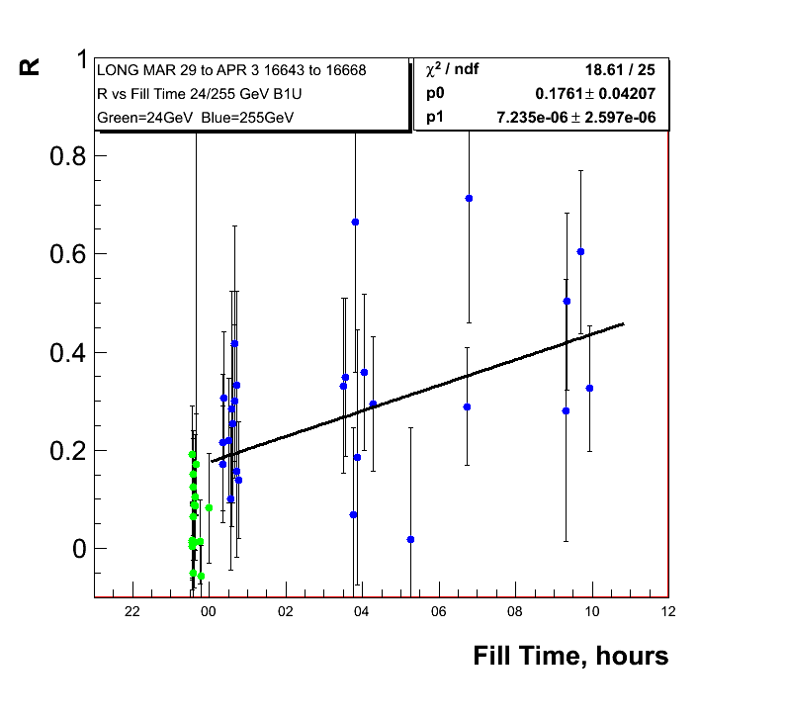
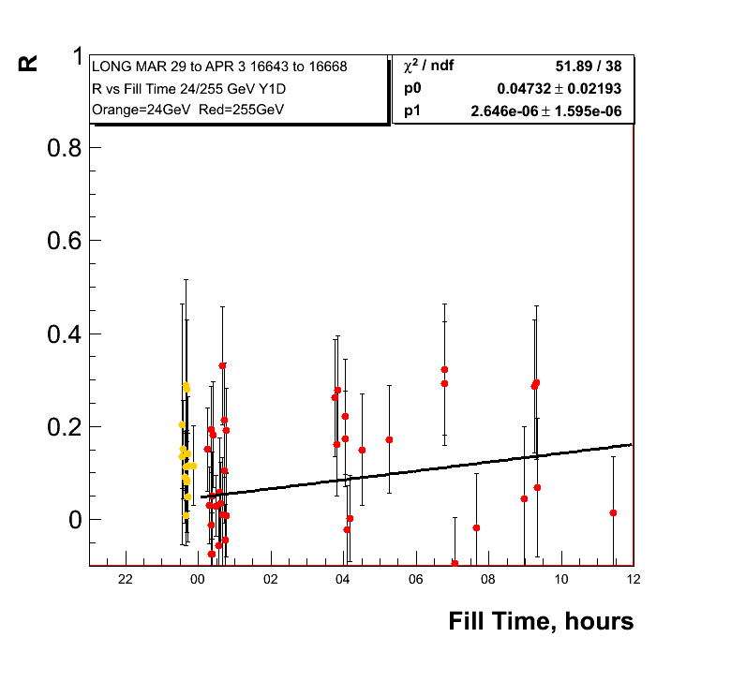
255 GeV Results
0.75%±0.13/hour
0.39%±0.10/hour
Jet same fill range

Slide 9
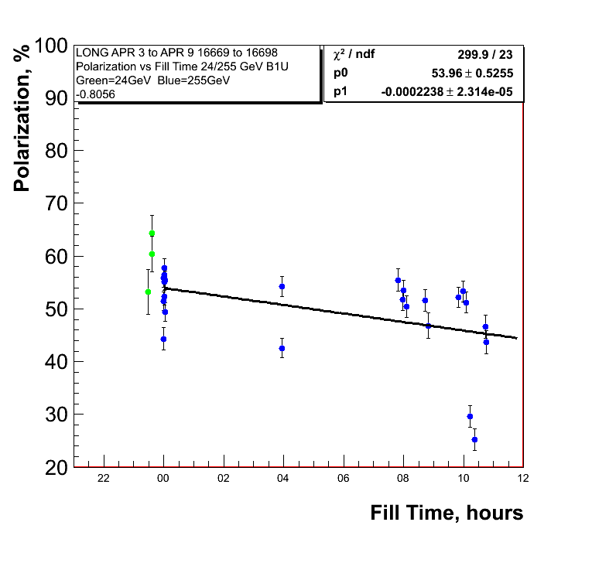
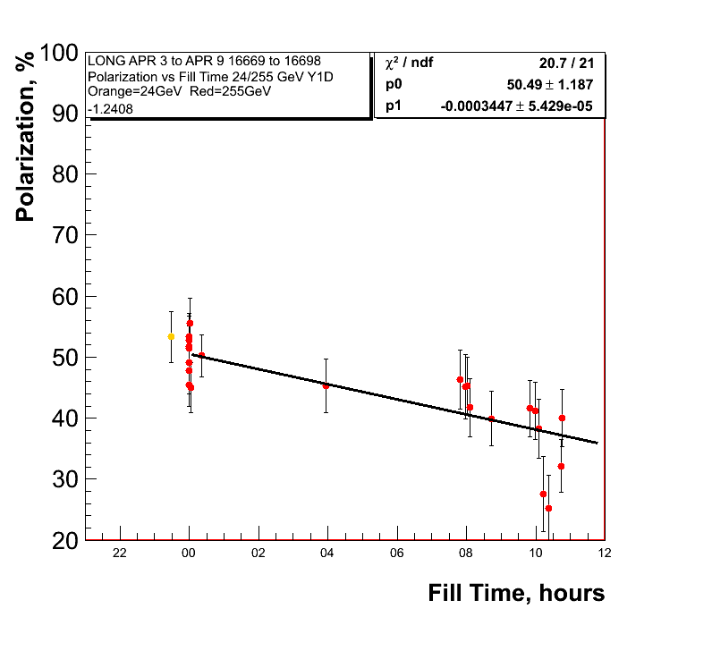
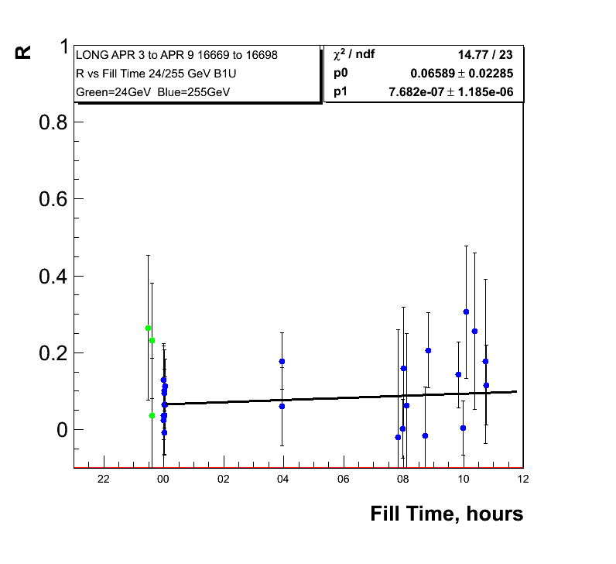
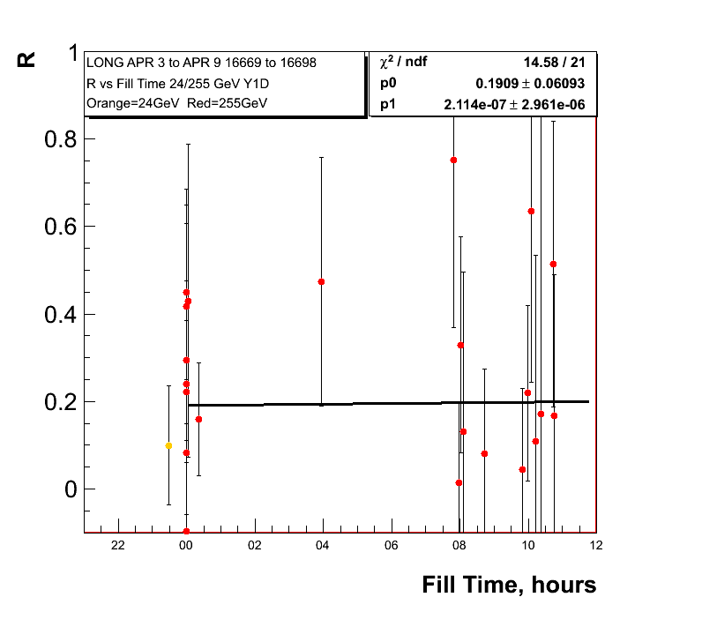
255 GeV Results
0.8%±0.08/hour
1.24%±0.19/hour

Slide 10
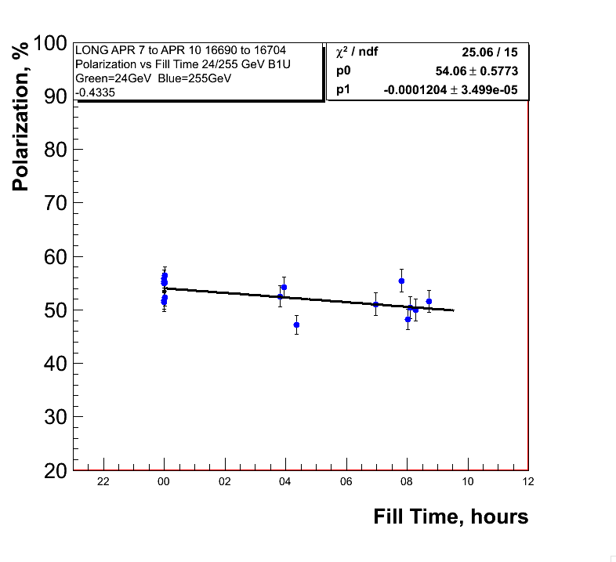
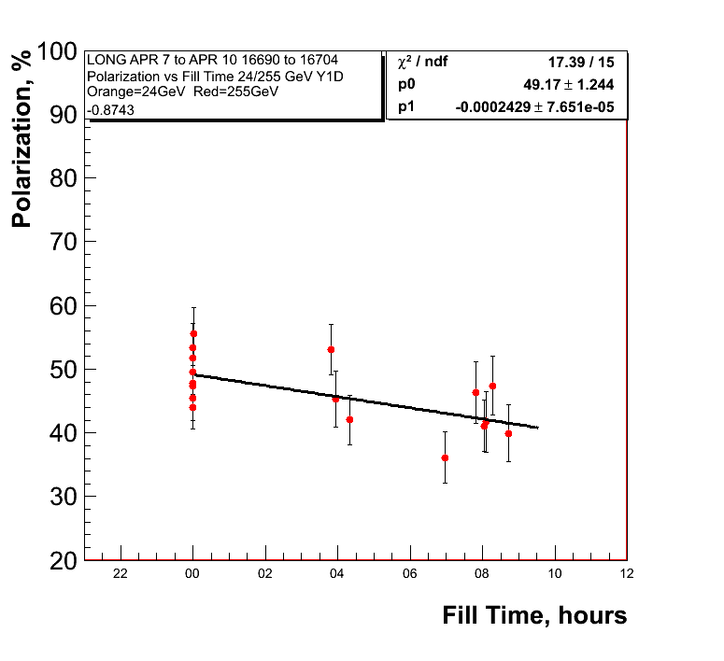
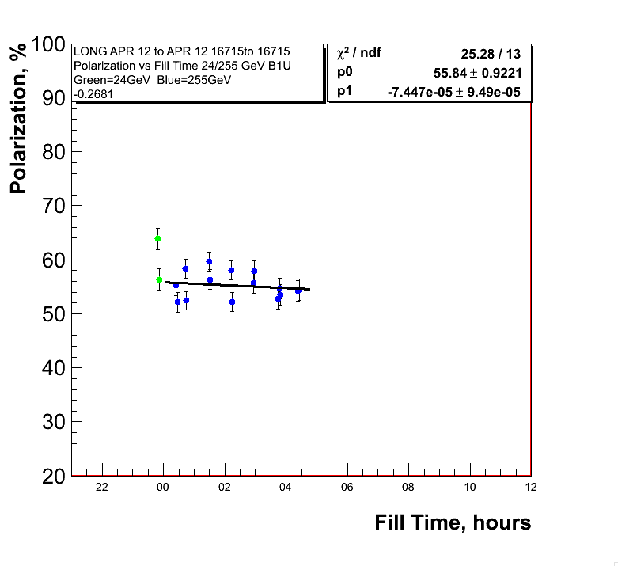
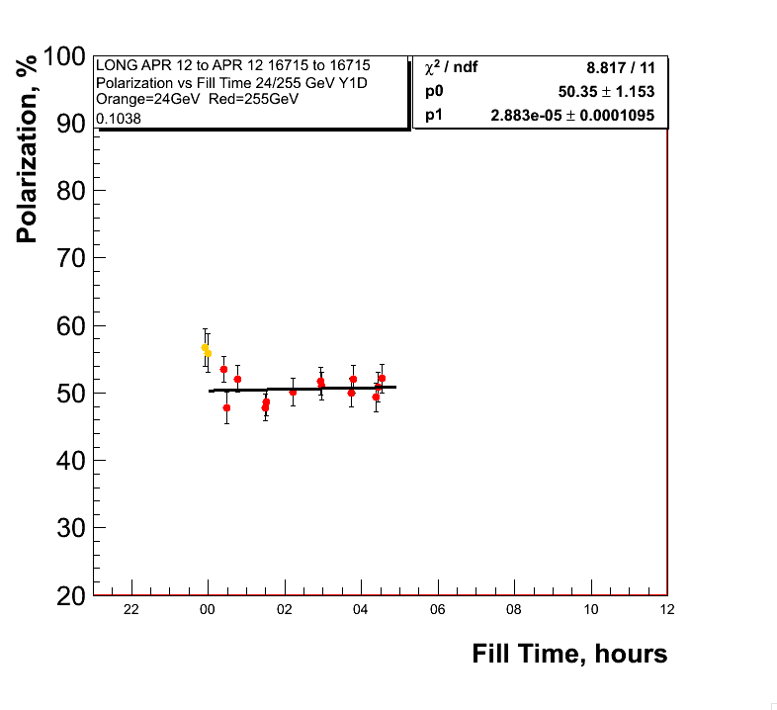
APEX STUDY flat top not colliding
fills before apex
APEX
Mei:2nd order snake
resonance
not responsible
for polarisation lifetime
Blue was sitting at resonance

Slide 11
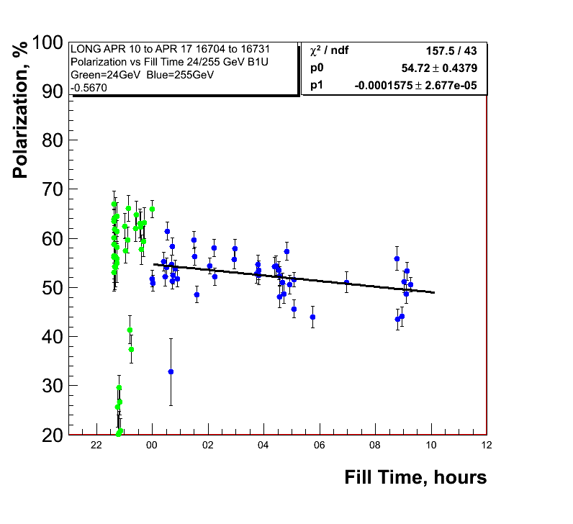
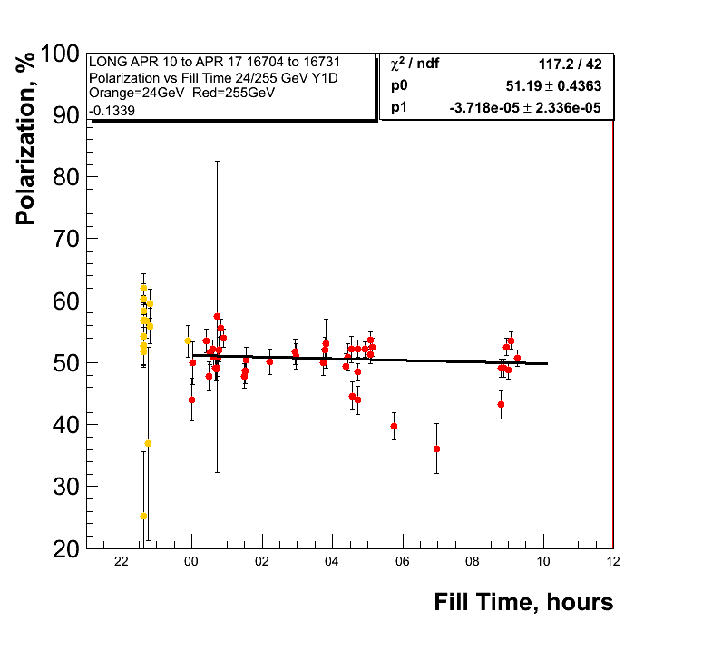
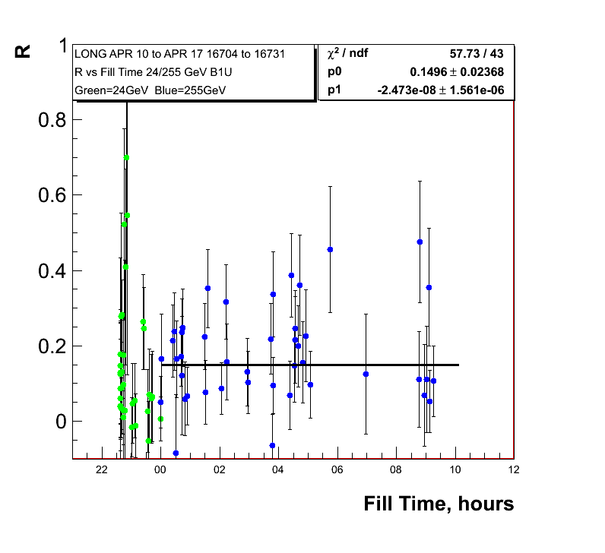
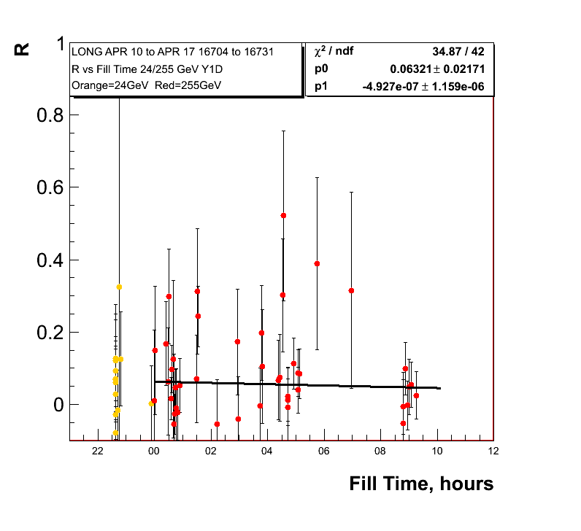
255 GeV Results
0.56%±0.096/hour
0.13%±0.08/hour
Polarisation
Lifetime since
last week

Slide 12
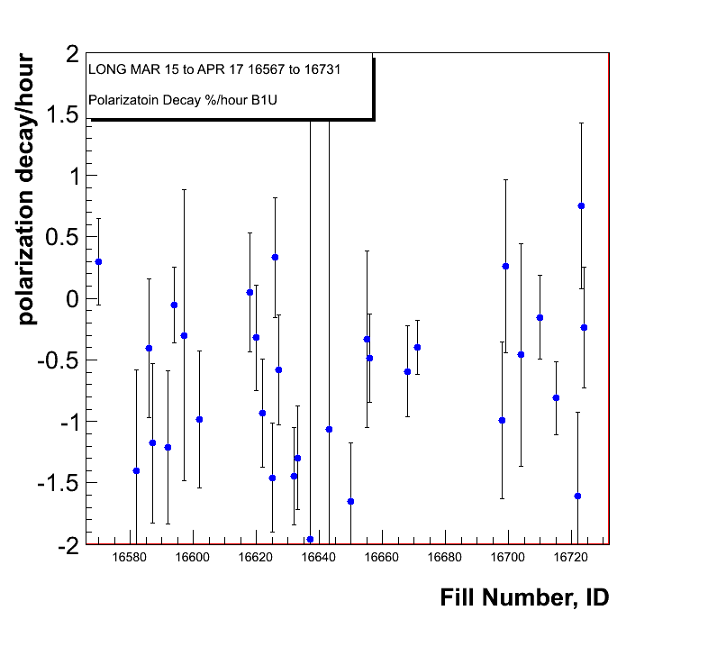
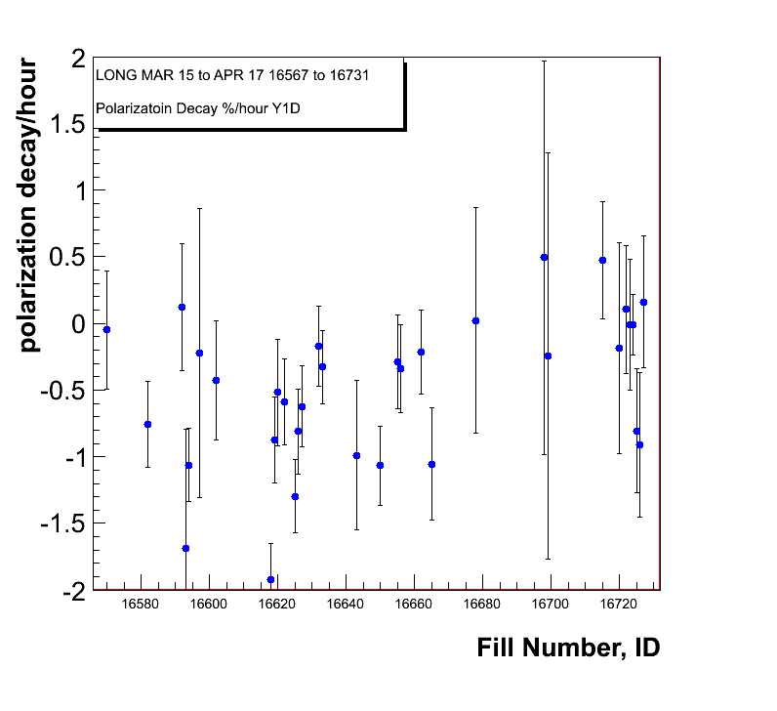
Polarisation Decay Per Fill
Shown is the
polarisation decay per fill
taking the measurements
after the rotator ramp
at 255 GeV
Blue Beam
Yellow Beam

Slide 13
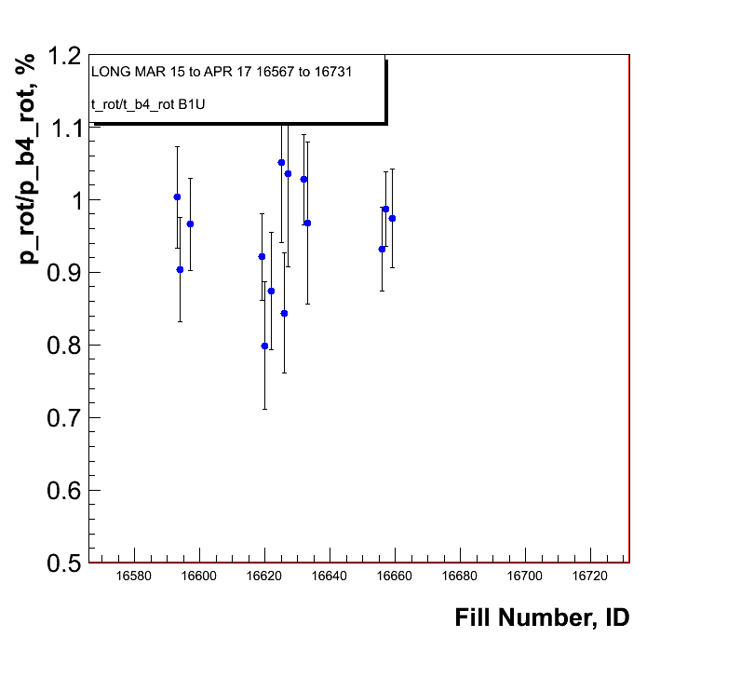
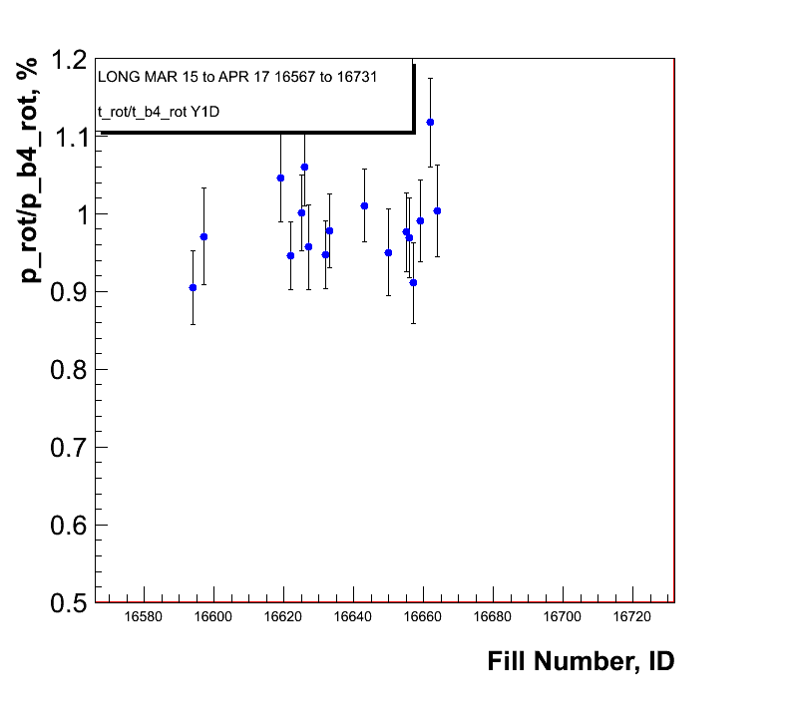
Polarisation loss through rotator ramp
Shown is the ratio of the
polarisation measurements
before and
after the rotator ramp
at 255 GeV
Blue Beam
Yellow Beam

