Slide 1
AGS PP Progress
Haixin Huang
January, 3, 2012

Slide 2
Daily Activities of Last Week
12/19 Difficulty to bring beam into Booster. Source only pulses on u5, not u4.
Even after resolved latching RLM problem.
AGS check-off list not ready due to U-line recertification.
12/20 1. linac energy is too low (-10%) for Booster injection.
2. LtB quad5 was off.
3. Only seven RF cavities available in the AGS (need 8 for proton).
12/21 Ring access to fix LtB q5, AGS RF station E.
Lab power feed line problem, no Booster.
Tuning linac energy to 200MeV. Semi-successful, up from 180 to 190MeV.
Accelerated beam with snake off then on. Tunemeter, IPM and CNI all worked.
12/22 Further raise linac energy to 200MeV but with all last three tanks.
Working on Booster A3 cavity.
Beam polarization close to 60% at flattop.
Booster harmonic scan done.
12/23 Test the beta function measurement at IPM.
Turn on jump quads. Seen benefit on polarization.
Reached 60% polarization with 1.5*10^11 at AGS extraction.

Slide 3
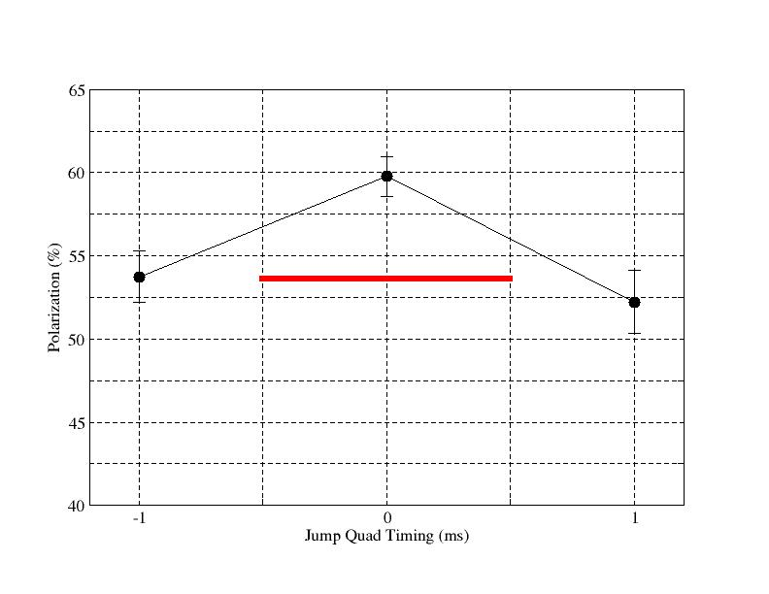
Polarization Shown Gain with JQ on
JQ on
JQ off
JQ on showed polarization gain.
Moving jump time by +-1ms showed lower polarization

Slide 4
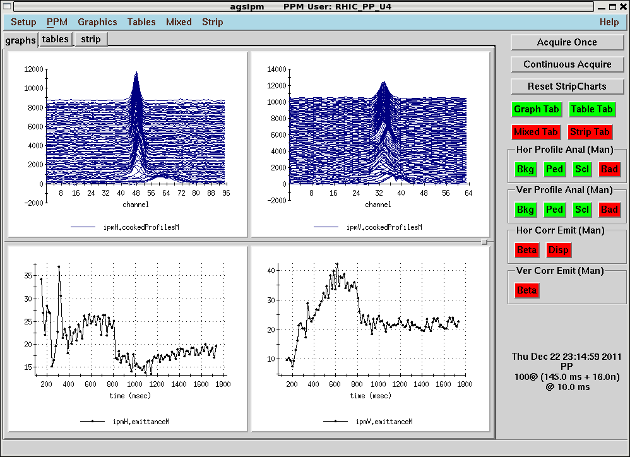
Emittance by IPM (JQ off)
17pi horizontal, 22 pi vertical for 2*10^11. Not too bad.

Slide 5
Progress and Plan
The archives of last April before the end of run were loaded in AGS and Booster.
Polarization reached 60% with 1.6-1.7*10^11. Source polarization was 78%.
Emittance is large, but we only had beam for less than 48 hours.
Jump quads were turned on and showed gain of polarization.
Booster harmonic scan is done. Little difference from the past.
Vertical damper was tested.
The next two weeks will be spent on emittance reduction (Booster and BtA tuning, injection damper, AGS optics setup) and polarization increase (parameter scan, fine tuning of jump timing, extraction field scan).

