Slide 1
PHENIX Status

Slide 2
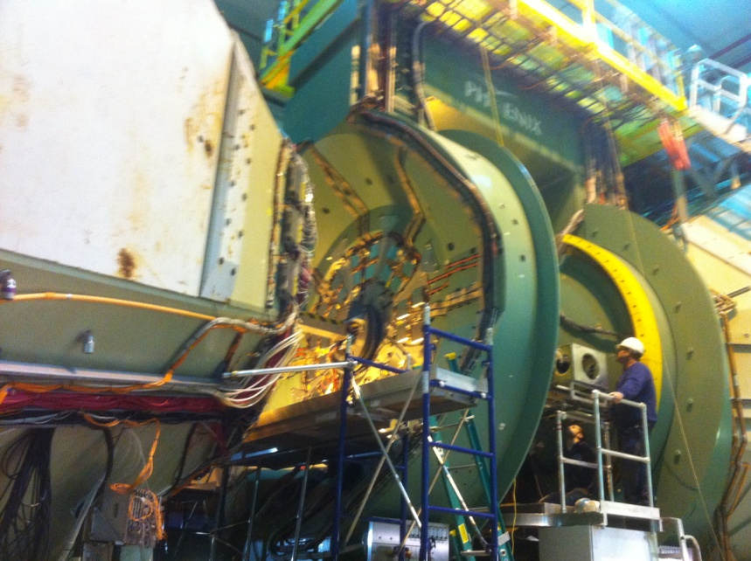
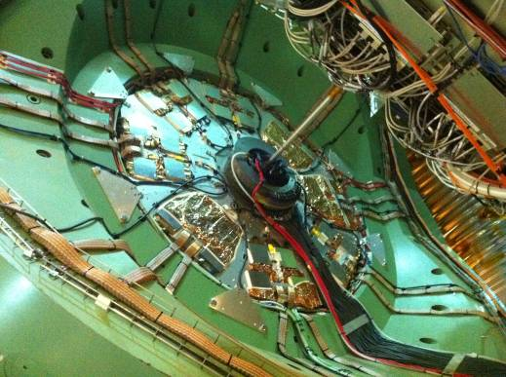
RPC installation
RPC1 N and S installed

Slide 3
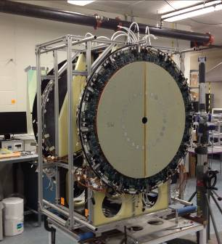
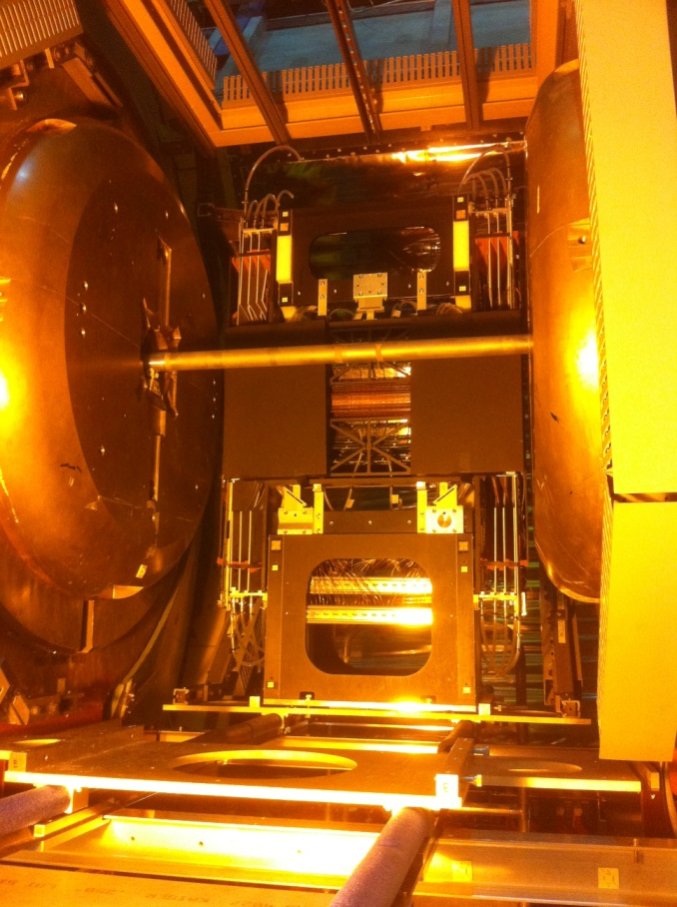
VTX/FVTX
Both halves in 1008
W installed

Slide 4
Remaining work
These tasks need to be mostly serial:
VTX/FVTX cabling
Decision to install upgraded MPC electronics
East Carriage roll-in
Safety system checkout (present target: week of January 3)

Slide 5
Commissioning
FVTX obviously requires a full court press; the entire detector has not yet been read out; first possible attempt will be end of December after cabling, cooling, LV, bias, protection systems become operational
VTX needs a second commissioning period
RPC’s need time to stabilize and testing integration into the trigger, then we would like as long a period of running with cosmic rays as possible

Slide 6
Reaction to the new reality
The shortened run places a huge premium on the very limited time for collisions. We can accomplish a lot of the commissioning with cosmics
This will let us make the best use of the limited beam time in Run 12.
VTX/FVTX and RPC can both make good progress with cosmic rays
Although we are still working towards and on track for a Jan 17 cooldown, with a shorter Run 12, we would prefer to start ~1 month later and do as much commissioning as possible with cosmics
We would maintain basically the present schedule for safety system checkout so we could begin operation

Slide 7
Running priorities for PHENIX
The PHENIX Executive Council meets this Thursday to discuss the priorities for a shortened run, starting from from the PAC priorities (see next slide for reminder) and ALD guidance
We will be able to disclose our priorities by Monday (Dec 12)

Slide 8
PAC Priorities
For Run 12 the PAC recommends the following (in order of priority):
1. 5 weeks of running with polarized proton collisions at 200 GeV.
2. 7 weeks of running with polarized proton collisions at 500 GeV.
3. 5 weeks of running with Cu+Au collisions at 200 GeV.
3. 3 weeks of running with U+U collisions at 193 GeV.

Slide 9
Summary
We’re on track and working toward a Jan 17 cooldown
We can accomplish a lot of the commissioning with cosmics which will let us make the best use of the limited beam time in Run 12
Suggest 4K cooldown start Feb 14 or 21

