Slide 1
PHENIX Preparations for Run 12
John Haggerty
Brookhaven National Laboratory

Slide 2
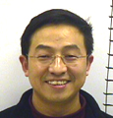
Run Coordinator
The Run 12 PHENIX Run Coordinator is Xiaochun He, from Georgia State University

Slide 3
PAC recommendations June 8, 2011*
For Run 12 the PAC recommends the following (in order of priority):
1. 5 weeks of running with polarized proton collisions at 200 GeV.
2. 7 weeks of running with polarized proton collisions at 500 GeV.
3. 5 weeks of running with Cu+Au collisions at 200 GeV.
4. 3 weeks of running with U+U collisions at 193 GeV.
*Assumes 26 cryo weeks; present guidance is 22 cryo weeks

Slide 4
PHENIX physics goals
500 GeV longitudinally polarized pp to advance the W program (requires high polarization, high luminosity, low background)
200 GeV transverse polarized pp for Au+Au comparison with vertex detector and a look at transverse single spin asymmetries
Cu+Au and U+U for studying effects of collision geometry

Slide 5
Run 12 schedule
Run schedule is not finalized, run expected to start in “early January” (January 1 is what our schedule is driving towards) and go for 22 weeks (nominal end June 3)
East Carriage roll-in sets time frame for operation; scheduled for December 5
Several weeks of reconnection, pink/blue/white sheets, should be ready for operation with flammable gas ~Christmas
Shield wall late December/early January
After gas starts, we would start cosmic ray shifts

Slide 6
Completely new for run 12
Forward Vertex Detector (FVTX)
Large effort under way to complete the detector
Substantial installation effort in the IR is under way
FVTX and VTX are to be mated into a single unit
RPC1
RPC1.N installed and tested with portable electronics
Cabling to racks on bridge followed by system testing
Completion will allow full operation of upgraded muon trigger

Slide 7
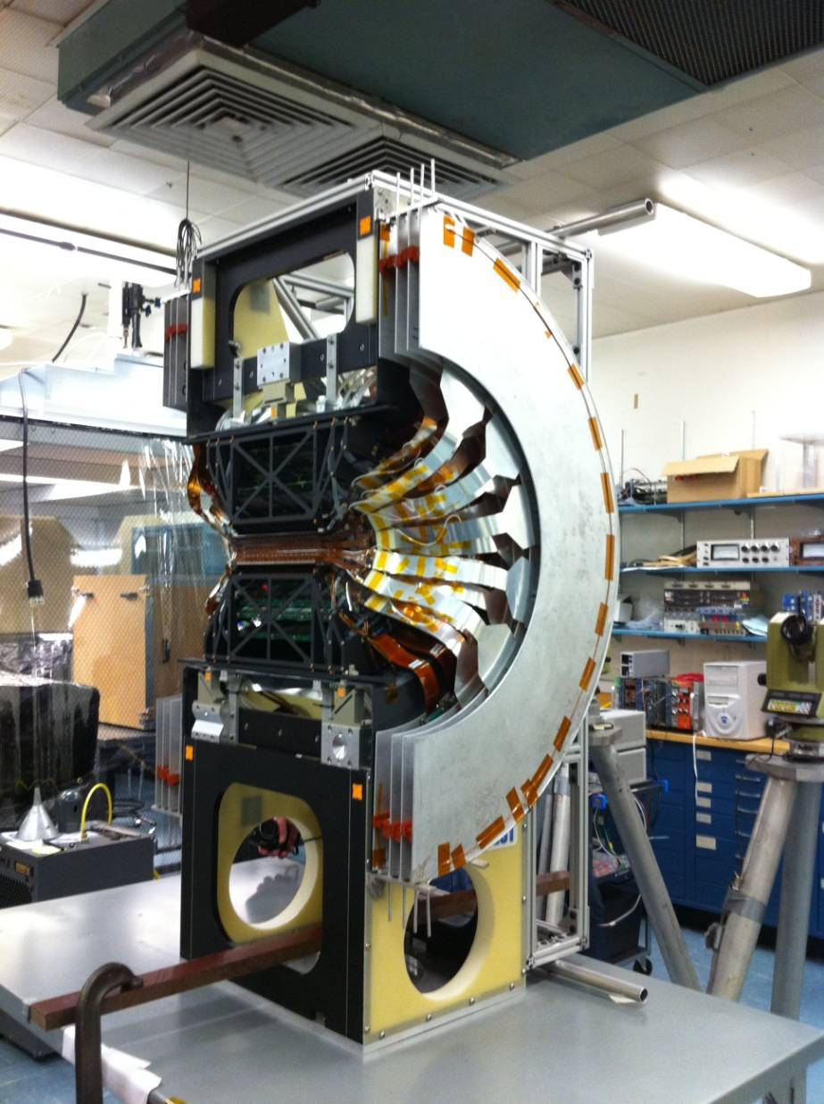
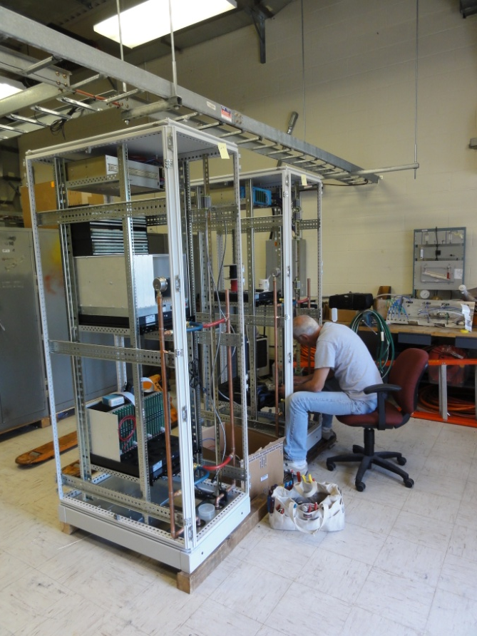
FVTX
Racks under construction
Lots of new wiring (fiber, LV, bias) starting soon
Mated with VTX and moved to 1008 November 7

Slide 8
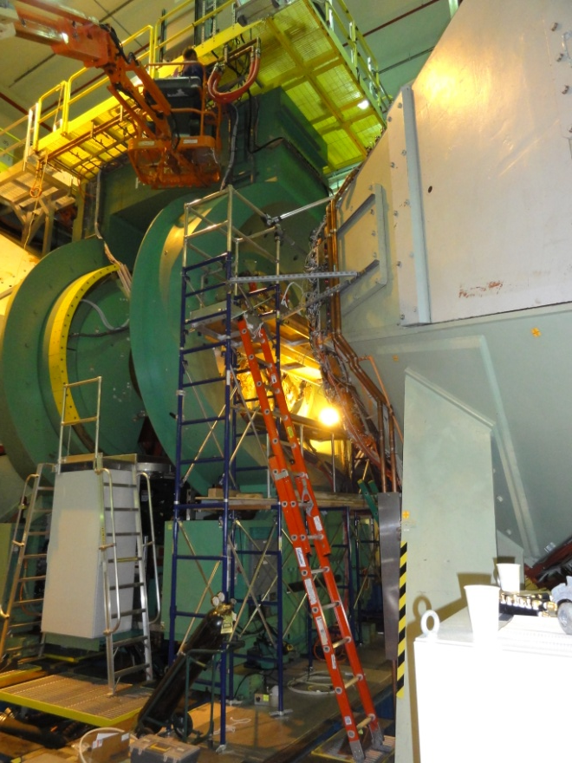
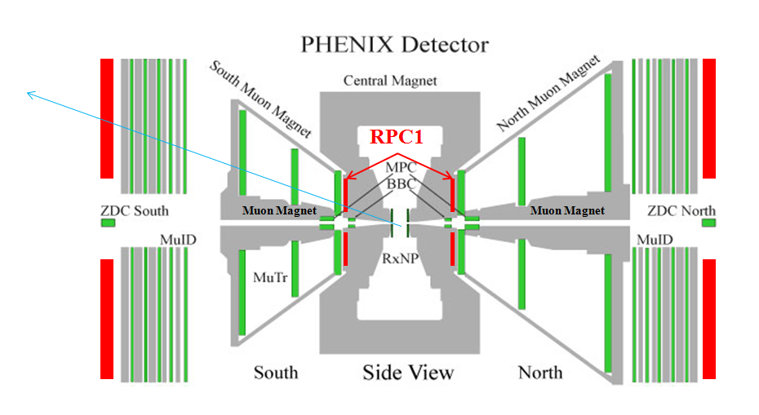
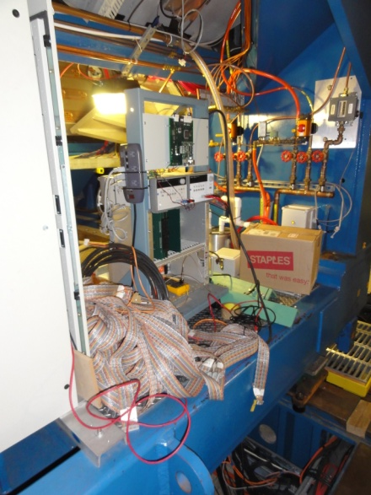
RPC1
RPC1.N installed
Testing with temporary electronics looks good
Begin RPC1S installation October 28

Slide 9
Major changes for run 12
Muon Tracker North station 1
The chambers and electronics were completely removed and serviced; they are back now and being checked
Barrel Silicon detectors (VTXP+VTXS)
Removed and disassembled for service
Opening up the pixel layers has uncovered some problems whose resolution is being studied; we don’t plan to allow it to affect the installation schedule
Muon Piston Calorimeter (MPC)
New electronics being installed

Slide 10
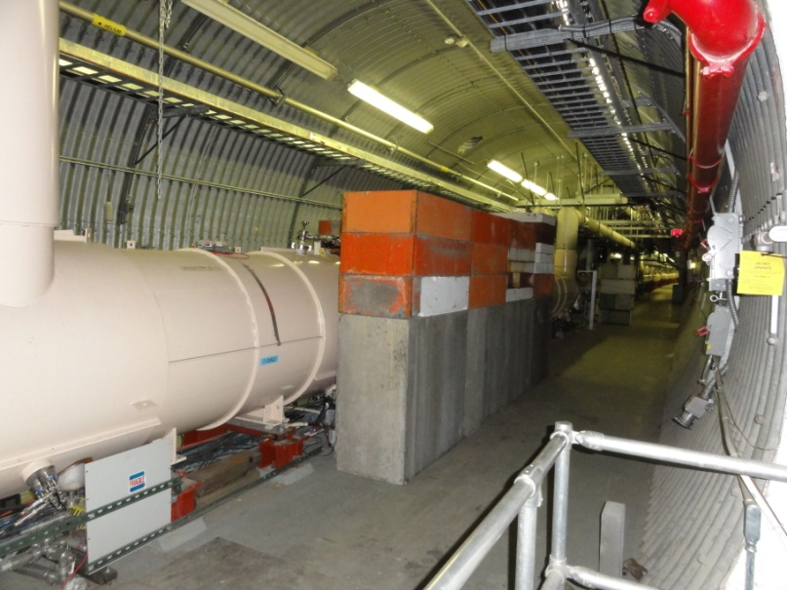
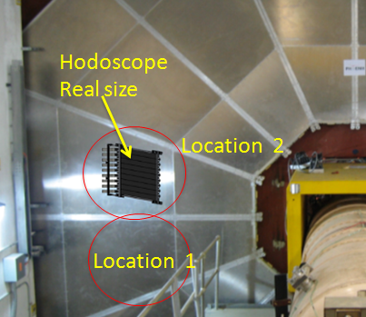
In the tunnel
Plan and procurement for modified shielding in the tunnel under way
Dave Phillips is planning for December installation
Small scintillator hodoscope to be installed behind RPC3 for absolute efficiency measurement (may be used for background as well)

Slide 11
Summary
A lot of critical systems have been/will be worked on:
BB
DC/PC
MUTR and RPC
VTX/FVTX
DAQ/Trigger
Shielding
Run 12 shifts to begin ~January 1, 2012

