Slide 1
A summary on Polarisation in Run-12 100GeV and first results for 250 geV
E.C. Aschenauer
presenting the work done by Alan, anders, Bill and Dima

Slide 2
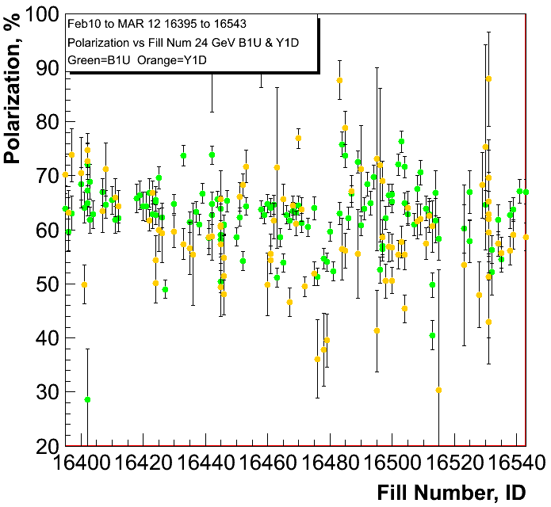
100 geV Results
polarisation at injection
Blue and Yellow
Caveat:
only first round of cleaning
up noise in polarimeters
was done
pC numbers not normalized
to jet

Slide 3
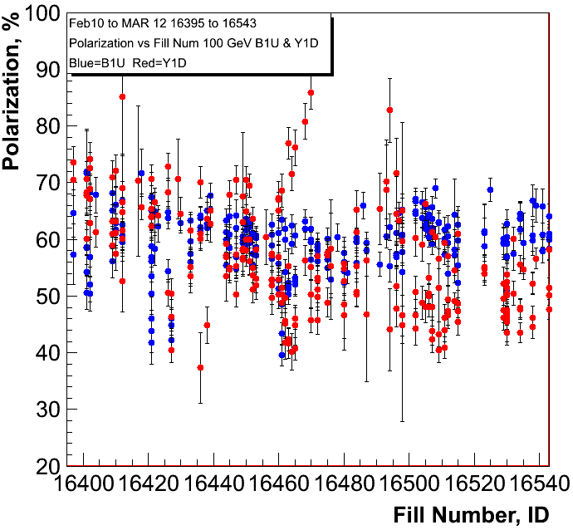
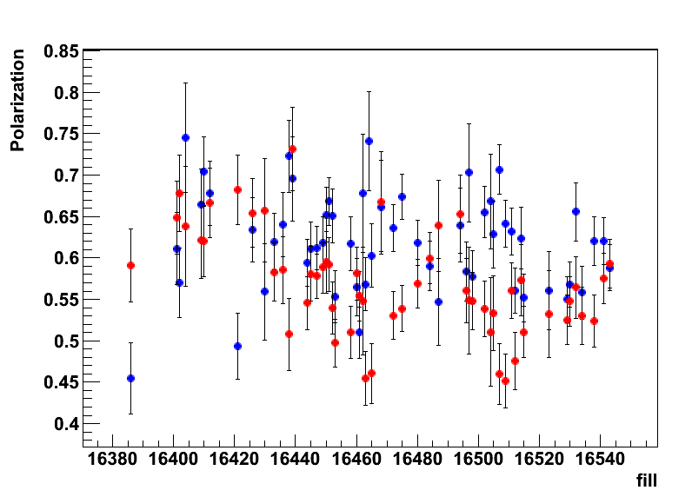
100 geV Results
polarisation at flat top
Blue and Yellow
H-JET

Slide 4
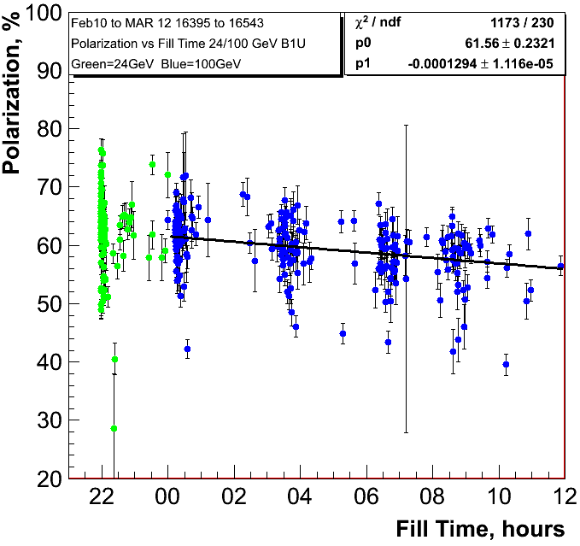
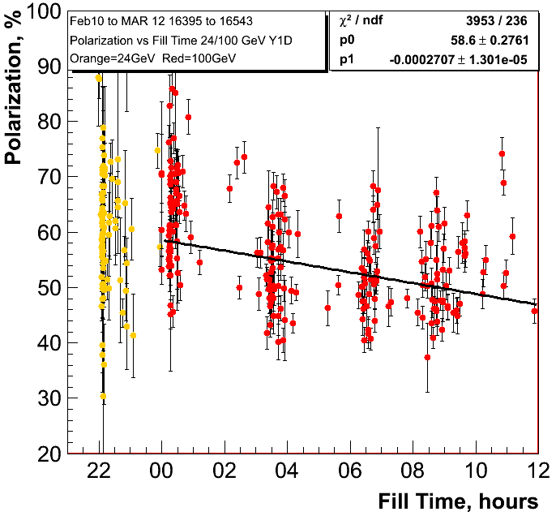
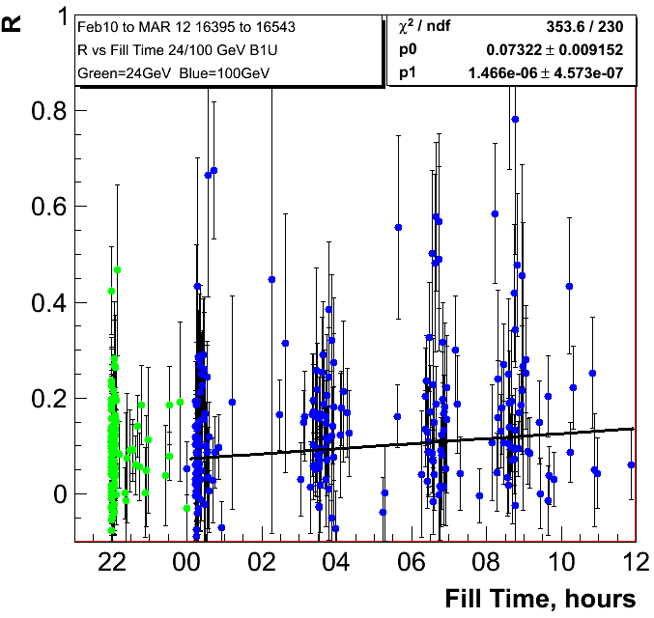
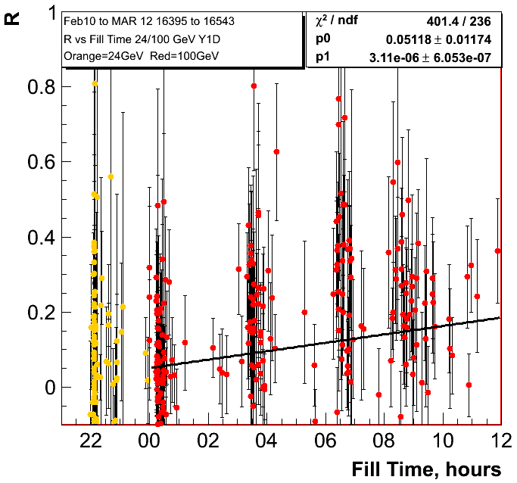
0.47%±0.040/hour
0.97%±0.047/hour

Slide 5
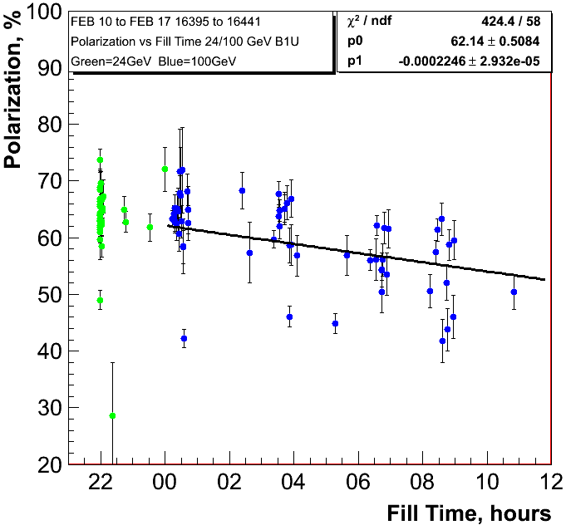
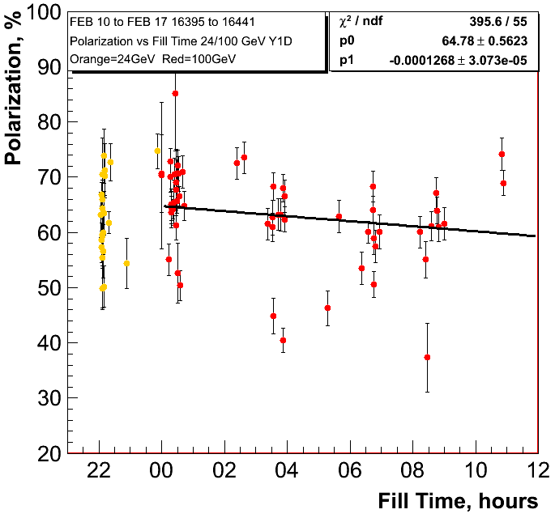
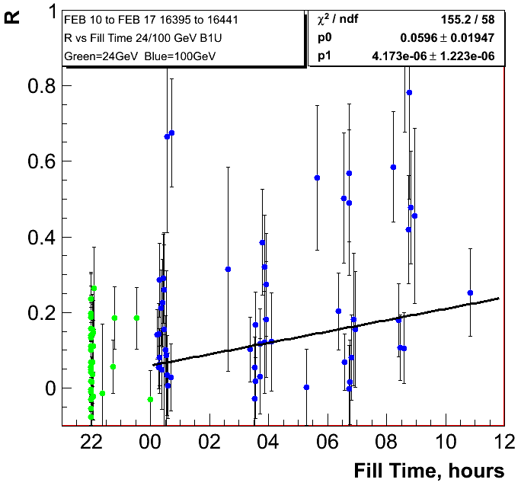
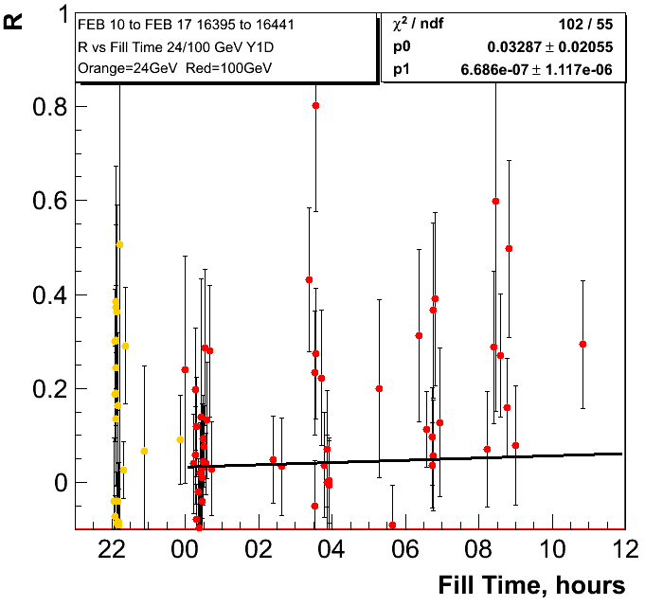
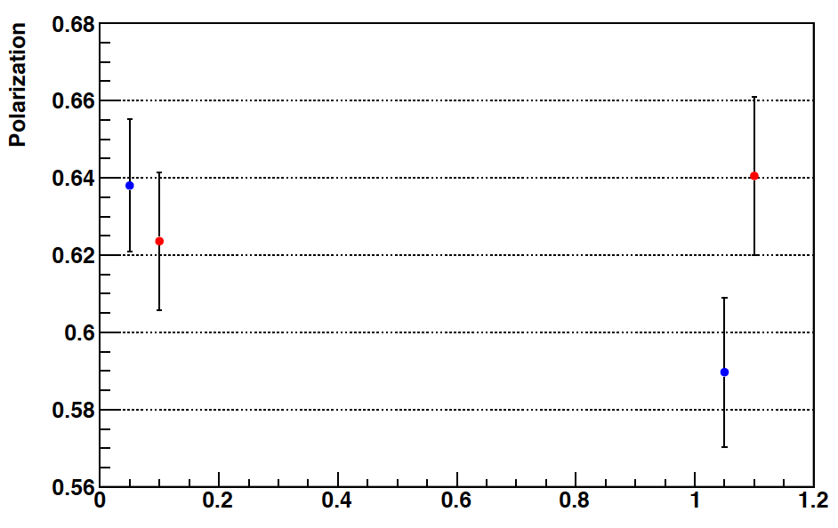
0.80%±0.11/hour
0.46%±0.11/hour
H-Jet
Fills: 16386-16439

Slide 6
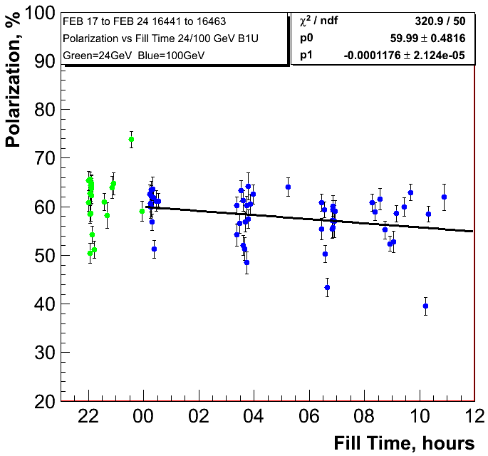
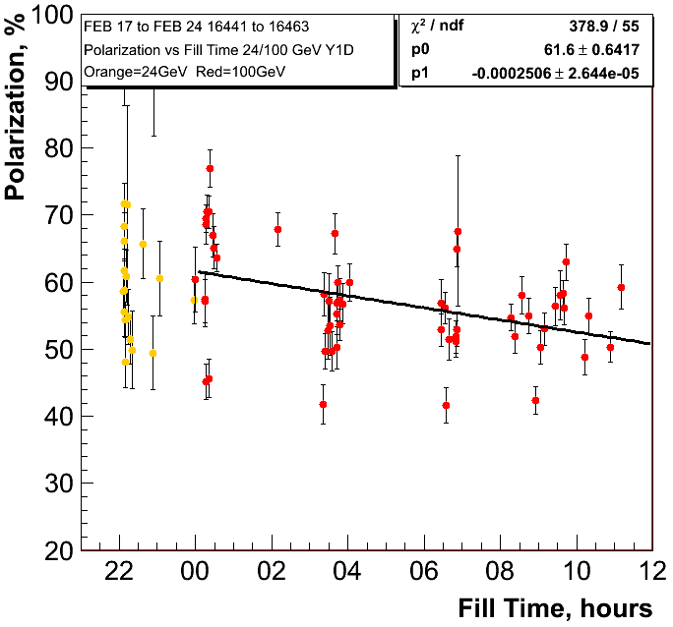
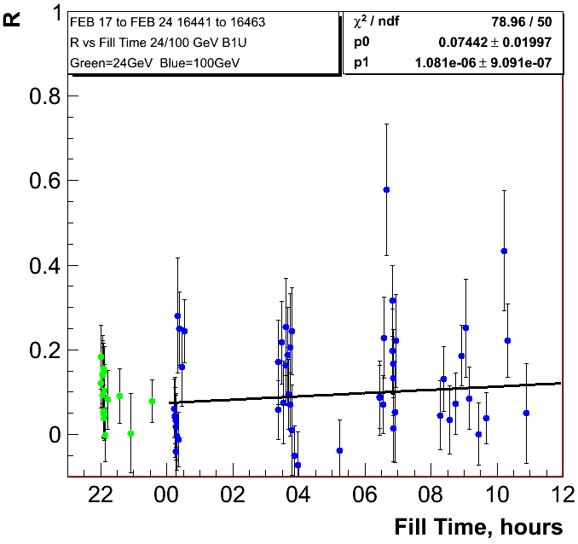
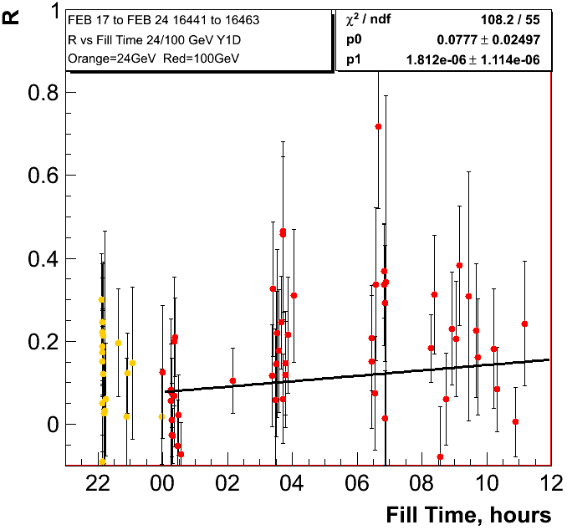
0.42%±0.08/hour
0.90%±0.095/hour

Slide 7
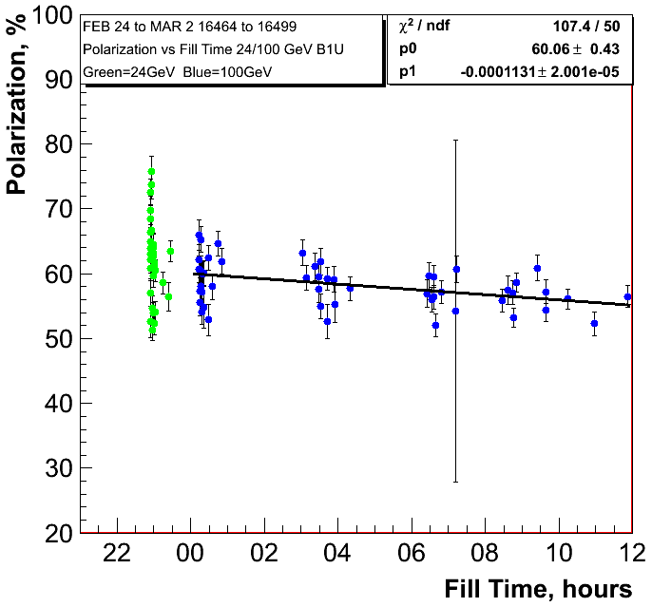
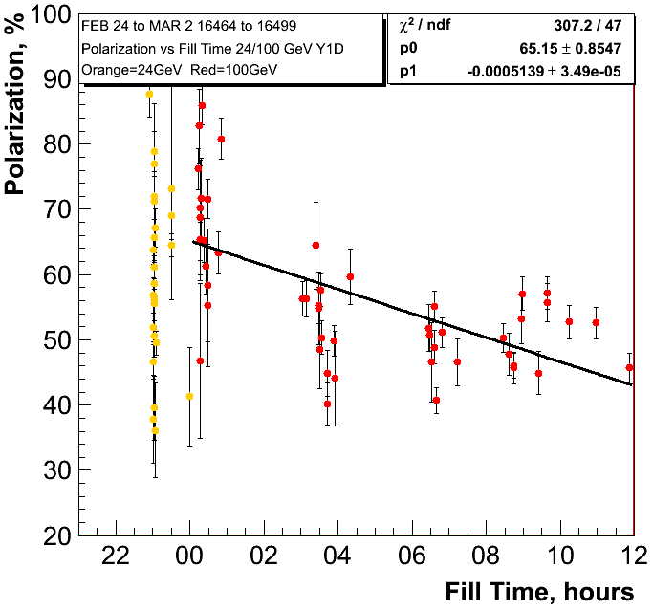
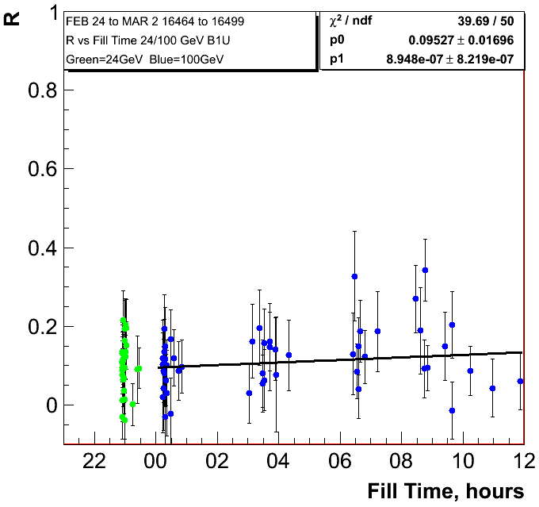
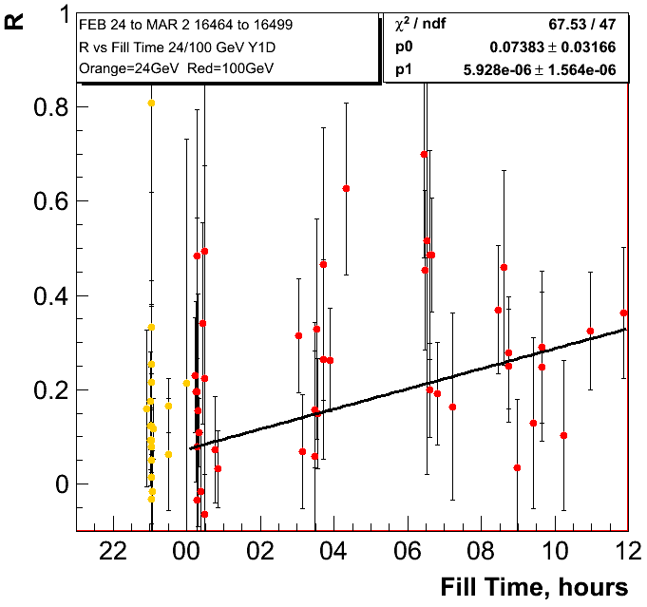
0.41%±0.07/hour
1.85%±0.13/hour

Slide 8
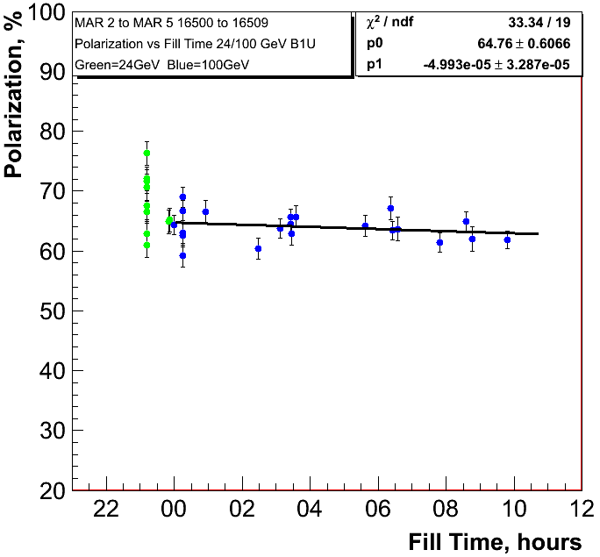
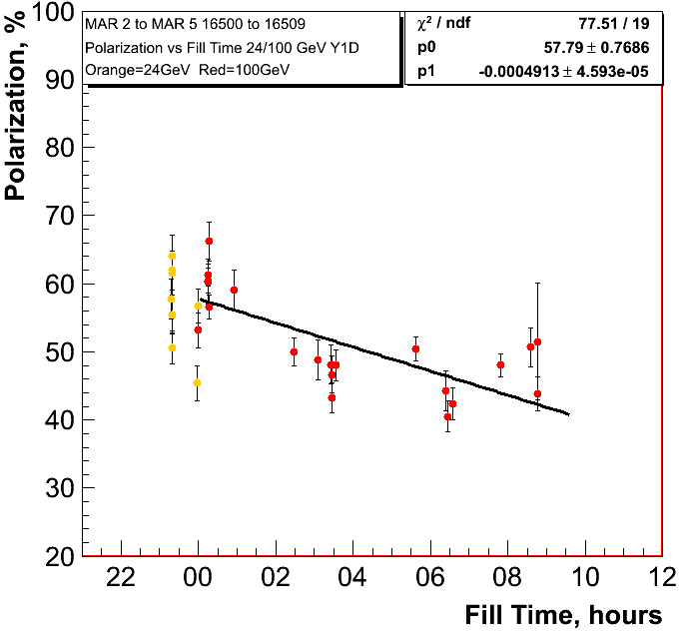
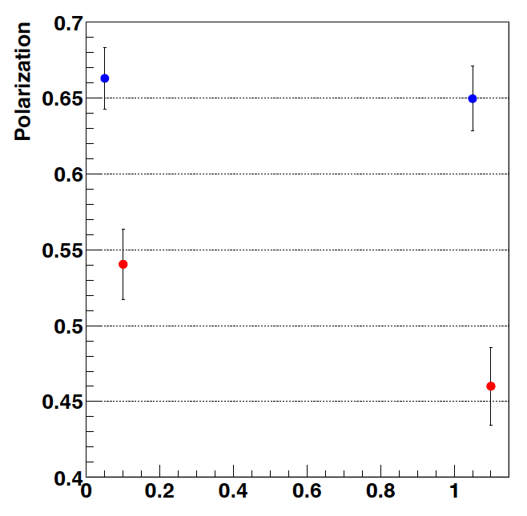
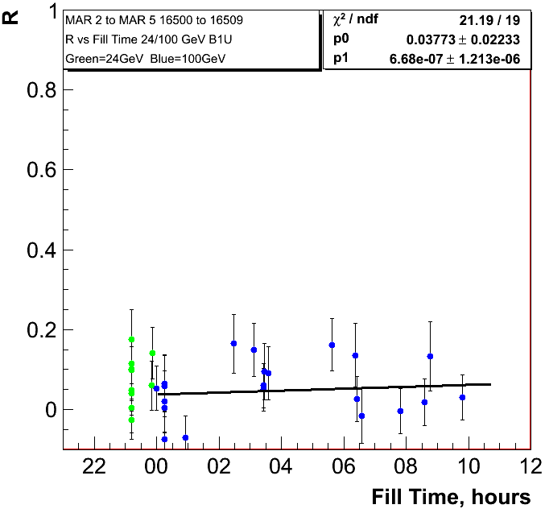
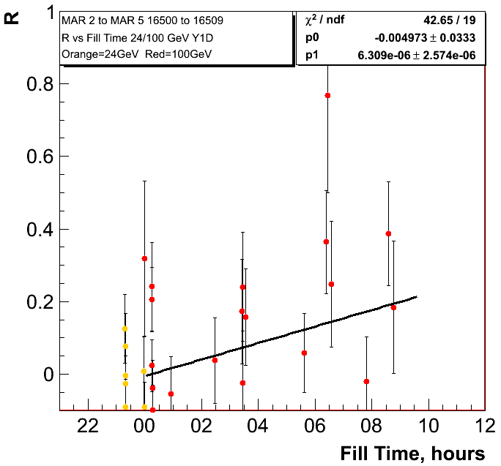
0.18%±0.118/hour
1.77%±0.17/hour
H-Jet
Fills: 16502-16511

Slide 9
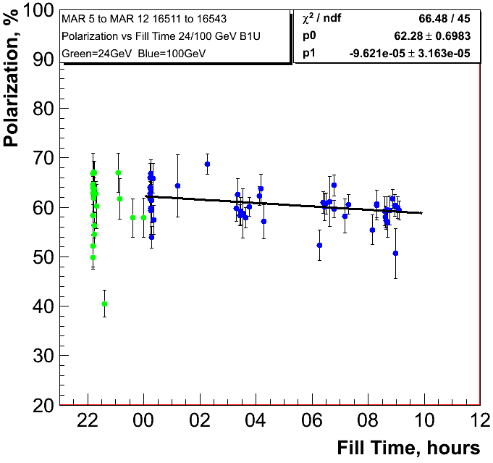
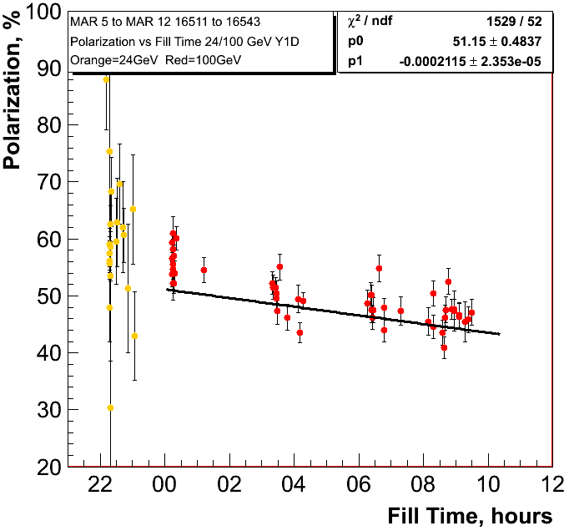
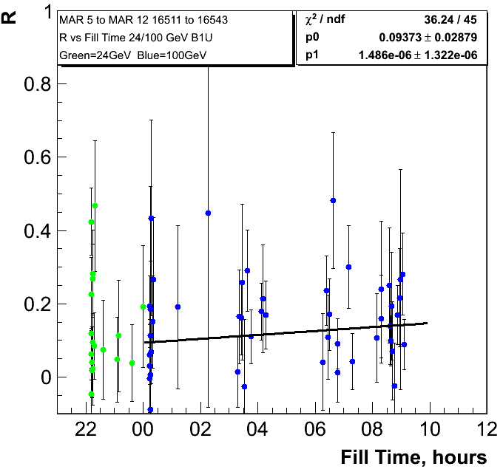
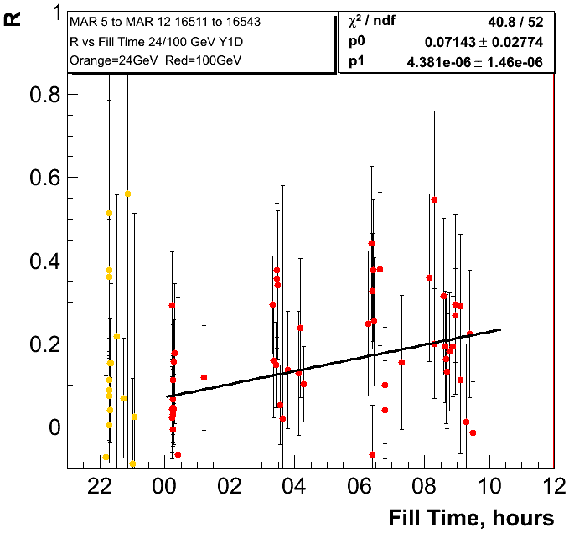
0.35%±0.11/hour
0.76%±0.08/hour

Slide 10
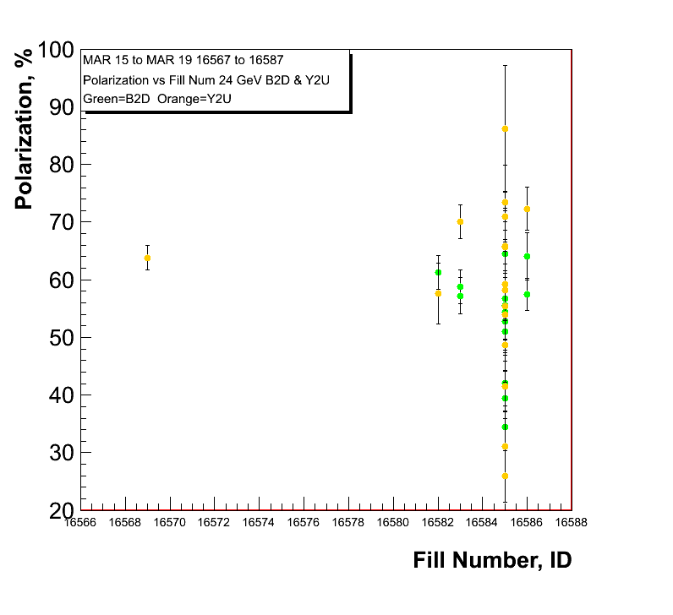
255 GeV Results
polarisation at injection
Blue and Yellow
Caveat:
pC numbers not normalized
to jet

Slide 11
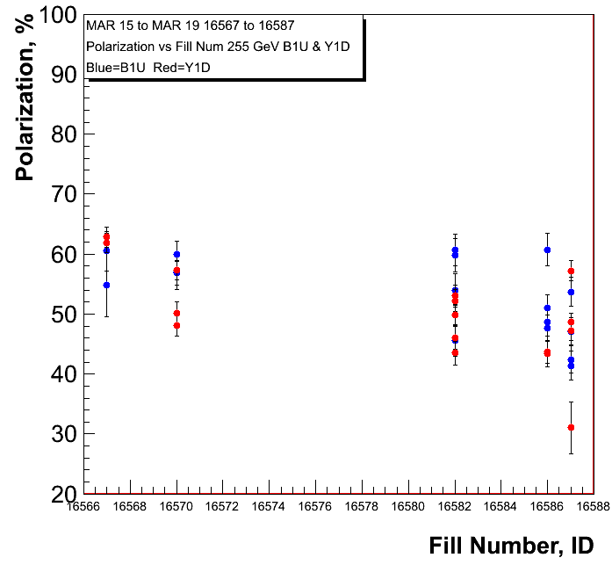
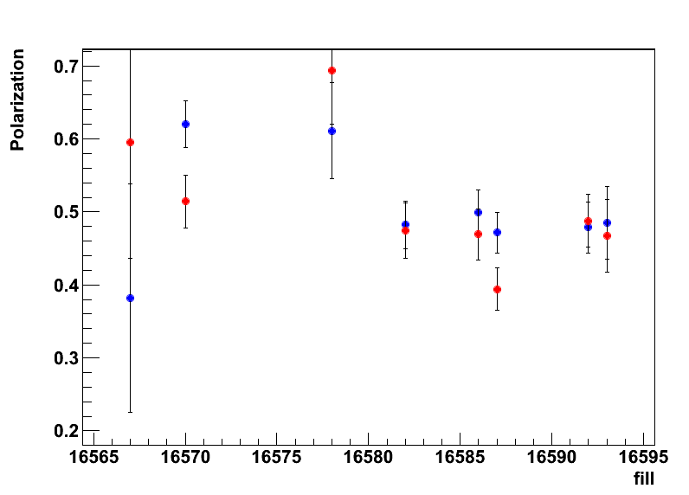
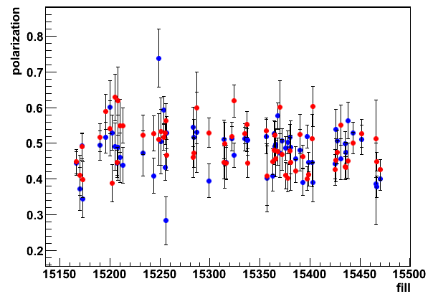
255 GeV Results
polarisation at flat top
Blue and Yellow
H-Jet
H-Jet Run-11
→ longitudinal

Slide 12
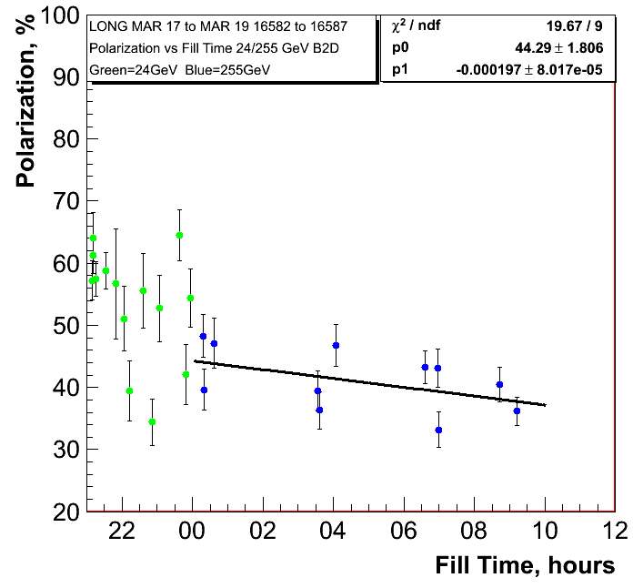
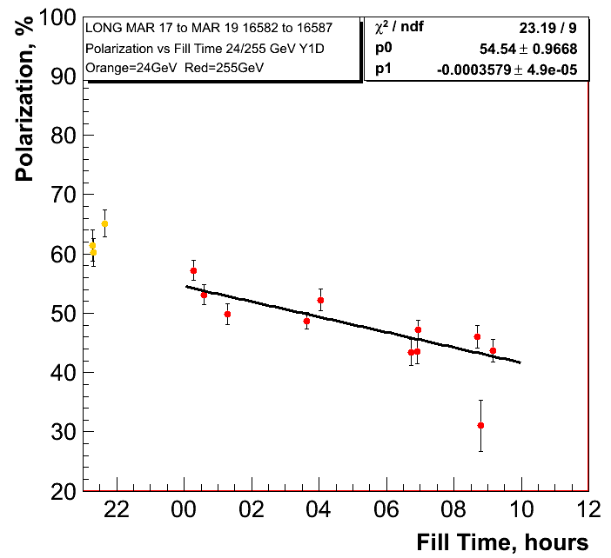
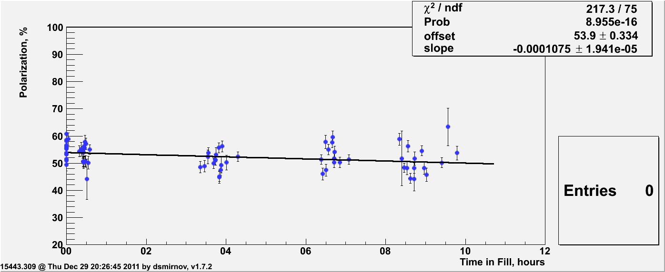
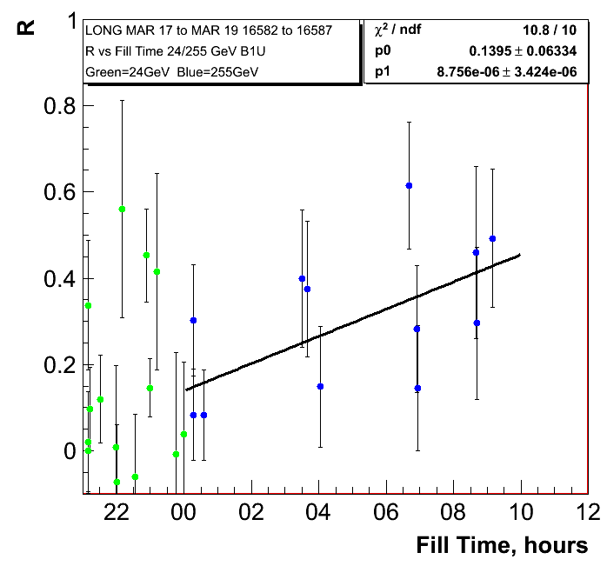
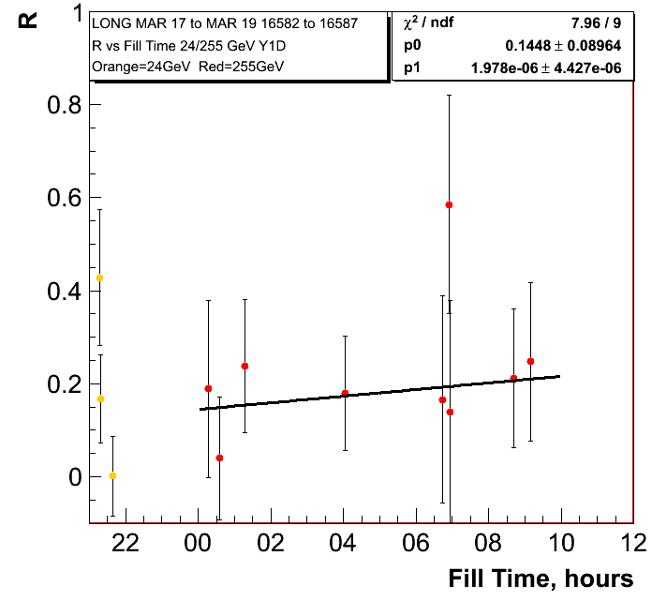
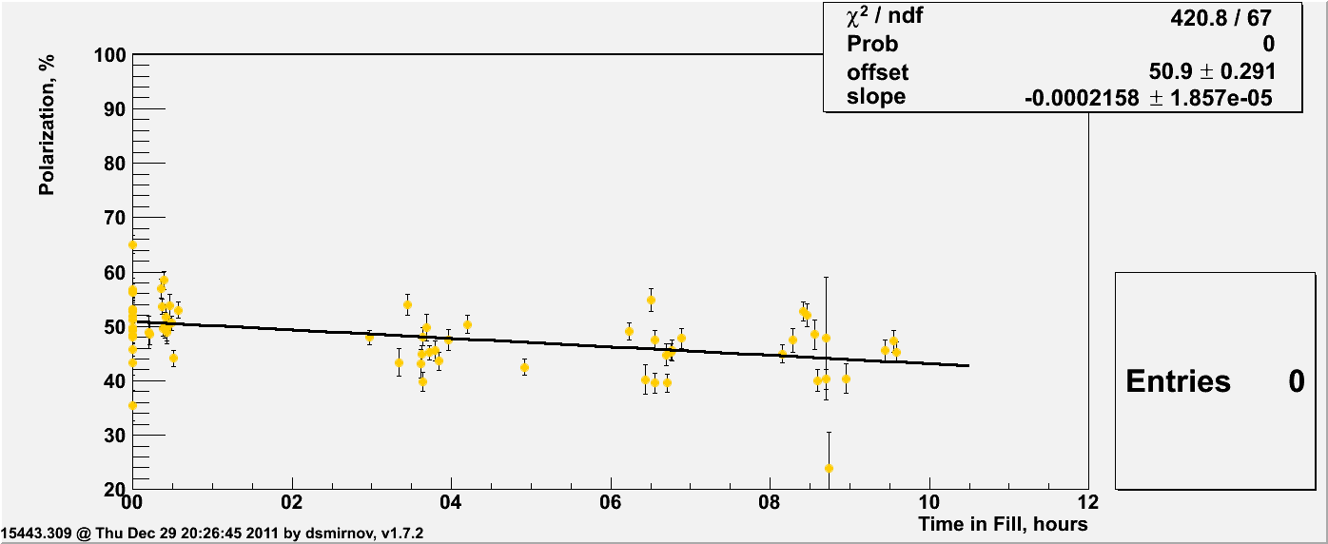
255 GeV Results
0.71%±0.28/hour
1.288%±0.18/hour
Run-11
0.39%±0.07/hour
Run-11
0.78%±0.07/hour

Slide 13
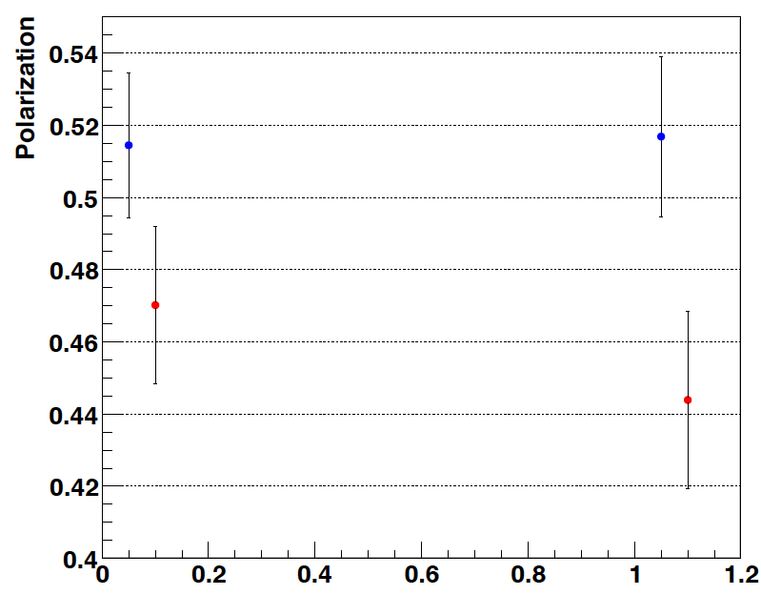
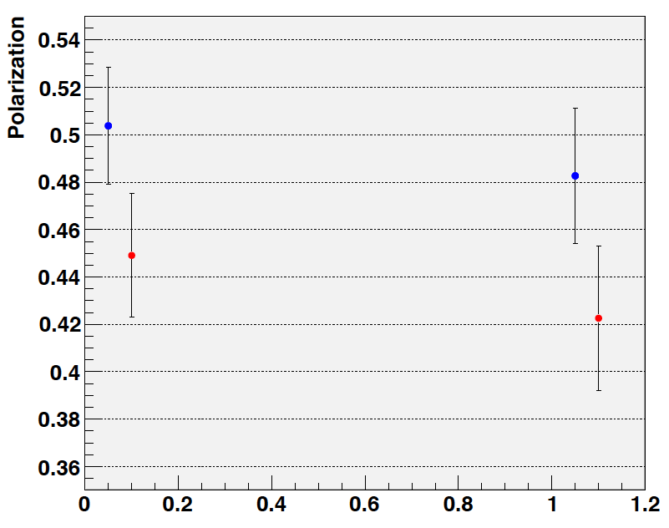
255 GeV Results
0.71%±0.28/hour
1.288%±0.18/hour
H-Jet:
Fills: 16570-16592
trans + longitudinal
H-Jet:
Fills: 16586-16592
longitudinal

Slide 14
Summary
100 GeV:
main loss in polarisation through decay in fill
polarisation decay varies from week to week for the two beams
jet and pC polarimeters consistent observing the same trends
255 GeV:
the polarisation loss through decay in fill and on the ramp
jet and pC polarimeters consistent observing the same trends
observed polarisation consistent with 2011 average
polarisation decay in fill “comparable” to 2011

