Slide 1
Run 11 as run
3 Jan, Begin cool-down to 4.5K
8 Jan, Cool-down to 4.5K complete in both rings, preliminary setup begins
24 Jan, 1 week Ramp-up with 8 hr/night beam to experiments
11 Feb (machine and ~experiments), begin ~10 week physics run (√s = 500 GeV pp)
7 Mar, cryo troubles, extended maintenance, 0900 hrs till 2000 hrs 14 Mar – lost 7.5 days
17 Mar, power distribution problem, extended maintenance, 1930 hrs till 0315 hrs 20 Mar – lost 2.3 days
18 Apr, end 9.4 week physics run at √s = 500 GeV
18 Apr jet target polarization measurement at injection (<5%)
19 Apr, short maintenance followed by setup for √s = 18 GeV AuAu
23 Apr, begin ~1 week physics run (√s = 19.6 AuAu)
2 May 08:00, end 1.3 week physics run at √s = 19.6 GeV
2 May, begin setup for √s = 200 AuAu
5 May, begin 2 day Ramp-up with 8 hr/night beam to experiments
6 May 11:37, begin ~8 week physics run at (√s = 200 GeV/n AuAu)
20 June 08:00, end 6.4 wk AuAu physics run at √s = 200 GeV/n, 8 hr APEX
20 -21 June, setup for √s = 27 GeV/n
22 June, begin 1 week √s = 27 GeV/n physics run
29 June 0600, end 1 week √s = 27 GeV/n physics run, begin warm-up
30 June, cryo warm-up ~ complete, end 25.4 weeks cryo operation

Slide 2
Singles Corrected (draft – another correction likely)
AnDY Revised 6/3/2011

Slide 6
one store
Blue average = 45.3 +/- 0.6%
Yellow Average = 45.8 +/- 0.6%

Slide 8
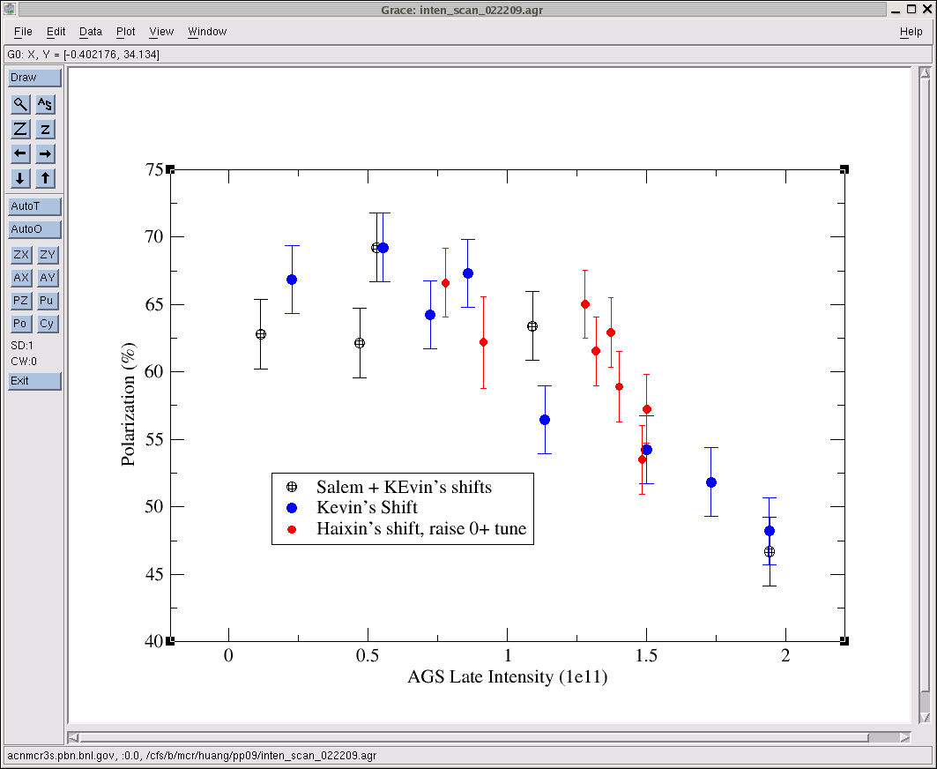
AGS pp log, 23 Feb 09, 00:26

Slide 9
i.e. there’s still an issue with singles corrections.

Slide 10
Final Lumi should change as it appears there’s an issue with the singles correction

Slide 12
7 April Up-Down Ramp measurement
Blue Beam
Current CNI average analyzing powers are:
Energy AN
24 0.0144
100 0.0122
250 0.0147

Slide 13
7 April Up-Down Ramp measurement
Yellow Beam (only Yellow 1 was
used as Yellow 2 was acting up)
Current CNI average analyzing powers are:
Energy AN
24 0.0144
100 0.0122
250 0.0147

Slide 14
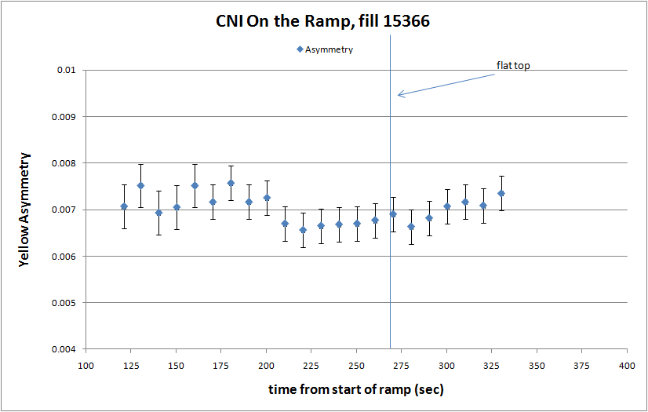

Slide 15
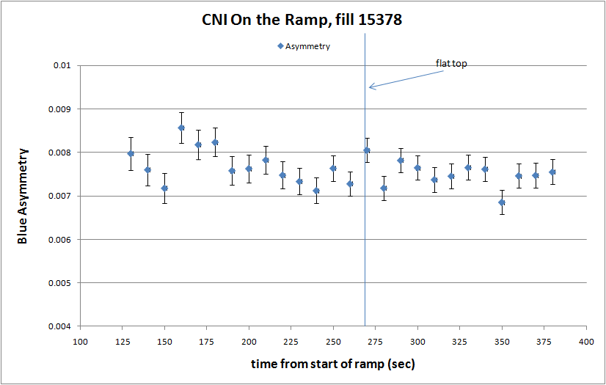

Slide 16
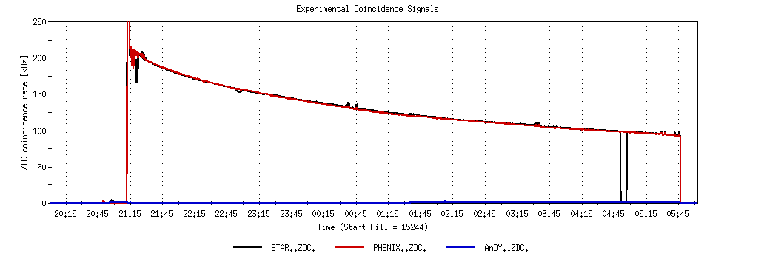
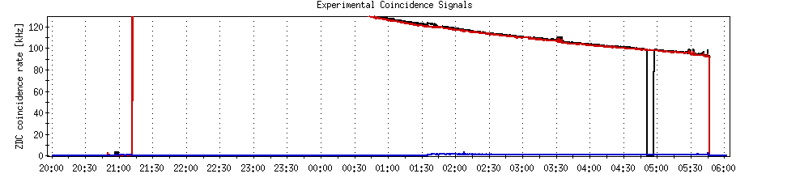
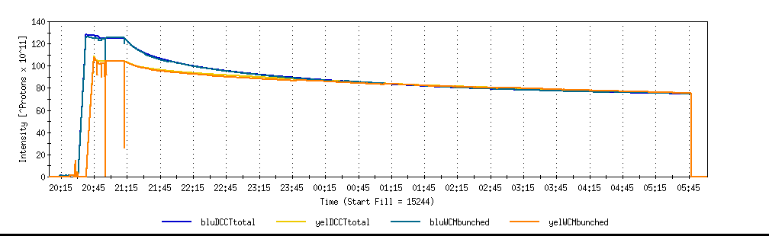
A good store with 9 MHz
Sat 2/26

Slide 17
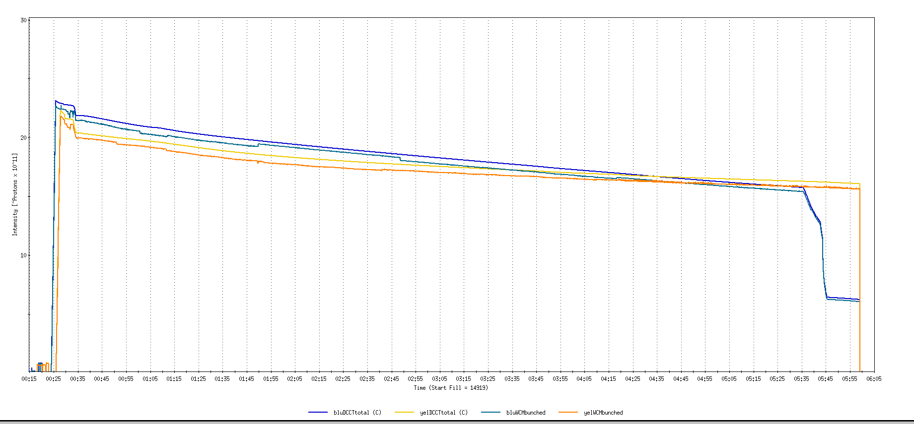
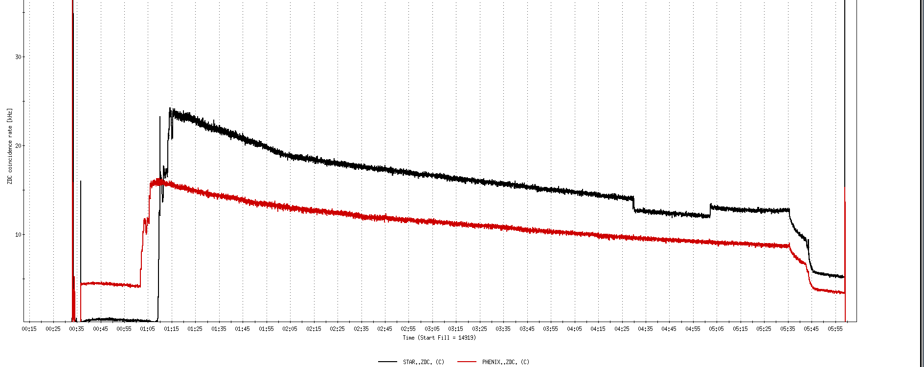
Run 11, First overnight store, Mon Jan 24 00:12
Fill number 14919,, √s=500 GeV
21 days since start of cool-down
28 x 27 bunches
β*=0.65 meters
20 x 10¹¹
For peak store lumi = 170 x 10³⁰ cm⁻²s⁻¹ (projected MAXIMUM)
ZDC Rate ~ 400K (assuming 2.4 mb n-pair xsection)
20K

Slide 18
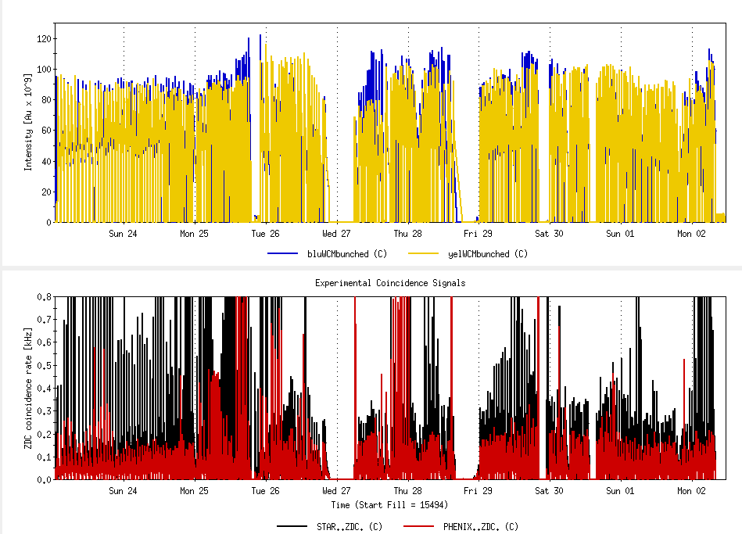
AuAu at √s = 19.6 GeV – all physics runs

Slide 19
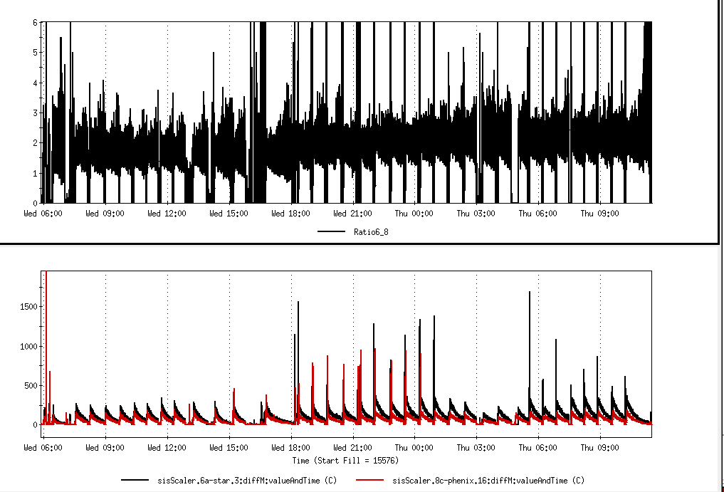
AuAu at √s = 19.6 GeV – all physics runs
ZDC Voltage increased
~15% difference

Slide 20
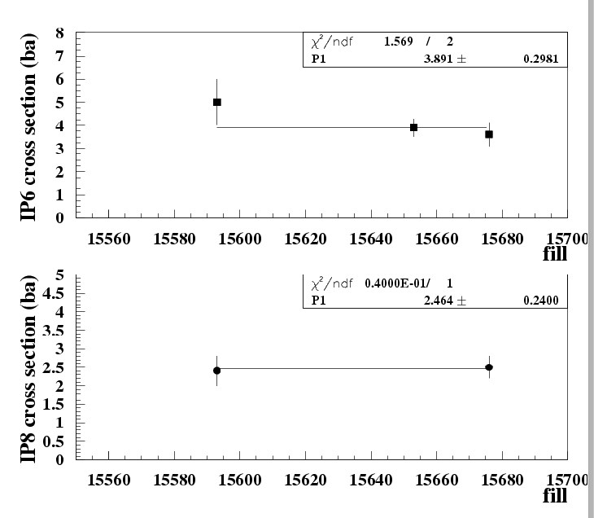
From Angelika, 5/3/2011
STAR beta* = 2.5 m, 111 colliding bunches
PHENIX beta* = 2.9 m, 102 colliding bunches

Slide 24
Corrected 5/3/2011

Slide 25
Corrected 5/3/2011

Slide 28
PHENIX Goal
STAR Goal

Slide 29
Goal (max)

Slide 34
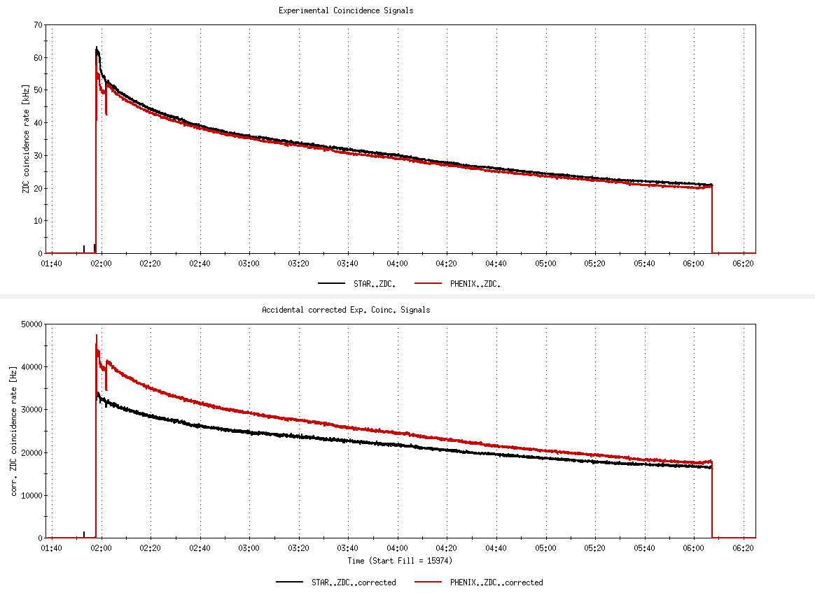
Fill 15974, not singles corrected
26%
Fill 15974, with singles correction
6%

Slide 35
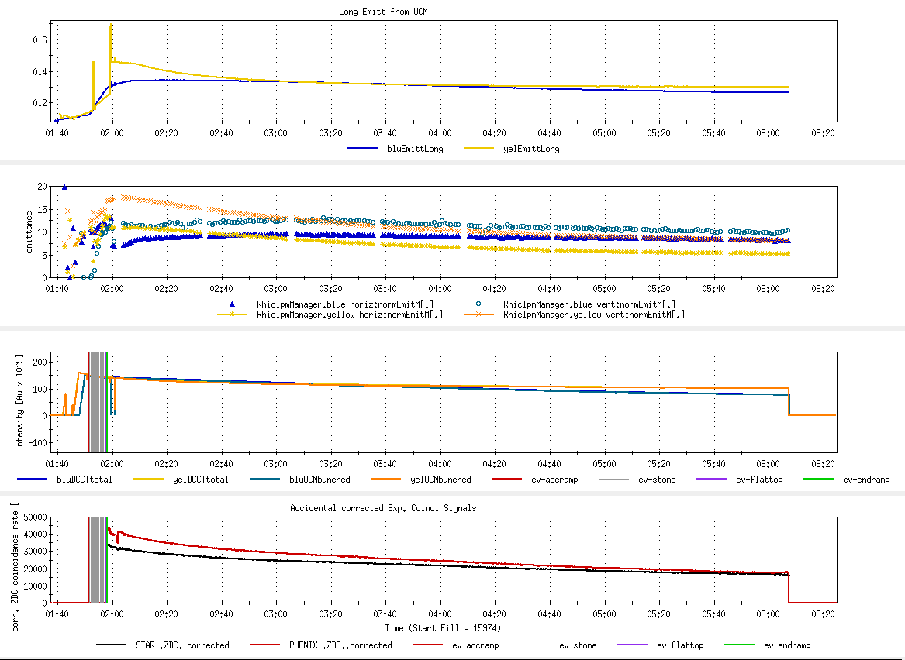
Fill 15974
Long emitt
Goal 17-20
x,y emitt
Goal 122
Blue/yellow ions
Peak Lumi goal 45 x 10²⁶ cm⁻²s⁻¹
Average Lumi goal 25 x 10²⁶ cm⁻²s⁻¹

Slide 37
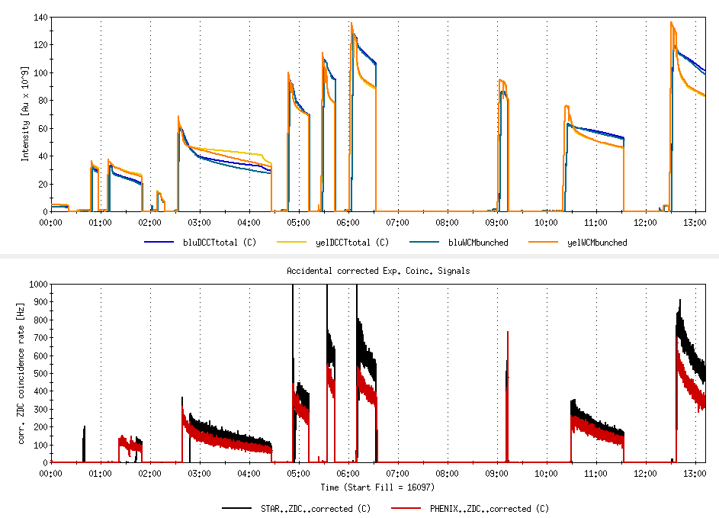
STAR Goal = 150M min-bias
PHENIX Goal = 5.2 μb⁻¹ sampled
√s = 27 GeV/n AuAu setup

Slide 38
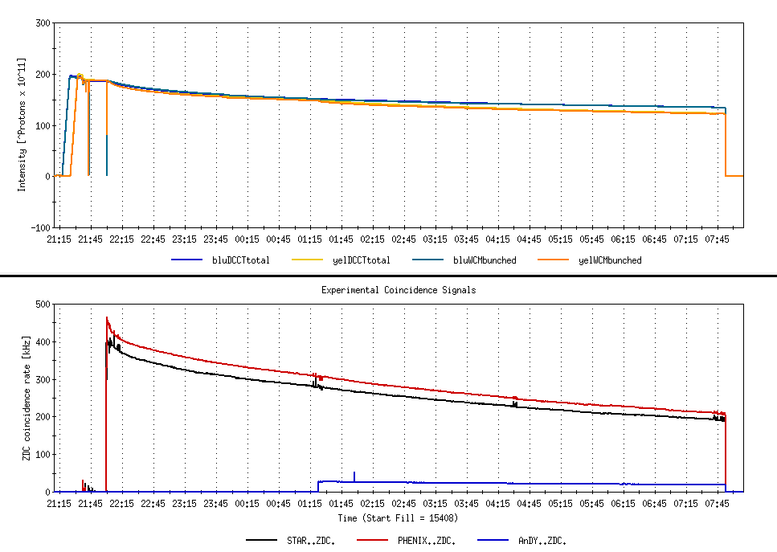
9.7 hour store comparing AnDY Lumi to STAR and PHENIX
Not singles corrected

Slide 39
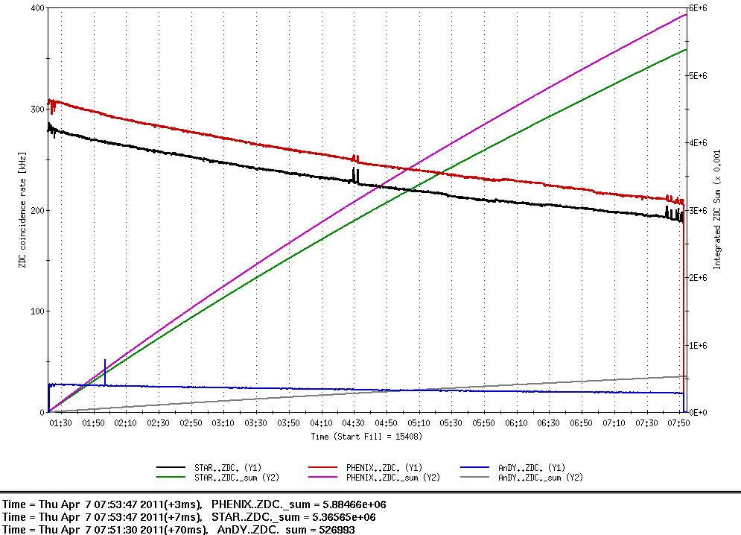
9.7 hour store comparing AnDY Lumi to STAR and PHENIX
β*’s
PHENIX ~0.7 m
STAR ~0.8 m
AnDY ~ 3 m
Not singles corrected
Lumi
PHENIX = 5.88E9/2.7mb = 2.18 pb⁻¹
STAR = 5.36E9/2.9 mb = 1.84 pb⁻¹
AnDY = 0.52E9/0.95 mb = 0.55 pb⁻¹
AnDY Lumi ~consistent with larger β* (x4 less Lumi)
PHENIX Lumi (singles corrected) for entire store = 3.09 pb⁻¹

Slide 40
Store 15408 – AnDY projection
2:00 β* = 3 meters
  AnDY fraction of store 15408 = 0.55/3.09 = 18%
With 2:00 β* = 1.5 meters
  AnDY fraction of store 15408 would have been 2x18%=36%
  using Fischer et.al. 11 May 2010 Table 7 lumi projections for Run12
  Physics Weeks Max Lumi Min Lumi AnDY Est (1.5 m β*)
  8 276 pb⁻¹ 98 pb⁻¹ 35-99 pb⁻¹
  10 388 pb⁻¹ 134 pb⁻¹ 48-140 pb⁻¹
  12 500 pb⁻¹ 170 pb⁻¹ 61-180 pb⁻¹
→ 100 pb⁻¹ is not an unreasonable expectation for a 10-12 week run

