Slide 1
Run 12 RHIC Machine/Experiments Meeting
29 Jun 2012
Run 12 Summary Slides

Slide 2
Run 12 Plan based on 20 weeks cryo operation
23 week schedule based on 4/10/12 Vigdor guidance, 6 June update
17 Jan, Begin cool-down to 4.5K
20 Jan, Cool-down to 4.5K in Blue and Yellow Ring complete, begin magnet setup
21-28 Jan, pp injection setup
28 Jan-3 Feb, LLRF, Ramp and store setup, begin 8 hr/night for experiments
3-10 Feb, 1 week ramp-up with 8 hrs/night for experiments
10 Feb, with store # 16397, begin 4 weeks pp physics with further ramp-up
16 Feb, 24/7 stores begin
12 (Monday) March, end 4.4 week pp physics √s = 200 GeV, begin ½ week setup for √s = 510 GeV pp
16 March, begin 5 week pp physics (machine only) √s = 510 GeV
17/18 March, STAR/PHENIX physics start with longitudal polarization
18 April (Wednesday 1300), end physics begin pp beam development/APEX
19 April (Thursday, 0800), end 4.9 week pp physics at √s = 510 GeV
19 April (Thursday, store 16580), begin 1 week setup for UU
22 April (evening) first overnight stores for experiments
25 April (Wednesday), begin 3 week UU physics run
15 May (Tuesday) end 2.9 week UU physics √s = 193 GeV/n, begin setup for √s = 200 GeV/n CuAu
18 May (Friday, store 16889) begin CuAu physics run
25 June (Monday, 08:00), end 5.5 week √s = 200 GeV/n CuAu run
25 June, begin √s = 5 GeV/n AuAu development
27 June (Wednesday, 12:00 – begin cryo warm-up
30 June, cryo warm-up complete (23.6 cryo-weeks)
Total Physics Weeks = 17.7

Slide 3
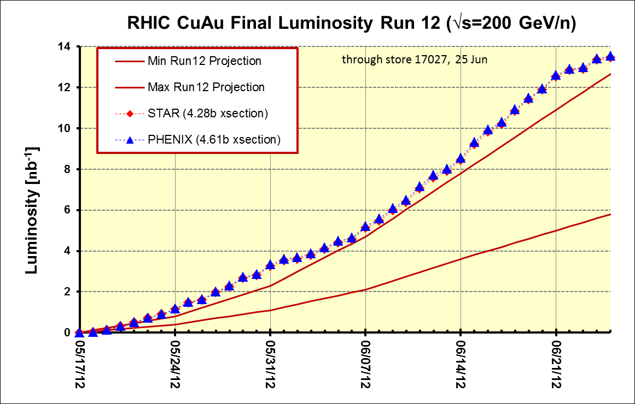
PHENIX BUR Goal = 2.4 nb⁻¹ sampled, ~11 delivered
STAR Goal = ~5 nb⁻¹ sampled, ~8 nb⁻¹ delivered
Goals
PHENIX
STAR

Slide 5
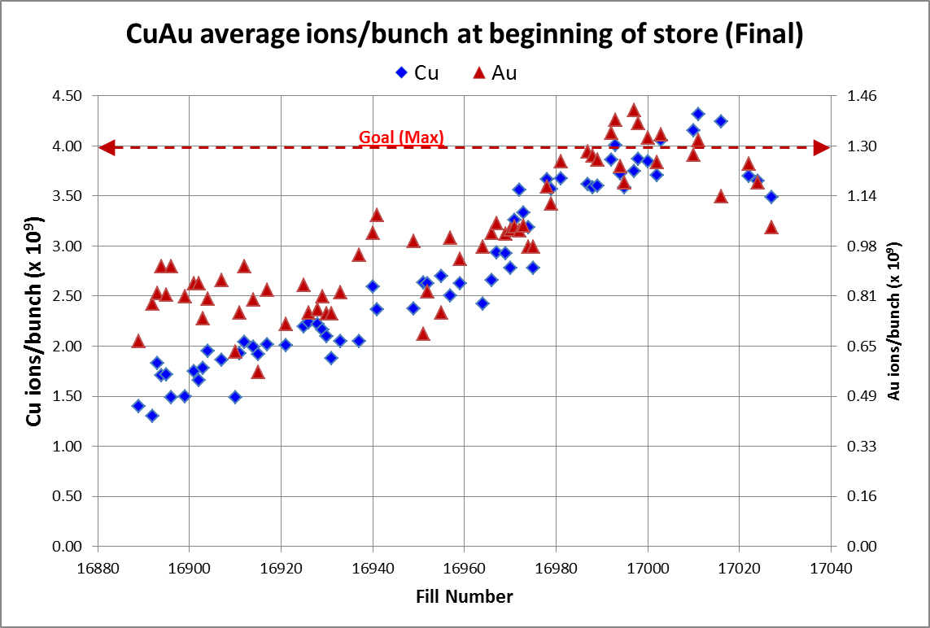
Through final store 17027, 25 June
http://www.rhichome.bnl.gov/AGS/Operations/Run12/Run12_Lumi_100Cu_100Au.xlsx

Slide 6
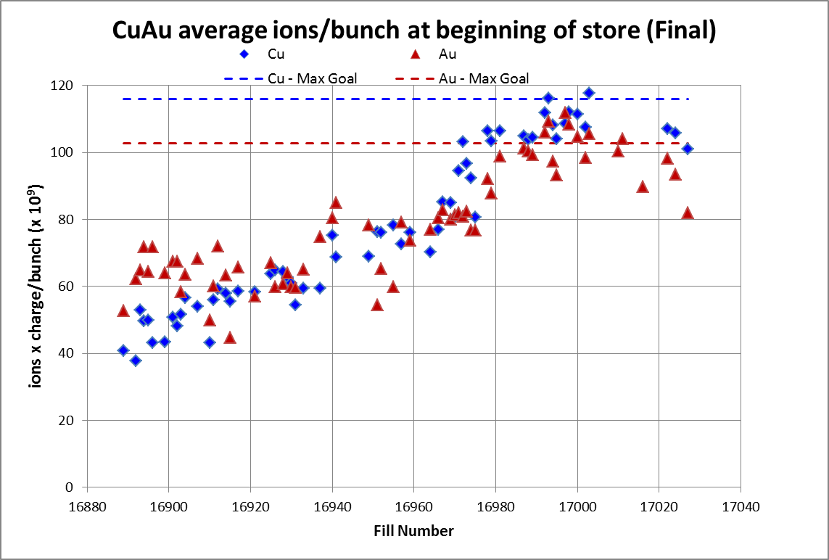
Through final store 17027, 25 June

Slide 7
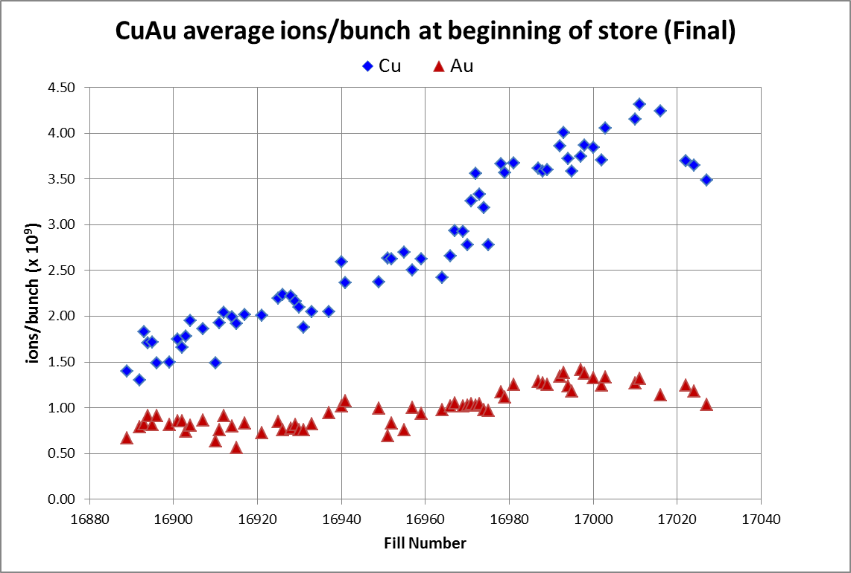
Through final store 17027, 25 June

Slide 8
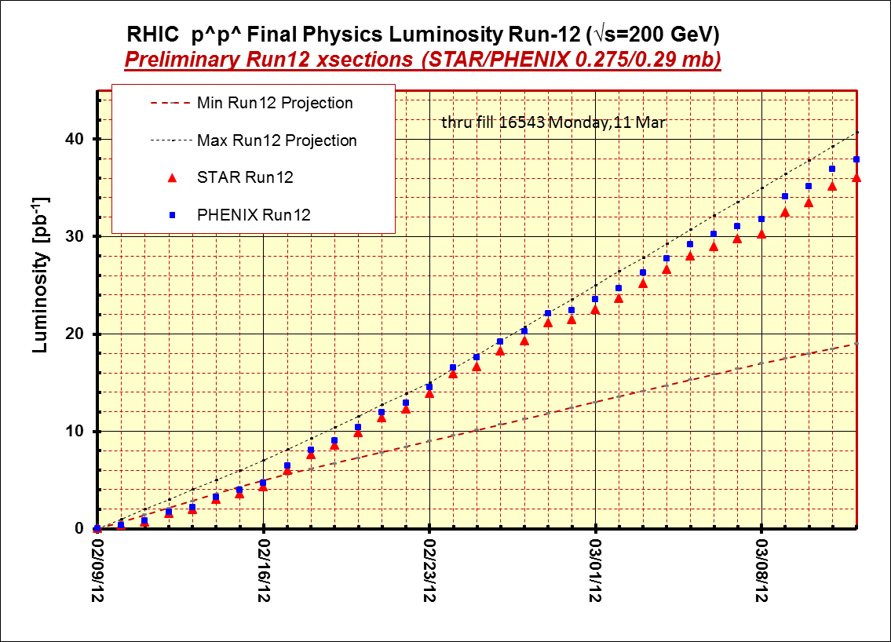
STAR & PHENIX Goal

Slide 9
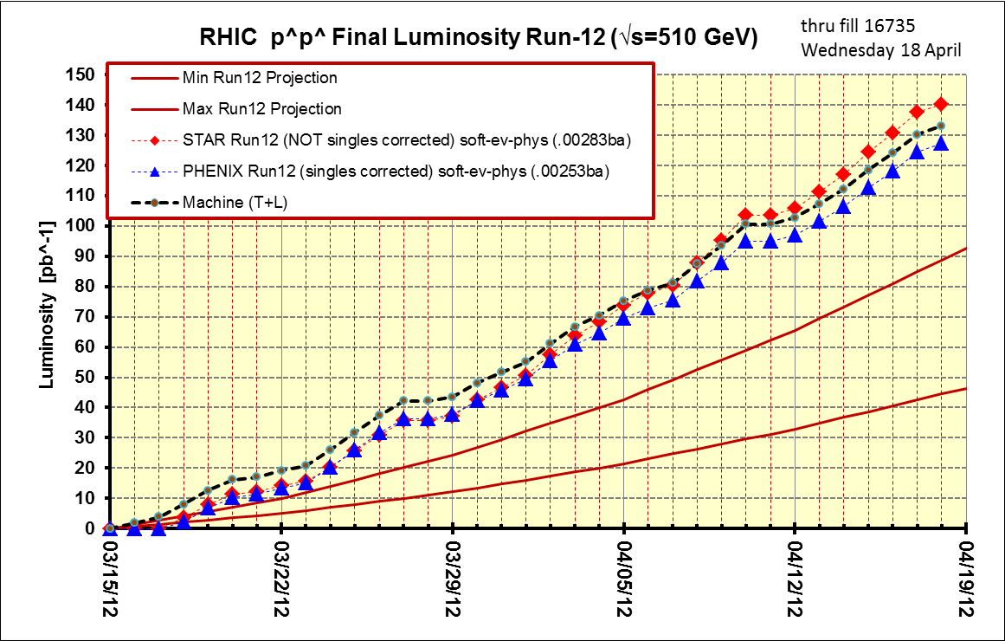
Thru final store, 16735, 18 Apr
PHENIX Goal
STAR Goal

Slide 10
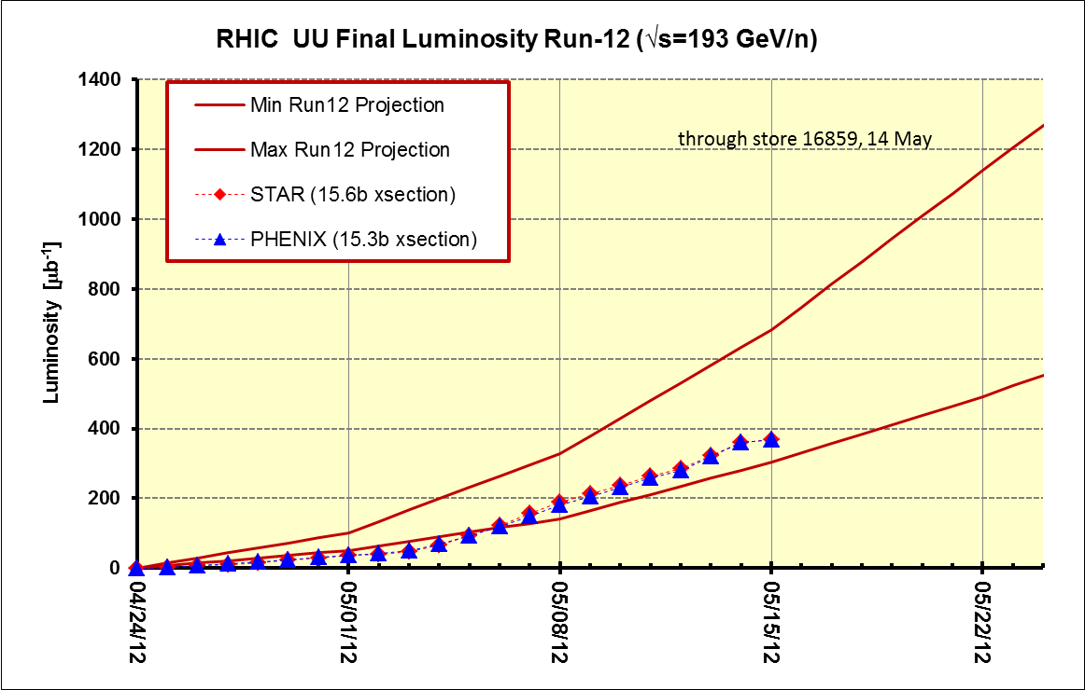
Best store (16857) = 3.0 x 10⁸ ions/bunch, blue/yellow beginning of store (physics)
~8.5 x 10⁸ ions/bunch
STAR and PHENIX ~Goals
~6 x 10⁸ ions/bunch
~3 x 10⁸ ions/bunch

Slide 12
Other Slides

Slide 13
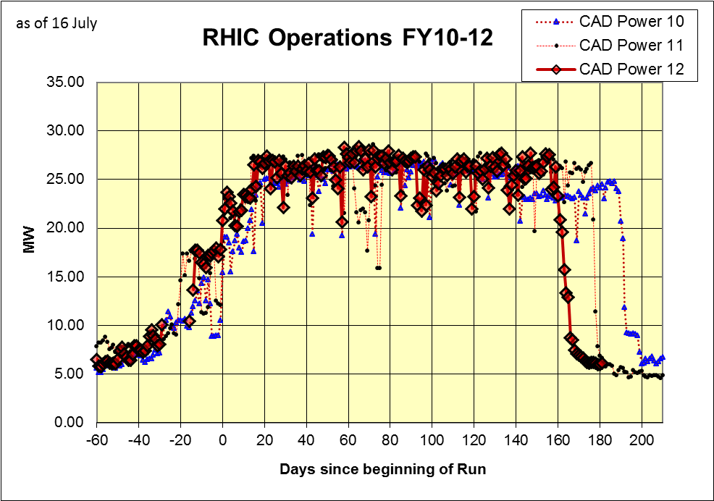

Slide 14
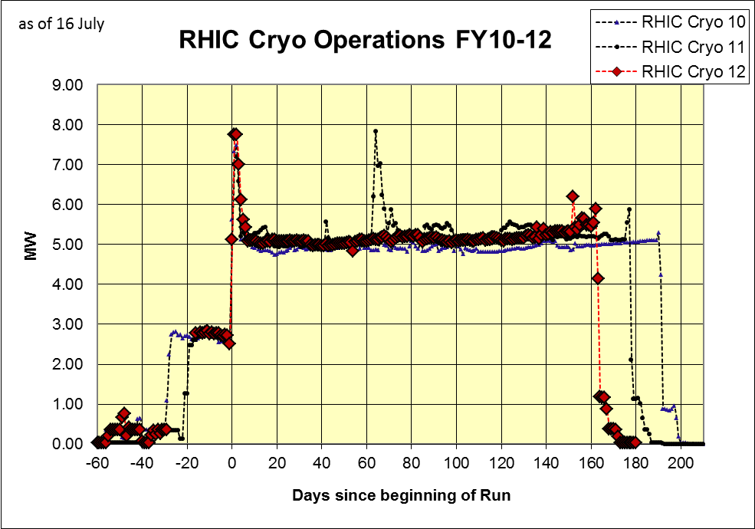

Slide 15
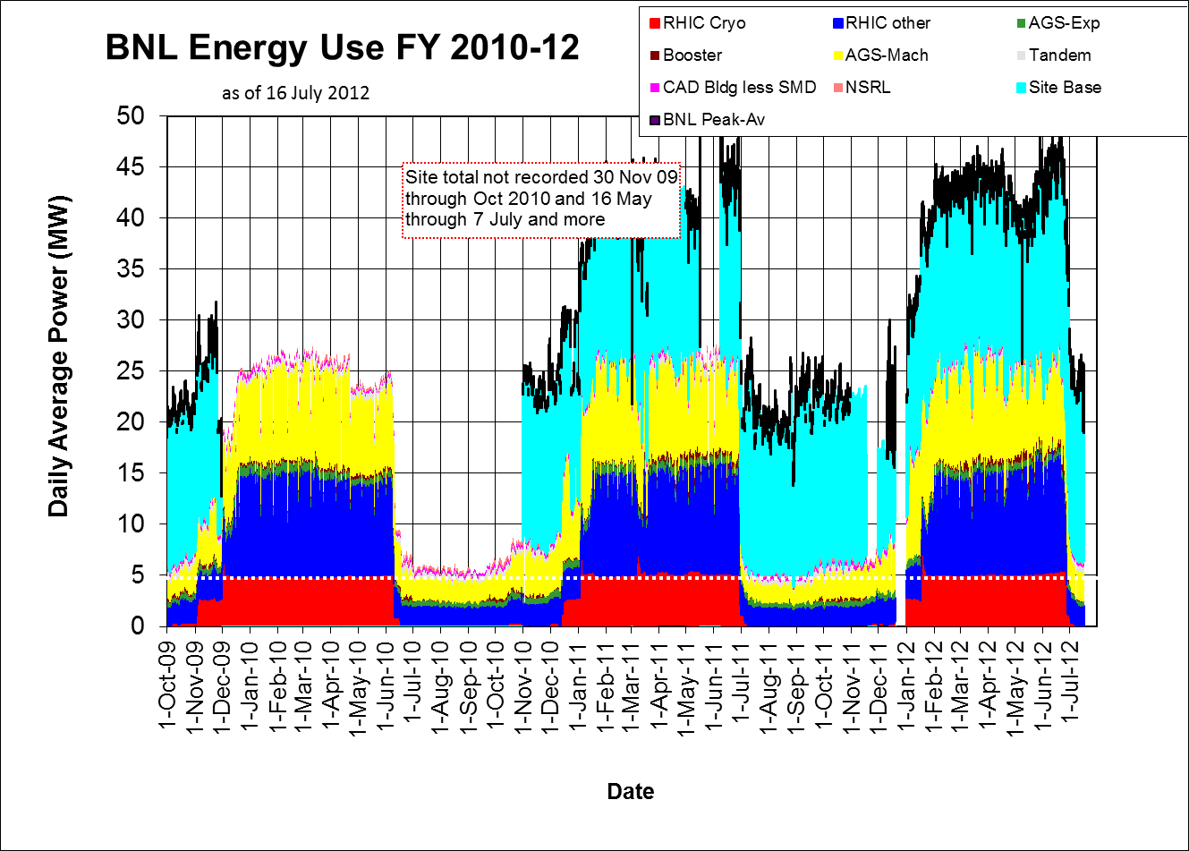

Slide 16
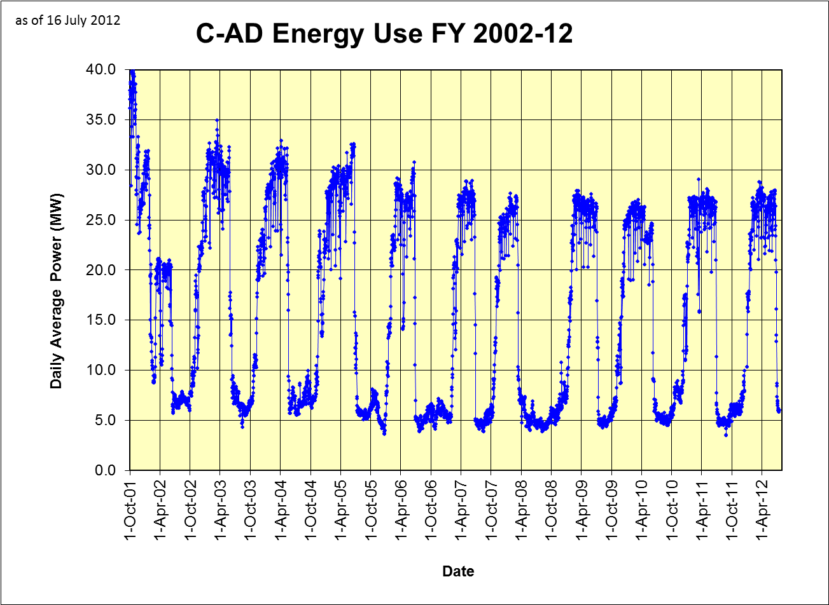
Thru 31 May

Slide 17
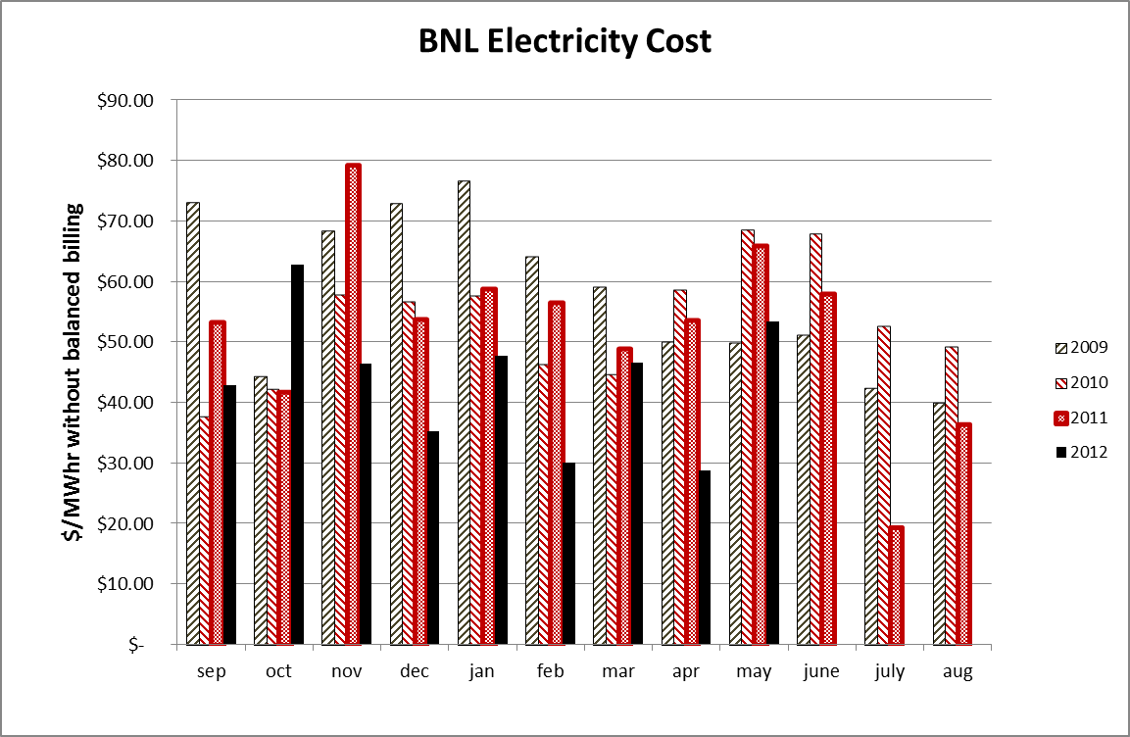

Slide 18
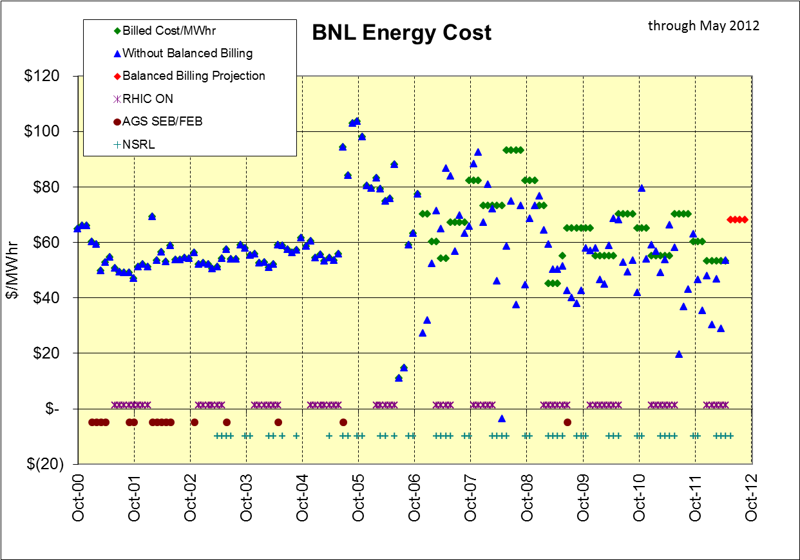
Total in bank through May = $2,768K (CAD contribution = $1,360K)
Total CAD rebate to date = $625K (owed $735K)

Slide 19
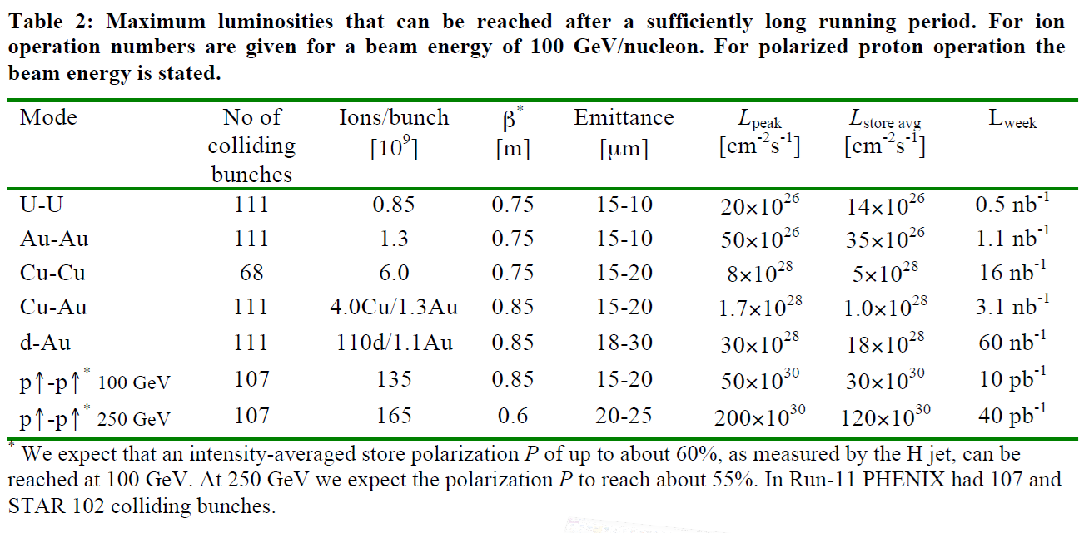

Slide 20
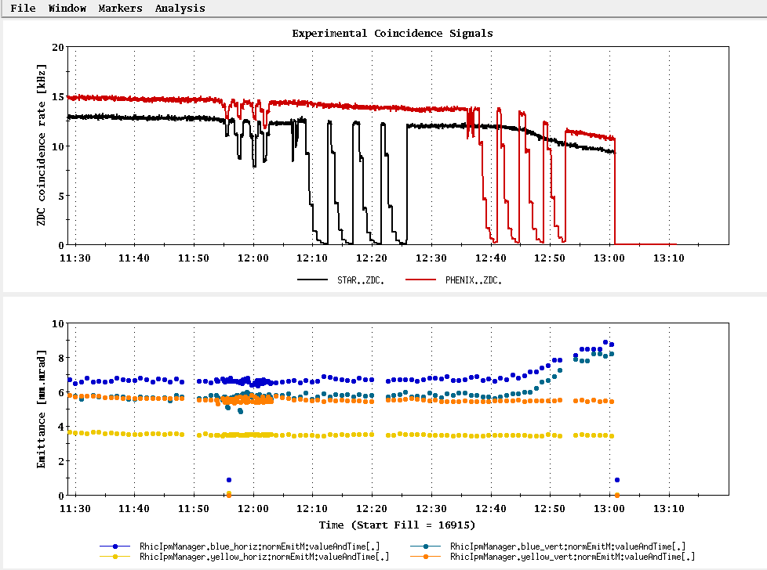
The last vernier scan – note emittance issue with the PHENIX scan

Slide 21
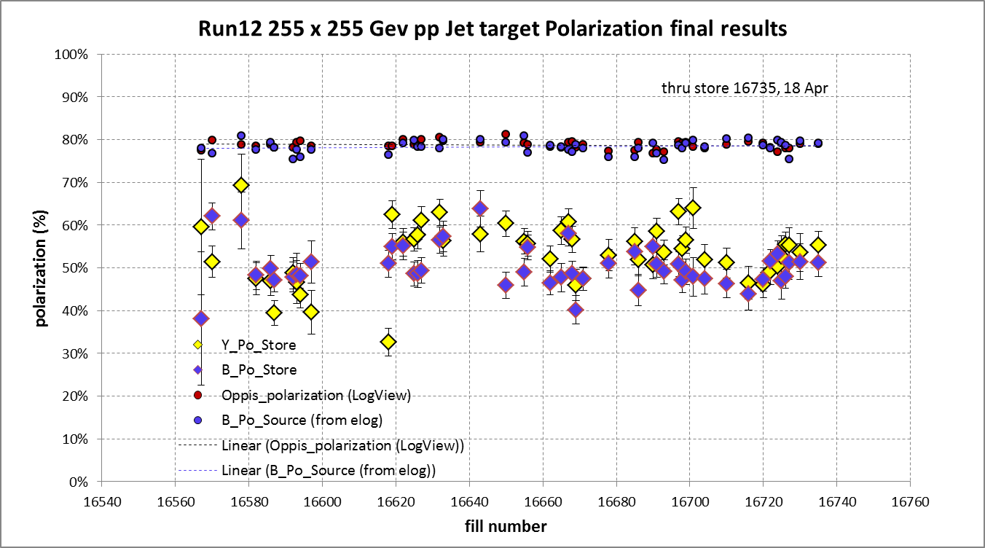
And Yellow beam at injection jet target Run 12 result = 63.0 ± 4.4%
Blue jet target weighted average = 50.3% ± 0.5%
Yellow jet target weighted average = 53.4% ± 0.5%

Slide 22
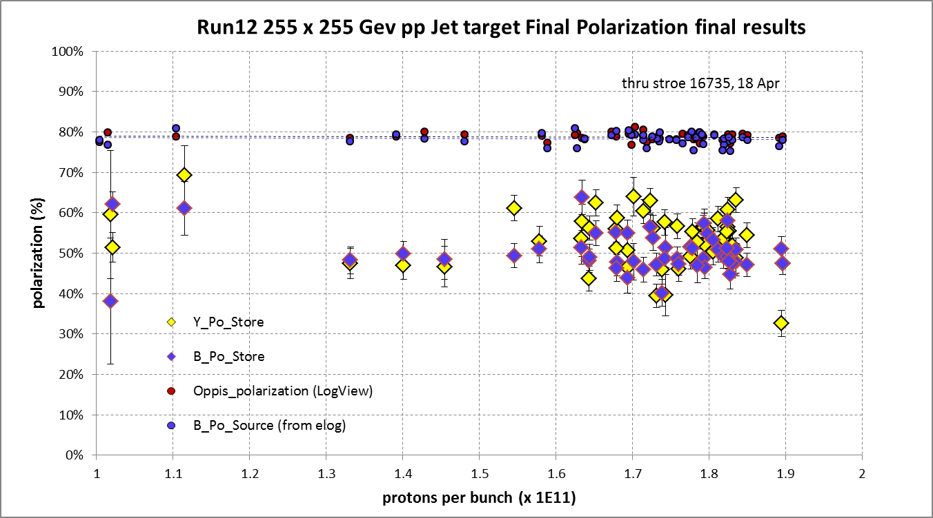
Yellow average = 53.4 ± 0.5%
Blue average = 50.3 ± 0.5%

Slide 23
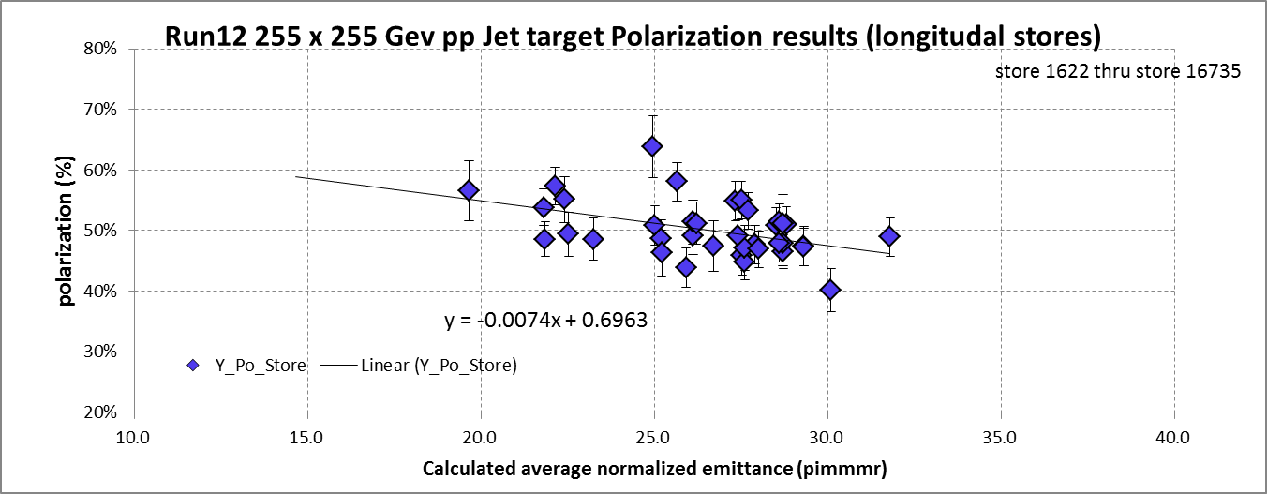
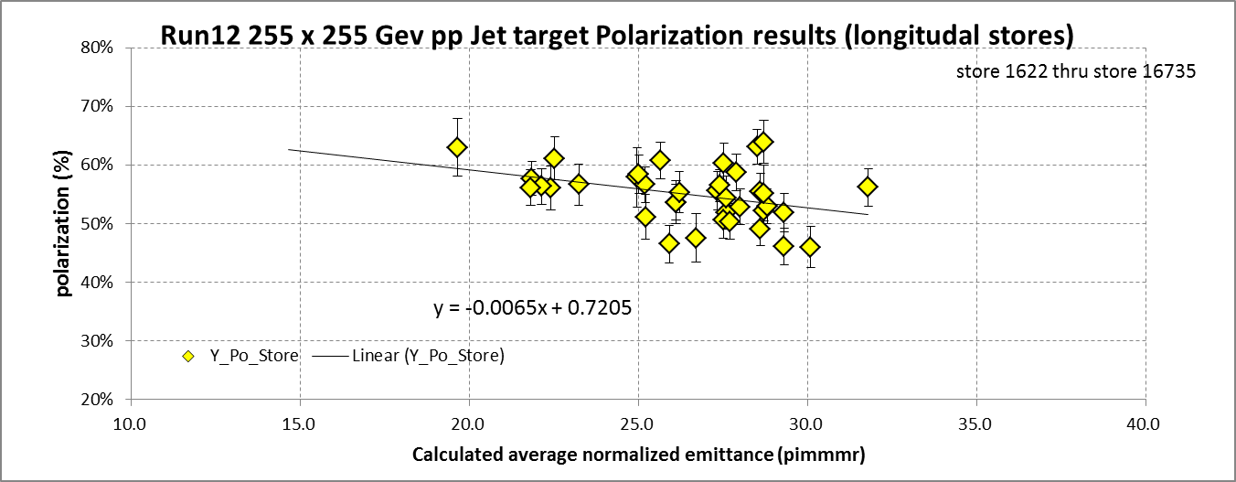

Slide 24
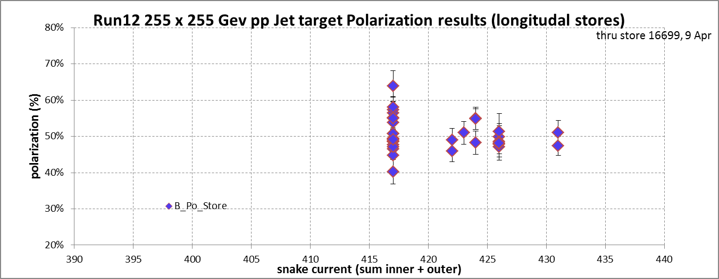
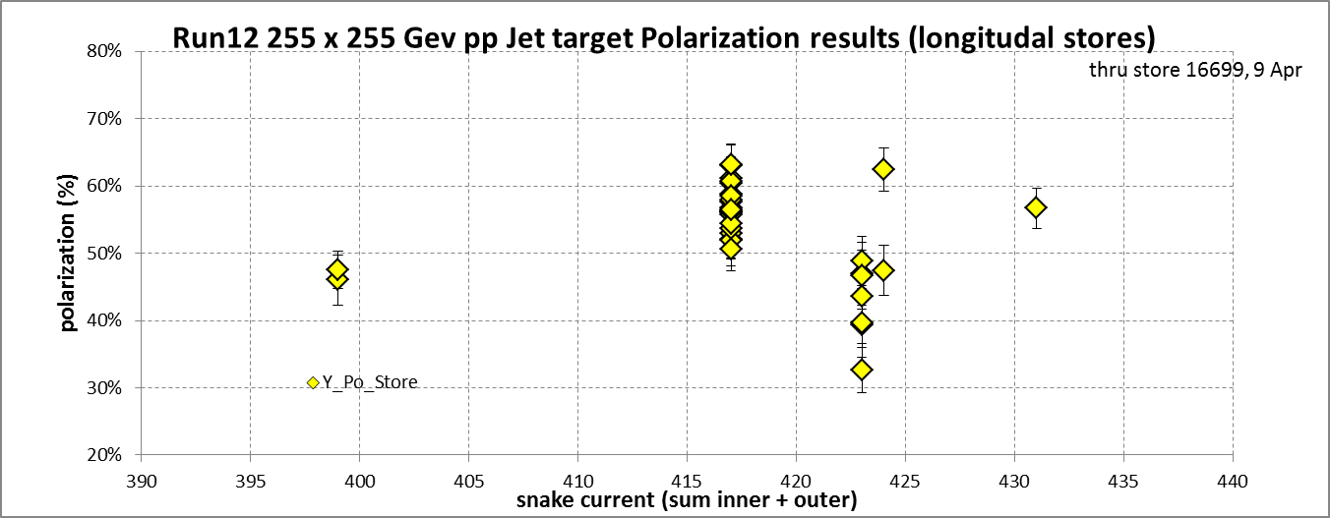

Slide 25
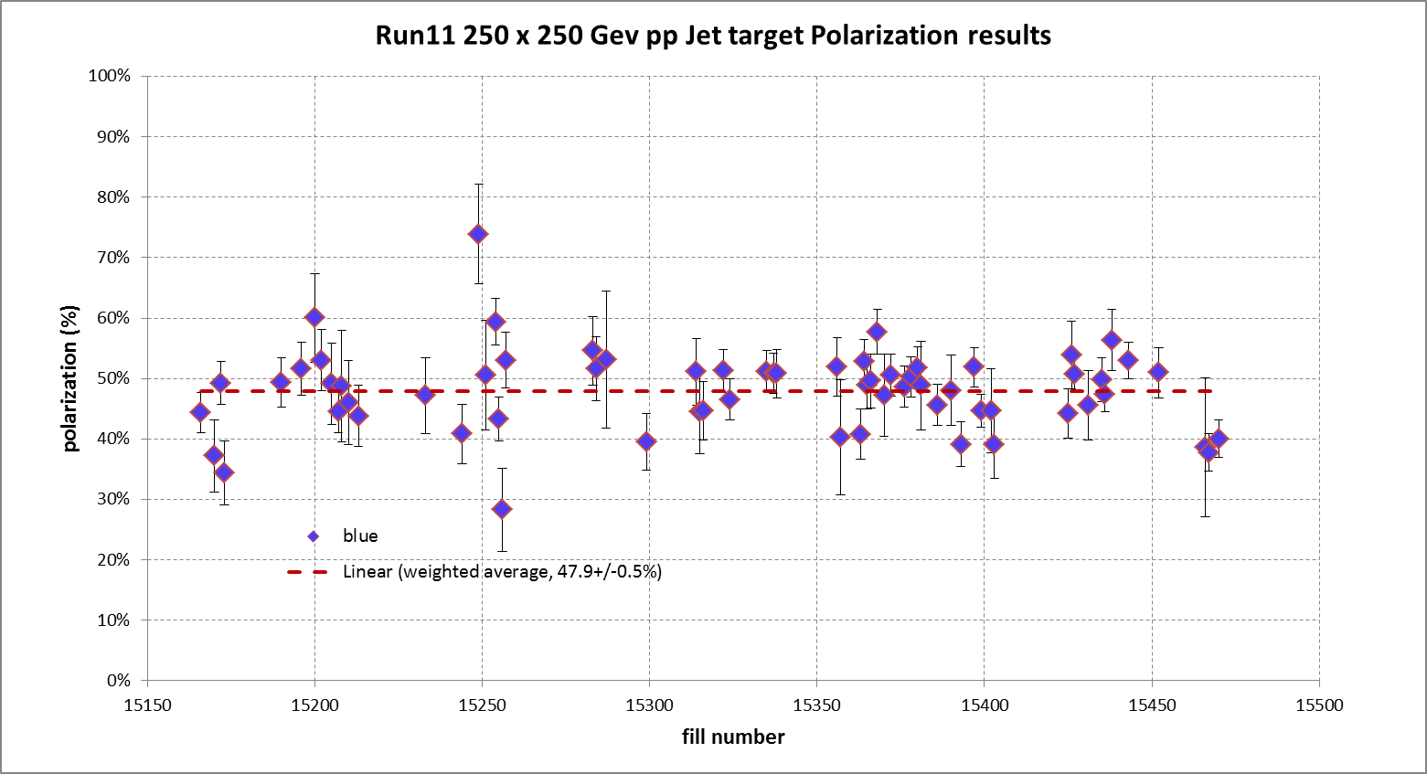
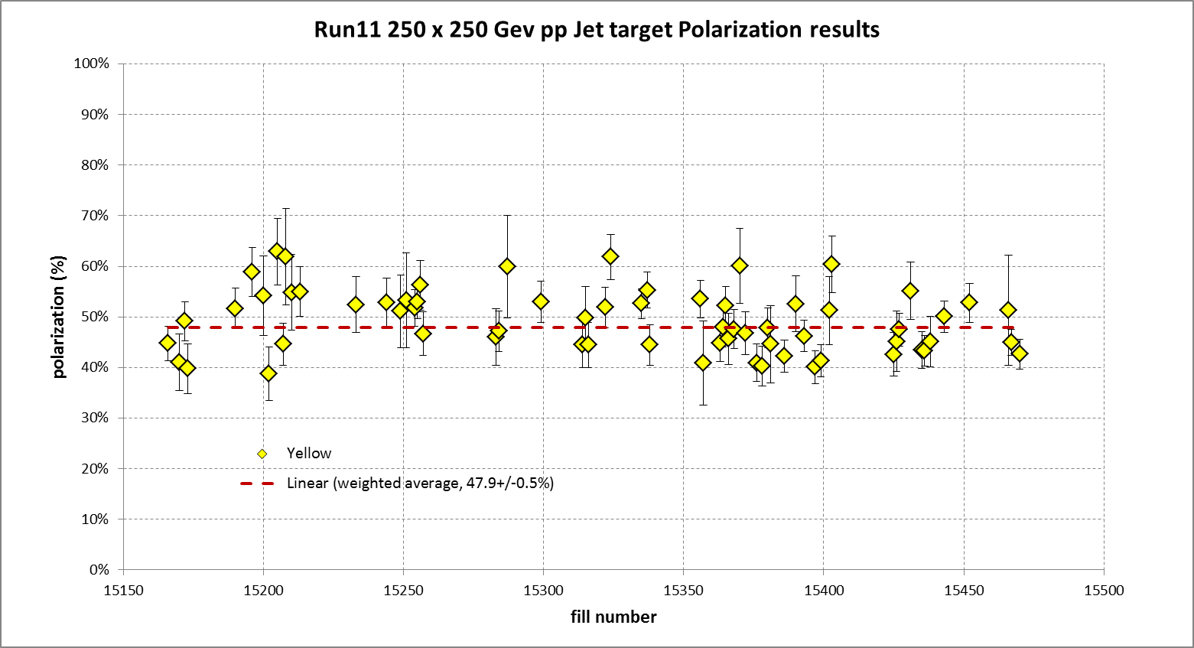

Slide 26
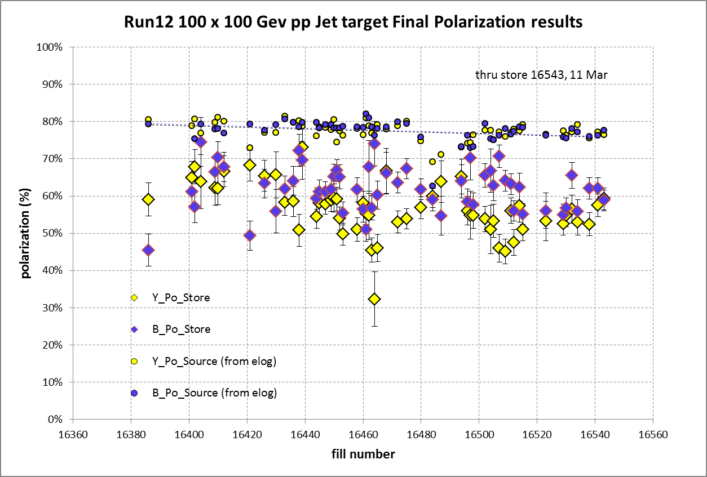
STAR & PHENIX Polarization Goals
Offline polarization is larger
Blue Jet weighted average = 61.2% ± 0.5%; source blue average = 77.5% → 20% lost
Yellow Jet weighted average = 55.8% ± 0.5%; source yellow average = 77.4% → 28% lost

Slide 27
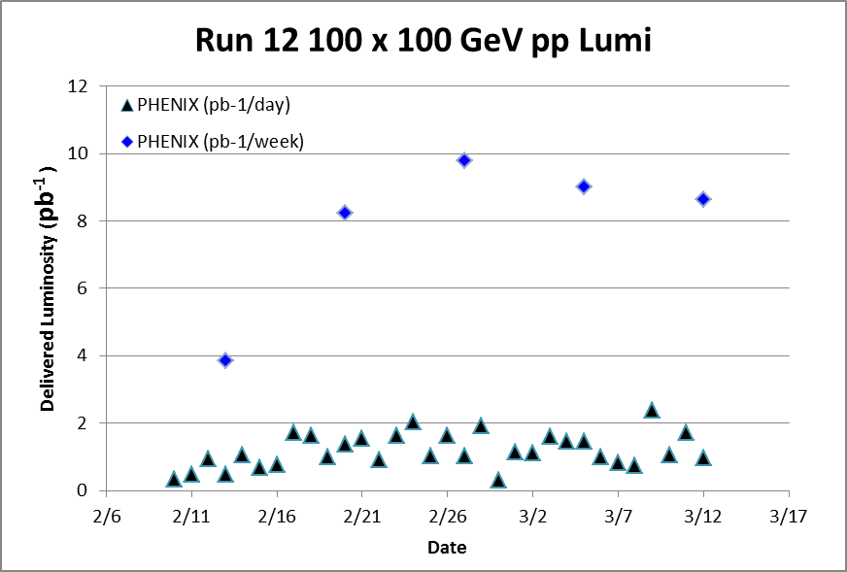
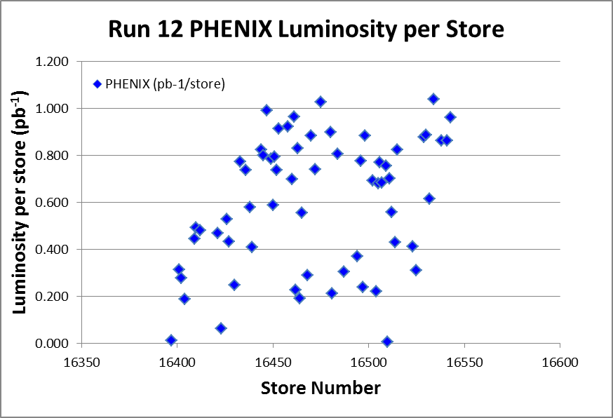
Target (max projection)
Best stores, 16475 and 16534

Slide 28
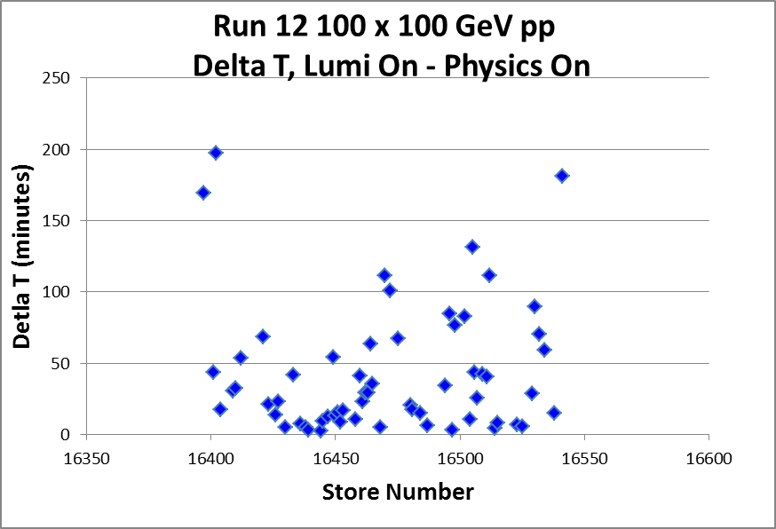
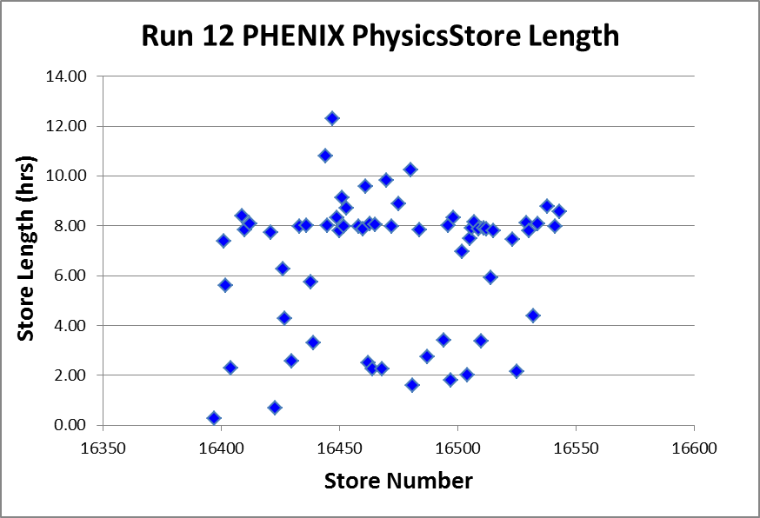
Best stores, 16475 and 16534

Slide 29
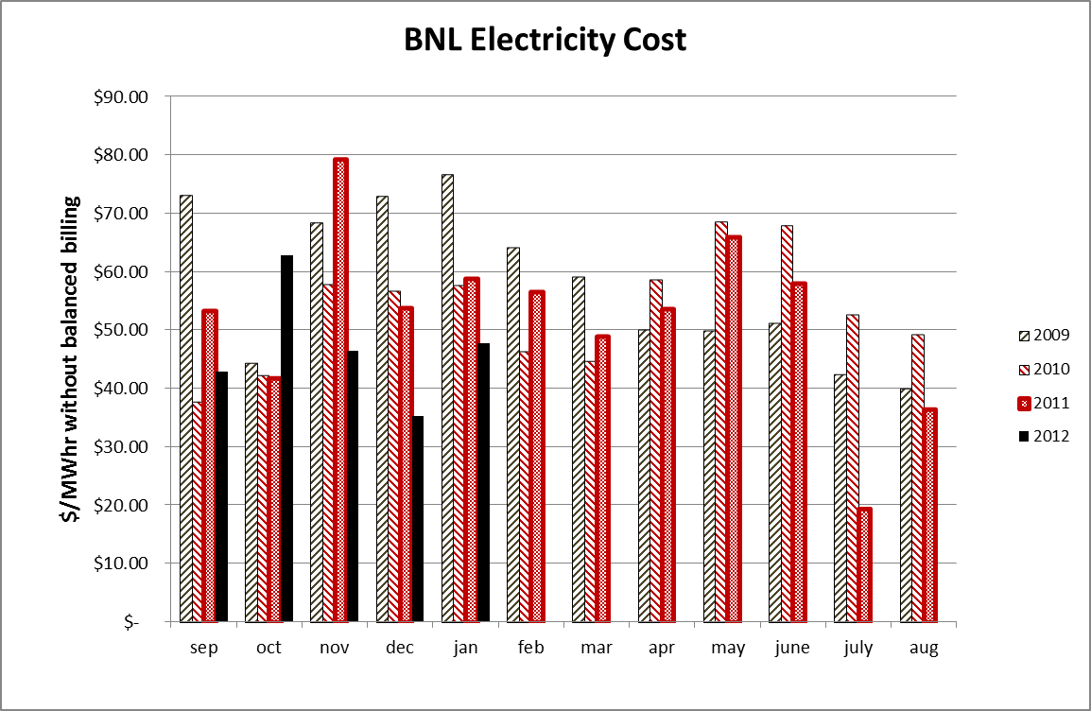

Slide 30
Blue Jet weighted average = 55.4 ± 0.5
Yellow Jet weighted average = 54.9 ± 0.5

