Slide 1
PHENIX Run-13 status
Hubert van Hecke
for the PHENIX collaboration

Slide 2
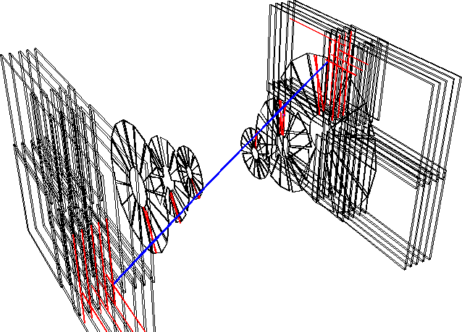
Commissioning continues
FVTX back and operating (>98% live channels)
Flammable gas is on since Feb 1, 2-person watch shifts started Jan 22
Cosmics taken since Feb 4, ongoing when there is no beam
Shielding wall rolled in on Friday 7, closed up since 8th
Full shifts available as of today
Detector, trigger studies ongoing
Full detector test today with all (~20) subsystems

Slide 3
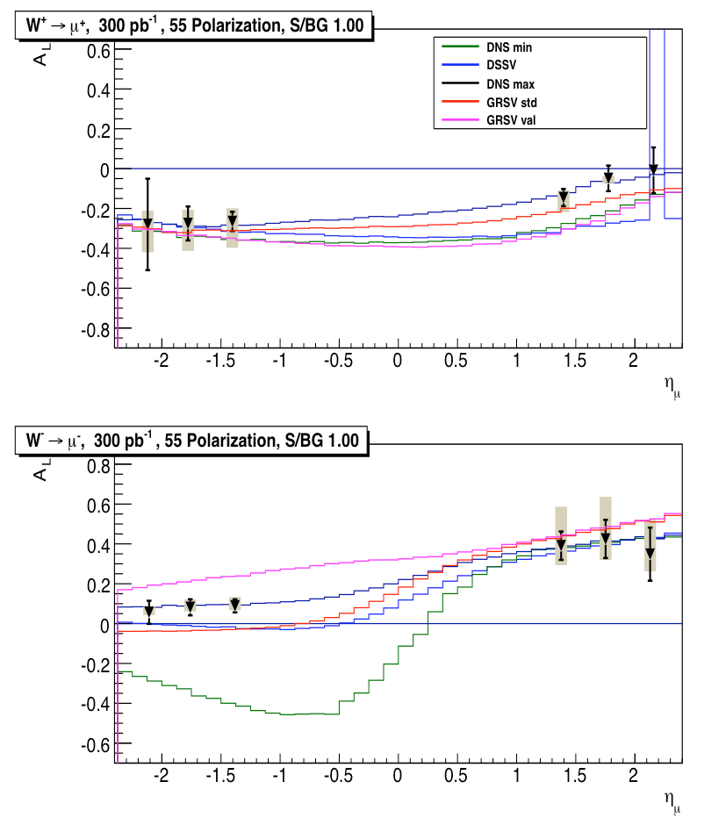
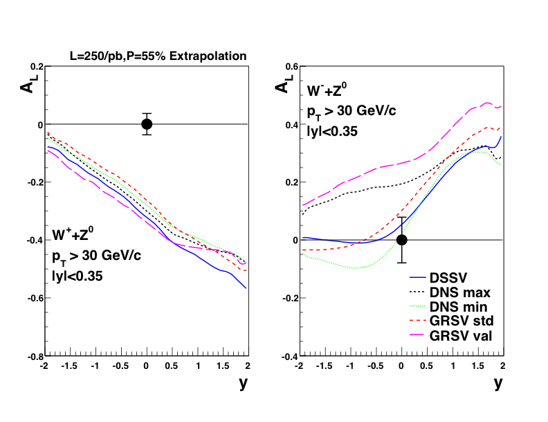
Run-13 top priority: finish the W program
Inclusive high pT leptons
∫Ldt=300pb⁻¹ in 30cm, P≥0.55
250pb⁻¹ recorded in Run-13
-> ~750pb⁻¹ delivered

Slide 4
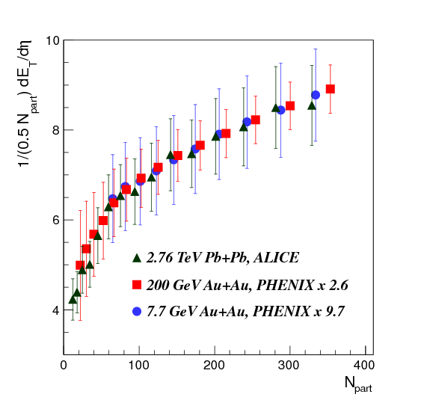
After that, energy scan program

