Slide 1
Run 13 RHIC Machine/Experiments Meeting
19 Feb 2013
Agenda:
Status reports

Slide 2
Run 13 plan based on 20 weeks cryo operation and Fischer et.al. RHIC Collider Projections (FY 2013 – FY 2017), 27 Sep 2012
11 Feb, Begin cool-down to 4.5K
15 Feb, Cool-down to 4.5K in Blue and Yellow Ring complete, begin magnet setup
today, 19 Feb…
15 Feb -1 Mar, RHIC √s = 510 GeV pp machine setup
1-8 Mar, machine ramp-up with 8 hr/night for experiment setup
8 Mar, begin √s = 510 GeV pp physics run
6 Jun, switch to √s = 15 GeV/n AuAu if pp goals are met and end 12.9 week √s = 510 GeV pp physics run
27 Jun, end ~2.5 week √s = 15 GeV/n AuAu physics run or 15.9 week √s = 510 GeV pp physics run, begin cryo warm-up
30 June, cryo warm-up ~complete (19.9 cryo-weeks)
See http://www.rhichome.bnl.gov/AP/Spin2013/ for the Run Coordinator’s detailed plan

Slide 3
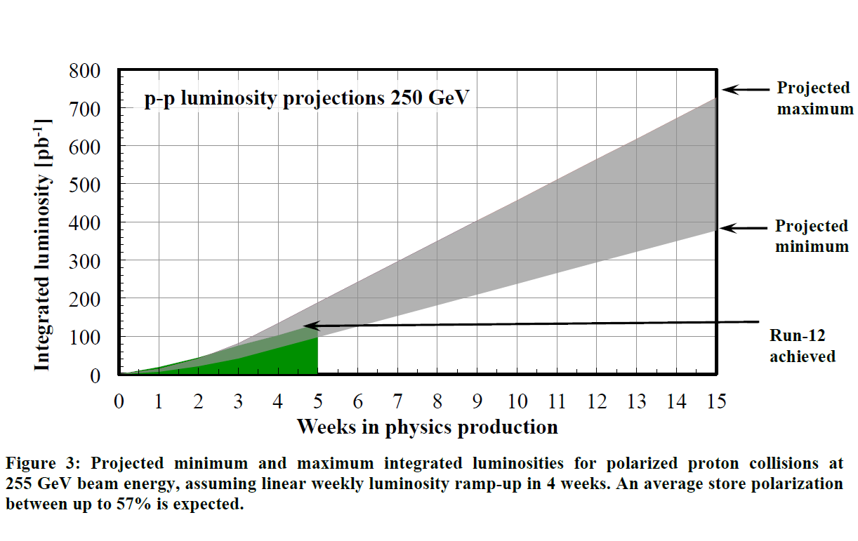
PHENIX Goal, 250 pb⁻¹ recorded, 750 pb⁻¹ delivered, ≥ 55% polarization
STAR Goal, 165 pb⁻¹ recorded, 275 pb⁻¹ delivered, ≥ 55% polarization
PHENIX GOAL
STAR GOAL
From Fischer et.al. RHIC Collider Projections (FY 2013 – FY 2017), 27 Sep 2012

Slide 4
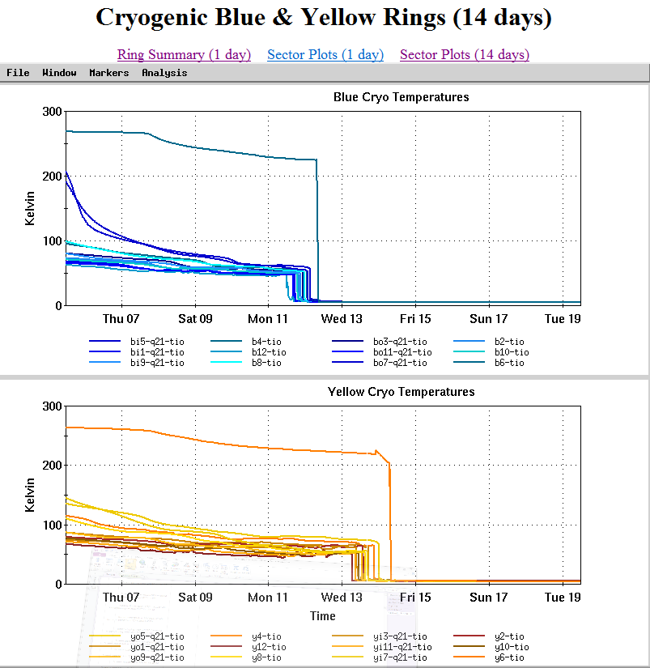

Slide 5
Additional Information

Slide 7
For Run 13 the PAC recommends the following (in order of priority):
Running with polarized proton collisions at 500 GeV to provide an integrated luminosity of 750 pb⁻¹ at an average polarization of 55%.
2. Depending on the amount of running time remaining after priority #1
  a. If less than 3 weeks remain, a week of 200 GeV Au+Au collisions.
  b. If at least 3 weeks of running time remain, 3 weeks of 15 GeV Au+Au
  collisions.
3. 8 days of 62 GeV p+p collisions.
4. At the discretion of the ALD, 4 days of low-luminosity running to accomplish the pp2pp goals.

Slide 8
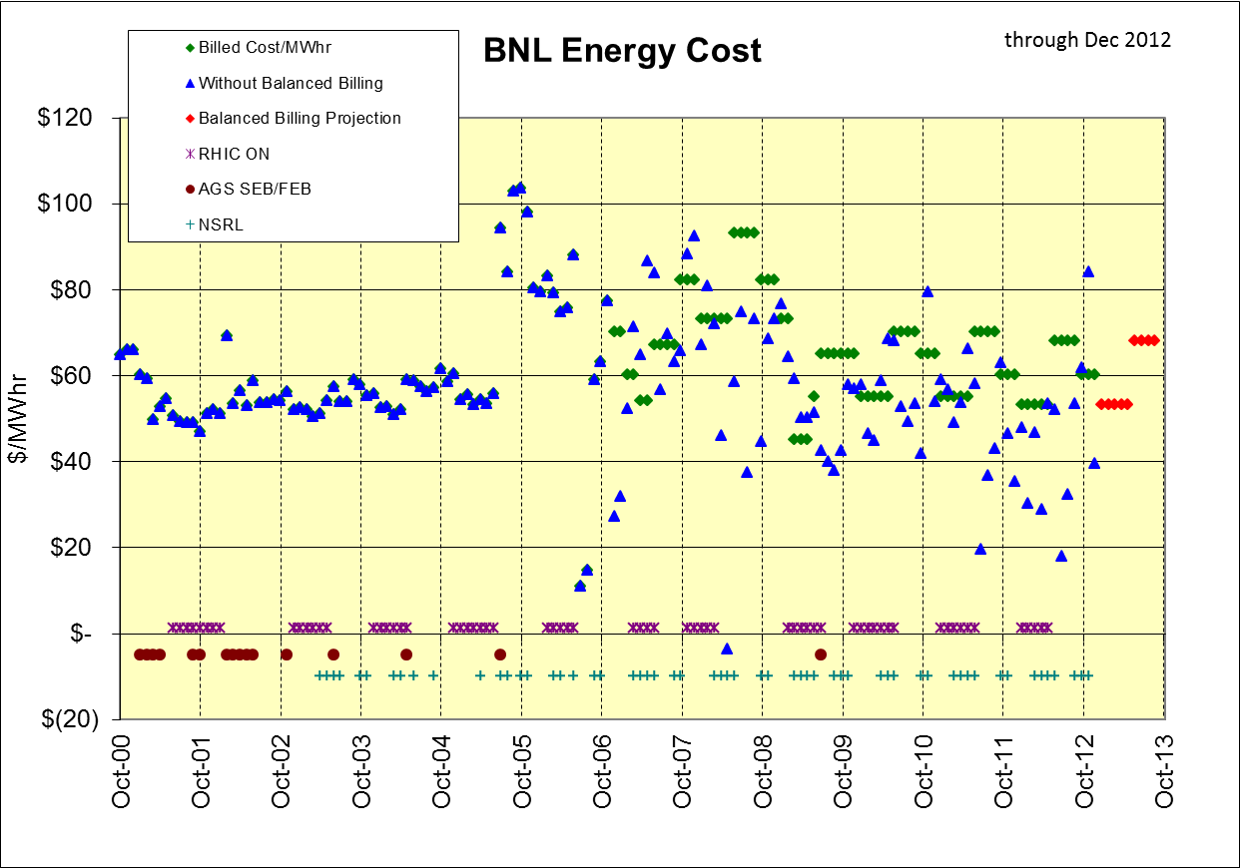
+$114.7K in bank through Dec 2012

Slide 13
