Slide 1
A summary on Polarisation in Run-13 for 255 geV
E.C. Aschenauer
presenting the work done
By Bill, DIMA and OLEG

Slide 2
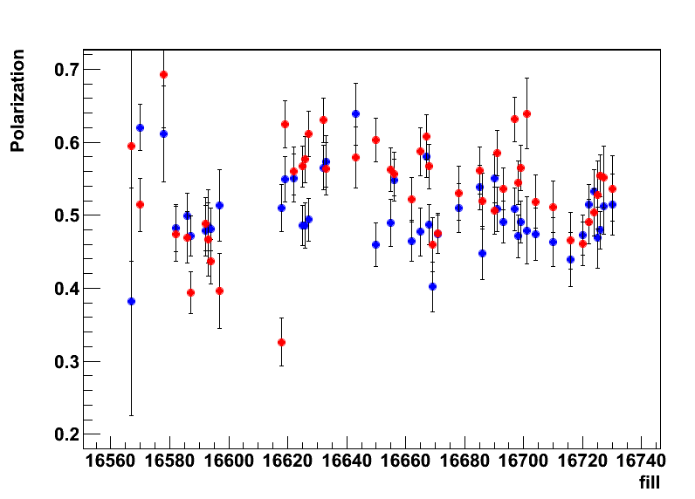
2012: H-Jet Results

Slide 3
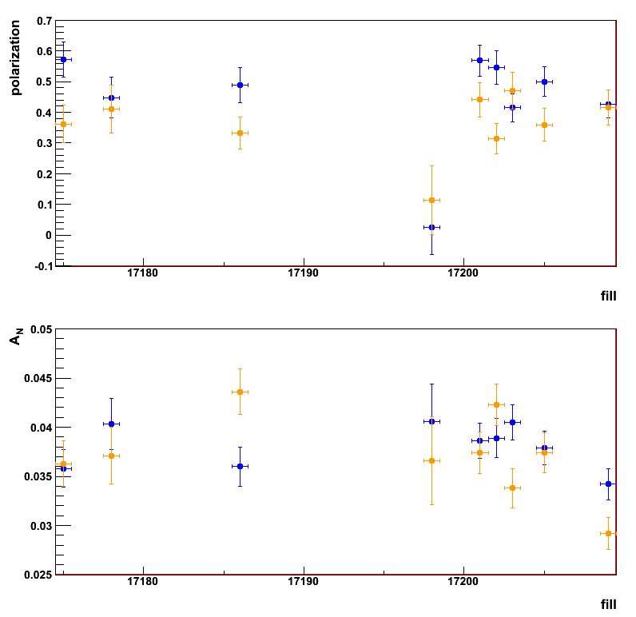
H-Jet Results
polarisation for
Blue and Yellow
t_{o}-calibration underway
minimal impact on
polarization,
makes A_{N} more stable
should be done by
tomorrow
→ next step calibrate pC

Slide 4
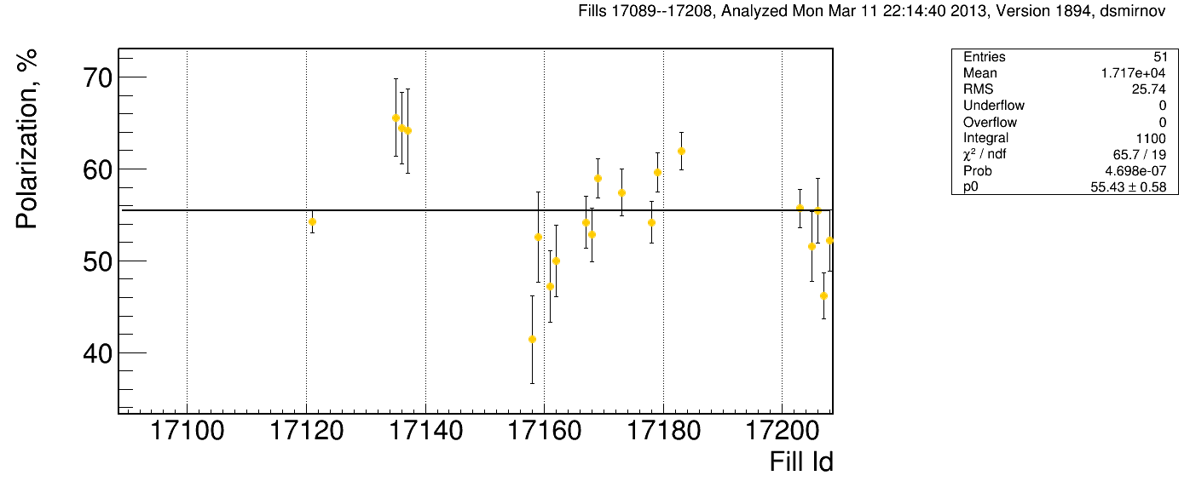
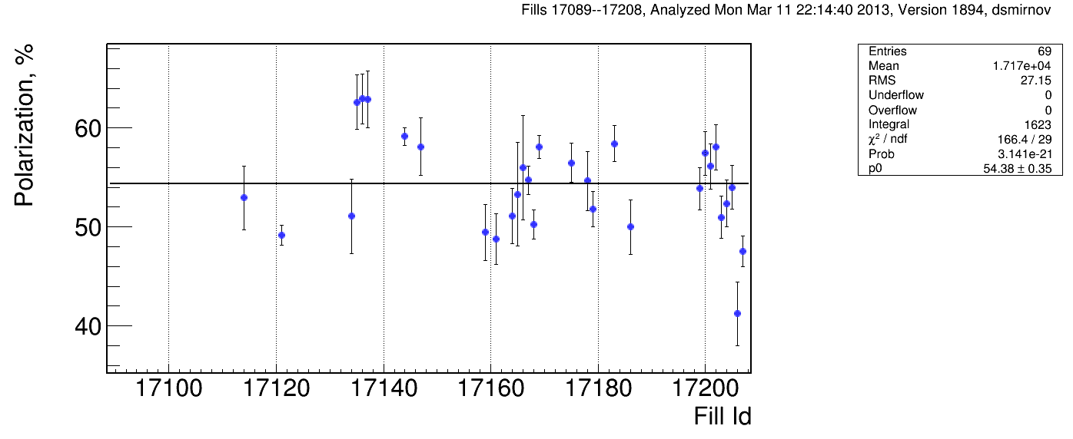
pC Results
Caveat: not yet normalized to jet – simple reason need statistics
Note:
measured analyzing power for injection, 100GeV and 255 GeV in run 11/12
have not seen an energy dependence of pC/H-jet normalization
→ can use the same normalization factor for flat top and injection
so injection measurements will be pretty accurate
fills shown in all plots: 17085—17208 for B1 and Y1
Injection

Slide 5
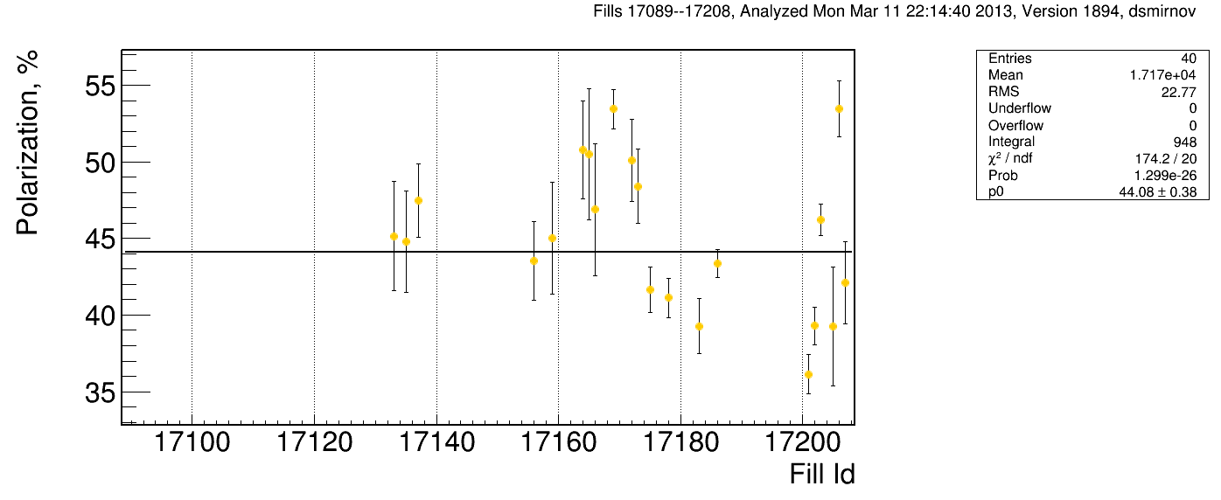
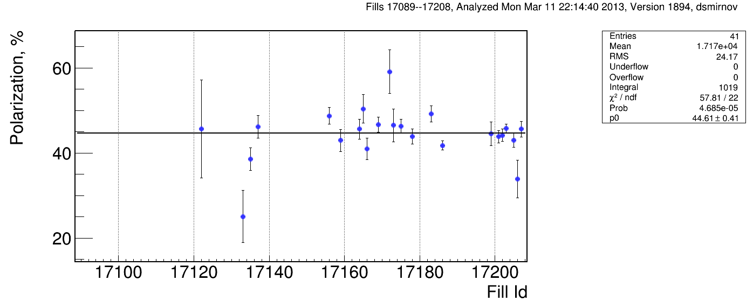
pC Results
at flat top

Slide 6
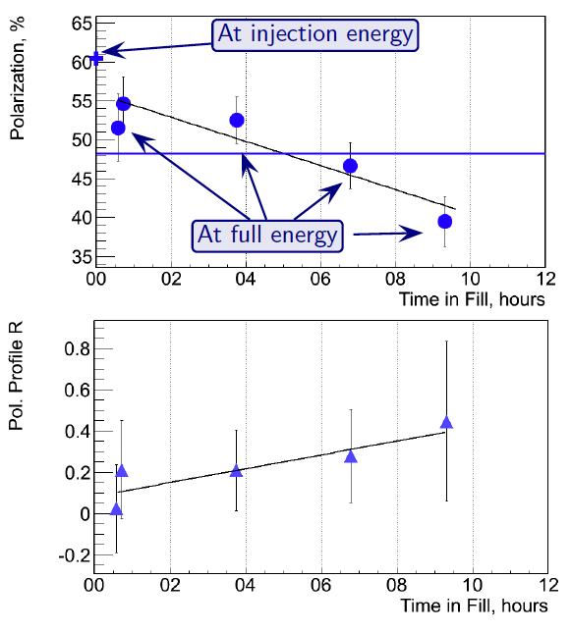
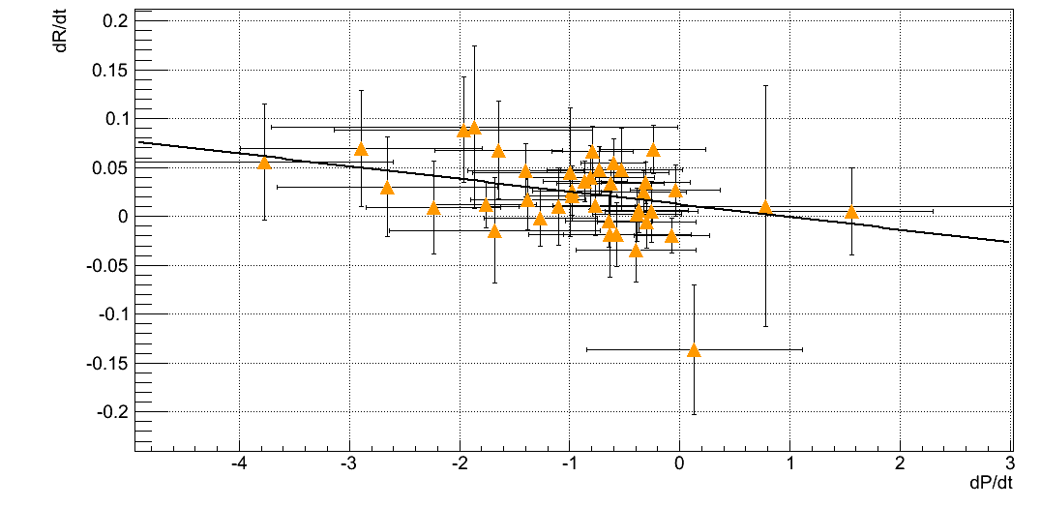
Hadron Polarisation for Experiments
Account for
beam polarization decay through fill → P(t)=P₀exp(-t/τ_{p})
growth of beam polarization profile R through fill
pCarbon
polarimeter
Collider
Experiments
x=x₀
correlation of
dP/dt to dR/dt
for all 2012 fills
at 250 GeV
Polarization lifetime has consequences for physics analysis
different physics triggers mix over fill
→ different <P>

Slide 7
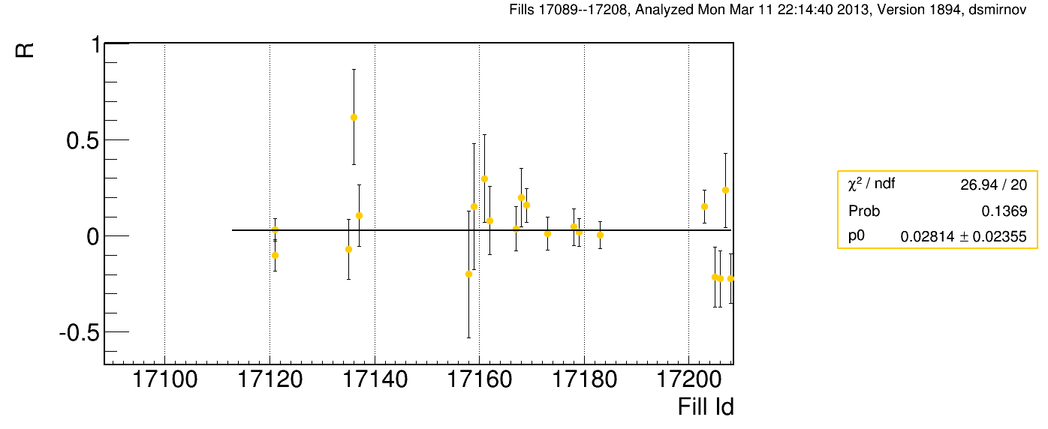
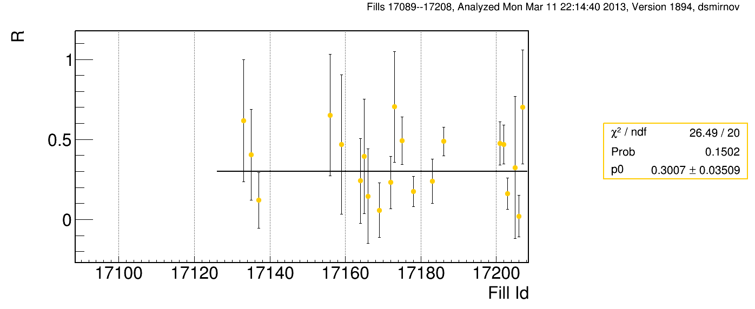
pC Results: profile R
at injection
2012: 0.054+/-0.0104
at flat top
2012: 0.133+/-0.009

Slide 8
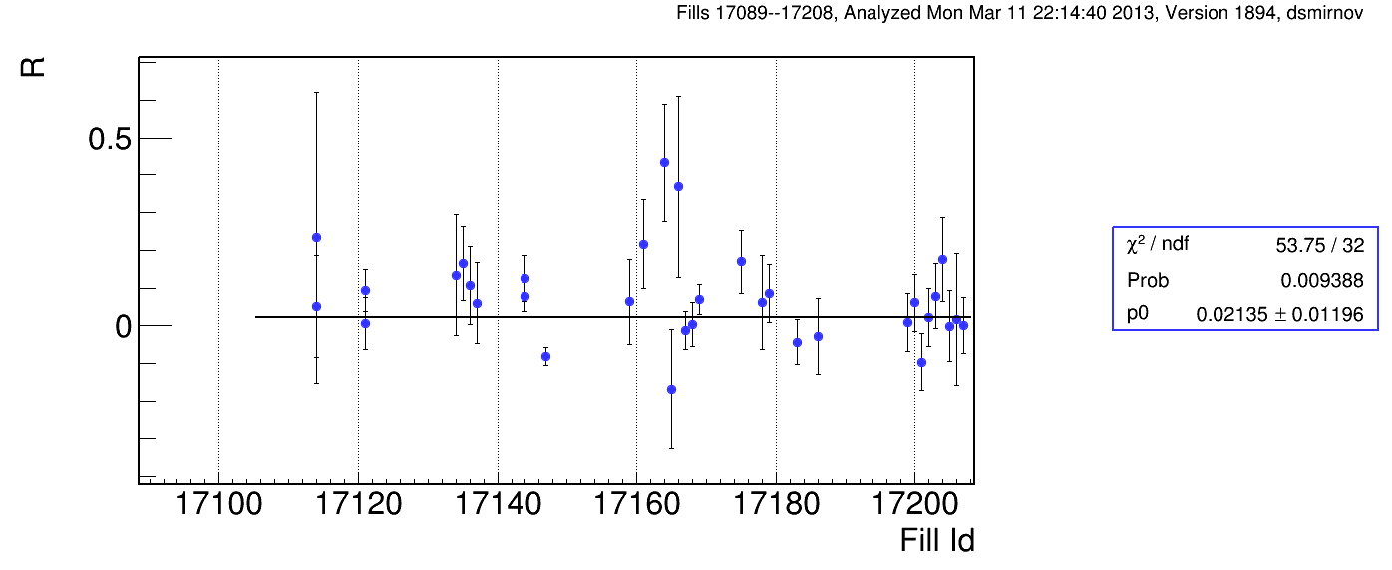
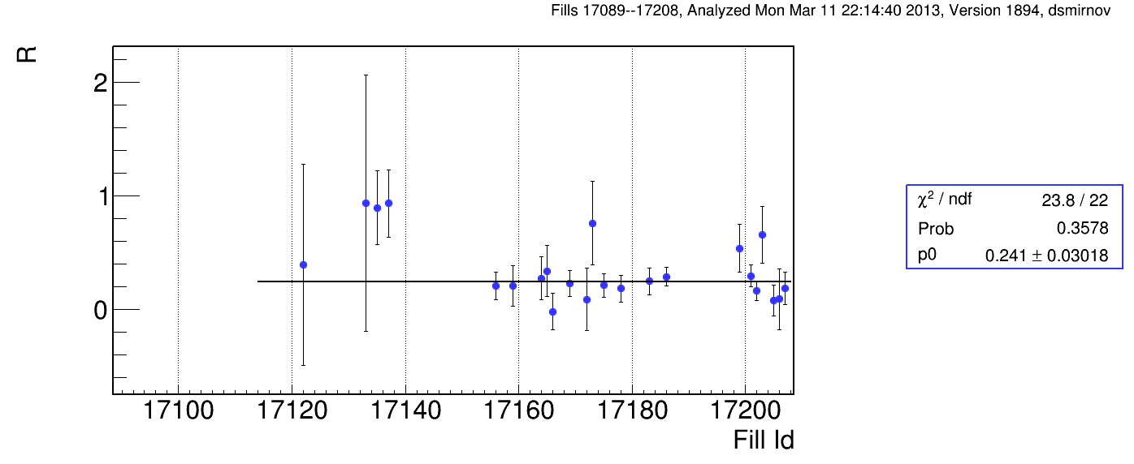
pC Results: profile R
at injection
2012: 0.038+/-0.014
at flat top
2012: 0.205+/-0.011

Slide 9
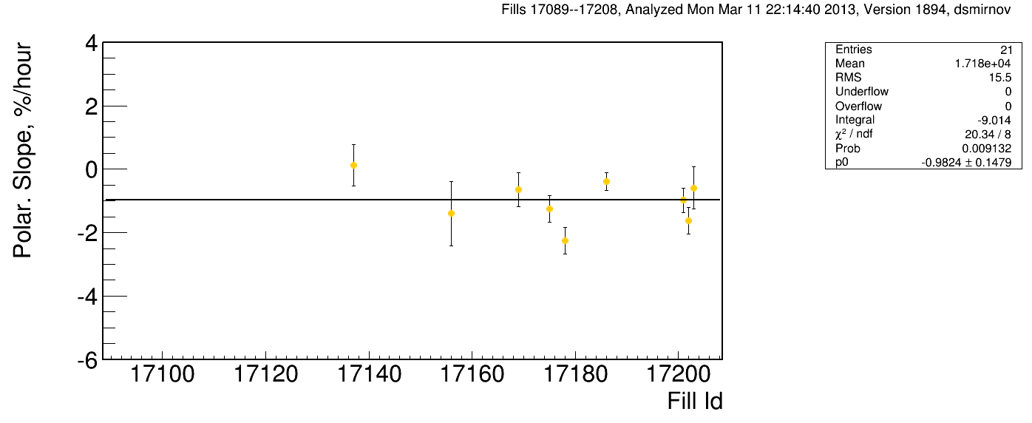
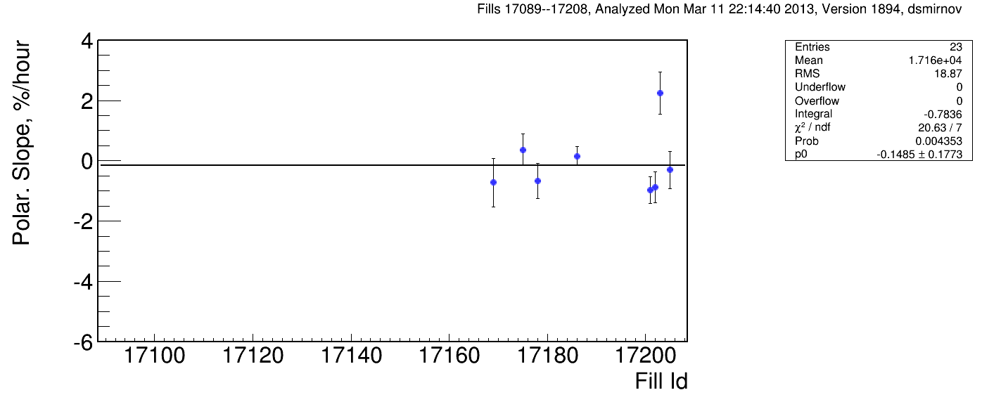
pC Results: Polarisation Decay
2012: -0.61+/-0.056
2012: -0.67+/-0.056

Slide 10
Our Worries Target Death Rate
Use factor 2 thicker targets compared to 2012
but still high death rate
Fill Date Time Energy B1 B2 Y1 Y2
-----------------------------------------------
17208 03/11 18:43 27 H5
17208 03/11 18:47 27 H2
17208 03/11 18:47 27 H4
17205 03/11 6:39 255 V5
17203 03/11 21:59 255 H1 H3 V3
17114 02/26 16:31 27 H6
17172 03/05 18:43 255 V5
17169 03/05 4:20 255 V3 H1
17134 03/01 23:33 255 V1
17121 02/27 18:55 27 V1
17209 03/12 05:08 255 V4
Remaining Targets:
==================
B1: 0 horizontal and 6 vertical
B2: 6 horizontal and 0 vertical
Y1: 4 horizontal and 6 vertical
Y2: 6 horizontal and 2 vertical
Will have to replace targets at one of the next access

