Slide 1
STAR ZDC (and ZDC at high rates in general)
James Dunlop

Slide 2
Killer Bits
Two flavors: with “killer bit” (non-updating deadtime) and without
Killer bit kills afterpulsing in heavy ions. Afterpulsing not a problem in pp, but…
At high rates, killer bit decreases rates substantially
Formula: Real = killed/(1-killed*deadtime)
E.g. for 1 us deadtime, 0.5 MHz killed = 1 MHz real
Believe PHENIX = 400 ns deadtime,0.714 MHz killed = 1 MHz real. Large correction at current singles rates.
This year: deadtime is user settable. Currently (as of March 14) at 1 us, like last years. Did a scan, formula works to within a few percent.
N.B. Issues with signal to C-AD before March 14. Ghosting in killer bit, and inadvertently set to 0.1 us

Slide 3
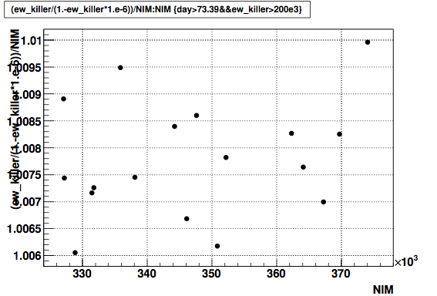
Killer bit correction good to few percent
As read back from RHIC, 1 us deadtime
(Corrected Killed)/Unkilled
Raw ZDC Coincidence unkilled

Slide 4
Signal routing
ZDC East w/o killer: sisscaler_6a_star_2
ZDC West w/o killer: sisscaler_6a_star_1
ZDC Coin w/o killer: sisscaler_6a_star_3
ZDC East w/ killer: not currently connected, but will show up at sisscaler_6a_star_6
ZDC West w/ killer: not currently connected, but will show up at sisscaler_6a_star_5
ZDC Coinc. w/ killer: sisscaler_6a_star_16

Slide 5
Singles/Doubles Corrections
Since singles rates are ~MHz, cannot ignore clocking of the beam. Significant probability of more than one hit in a single crossing, needs to be accounted for.
Simple (ignoring clocking) formula:
Real = EW – (E*W)/clock
Full formula
Real = -clock*ln(1.-(EW-E*W/clock)/(clock+EW-E-W))
Differences are very significant at current rates
Added complication of killer bits. STAR internally uses only non-killed data for correction. PHENIX?
NOTE: this formula assumes uniform population bunch-by-bunch. STAR actually does the final correction bunch-by-bunch, but not possible in real time or in RHIC scalers.

Slide 6
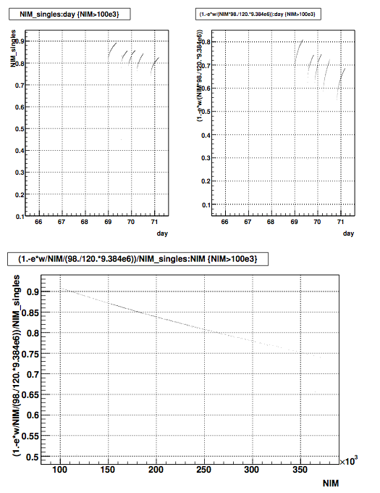
Full Formula
Simple formula
With wrong correction formula, will underestimate instantaneous
luminosity by large amount
Simple/Full
Raw ZDC coincidence rate, unkilled [Hz]

Slide 7
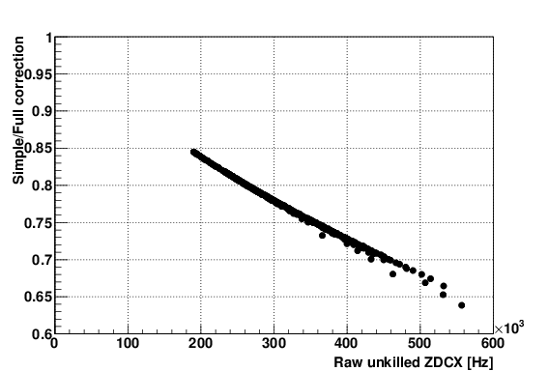
Underestimate of Luminosity

Slide 8
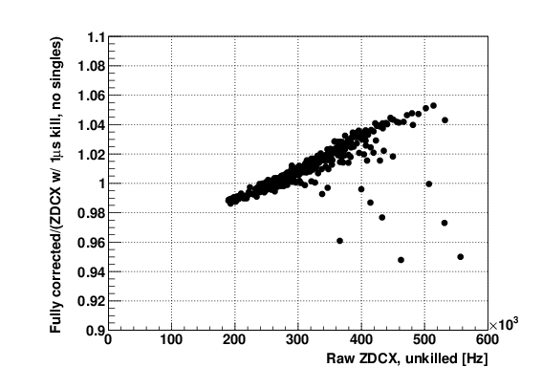
Accidental cancellation
By pure accident, ZDC coincidence w/ 1 us dead, no singles correction = Real ZDC coincidence after full correction, to within +/- 5%

