Slide 1
PHENIX Run-13 status
Hubert van Hecke
for the PHENIX collaboration

Slide 2
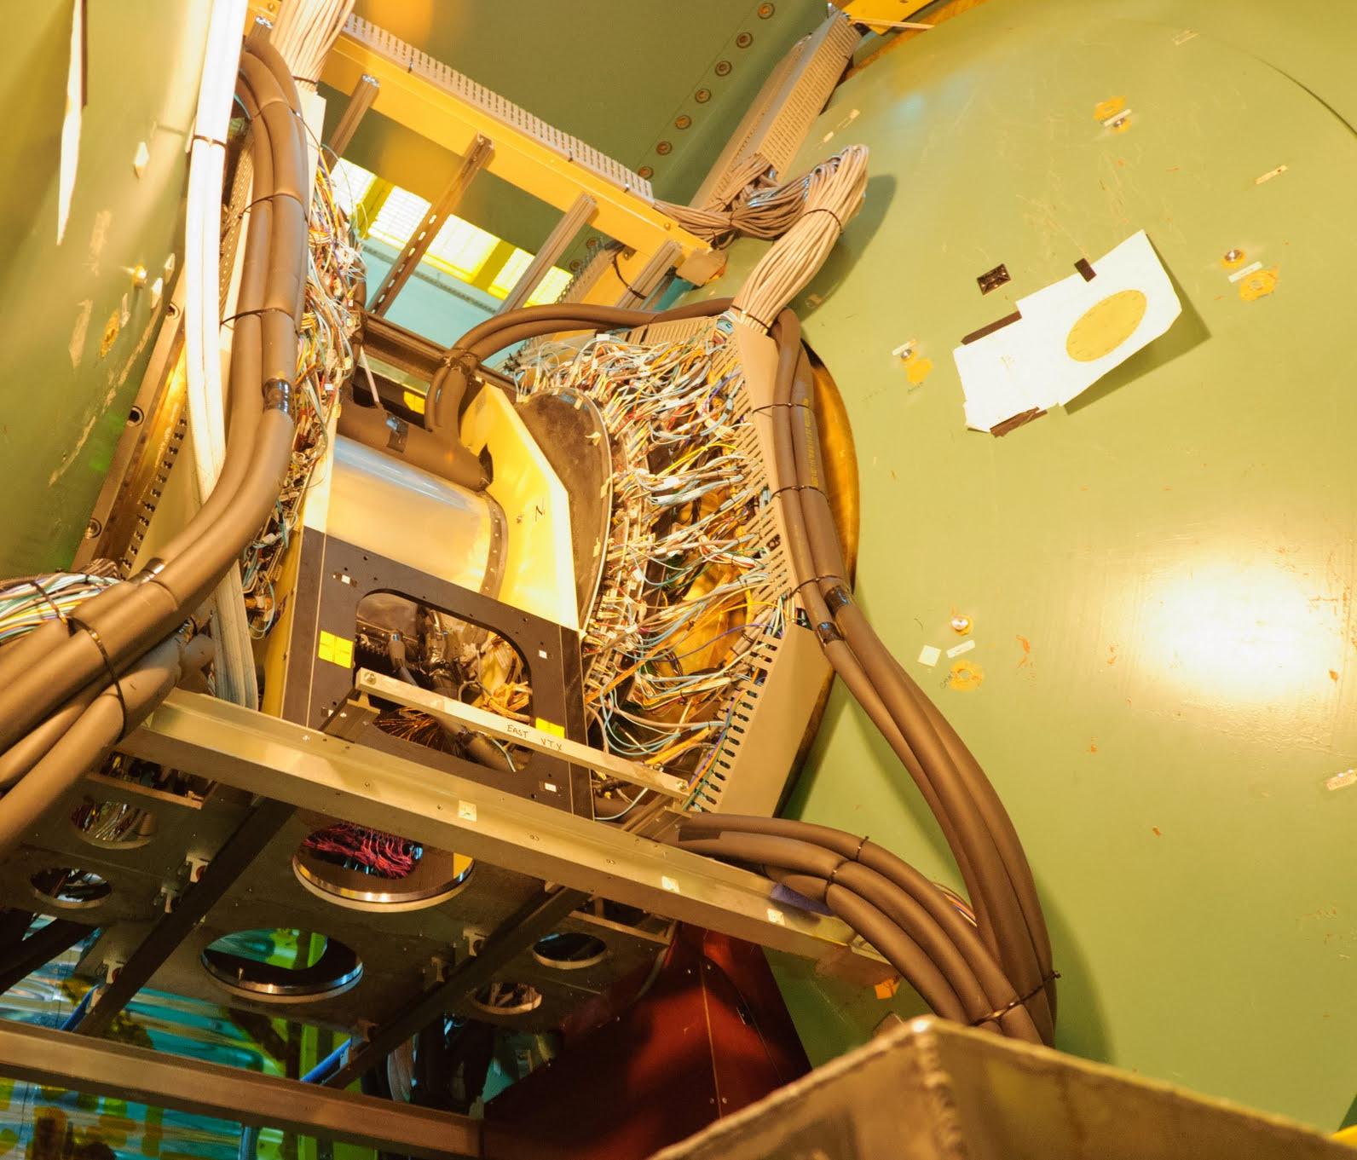
Preparations continue
Tuning up the trigger system
Check out subsystem monitoring
Prepare the fast-production system
With beam, system checks and full-detector runs
No beam: calibrations
(IR access when available)
On Friday, move the Silicon
detectors in from the retracted position.

Slide 3
Criteria for start-of-physics
109 bunches in the machine
Longitudinal polarization established, <5% transverse component
>=55% polarization at the start of the store
Beta* = 0.65
>1*10¹¹ protons/bunch

