Slide 1
Run 13 RHIC Machine/Experiments Meeting
16 April 2013
Agenda:
Status Reports
Progress report on FGT commissioning (Berndt Surrow)

Slide 2
Run 13 plan based on 20 weeks cryo operation and Fischer et.al. RHIC Collider Projections (FY 2013 – FY 2017), 27 Sep 2012
11 Feb, Begin cool-down to 4.5K
15 Feb, Cool-down to 4.5K in Blue and Yellow Ring complete, begin magnet setup
26 Feb, first collisions
15 Feb -1 Mar, RHIC √s = 510 GeV pp machine setup
1-8 Mar, machine ramp-up with 8 hr/night for experiment setup
9 Mar (store 17201), begin √s = 510 GeV pp physics run
today, 16 Apr…
27 May, end 15 cryo weeks
6 Jun, switch to √s = 15 GeV/n AuAu if pp goals are met and end 12.7 week √s = 510 GeV pp physics run
27 Jun, end ~2.5 week √s = 15 GeV/n AuAu physics run or 15.9 week √s = 510 GeV pp physics run, begin cryo warm-up
30 June, cryo warm-up ~complete (19.9 cryo-weeks)
See http://www.rhichome.bnl.gov/AP/Spin2013/ for the Run Coordinator’s detailed plan

Slide 3
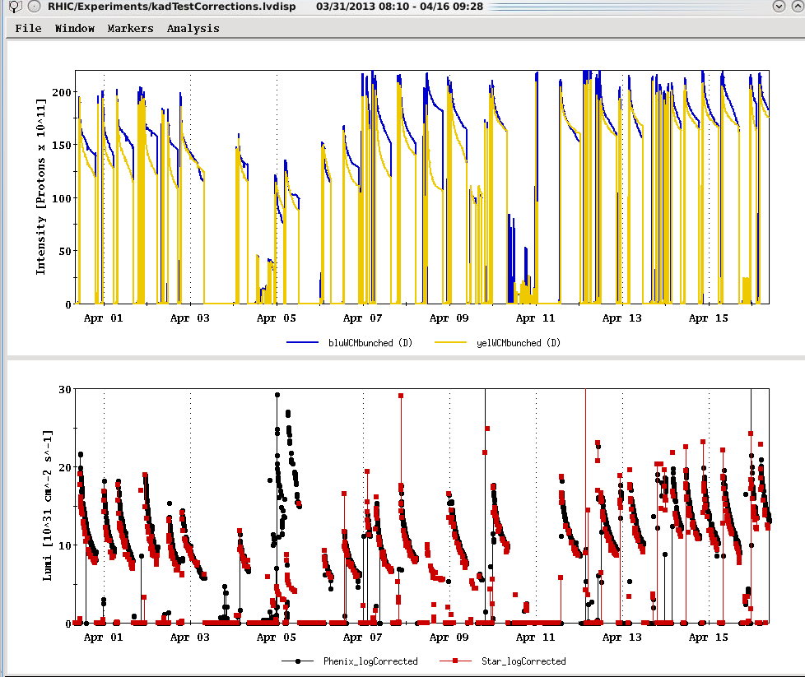
Run 12 lattice
Maximum goal
Maximum goal (peak lumi)
NEW RECORD!

Slide 4
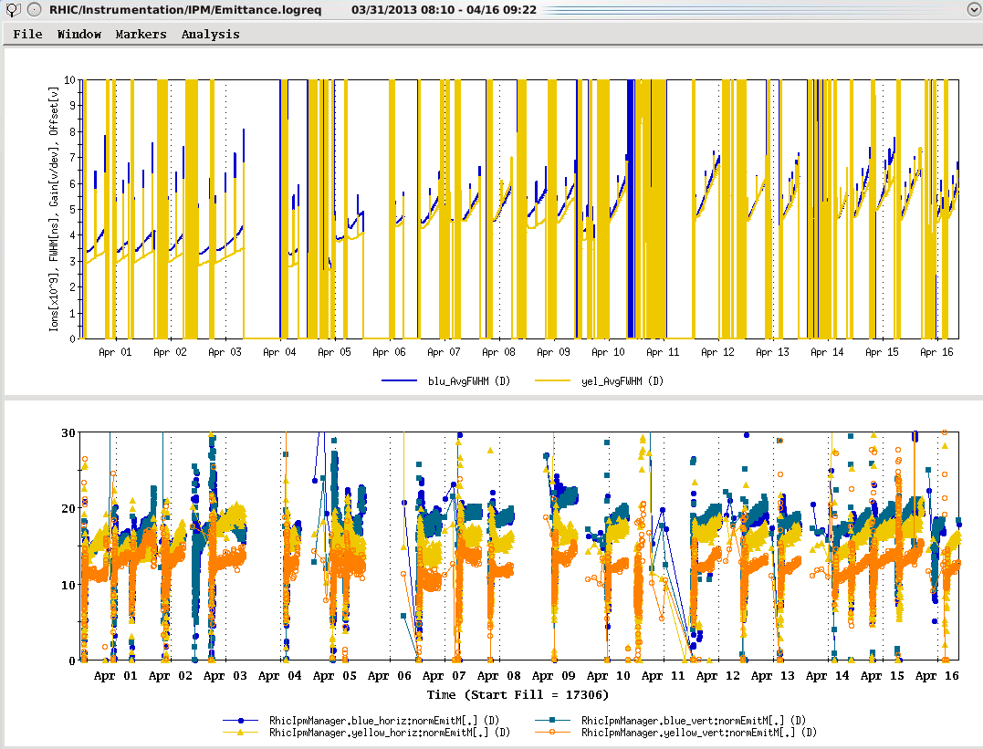
Run 12 lattice

Slide 5
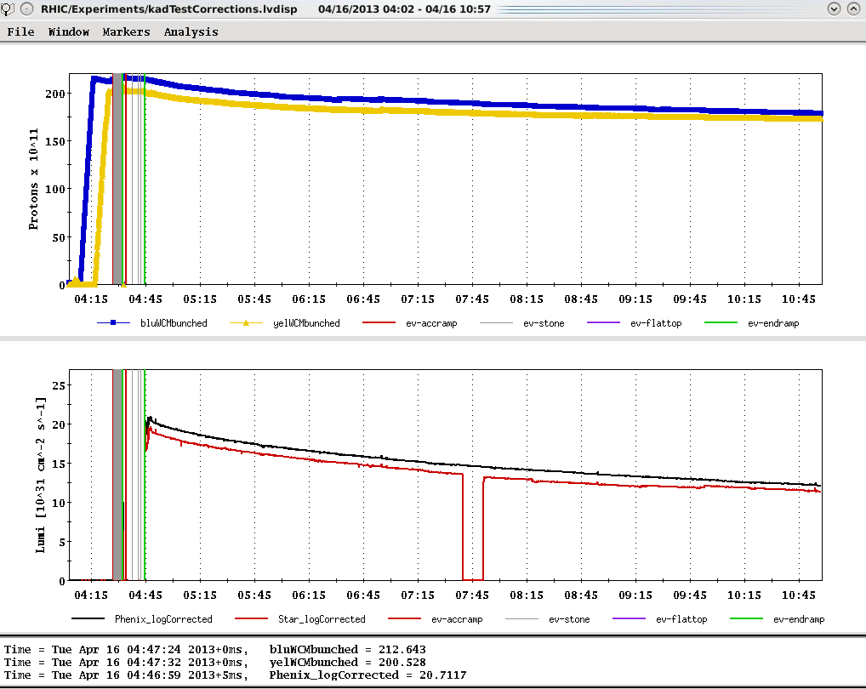
Ions (maximum)
Store 17391, 4/16/2013 – best peak lumi to date
L_{peak}(= 2.1x10³² cm⁻²s⁻¹
L_{peak}(maximum=2.7x10³²)
L_{average}(maximum=1.6x10³²)

Slide 6
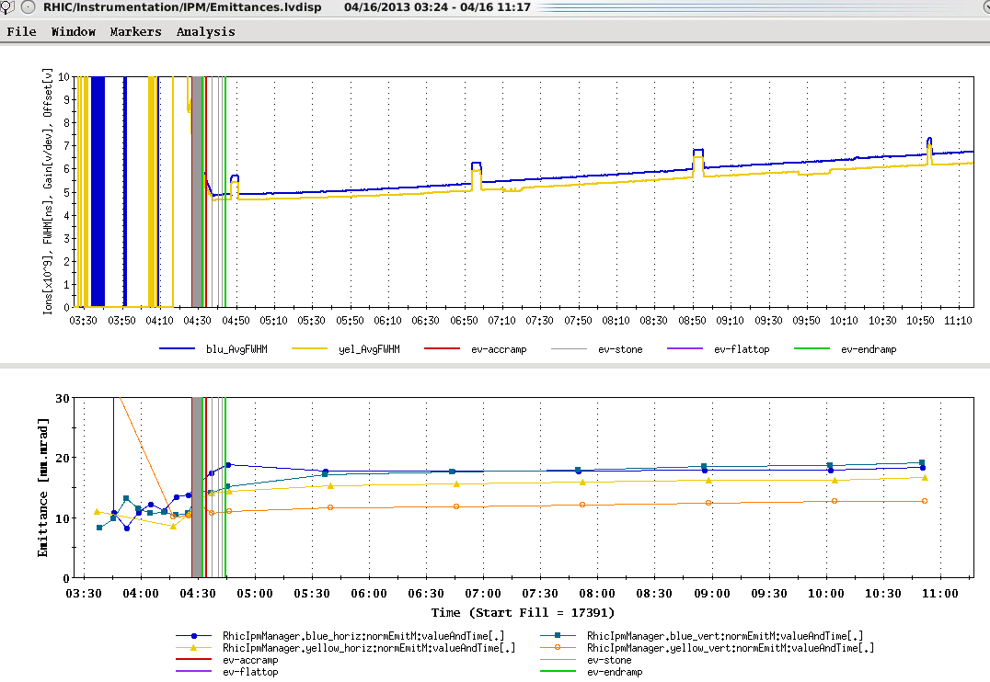
Goal emittance (19-25 π mm-mr)

Slide 7
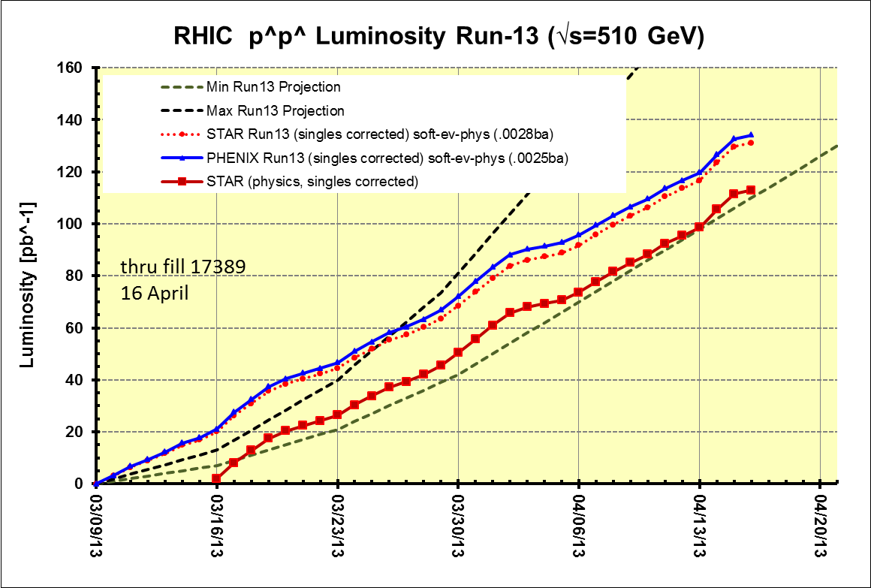
Preliminary, with Run 13 cross sections, PHENIX and STAR log based singles correction

Slide 8
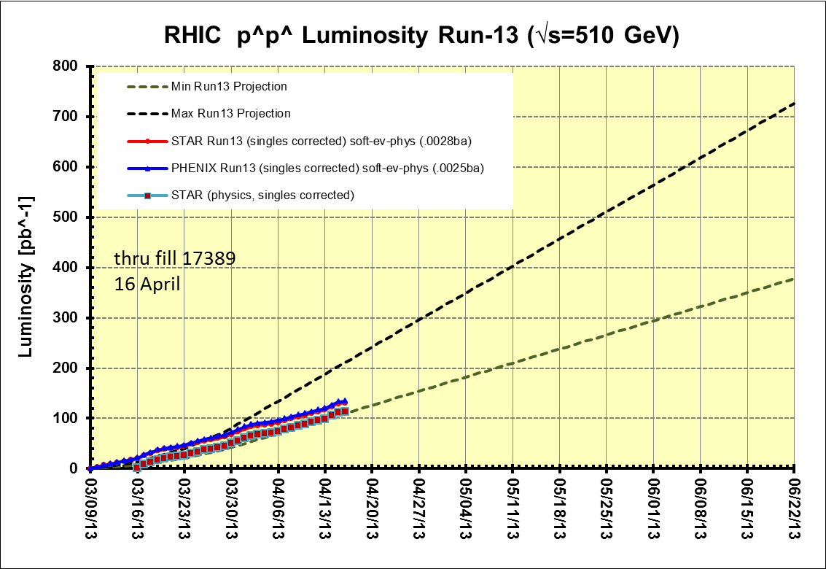
Preliminary, with Run 13 cross sections, PHENIX and STAR log based singles correction
PHENIX Goal, 250 pb⁻¹ recorded, 750 pb⁻¹ delivered, ≥ 55% polarization
STAR Goal, 165 pb⁻¹ recorded, 275 pb⁻¹ delivered, ≥ 55% polarization
PHENIX GOAL
15 cryo weeks
STAR GOAL
Decision time for low energy AuAu
Preliminary, with Run 13 cross sections, singles corrected

Slide 9
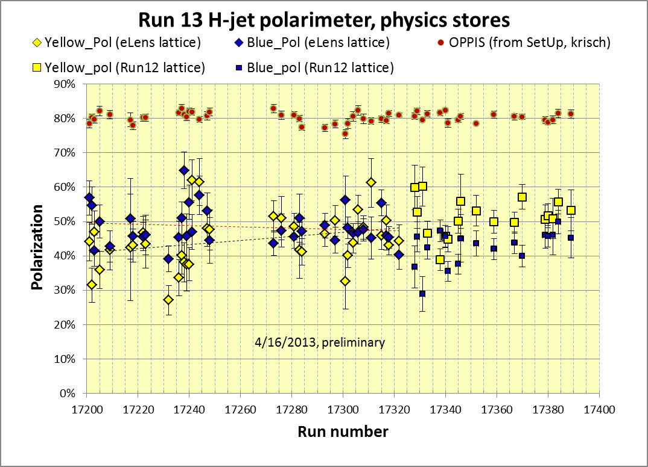
Yellow average = 44.3 ± 0.8%
Blue average = 47.7 ± 0.7%
stores 17201-17322 (eLens lattice)
Yellow average = 50.0 ± 0.9%
Blue average = 42.6± 0.9%
stores 17328 – 17389 (Run 12 lattice)
https://wiki.bnl.gov/rhicspin/Polarimetry/H-jet/Run13

Slide 10
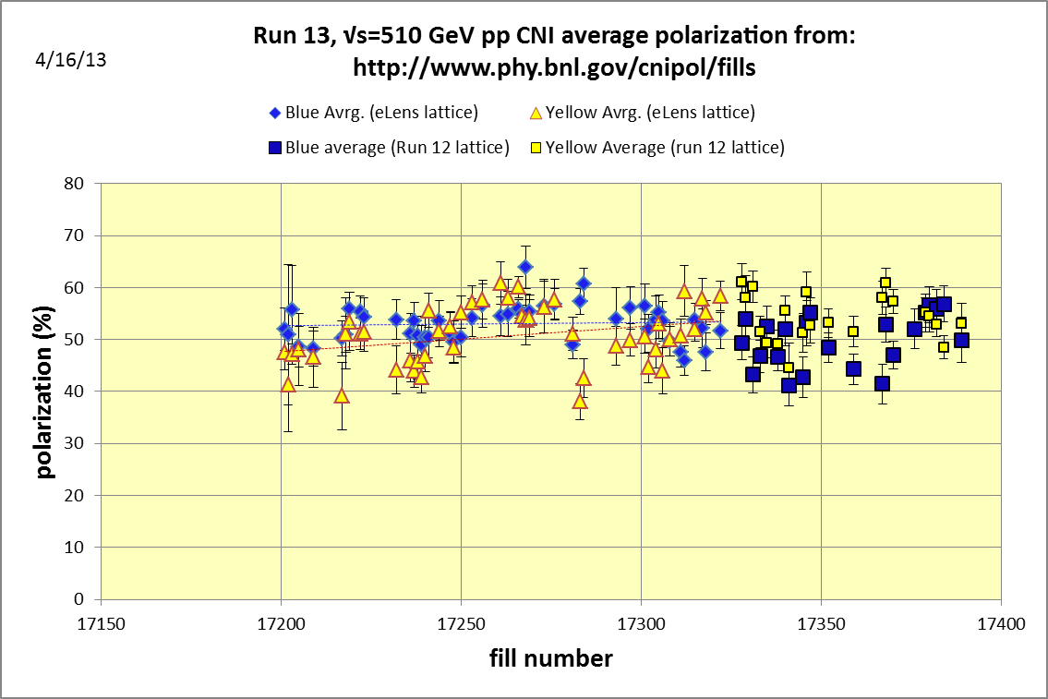
Yellow average = 52.3± 0.5%
Blue average = 53.5 ± 0.5%
Average = 52.9%
stores 17201-17322 (eLens lattice)
Yellow average = 54.0± 0.7%
Blue average = 49.7± 0.7%
Average = 51.9%
stores 17328-17389 (Run 12 lattice)
With 4/16/2013 update to all measurements

Slide 11
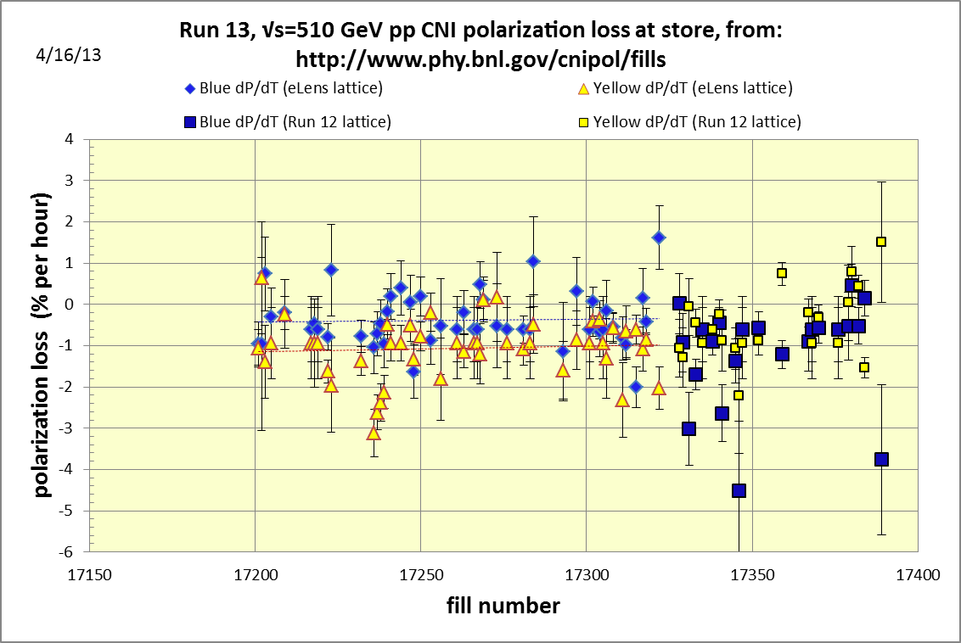

Slide 12
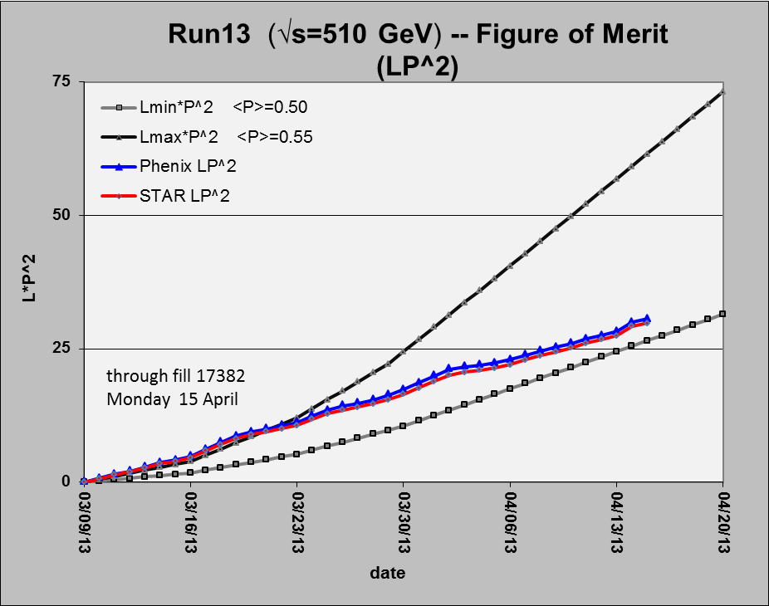
Preliminary, with Run 13 cross sections, PHENIX and STAR log based singles correction
Using average polarizations from CNI polarization from http://www.phy.bnl.gov/cnipol/fills/

Slide 13
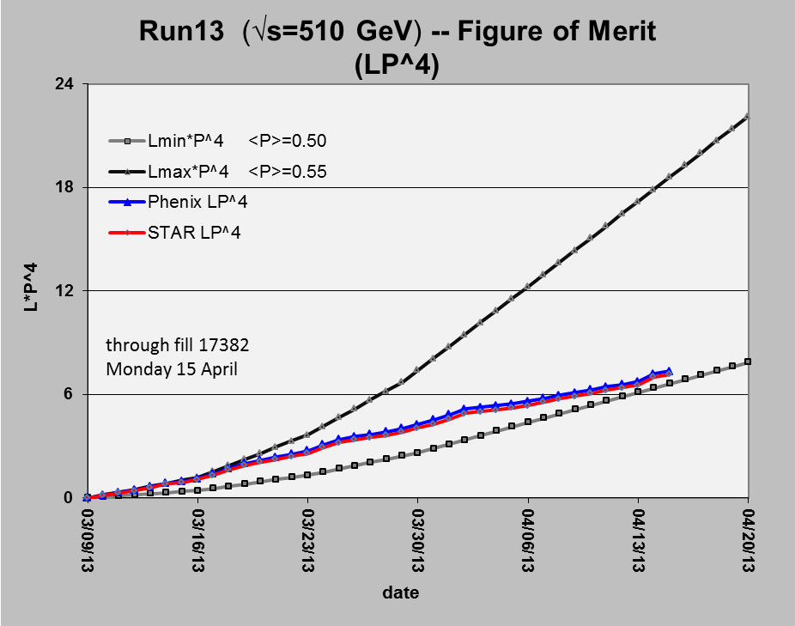
Preliminary, with Run 13 cross sections, PHENIX and STAR log based singles correction
Using average polarizations from CNI polarization from http://www.phy.bnl.gov/cnipol/fills/

Slide 14
Additional Information

Slide 15
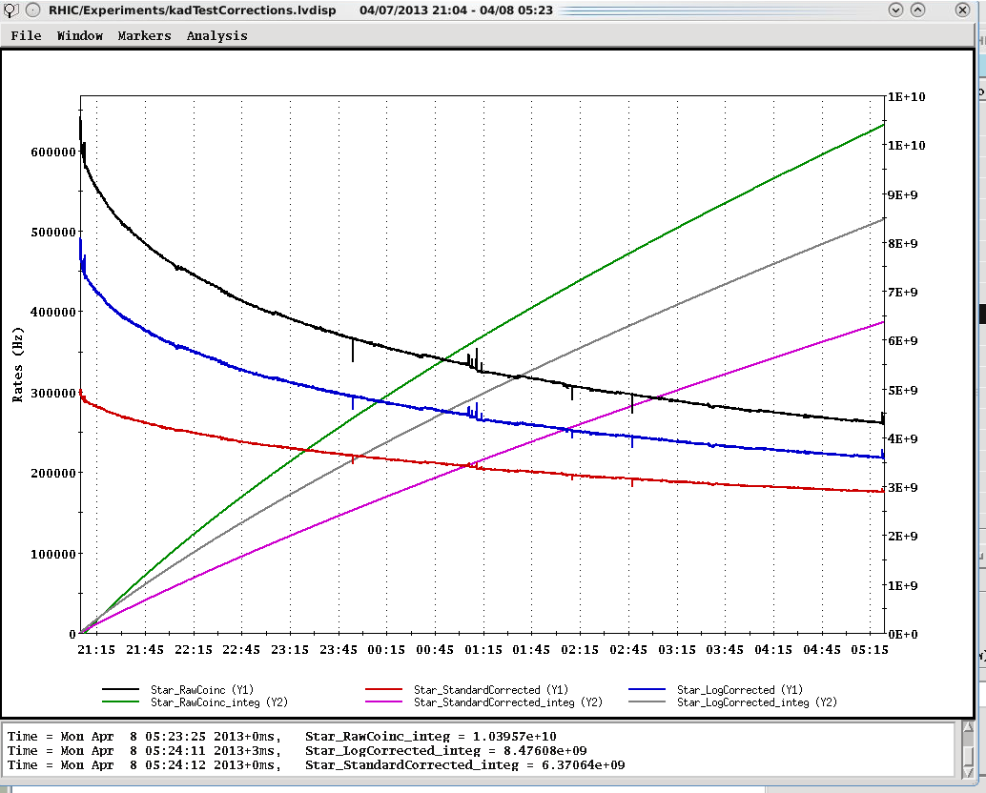
Example Store for STAR (17340) with “physics” time cuts
Log based singles correction → 8.48E8/2.8mb = 3.03 pb-1
Standard singles correction → 6.371E8/2.5mb = 2.55 pb-1
~x1.5
(1.3 lumi)
Raw ZDC coinc
ZDC Log singles corr.
~x1.2
(1.1 lumi)
}
ZDC Standard singles corr.
integrals
Integrated lumi Log/Standard = 1.19

Slide 16
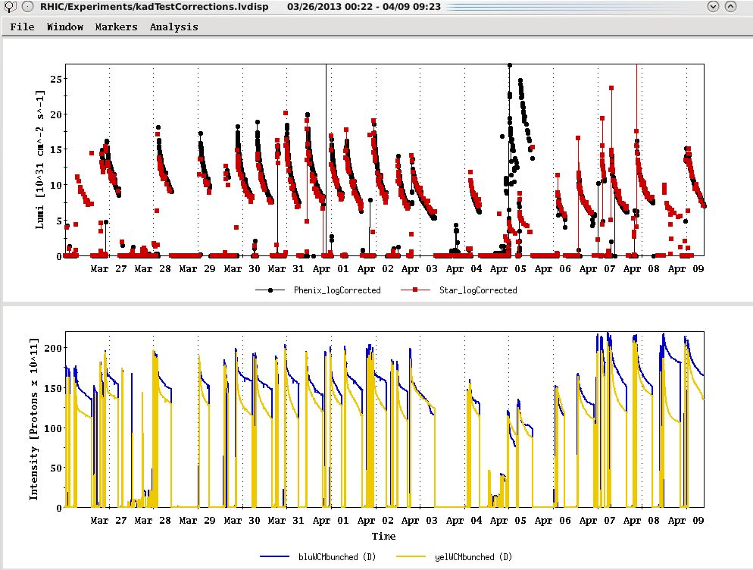
Physics stores
Past 2 Weeks
Run 12 lattice
L_{peak}(maximum=2.7E32)
17340
L_{average}(maximum)
Using Run 13 cross sections with log based singles correction
Ions (maximum)

Slide 17

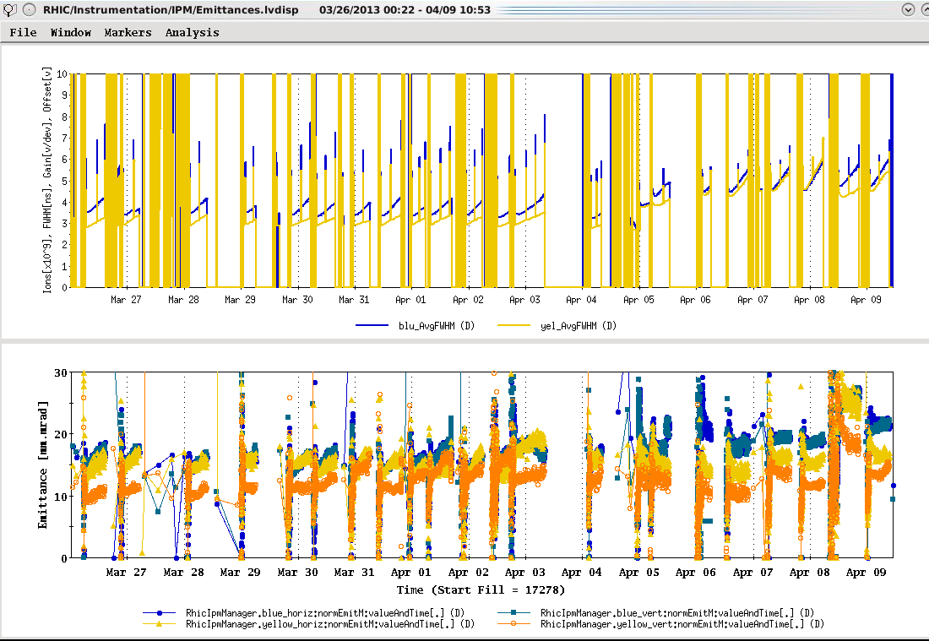
Run 12 lattice

Slide 18
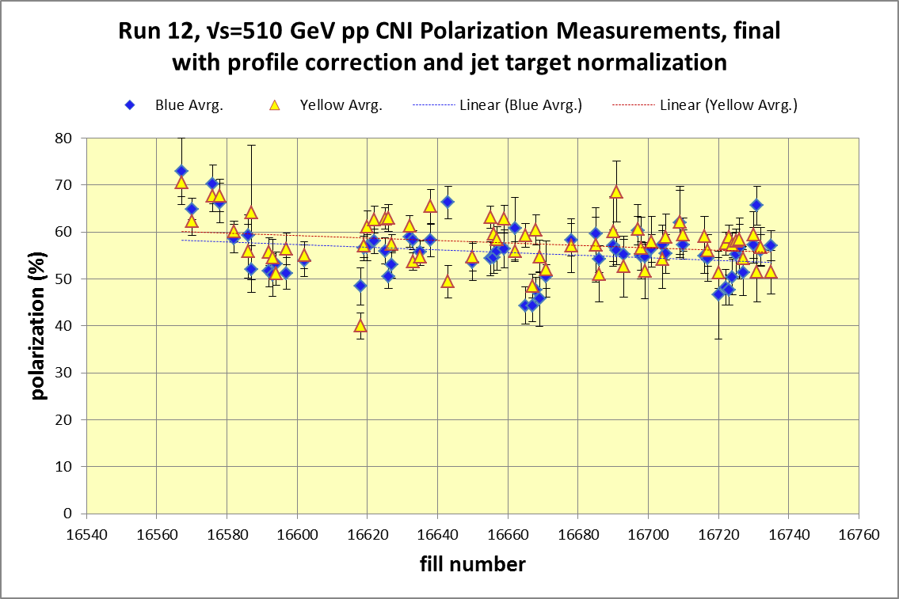
Yellow average = 48.12± 0.4%
Blue average = 53.1 ± 0.5%
http://www.phy.bnl.gov/cnipol/fills/

Slide 19
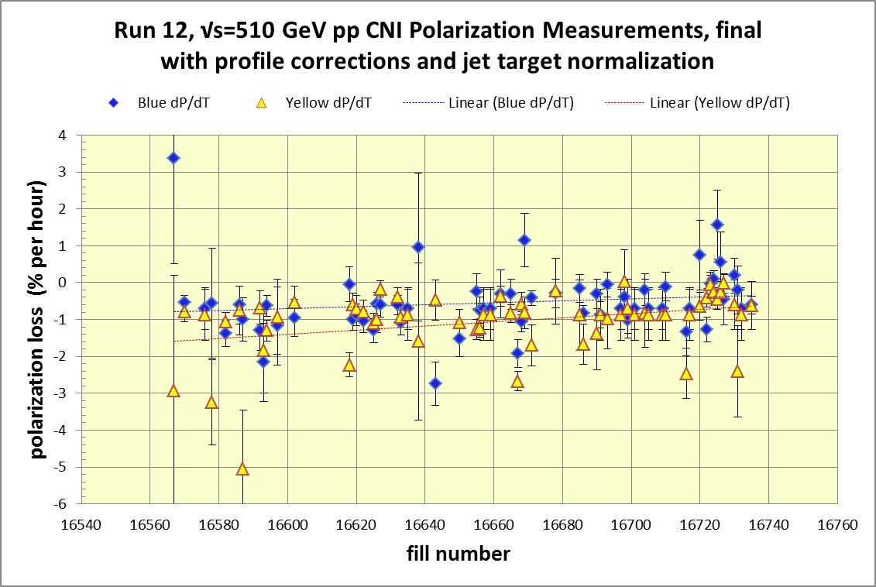
Yellow average = 57.7± 0.4%
Blue average = 55.9 ± 0.4%
Average = 56.8%
http://www.phy.bnl.gov/cnipol/fills/

Slide 20
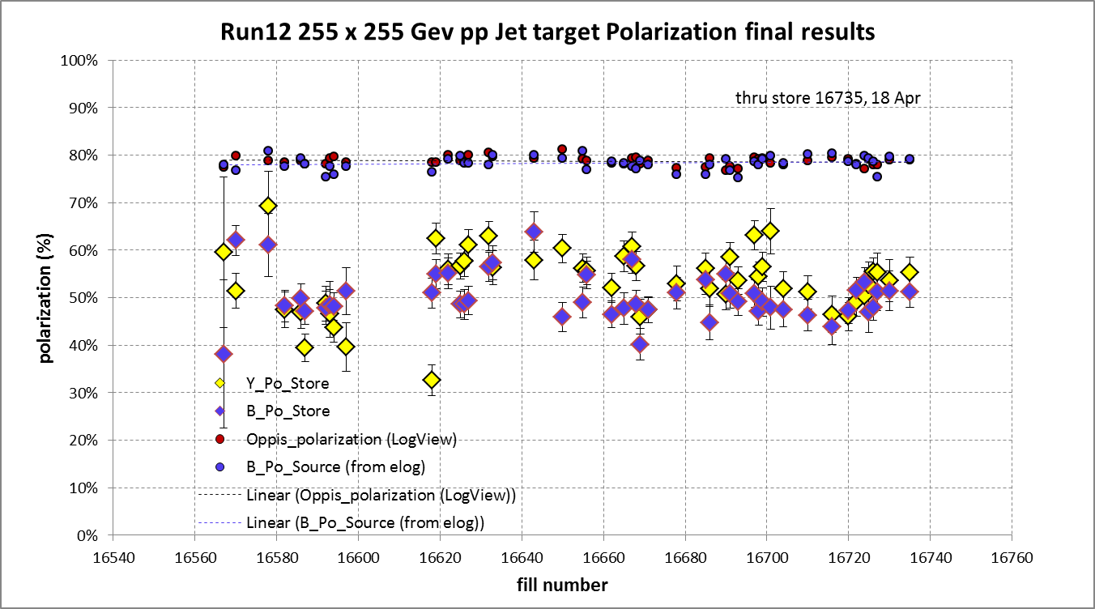
And Yellow beam at injection jet target Run 12 result = 63.0 ± 4.4%
Blue jet target weighted average = 50.3% ± 0.5%
Yellow jet target weighted average = 53.4% ± 0.5%

Slide 21
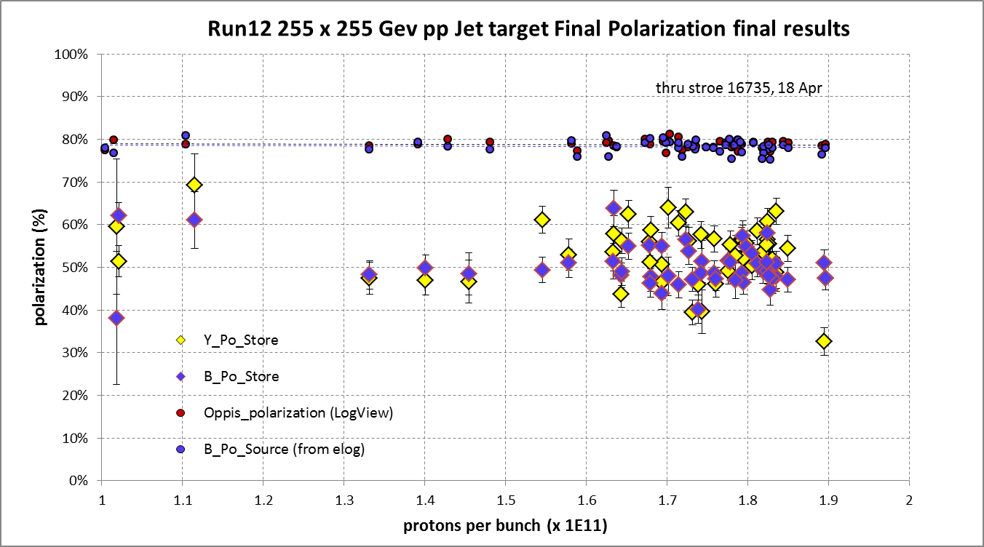
Yellow average = 53.4 ± 0.5%
Blue average = 50.3 ± 0.5%

Slide 22
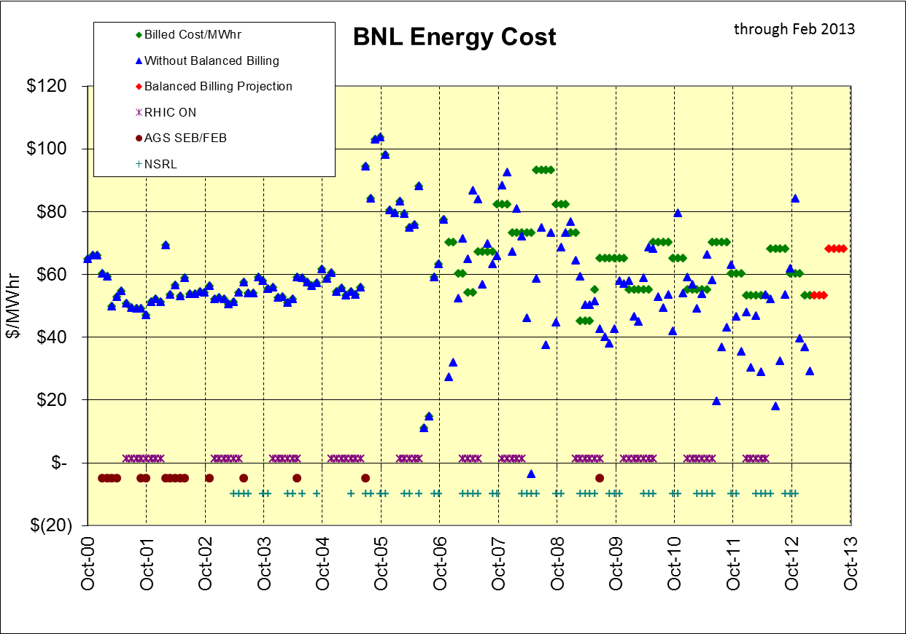
Feb 2013 bill
$28.89 actual
billed at $53/Mwhr
+$1,132K in BNL bank through Feb 2013
Dec-Jan-Feb

Slide 23
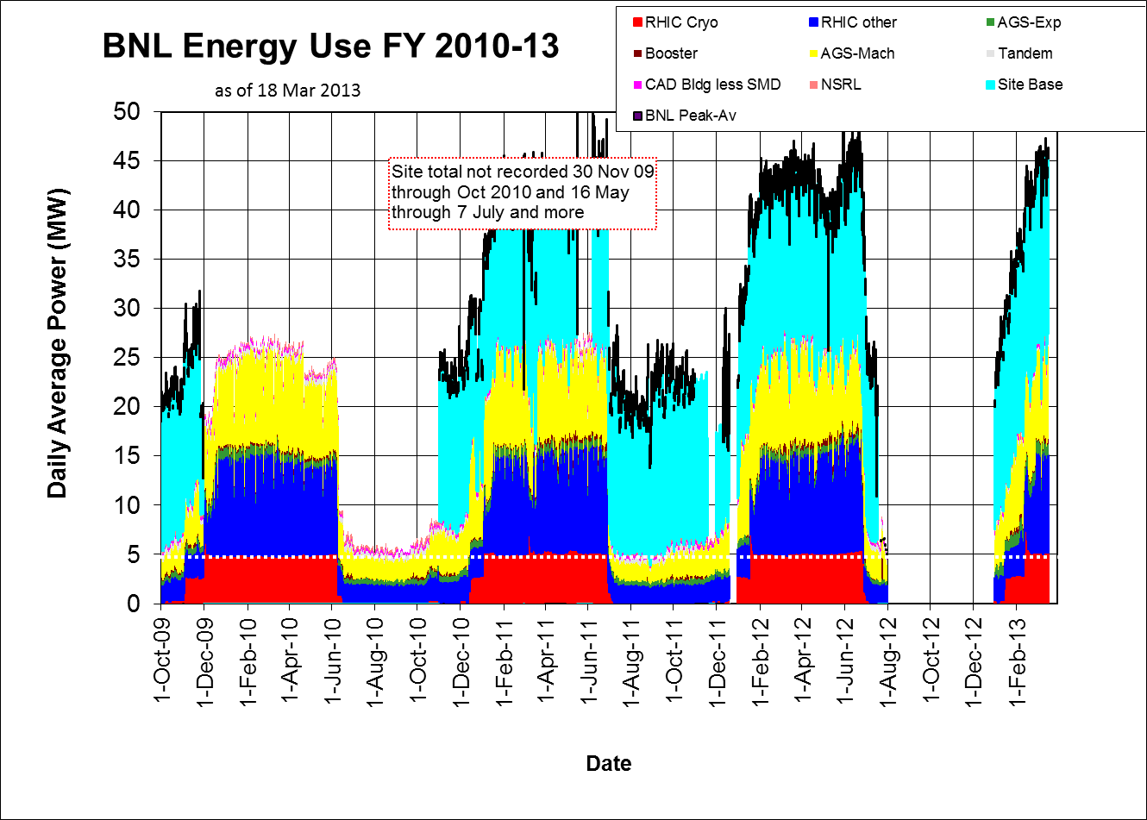

Slide 24
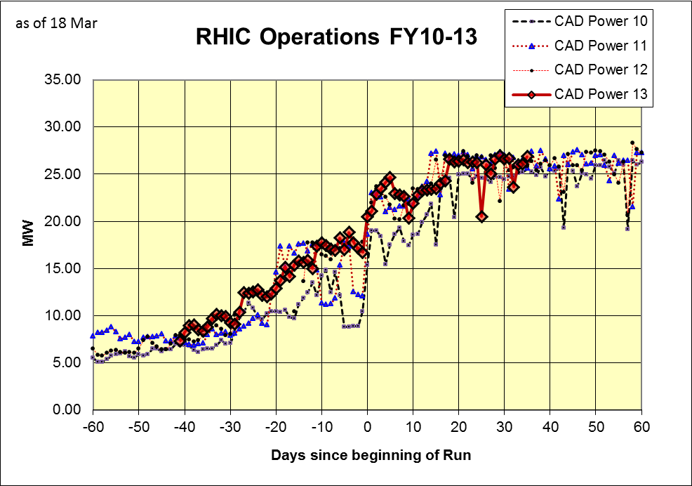

Slide 25
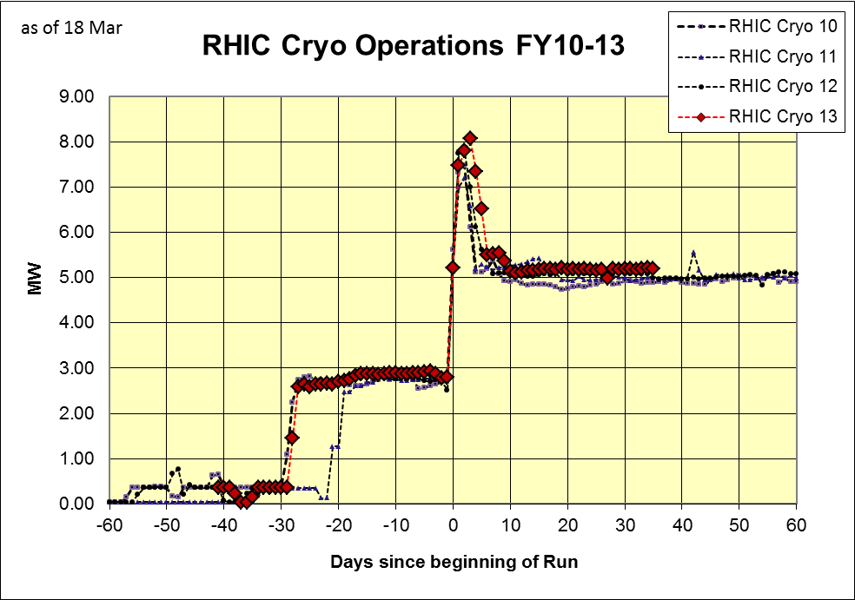

Slide 26
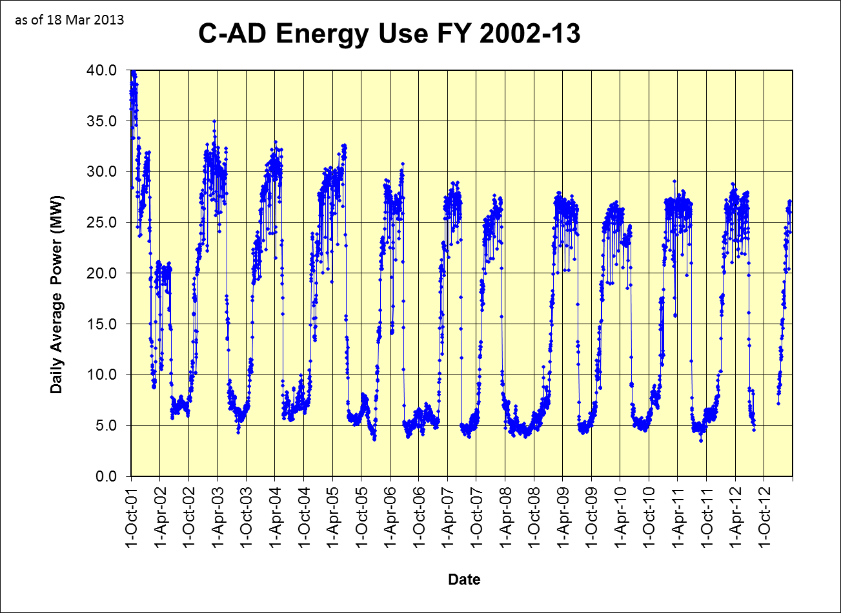

Slide 27
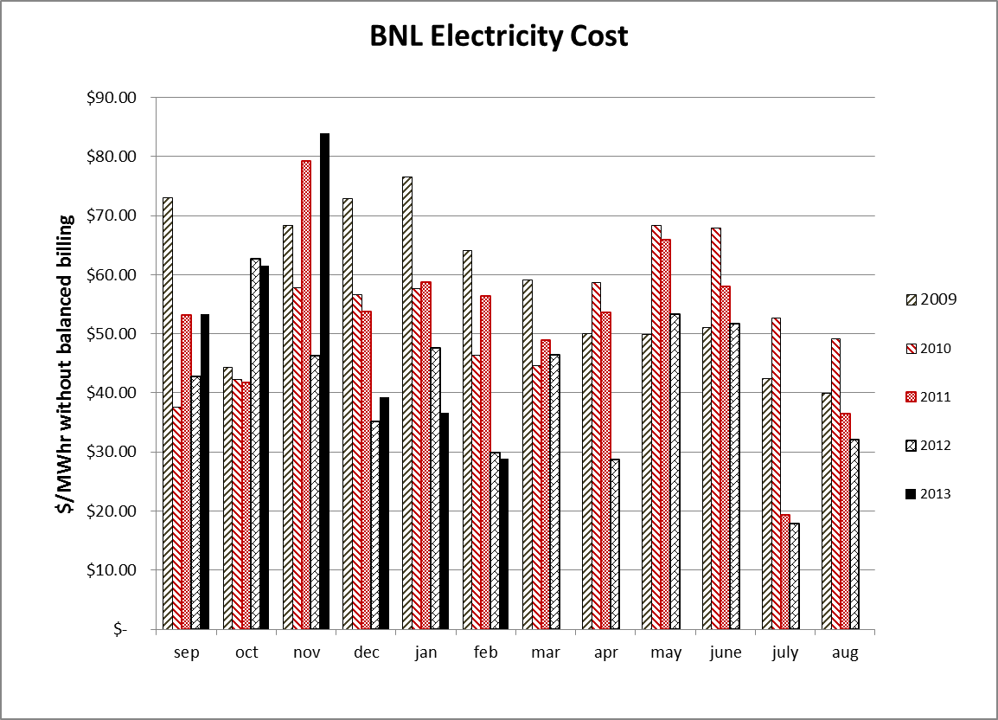

Slide 28
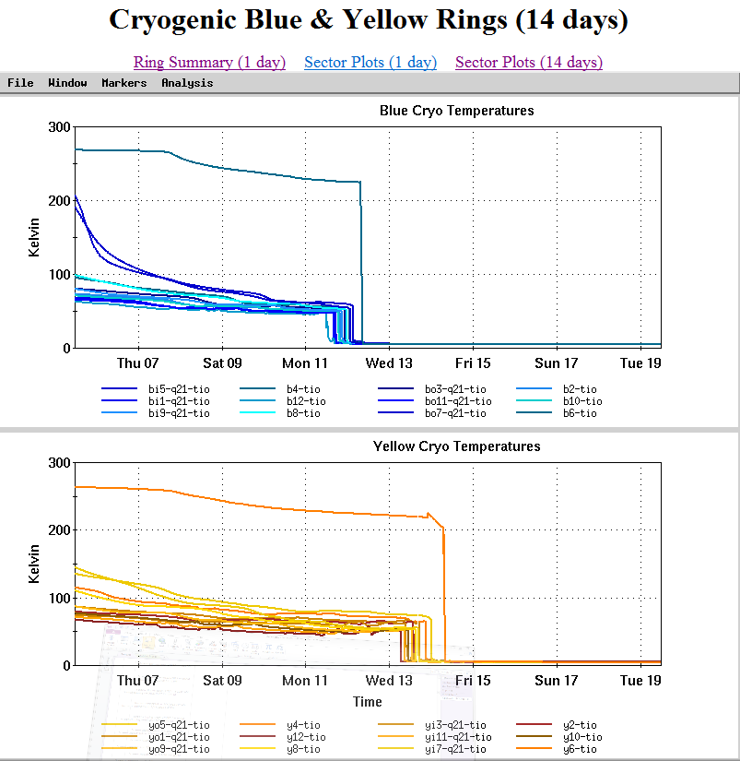

Slide 30
For Run 13 the PAC recommends the following (in order of priority):
Running with polarized proton collisions at 500 GeV to provide an integrated luminosity of 750 pb⁻¹ at an average polarization of 55%.
2. Depending on the amount of running time remaining after priority #1
  a. If less than 3 weeks remain, a week of 200 GeV Au+Au collisions.
  b. If at least 3 weeks of running time remain, 3 weeks of 15 GeV Au+Au
  collisions.
3. 8 days of 62 GeV p+p collisions.
4. At the discretion of the ALD, 4 days of low-luminosity running to accomplish the pp2pp goals.

