Slide 1
Run 13 RHIC Machine/Experiments Meeting
30 April 2013
Agenda:
Status Reports
Arguments for/against low energy Au run

Slide 2
Run 13 plan based on 17 weeks cryo operation
11 Feb, Begin cool-down to 4.5K
15 Feb, Cool-down to 4.5K in Blue and Yellow Ring complete, begin magnet setup
26 Feb, first collisions
15 Feb -1 Mar, RHIC √s = 510 GeV pp machine setup
1-8 Mar, machine ramp-up with 8 hr/night for experiment setup
9 Mar (store 17201), begin √s = 510 GeV pp physics run
today, 30 Apr…
decision time for switch to √s = 15 GeV/n AuAu.
if decide to run AuAu for 2.5 weeks (2 weeks physics)
20 May (Monday), switch to 15 GeV/n AuAu – begin ½ week AuAu setup
24 May (Friday), begin 15 GeV/n AuAu physics
7 June (Friday), end ~2.0 week √s = 15 GeV/n AuAu physics run or 13.0 week √s = 510 GeV pp physics run, begin cryo warm-up
10 June, cryo warm-up ~complete (17.0 cryo-weeks)

Slide 3
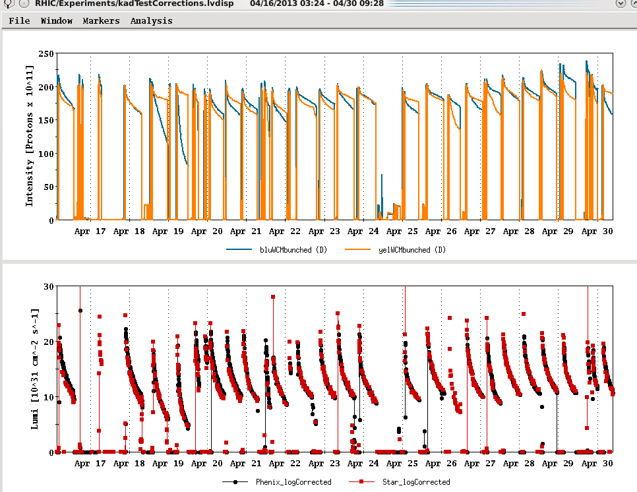
Run 12 lattice
Maximum goal
PREVIOUS RECORD
Maximum goal (peak lumi)

Slide 4
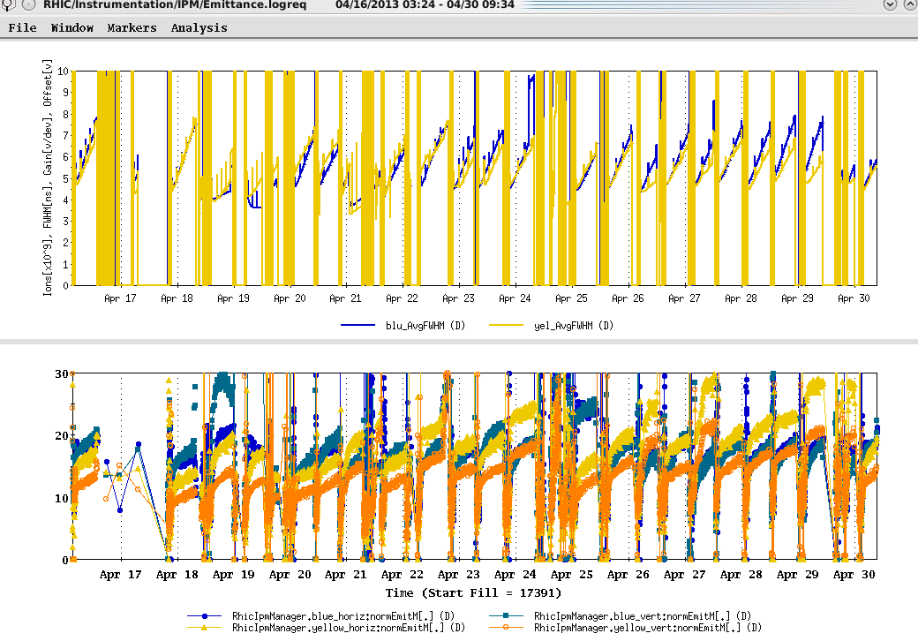

Slide 5
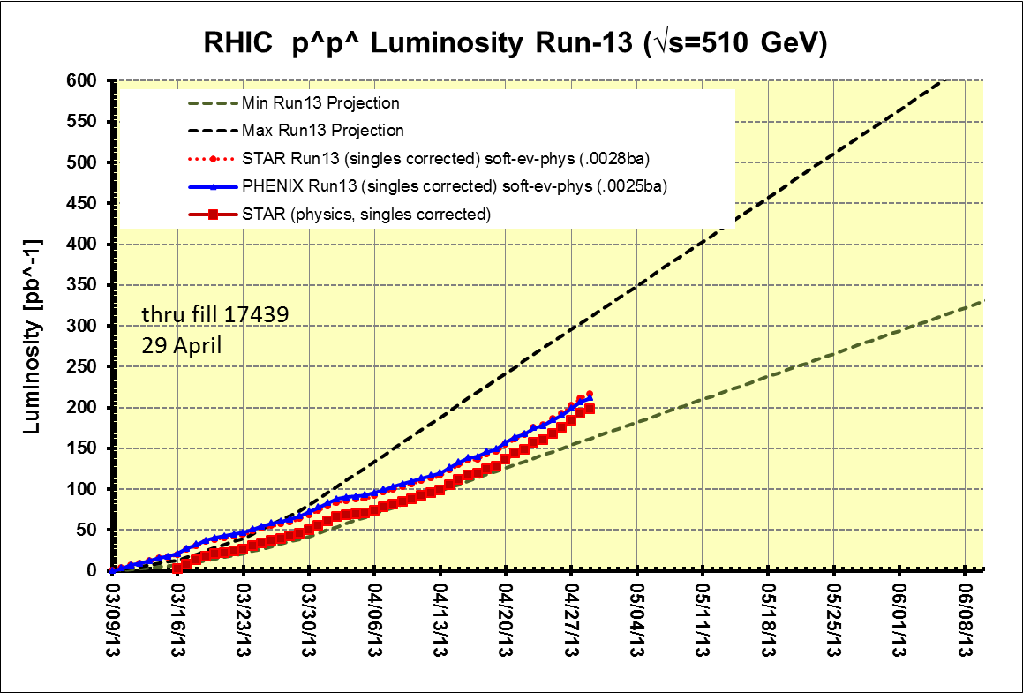
Preliminary, with Run 13 cross sections, PHENIX and STAR log based singles correction
PHENIX Goal, 250 pb⁻¹ recorded, 750 pb⁻¹ delivered, ≥ 55% polarization
STAR Goal, 165 pb⁻¹ recorded, 275 pb⁻¹ delivered, ≥ 55% polarization
(PHENIX Goal)
Switch to low energy AuAu ??
17 cryo
weeks
(STAR Goal)
Begin cryo
warm-up
Decision time for low energy AuAu
Preliminary, with Run 13 cross sections, singles corrected

Slide 6
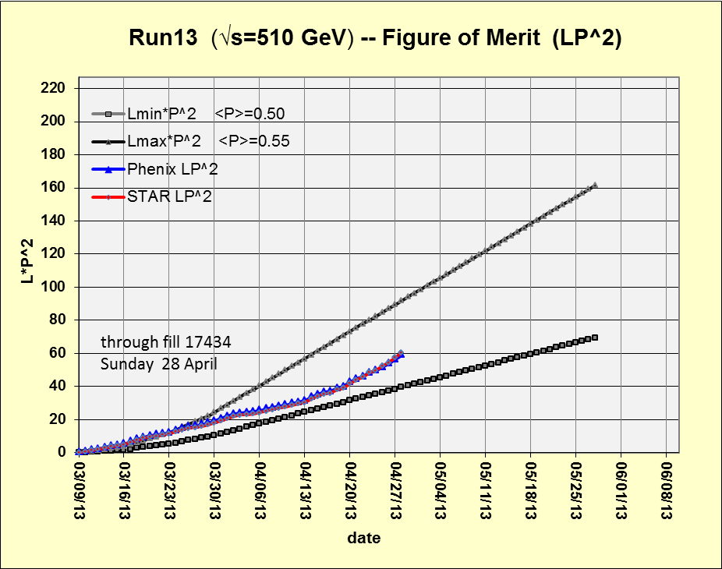
Preliminary, with Run 13 cross sections, PHENIX and STAR log based singles correction
750*(0.55)²
275*(0.55)²
Using average polarizations from CNI polarization from http://www.phy.bnl.gov/cnipol/fills/

Slide 7
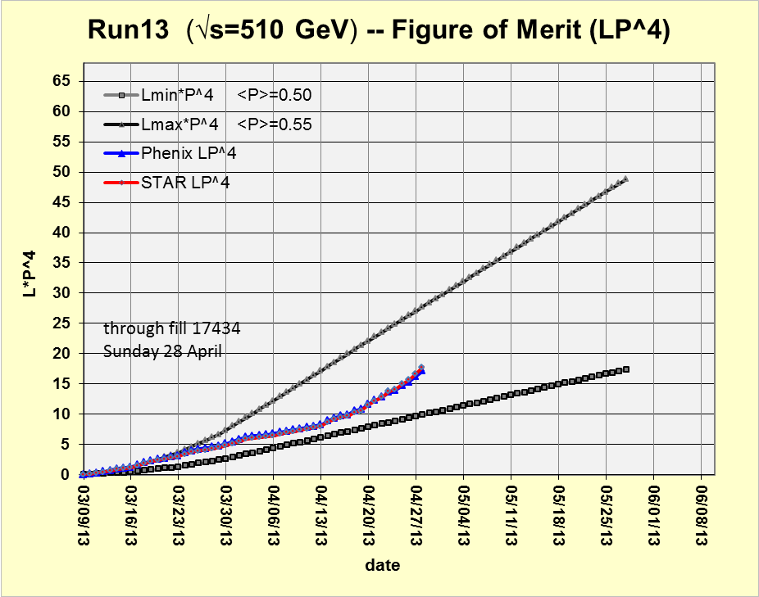
Preliminary, with Run 13 cross sections, PHENIX and STAR log based singles correction
750*(0.55)⁴
275*(0.55)⁴
Using average polarizations from CNI polarization from http://www.phy.bnl.gov/cnipol/fills/

Slide 8
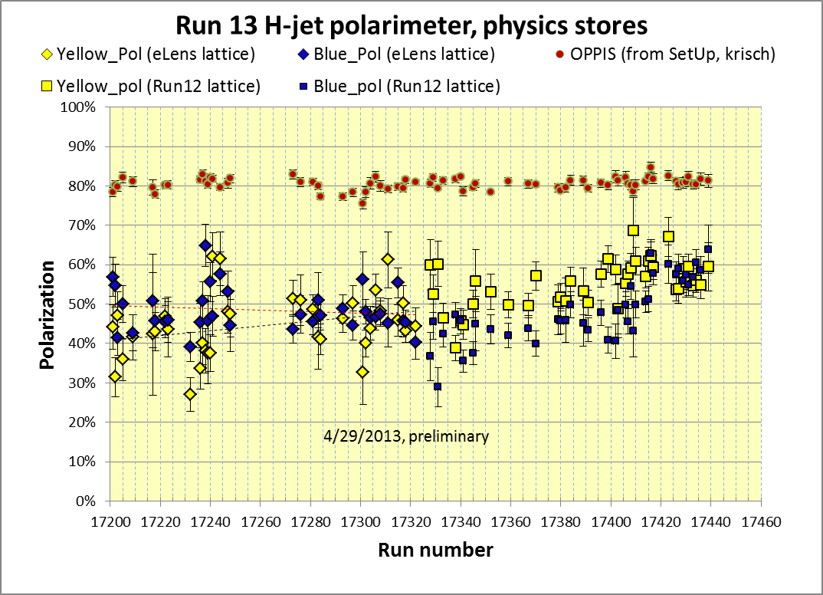
Yellow average = 44.3 ± 0.8%
Blue average = 47.7 ± 0.7%
Average = 46.0%
stores 17201-17322 (eLens lattice)
Yellow average = 54.7 ± 0.6%
Blue average = 48.9± 0.5%
Average = 51.8%
stores 17328 – 17439 (Run 12 lattice)
https://wiki.bnl.gov/rhicspin/Polarimetry/H-jet/Run13

Slide 9
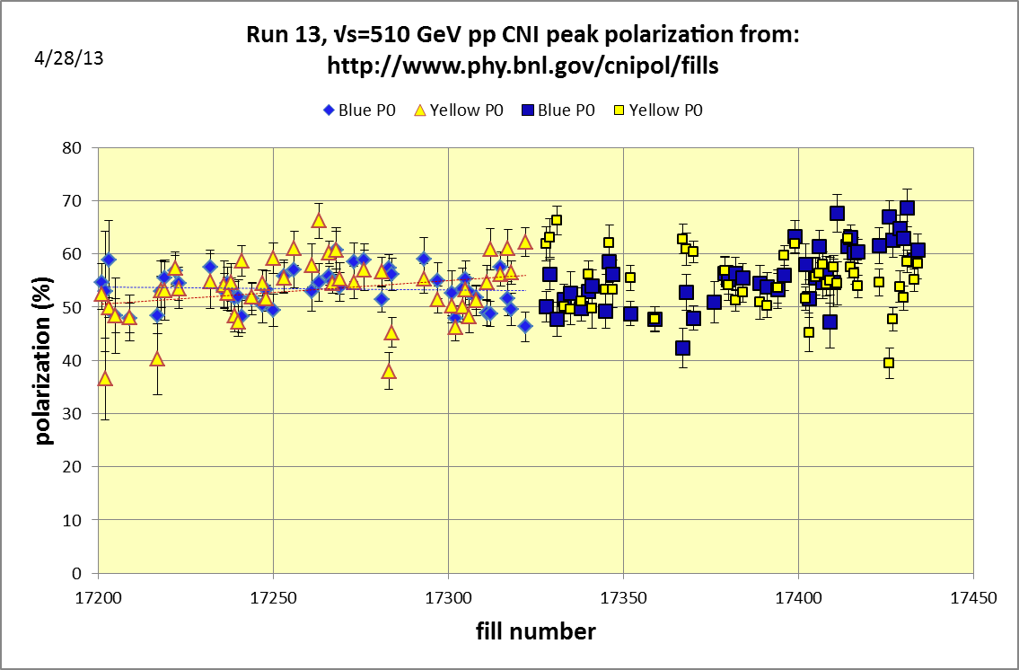
Yellow average = 52.5± 0.6%
Blue average = 53.4± 0.7%
Average = 53.0%
stores 17201-17322 (eLens lattice)
Yellow average = 55.0± 0.4%
Blue average = 54.3± 0.5%
Average = 54.7%
stores 17328-17434 (Run 12 lattice)

Slide 10
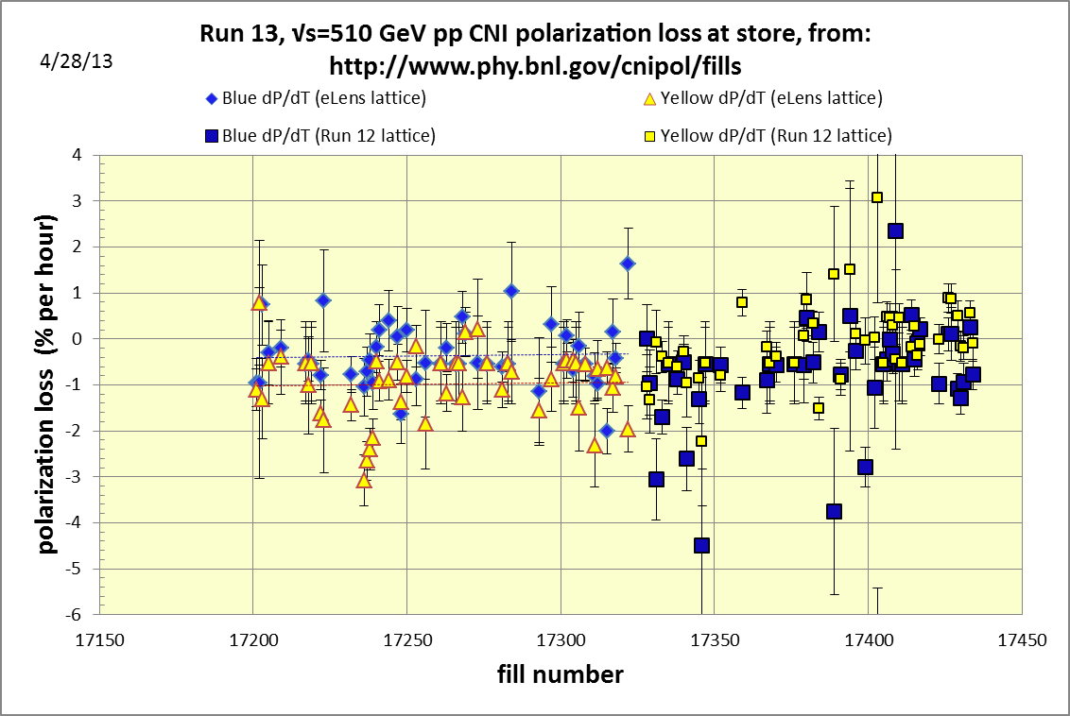

Slide 11
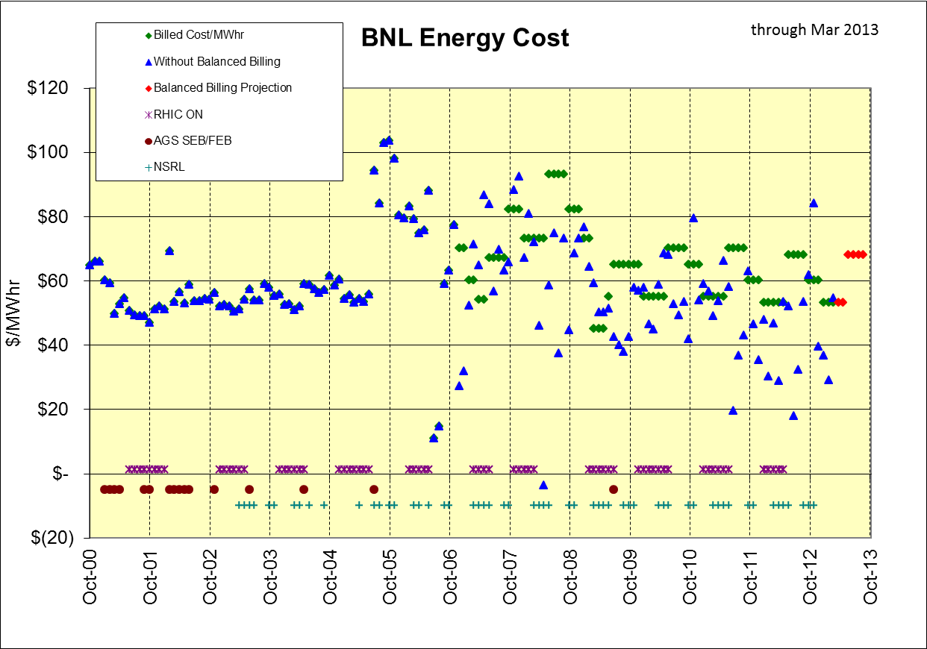
+$1,086K in BNL bank through Mar 2013 (~$450K should come back to CAD)
March
Mar 2013 bill
$54.39 actual
billed at $53/Mwhr

Slide 12
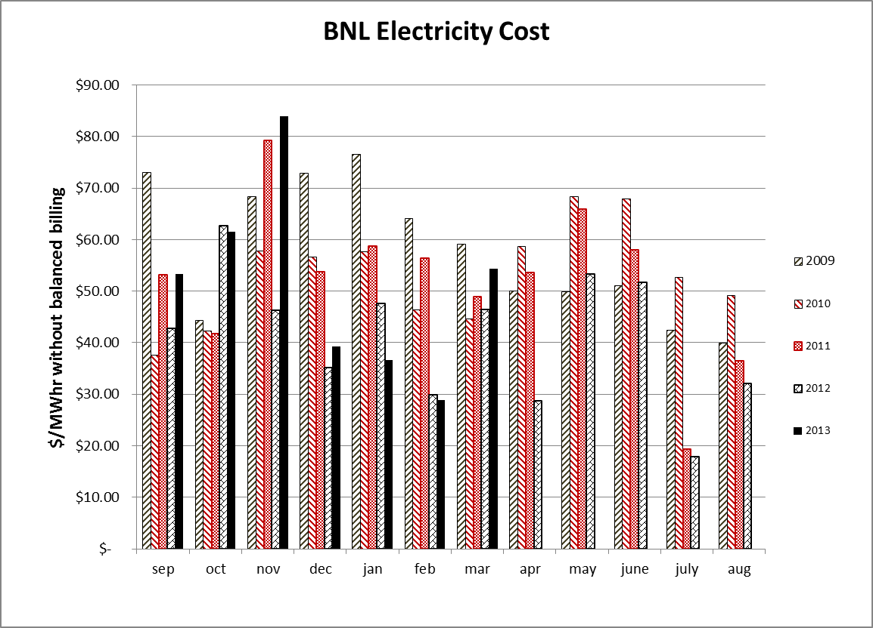

Slide 13
Additional Information

Slide 14
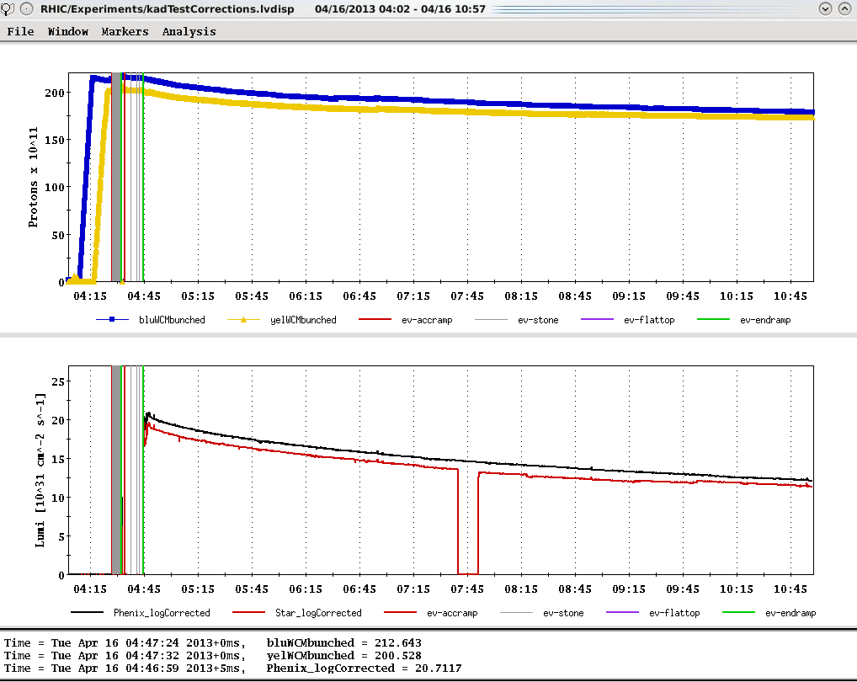
Ions (maximum)
Store 17391, 4/16/2013 – best peak lumi to date
L_{peak}(= 2.1x10³² cm⁻²s⁻¹
L_{peak}(maximum=2.7x10³²)
L_{average}(maximum=1.6x10³²)

Slide 15
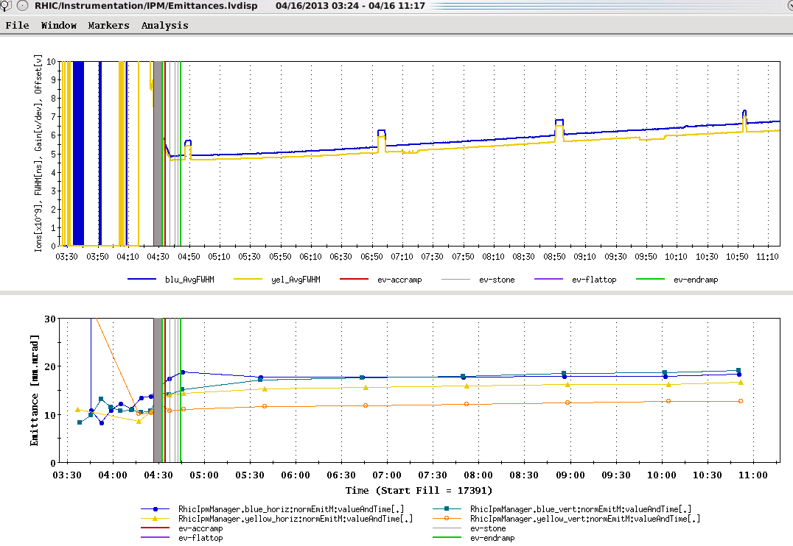
Goal emittance (19-25 π mm-mr)

Slide 16
Run 13 plan based on 20 weeks cryo operation and Fischer et.al. RHIC Collider Projections (FY 2013 – FY 2017), 27 Sep 2012
11 Feb, Begin cool-down to 4.5K
15 Feb, Cool-down to 4.5K in Blue and Yellow Ring complete, begin magnet setup
26 Feb, first collisions
15 Feb -1 Mar, RHIC √s = 510 GeV pp machine setup
1-8 Mar, machine ramp-up with 8 hr/night for experiment setup
9 Mar (store 17201), begin √s = 510 GeV pp physics run
today, 23 Apr…
27 May, end 15 cryo weeks
6 Jun, switch to √s = 15 GeV/n AuAu if pp goals are met and end 12.7 week √s = 510 GeV pp physics run
27 Jun, end ~2.5 week √s = 15 GeV/n AuAu physics run or 15.9 week √s = 510 GeV pp physics run, begin cryo warm-up
30 June, cryo warm-up ~complete (19.9 cryo-weeks)
See http://www.rhichome.bnl.gov/AP/Spin2013/ for the Run Coordinator’s detailed plan

Slide 17
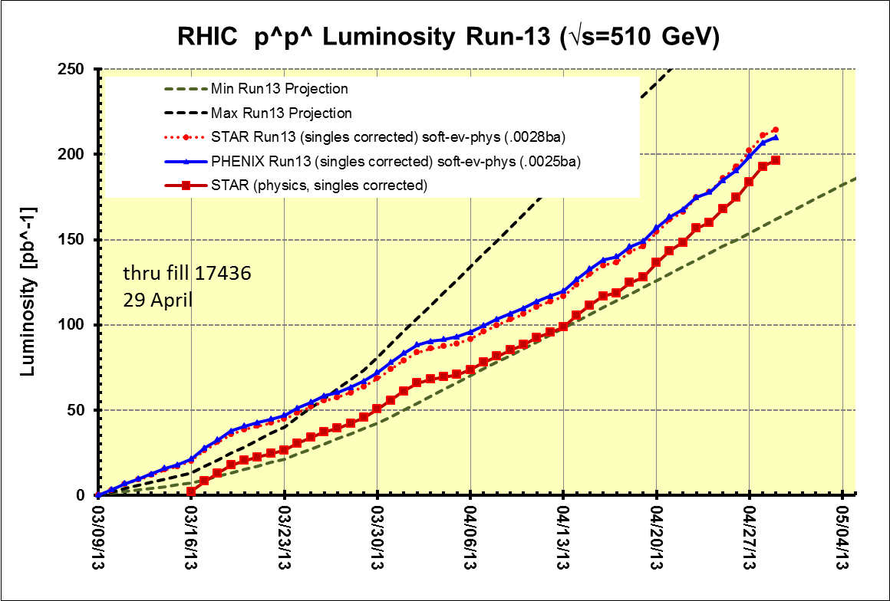
Preliminary, with Run 13 cross sections, PHENIX and STAR log based singles correction

Slide 18
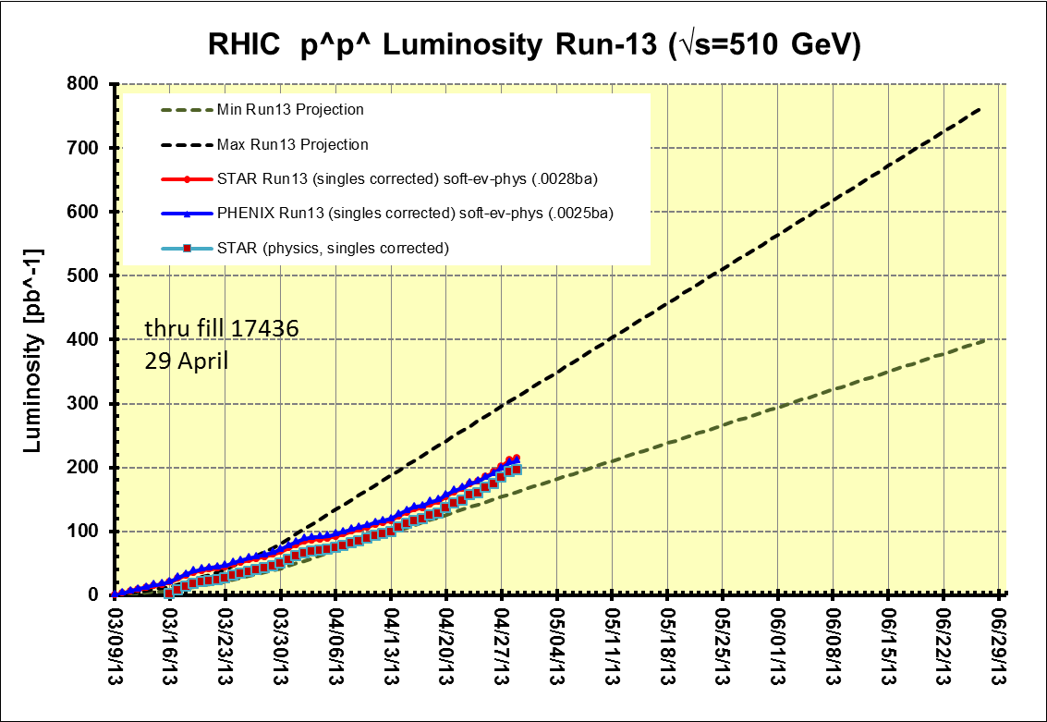
Preliminary, with Run 13 cross sections, PHENIX and STAR log based singles correction
PHENIX Goal, 250 pb⁻¹ recorded, 750 pb⁻¹ delivered, ≥ 55% polarization
STAR Goal, 165 pb⁻¹ recorded, 275 pb⁻¹ delivered, ≥ 55% polarization
PHENIX GOAL
Switch to low energy AuAu ??
15 cryo weeks
17 cryo weeks
STAR GOAL
19.9 cryo weeks
Decision time for low energy AuAu
Preliminary, with Run 13 cross sections, singles corrected

Slide 19
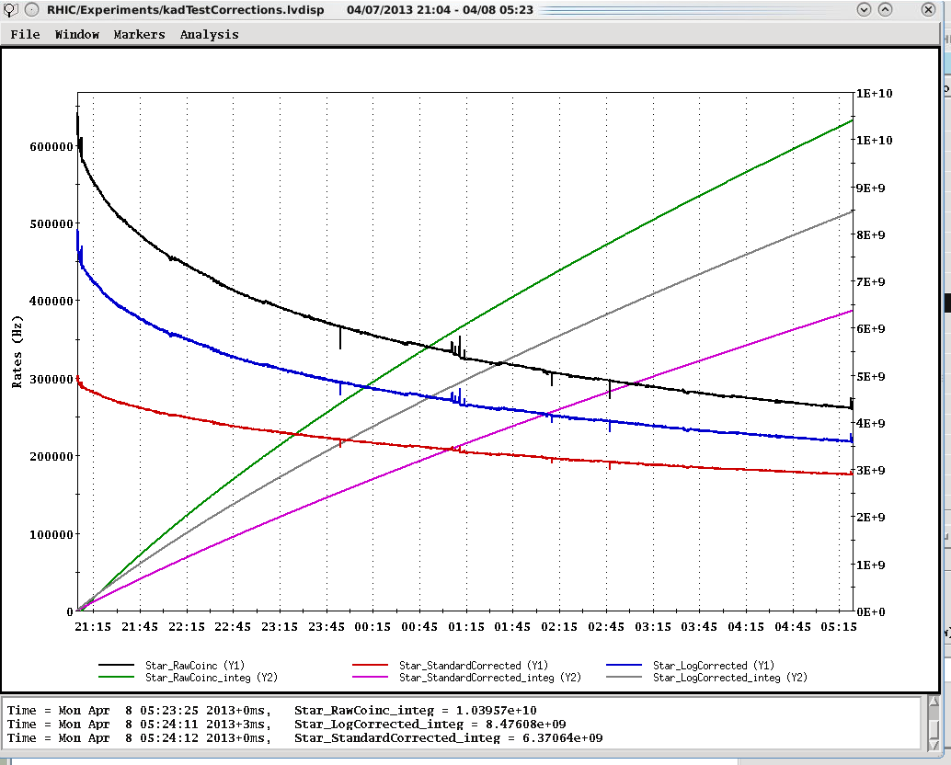
Example Store for STAR (17340) with “physics” time cuts
Log based singles correction → 8.48E8/2.8mb = 3.03 pb-1
Standard singles correction → 6.371E8/2.5mb = 2.55 pb-1
~x1.5
(1.3 lumi)
Raw ZDC coinc
ZDC Log singles corr.
~x1.2
(1.1 lumi)
}
ZDC Standard singles corr.
integrals
Integrated lumi Log/Standard = 1.19

Slide 20
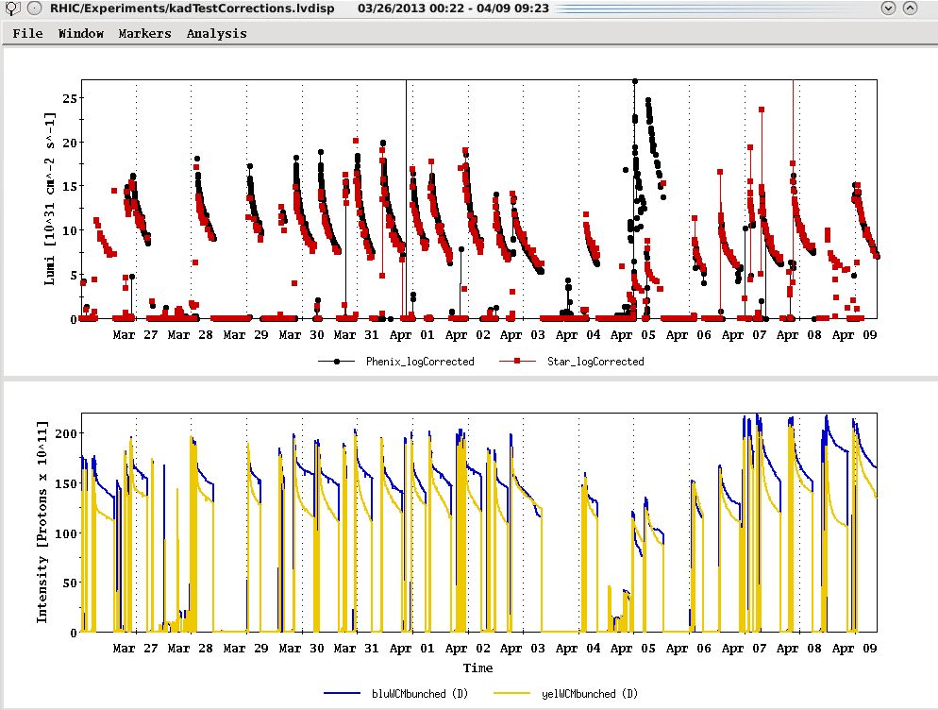
Physics stores
Past 2 Weeks
Run 12 lattice
L_{peak}(maximum=2.7E32)
17340
L_{average}(maximum)
Using Run 13 cross sections with log based singles correction
Ions (maximum)

Slide 21

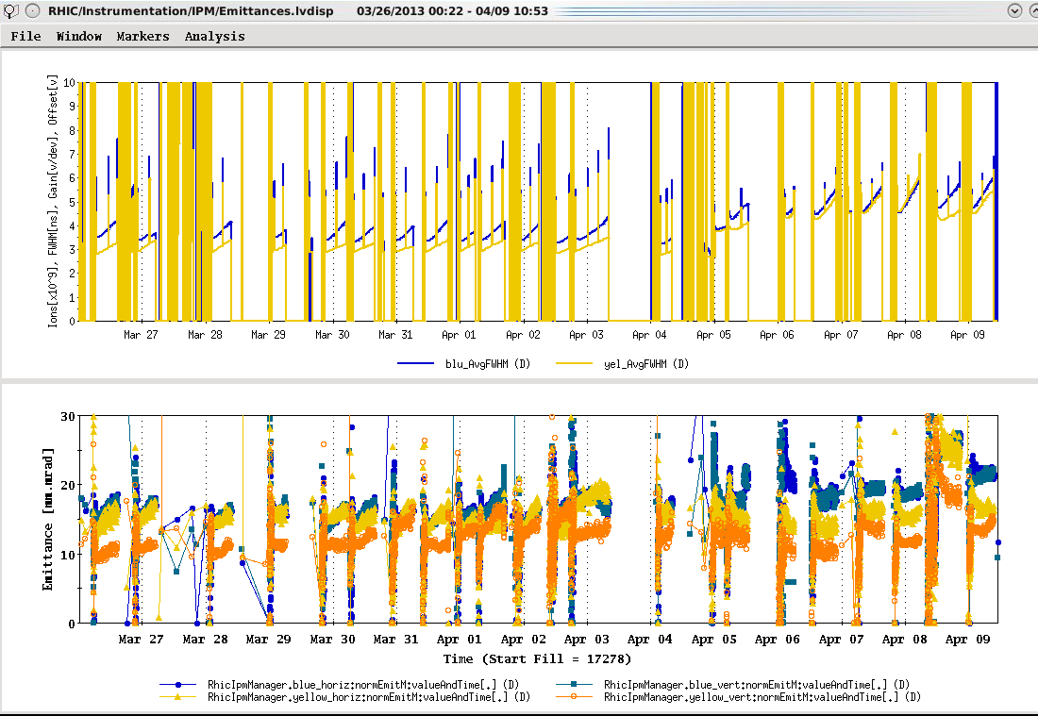
Run 12 lattice

Slide 22
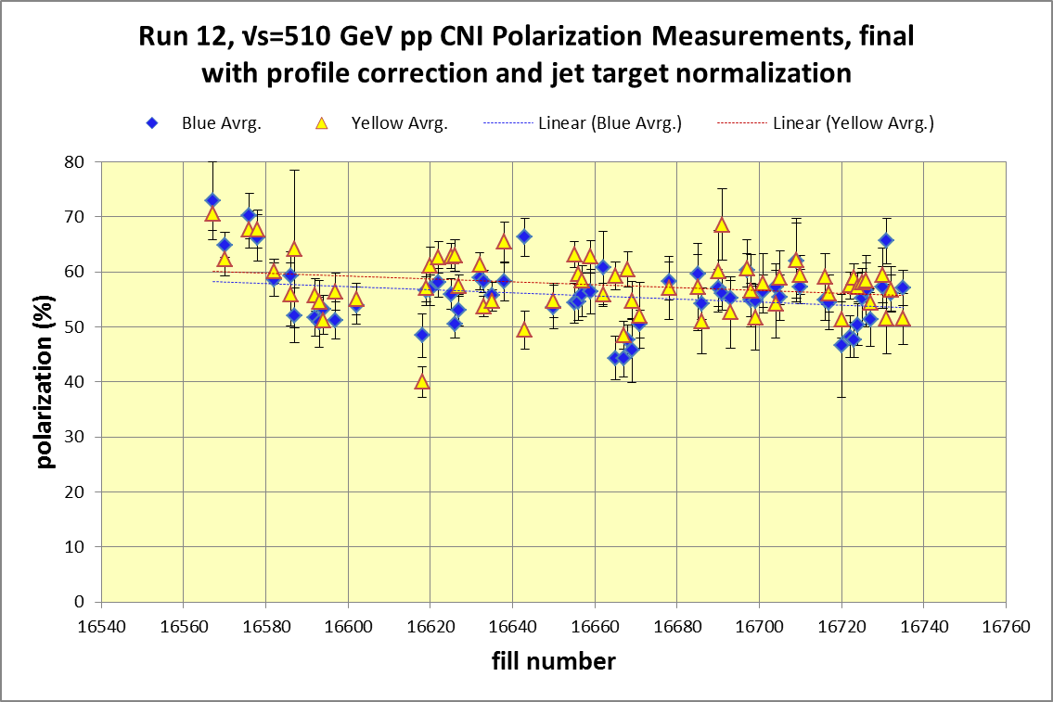
Yellow average = 48.12± 0.4%
Blue average = 53.1 ± 0.5%
http://www.phy.bnl.gov/cnipol/fills/

Slide 23
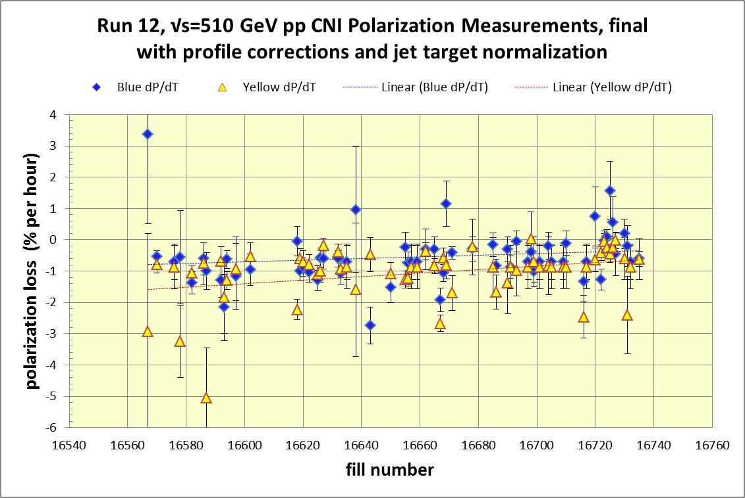
Yellow average = 57.7± 0.4%
Blue average = 55.9 ± 0.4%
Average = 56.8%
http://www.phy.bnl.gov/cnipol/fills/

Slide 24
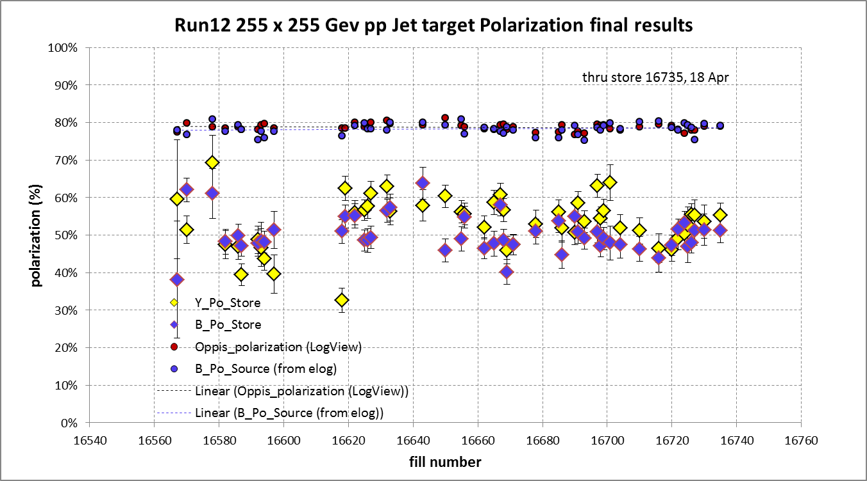
And Yellow beam at injection jet target Run 12 result = 63.0 ± 4.4%
Blue jet target weighted average = 50.3% ± 0.5%
Yellow jet target weighted average = 53.4% ± 0.5%

Slide 25
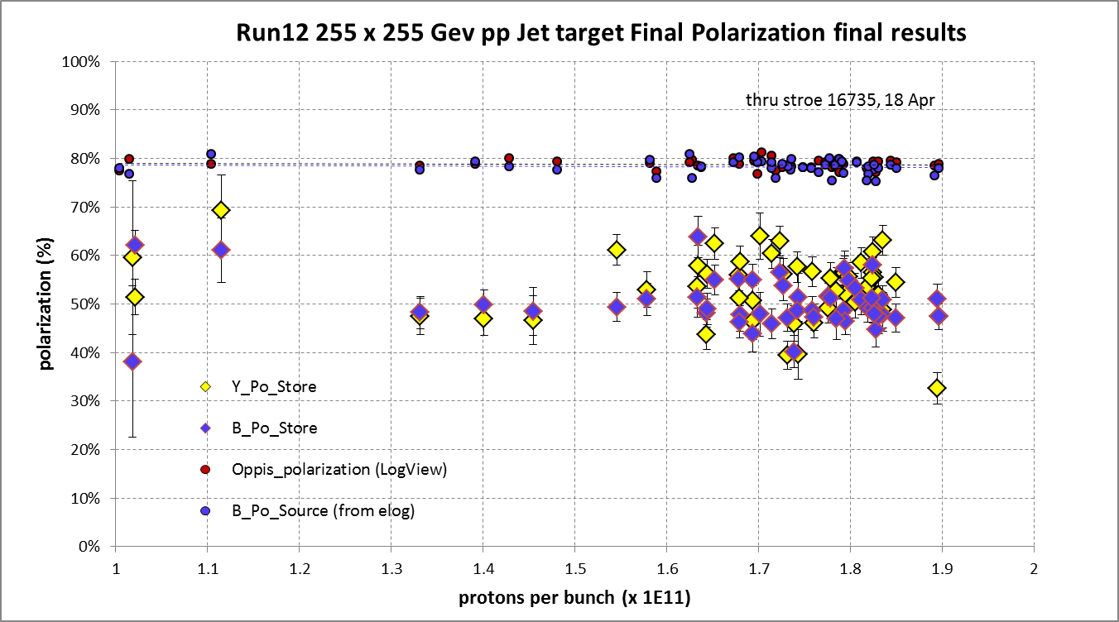
Yellow average = 53.4 ± 0.5%
Blue average = 50.3 ± 0.5%

Slide 26
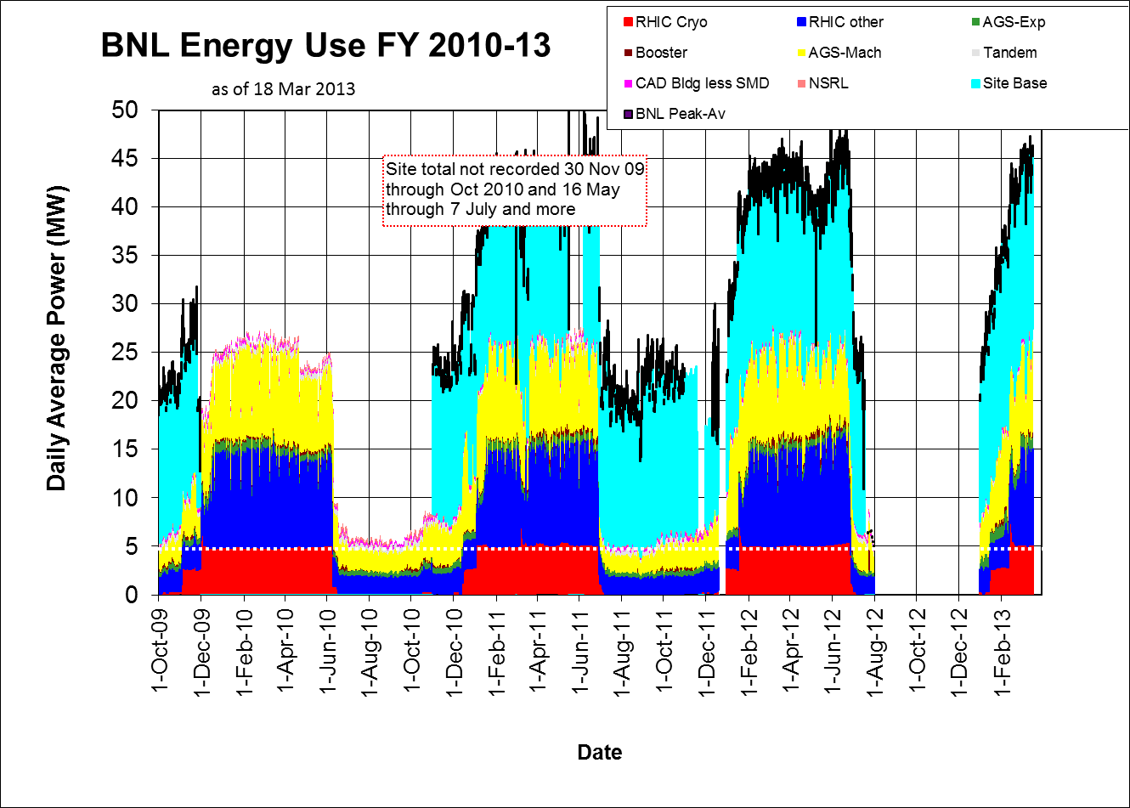

Slide 27
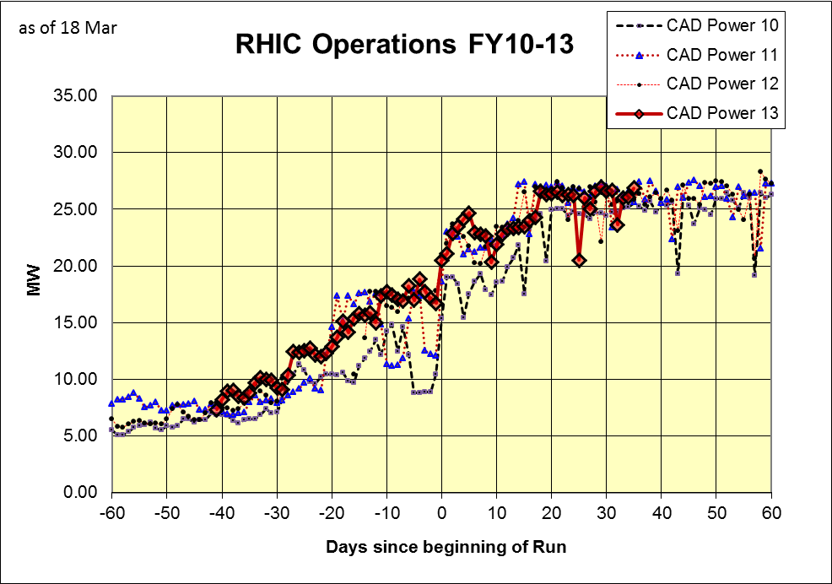

Slide 28
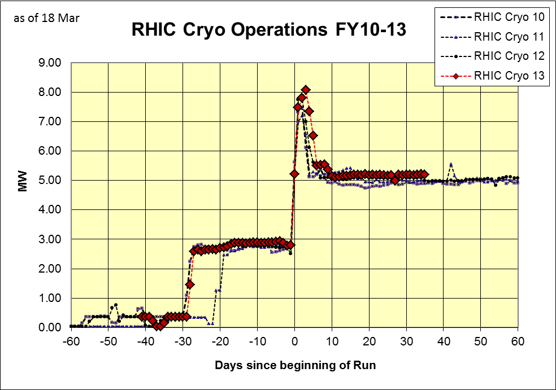

Slide 29
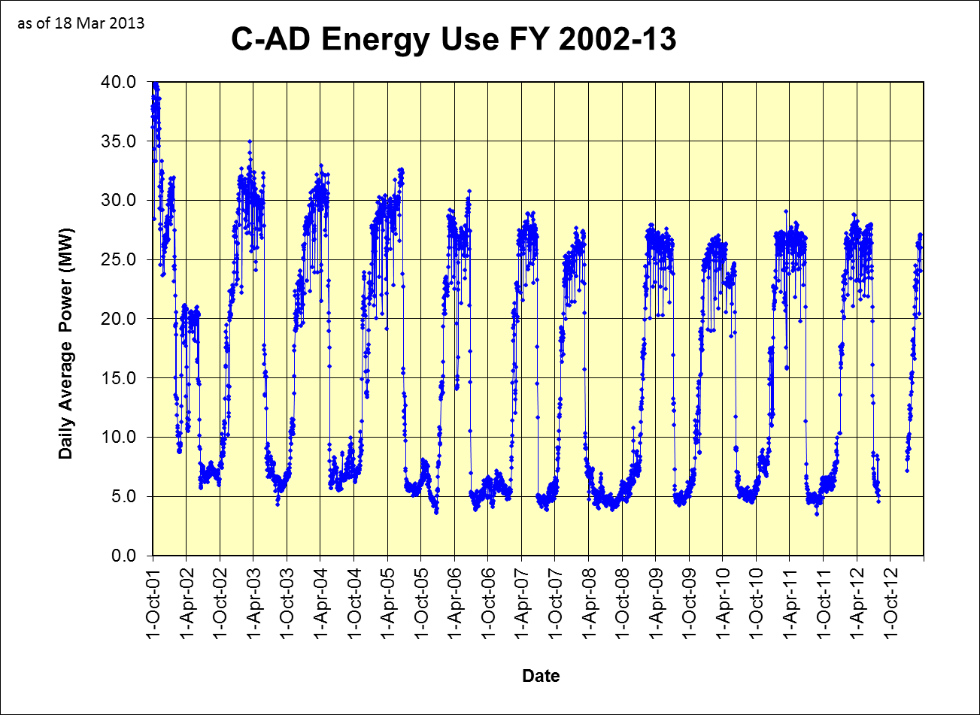

Slide 30
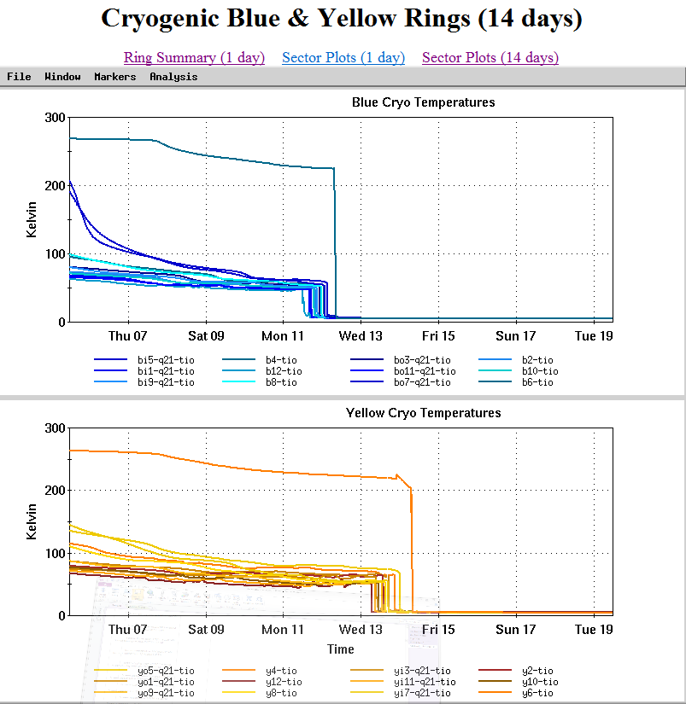

Slide 32
For Run 13 the PAC recommends the following (in order of priority):
Running with polarized proton collisions at 500 GeV to provide an integrated luminosity of 750 pb⁻¹ at an average polarization of 55%.
2. Depending on the amount of running time remaining after priority #1
  a. If less than 3 weeks remain, a week of 200 GeV Au+Au collisions.
  b. If at least 3 weeks of running time remain, 3 weeks of 15 GeV Au+Au
  collisions.
3. 8 days of 62 GeV p+p collisions.
4. At the discretion of the ALD, 4 days of low-luminosity running to accomplish the pp2pp goals.

