Slide 1
Run 13 RHIC Machine/Experiments Meeting
21 May 2013
Agenda:
Status Reports

Slide 2
Run 13 plan based on 17 weeks cryo operation
11 Feb, Begin cool-down to 4.5K
15 Feb, Cool-down to 4.5K in Blue and Yellow Ring complete, begin magnet setup
26 Feb, first collisions
15 Feb -1 Mar, RHIC √s = 510 GeV pp machine setup
1-8 Mar, machine ramp-up with 8 hr/night for experiment setup
9 Mar (store 17201), begin √s = 510 GeV pp physics run
5 April, reverted to Run 12 lattice
today, 21 May
10 June (Monday, 0800), end 13.4 week √s = 510 GeV pp physics run, begin cryo warm-up
13 June, cryo warm-up ~complete (17.4 cryo-weeks)

Slide 4
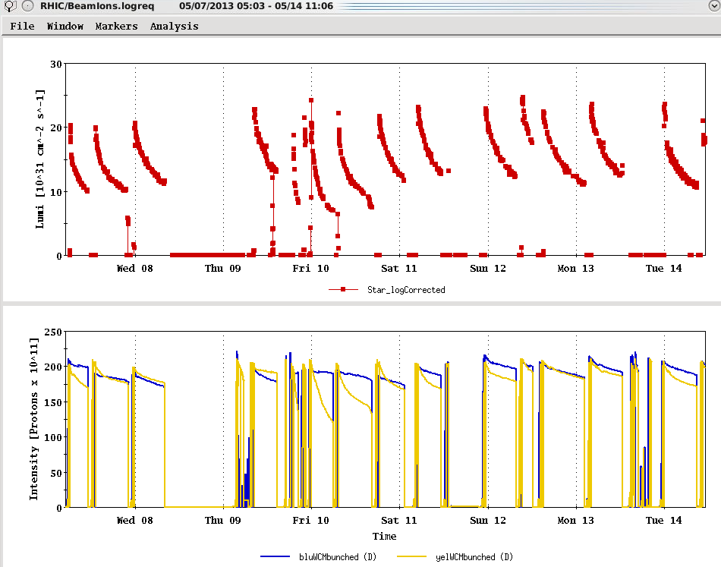
Maximum goal (peak lumi)
Maximum goal (average lumi)
Maximum goal

Slide 5
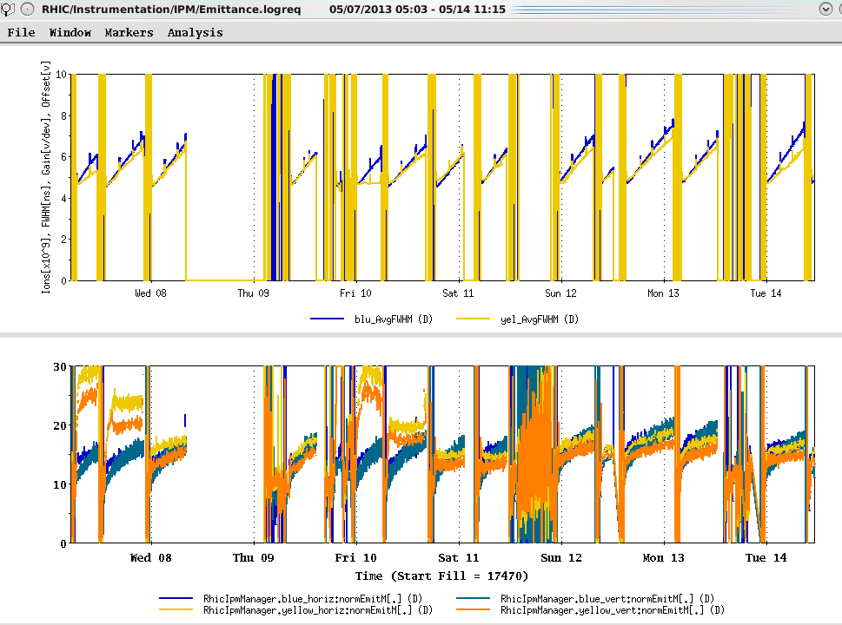

Slide 6
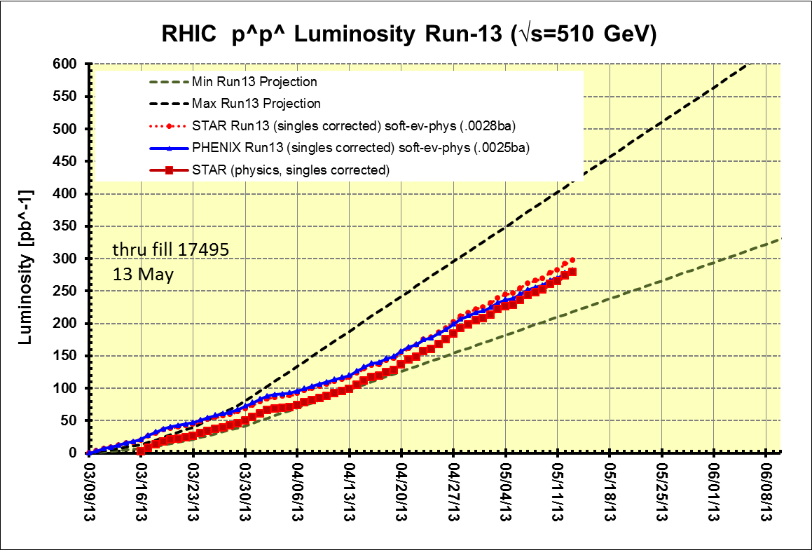
Preliminary, with Run 13 cross sections, PHENIX and STAR log based singles correction
PHENIX Goal, 250 pb⁻¹ recorded, 750 pb⁻¹ delivered, ≥ 55% polarization
STAR Goal, 165 pb⁻¹ recorded, 275 pb⁻¹ delivered, ≥ 55% polarization
(PHENIX Goal)
17.4 cryo
weeks
(STAR Goal)
Begin cryo
warm-up
Preliminary, with Run 13 cross sections, singles corrected

Slide 7
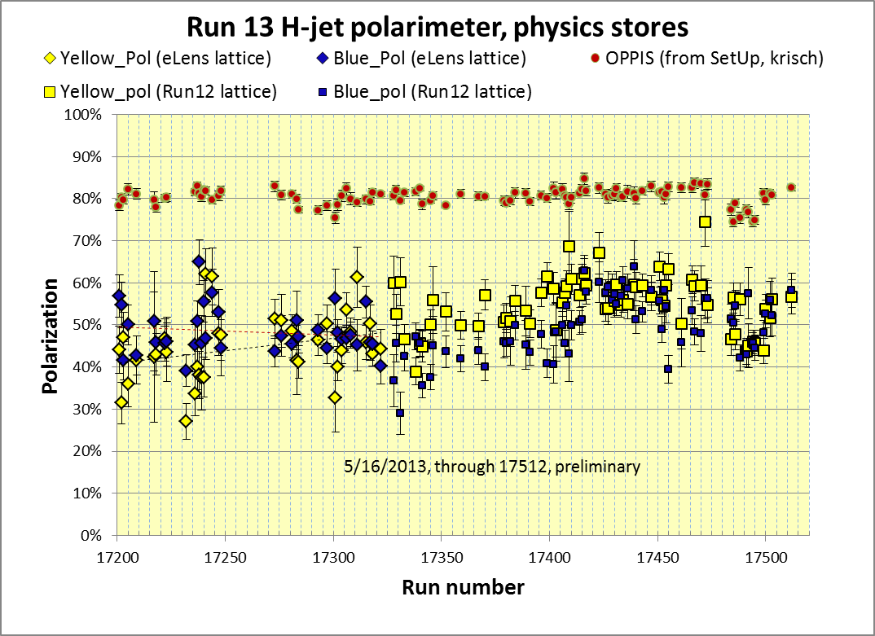
Yellow average = 44.3 ± 0.8%
Blue average = 47.7 ± 0.7%
Average = 46.0%
stores 17201-17322 (eLens lattice)
Yellow average = 54.5 ± 0.4%
Blue average = 49.4 ± 0.4%
Average = 52.0%
stores 17328 – 17512(Run 12 lattice)
Average for all fills: Blue = 49.0 +/- 0.4%, Yellow = 52.1% +/- 0.4%
https://wiki.bnl.gov/rhicspin/Polarimetry/H-jet/Run13

Slide 8
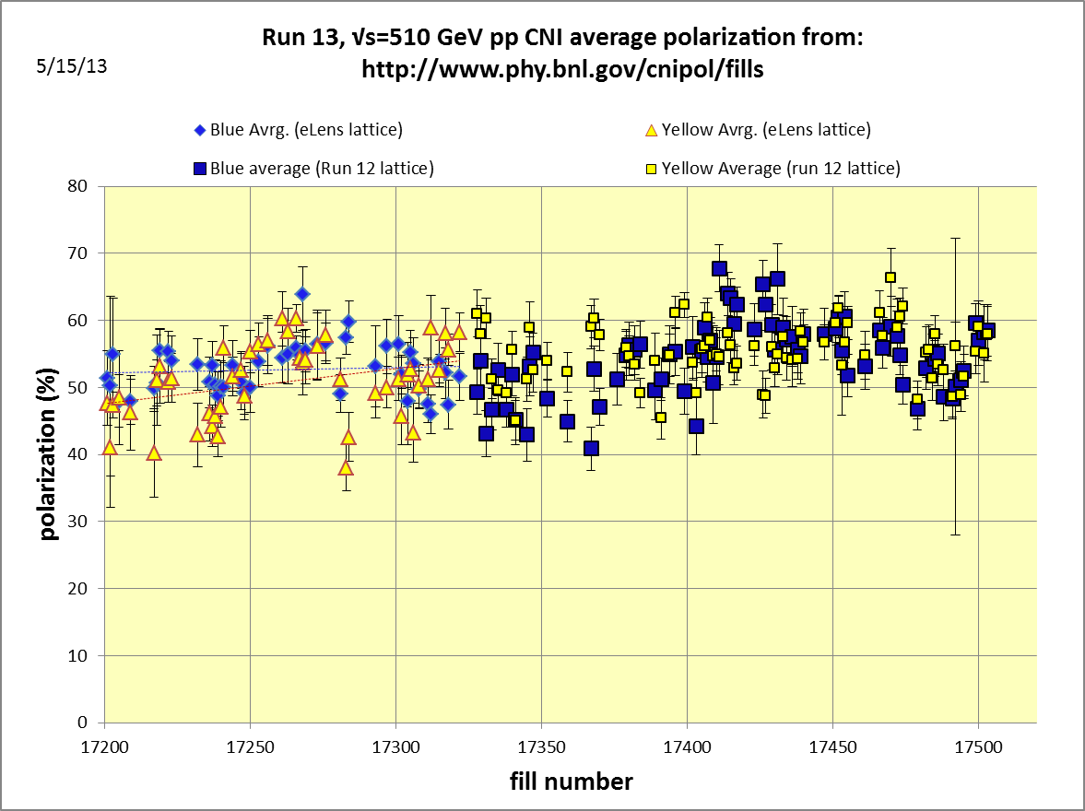
Yellow average = 52.7± 0.5%
Blue average = 53.3± 0.5%
Average = 53.0%
stores 17201-17322 (eLens lattice)
Yellow average = 55.5± 0.3%
Blue average = 54.3± 0.4%
Average = 54.9%
stores 17328-17503 (Run 12 lattice)
Average for all fills: Blue = 53.9% +/- 0.3%, Yellow = 54.6% +/- 0.3%

Slide 9
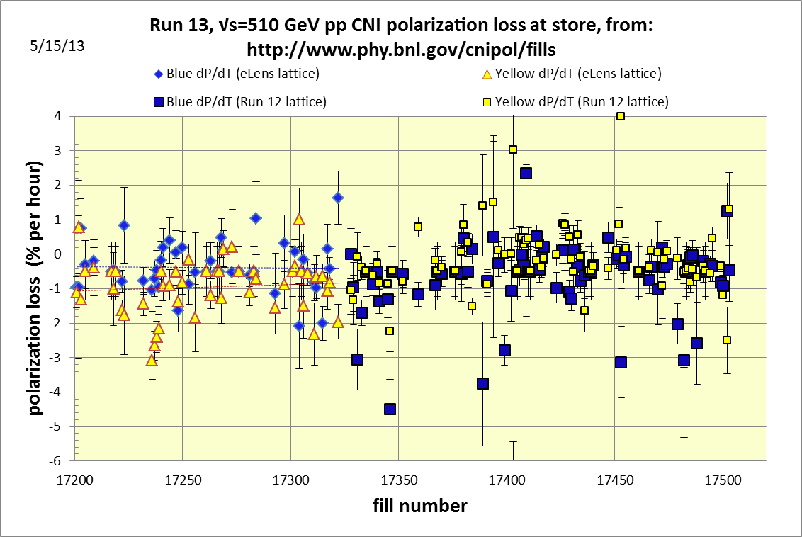

Slide 10
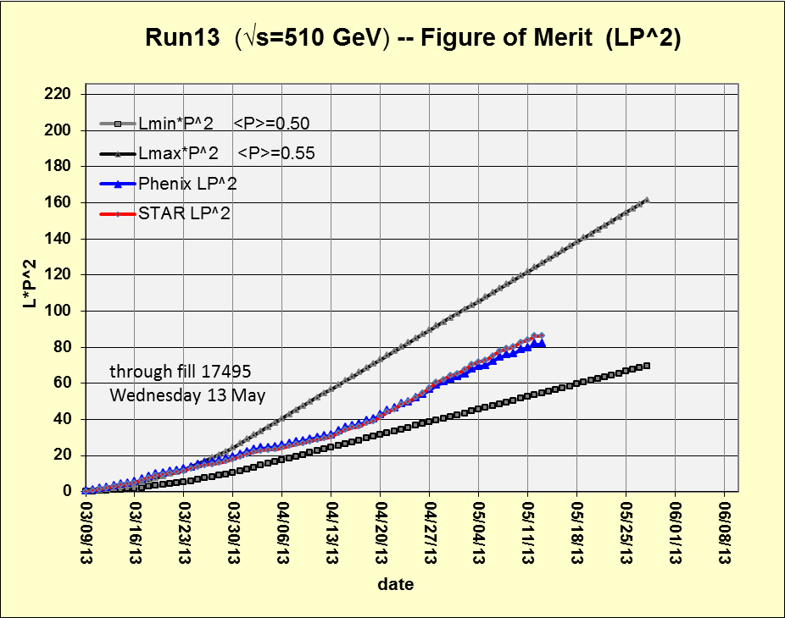
Preliminary, with Run 13 cross sections, PHENIX and STAR log based singles correction
750*(0.55)²
275*(0.55)²
Using average polarizations from CNI polarization from http://www.phy.bnl.gov/cnipol/fills/

Slide 11
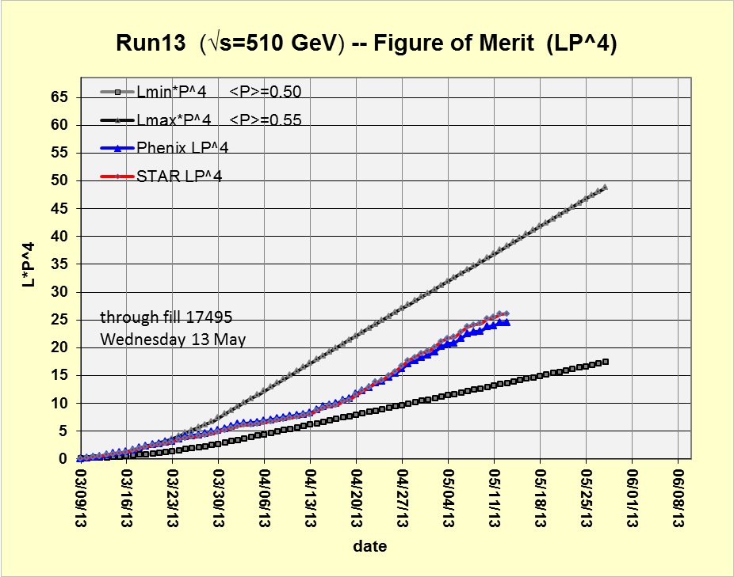
Preliminary, with Run 13 cross sections, PHENIX and STAR log based singles correction
750*(0.55)⁴
275*(0.55)⁴
Using average polarizations from CNI polarization from http://www.phy.bnl.gov/cnipol/fills/

Slide 12
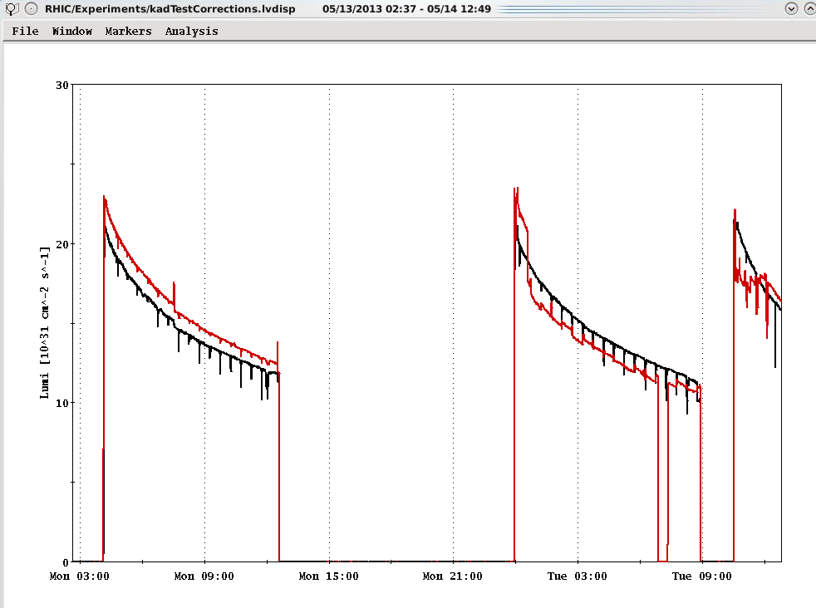
Unresolved issue…
STAR Lumi has been above PHENIX since the STAR crossing angle was fixed
around mid-April
??

Slide 13
Additional Information

Slide 14
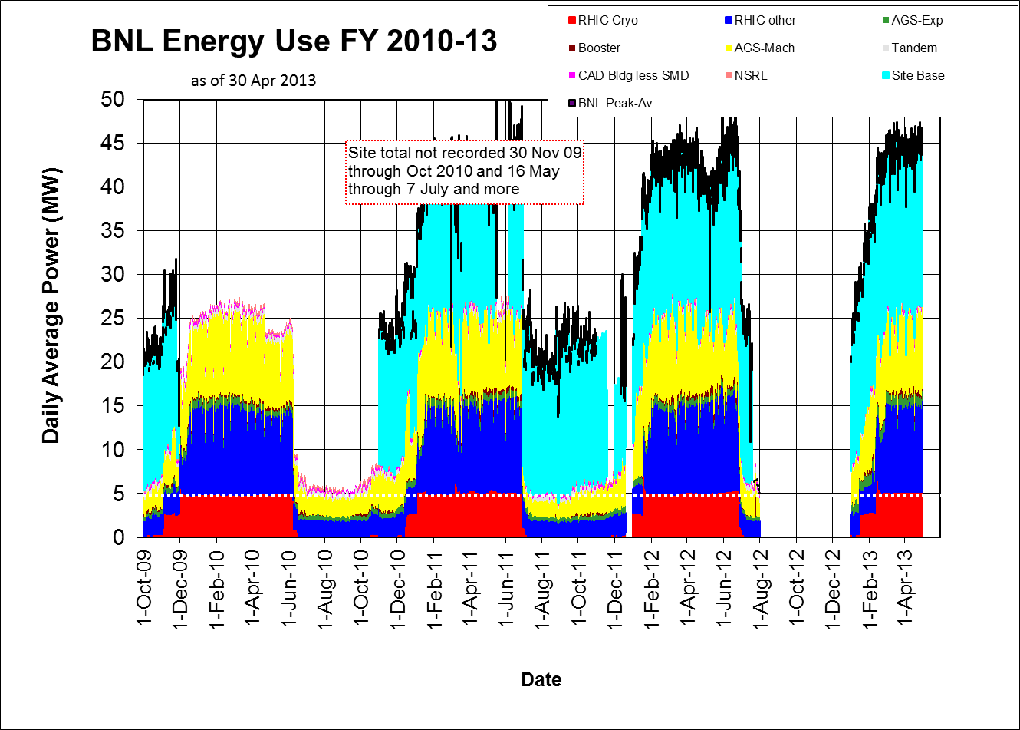

Slide 15
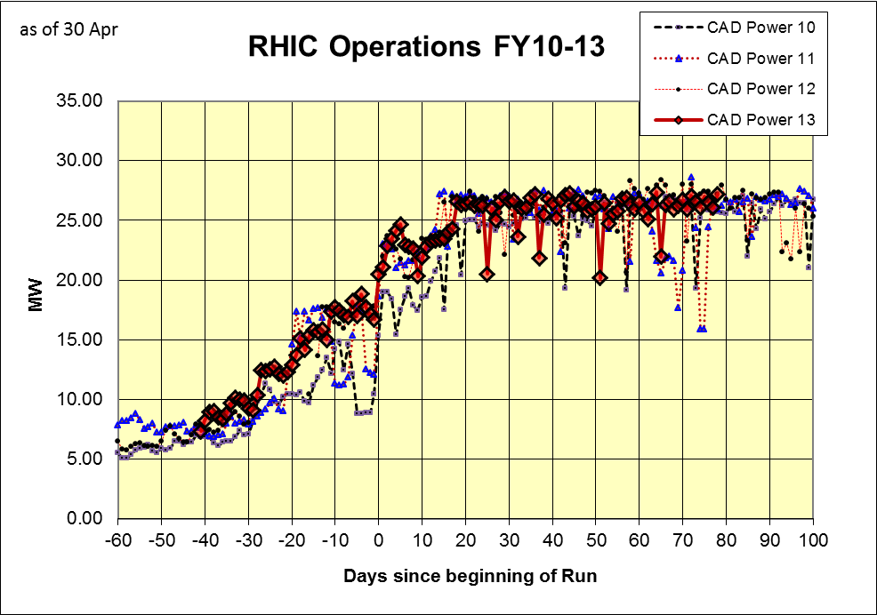

Slide 16
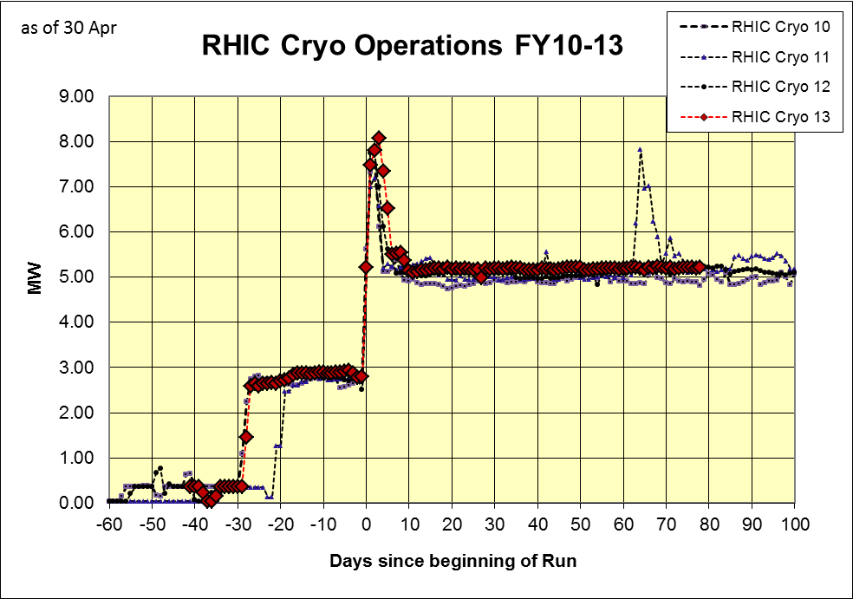

Slide 17
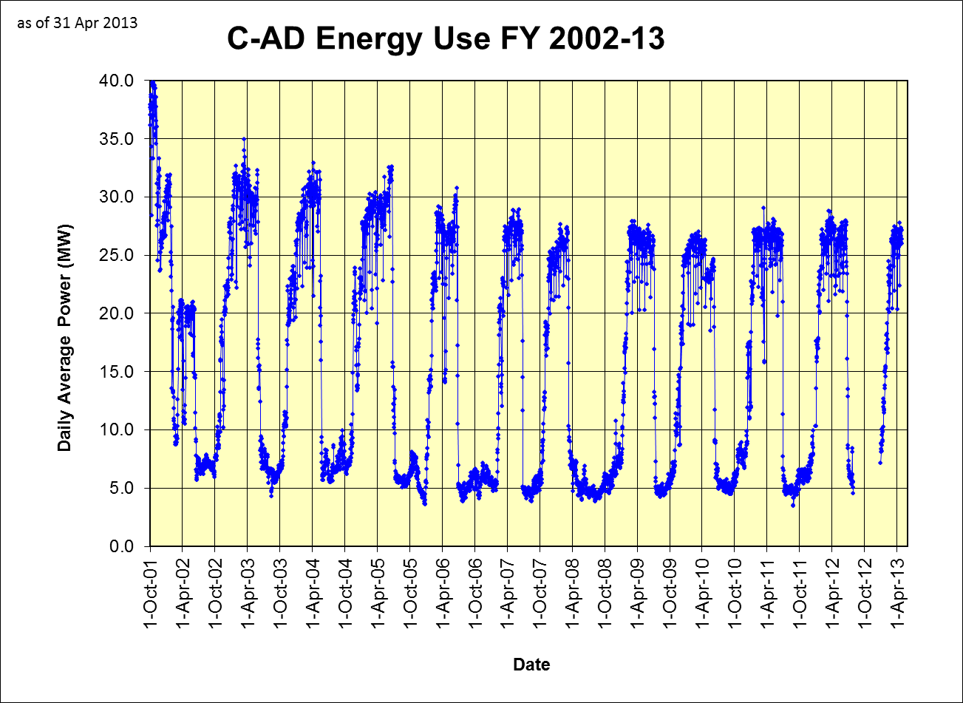

Slide 18
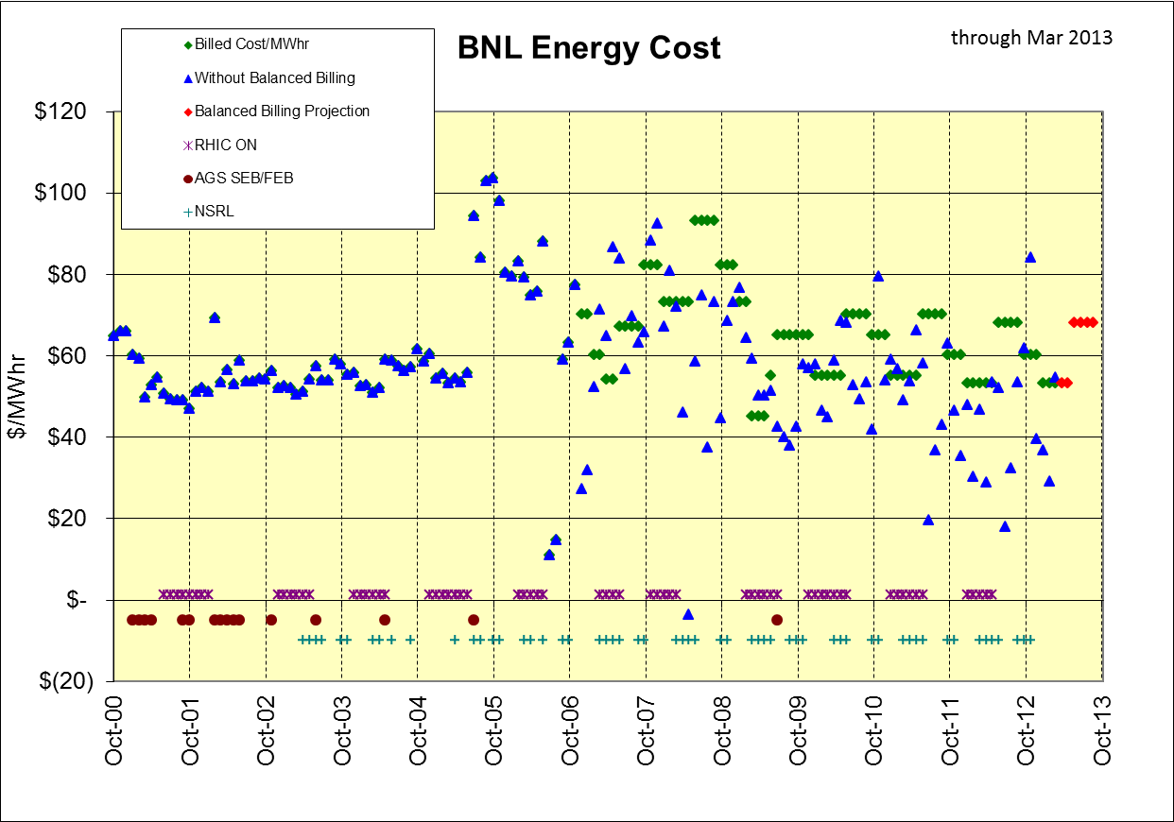
+$1,086K in BNL bank through Mar 2013 (~$450K should come back to CAD)
March
Mar 2013 bill
$54.39 actual
billed at $53/Mwhr

Slide 19
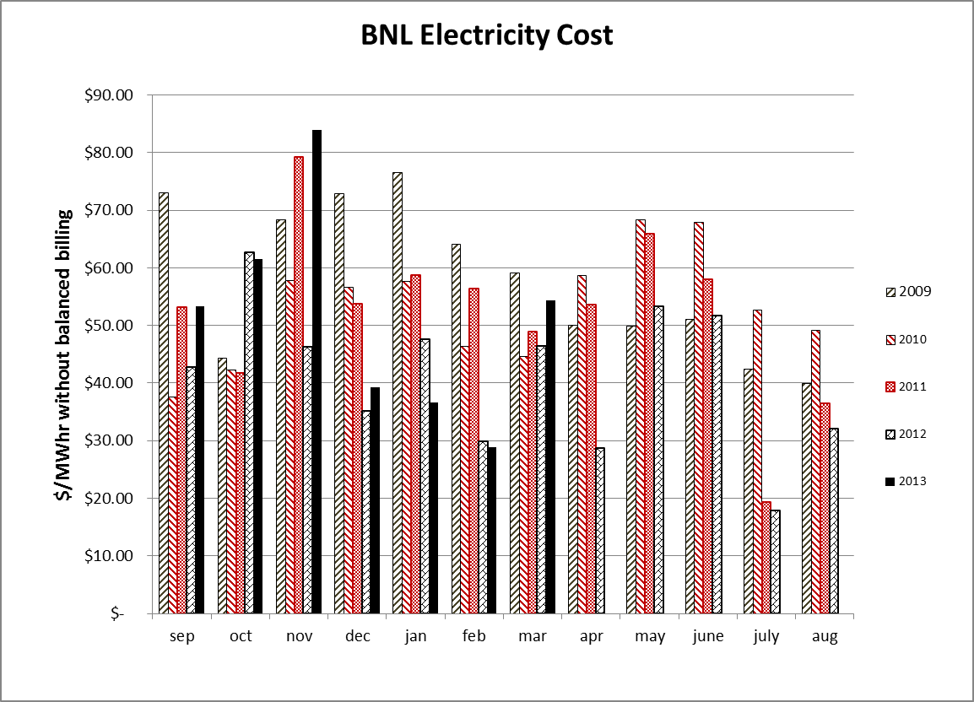

Slide 20
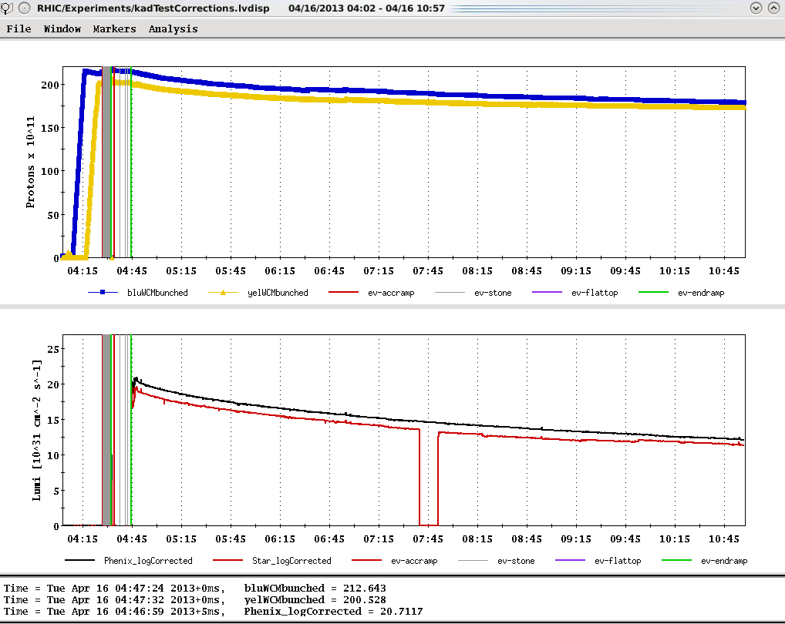
Ions (maximum)
Store 17391, 4/16/2013 – best peak lumi to date
L_{peak}(= 2.1x10³² cm⁻²s⁻¹
L_{peak}(maximum=2.7x10³²)
L_{average}(maximum=1.6x10³²)

Slide 21
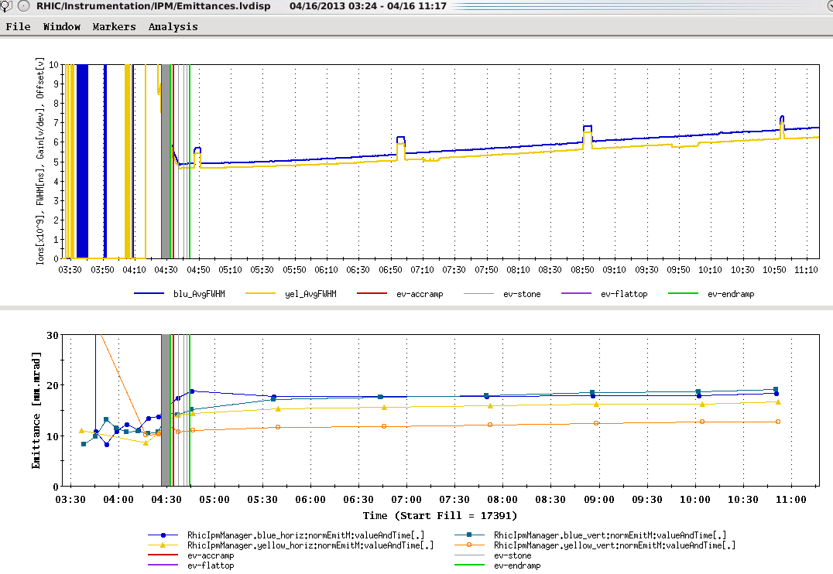
Goal emittance (19-25 π mm-mr)

Slide 22
Run 13 plan based on 20 weeks cryo operation and Fischer et.al. RHIC Collider Projections (FY 2013 – FY 2017), 27 Sep 2012
11 Feb, Begin cool-down to 4.5K
15 Feb, Cool-down to 4.5K in Blue and Yellow Ring complete, begin magnet setup
26 Feb, first collisions
15 Feb -1 Mar, RHIC √s = 510 GeV pp machine setup
1-8 Mar, machine ramp-up with 8 hr/night for experiment setup
9 Mar (store 17201), begin √s = 510 GeV pp physics run
today, 23 Apr…
27 May, end 15 cryo weeks
6 Jun, switch to √s = 15 GeV/n AuAu if pp goals are met and end 12.7 week √s = 510 GeV pp physics run
27 Jun, end ~2.5 week √s = 15 GeV/n AuAu physics run or 15.9 week √s = 510 GeV pp physics run, begin cryo warm-up
30 June, cryo warm-up ~complete (19.9 cryo-weeks)
See http://www.rhichome.bnl.gov/AP/Spin2013/ for the Run Coordinator’s detailed plan

Slide 23
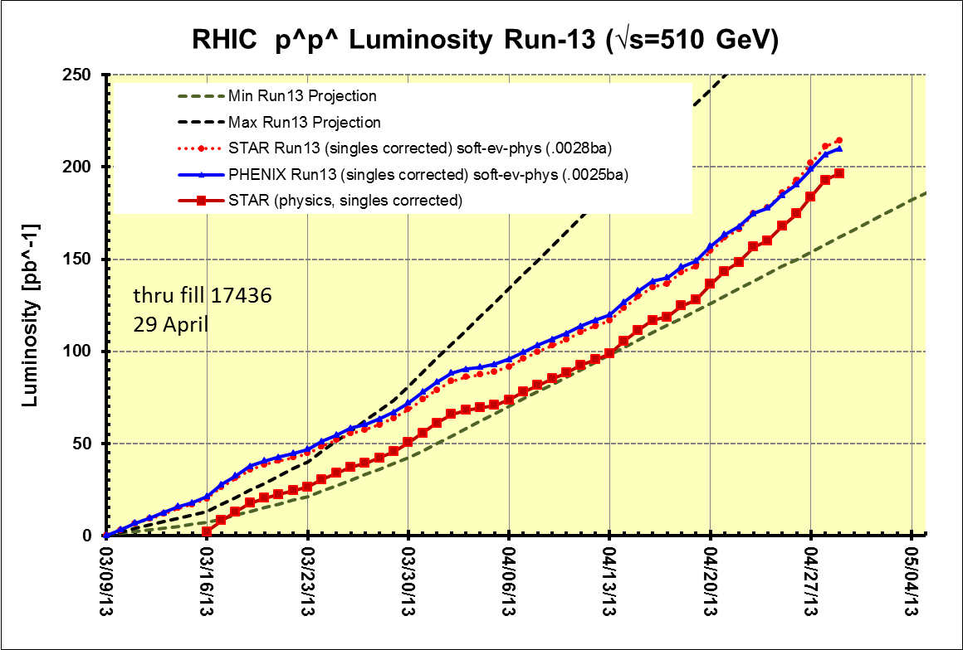
Preliminary, with Run 13 cross sections, PHENIX and STAR log based singles correction

Slide 24
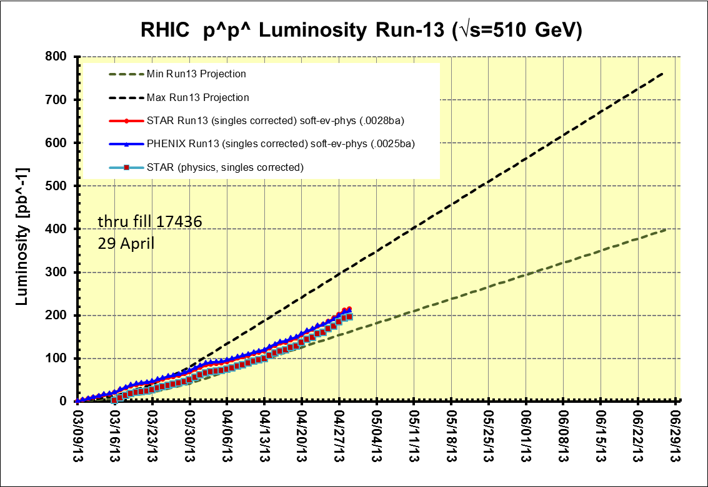
Preliminary, with Run 13 cross sections, PHENIX and STAR log based singles correction
PHENIX Goal, 250 pb⁻¹ recorded, 750 pb⁻¹ delivered, ≥ 55% polarization
STAR Goal, 165 pb⁻¹ recorded, 275 pb⁻¹ delivered, ≥ 55% polarization
PHENIX GOAL
Switch to low energy AuAu ??
15 cryo weeks
17 cryo weeks
STAR GOAL
19.9 cryo weeks
Decision time for low energy AuAu
Preliminary, with Run 13 cross sections, singles corrected

Slide 25
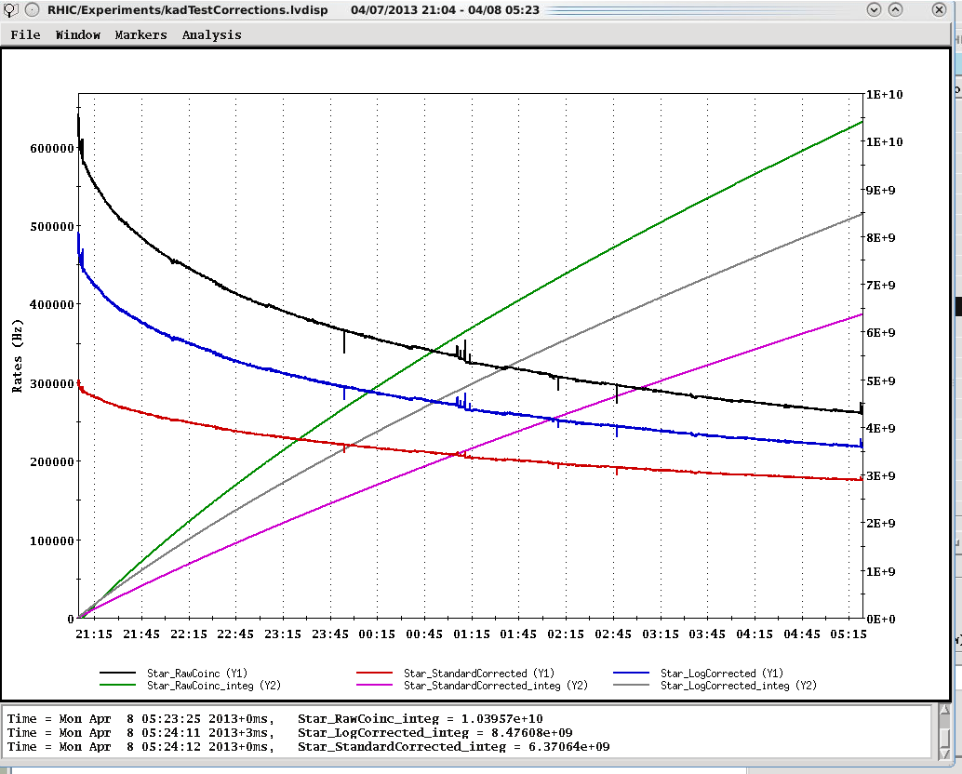
Example Store for STAR (17340) with “physics” time cuts
Log based singles correction → 8.48E8/2.8mb = 3.03 pb-1
Standard singles correction → 6.371E8/2.5mb = 2.55 pb-1
~x1.5
(1.3 lumi)
Raw ZDC coinc
ZDC Log singles corr.
~x1.2
(1.1 lumi)
}
ZDC Standard singles corr.
integrals
Integrated lumi Log/Standard = 1.19

Slide 26
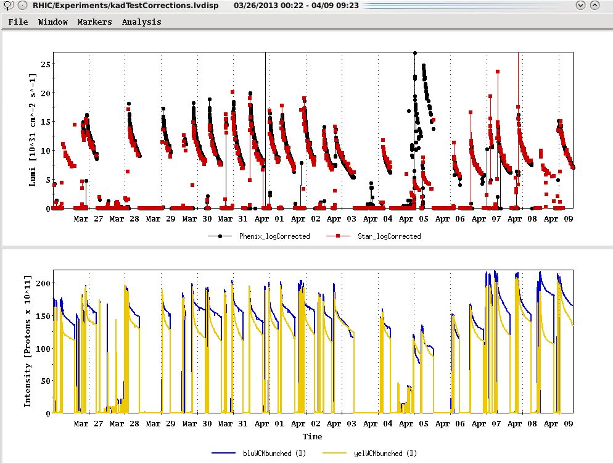
Physics stores
Past 2 Weeks
Run 12 lattice
L_{peak}(maximum=2.7E32)
17340
L_{average}(maximum)
Using Run 13 cross sections with log based singles correction
Ions (maximum)

Slide 27

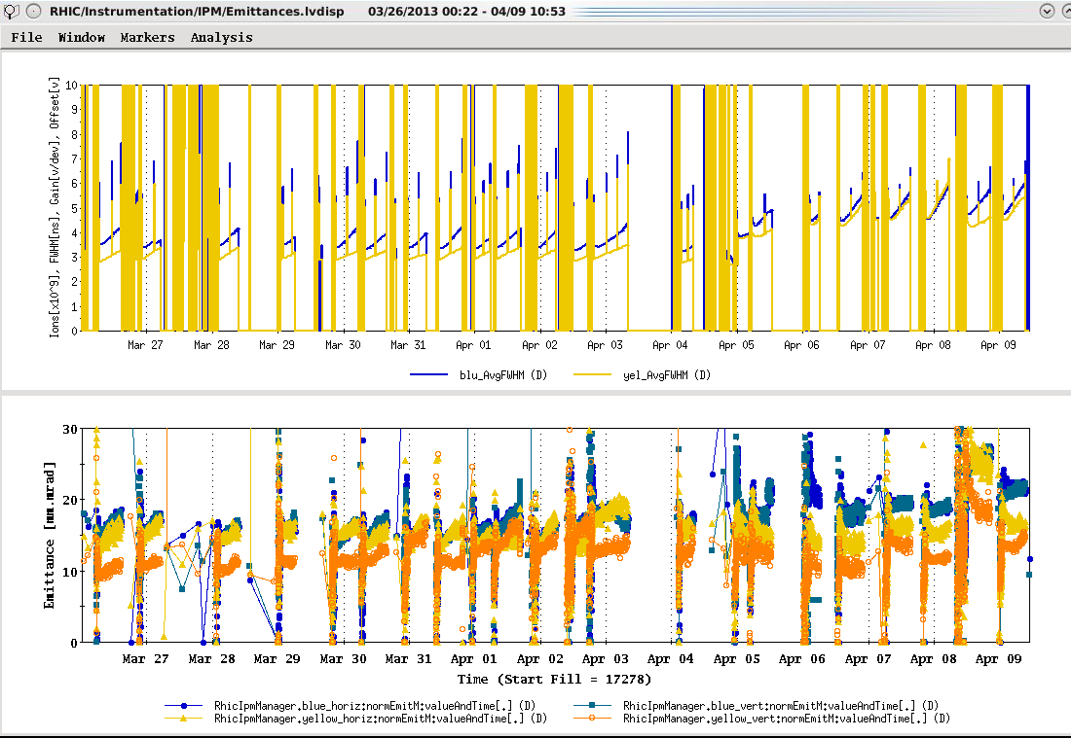
Run 12 lattice

Slide 28
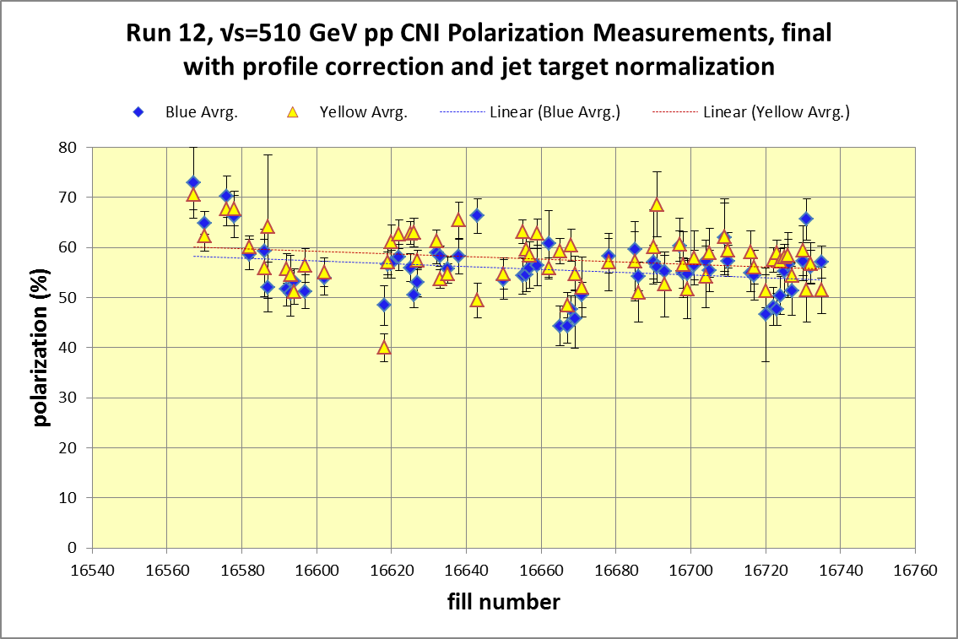
Yellow average = 48.12± 0.4%
Blue average = 53.1 ± 0.5%
http://www.phy.bnl.gov/cnipol/fills/

Slide 29
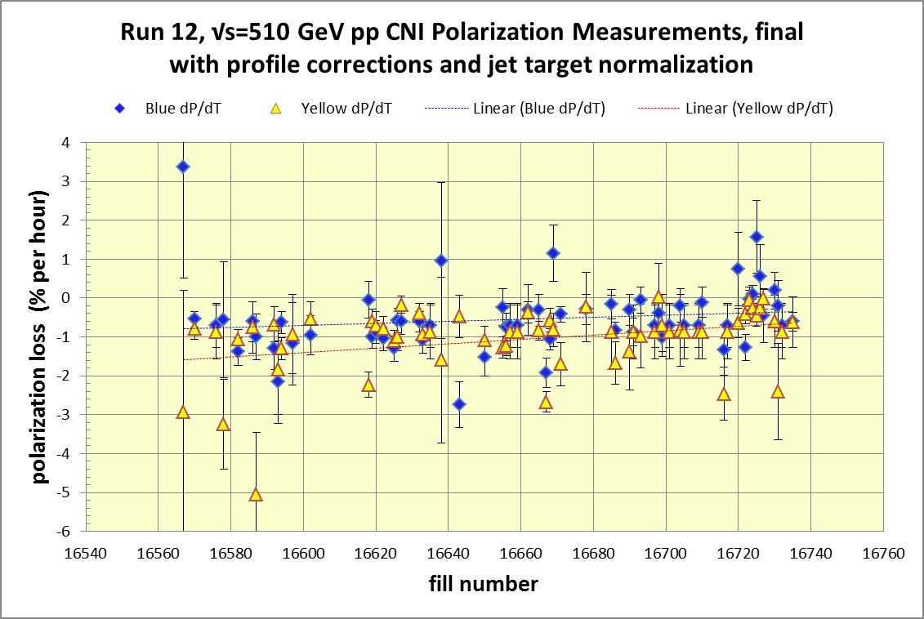
Yellow average = 57.7± 0.4%
Blue average = 55.9 ± 0.4%
Average = 56.8%
http://www.phy.bnl.gov/cnipol/fills/

Slide 30
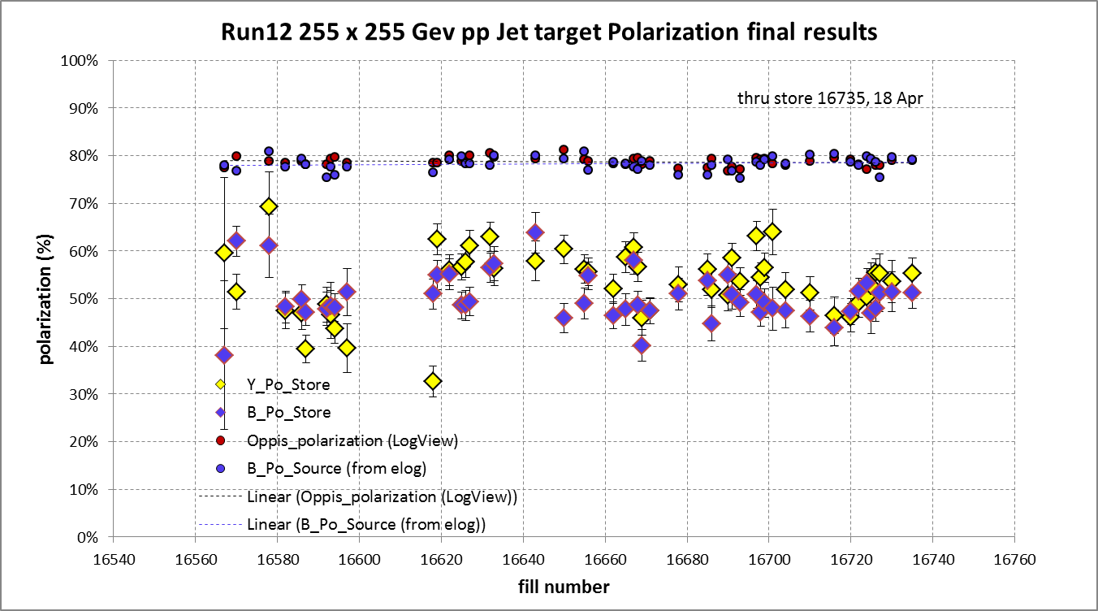
And Yellow beam at injection jet target Run 12 result = 63.0 ± 4.4%
Blue jet target weighted average = 50.3% ± 0.5%
Yellow jet target weighted average = 53.4% ± 0.5%

Slide 31
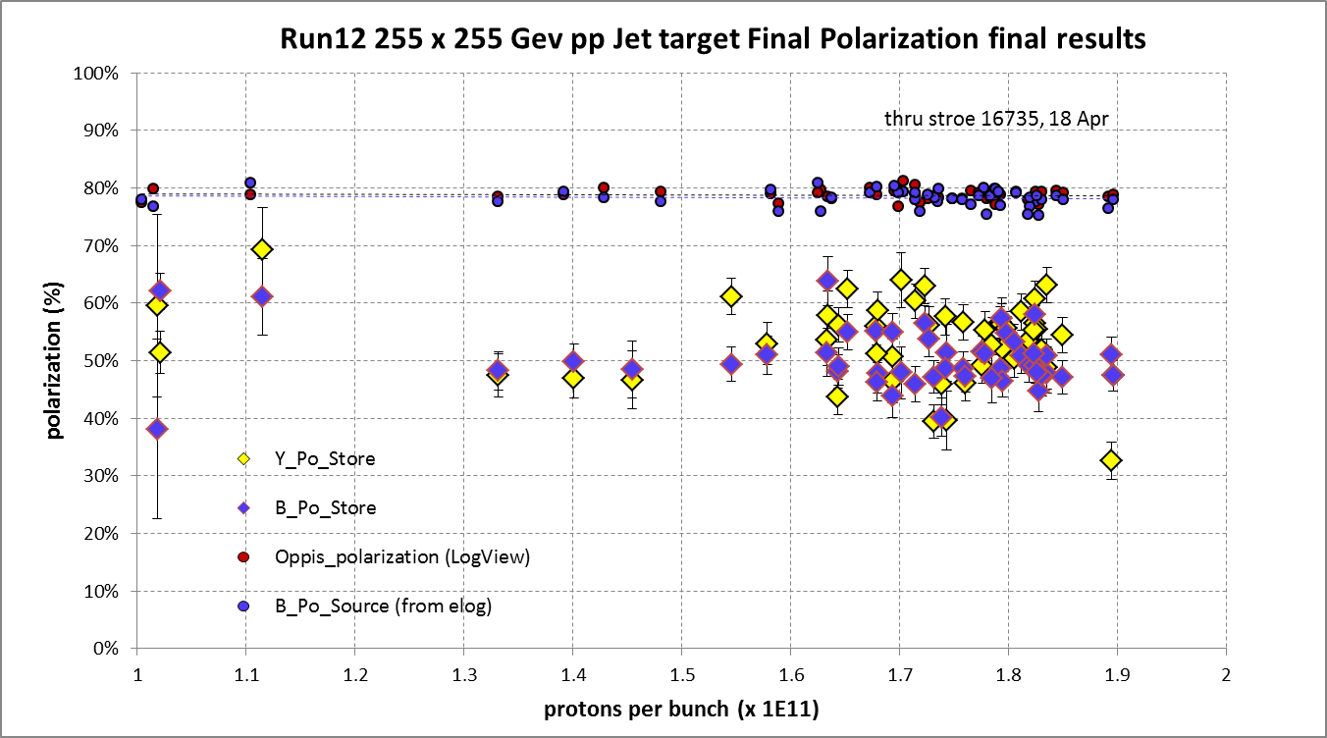
Yellow average = 53.4 ± 0.5%
Blue average = 50.3 ± 0.5%

Slide 32
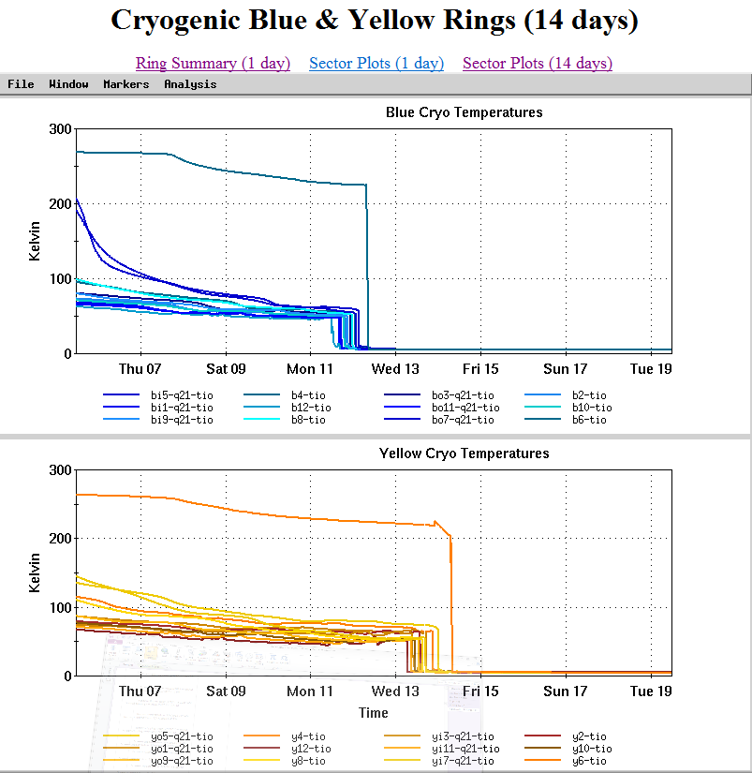

Slide 33
For Run 13 the PAC recommends the following (in order of priority):
Running with polarized proton collisions at 500 GeV to provide an integrated luminosity of 750 pb⁻¹ at an average polarization of 55%.
2. Depending on the amount of running time remaining after priority #1
  a. If less than 3 weeks remain, a week of 200 GeV Au+Au collisions.
  b. If at least 3 weeks of running time remain, 3 weeks of 15 GeV Au+Au
  collisions.
3. 8 days of 62 GeV p+p collisions.
4. At the discretion of the ALD, 4 days of low-luminosity running to accomplish the pp2pp goals.

