Slide 1
Coherent electron Cooling experiment at RHIC
Vladimir N Litvinenko
July 7, 2020

Slide 2
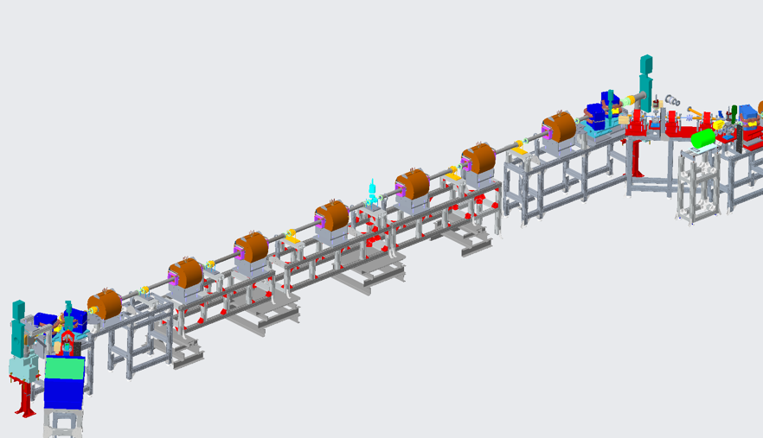
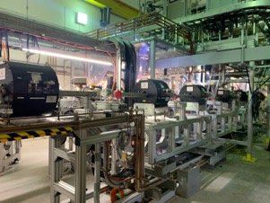
CeC PCA Beamline
CeC SRF accelerator
* Work in progress
* Completed
Unchanged
Kicker
Modulator
Unchanged
4-cell PCA
New water-cooled solenoids
Dipoles gap modification
New Stands
New Profile Monitor
New BPM housing and buttons
12 Kicker-Modulator V/H Trims
New Y vacuum chamber for dipoles
New NEG coated beamline vacuum chambers
New stand supports for magnets
New RF shielded bellows
New conical transitions to RHIC
New beam line supports
Water Manifold for Solenoids
New replacement V/H trims for LEBT
Lead Shielding blocks
ATF Quads
BPM
Solenoid
Profile Monitor
V/H Trims

Slide 3
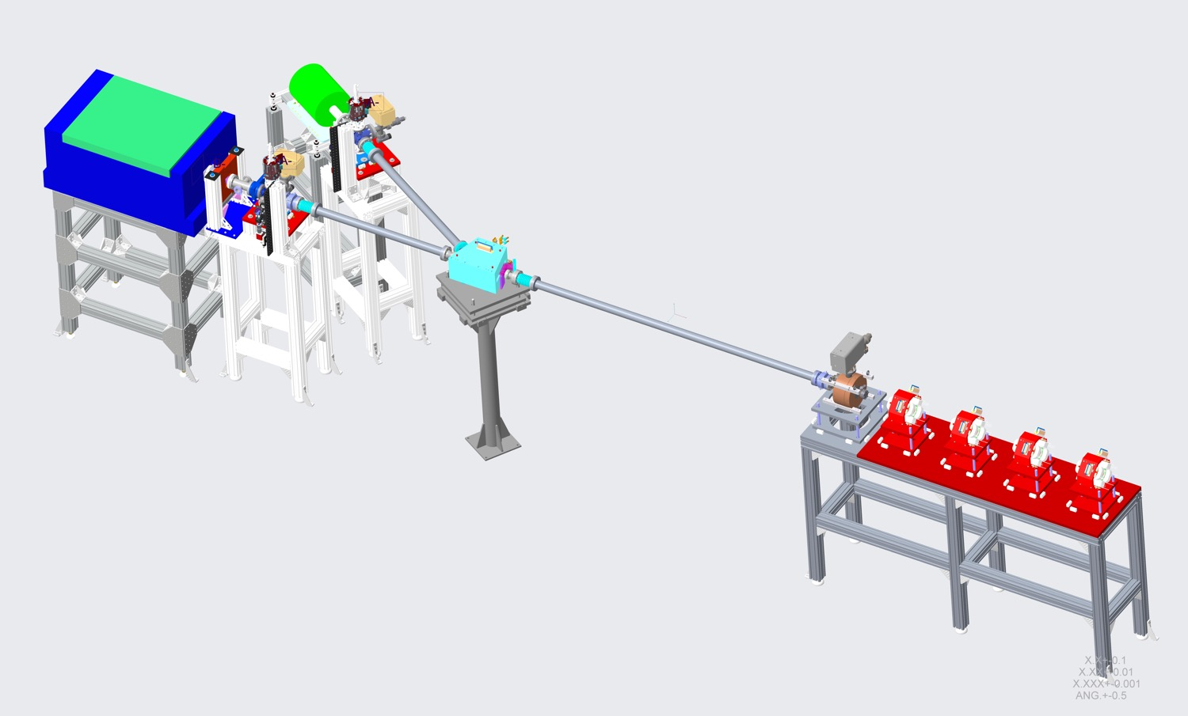
2020 Diagnostics Beamline
HP Beam Dump
LP Beam Dump
CeC PM
ERL Dipole
CeC Quads
CeC BPM
New High Power Beam Dump
New 1.3 GHz Transvers Deflecting Cavity
New Power Amplifier
New Profile Monitor YAGs (2)
New BPMs (2)
Re-use ERL Dipole
Re-use CeC Quads
Re-use CeC LE Beam Dump
New ICT
1.3 GHz Cavity

Slide 4
Goals for Run 20
Establish e-beam Key Performance Parameters (KPP)
Milestone July 16, 2020
Investigate Plasma Cascade Amplifier (PCA)
Milestone – August 31, 2020
Investigate Ion Imprint in the electron beam
Milestone – September 30, 2020
Because of the photocathode situation, we may interchange 2nd and 3rd milestones

Slide 5
Establish e-beam KPP Nearly complete
Parameter
Lorentz factor | 28.5 v
Repetition frequency, kHz | 78.2 v
Electron beam full energy, MeV | 14.56 V
Total charge per bunch, nC | 1.5 V
Average beam current, μA | 117
Ratio of the noise power in the electron beam to the Poison noise limit | <100 V Need to verify
RMS momentum spread σ_{p} = σ_{p}/p, rms | ≤1.5×10⁻³ V
Normalized rms slice emittance, μm rad | ≤ 5 V

Slide 6
Use of Dedicated time Total allocation for this Run is 8 days
This week 2 x 12 hrs (1 day)
Complete KPP studies
Develop RHIC ramp to 26.5 GeV/u
Rest of July (2 days)
Establish beam dynamics in the PCA
Establish BBA and orbit control in the common section
Start investigation of PCA
August (3 days)
Complete investigation of PCA
Establish overlap of electron and Ion beams
Start investigation of Ion imprint
September (2 days)
Complete investigation of Ion imprint

Slide 7
Additional factors
We may need to complete Fault studies of e-beam co-propagating with the ion beam in Yellow ring (new parallel mode of operation)
With current mode, we will request operations with abort gaps aligned at 2 o’clock (10% portion of time charged to the dedicated CeC mode)

