Slide 1
Run 2020

Slide 2
Scheduling Physicist:
Robert Pak
e-mail: pak@bnl.gov
Office Phone: (631) 344-4380

Slide 3
Run20 Planned Schedule

Slide 4
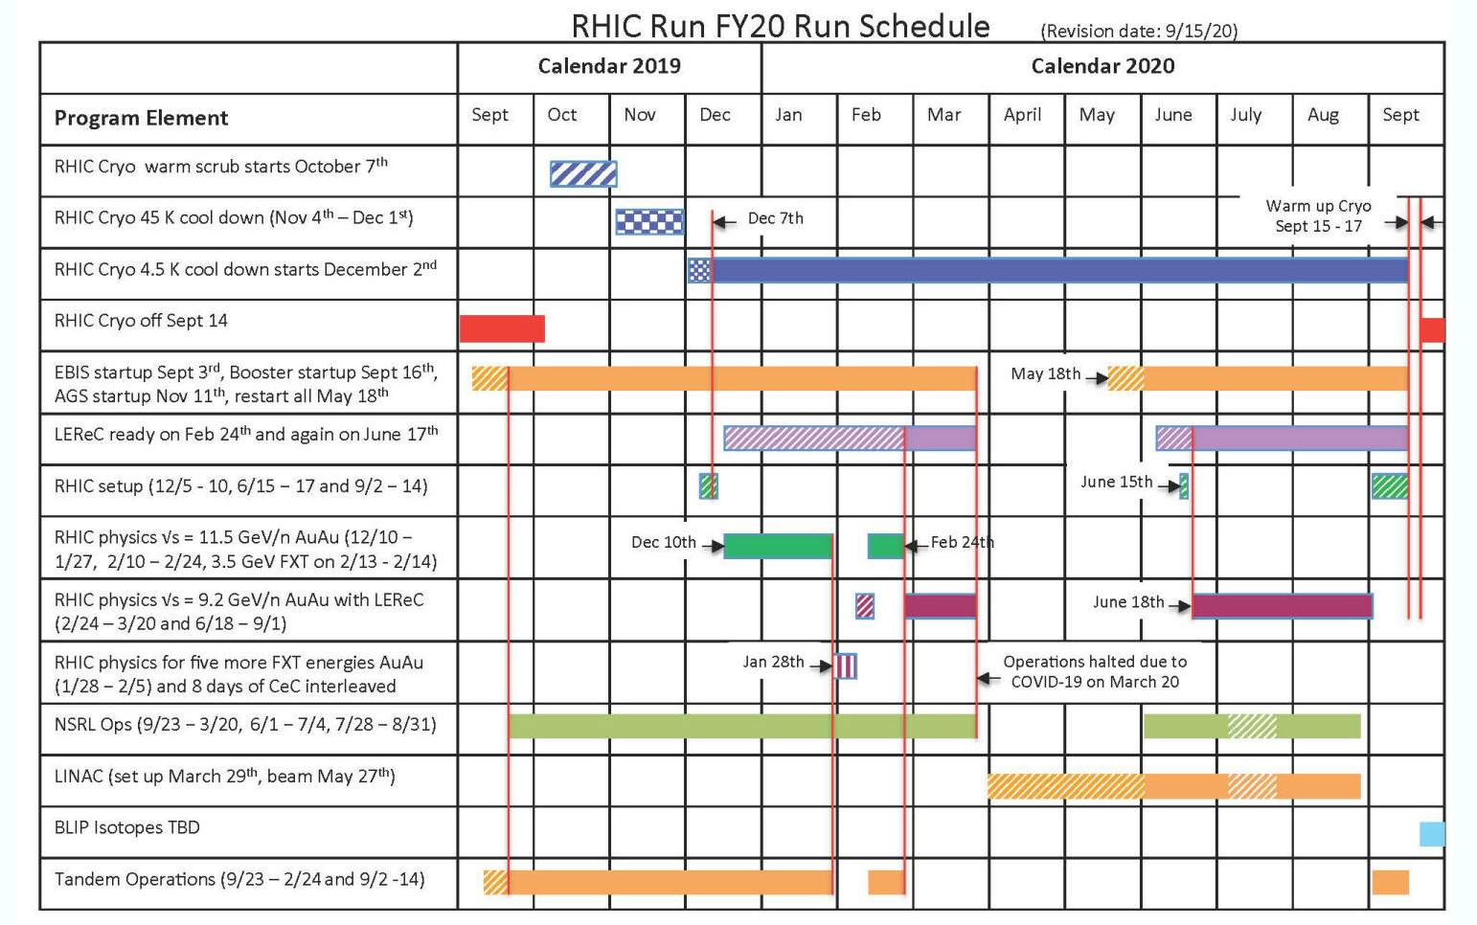
Run20 Final Schedule

Slide 5
Run 2020 Schedule
Blue cooldown begins: 11/04/2019
Yellow cooldown begins: 11/04/2019
Blue 4K reached: 12/03/2019
First circulating bunch (Au) in Blue: 12/05/2019
Yellow 4K reached: 12/06/2019
First circulating bunch in Yellow (Au):12/07/2019
LEReC Running Start: 12/12/2019
Physics Start for ¹⁹⁷Au⁷⁹⁺ on ¹⁹⁷Au⁷⁹⁺: 12/10/2019
Fixed Target ¹⁹⁷Au⁷⁹⁺ Start: 01/27/2019
End Physics Operations: 03/20/2019
Suspension of RHIC and LEReC activities: 03/20/2019
Resumption of RHIC activities: 06/15/2020
Begin Cryo Warmup: 09/15/2020
Cryo Warmup Complete: 09/18/2020

Slide 6
Mode Schedule
Mode 1A: ¹⁹⁷Au⁷⁹⁺ on ¹⁹⁷Au⁷⁹⁺ at 5.75GeV/nucleon
  Beam operation: 12/05/2019 - 02/24/2020
Mode 1B: ¹⁹⁷Au⁷⁹⁺ on ¹⁹⁷Au⁷⁹⁺ at 4.59GeV/nucleon
  Beam operation: 12/16/2020-03/20/2020
  Beam operation cont.:06/15/2020-09/01/2020
Mode 1C: ¹⁹⁷Au⁷⁹⁺ at 31.2GeV/nucleon on fixed target ¹⁹⁷Au foil
  Beam operation: 01/27/2020 - 01/29/2020
Mode 1D: ¹⁹⁷Au⁷⁹⁺ at 9.8GeV/nucleon on fixed target ¹⁹⁷Au foil
  Beam operation: 01/29/2020 - 02/01/2020
Mode 1E: ¹⁹⁷Au⁷⁹⁺ at 19.5GeV/nucleon on fixed target ¹⁹⁷Au foil
  Beam operation: 02/01/2020 - 02/02/2020
Mode 1F: ¹⁹⁷Au⁷⁹⁺ at 13.5GeV/nucleon on fixed target ¹⁹⁷Au foil
  Beam operation: 02/02/2020 - 02/03/2020
Mode 1G: ¹⁹⁷Au⁷⁹⁺ at 7.3GeV/nucleon on fixed target ¹⁹⁷Au foil
  Beam operation: 02/03/2020 - 02/05/2020
Mode 1H: ¹⁹⁷Au⁷⁹⁺ at 5.75GeV/nucleon on fixed target ¹⁹⁷Au foil
  Beam operation: 02/13/2020 - 02/14/2020
Mode 1I: LEReC cooling commissioning with ¹⁹⁷Au⁷⁹⁺ 3.85GeV/nucleon
  Beam operation: 09/01/2020-09/07/2020
Mode 1J: ¹⁹⁷Au⁷⁹⁺ in Yellow ring for CeC PoP at 26.5GeV/nucleon particle energy
  Beam operation: 03/11/2020-09/14/2020

Slide 7
Run Coordinators
Chuyu Liu [RHIC and STAR Operations]
  Email: cliu1@bnl.gov
  Office Phone: (631) 344-4431
  Modes: 1A, 1B, 1C, 1D, 1E, 1F, 1G, 1H
Vladimir Litvinenko [CeC Operations]
  Email: vl@bnl.gov
  Office Phone: (631) 344-2570
  Modes: 1J
Igor Pinayev [CeC Operations]
  Email: pinayev@bnl.gov
  Office Phone: (631) 344-5706
  Modes: 1J

Slide 8
Run Overview

Slide 9
Basic Run Parameters
Mode Name | Energy/ Nucleon [GeV] | No. Bunches | Ions/ bunch [10⁹] | Β* [m] | rms emittance [μm] | Peak Luminosity [cm⁻²s⁻¹] | Average Luminosity [cm⁻²s⁻¹] | STAR Luminosity [μb⁻¹]
1A | 5.75 | 111 | 1.3 | 4 | 2.0 | 90×10²⁴ | 50×10²⁴ | 143
1B | 4.59 | 111 | 1.2 | 4.5◻3.5◻3.0 | 1.5 | 48×10²⁴ | 35.5×10²⁴ | 176
1C | 31.2 | 12 | 1.5 | 5 | 3◻3 |  |  | 23
1D | 9.8 | 12 | 1.25 | 10 | 2◻2 |  |  | 23
1E | 19.5 | 12 | 1 | 10 | 1.5 |  |  | 25
1F | 13.5 | 12 | 1 | 10 | 2.4◻1.8 |  |  | 21
1G | 7.3 | 12 | 1 | 10 | 1.4 |  |  | 24
1H | 5.75 | 12 | 1 | 10 | 2◻1.5 |  |  | 24
1I | 3.85 | 111 | 0.8 | 4.5◻3.0 | 1.5◻0.5 | 44×10²⁴ | 19×10²⁴

Slide 10
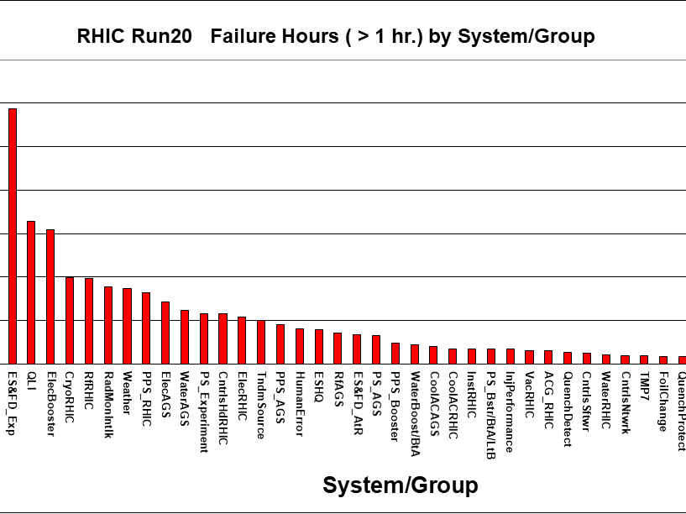

Slide 11
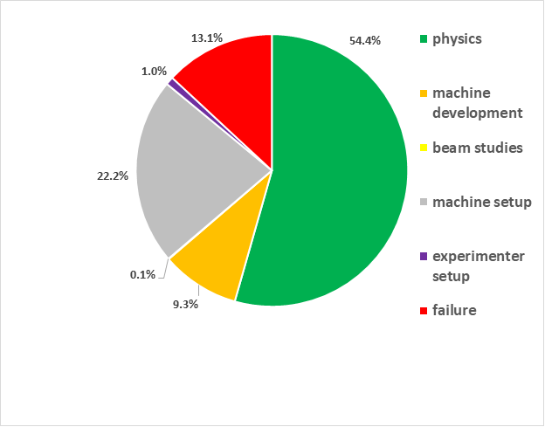
Percentage of Time per Mode Run20

Slide 12
LEReC Cooling

Slide 13
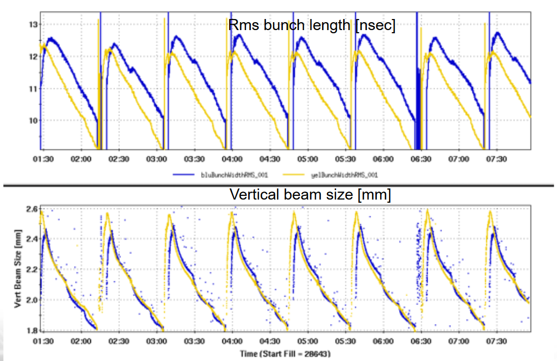
Image courtesy of A. Fedotov

Slide 14
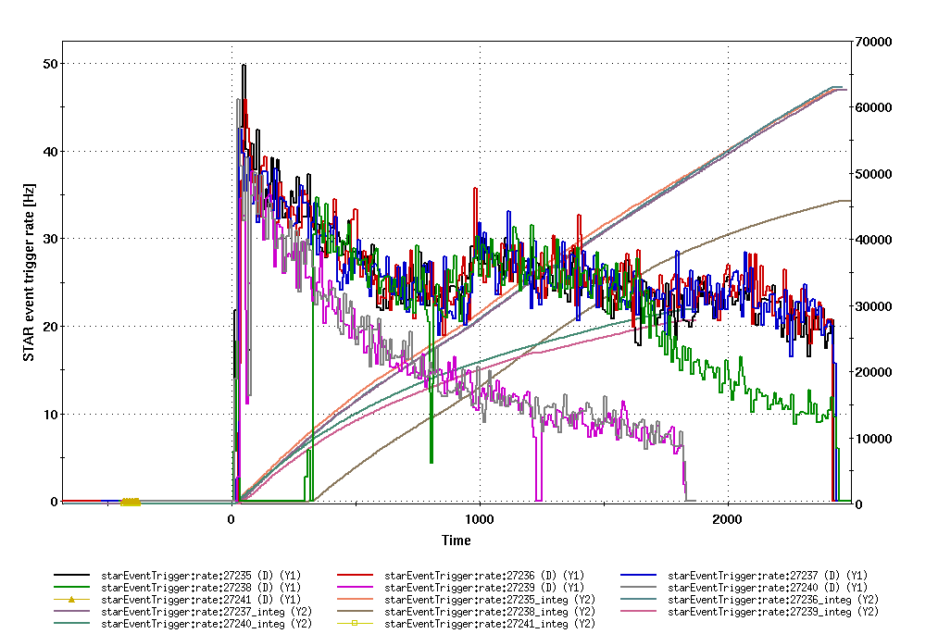
Event rate comparison cooling vs no cooling for 4.59 GeVores.

Slide 15
Luminosity for ¹⁹⁷Au⁷⁹⁺ on ¹⁹⁷Au⁷⁹⁺ Physics

Slide 17
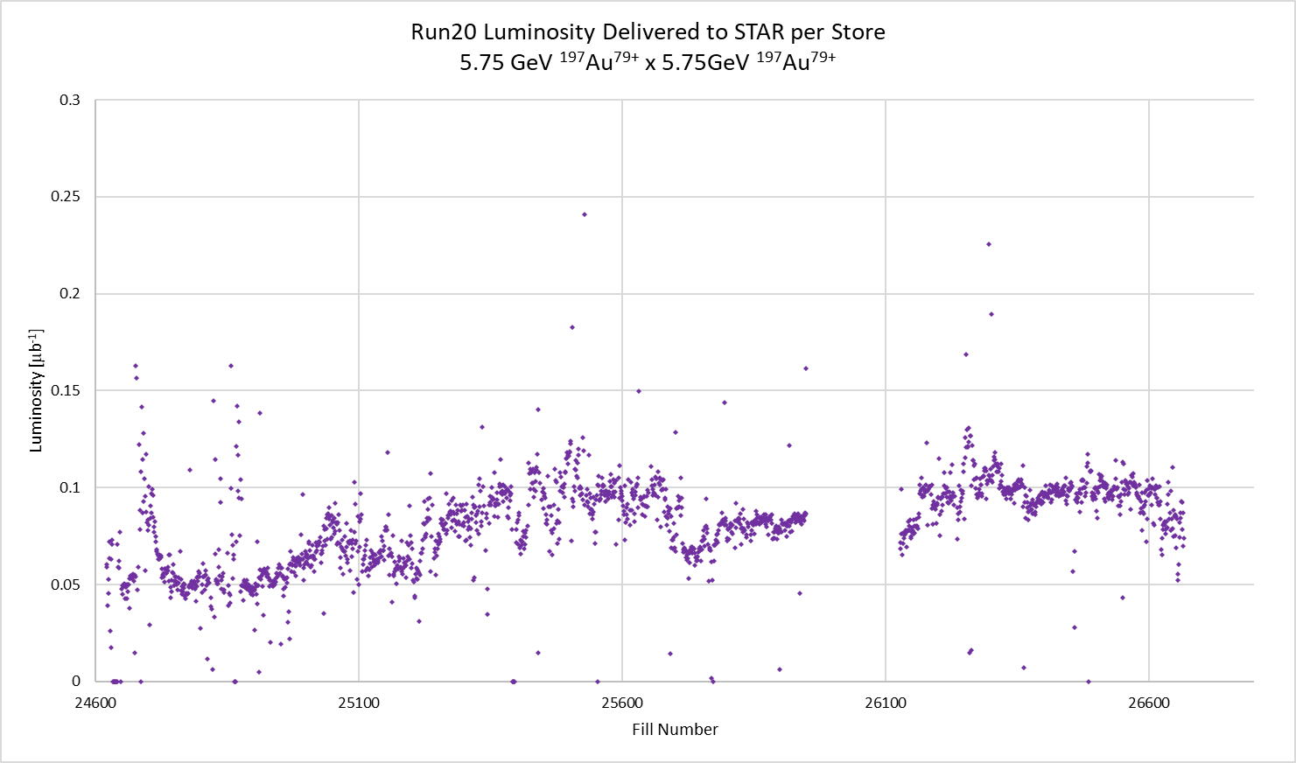

Slide 18
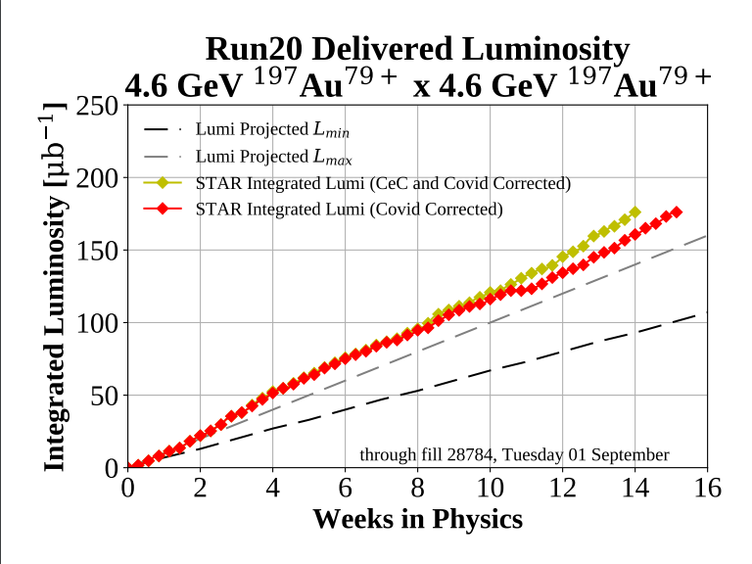

Slide 19
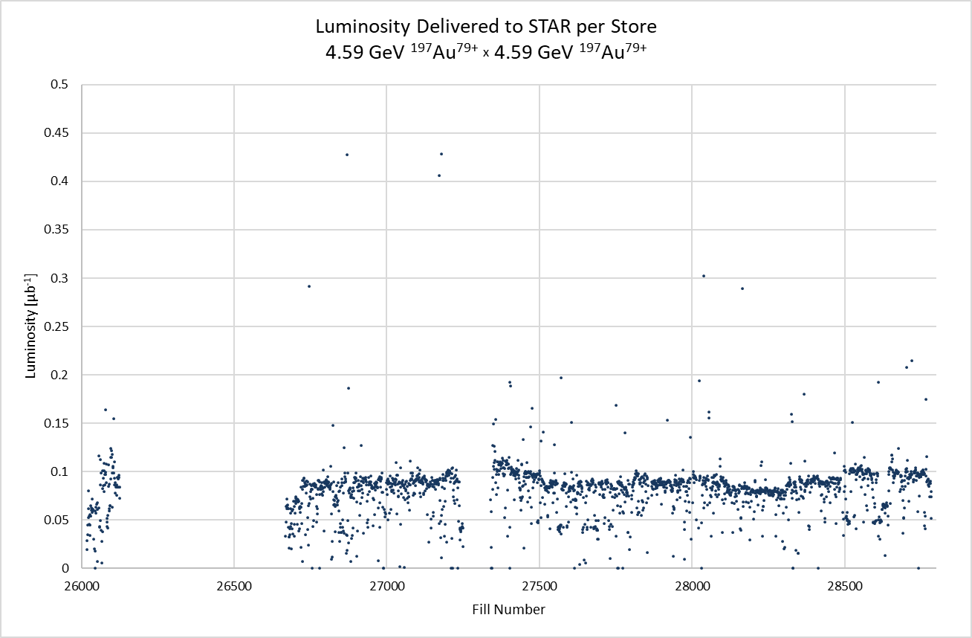

Slide 20
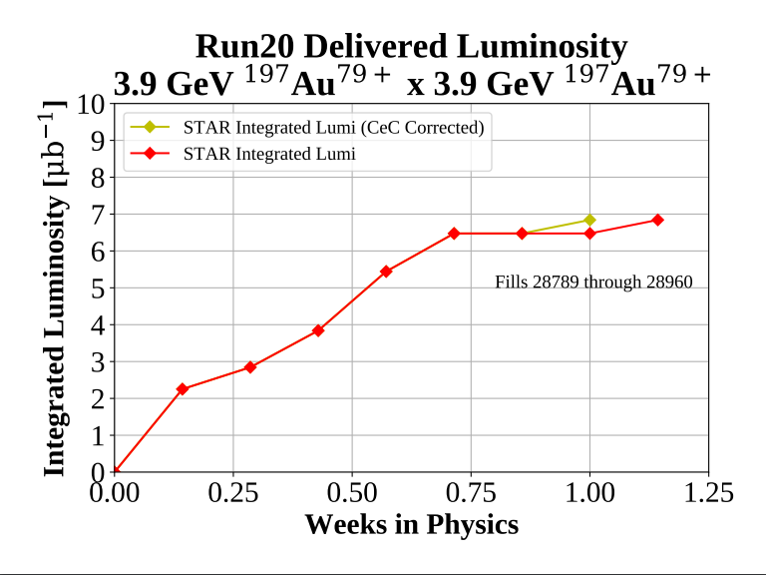

Slide 21
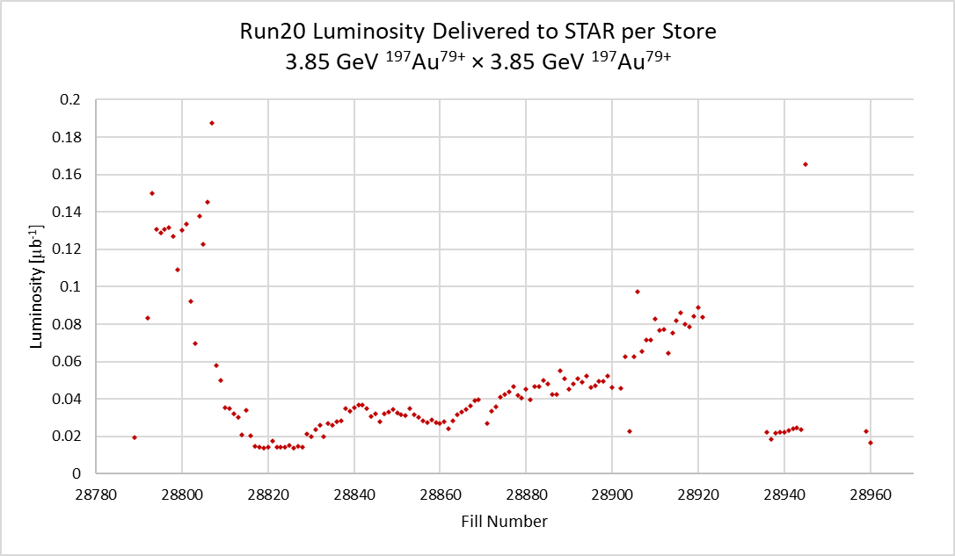

Slide 22
¹⁹⁷Au⁷⁹⁺ Physics on Fixed Target ¹⁹⁷Au foil

Slide 23
Basic Fixed Target Numbers
Energy/Nucleon | Time in Physics [Hrs] | Total Events
31.2 GeV | 25.5 | 112M
19.5 GeV | 34.5 | 108M
13.5 GeV | 24.25 | 118M
9.8 GeV | 34.5 | 108M
7.3 GeV | 27 | 117M
5.75 GeV | 22.5 | 116M

Slide 24
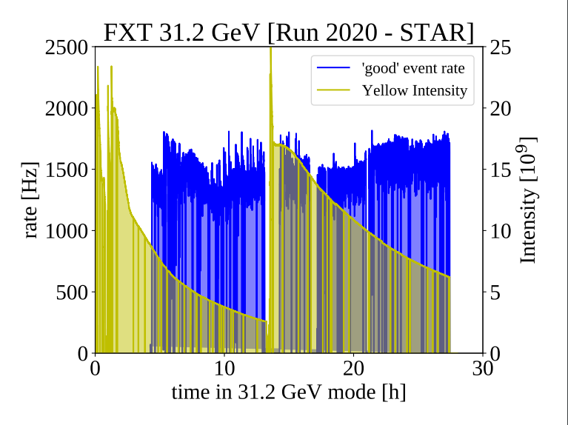

Slide 25
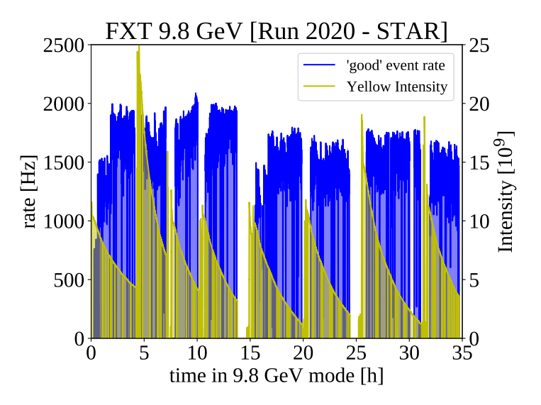

Slide 26
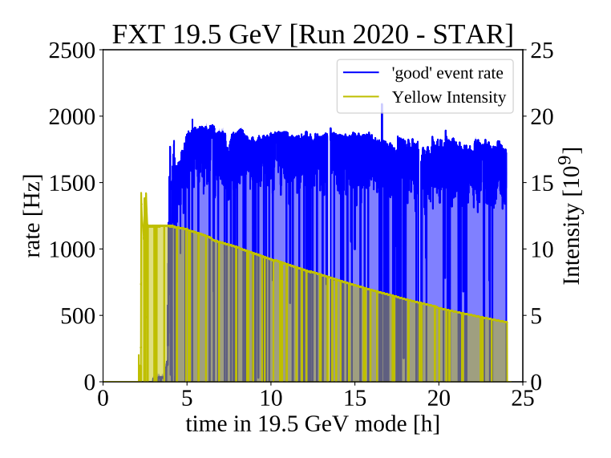
F

Slide 27
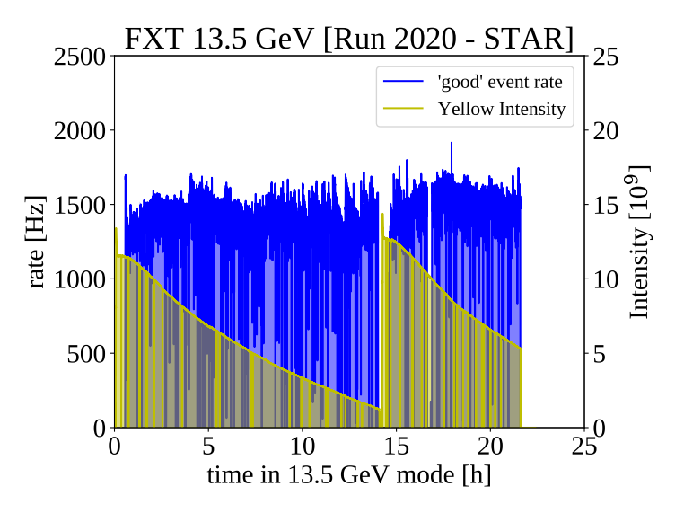

Slide 28
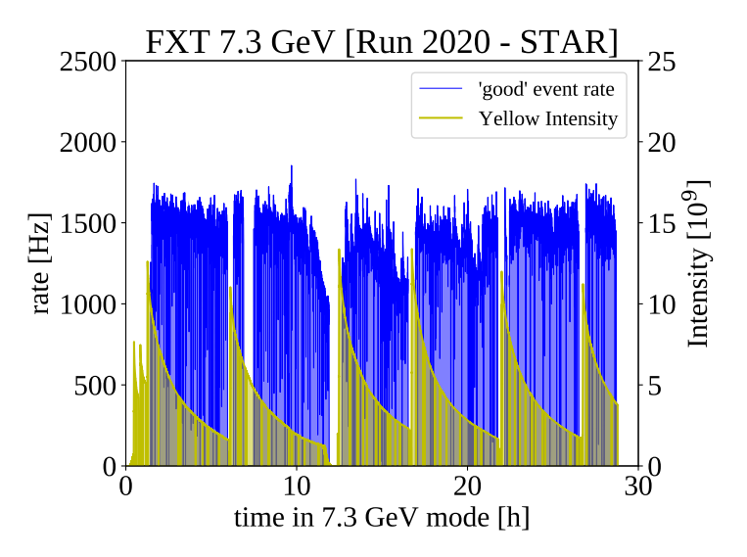

Slide 29
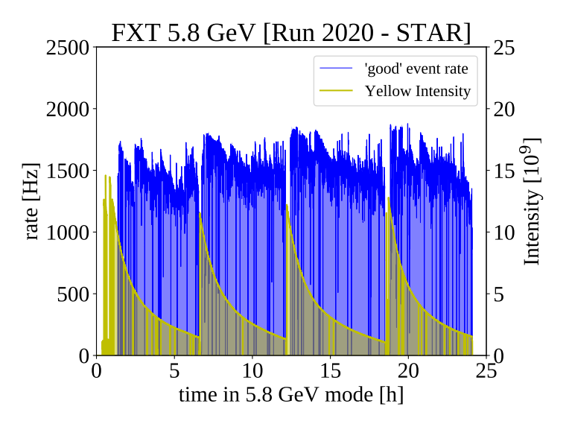

Slide 30
Power and Cryo Use
Power consumption data shown through 2020

Slide 31
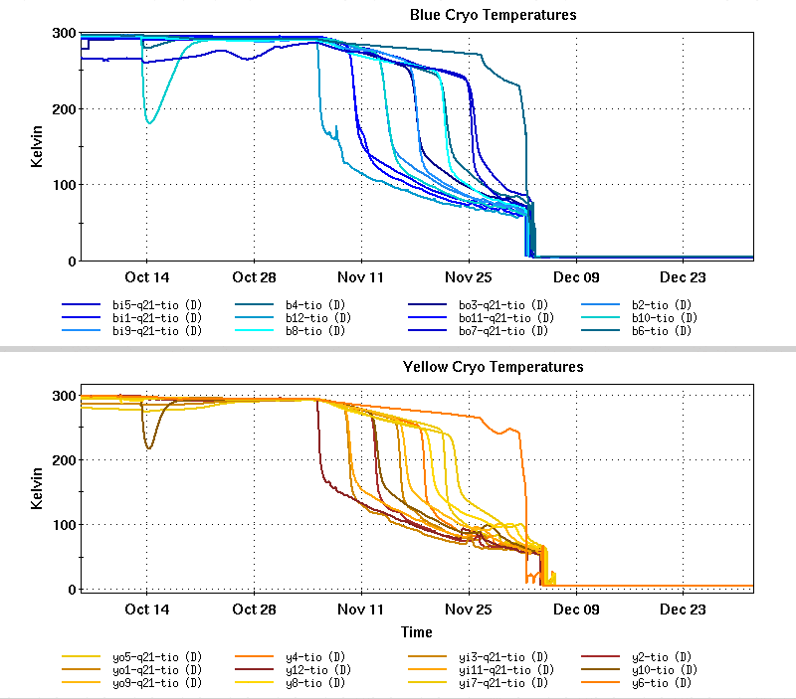
Cryo Cooldown
29.0 Cryo Weeks for physics
12.4 Cryo Weeks with no ops

Slide 32
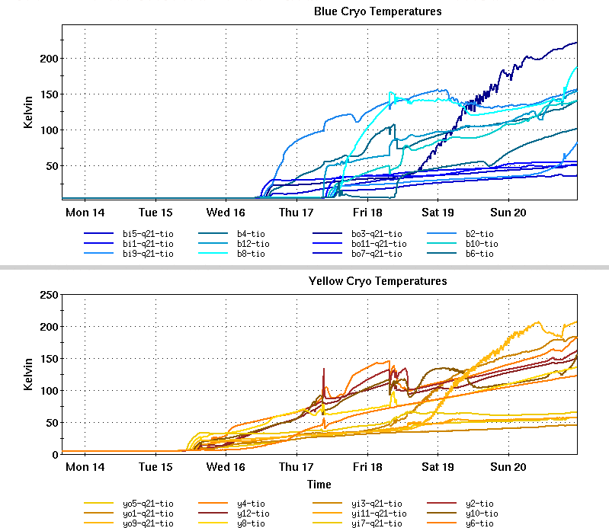

Slide 33
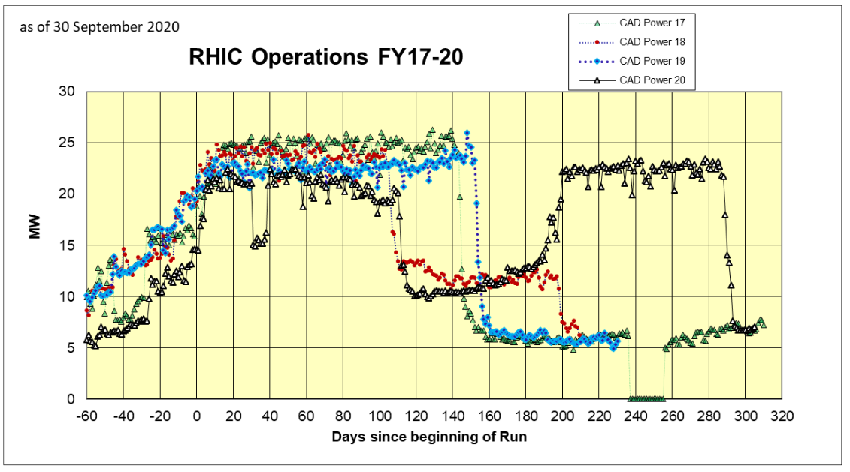

Slide 34
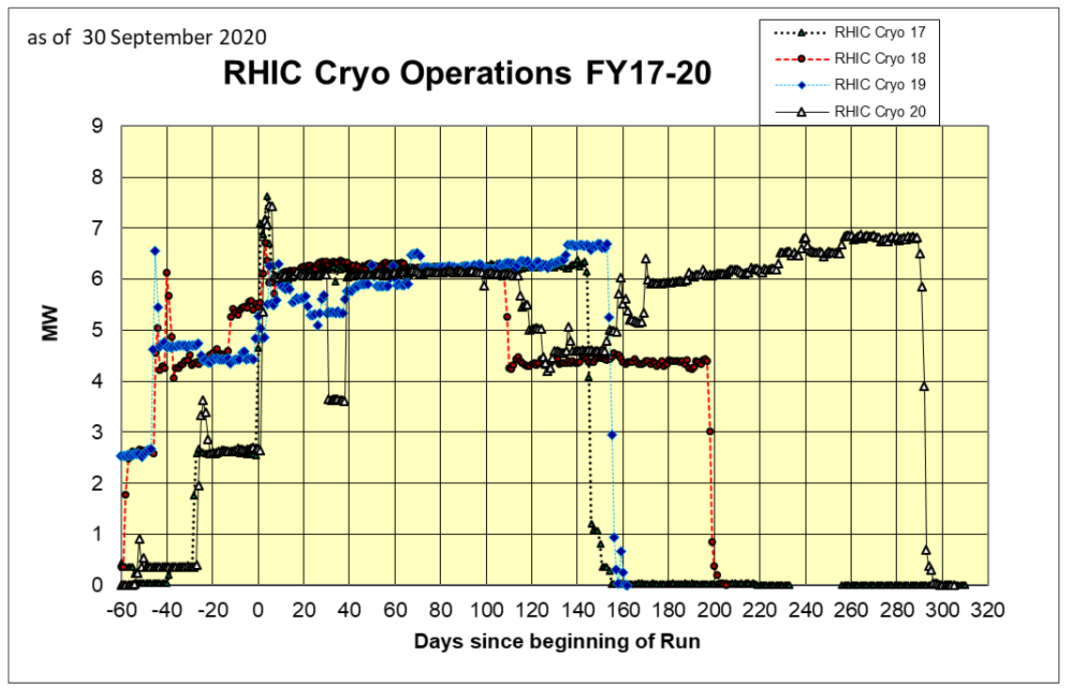

Slide 35
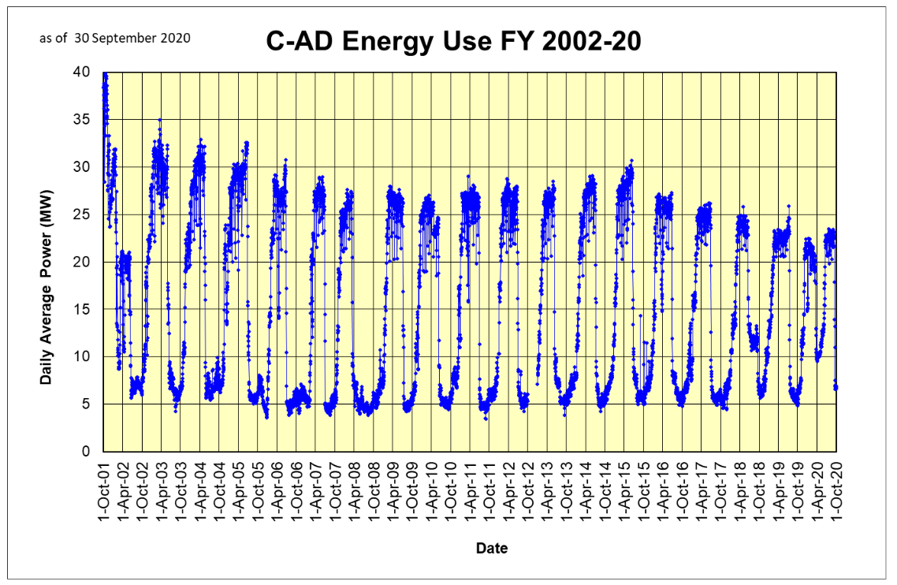

Slide 36
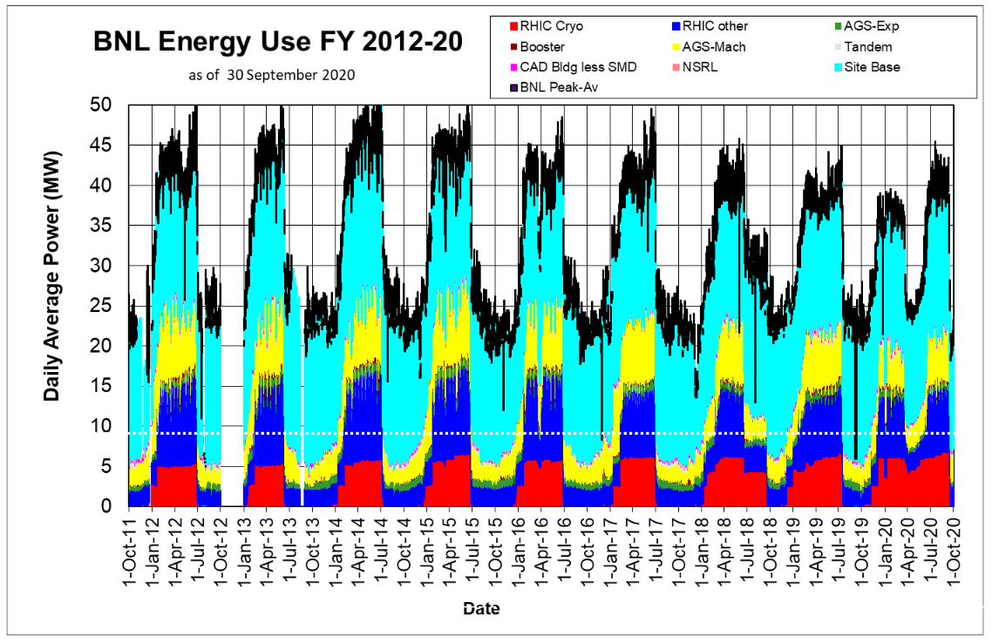

Slide 37
Useful Websites
Machine/Detector Planning Page
  http://server.c-ad.bnl.gov/esfd/RMEM_20/rhic_planning.htm
RHIC Run Overview (FY01-FY20)
  https://www.rhichome.bnl.gov/RHIC/Runs/index.html#Run-20
RHIC Retreat Page (FY20)
  https://indico.bnl.gov/event/9276/
Store Statistics
  https://www.agsrhichome.bnl.gov/AGS/Operations/Run20/
Scheduling Physicist
  https://www.c-ad.bnl.gov/esfd/Scheduling_Physicist/FY20_Collider-Accelerator_Schedule.htm

