Slide 1
Run 22 RHIC Machine/Experiments Meeting
January 25, 2021
Agenda:
Welcome and Overall schedule for the FY 22 RHIC run - W. Christie
STAR status, schedule, and update - J.H. Lee
CeC status, schedule, and update - V. Litvinenko
RHIC status, schedule, and update - V. Schoefer
APEX program status, schedule, and update - Y. Luo
All Other Business (AOB)

Slide 2
Rough Look at Long Term Schedule
2021 |  |  |  |  |  |  |  |  |  |  |  | 2022 |  |  |  |  |  |  |  |  |  |  |  | 2023
J | F | M | A | M | J | J | A | S | O | N | D | J | F | M | A | M | J | J | A | S | O | N | D | J | F
SD1
2021 Run (24 wks) 1/25 – 7/12
SD2 (18 wks) 7/12 – 11/15
2022 Run (20 wks) 11/15 – 4/4
sPHENIX1 (16) 4/4 – 7/25
sPHENIX2 (17 wk) 7/25 – 11/23
sPHENIX3 (67 D) 11/24 – 1/30
2023
Run
N.B. We are nine weeks and 1 day past the November 15th date start of RHIC run 2022.
We are seven weeks and one day past the November 29th date where the Helium cooldown of the Yellow ring started.
N.B. This Schedule was the result of meetings that were held in late summer of 2020 to discuss the longer-term schedule.

Slide 3
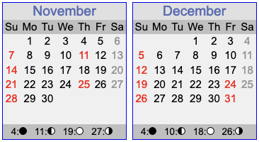
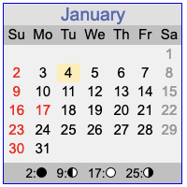
A calendar for the remainder of Calendar 2021
Today’s date
Scheduled start of Helium cooldown. With schedule issue that arose three weeks ago, the cooldown started for only the Blue ring.
Yellow ring cooldown started.
First collisions for STAR.
Discussion topics. Key questions are:
Prognosis for recovering the Siemen's Motor Generator
polarizations that can be achieved for the Blue and Yellow beams
understanding any tilts to the polarization direction at both STAR and the p-C polarimeter.
Luminosity increase, optimizing the rate of FOM to reach the STAR goal.
Efficiently interleaving the STAR, CeC, APEX, and Collider development efforts.

Slide 4
All Other Business (AOB)
AOB

Slide 5
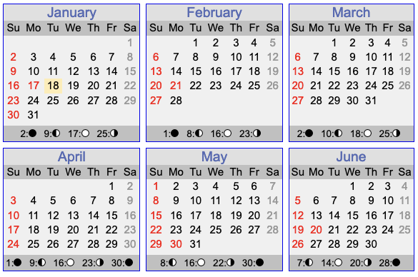
Calendar for first 6 months of 2022.

Slide 6
Program Advisory Committee (PAC) recommendations on the 2022 RHIC Run
2.2 Discussion and Recommendations for RHIC Run 22
The Run 22 BUR of a transversely polarized pp run at 510 GeV with the STAR Forward Upgrade represents a unique opportunity to address important issues in spin physics and will allow exploration of the regimes of low and high-x physics with unprecedented precision. New results anticipated for Run 22 with the Forward Upgrade can have important impacts on the planning for EIC, as well as on the interpretation of EIC data. The PAC strongly endorses the STAR Run 22 BUR.
.
.
.
If Run 22 were to be reduced from 20 to 18 weeks that would result in at least a 15% reduction of the integrated luminosity and have a very detrimental effect on the prospects of achieving all the physics goals. Given that the CeC beam time would additionally reduce the STAR run by 2.6 weeks, this would have further negative effects on the physics programme. C-AD is strongly encouraged to optimize RHIC operations to fulfill the goals of both CeC and STAR.
What is shown here are the first and eighth paragraphs from the PAC report concerning the 2022 RHIC run. The other paragraphs of the section deal with physics, as opposed to operations topics.

