Slide 1
Run 22 RHIC Machine/Experiments Meeting
March 15, 2022
Agenda:
Welcome and Overall schedule for the FY 22 RHIC run - W. Christie
STAR status, schedule, and update - J.H. Lee
CeC status, schedule, and update - V. Litvinenko
RHIC status, schedule, and update - V. Schoefer
APEX program status, schedule, and update - Y. Luo
All Other Business (AOB)

Slide 2
Rough Look at Long Term Schedule
2021 |  |  |  |  |  |  |  |  |  |  |  | 2022 |  |  |  |  |  |  |  |  |  |  |  | 2023
J | F | M | A | M | J | J | A | S | O | N | D | J | F | M | A | M | J | J | A | S | O | N | D | J | F
SD1
2021 Run (24 wks) 1/25 – 7/12
SD2 (18 wks) 7/12 – 11/15
2022 Run (20 wks) 11/15 – 4/4
sPHENIX1 (16) 4/4 – 7/25
sPHENIX2 (17 wk) 7/25 – 11/23
sPHENIX3 (67 D) 11/24 – 1/30
2023
Run
Two-week extension
New end date April 18th
N.B. We are seventeen weeks and 1 day past the November 15th date start of RHIC run 2022.
We are fifteen weeks and one day past the November 29th date where the Helium cooldown of the Yellow ring started.
N.B. This Schedule (without the two-week extension) was the result of meetings that were held in late summer of 2020 to discuss the longer-term schedule.

Slide 3
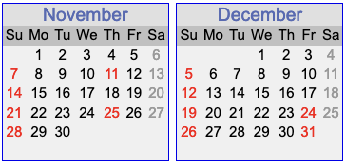
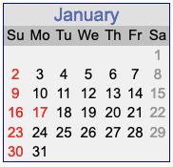
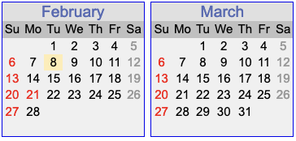
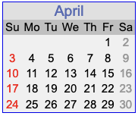
A calendar for the RHIC FY 2022 Run
Today’s date
Current date for end of beam Ops
Scheduled start of Helium cooldown. With schedule issue, the cooldown started for only the Blue ring.
Yellow ring cooldown started.
First collisions for STAR.

Slide 4
Discussion Topics for Today
Discussion topics. Continuing questions are:
Polarizations that can be achieved for the Blue and Yellow beams
Understanding any tilts to the polarization direction at both STAR and the p-C polarimeter.
Optimizing the rate of FOM (Lum & P) to reach the STAR goal.
Efficiently interleaving the STAR, CeC, APEX, and Collider development efforts.
Discussion of possible ideas to adapt our operations/scheduling model to adapt to the higher rate and length of failures this year.
Plans for use of the recent two-week extension of the run.
Current status of the STAR Physics program progress:
The STAR has currently reached about 55% of the FOM goal (~65.8/120).

Slide 5
All Other Business (AOB)
AOB

Slide 6
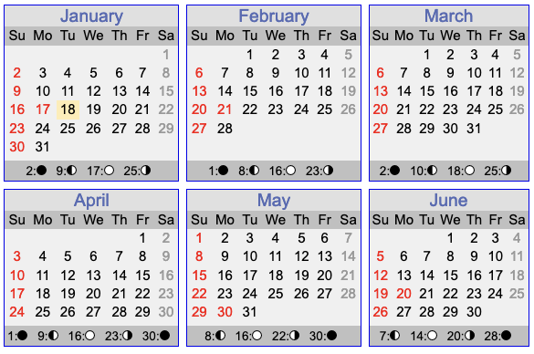
Calendar for first 6 months of 2022.
Today’s date
Current date for end of beam Ops

Slide 7
Program Advisory Committee (PAC) recommendations on the 2022 RHIC Run
2.2 Discussion and Recommendations for RHIC Run 22
The Run 22 BUR of a transversely polarized pp run at 510 GeV with the STAR Forward Upgrade represents a unique opportunity to address important issues in spin physics and will allow exploration of the regimes of low and high-x physics with unprecedented precision. New results anticipated for Run 22 with the Forward Upgrade can have important impacts on the planning for EIC, as well as on the interpretation of EIC data. The PAC strongly endorses the STAR Run 22 BUR.
.
.
.
If Run 22 were to be reduced from 20 to 18 weeks that would result in at least a 15% reduction of the integrated luminosity and have a very detrimental effect on the prospects of achieving all the physics goals. Given that the CeC beam time would additionally reduce the STAR run by 2.6 weeks, this would have further negative effects on the physics programme. C-AD is strongly encouraged to optimize RHIC operations to fulfill the goals of both CeC and STAR.
What is shown here are the first and eighth paragraphs from the PAC report concerning the 2022 RHIC run. The other paragraphs of the section deal with physics, as opposed to operations topics.

